Slide 1

FOR THE
RECORD
“For the record, this is why I did it.”
A private Android journal for work and wallet decisions
CLOCK IN 2026 / Preview 0.3.0
Notes:
Product pitch for CLOCK IN 2026. This deck describes the preview and explicitly distinguishes implementation from live network validation. Brand wording supplied by the owner.

Slide 2
The reason is easy to lose
A finished task shows an outcome.
A transaction shows an event.
The thinking behind either can disappear.
FOR THE RECORD keeps the intention, the result
and a useful next action together.
Product hypothesis: a clear next action makes returning easier. Retention is not yet measured.
FOR THE RECORD / 02
Notes:
Product rationale, not a measured market claim. No interviews, retention cohort, user counts or product-market-fit evidence have been supplied. Source: docs/TRADE_JOURNAL.md and current work-session domain/UI source.

Slide 3
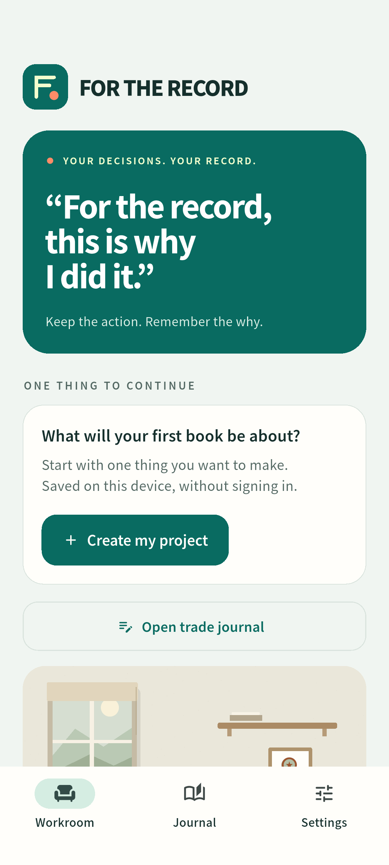
A useful first session
Create a project.
Write one intention.
Choose a focus duration.
Save the result and next action.
Core journaling works offline
without an account or wallet.
FOR THE RECORD / 03
Notes:
Screenshot is from the current app and shows demonstration records if present. Core workflow evidence is in lib/ui/home.dart, focus.dart, books.dart and the domain controller. See current release validation for the exact tested version.

Slide 4
Context for a wallet decision
Reason
Plan
Emotion
Next action
Supported wallet activity anchors a private reflection.
Chain facts stay separate from editable writing.
Native MWA selects the wallet.
The app reads public Solana activity.
NO PAID BACKEND REQUIRED FOR THE JOURNAL
Public RPC is best effort. Real-wallet validation remains pending.
FOR THE RECORD / 04
Notes:
The direct preview uses native Mobile Wallet Adapter and public RPC for read-only activity. Source: lib/data/direct_activity.dart and lib/data/remote.dart. The local parser recognizes a narrow set of Jupiter v6 classic SPL swaps. Unsupported formats remain unsupported. Public RPC has limits and is not production infrastructure: https://solana.com/docs/references/clusters . A successful real-wallet run remains unverified.

Slide 5
Clear data boundaries
On the device
Direct wallet reads
SQLite keeps work records
and private reflections.
JSON export gives users
a portable copy.
MWA supplies the selected
public wallet account.
Public RPC supplies
finalized activity.
No paid server is required for the journal. Optional shared rooms and purchases remain separate.
FOR THE RECORD / 05
Notes:
Local records: lib/data/repository.dart. Direct read-only wallet activity: lib/data/direct_activity.dart and lib/data/remote.dart. The legacy Firebase backend remains for optional cloud features. No billing upgrade is required for the direct journal path. MWA overview: https://docs.solanamobile.com/developers/mobile-wallet-adapter . Public RPC does not provide an unlimited production service guarantee.

Slide 6
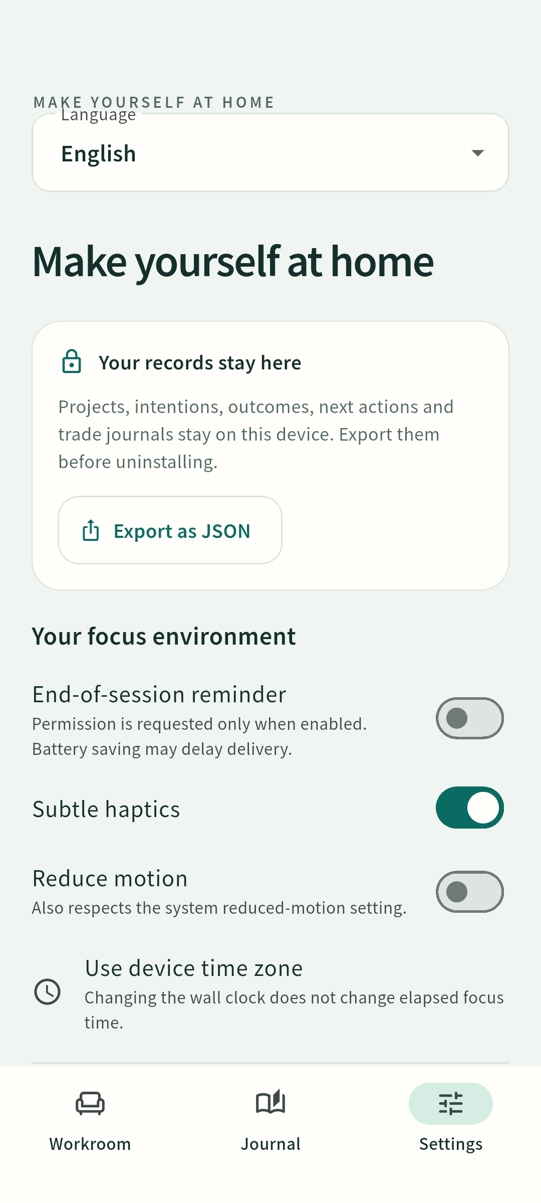
An approachable
phone experience
English by default. Eight language choices.
Your own writing keeps its language.
Optional motion, haptics and reminders.
Clear save and recovery states.
Local usefulness without a network.
EN KO JA ZH HI ES PT FR
FOR THE RECORD / 06
Notes:
Languages in current lib/l10n/strings.dart: English, Korean, Japanese, Simplified Chinese, Hindi, Spanish, Portuguese, French. Source: Settings and localization implementation. Fluent-speaker review and physical-device accessibility review remain release tasks. Large text and glyph rendering must be verified for each release.

Slide 7
Delivery status
Implemented
Open release gates
Offline work journal
Private reflection storage
Native wallet bridge
Direct read-only activity path
Real-wallet device evidence
Fluent-speaker review
Production RPC strategy
Production signing
Local and emulator evidence is retained. Fixtures are not live trading evidence.
FOR THE RECORD / 07
Notes:
Current version 0.3.0 evidence: docs/VALIDATION_0.3.0.md. Flutter analysis clean, 84 Flutter tests and 40 optional-backend tests pass. Eight languages fit 360 logical pixels at 200 percent text scale. Android emulator integration verifies local SQLite/native clock and actual no-wallet handling. Public RPC getVersion establishes reachability only. No production-signing key, live wallet success, physical-Seeker success, user traction or mainnet SKR payment is asserted.

Slide 8
The next release gate
Prove wallet reads on a device.
Record the verified live flow.
Prepare the dApp Store release.
Then test whether users return to their next action.
workroom-seeker-6984.web.app
FOR THE RECORD / 08
Notes:
Official requirements checked 2026-09-20: https://solanamobile.radiant.nexus/ and https://solanamobile.com/blog/clock-in-the-solana-mobile-hackathon . The portal Brief requests a three-minute demo. The terms require functional Android APK, source, demo and pitch with meaningful Solana interaction and MWA: https://solanamobile.radiant.nexus/legal/clock-in-terms.pdf . This preview is not represented as submission complete.

