Slide 1
SolSettle
A fixed USDC invoice on Solana
For independent businesses whose clients hold assets on other chains.
Encode Solana Developer Hackathon / Aurora Intents
Notes:
Project source: https://github.com/openai-lover/solsettle. Target track: https://www.encodeclub.com/programmes/solana-hackathon-2026

Slide 2
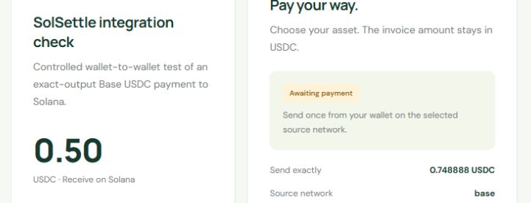
The payer receives a fixed quote
0.748888 USDC
Sent on Base
The invoice called for
0.50 USDC on Solana.
Aurora quoted the Base input.
The payer checked the amount
and signed in their wallet.
Recorded checkout before the funded payment
Notes:
Funded invoice SS-7824D845. Exact Base USDC deposit: https://basescan.org/tx/0x4deafb688eb0db7033a1c66c42498cca5de73faabb79ddc5c730e8b7138e8353 . Original Aurora quote bound the receiving and refund wallets, amount and route. No private wallet key is used by the application.

Slide 3
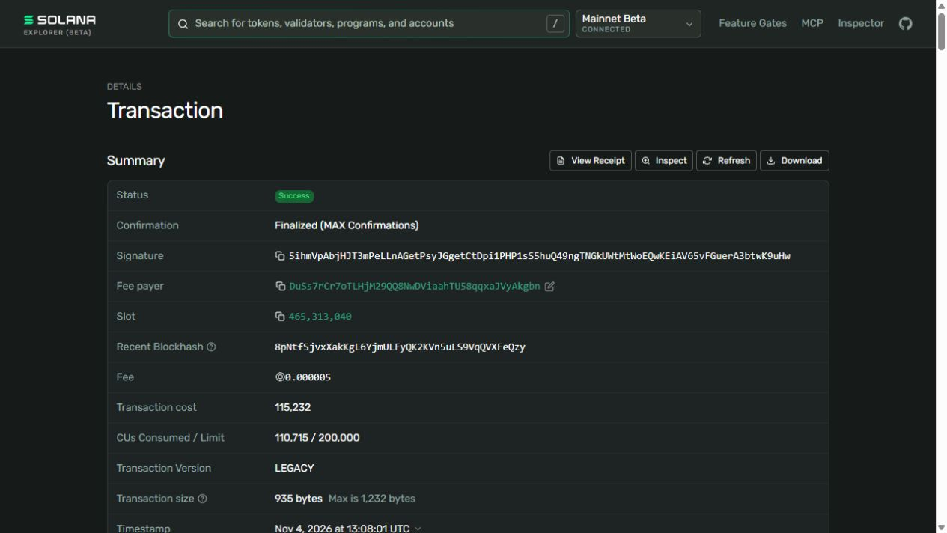
The finalized Solana credit
0.50 USDC
Received by the merchant
Aurora reported success. SolSettle checked the destination signature, the canonical USDC mint and a net credit of 500,000 atomic units to the invoice wallet.
Finalized at Solana slot 465,313,040
Notes:
Official destination explorer: https://explorer.solana.com/tx/5ihmVpAbjHJT3mPeLLnAGetPsyJGgetCtDpi1PHP1sS5huQ49ngTNGkUWtMtWoEQwKEiAV65vFGuerA3btwK9uHw . Solana getTransaction at finalized commitment, checked against SPL transfer instructions and pre/post balances.

Slide 4
A partial refund on a paid invoice
The same funded attempt produced three verifiable transfers.
0.748888
0.500000
0.000315
Base USDC deposited
Solana USDC credited
Base USDC returned
Aurora reported the return. A separate Base USDC transfer log confirms the amount and refund wallet. The Solana invoice remains paid.
Notes:
Source deposit: https://basescan.org/tx/0x4deafb688eb0db7033a1c66c42498cca5de73faabb79ddc5c730e8b7138e8353 . Actual partial return: https://basescan.org/tx/0x23bb6e6b2d97c5fb37db8c0d319aa55469660798a38f40b73f5cf45ad8d65f3e . The three figures are transfers, not a complete fee breakdown. A separate underfunding/full-refund example is explicitly simulated.

Slide 5
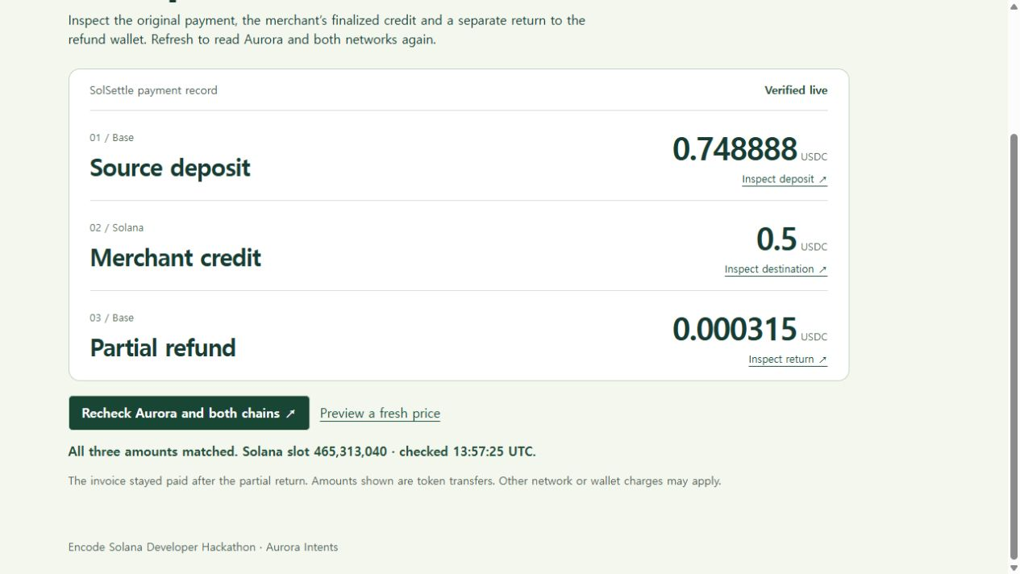
Recheck the funded receipt
Select “Recheck Aurora and both chains” on the project receipt. The app fetches the provider status and verifies all three transfers again.
26 automated checks
Quote identity, missing evidence, shortfalls and refund handling
Notes:
Reproducible payment record: https://solsettle-invoices.nununong.chatgpt.site/settlement . Public source and setup: https://github.com/openai-lover/solsettle. The prototype uses unsigned invoice links and browser-local records.

