Slide 1
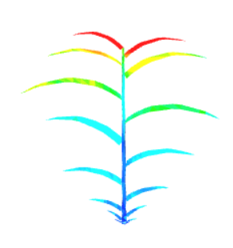
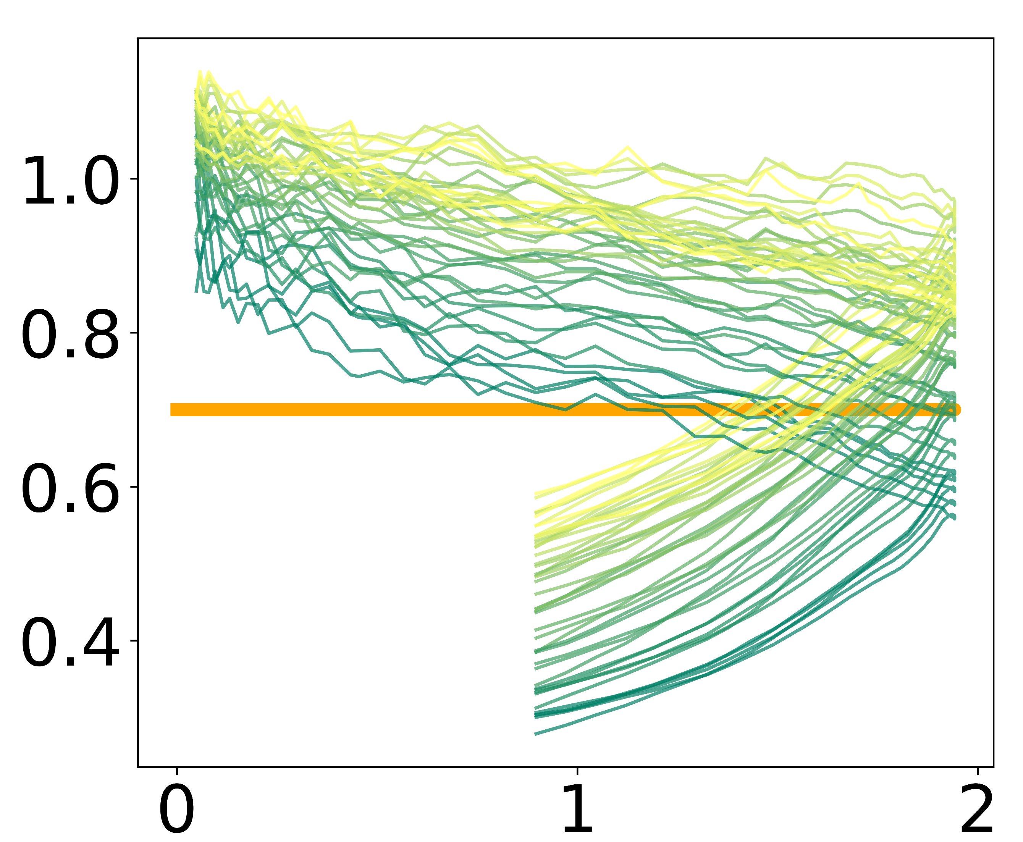
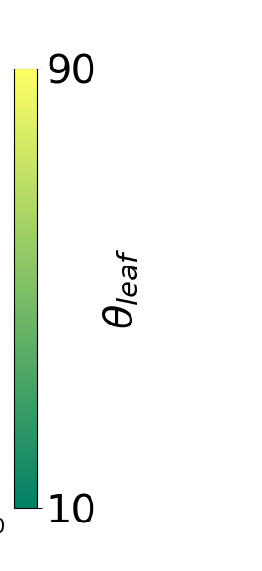



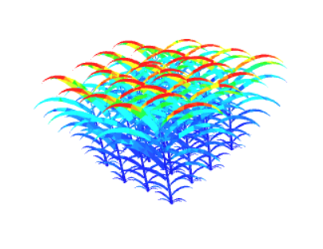
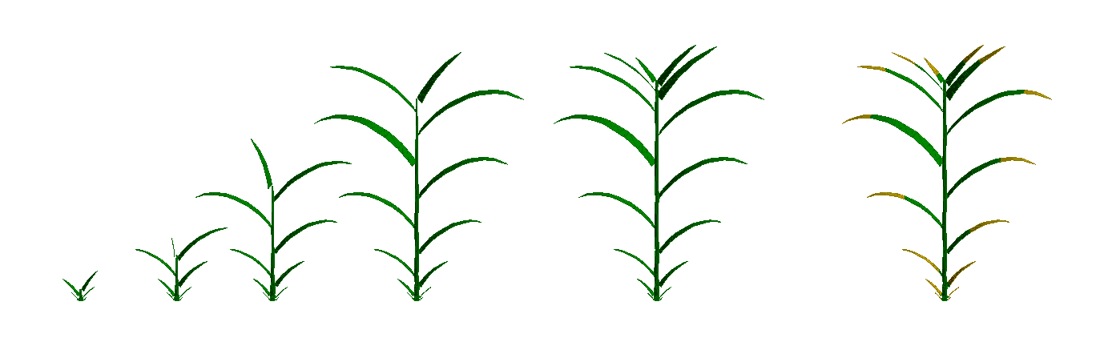

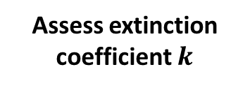


Field data
$$k$$
Crop model
$$LAI$$
Beer Lambert law
Radiosity model
Assess extinction coefficient $k$
1
Growth dynamics
3
4
Compute LAI and height
Compute light intercepted from 3D+t scenes
ArchiCrop
Architectural & development parameters
Botanical knowledge
$$27\%$$
Cum. aPAR (MJ/m²)
2
Compute 3D+t scenes
Days after emergence

