Slide 1
Time processing - Biomass
Visualea – 1 plante (A310, 1407) – 124 images
  24/05/2013 – 26/06/2013 (Dates acquisition)
Binarization | user
Adaptive Threshold | 62.0837888718s
HSV | 85.7370150089s
Meanshift | 73.9134738445s

Slide 2
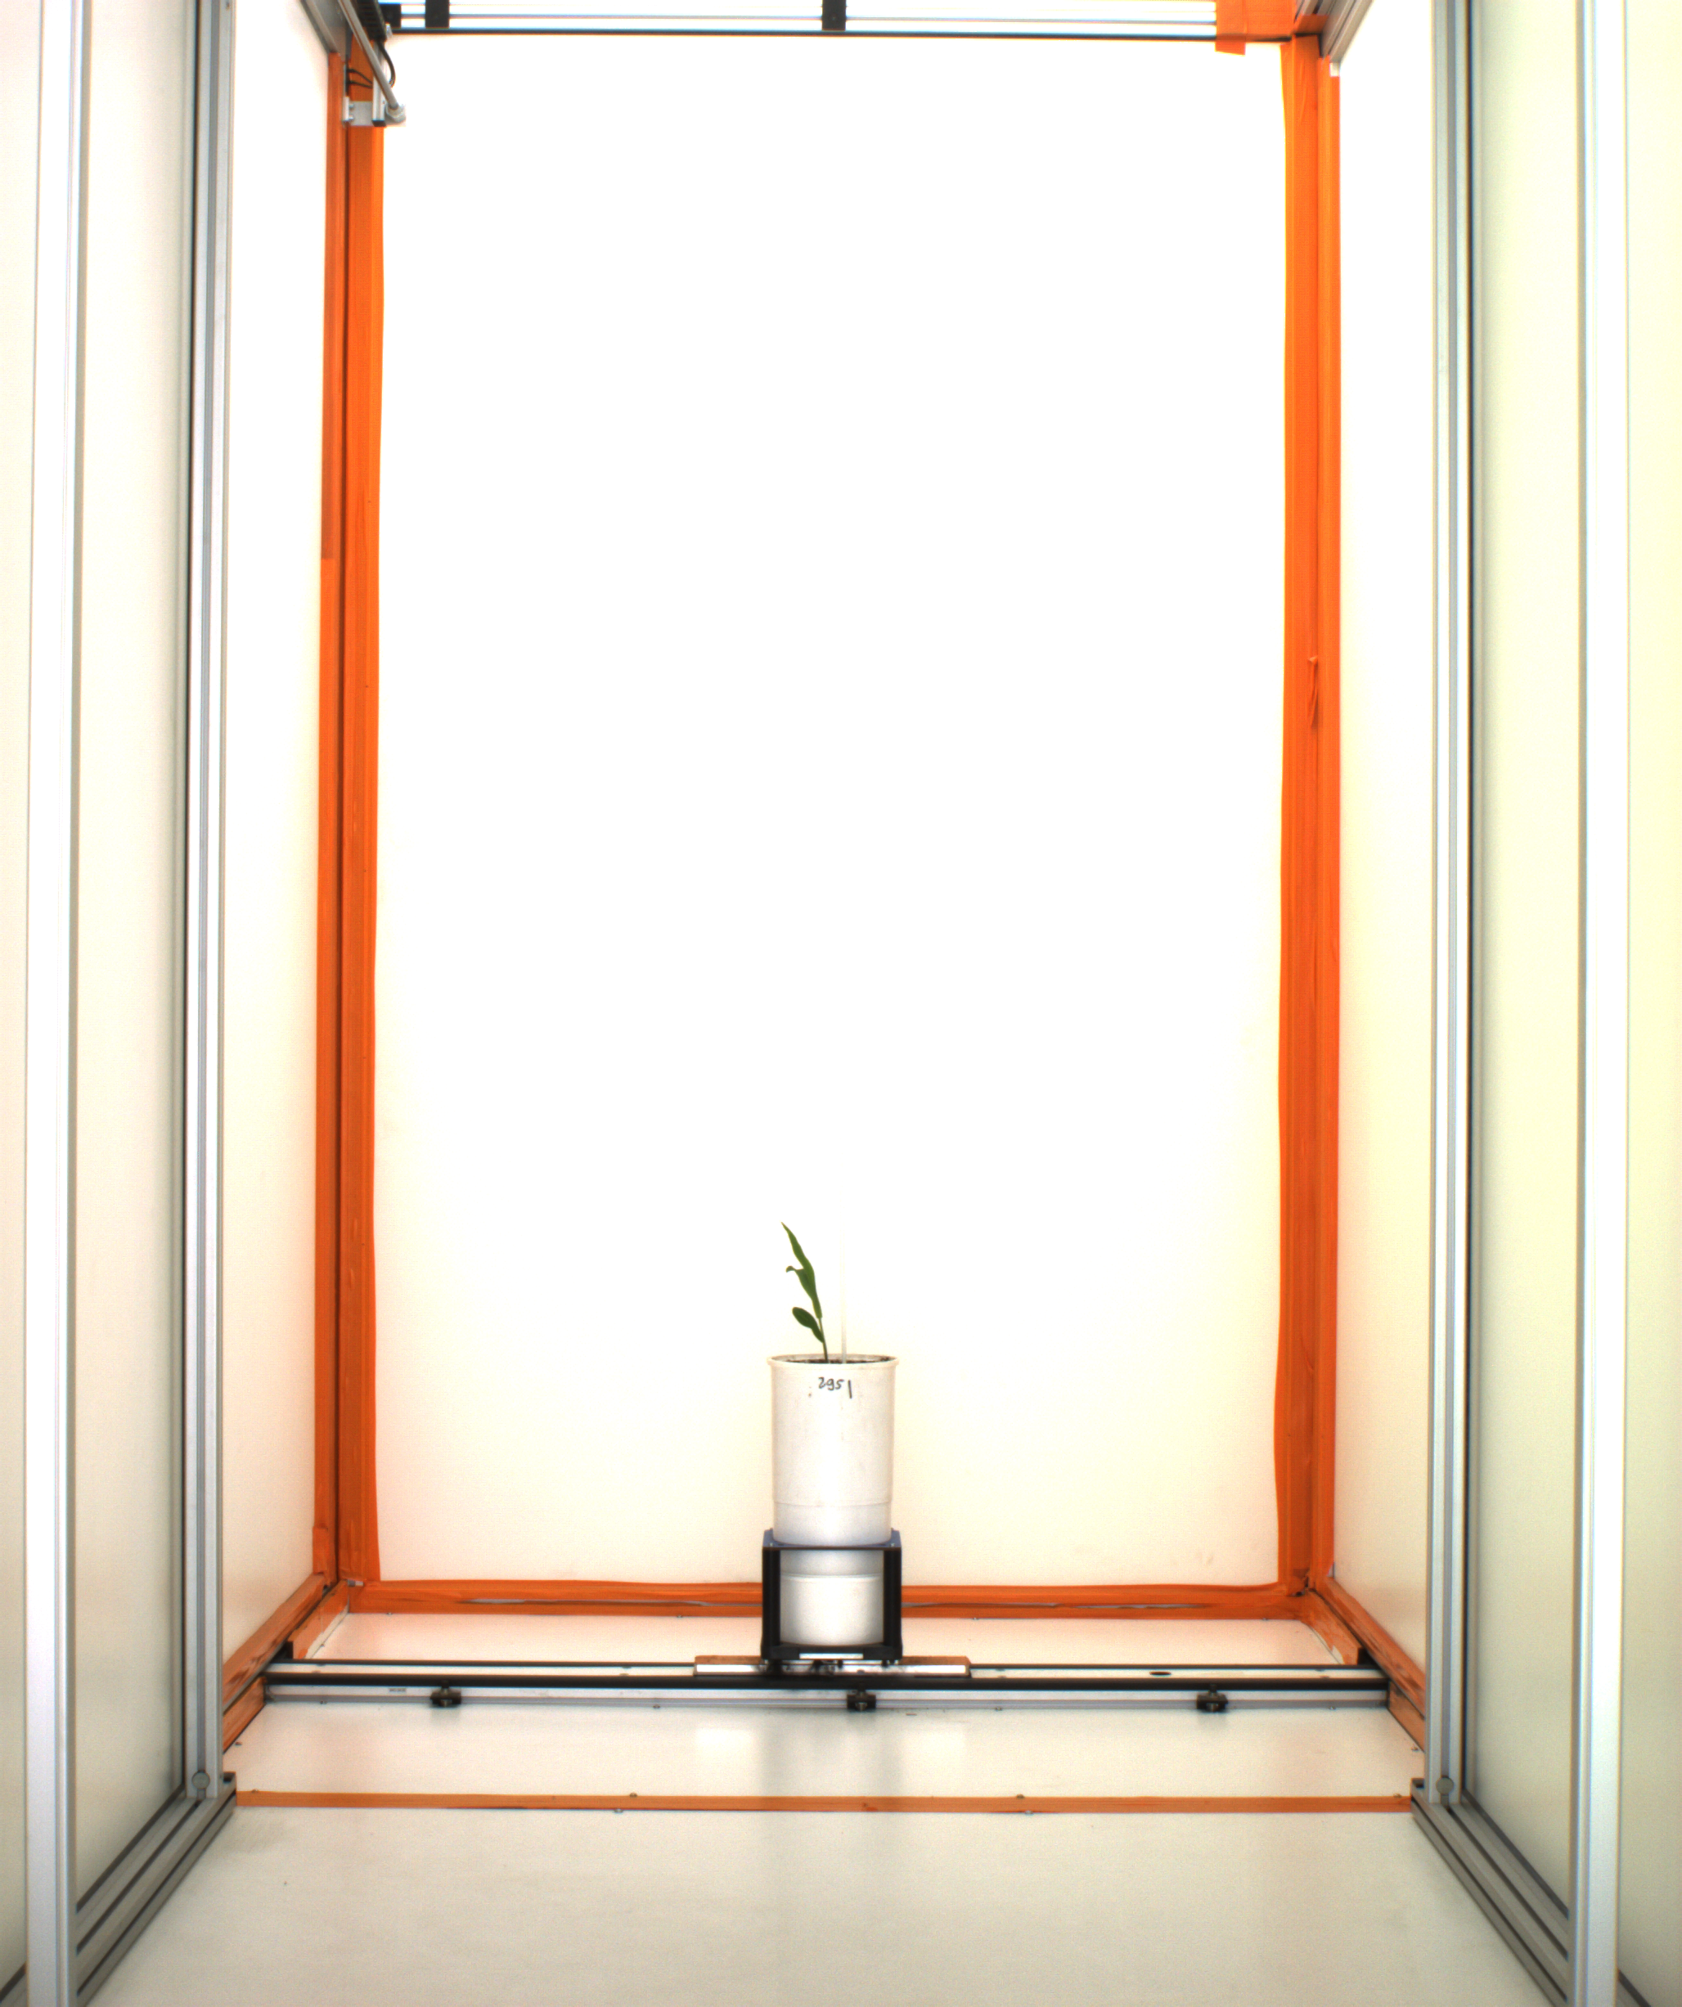
Input Data (1/3)

Slide 3
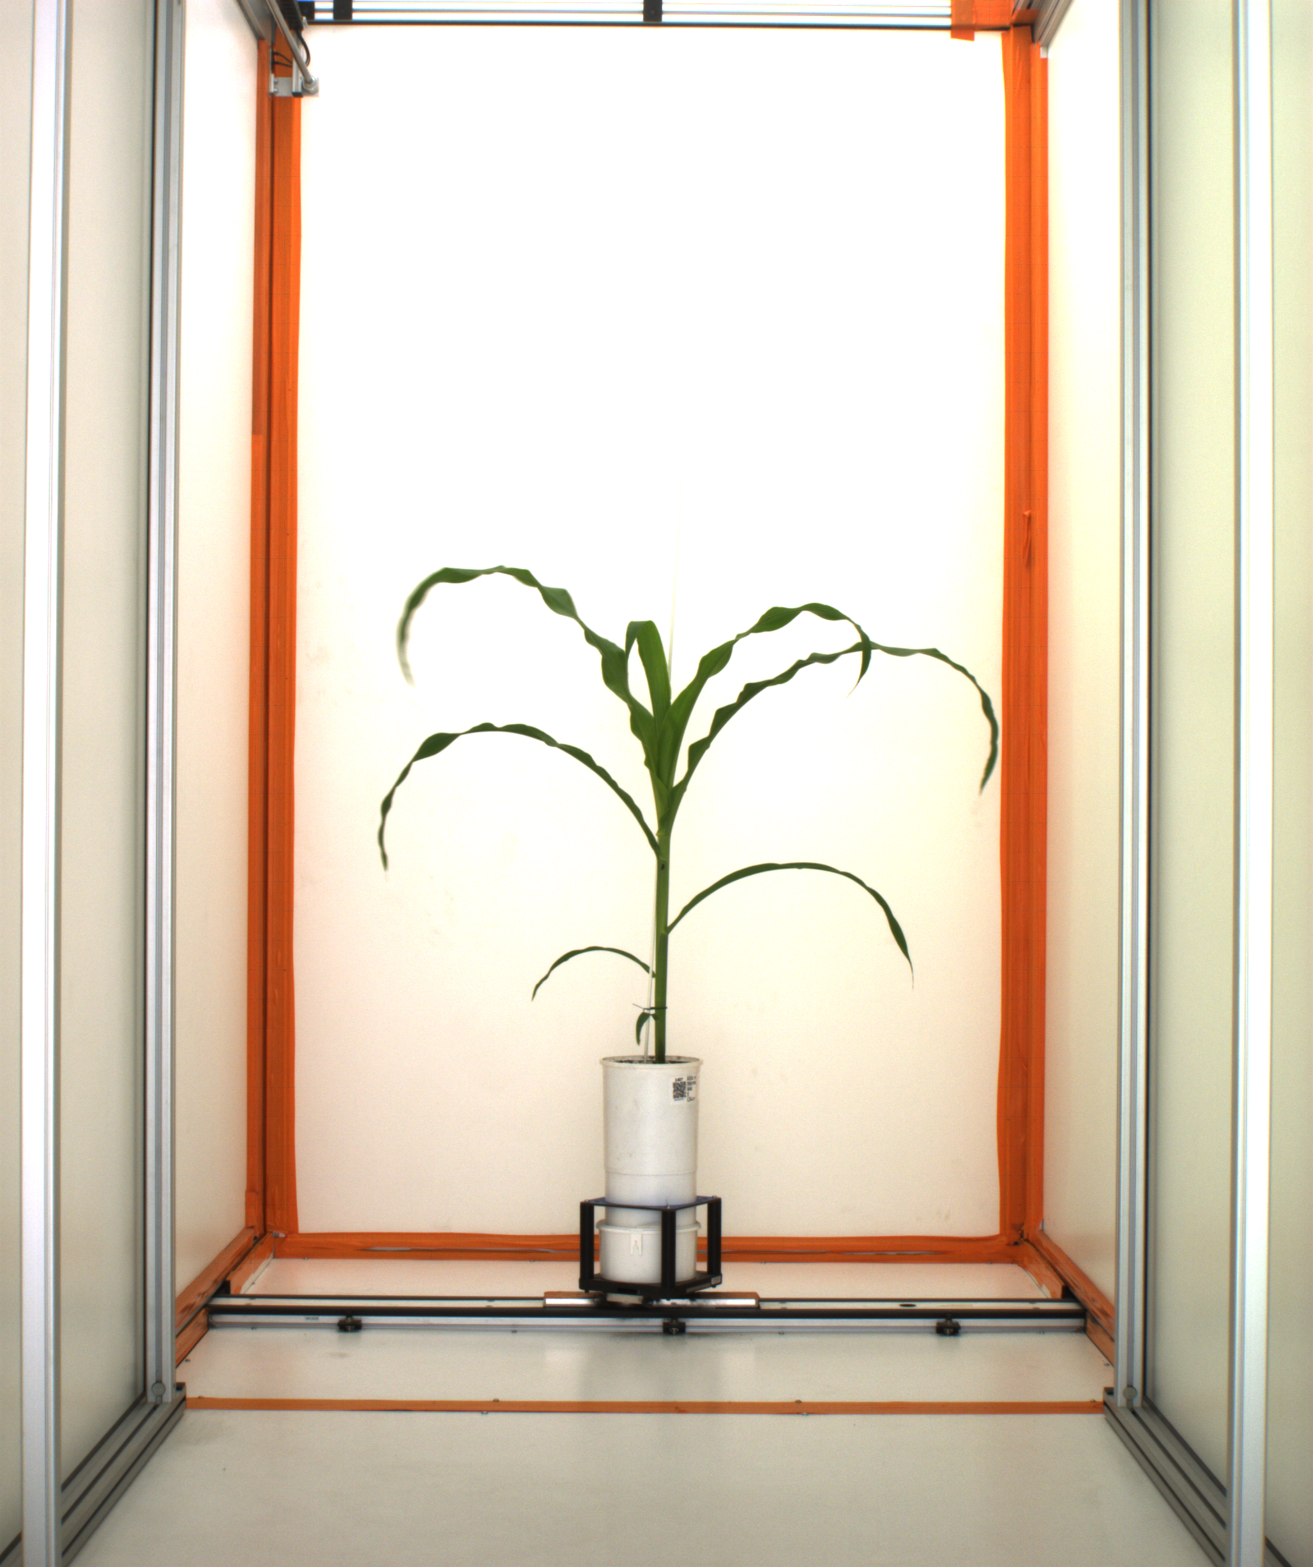
Input Data (2/3)

Slide 4
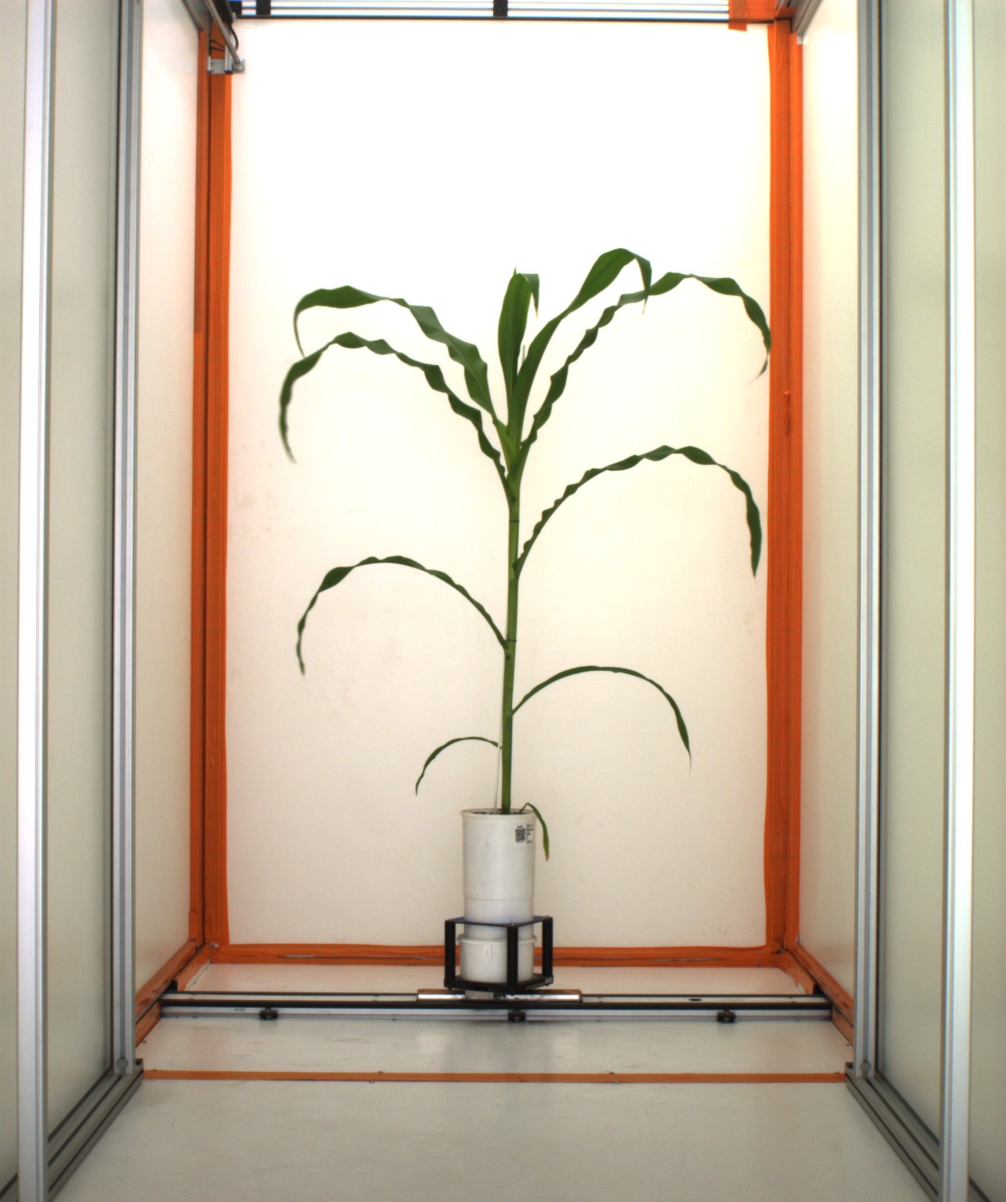
Input Data (3/3)

Slide 5

Output data Binarization (1/3)

Slide 6

Output data Binarization (2/3)

Slide 7

Output data Binarization (3/3)

Slide 8
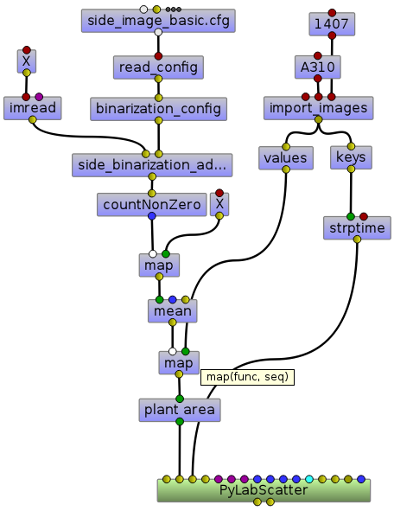
Adaptive Threshold (1/3)

Slide 9
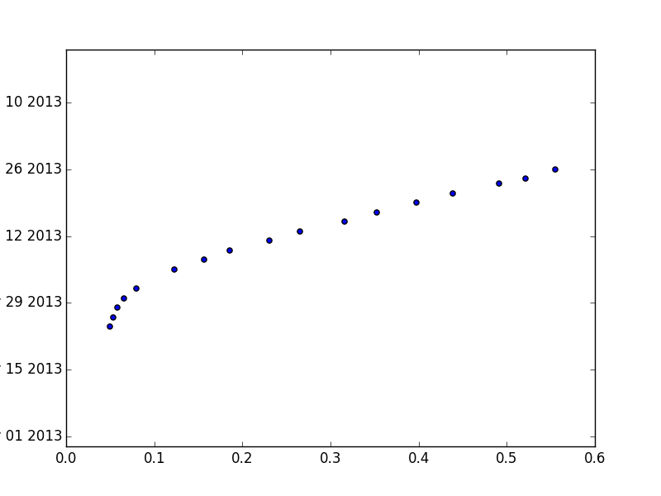
Adaptive Threshold (2/3)

Slide 10
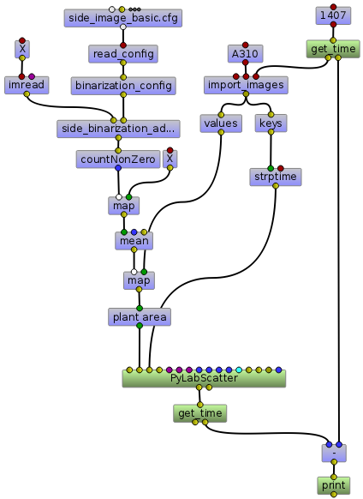
Adaptive Threshold (3/3)

Slide 11
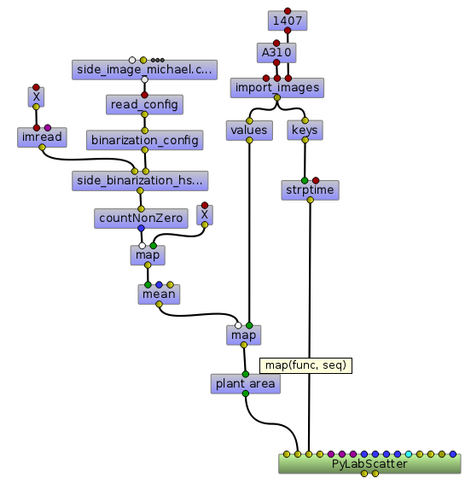
HSV (1/3)

Slide 12
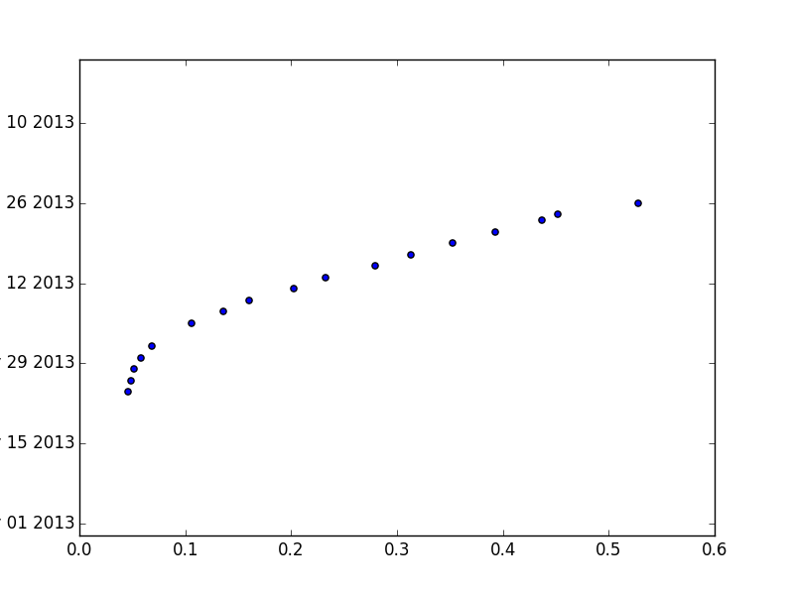
HSV (2/3)

Slide 13
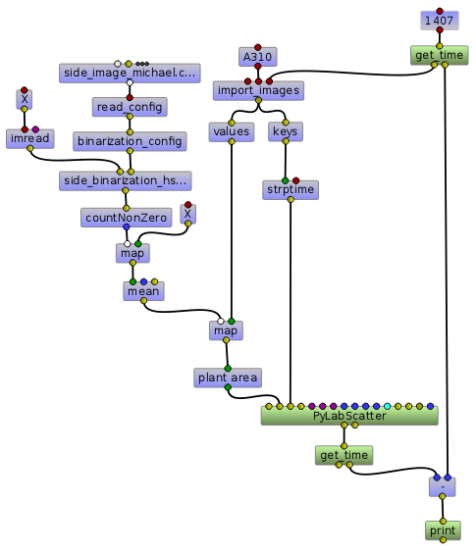
HSV (3/3)

Slide 14
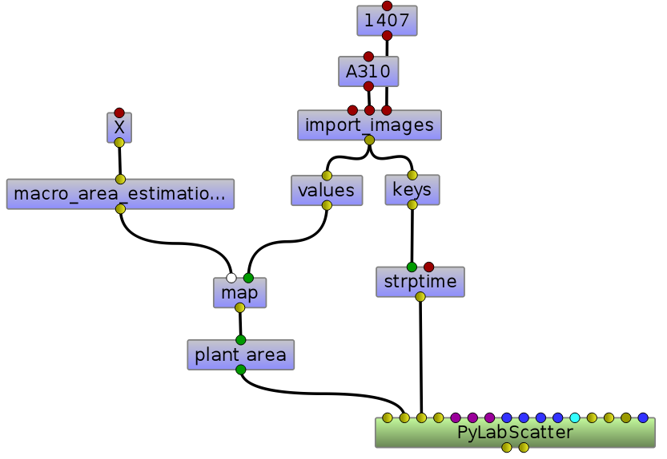
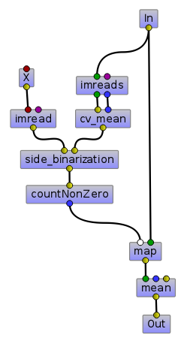
Meanshift (1/3)

Slide 15

Meanshift (2/3)

Slide 16
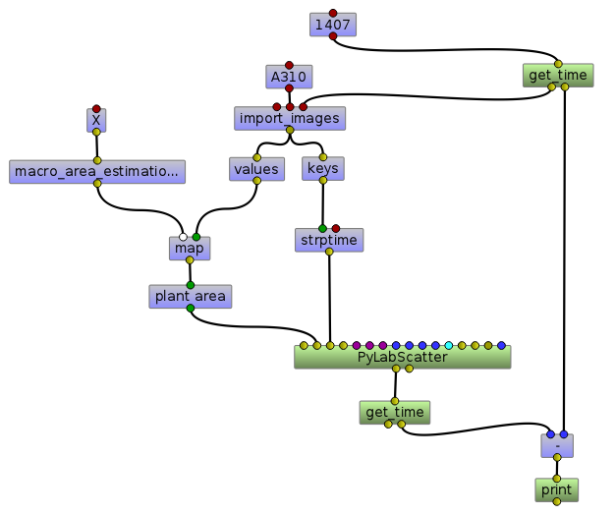
Meanshift (3/3)

Slide 17
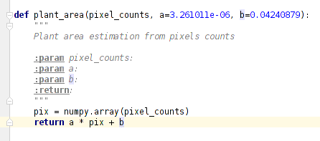
Model : Plant Area

