Slide 1

P4P : Provider Portal for (P2P) Applications
Y. Richard Yang
Laboratory of Networked Systems
Yale University
Sept. 25, 2008 STIET Research Seminar

Slide 2
Acknowledgements
Joint work with
  Haiyong Xie (Yale now at Akamai)
  Arvind Krishnamurthy (University of Washington)
  Members of Yale Laboratory of Networked Systems (LANS). In particular, Richard Alimi, Hao Wang, Ye Wang, Glenn Thrope
  Avi Silberschatz (Yale)
Extremely grateful to help from
  Charles Kalmanek (AT&T Labs)
  Marty Lafferty (DCIA)
  Doug Pasko (Verizon)
  Laird Popkin (Pando)
  Rich Woundy (Comcast)
  Members of the P4P working group

Slide 3
Outline
The problem space
The P4P framework
The P4P interface
Evaluations
Discussions and ongoing work

Slide 4
Content Distribution using the Internet
A projection
The Internet is increasingly being used for digital content and media delivery.
“Within five years, all media will be delivered across the Internet.”
- Steve Ballmer, CEO Microsoft, D5 Conference, June 2007
Notes:
The context of the P4P project is content distribution in the Internet.
Not only web documents, but also software, sw update, books, video, movie rental, and many more measurement collections

Slide 5
Challenges: Content Owner’s Perspective
Content protection/security/monetization
Distribution costs

Slide 6



Traditional Client-Server
More users
Worse performance (C₀/n)
Higher cost
server
C₀
client 1
client n
client 2
Slashdot effect, CNN on 9/11

Slide 7
Bandwidth Demand
“Desperate Housewives” available from ABC
  one hour (320x240 H.264 iTunes): 210MB
  assume 10,000,000 downloads
  ⇒ 64 Gbps non-stop for 3 days !
HD video is 7~10 times larger than non-HD video
http://dynamic.abc.go.com/streaming/landing?lid=ABCCOMGlobalMenu&lpos=FEP
http://www.pbs.org/cringely/pulpit/pulpit20060302.html; Will Norton Nanog talk
Notes:
Mention 320x240 is no HD

Slide 8
Classical Solutions
IP multicast: replication by routers
  overhead
  less effective for asynchronous content
  lacking of billing model, require multi-ISP coop.
Cache, content distribution network (CDN), e.g., Akamai
  expensive
  limited capacity: “The combined streaming capacity of the top 3 CDNs supports one Nielsen point.”

Slide 9
Scalable Content Distribution: P2P
Peer-to-peer (P2P) as an extreme case of multiple servers:
  each client is also a server

Slide 10




Example: BitTorrent
HTTP GET MYFILE.torrent
MYFILE.torrent
webserver
user
“register”
list of random peers
ID1 169.237.234.1:6881
ID2 190.50.34.6:5692
ID3 34.275.89.143:4545
…
ID50 231.456.31.95:6882
appTracker
…
Peer 40
Peer 1
Peer 2

Slide 11
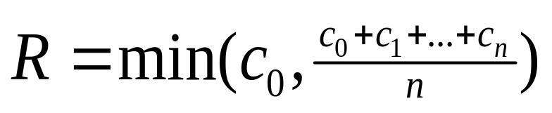
Benefits of P2P
Low cost to the content owners: bandwidth and processing are (mostly) contributed/paid by end users
Scalability/capacity:
  theoretical capacity*:
  claim by one P2P:
  10 Nielsen points
server
C₀
C₁
client 1
C_{n}
C₂
C₃
client 2
client n
client 3
*First derived in Mundinger’s thesis (2005).

Slide 12
Integrating P2P into Content Distribution
P2P is becoming a key component of content delivery infrastructure for legal content
  some projects
    iPlayer (BBC), Joost, Pando (NBC Direct), PPLive, Zattoo, BT (Linux)
    Verizon P2P, Thomson/Telephonica nano Data Center
Some statistics
  15 mil. average simultaneous users
  80 mil. licensed transactions/month

Slide 13
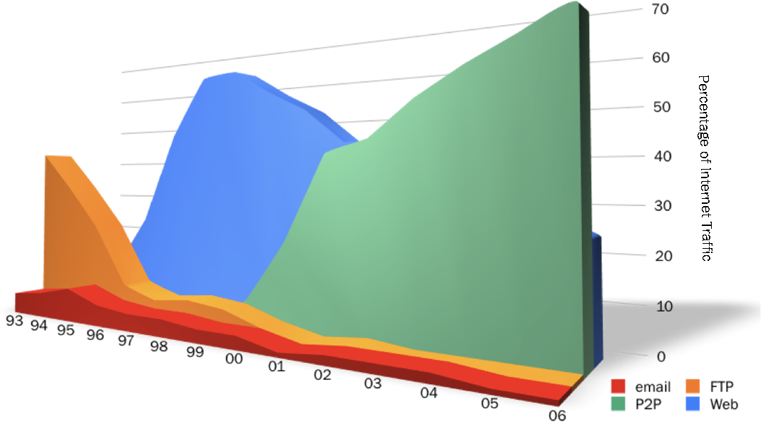
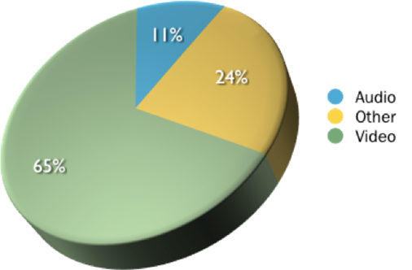
P2P : Bandwidth Usage
Traffic: Internet Protocol Breakdown 1993 - 2006
File-Types: Major P2P Networks - 2006
Up to 50-70% of Internet traffic is contributed by P2P applications
Cache logic research: Internet protocol breakdown 1993 – 2006;
Velocix: File-types on major P2P networks.
Notes:
P2P:
(1) bandwidth-demanding video streaming P2P applications,
(2) P2P-based content distribution is also becoming more and more popular, e.g., BitTorrent is used to distribute software updates, download movies

Slide 14
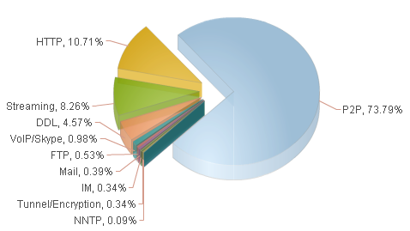
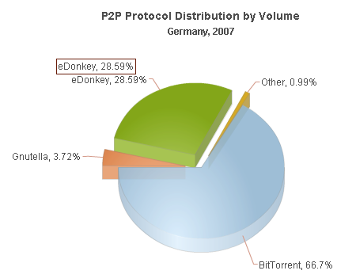
P2P : Bandwidth Usage
Germany: 70% Internet traffic is P2P
ipoque: Nov. 2007
Notes:
P2P:
(1) bandwidth-demanding video streaming P2P applications,
(2) P2P-based content distribution is also becoming more and more popular, e.g., BitTorrent is used to distribute software updates, download movies

Slide 15
P2P Problem : Network Inefficiency
P2P applications are largely network-oblivious and may not be network efficient
  Verizon (2008)
    average P2P bit traverses 1,000 miles on network
    average P2P bit traverses 5.5 metro-hops
  Karagiannis et al. on BitTorrent, a university network (2005)
    50%-90% of existing local pieces in active users are downloaded externally
Notes:
Clearly P2P is popular and good to content owners. However, from the network’s perspective, P2P is a problem. One key problem is network inefficiency.

Slide 16
ISP’s Attempts to Address P2P Issues
Upgrade infrastructure
Usage-based charging model
Rate limiting, or termination of services
P2P caching
ISPs cannot effectively address network efficiency alone.

Slide 17
P2P’s Attempt to Improve Network Efficiency
P2P has flexibility in shaping communication patterns
Adaptive P2P tries to use this flexibility to adapt to network topologies and conditions
  e.g., selfish routing, Karagiannis et al. 2005, Bindal et al. 2006, Choffnes et al. 2008 (Ono)

Slide 18
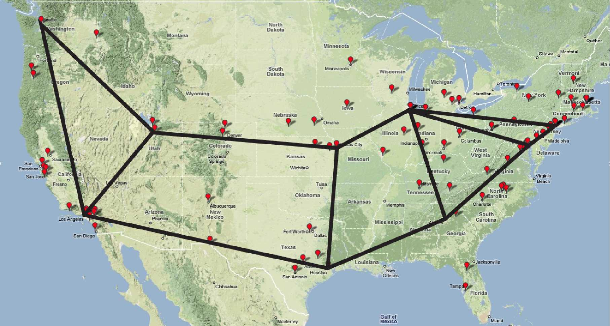
Problems of Adaptive P2P
Overhead: Adaptive P2P needs to reverse engineer network topology and traffic load
Reverse engineering of network cost and policy may be extremely challenging, if not impossible
GEANT
ISP 2
Level 3

Slide 19
Problem of Adaptive P2P : Inefficient Interactions
  Internet Service Provider (ISP): traffic engineering to change routing to shift traffic away from highly utilized links
    current traffic pattern ➔ new routing
  Adaptive P2P: direct traffic to lower latency paths
    current routing matrix ➔ new traffic pattern
Nash equilibrium points can be inefficient
Qiu, Yin, Yang, Shenker, Selfish routing : SIGCOMM 2003

Slide 20
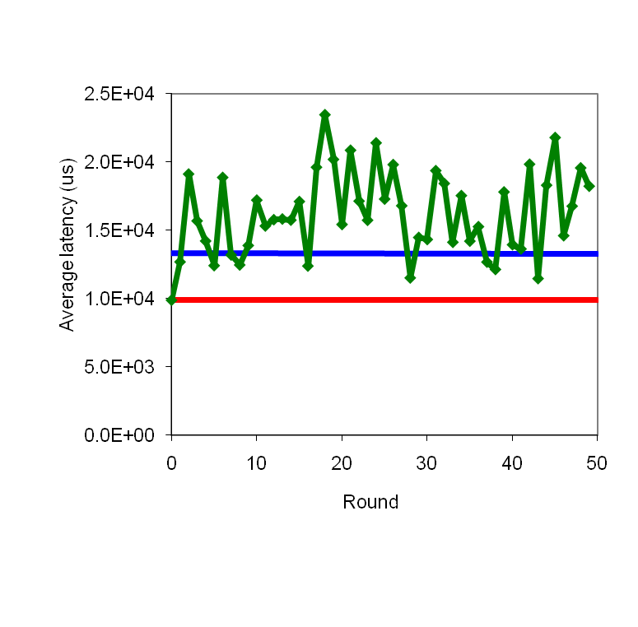
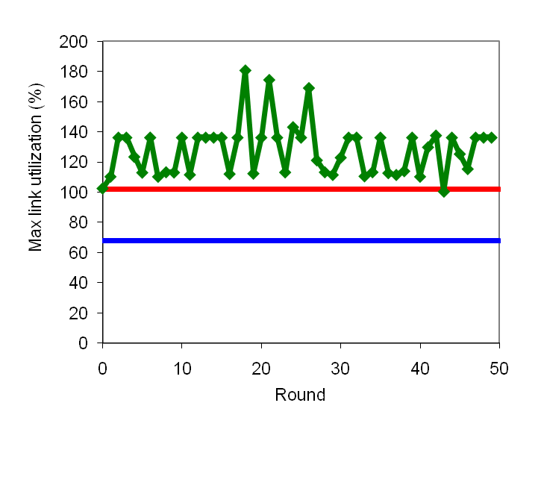
ISP Traffic Engineering+ P2P Latency Optimizer
red: adaptive P2P adjusts alone; fixed ISP routing
blue: ISP traffic engineering adapts alone; fixed P2P communications
ISP optimizer interacts poorly with adaptive P2P.
Notes:
red p2p alone
blue: TE alone

Slide 21

A Fundamental Problem in Internet Architecture
Feedback from Internet networks to network applications is extremely limited
  e.g., end-to-end flow measurements and limited network feedback

Slide 22
P4P Objective
Design an open framework to enable better cooperation between network providers and network applications
P4P: Provider Portal for (P2P) Applications
Notes:
The motivation for involving ISPs in this process :
ISPs are best positioned with respect to gathering information regarding the state of the network and the needs of
P2P systems. By letting ISPs make recommendations and letting the peer-to-peer systems use these as hints
in their peering process, we hope to design a system that is efficient and incurs low operational costs

Slide 23
The P4P Framework
Data plane, e.g.,
  applications mark importance of traffic
  routers mark packets to provide faster, fine-grained feedbacks
  transparent storage in the network (data locker) for last mile
Management plane
  monitoring compliance
Control plane

Slide 24
P4P Control Plane
ISP A
Providers
  publish information
  (API) via iTrackers
Applications
  query providers’ information
  adjust traffic communication
  patterns accordingly
iTracker
iTracker
P2P
ISP B

Slide 25
Example: Tracker-based P2P
Information flow
  1. peer queries appTracker
  2/3. appTracker queries iTracker
  4. appTracker selects a set of active peers
iTracker
appTracker
2
3
1
4
ISP A
peer

Slide 26
Two Major Design Requirements
Both ISP and application control
  no one side dictates the choice of the other
Extensibility and neutrality
  ISP: application-agnostic (no need to know application specific details)
  application: network-agnostic (no need to know network specific details/objectives)
Notes:
Simplicity and ease of implementation
Scalability
Extensibility: support diverse ISP objectives and applications scenarios in large networks
Fault tolerant
Privacy preservation
Mention the 1Mbps inside, 5 outside selection issue

Slide 27
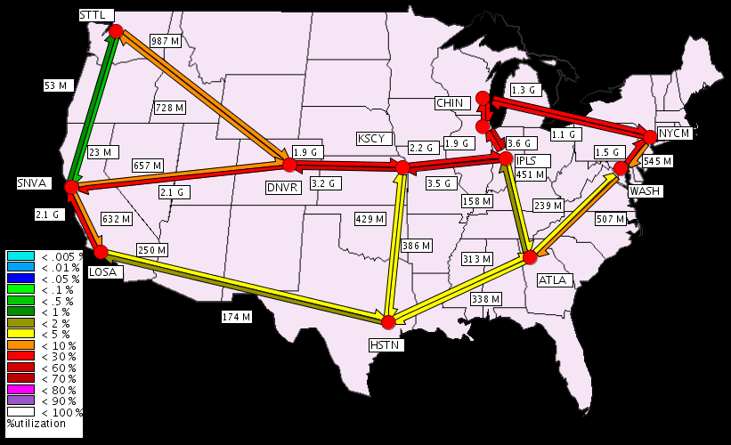
A Motivating Example
ISP objective:
  minimize maximum
  link utilization (MLU)
P2P objective:
  optimize system
  throughput

Slide 28
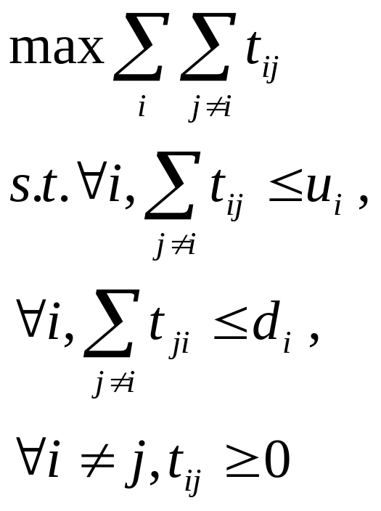
Specifying P2P Objective
P2P objective
  optimize system throughput
Using a fluid model*, we can derive that: optimizing P2P throughput
⇒
maximizing up/down link capacity usage
*Modeling and performance analysis of bittorrent-like peer-to-peer networks. Qiu et al. Sigcomm ‘04
Notes:
Need to also add tit-for-tat and other constraints

Slide 29
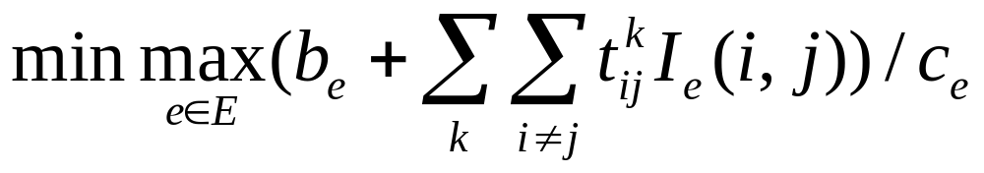
Specifying ISP Objective
ISP Objective
  minimize MLU
Notations:
  assume K P2P applications in the ISP’s network
  b_{e}: background traffic volume on link e
  c_{e}: capacity of link e
  I_{e}(i,j) = 1 if link e is on the route from i to j
  t^{k} : a traffic demand matrix {t^{k}_{ij}} for each pair of nodes (i,j)

Slide 30
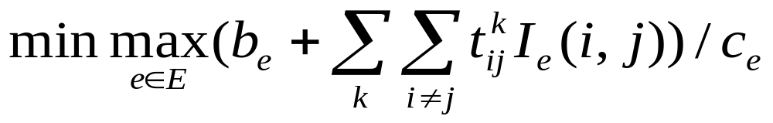
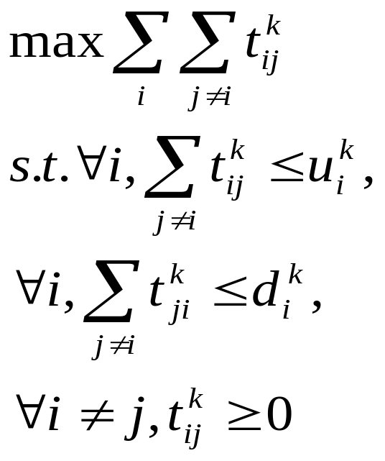
System Formulation
Combine the objectives of ISP and applications
s.t., for any k,
T¹
t^{k}
T^{k}

Slide 31
Possible Solution
s.t., for any k,
A straightforward approach:
centralized solution
  applications: ship their information
  to ISPs
  ISPs: solve the optimization problem
Issues
  not application-agnostic
  not scalable
  violation of P2P privacy

Slide 32
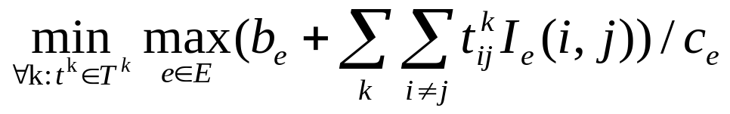
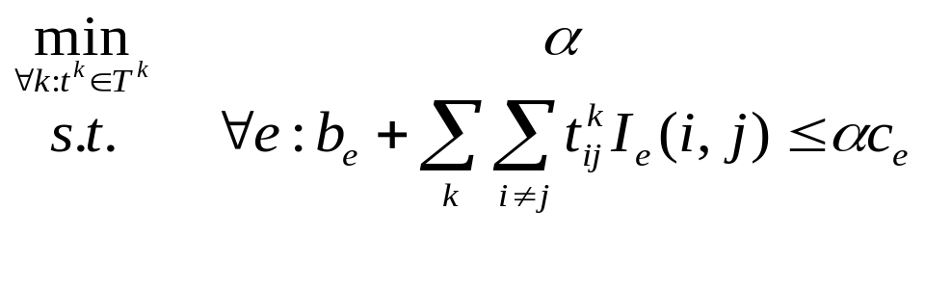
Constraints Couple Entities
Constraints couple ISP/P2Ps together!

Slide 33
Objective: Decouple ISP/P2Ps
t^{k}
Introduce p_{e} to decouple the constraints
T^{k}
p_{e}

Slide 34
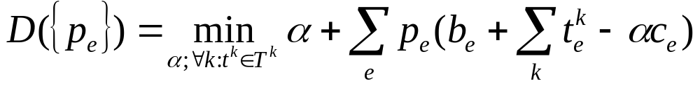
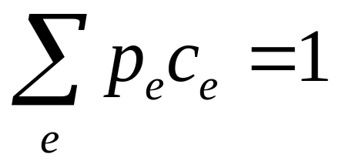
ISP MLU: Dual
With dual variable p_{e} (≥ 0) for the inequality of each link e
To make the dual finite, need

Slide 35
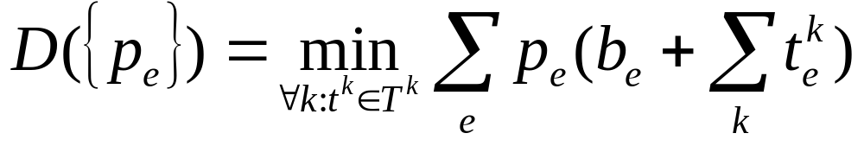
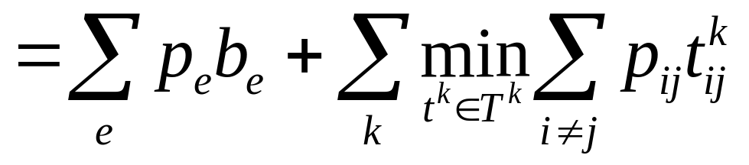
ISP MLU: Dual
Then the dual is
where p_{ij} is the sum of p_{e} along the path from node i to node j

Slide 36
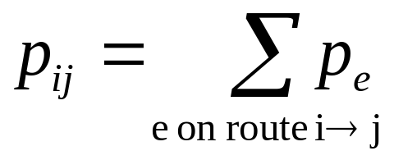
ISP/P2P Interactions
The interface between applications and providers is the dual variables {p_{ij}}
p_{e1}(t)
p_{e2}(t)
t^{k}(t)
t^{k}
T^{k}

Slide 37
The API: Two Views
1
2
Provider (internal) view
Application (external)
view
  each pair of nodes has “cost”
  called pDistance
  pDistance perturbed
  for ISP privacy
6
3
5
4
1
2
6
3
5
4

Slide 38
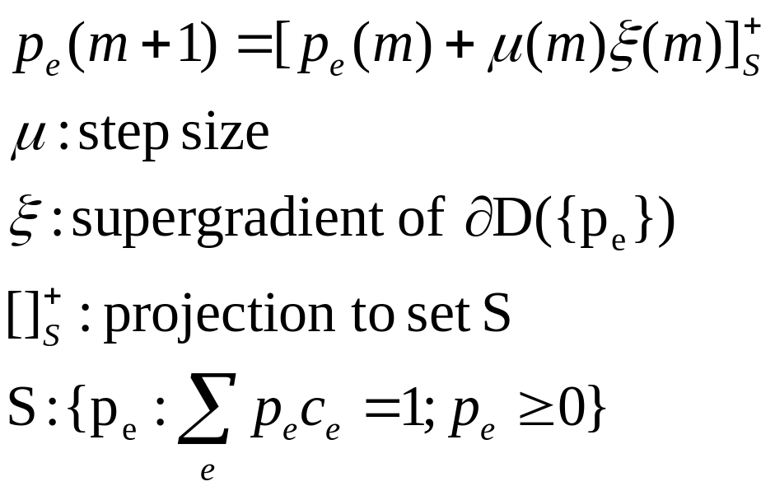
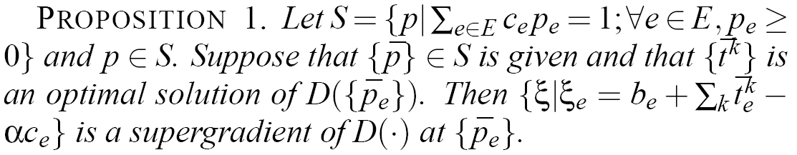
Update pDistance
At update m+1,
  calculate new “shadow prices” for all links,
  then compute pDistance for all
  node pairs

Slide 39
Generaliztion
The API handles other ISP objectives and
P2P objectives
ISPs
Applications
Minimize MLU
Maximize throughput
Minimize bit-distance product
Robustness
Minimize interdomain cost
Rank peers using pDistance
Customized objectives
…

Slide 40
Interdomain
Provider1
p?
1
2
Provider 2
p?
6
3
p?
5
4
Provider 3

Slide 41
P4P for Interdomain Cost: Multihoming
Multihoming
  a common way of connecting to Internet
  improve reliability
  improve performance
  reduce cost
ISP 1
Internet
ISP
ISP 2
ISP K

Slide 42
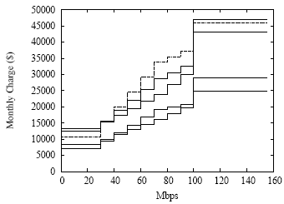
Network Charging Model
Cost = C₀ + C(x)
  C₀: a fixed subscription cost
  C: a non-decreasing function
  mapping x to cost
  x: charging volume
    total volume based charging
    percentile-based charging (95-th percentile)

Slide 43
Percentile Based Charging
Sorted volume
95%*N
N
Interval
Charging volume: traffic in the (95%*N)-th sorted interval

Slide 44
Interdomain Cost Optimization:
Problem Specification (2 ISPs)
Sorted volume
Volume
v1
Sorted volume
Time
v2
Goal: minimize total cost = C1(v1)+C2(v2)

Slide 45
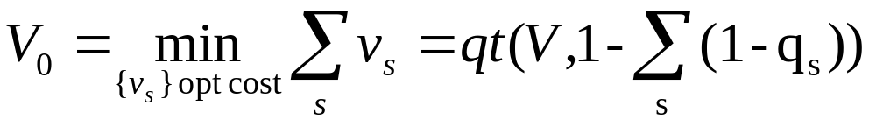
Theorem
Let q_{s} be the quantile of ISP_{s}, C_{s}() its charging function, v_{s} its charging volume, and V the time series of total traffic. Then
Example, suppose two ISPs with q_{s} = 0.95
then 1- [(1-0.95) + (1-0.95)] = 0.90

Slide 46
Sketch of ISP Algorithm
Determine charging volume for each ISP
  compute V0
  using dynamic programming to find {v_{s}} that minimize ∑_{s} c_{s}(v_{s}) subject to ∑_{s}v_{s}=V0
Assign traffic threshold v for each ISP at each interval

Slide 47
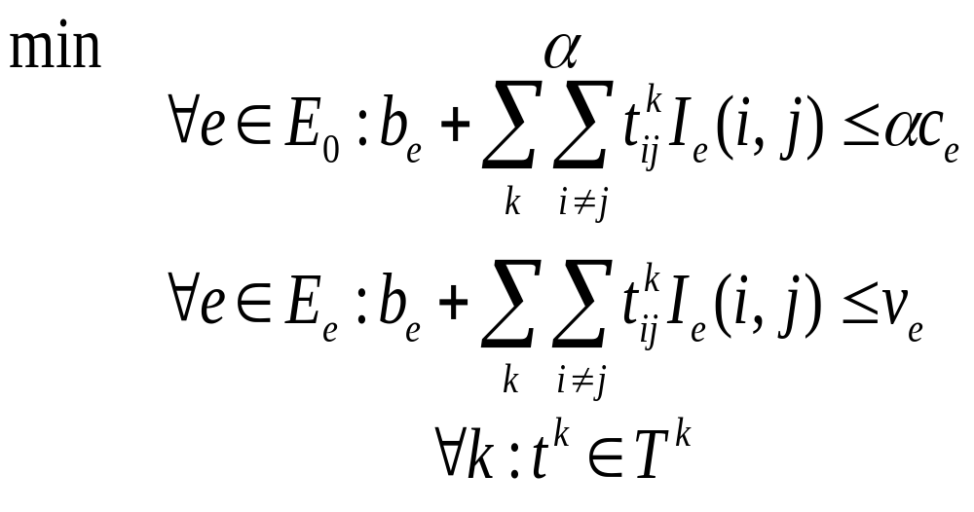
Integrating Cost Min with P4P
Notes:
Interdomain

Slide 48
Evaluation Methodology
BitTorrent simulations
  Build a simulation package for BitTorrent
  Use topologies of Abilene and Tier-1 ISPs in simulations
Abilene experiment using BitTorrent
  Run BitTorrent clients on PlanetLab nodes in Abilene
  Interdomain emulation
Field tests using Pando clients
  Applications: Pando pushed videos to 1.25 million clients
  Providers: Telefonica/Verizon iTrackers

Slide 49
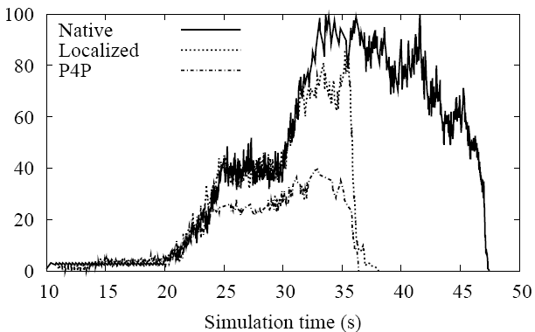
BitTorrent Simulation: Bottleneck Link Utilization
native
Localized
P4P
P4P results in less than half utilization on bottleneck links

Slide 50
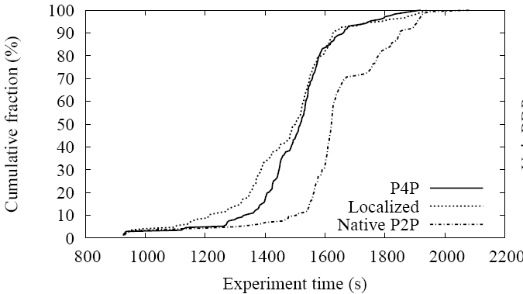
BitTorrent Abilene: Completion Time
P4P achieves similar performance with localized at percentile higher from 50%.

Slide 51
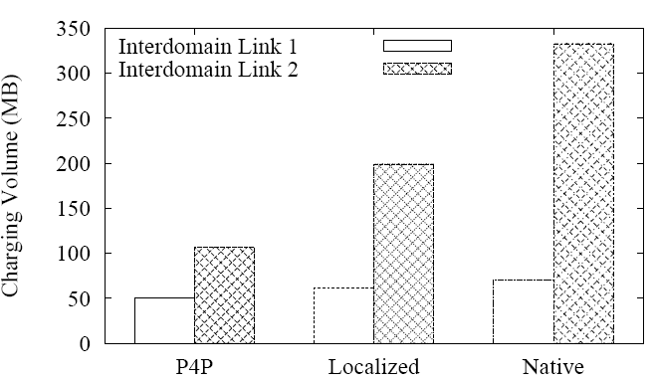
Abilene Experiment: Charging Volume
Charging volume of the second link: native BT is 4x of P4P; localized BT is 2x of P4P

Slide 52
Field Tests: ISP Perspectives (Feb’08)
1.70
Interdomain traffic statistics
  ingress: Native is 53% higher
  egress: Native is 70% higher
Intradomain traffic statistics
1.53
Normalized Volume
1
1
ingress
egress
5.5
57.98%
% of Local Traffic
BDP
6.27%
0.89
Native
P4P
Native
P4P

Slide 53
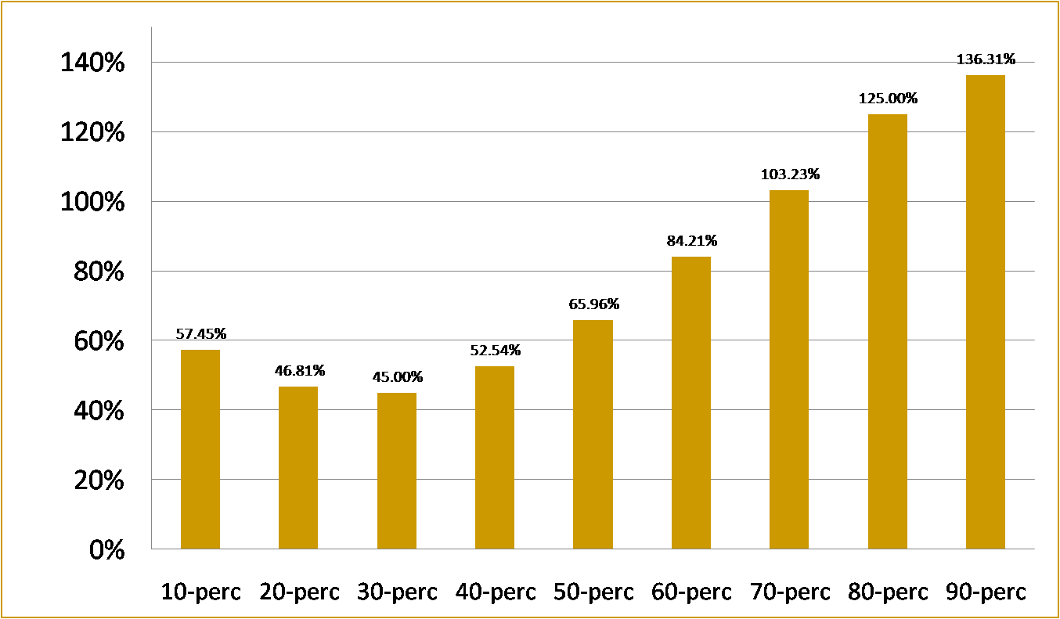
Field Tests: P4P Download Rate Improvement for an ISP (July 2008)

Slide 54
Summary & Future Work
Summary
  P4P for cooperative Internet traffic control
  Optimization decomposition to design an
  extensible and scalable framework
  Concurrent efforts: e.g, Feldmann et al, Telefonica/Thompson
Future work
  P4P capability interface (caching, CoS, data locker)
  Other P2P application integration (streaming)
  Incentives, privacy, and security analysis of P4P

Slide 55
Current P4P-WG
Core Group | AT&T Bell Canada Bezeq Intl BitTorrent Cisco Systems Comcast Grid Networks Joost | Kontiki LimeWire Manatt Oversi Pando Networks PeerApp PPLive Solid State | Telefonica Group Velocix VeriSign Verizon Vuze U. of Toronto U. of Washington Yale U.
Observers | Abacast AHT Intl AjauntySlant Akamai Alcatel Lucent CableLabs Cablevision Cox Comm Exa Networks IBM | Juniper Networks Lariat Network Level 3 Communications Limelight Networks Microsoft MPAA NBC Universal Nokia Orange Princeton University | RawFlow RSUC/GweepNet SaskTel Solana Networks Speakeasy Network Stanford University Thomson Time Warner Cable Turner Broadcasting UCLA

Slide 56
Thank you and Questions

Slide 57
Major Design Requirements
Simplicity and intuitive interpretation
  to both network operators and application developers (may imply two views)
Both ISP and application control
  no one side dictates the choice of the other
  application still has capability for optimization: P2P vendors compete on optimization techniques; ISP involvement should not make this extremely hard or impossible
Extensibility and neutrality
  ISP: application-agnostic info (not a mechanism that may be perceived for ISPs to manipulate info/decision to play “favorites” for particular types of app)
  application: no need to know network specific details/objectives, but fine-grained enough info for good optimization
Notes:
Simplicity and ease of implementation
Scalability
Extensibility: support diverse ISP objectives and applications scenarios in large networks
Fault tolerant
Privacy preservation
Mention the 1Mbps inside, 5 outside selection issue

Slide 58
Major Design Requirements (Cont’)
Scalability
  ISP: avoid handling per peer-join request
  application: local/cached info from ISP useful during both initial peer joining and re-optimization
Privacy preservation
  ISP: information (spatial, time, status, and policy) aggregation and transformation (e.g., interdomain link cost to congestion level due to virtual capacity)
    e.g., some ISPs already publically report aggregated performance: e.g., AT&T, Qwest inter-city performance http://stat.qwest.net/index_flash.html
  application client privacy from ISP: no individual session info sent to ISP
  P2P vendor privacy: no revealing of client base information
Fault tolerance
Notes:
Simplicity and ease of implementation
Scalability
Extensibility: support diverse ISP objectives and applications scenarios in large networks
Fault tolerant
Privacy preservation
Mention the 1Mbps inside, 5 outside selection issue

Slide 59
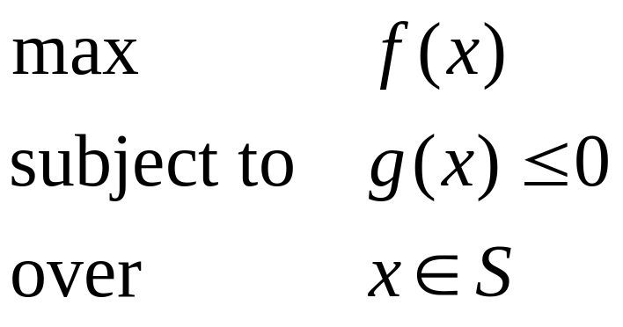
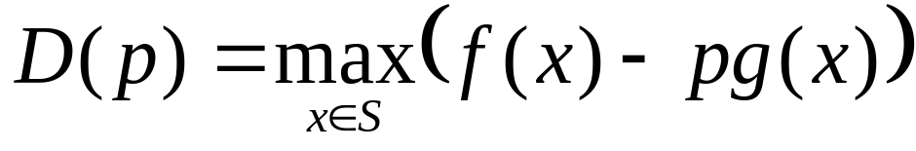
A One-Slide Summary of Optimization Theory
Introduce p for the constraint:
p (>= 0) is called shadow price in economics
D(p) is called the dual
f(x)
p₁
p₂
S
D(p) provides an upper bound on solution.
- Then according to optimization theory: when D(p) achieves minimum over all p (>= 0), then the optimization objective is achieved when certain concavity conditions are satisfied.
g(x)

