Slide 1

Nexus
Mohit Lilhare • Chaitanya Petkar • Parth Godbole

Slide 2


Contents
01
05
Introduction
Findings and Results
02
06
Problem Statement
Key Takeaways
03
07
Objectives
Conclusion
04
Tools & Methodology

Slide 3
Introduction
A clear ppt on Minor Project

Slide 4

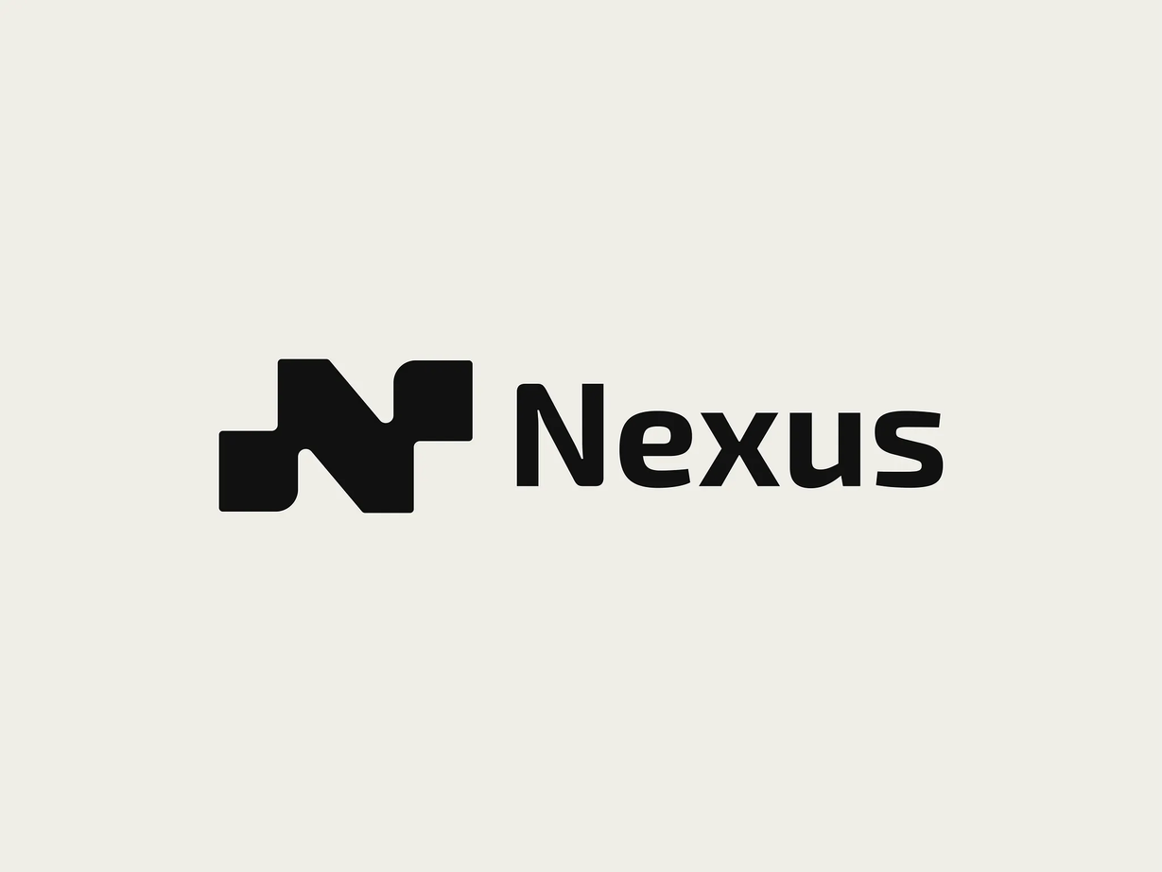
Nexus
A free Chrome extension that lets you highlight any text on a webpage and instantly fact-check it using Google Search and Gemini.

Slide 5

Problem
Statement
Internet users need real-time tools to verify claims on websites and social media, but manual fact-checking doesn't scale and most AI systems lack transparency or rely on outdated training data.

Slide 6

Why it matters
A solution requires immediate, search-grounded, transparent fact-checking integrated directly into the user's browsing experience.
68%
60,000
global internet users encounter misleading content on social platforms monthly
AI-generated news articles are published every day.

Slide 7


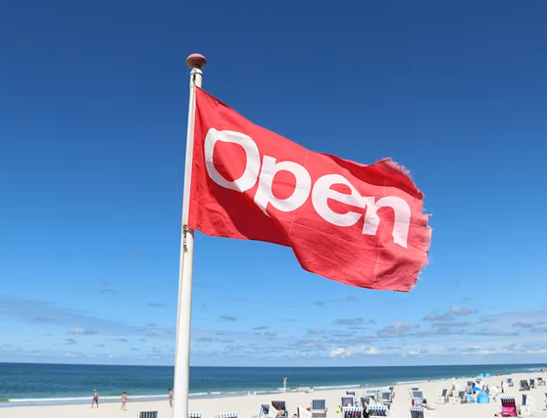

Goals and Objectives
Real-time claim verification
Open-source & accessible
Universal coverage
RAG with Google Search grounding for transparent, cited, evidence-based responses.
Text selection for claims on any webpage, social media, PDFs, and Google Docs.
Free Chrome extension requiring only Google Gemini API key, no data tracking

Slide 8
User triggers verification
Highlight text on any webpage and select verify via right-click, keyboard shortcut, or toolbar icon.
Tools and Methodology
System retrieves & analyzes
Extension sends claim to Gemini API, which auto-generates search queries, retrieves real-time results from Google Search
Results displayed
Popup shows comprehensive fact-check with inline citations, source URLs, and titles for full transparency

Slide 9




Google Gemini API with Search Grounding
Highlight Text on Page
01.
04.
User selects any claim on webpage, PDF, slides, or docs
Send claim to Gemini with google_search tool enabled for real-time verification.
Trigger Fact Check
Fact-Check Results with Citations
02.
05.
Click right-click menu, keyboard shortcut, or toolbar icon to initiate verification.
Gemini synthesizes search results to generate classification, evidence snippets, source links, and justification.
Extract and Prepare Claim
03.
06.
Display Popup in Sidebar
Chrome extension captures highlighted text, cleans format, and identifies key terms.
Present formatted results with clickable source links and inline citations for user review.

Slide 10
Findings and Results
The Results of Nexus
are ...

Slide 11
Key Findings
High performance RAG
Universal access
Production-validated
<100KB extension, <5s response time, zero hallucinations through real-time search grounding.
Free, no-setup tool works on all websites for all users (free & paid Gemini tiers).
Community adoption and GitHub contributions prove browser-native fact-checking is viable

Slide 12

Conclusion
Nexus is an RAG application combining Gemini API with real-time search grounding to provide free, private, verifiable fact-checking. As misinformation threatens global information integrity, this accessible tool demonstrates that sophisticated AI can combat disinformation at zero cost.

Slide 13
Referenecs
IEEE Access
Email
Evolution of Deep Learning Models for Misinformation Detection in Social Media Textual Data. Elgammal, Z. & Alhajj, R.
hello@reallygreatsite.com
Email
Phone
hello@reallygreatsite.com
123-456-7890
Social media
Address
@reallygreatsite
123 Anywhere St., Any City, ST

