Slide 1
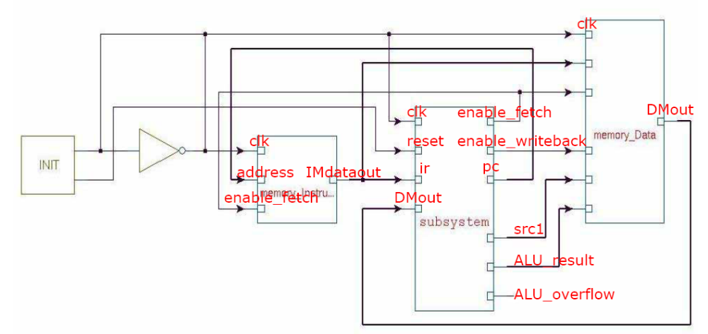
A Simplified CPU Architecture (1/2)
Overall Architecture
Data
memory
Instruction
memory
Kernel

Slide 2
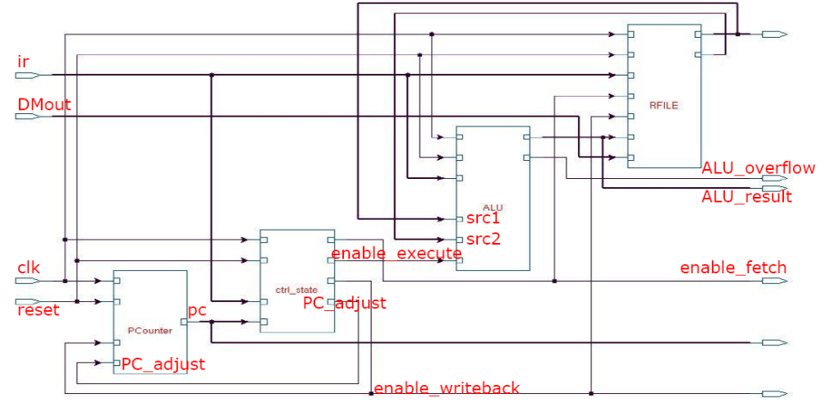
A Simplified CPU Architecture (2/2)
Kernel subsystem
Datapath
controller

Slide 3
CPU in Action (ALU REG <- REG )
RF[dst] <- ALU(RF(src),RF(dst))
Datapath
to DM
to IM
enable
to IM
address
controller

Slide 4
CPU in Action ALU( REG <- IMM )
RF[dst] <- ALU(RF(dst), IMM)
Datapath
to DM
to IM
enable
to IM
address
controller

Slide 5
CPU in Action( LD REG <- IMM )
RF<- LD( IMM )
Datapath
to DM
to IM
enable
to IM
address
controller

Slide 6
CPU in Action( LD REG <- MEM )
RF <- LD( MEM )
Datapath
to DM
to IM
enable
to IM
address
controller

Slide 7
CPU in Action( SW MEM <- REG )
MEM<- SW( REG )
Datapath
to DM
to IM
enable
to IM
address
controller

Slide 8
CPU in Action( SW MEM <- IMM )
MEM<- SW( IMM )
Datapath
to DM
to IM
enable
to IM
address
controller

