Slide 1
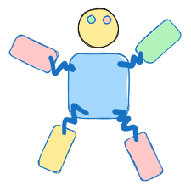
Pet3 A virtual on-chain pet chrome extension

Slide 2
Feature
Physics engine
Lucky box
Artela network
Score system
Combination body (future)
NFT level up (future)

Slide 3
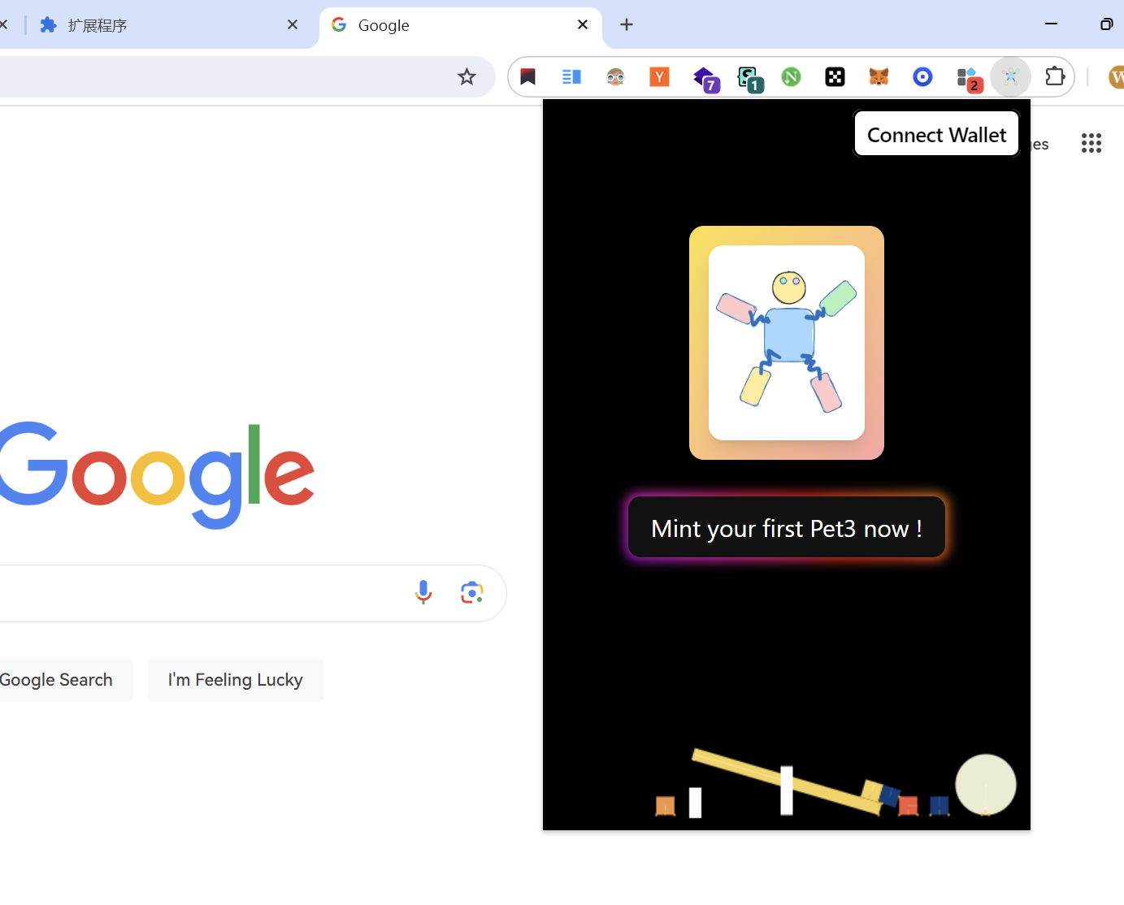

Slide 4
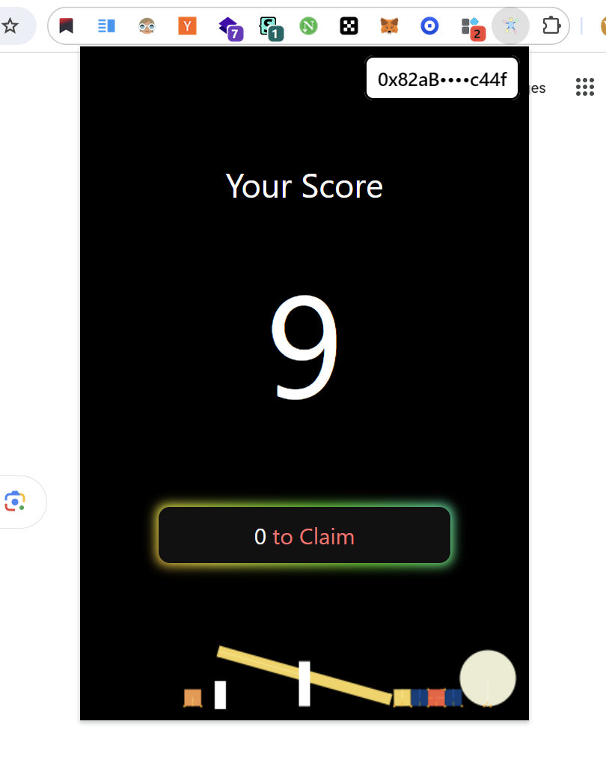

Slide 7
Thanks
wujerry116@gmail.com
TG: JerryImba

