Slide 1
IMAGE SEGMENTATION DEEP LEARNING
SEGMENTING THE CARVANA IMAGE DATASET
ERWIN SMITH
SEBASTIAN KOCH
YI-JIE YANG
Check GitHub repository: yej117/Image_Segmentation_Deep_Learning

Slide 2
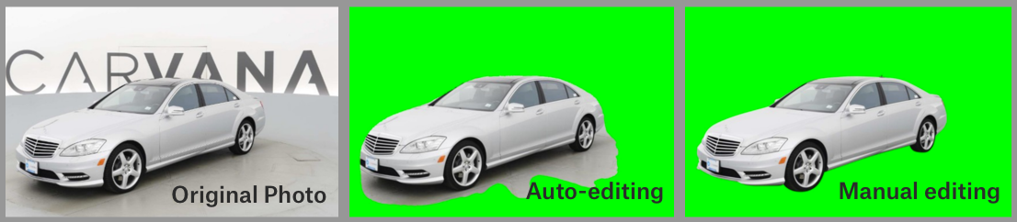
PROJECT SUMMARY:
For this project, we attempted the task of image segmentation through using a dataset from Kaggle; specifically the Carvana Masking Challenge.
The idea comes from the interests of knowing how to segment the object from the image. The datasets from the Carvana Image Masking Challenge is based on high quality car photos and the backgrounds of the images usually contain similar colors as cars.

Slide 3
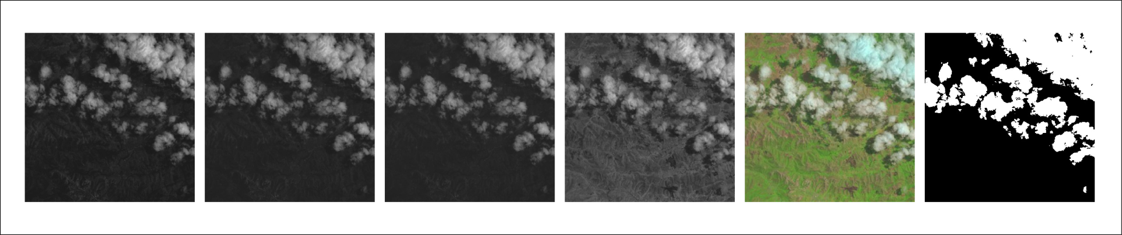
WHY THIS DATASET:
We first wanted to gain some basic understanding of image segmentation.
Car more easily separated from background – i.e. we have a somewhat more neutral background.
Once we have gained this basic understanding:
Perhaps then move on to more complex tasks like cloud segmentation.
This is a more complex task as there are more background features/colours.
A bit too complex for now – but someday!

Slide 4
STORY:
We initially wanted to do image segmentation on a cloud dataset.
This may have been useful in many applications such as in agriculture.
We found this a bit too challenging as beginners.
We decided to first try something a bit simpler as practice.
This led us to the Carvana Image Segmentation Challenge.

Slide 5
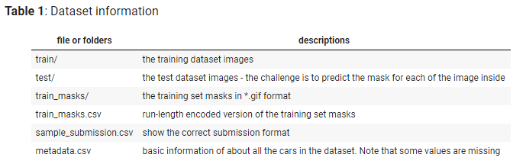
MORE ABOUT THE DATASET:
The dataset contains a large number of car images (as .jpg files). Each car has exactly 16 images, each one taken at different angles.
The dataset provided by the challenge was separated into different folders and files as the following table (information from the Kaggle challenge website)

Slide 6





TOOLS
Jupyter Notebook
Google Colab
GitHub
Google Drive
Carvana Masking Challenge Dataset from Kaggle.

Slide 7
OUTLINE
Data Preparation
Network Architecture U-Net: developed by Ronneberger et al., 2015
Results: Model preformance
Examples from Mercedes-Benz website
Story Behind
Future Work

Slide 8
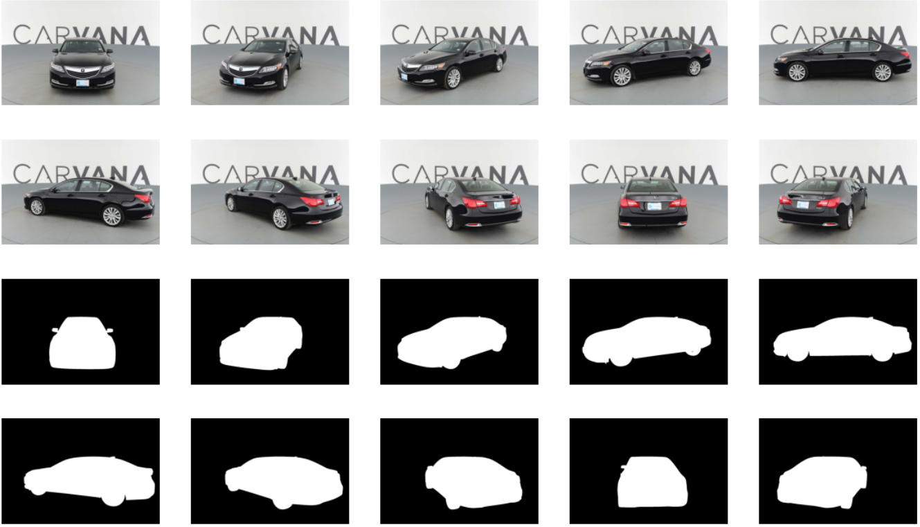
DATA PREPARATION (1/2)
Upload the dataset to a shared google drive
A glimpse of the dataset

Slide 9
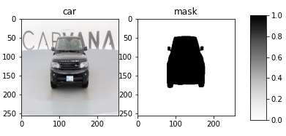
DATA PREPARATION (2/2)
Resize the image into (256, 256)
Data augmentation with ImageDataGenerator the following parameters
rotation_range | 90
width_shift_range | 0.2
height_shift_range | 0.2
shear_range | 0.2
zoom_range | 0.2
horizontal_flip | True
fill_mode | 'nearest'

Slide 10
NETWORK ARCHITECTURE: U-net (Ronneberger et al., 2015)
An end-to-end fully convolutional network with no dense layer
Accept image of any size
Especially useful for image segmentation tasks
Works through repeated applications of convolutions, each followed by a rectified linear unit (ReLU) and max pooling (up-sampling)

Slide 11
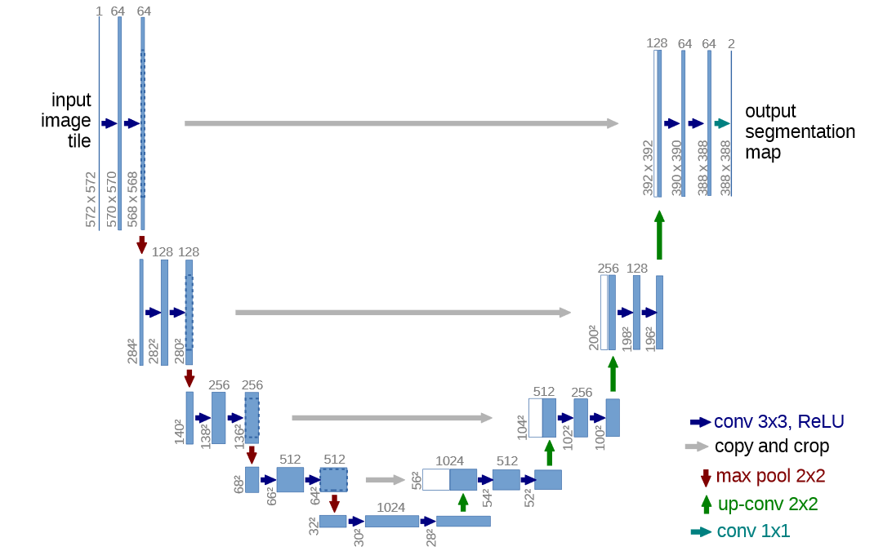
NETWORK ARCHITECTURE: U-net
Input:
(256, 256, 3)
Output layer:
Conv2D (2,2)
⁞
Conv2D (3,3)
Conv2D (3,3)
concatenate
Conv2DTranspose (2,2)
Conv2D (3,3)
Conv2D (3,3)
MaxPooling2D (2,2)
⁞
Conv2D (3,3)
Conv2D (3,3)
(ref: Ronneberger et al., 2015)

Slide 12
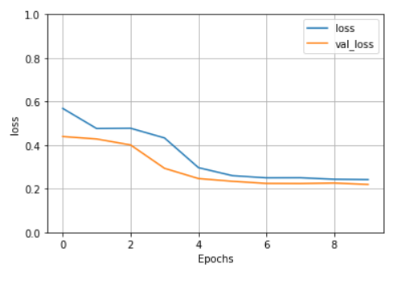
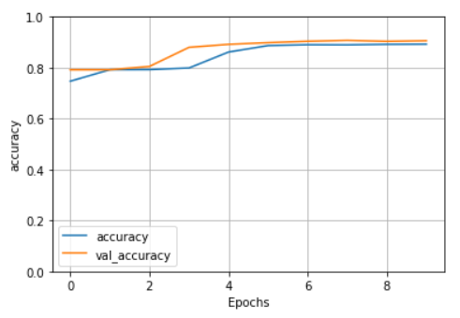
RESULTS
Test dataset
loss: 0.2288
accuracy: 0.9013

Slide 13
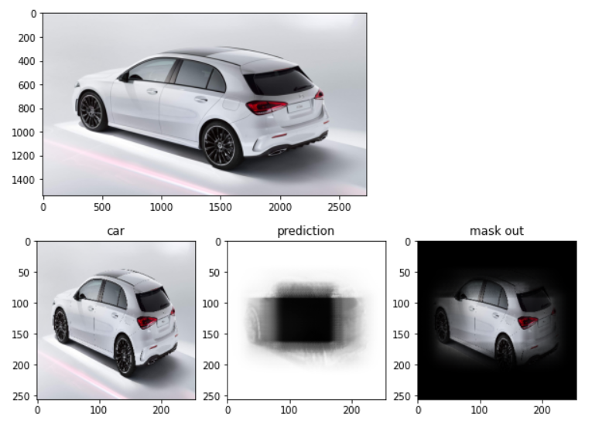
EXAMPLES (1/2)

Slide 14
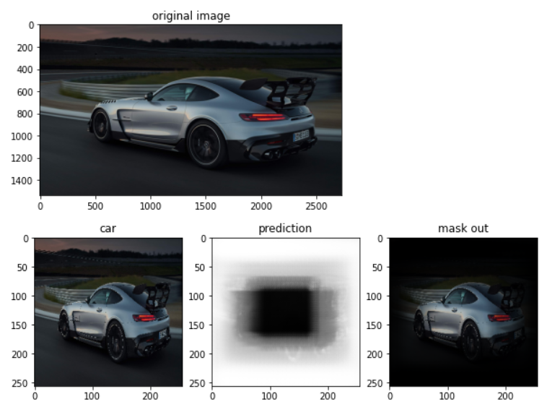
EXAMPLES (2/2)

Slide 15
FUTURE WORK:
Try different network architecture, for example: SegNet, ResNet, FractalNet,...
Use image segmentation for estimating cloud cover – which may be a great application in many fields such as rain and related weather prediction!

Slide 16
THANK YOU!

