Slide 1
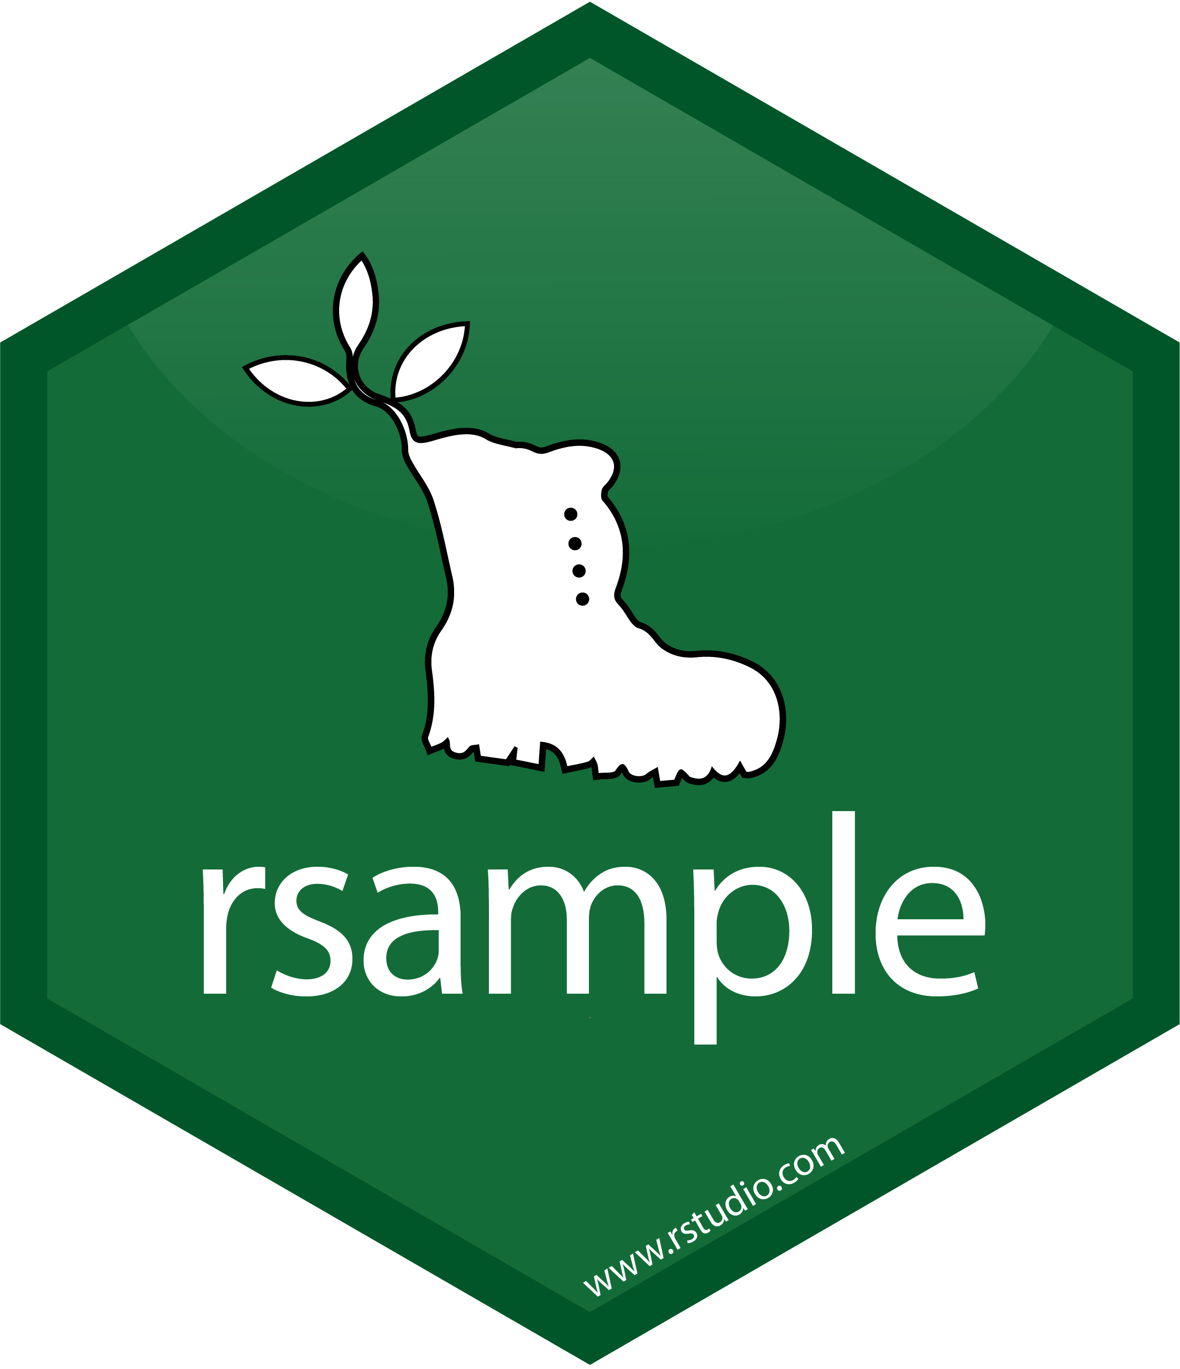





Overview of tidymodels
Use when? | Package | Step | Functions
Always |  | 1. Split into testing and training sets | initial_split() training() testing()
Only if performing cross validation or tuning |  | Split training set into cross validation sets | Functions from rsample such as vfold_cv()
Always |  | 2. Create recipe & assign variable roles | recipe() update_role()
Only if performing preprocessing |  | Specify preprocessing steps | step_*()
Only if performing preprocessing and want to see the preprocessed data |  | Check the preprocessing | prep(retain = TRUE) bake()
Always |  | 3. Specify model, engine, and mode | Parsnip function for specific modeling package (ex. decision_tree()) (https://www.tidymodels.org/find/parsnip/) set_engine() set_mode()
Only if tuning |  | Specify hyperparameters to tune | tune() within model function
Always |  | 4. Create workflow, add recipe, add model | workflow() add_recipe() add_model()
Only if not using cross validation |  | 5.1 Fit workflow | fit()
Only if performing cross validation |  | 5.2 Fit workflow with cross validation | fit_resamples()
Only if tuning |  | 5.3 Fit workflow with tuning | tune_grid()
Always |  | 6. Get predictions | predict()
if not looking at resamples (cross validation, tuning) |  | 7.1 Use predictions to get performance metrics | rmse() (continuous outcome) accuracy() (categorical outcome) metrics() (either type of outcome)
Only if performing cross validation or tuning |  | 7.2 Use fit_resamples() or tune_grid() output to get performance metrics | collect_metrics() show_best()

