Slide 1
Introduction of ParcelMakerTM
ver 1.0
Akira HOSOKAWA
IEC/SC 3D/WG 3 expert

Slide 2
What is ParcelMakerTM?
ParcelMakerTM is a reference implementation of IEC 62656-1, for helping users to view, develop, and validate data dictionaries in the form of spreadsheets compliant to IEC 62656-1 on Microsoft® Excel®.
ParcelMakerTM is developed by Toshiba with Visual Basic for Applications (VBA, in short). Your own codes can coexist with ParcelMakerTM.
For standardization purpose, ParcelMakerTM is freely available (a license file for your computer is required).

Slide 3
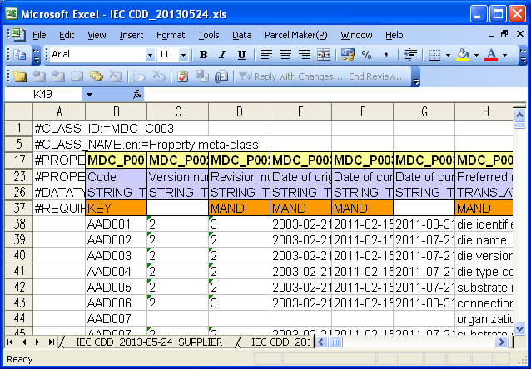
Snapshot

Slide 4
How to use
Almost all of the functions are available from the following:
ParcelMaker menu in the Addin menu of Excel®
Generate worksheets on the active workbook for developing a data dictionary from scratch
Import/export worksheets from/to files in the form of CSV or Excel®, which contains data conformant to IEC 62656-1 to/from the active workbook
Validate a data dictionary on the active workbook
Context menu in a worksheet
Show a class structure (available from a CLASS sheet)
Rename the identifier of a concept to another (available from the Code column (identified with MDC_P001_n) on each sheet)
Double clicking a cell in the data section of a worksheet
Show a special GUI for editing a (structured) value (an identifier in blue on the #PROPERTY_ID line indicates that the column has a special GUI)
Detailed usage will be available from a user manual

Slide 5
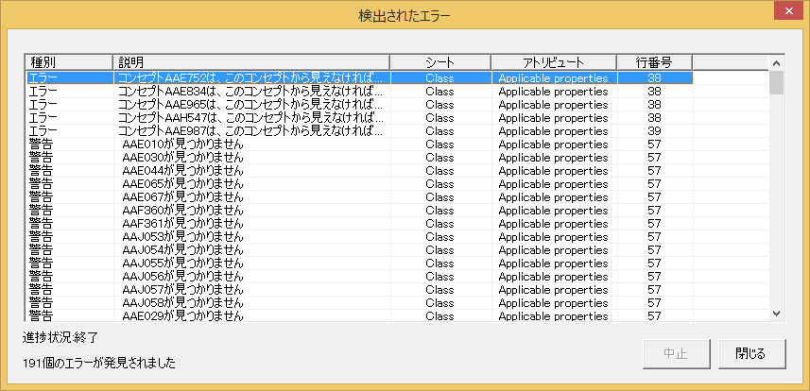
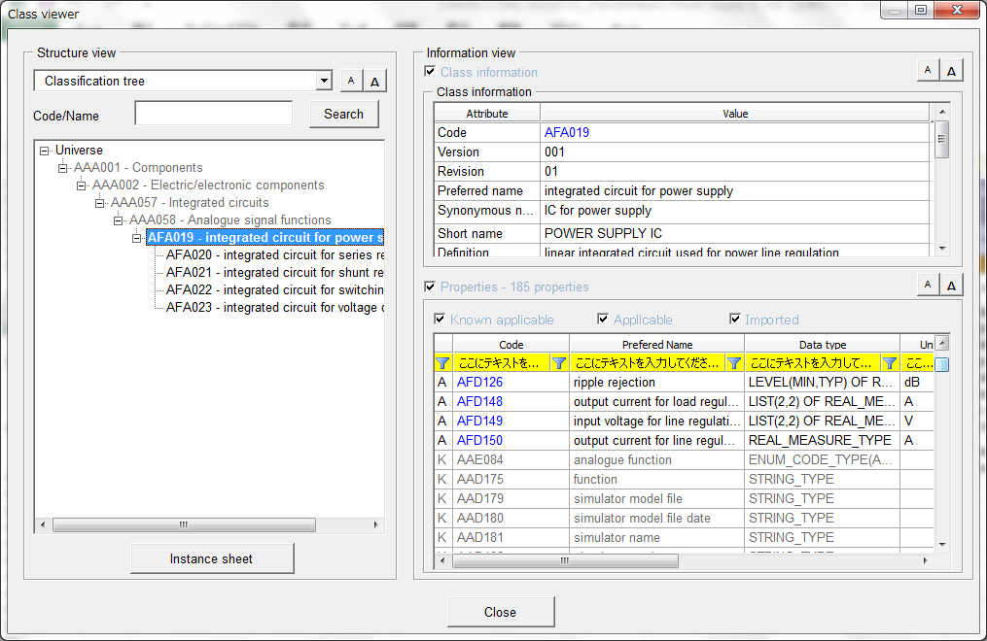
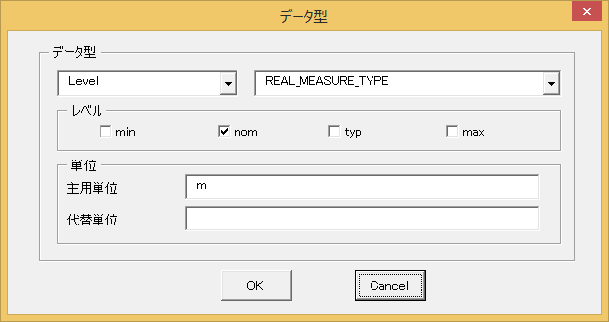
How to use (example)
A) Parcel Maker→Tools→Validation
C) Double-clicking a cell on
MDC_P021(data type)
B) Context menu→ Class Viewer

Slide 6
System requirements
Microsot® Windows® 7® or later (32/64 bit)
Microsoft® Excel® 2010 or later (32/64 bit)

Slide 7
How to start
Install ParcelMakerTM to your computer
Get a license file for your computer
Inform the developer of MAC address(es) of your computer by e-mail
Copy your license file to the Addin folder under the ParcelMakerTM installation directory.
“C:\Program Files (x86)\Toshiba\Parcel Maker\Addin”, as default.
Enable the ParcelMakerTM addin
Click Excel Option
Click Add-ins
Under Manage, click Excel Add ins and then click Go
In the Add-Ins dialog box, click Browse and then select ParcelMaker.xla in the above the Addin folder.
After restart Microsoft® Excel®, ParcelMaker menu will appear in the Addin menu.
Note: If the Addin menu does not appear, please add “C:\Program Files (x86)\Toshiba\Parcel Maker\Addin” as a trusted location. Trusted locations setting is available from Trust Center in Excel Option.

Slide 8
Contact
If you need to have your license or have any question, please contact
Mr. Akira HOSOKAWA (akira.hosokawa@toshiba.co.jp)
Mr. Hiroshi MURAYAMA (smarthiroshi.icloud.com)

Slide 9
Tutorial for defining your data dictionary

Slide 10
Tutorial for beginners
This tutorial shows how to describe a data dictionary by using ParcelMakerTM with a simple example which uses only basic feature of IEC 61360-2/IEC 62656-1. Typical steps are as follows;
Design your data dictionary,
Prepare parcel sheets,
Edit details of each concept,
View the class hierarchy of your data dictionary,
Validate your data dictionary.
(informative) Small tips
NOTE1: For information of advanced one, please look at IEC 61360-1/IEC 62656-2 (guide for IEC 61360-2/IEC 62656-1, respectively).
NOTE2: Parcel sheets of existing standardized data dictionaries will be available from the IEC CDD website.

Slide 11
1. Design your data dictionary
Example: Classification of “Nut”
TOS#P0001##001
manufacturer
TOS#C001##001
Nut
TOS#E0001##001
Enumerated code list
for materials of nut
TOS#P0002##001
material
a list of choices for enumeration type
TOS#P0003##001
Height of nut
properties which are newly applicable to this class
is-a relationship, where all properties of a class are inherited to its sub classes
TOS#P0004##001
pitch
TOS#T0001##001
Waspaloy
choices
TOS#T0002##001
SUS303
TOS#C002##001
Hexagon nut
TOS#P0003##001
width across flats
Legend
class
TOS#C003##001
Wing nut
TOS#P0004##001
height of wing
property
enumeration
term
NOTE: In IEC 61360-2, any relationship between concepts shall be described by using those identifiers

Slide 12
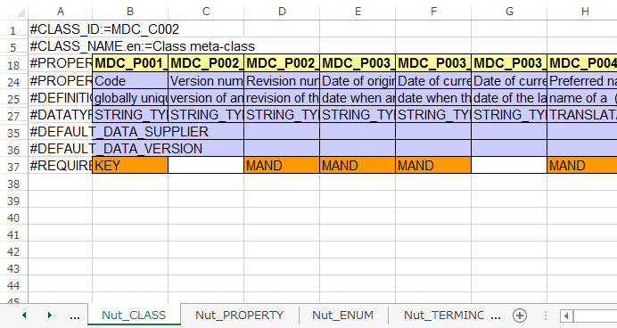
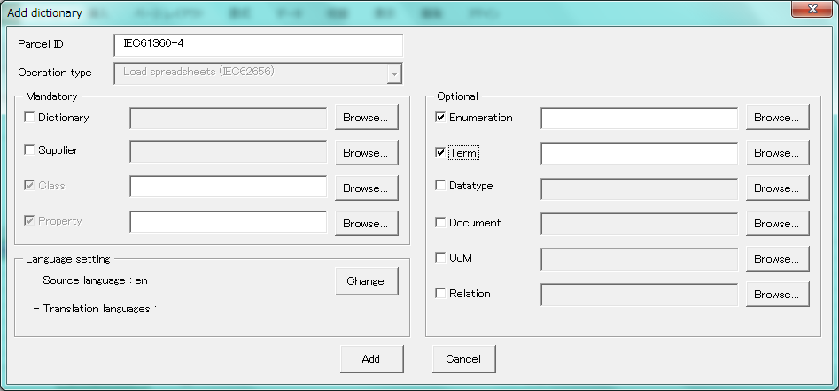
2. Prepare parcel sheets
Execute Microsoft® Excel® from Windows startmenu,
Click Parcel Maker→File→New in the Addin menu,
In the Add Dictionary dialog box (see below), edit your data dictionary name in the Parcel ID textbox, and then check parcel sheets to be generated,
Click Add, and then those sheets as template will be generated on a new workbook.

Slide 13
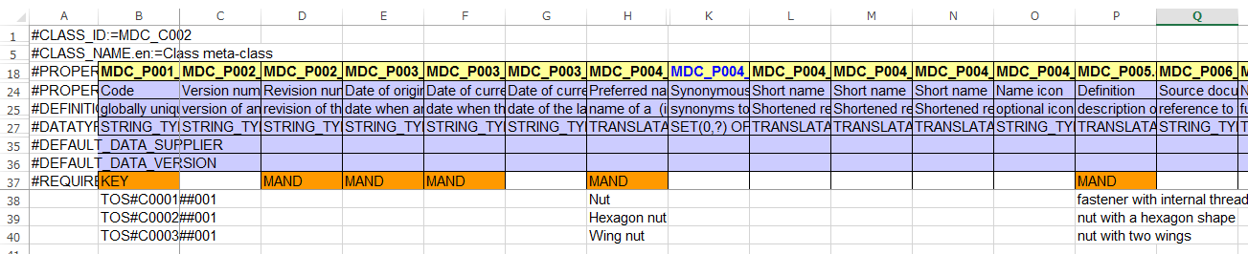
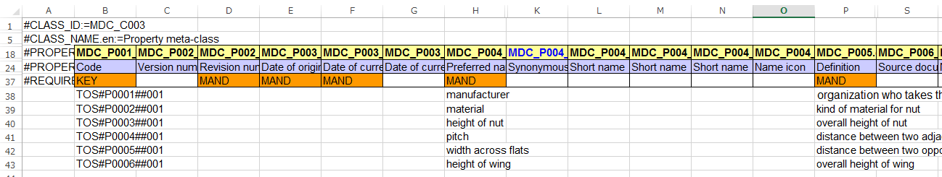
3. Edit details of each concept (1/4)
Common for each parcel sheet
Edit an identifier of a concept → MDC_P001_n (n is integer)
Edit a preferred name of a concept → MDC_P004_1.en
Edit a definition of a concept → MDC_P005_1.en
NOTE: IEC 61360-6 (Quality guide) is recommended to be referred when you edit values of those attributes.
Class sheet
A
B
C
Property sheet
A
B
C

Slide 14
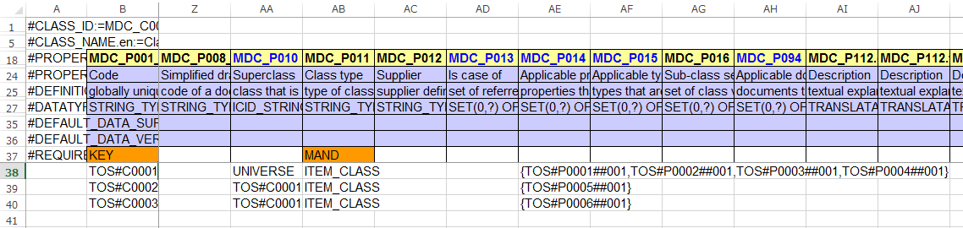
3. Edit details of each concept (2/4)
In class sheet
Edit a class type → MDC_P011 (if product class, ITEM_CLASS should be selected)
Edit a superclass → MDC_P010 (Special GUI for selecting a superclass)
Edit applicable properties → MDC_P014 (Special GUI for picking up properties to be newly applicable to a class)
Properties should be prepared in the property sheet in advance.
Class sheet
A
B
C

Slide 15
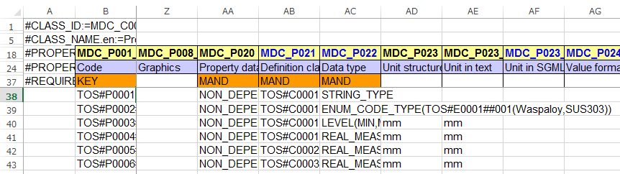
3. Edit details of each concept (3/4)
In property sheet
Edit a Property data element type → MDC_P020 (if a property doesn’t depend on any other one, and the property isn’t depended on any other property, NON_DEPENDENT_P_DET should be selected)
Edit a definition class → MDC_P021 (Special GUI for selecting a definition class)
Edit a data type → MDC_P022 (Special GUI for editing data type)
If property has choices of values, a list of choices should be defined in Enumeration sheet and each choice should be defined in Term sheet in advance.
Edit a unit if data type is MEASURE_TYPE → MDC_P023 (unit can be edited in the data type GUI)
Property sheet
A
B
C
D

Slide 16
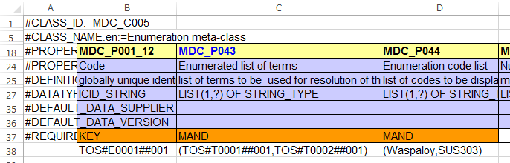
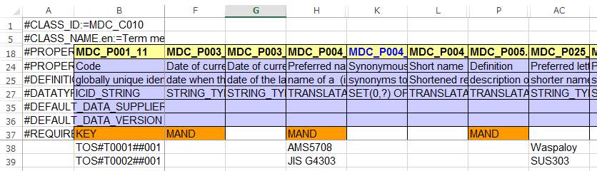
3. Edit details of each concept (4/4)
In enumeration sheet
Edit a list of identifiers of choices → MDC_P043 (Special GUI for picking up choices)
Edit a list of choices → MDC_P044 (Choices will be automatically set via GUI for MDC_P043)
In term sheet
Edit a choice as value→ MDC_P025_1
Enumeration sheet
A
B
Term sheet
C

Slide 17
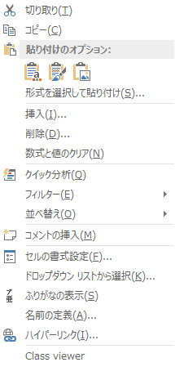
4. View the class hierarchy
Right click on the data section on the class sheet to show the context menu, and then click Class viewer for displaying Class viewer dialog
Class sheet

Slide 18
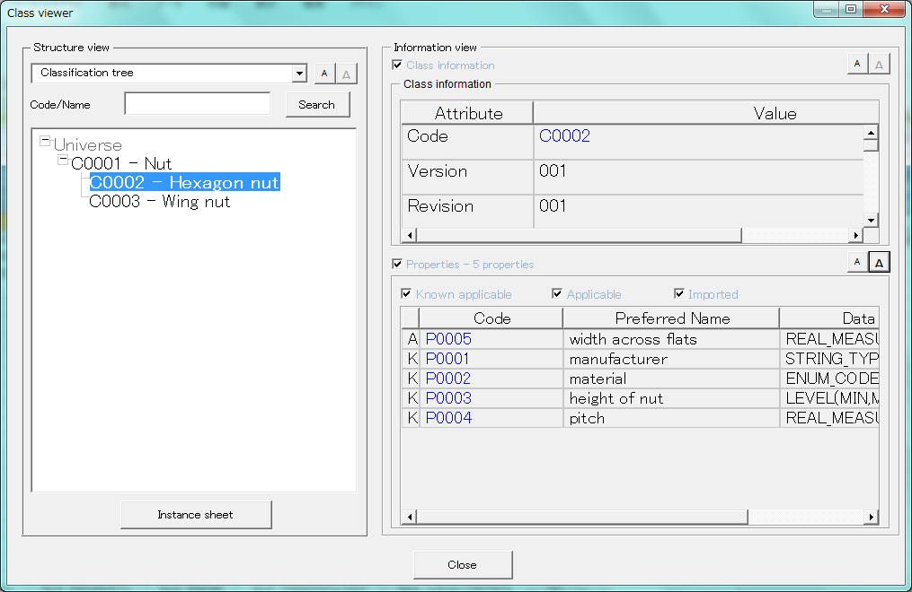
4. View the class hierarchy
Details of the class focused on the class hierarchy
Class hierarchy of your dictionary
Properties of the class focused on the class hierarchy
(“A” indicates the property is newly applicable to the class,
and “K” indicates the property is inherited form its superclass)

Slide 19
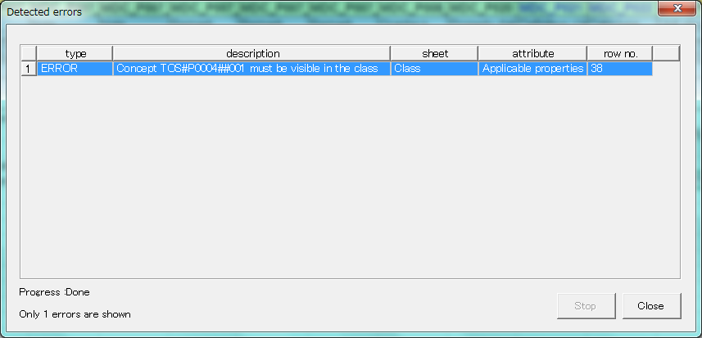
5. Validate your data dictionary
You can check the consistency of your data dictionary by using the Validation function of ParcelMakerTM.
Click Parcel Maker→Tools→Validation, and then a validation process will be automatically started.
If one or more errors are detected, those errors will be listed in the Detected errors dialog.
1 error detected

Slide 20
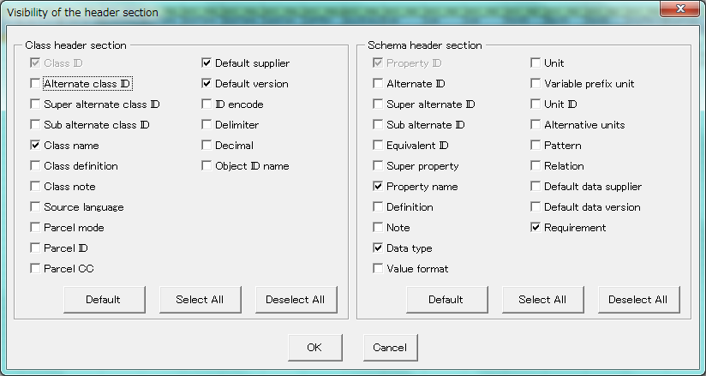
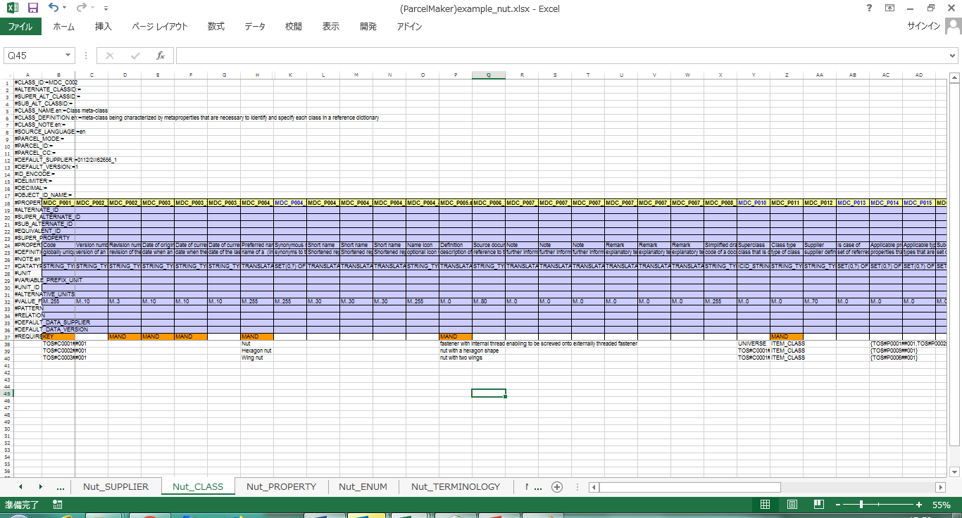
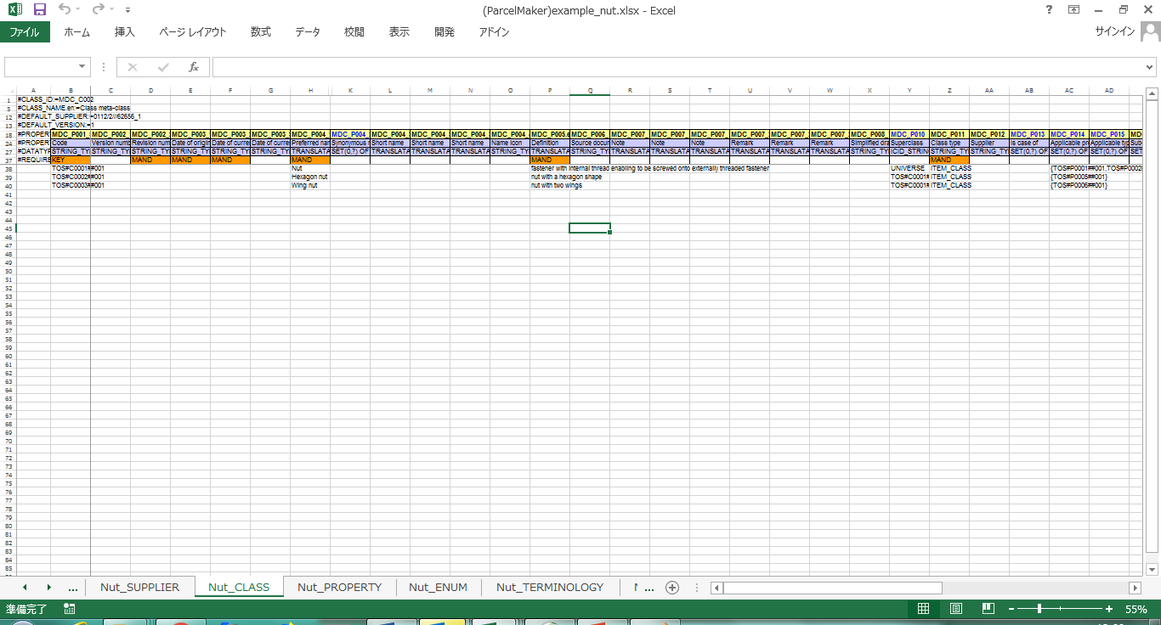
(Informative) Small Tips (1/2)
Each parcel sheet has many header items, but some of those are not required for your purpose. ParcelMakerTM has a special function to hide/unhide each header item of each parcel sheet in a workbook. The function is available from Parcel Maker→Settings→Show/Hide header lines.
Show/Hide header lines dialog
Show only class ID, class name, property id, property name, data type and requirement

Slide 21
(Informative) Small Tips (2/2)
Each parcel sheet has many cell columns. If there are many data lines in a parcel sheet, it may be difficult to know on which cell column you focus. In many cases, freeze rows/columns function provided by Microsoft® Excel® is useful. The function is available from View→Freeze Panes.
Other functions provided by Excel® will be helpful for your work. ParcelMakerTM does NOT disturb them as well as your own macros.

Slide 22
Bibliography
Data model
IEC 61360-2
IEC 62656-1
Guide for developing your data dictionary
IEC 61360-1
IEC 62656-2
Quality guide for semantics
IEC 61360-6

