Slide 1

Outlook Automation
June 19th, 2014
Julien Kerihuel j.kerihuel@openchange.org

Slide 2
Contents
About me
What is the OpenChange Project?
Stress Testing: automation challenges
openchangesim: stress testing tool
Limitations

Slide 3






Julien Kerihuel - Zentyal CTO
@jkerihuel
OpenChange Project Founder
> 10 years of my life
Free Software foundations:
wireshark, samba
December 2003 – February 2005:
OpenChange - End of Study Project

Slide 4
What is the OpenChange Project?

Slide 5
What is OpenChange?
Started in 2004
Free Software released under GPLv3 or later
Portable implementation of Exchange protocols
  Client library
  Command line utilities
  Server
  Proxy
  Test tools
Support documented RPC calls, and some legacy...

Slide 6
Stress Testing
Automation Challenges

Slide 7

Stress Testing Definition
Source: http://gph.is/1h74Kea

Slide 8
Stress Testing Definition
Put a system under a lot of stress and ensure its behavior matches requirements and expectations
Be able to stress a specific part of a product
In Exchange Protocol's world it means:
  Generate lot of network traffic
  Mimic Outlook usual operations
  Define variable of agitations

Slide 9
Stress Testing Objectives
Guarantee that SUT (system under test) will meet customers requirements
Test robustness / expose weakness of a server or device
Find system's limits where noticeable degradation of the quality of service is experienced
Useful to write initial best deployment practices

Slide 10
Outlook automation challenges
  Ability to emulate client connections from hundreds simultaneous clients, using distinct IP addresses
    Don't really want to run hundreds of Windows machine and manually operate Outlook
  Different client behaviors depending on the platform targeted
  Customizable scenarios to generate entropy and control configuration parameters

Slide 11

Outlook automation challenges
  In a nutshell ...
Source: http://gph.is/1a9kAWL

Slide 12

Outlook automation challenges
  Or more realistically ...
Source: http://gph.is/16PI2m7

Slide 13
Openchangesim
Stress testing tool

Slide 14
Overview
OpenChangeSim
libmapi
Samba / DCERPC library
...
TAP interface
TAP interface
TAP interface

Slide 15
Overview
Stress Testing Tool – MAPI Traffic Simulator
Source code available on GitHub
Released under the terms of the GNU Public License v3 or later (GPL)
Available for Linux (Ubuntu, Fedora, etc.)
https://github.com/openchange/openchangesim/

Slide 16
Main Features
Generates traffic from different IP addresses
Scenario based environment - plugin engine
Structured scenario configuration files
Logging mechanism to measure performance

Slide 17
Network traffic
Create TAP interface at runtime
Each interface assigned unique IP addresses
  IP ranges defined in configuration file
Each synthetic client uses separate interface
Clean up interfaces upon termination

Slide 18
Network traffic
$ sudo ./build/openchangesim --server=ZENTYAL
[*] Initializing modules
[*] sendmail : Module loaded
[*] fetchmail : Module loaded
[*] Creating profile 2/3: 192.168.42.122 ZENTYAL/ocsim2@ZENTYAL-DOMAIN.LAN
[*] Creating profile 3/3: 192.168.42.123 ZENTYAL/ocsim3@ZENTYAL-DOMAIN.LAN
[*] 3 User profiles ready
[*] Interface tap0 (fd 6) deleted
[*] Interface tap1 (fd 8) deleted
[*] Interface tap2 (fd 10) deleted
[*] All 3 virtual interfaces pending physical deletion
$ ps aux | grep openchangesim
root 16056 0.0 0.0 88116 2576 pts/41 S+ 20:37 0:00 sudo ./build/openchangesim --server=ZENTYAL
root 16063 0.3 0.0 241848 6212 pts/41 S+ 20:37 0:00 ./build/openchangesim --server=ZENTYAL
root 16065 0.3 0.0 242264 6220 pts/41 S+ 20:37 0:00 ./build/openchangesim --server=ZENTYAL
root 16066 0.3 0.0 241848 6228 pts/41 S+ 20:37 0:00 ./build/openchangesim --server=ZENTYAL

Slide 19
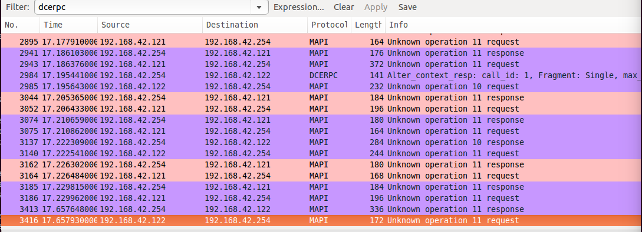
Network traffic
192.168.42.254: SUT
192.168.42.121: ocsim instance
192.168.42.122: ocsim instance

Slide 20
Server configuration blocks
server {
name = EXCHANGE;
version = 2010;
address = xxx.xxx.xxx.xxx;
domain = DOMAIN;
realm = REALM;
generic_user = user;
generic_user_range = 1-1000;
generic_password = "SecretPassword";
ip_range = 172.16.10.1 - 172.16.40.254;
};
Template for account names: user1, user2 … user1000
version attribute trigger different MAPI behaviors
ip_range uses RFC1918 address block to determine netmask

Slide 21
User accounts
One-shot profile creation operation
Profiles then duplicated for other generic users
Powershell scripts provided to generate users accounts on server side
Remote and automatic account creation also possible through openchangepfadmin tool
$ mapiprofile -f ~/.openchange/openchangesim/profiles.ldb --list
We have 5 profiles in the database:
Profile = EXCHANGE2003/ocsim2@OPENCHANGE.LAN
Profile = ZENTYAL/ocsim1@ZENTYAL-DOMAIN.LAN
Profile = ZENTYAL/ocsim2@ZENTYAL-DOMAIN.LAN
Profile = ZENTYAL/ocsim3@ZENTYAL-DOMAIN.LAN
Profile = EXCHANGE2003/ocsim1@OPENCHANGE.LAN

Slide 22
Scenario configuration blocks
scenario {
name = "sendmail";
repeat = 200;
case {
inline_utf8 = "Hello world, this is an inline utf8 body";
attachment = "/tmp/file0.jpg";
};
case {
file_html = "/tmp/html_body.html";
attachment = "/tmp/file1.png";
attachment = "/tmp/file2.png";
};
};
scenario {
name = "fetchmail";
repeat = 300;
};
Template for account names: user1, user2 … user1000
version attribute trigger different MAPI behaviors
ip_range uses default class A,B,C netmasks to calculate available IP addresses

Slide 23
Logging mechanism
Syslog based
Pre-defined format:
[date][workstation][process_name][process_pid]: scenario: client IP address "scenario_case": time
# tail -f /var/log/openchangesim.log
Sep 9 13:26:33 mapiproxy openchangesim[1968]: sendmail: 192.168.0.191 "scenario case 1": 10 seconds 600209 microseconds
Sep 9 13:26:33 mapiproxy openchangesim[1955]: sendmail: 192.168.0.178 "scenario case 1": 11 seconds 199173 microseconds
Sep 9 13:26:33 mapiproxy openchangesim[1960]: sendmail: 192.168.0.183 "scenario case 1": 11 seconds 62624 microseconds
Sep 9 13:26:33 mapiproxy openchangesim[1925]: sendmail: 192.168.0.150 "scenario case 1": 5 seconds 148577 microseconds
Sep 9 13:26:33 mapiproxy openchangesim[1965]: sendmail: 192.168.0.188 "scenario case 1": 10 seconds 701219 microseconds
Sep 9 13:26:33 mapiproxy openchangesim[1919]: sendmail: 192.168.0.144 "scenario case 1": 5 seconds 115201 microseconds
Sep 9 13:26:33 mapiproxy openchangesim[1929]: sendmail: 192.168.0.154 "scenario case 1": 3 seconds 875085 microseconds
Sep 9 13:26:33 mapiproxy openchangesim[1928]: sendmail: 192.168.0.153 "scenario case 1": 3 seconds 521680 microseconds
Sep 9 13:26:33 mapiproxy openchangesim[1933]: sendmail: 192.168.0.157 "scenario case 1": 3 seconds 522270 microseconds
Sep 9 13:26:33 mapiproxy openchangesim[1930]: sendmail: 192.168.0.155 "scenario case 1": 3 seconds 664552 microseconds

Slide 24
Limitations

Slide 25
Limitations
Exchange 2013 support not included in v1.0
No Packed MAPI calls support
No EWS support
No cached mode support
Limited number of scenarios
  But Open Source and contributions always welcome!

Slide 26
Demo / Setup
OpenChange
1512
Drop by the office nearby the lunch area

Slide 27
Thanks
All Microsoft staff involved in this event and making this happen.

Slide 28

Julien Kerihuel,
OpenChange Founder
j.kerihuel@openchange.org
www.openchange.org
Questions?

