Slide 1
Nuestros trabajos en Open Data para Smart Cities
Oscar Corcho
Escuela Técnica Superior de Ingenieros Informáticos,
Universidad Politécnica de Madrid
Campus de Montegancedo sn, 28660 Boadilla del Monte, Madrid
http://www.oeg-upm.net/
ocorcho@fi.upm.es

Slide 2
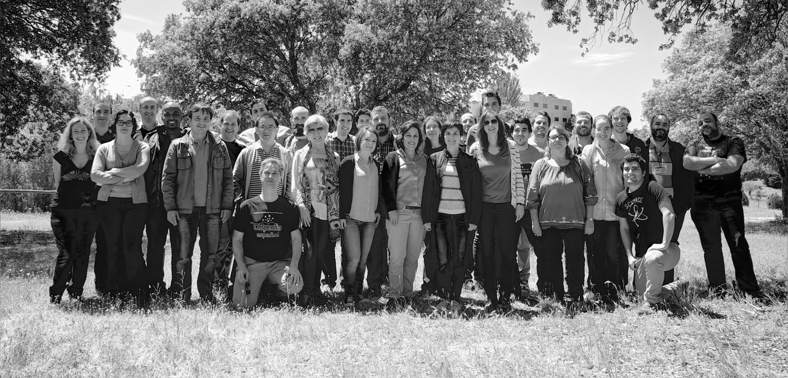

About us
Directors: A. Gómez-Pérez, O. Corcho
Research Group (30 people)
2 Full Professors
8 Associate/Assistant Professors
7 Postdocs
12 PhD Students
5 MSc and BSc Students
3 software engineers
1 system administrator
2 project managers
150+ Past Collaborators
30+ Past Visitors
http://www.oeg-upm.net/
https://github.com/oeg-upm
@oeg-upm

Slide 3

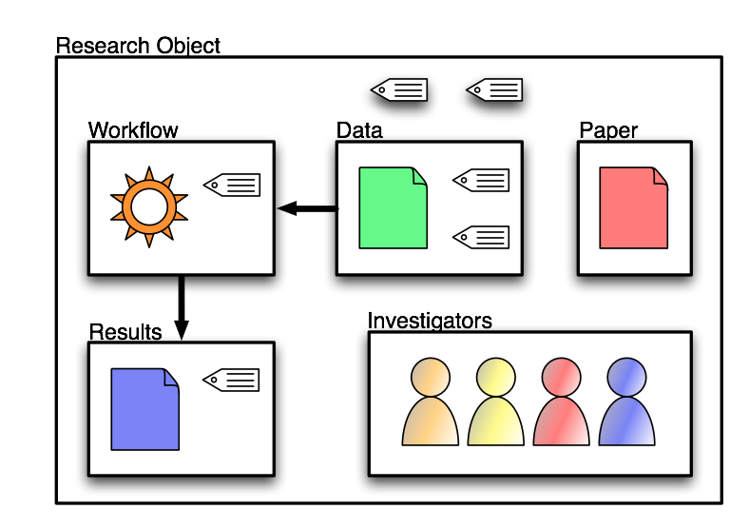

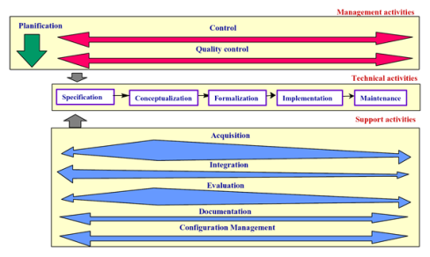


Our Research Areas
Ontological Engineering
Ontology-based Data Integration
Semantic e-Science
(Social) Semantic Web and Linked Data
Natural Language Processing
2004
2008
1995
2000
1997
Notes:
http://www.dataimc.com/image/integration1.jpg
http://www.getsticki.com/corporate/Portals/1/images/CustomerAndLaptops.jpg
http://rhizomik.net/~roberto/thesis/figures/MethontologyLifeCycle.png
http://webilus.com/wp-content/uploads/2007/11/folksonomy.thumbnail.jpg
http://ocw.mit.edu/NR/rdonlyres/Global/F/F524CEB7-B7A5-406A-8281-76C5DAAE3AAC/0/chp_brain_language_3.jpg

Slide 4
Our relation with Open Data
Leader of the Open Data Institute node in Madrid
Development of the UNE 178301 Technical Norm on Open Data for Smart Cities
Co-created with several cities (e.g., ZGZ) and other public administrations and companies
Maturity model for cities
10 datasets and their corresponding vocabularies
http://vocab.linkeddata.es/datosabiertos/def
A lot of Linked Data development experience (see next slide)

Slide 5
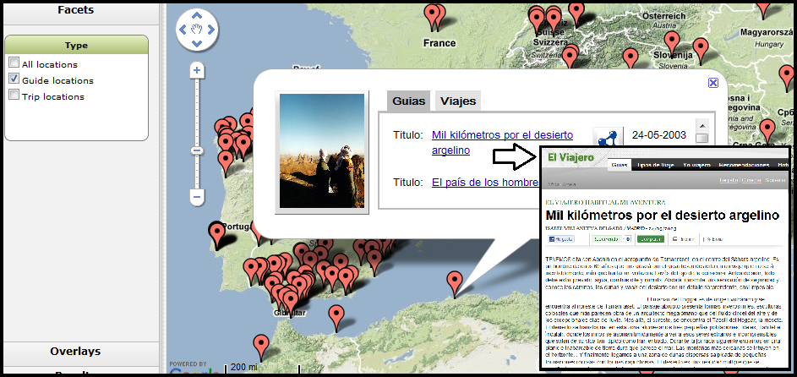
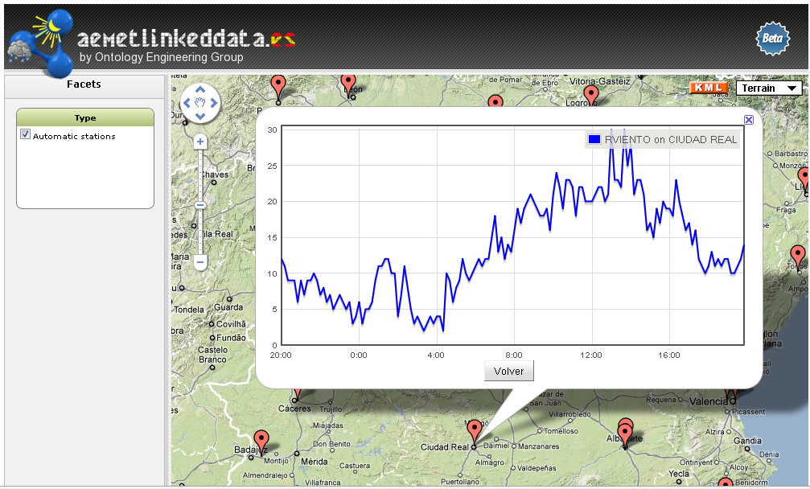
Linked Data
Geographical (Map4RDF and Geometry2RDF)
http://geo.linkeddata.es/
Culture (http://datos.bne.es/)
Cities and Open Data
Ayuntamiento de Zaragoza (helping)
http://ciudad2020.linkeddata.es/
News and Media
http://webenemasuno.linkeddata.es/
http://rtve.linkeddata.es/
Meteorological information
http://aemet.linkeddata.es/
Transport
http://transporte.linkeddata.es/
Soon with CRTM

Slide 6

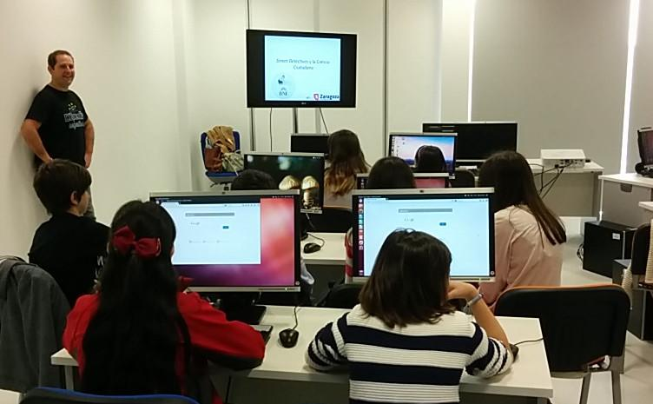
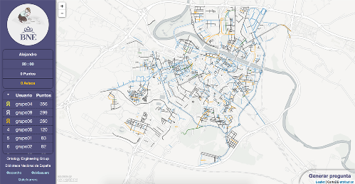
Citizen Science
Improve data of our city

Slide 7
Herramientas de desarrollo de ontologías
Tools to be used for ontology development
Ontoology
http://ontoology.linkeddata.es/
https://github.com/OnToology/OnToology
WIDOCO: https://github.com/dgarijo/Widoco
Oops!: http://oops.linkeddata.es/
Ar2dtool: https://github.com/idafensp/ar2dtool
Management of vocabularies
http://vocab.linkeddata.es
http://smartcity.linkeddata.es

Slide 8
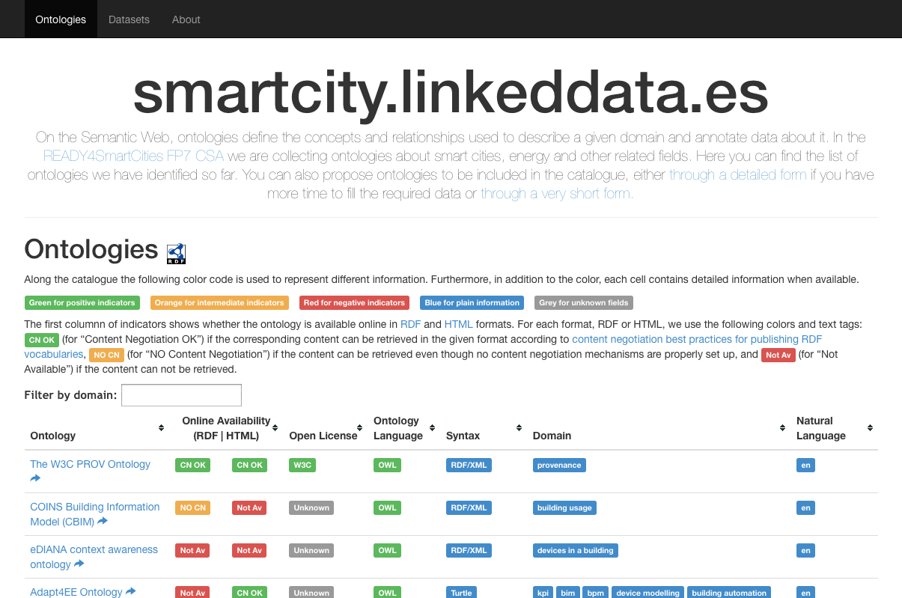
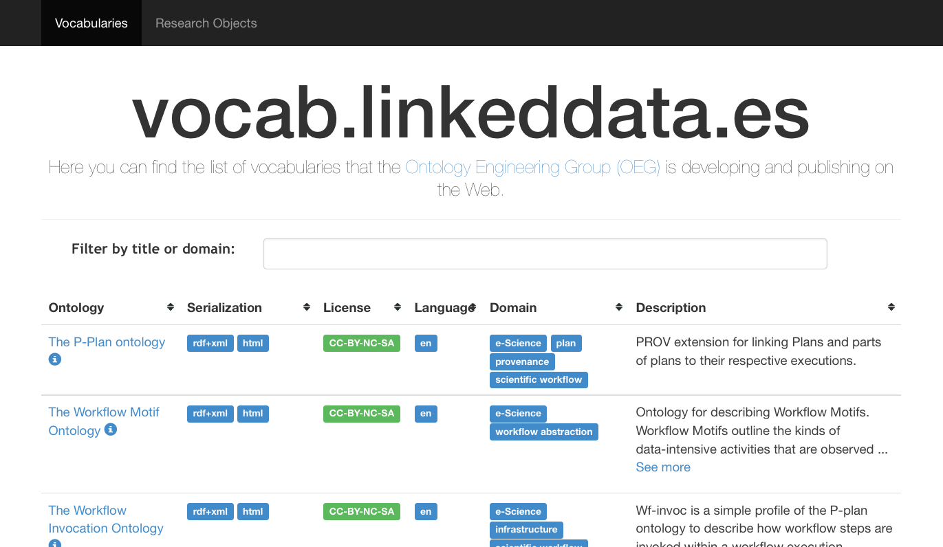

Registros de ontologías
http://smartcity.linkeddata.es/
Vocabularios para ciudades inteligentes (y dominios relacionados)
http://vocab.linkeddata.es/
Vocabularios desarrollados por miembros del OEG

Slide 9
Algunos proyectos europeos en el área
Mobile-AGE (H2020, 1 Feb 2016 – 31 Jan 2019)
Open Data (creación y apps) para personas mayores
SlideWiki (H2020, 1 Jan 2016 – 31 Dec 2018)
www.slidewiki.org
Generación de materiales educativos Open CourseWare
Compromiso de generación de materiales educativos sobre open data
Ready4SmartCities
www.ready4smartcities.eu
Sistemas de gestión de energía
Catálogos, guías y summer school sobre Linked Data para Smart Cities
VICINITY (H2020,
http://vicinity.informatik.uni-kl.de/
IoT

