Slide 1

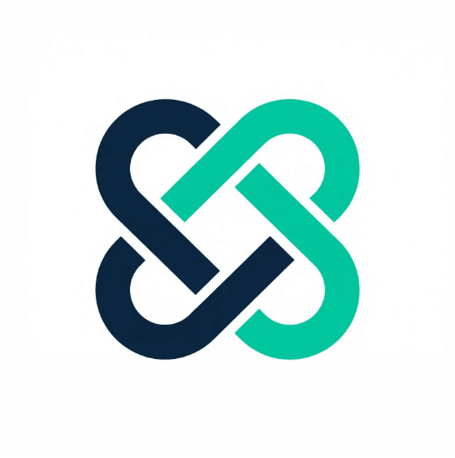
MeshGuard
Governance Control Plane for the Agent Mesh
David Hurley, Founder
meshguard.app

Slide 2

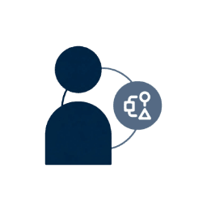

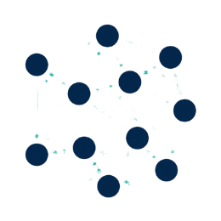
The AI landscape is evolving from assistants to autonomous agent ecosystems
2022-2023
2024-2025
2026+
Copilots
Agents
Agent Mesh
Human-in-the-loop AI assistance. Augmenting workflows with suggestions and completions.
Autonomous task execution. Systems capable of executing multi-step tasks independently.
Networked agent-to-agent delegation. Complex execution chains without human oversight.
The Shift: When a sales agent delegates to a data agent, traditional identity controls break down. Each delegation is a potential security gap.

Slide 3
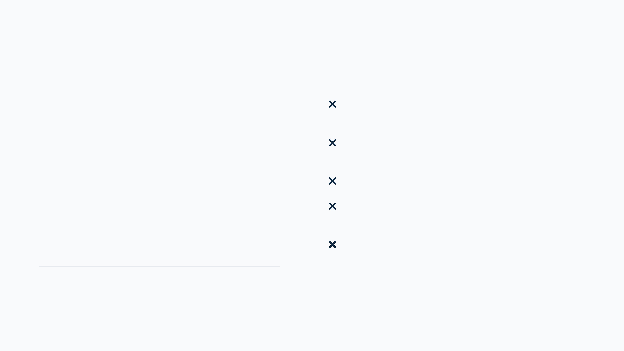
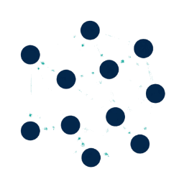
Agent-to-agent delegation creates ungoverned execution chains with zero visibility
No identity verification for agent-to-agent calls
Zero policy enforcement at delegation boundaries
Incomplete audit trails across agent chains
When Agent A delegates to Agent B, traditional identity controls break down. Organizations are operating blind—unable to verify identity, enforce policies, or maintain audit trails across the mesh.
Compliance risk exposure for regulated industries
Security vulnerabilities in multi-agent workflows
The Governance Gap
Regulatory frameworks like GDPR and SOC 2 require audit trails that current agent architectures cannot provide.

Slide 4
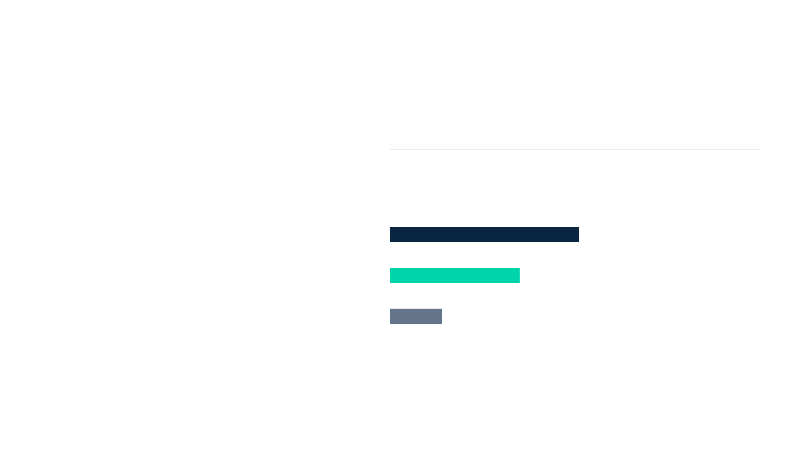

Gartner predicts 40% of enterprises will deploy agent mesh architectures by 2026
40%
Total Addressable Market
$8 Billion by 2026
Enterprises deploying autonomous agent networks within 12 months.
Enterprise AI Adopters
$4.1B
AI-Native Products
$2.8B
Regulated Industries
$1.1B
73%
$180K
2.3x
CIOs cite governance as their top AI concern
Average annual enterprise spend on AI security
Faster adoption rate in regulated sectors

Slide 5




MeshGuard provides the missing governance layer for agent-to-agent interactions
Sitting between agents as a governance control plane, MeshGuard intercepts every delegation request to enforce identity, policy, and audit requirements in real-time.
Identity Management
Policy Enforcement
Audit Infrastructure
Issues verifiable credentials to agents and ensures authorized identities before delegation.
Evaluates requests against rules for data access, rate limits, and compliance in real-time.
Captures execution traces with context propagation for forensic analysis and compliance.
Integrates seamlessly with your existing agent stack
LangChain
AutoGPT
CrewAI
Custom Agents

Slide 6


MeshGuard's architecture provides comprehensive governance without performance overhead
01
Identity Provider
Issues verifiable credentials to agents. Manages the agent registry with unique identities and metadata.
Dashboard & Analytics
02
Policy Engine
Evaluates delegation requests against customizable rules. Checks permissions and compliance in real-time.
03
Audit Store
Identity
Provider
Audit
Store
Captures immutable logs of every interaction. Enables forensic analysis and regulatory reporting.
Policy
Engine
04
SDK Layer
Lightweight libraries for LangChain, AutoGPT, etc. Handles credential management transparently.
SDK Layer (Agent Integration)
05
Dashboard & Analytics
Real-time visibility into agent activity with drill-down capabilities and alerting.

Slide 7







Existing solutions weren't designed for autonomous agent delegation patterns
Traditional IAM
API Gateways
AI Governance
MeshGuard
Okta, Auth0, Ping
Kong, Apigee
Arthur, Fiddler
The Agent Standard
Built For
Built For
Built For
Built For
Human Users
Sync Requests
Model Bias
Autonomous Agents
Model
Model
Model
Model
Session-based
Request/Response
Monitoring
Delegation Chains
Cannot handle agent
No context propagation
No identity or policy
Native identity, policy &
delegation chains
across hops
enforcement
audit for mesh

Slide 8
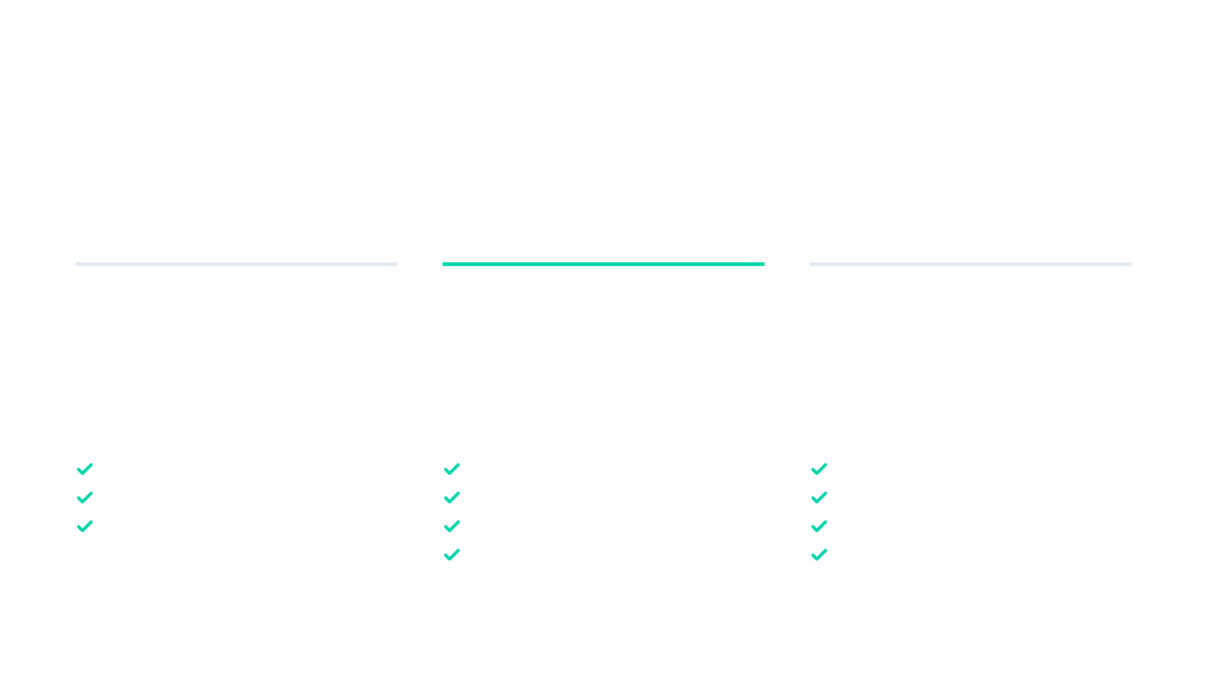

Predictable pricing aligned with agent deployment scale and governance requirements
Starter
Professional
Enterprise
$2,000/mo
$10,000/mo
Custom
For teams building initial agent prototypes and MVPs.
For production agent deployments requiring security.
For large-scale, regulated deployments.
Up to 100,000 delegations/mo
Up to 1M delegations/mo
Unlimited delegations
Basic policy templates
Custom policy engine
On-premise deployment
30-day audit retention
1-year audit retention
Custom compliance reporting
SSO Integration
SLA guarantees
Value Alignment: Our usage-based model scales with the complexity of your agent mesh, ensuring governance costs match value delivered.

Slide 9


Four-quarter roadmap focused on product-market fit and enterprise readiness
Q1 2026
Q2 2026
Q3 2026
Q4 2026
MVP Launch
Compliance
Enterprise
Scale
Core Identity & Policy Engine
Advanced Policy Primitives
SSO & On-premise Deployment
High-volume Infrastructure
LangChain & AutoGPT SDKs
CrewAI Support
AI Policy Recommendations
Analytics Dashboard
Onboard 5 Design Partners
SOC 2 Type 1 Certification
SOC 2 Type 2 & ISO 27001
Reach 25 Paying Customers
Strategic Focus: Balancing rapid feature iteration with the rigorous security certifications required by enterprise buyers.

Slide 10


Raising seed round to build the governance standard for agent mesh architectures
Use of Funds
Engineering
$1.5M
$3M
Expand core team, enterprise features, security certs
Go-to-Market
$800K
Sales leadership, partner program, events
Operations
$500K
Establish MeshGuard as the category leader. Reach 25 paying customers and $1.2M ARR by Q4 2026.
Infrastructure, legal, finance
Contingency
$200K
David Hurley, Founder
Strategic buffer
david@meshguard.app
meshguard.app

