Slide 1
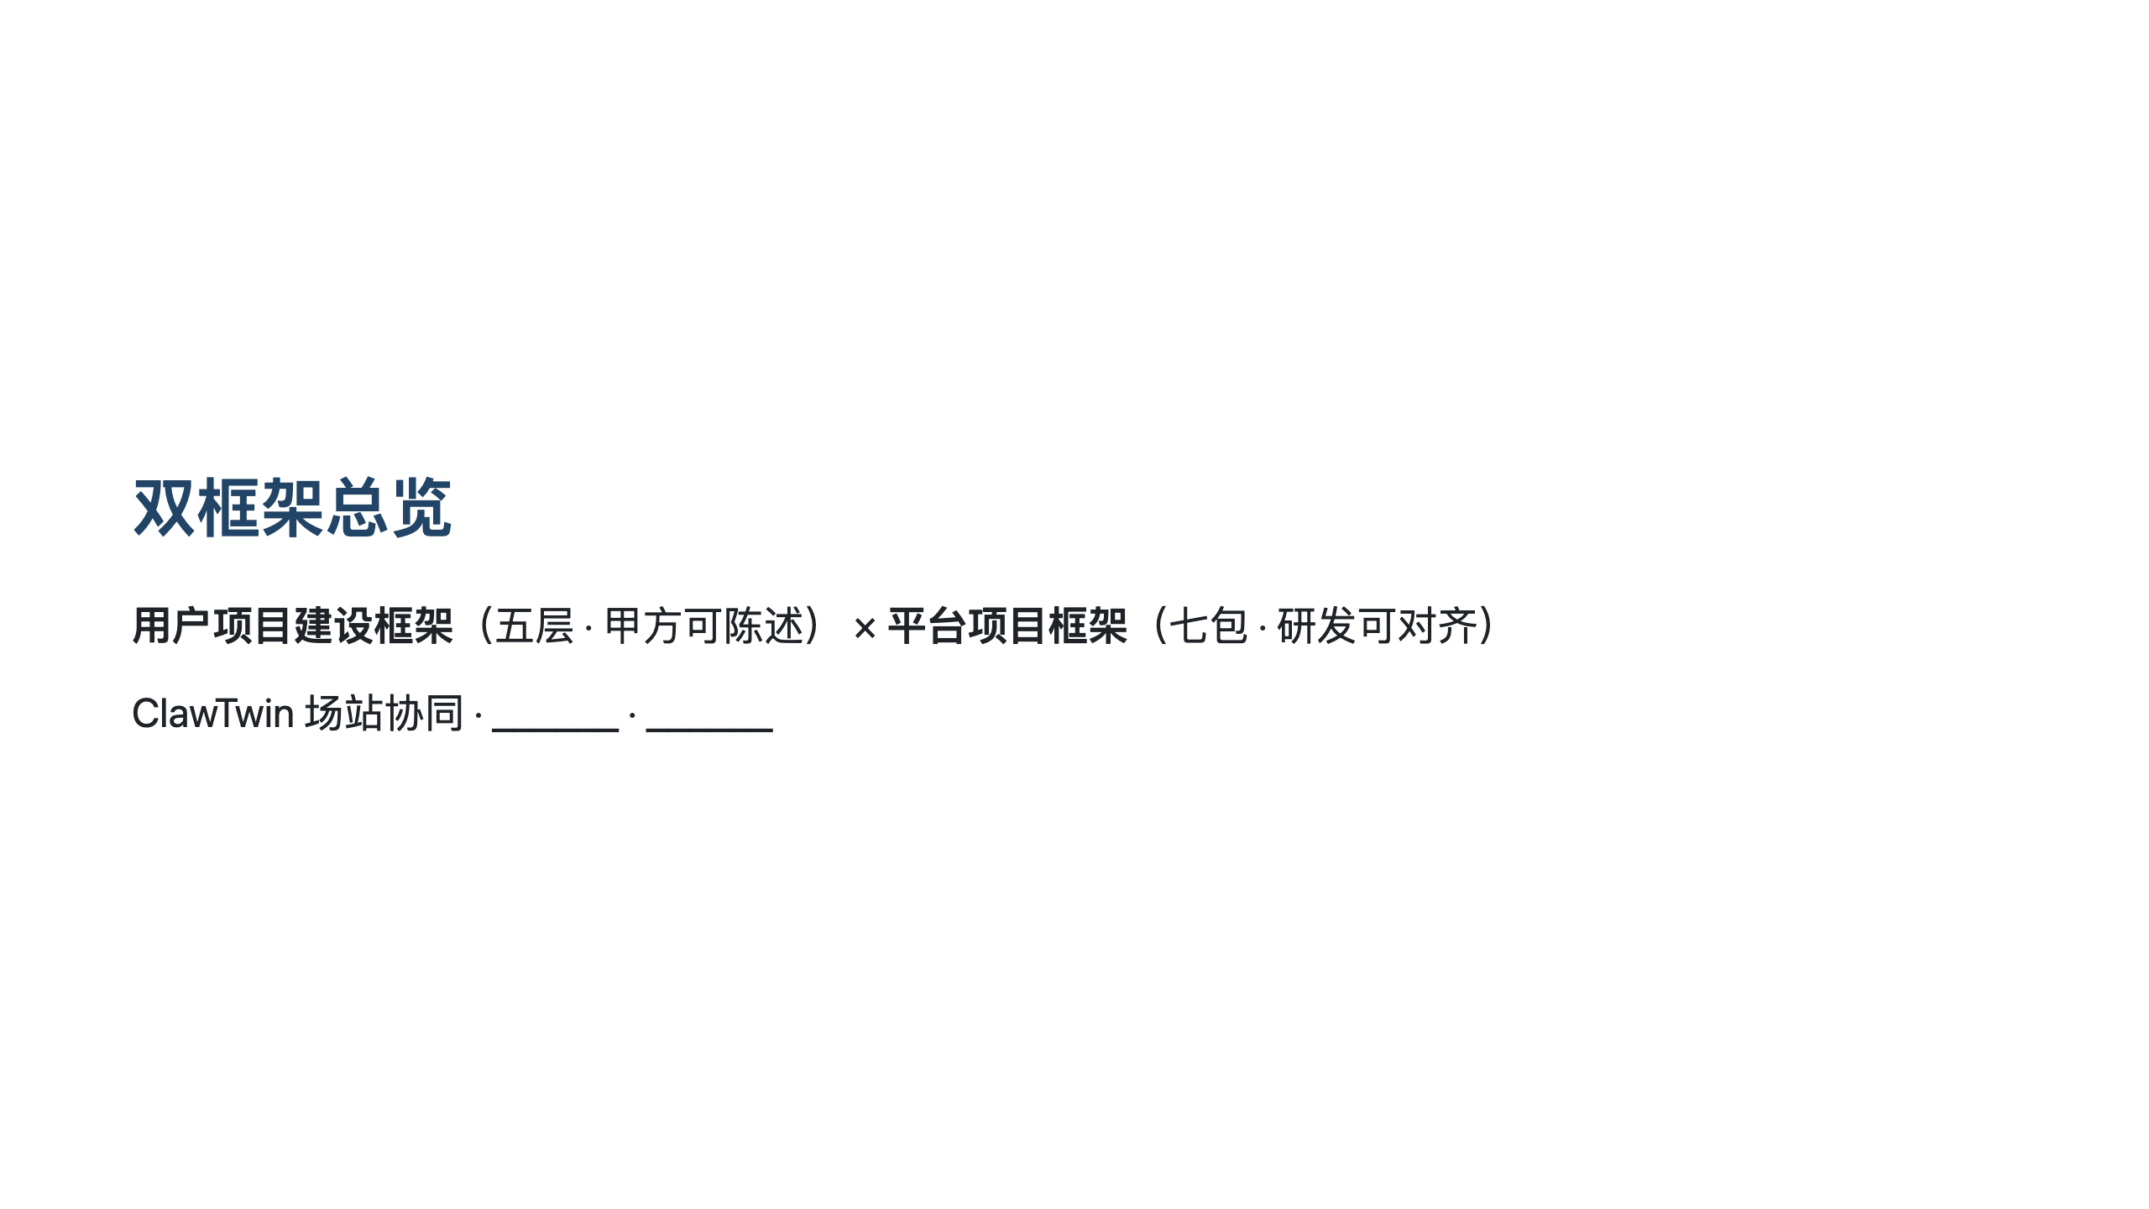
Notes:
导出：须 `--no-stdin`；嵌入 diagrams 下 SVG 须加 `--allow-local-files` cd contrib/industrial-oilgas-skills/presentations npx @marp-team/marp-cli@latest clawtwin-dual-framework-deck.md -o clawtwin-dual-framework-deck.pptx --allow-local-files --no-stdin npx @marp-team/marp-cli@latest clawtwin-dual-framework-deck.md -o clawtwin-dual-framework-deck.pdf --allow-local-files --no-stdin

Slide 2
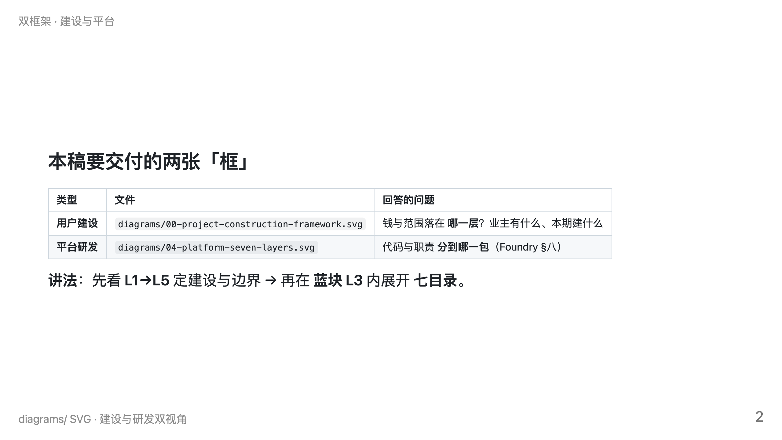

Slide 3
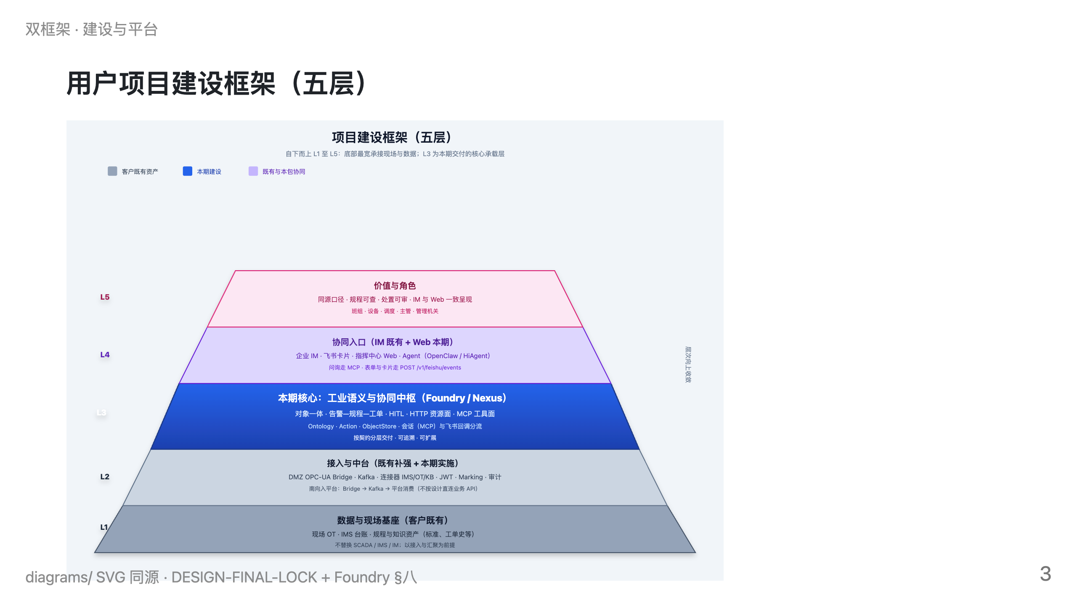
Notes:
全图自下而上：愈下愈宽承接现场；L3 为本期中枢

Slide 4
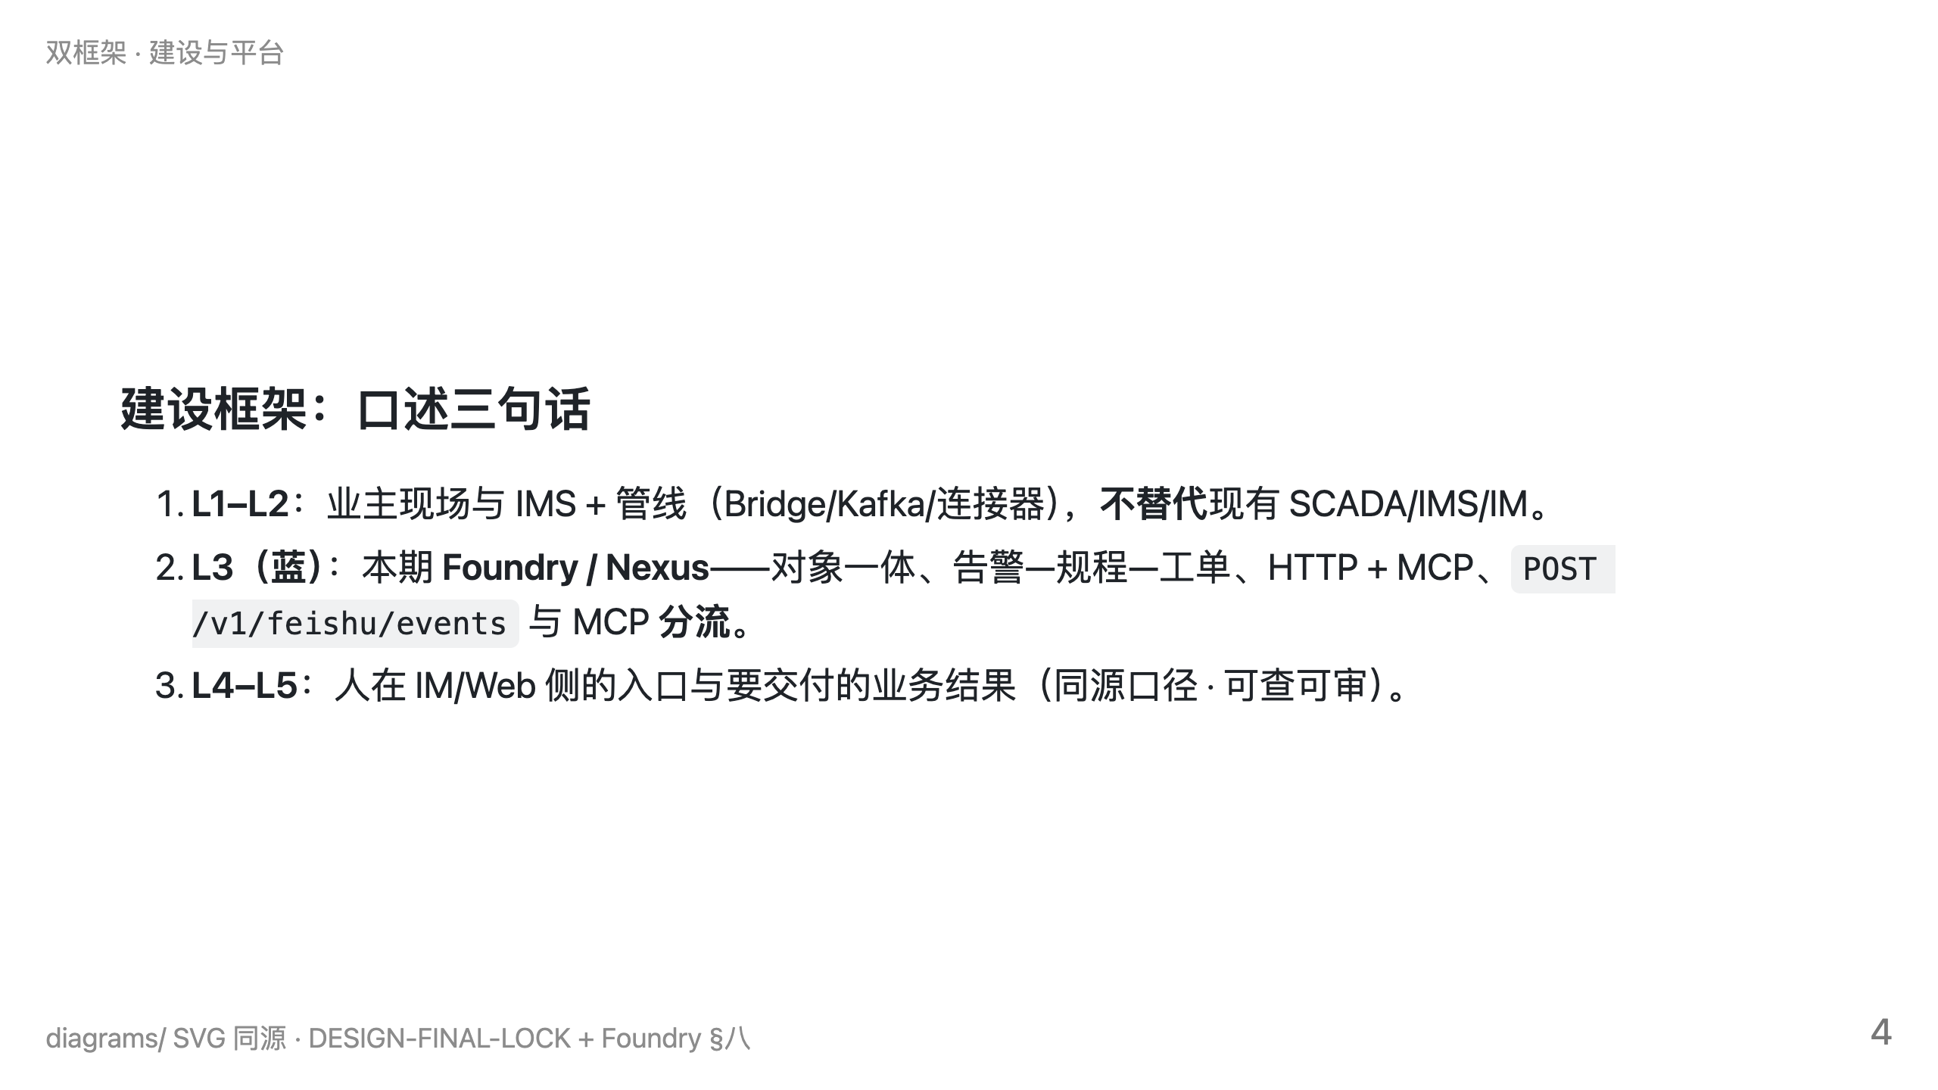

Slide 5
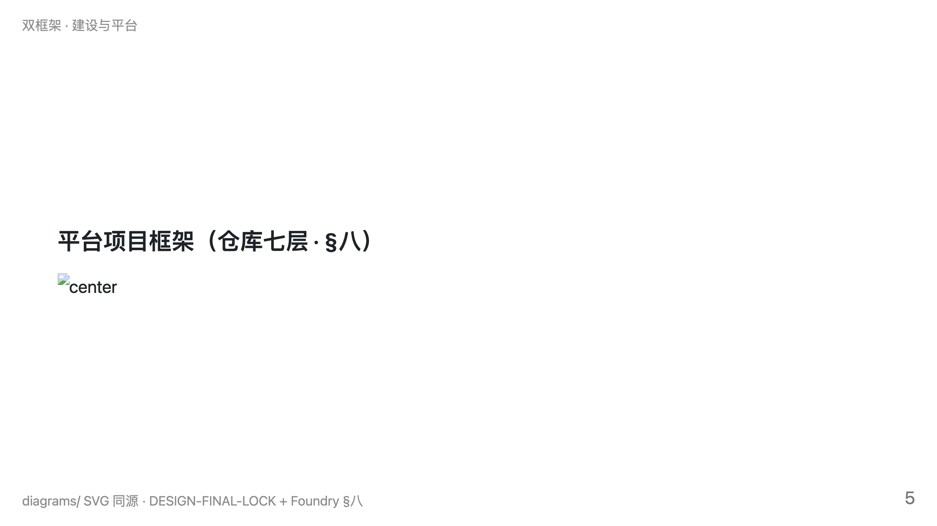
Notes:
ontology → core → apps → … 与 DESIGN-FINAL-LOCK 契约一致

Slide 6
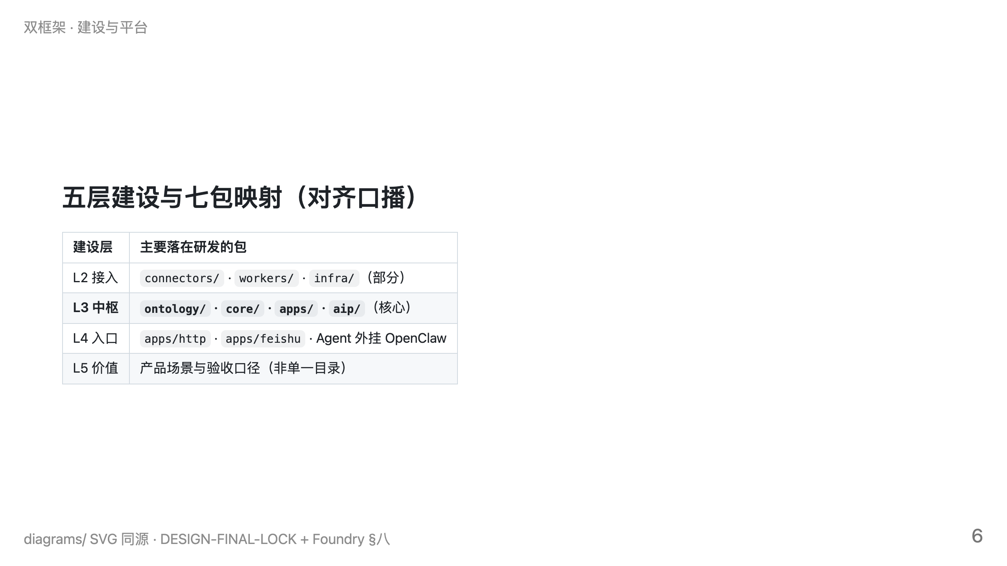

Slide 7
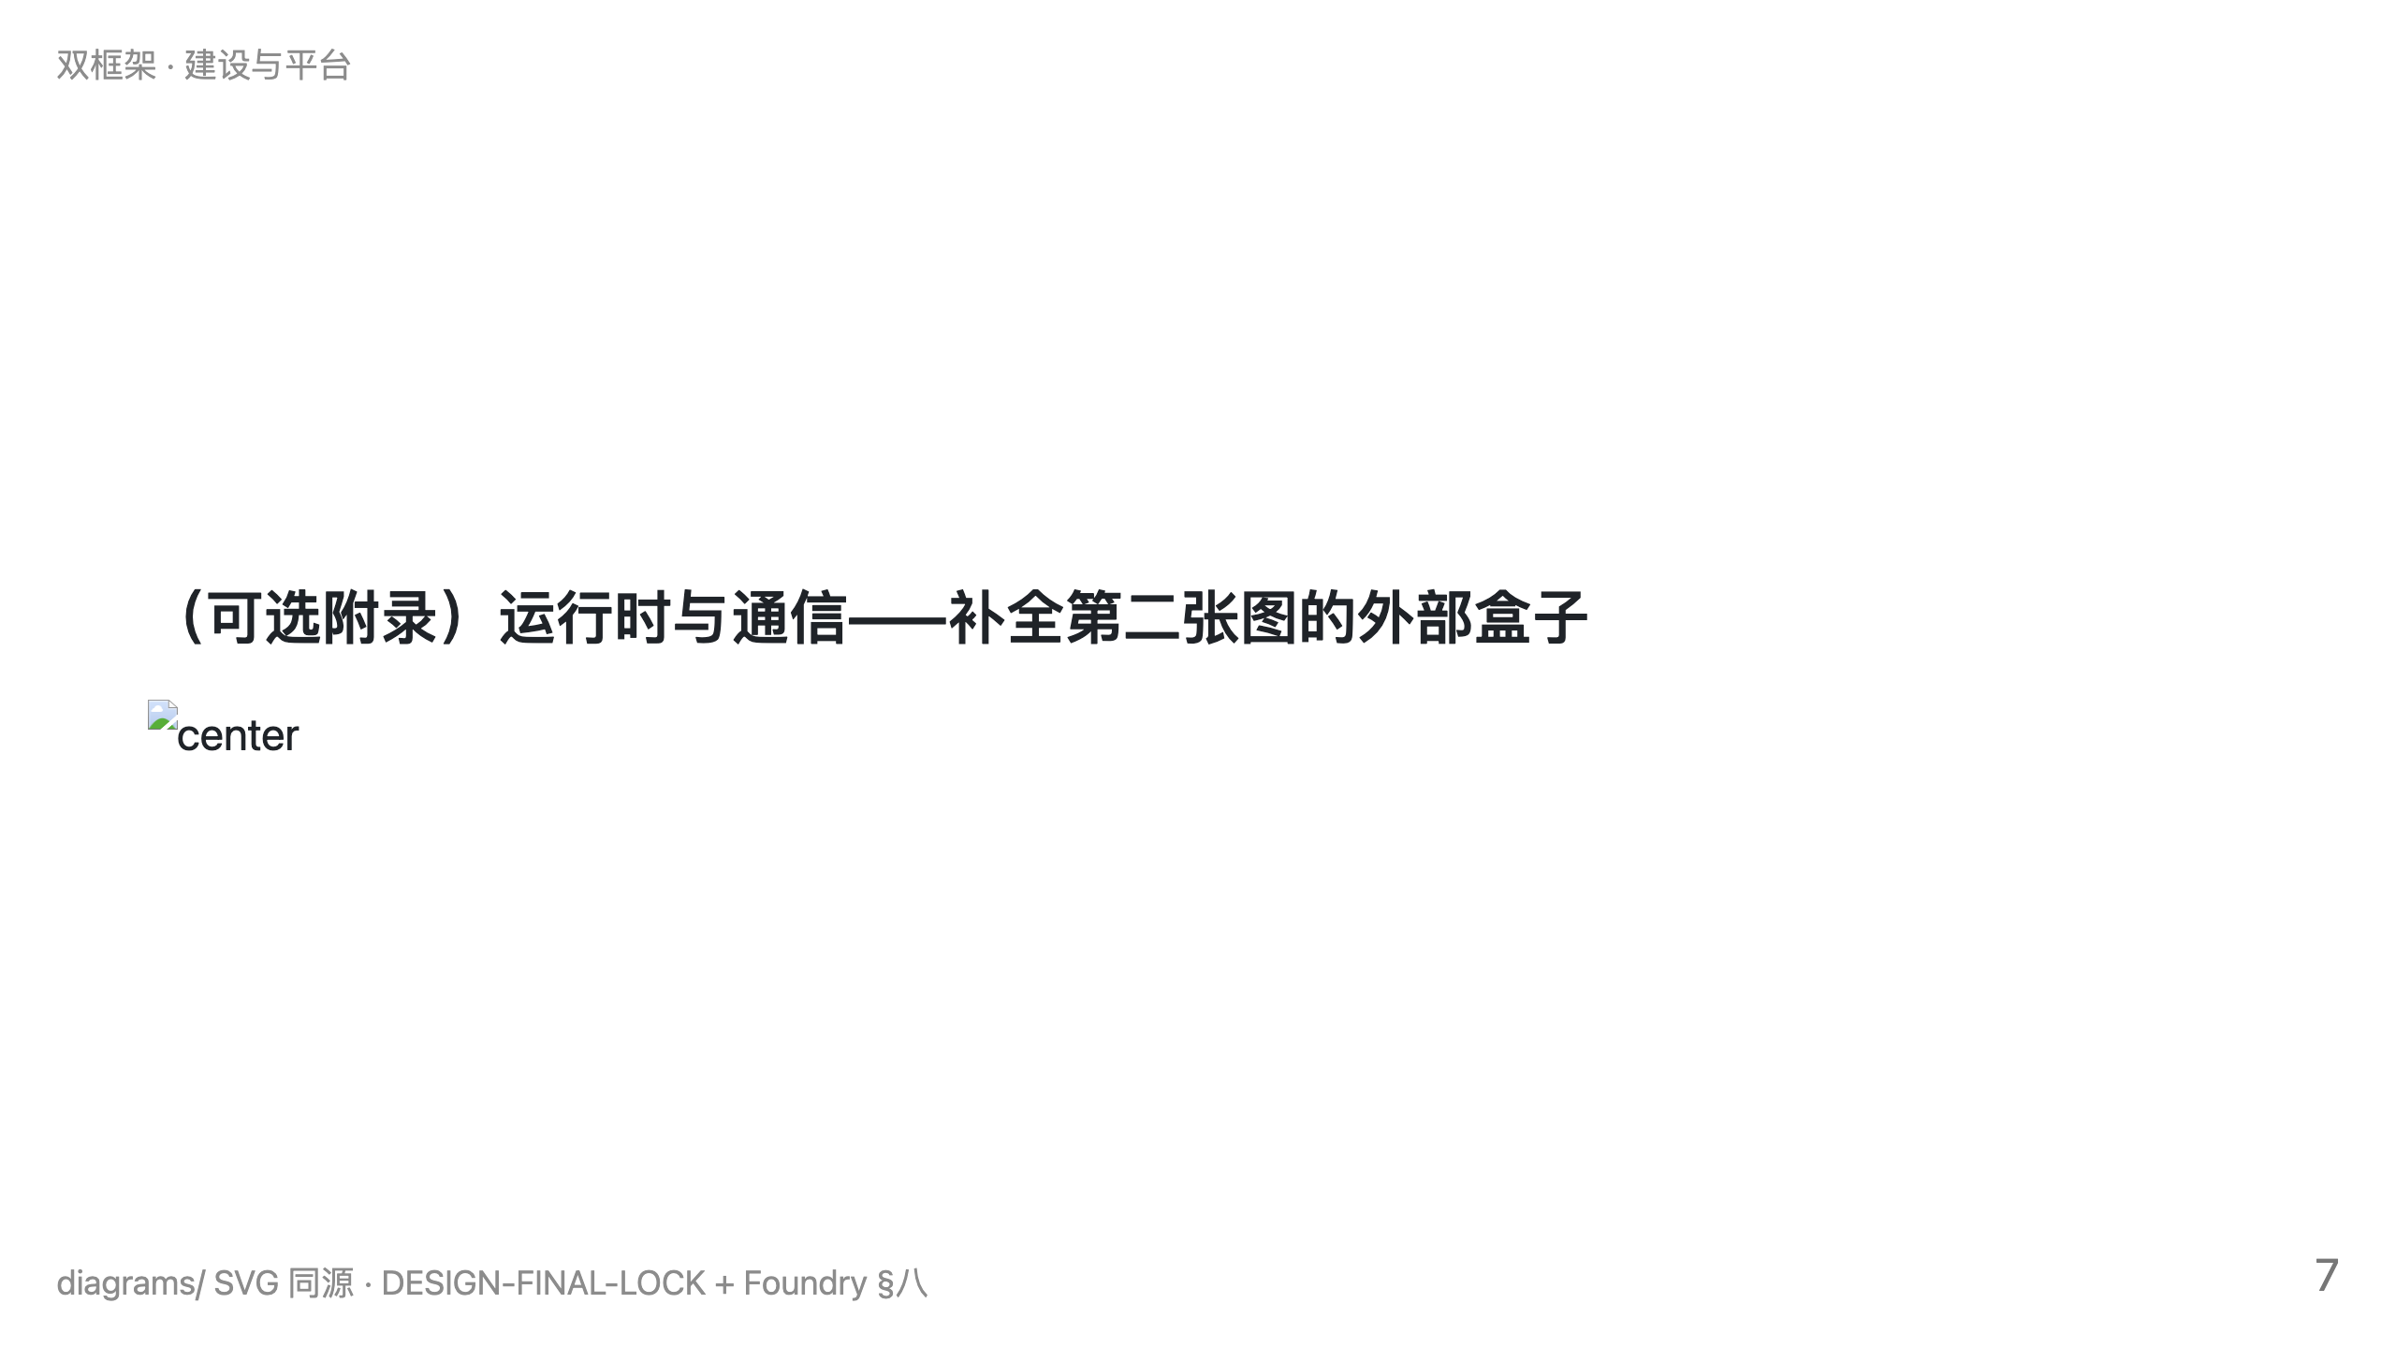

Slide 8
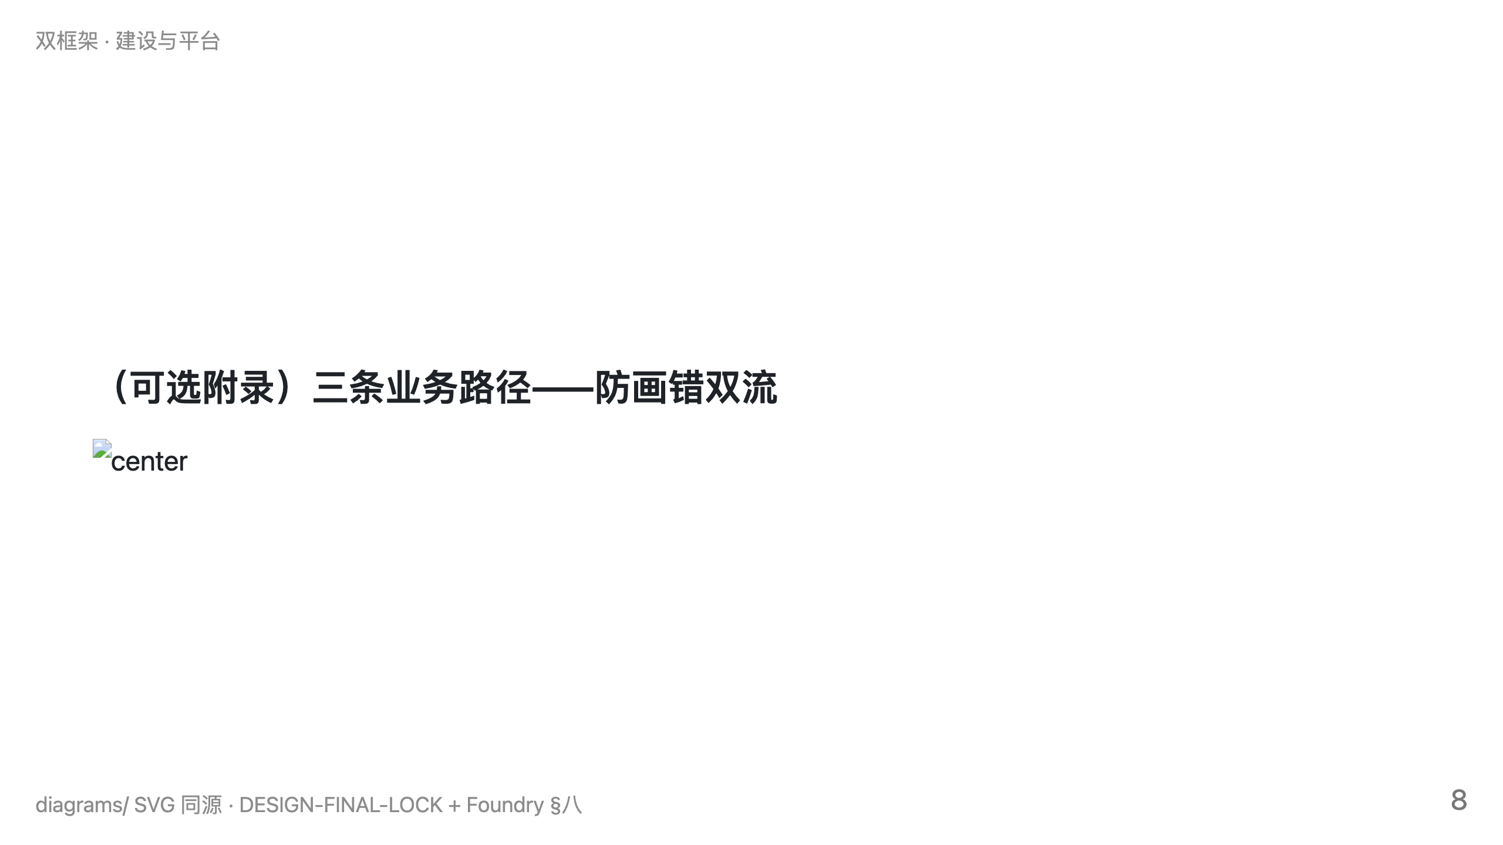

Slide 9
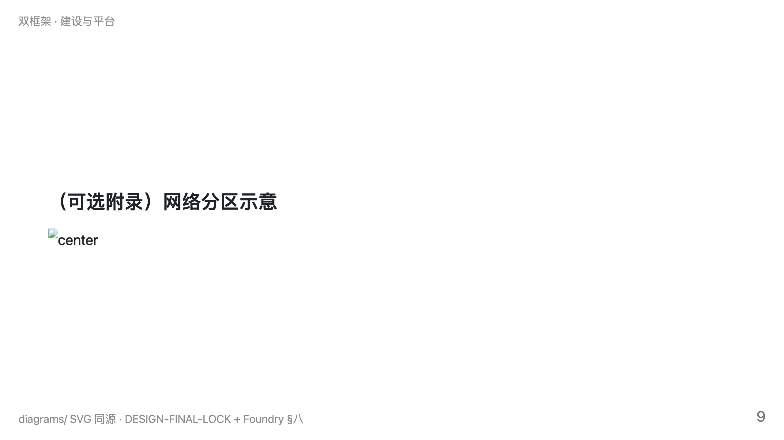

Slide 10
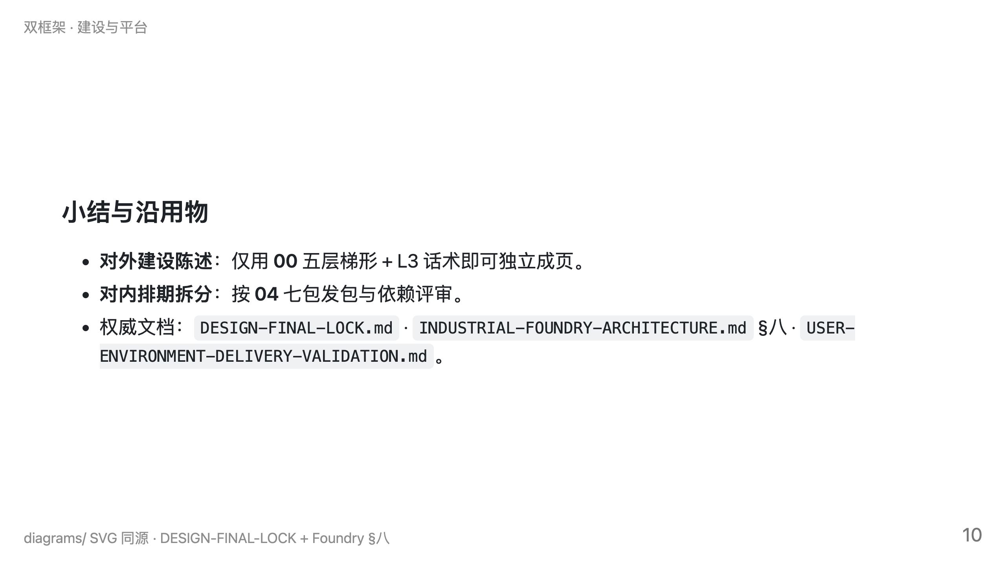

Slide 11
