Slide 1
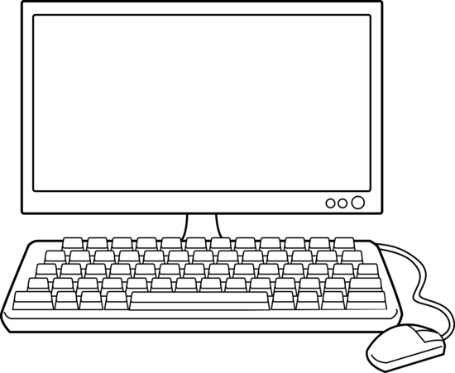

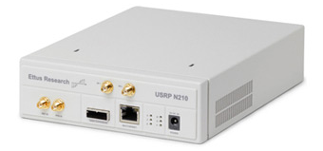
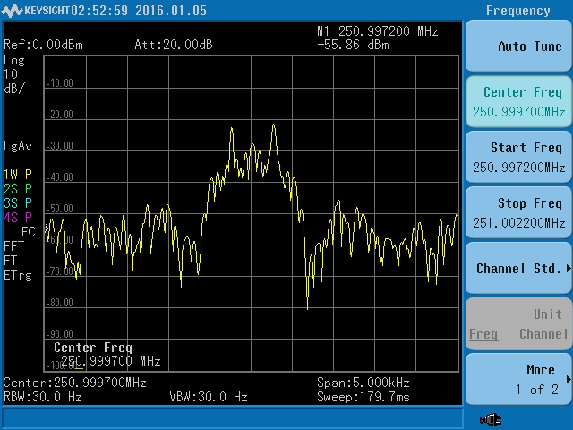
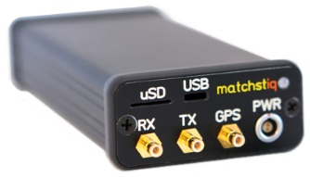
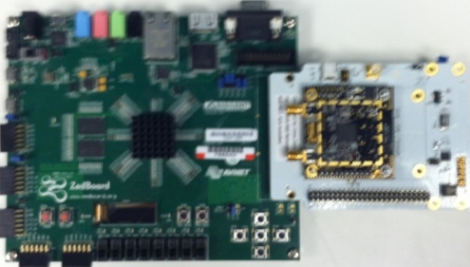
AngryViper Host Machine
OS: CENTOS 7 AngryViper, GNUradio installed
Ettus N210 SDR
With WBX daughtercard installed
Ethernet for control
via GNUradio
Ethernet for NFS mount between Platform Under Test and Host
USB for serial port access
Spectrum Analyzer
Splitter
Platform Under Test
Epiq Matchstiq-Z1 or Zedboard
Enabled for AngryViper
 | Command and Control connections |  | RF connections

