Slide 1

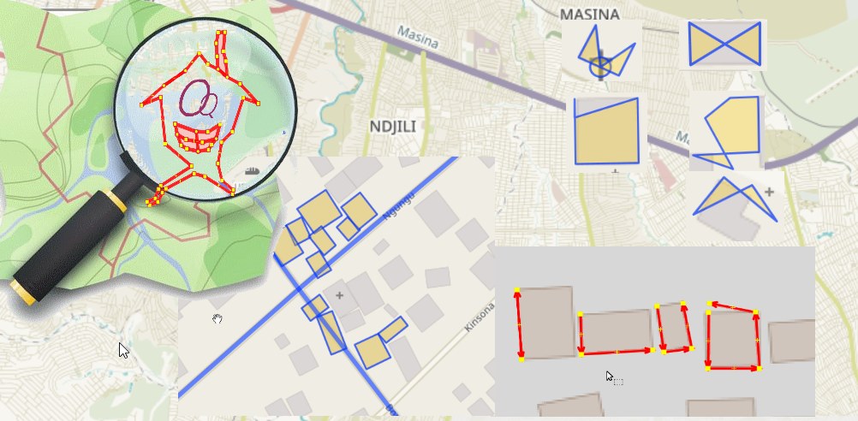
OSM Quality Mapping : Metrics to Monitor Buildings Outbounds
OQ Analysis Functions
Pierre Béland, Potentiel 3.0
SOTM, 2019-09-25, Heidelberg

Slide 2
OSM-DRC & Potentiel 3.0
OpenCities Kinshasa Project (June 2018)
& Ebola 2018 Coordination North of DRC
Development of Building Quality Tool to Monitor & Revise Crowdmapping
Observe areas / Projects / Contributors with ratios significantly higher then the average
Publications : Blog OpenDatalabRDC
https://opendatalabrdc.github.io/Blog

Slide 3
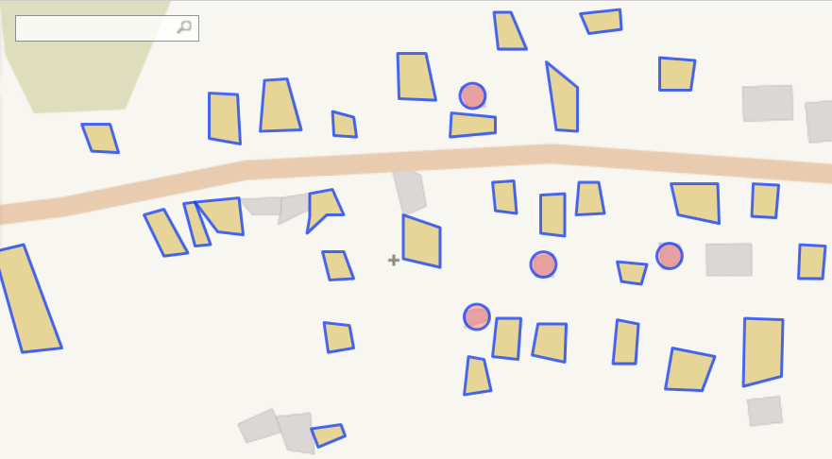
OSM Building Quality Problems
Geometry imprecision

Slide 4
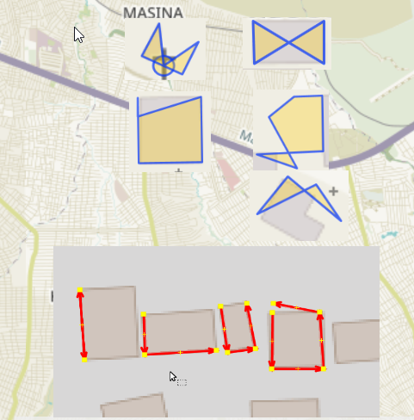
OSM Building Quality Problems
Self-intersection, Invalid polygons

Slide 5
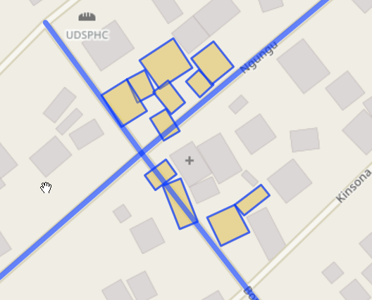
OSM Building Quality Problems
Building Overlaps + With others (ie. roads, landcover)

Slide 6
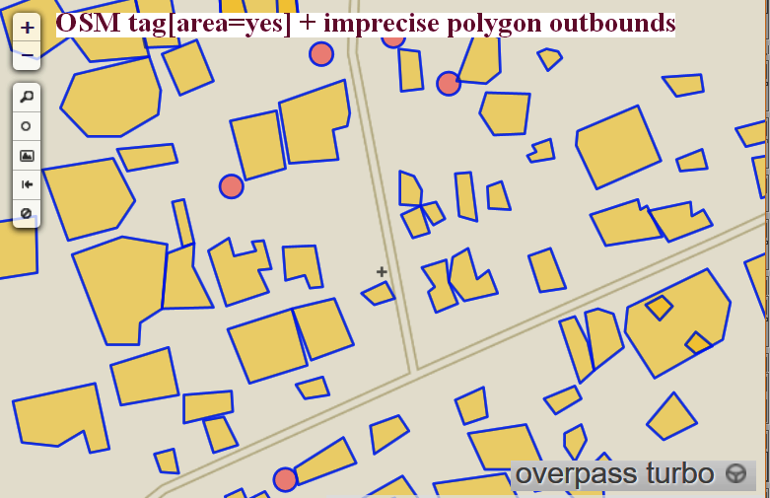
Areas without Building Tag

Slide 7
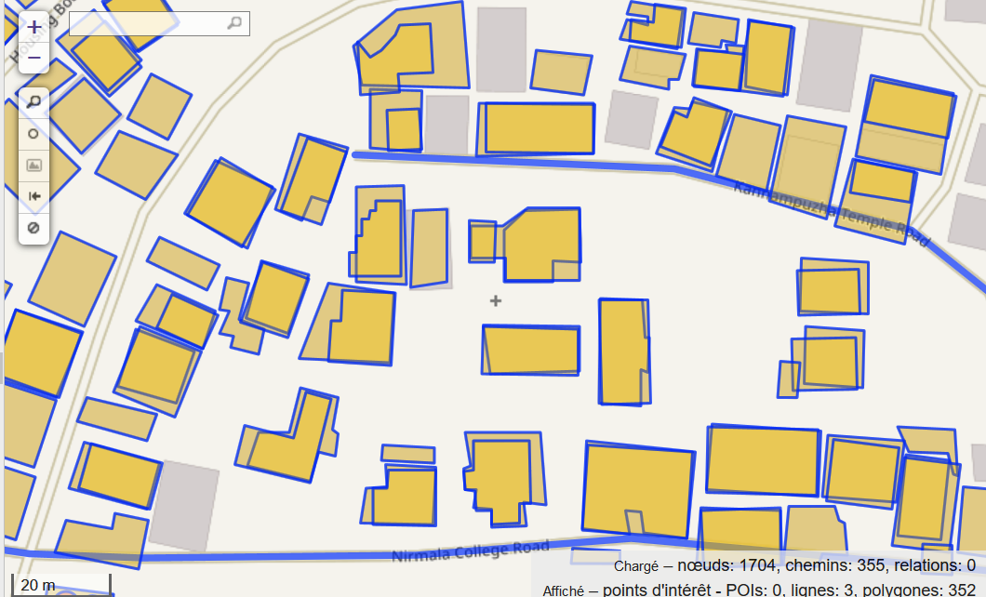
OSM Building Quality Problems
Overlaps & Duplicates with Imagery offset problems
Notes:
→ Eveb with the various QA tools, JOSM validators and Tasking Manager Validation, Coordinators of mapping projects are often caugth with Important quality problems to manage.
Overview of the projects can be obtaiined in various ways
- Stats on Irregular Geometry and Errors
- Visualisations
- List of OSM object id’s to extract and validate

Slide 8
OSM-DRC & Potentiel 3.0
2018 Ebola Outbreak coordination
Dec.2018 Butembo Emergency Response
Different Imagery offsets used
Local volunteers observed High level of errors, Duplicates, Overlaps, roads realigned to correct overlaps
  Daily monitoring with OQ_Analysis did show rapid degradation of Mapping Quality in context of Mapathons & images with various offsets
Coordination team could react quickly
  Task restarted with access by experienced mappers only

Slide 9
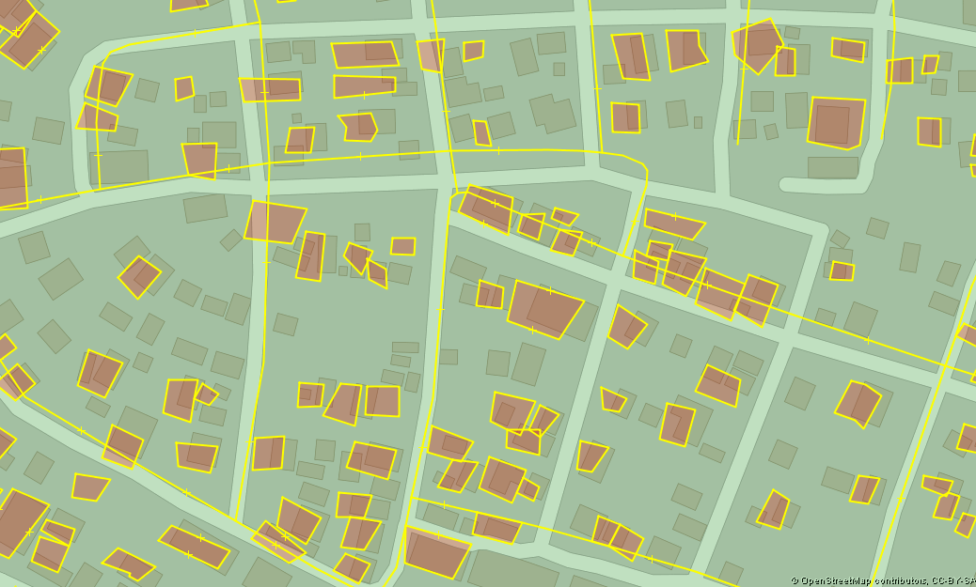


OSM-DRC 2018 Ebola Outbreak
Emergency Response
Flagged 2018-12-11 Revision

Slide 10
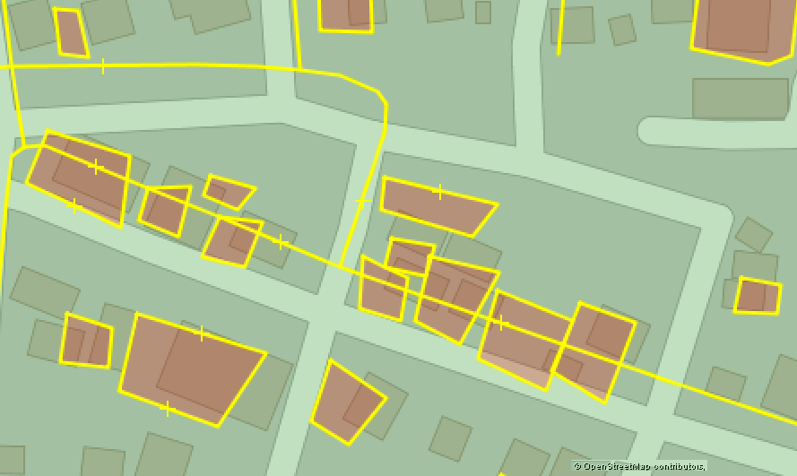
OSM-DRC 2018 Ebola Outbreak
Emergency Response
Flagged 2018-12-11 Revision

Slide 11
Areas covered by
Task Manager Projects
15 Projects in developping countries 2018-08-30
Re-evaluated 2019-08-01
  Individual buildings in general
  High level of New contributors without experience
  Ratio of Irregular Buildings vs Area covered by projects
    TM-4975 Irregular Buildings ratio from 60% in 2018 to 0.5% in 2019 + double number of buildings
    TM-5019 Irregular ratio of 42% → 500 huts quasi-regular
    12 angles, average angle=150 deg, but angles vary from 145.9 to 156.2
    13 other projects : Ratios between 0.5 and 20% and low edit level since 2018
Notes:
Analysis on https://opendatalabrdc.github.io/Blog/#!index_en.md
Mapping Ωuality reveals Insufficient Training & Monitoring
Tasking Manager has the capacity to brings in thousand of contributors to contribute
A Black Box of Participation
How could it better contribute to coordination / monitoring, filter contributors, and follow various mapping teams (mapathons, etc.) ?

Slide 12
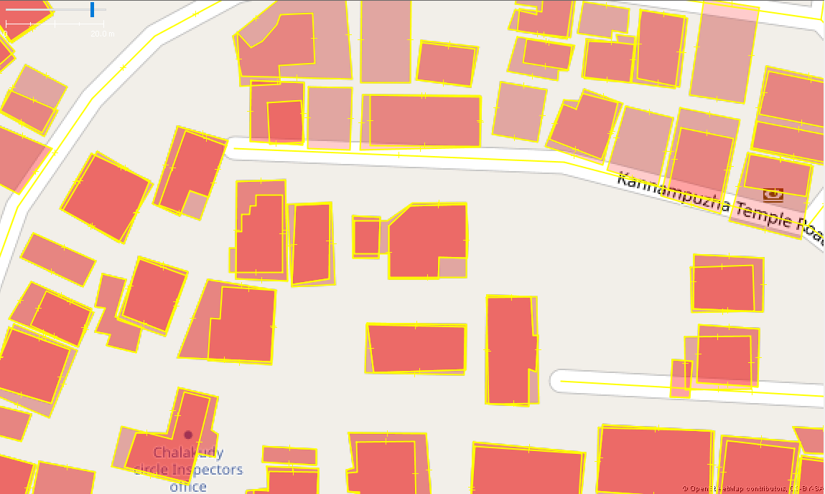
Task Manager project 2018-08
Duplicates not detected 1 year later
Notes:
TM-5010
https://www.openstreetmap.org/#map=19/10.30033/76.33467

Slide 13
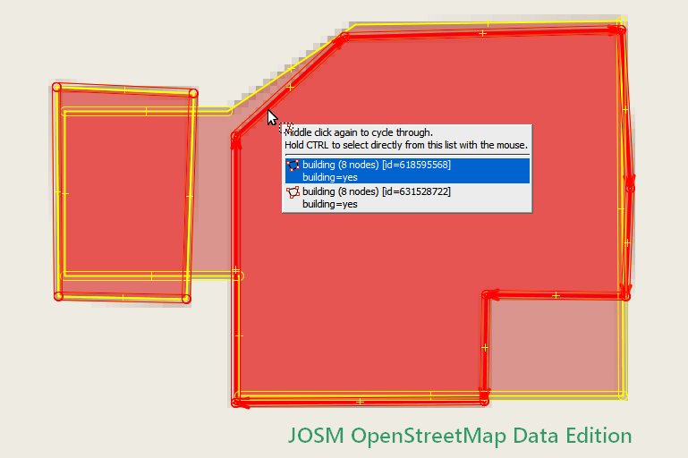
Task Manager project 2018-08
Duplicates not detected 1 year later
Notes:
TM-5010
https://www.openstreetmap.org/#map=19/10.30033/76.33467

Slide 14
16 Various Towns
,
Higher ratio of adjacent buildings (shared nodes)
Image Quality important in such context
Various layers collision observed
  with 3D schemas
  landuse vs amenity vs buildings
  Shades of green that cross buildings
  Overlaps of Building, amenity=[school, hospital etc], landuse, parking and other polygon types
Imports Toronto Irregular ratio of 54%
vs Dallas ratio of 14%
Layers Collisions Cambridge, Kyoto

Slide 15
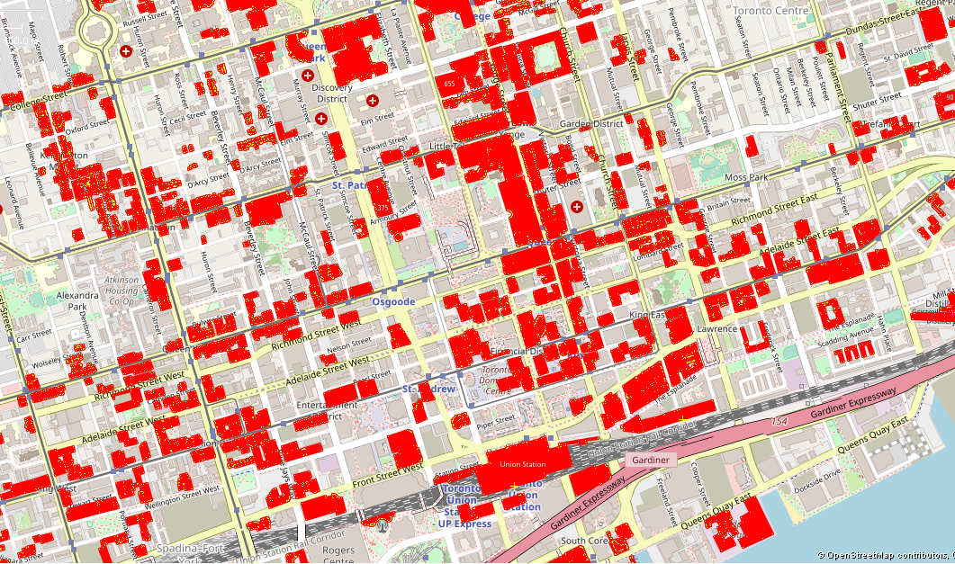
Toronto Adjacent buildings that share walls
Notes:
Adjacent buildings that share nodes
Needs good imagery to observe building outlines
More risk of geometry imprecision

Slide 16
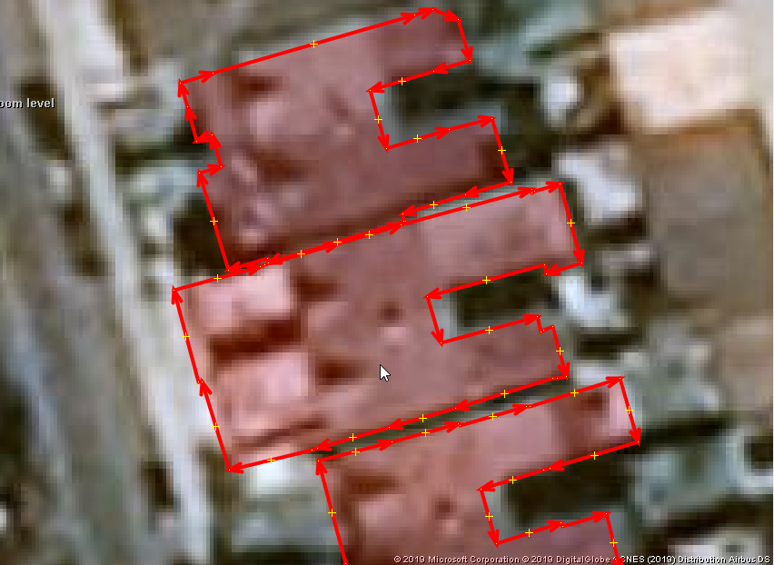
Toronto : Excess detail Near straigth line
Notes:
Adjacent buildings that share nodes
Needs good imagery to observe building outlines
More risk of geometry imprecision

Slide 17
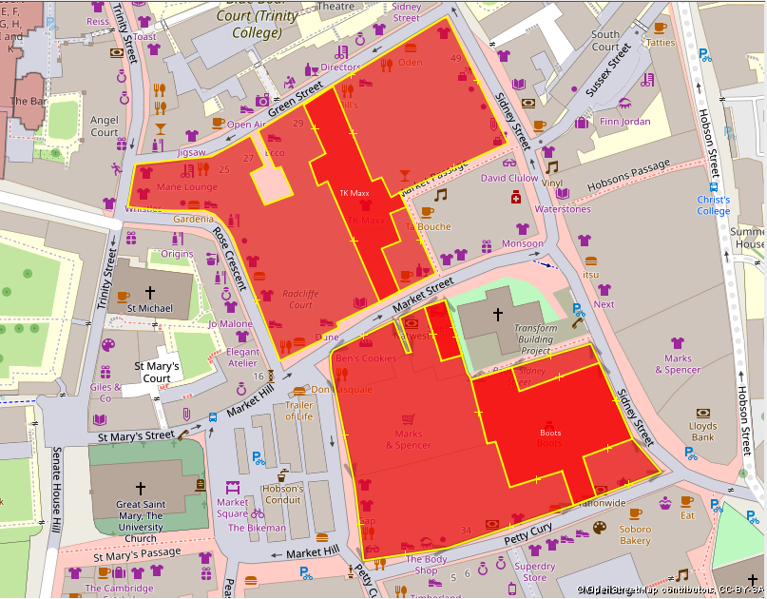
Building Overlaps
Cambridge, Buildings inside buildings (no building:part attrib)
Notes:
Error detection Overlaps
_
OQ_Analysis Offers
- overview, stats
- osm id’s
- visualisations

Slide 18
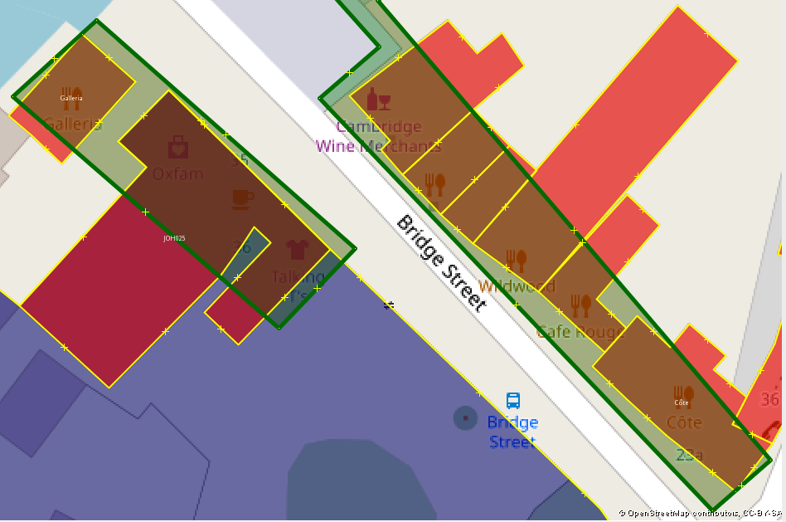
Overlaps with other objects
Cambridge, Overlaps
Shade of green (landuse)
crosses buildings

Slide 19
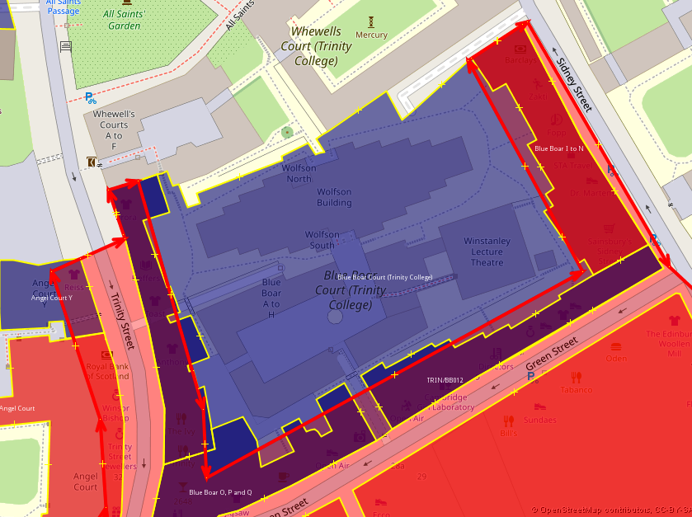
Overlaps with other objects
Cambridge, Overlaps
[Landuse=retail] crosses University land & buildings

Slide 20
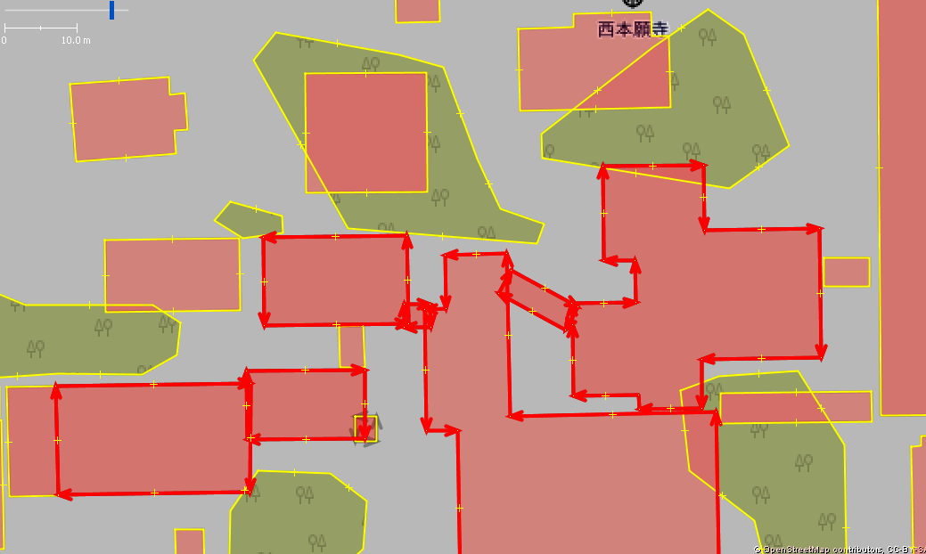
Kyoto, Building Overlaps
[

Slide 21
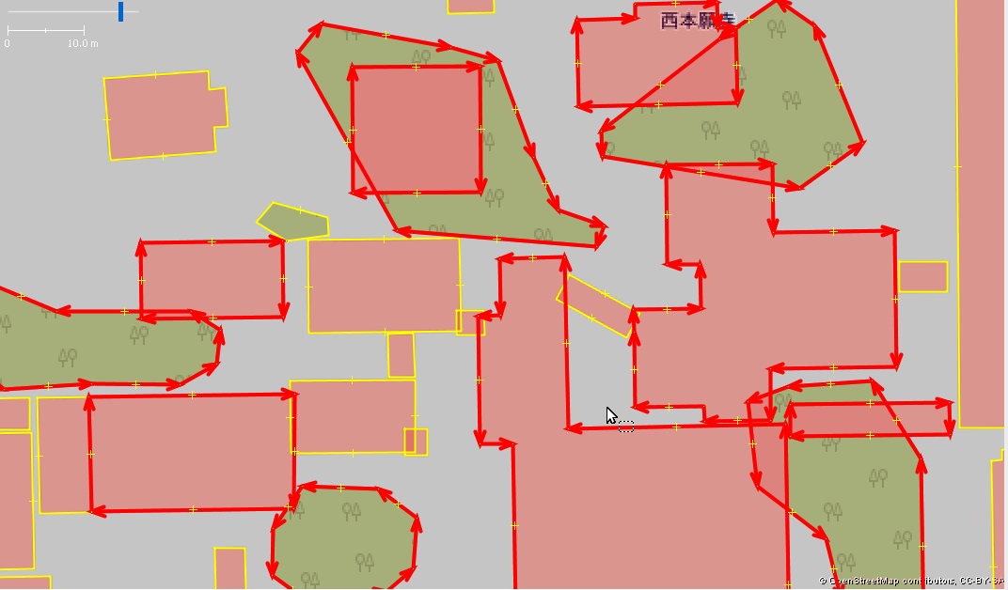
Kyoto, Overlaps
[natural=*l] crosses buildings

Slide 22
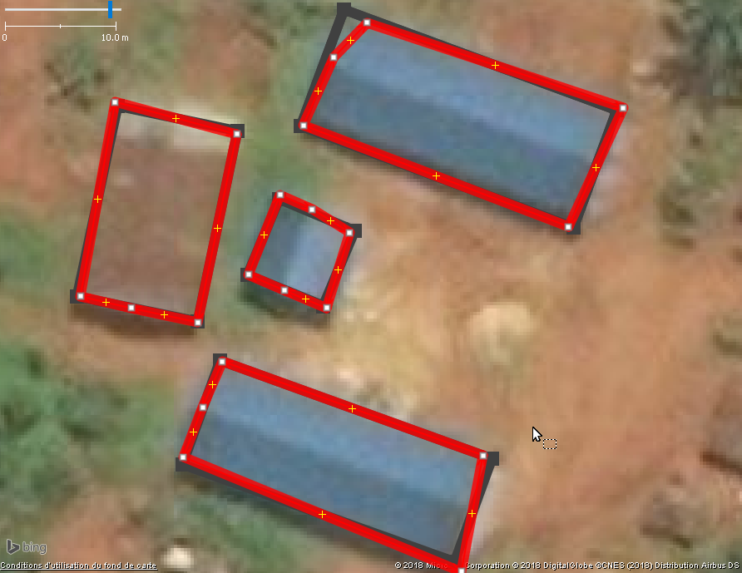
Geometry Classification
Angles Analysis

Slide 23
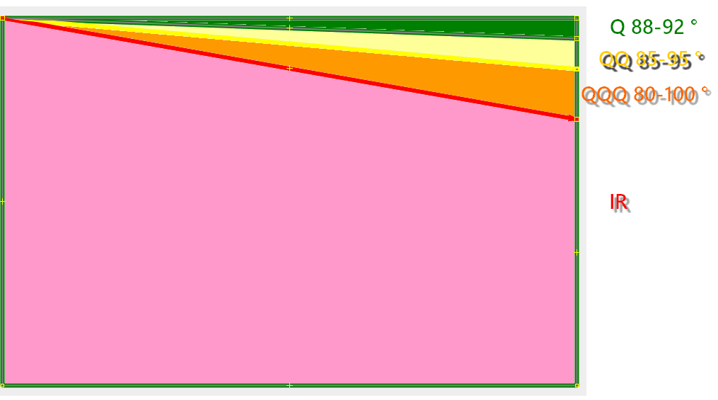
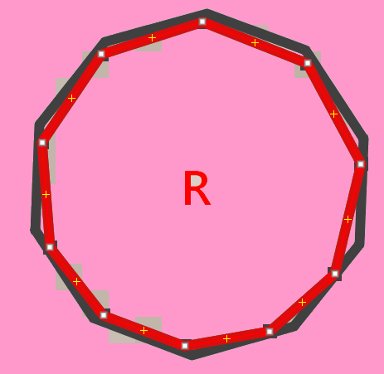
Angles Classification

Slide 24
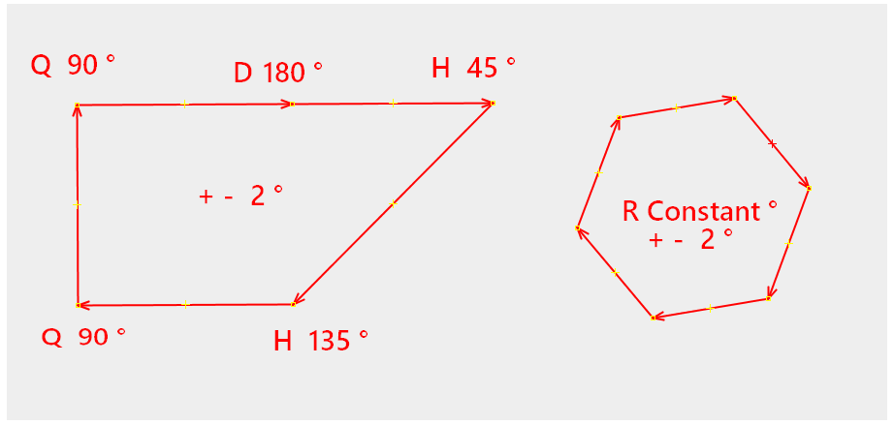
Angles Classification
Regular Angles We accept +- 2 degres

Slide 25
Angles Distribution
2019-08-01 Sample 2.7 million buildings, 15.7 million angles
% of total angles
1.7% D 180 degres (point on a straigth line to be ignored)
Regular 91.6% (93% excluding D 180)
  0.7% R Regular Polygon Forms such as hexadecimal, etc.
  90.7% Q Orthogonal forms (right angle) 88-92 deg.
  0.2% H 45 degres : 43-47 deg.
Quasi-Regular 3.1%
  2.7% QQ Orthogonal 85-95 deg. (Except Q)
  0.2% DD 175-185 deg.
  0.2% HH 40-50 deg.
Irregular 3.3%
  1.3% QQQ Close to orthogonal 80-100 deg. (Except Q, QQ)
  2.0% Ireg All others
Notes:
Classification to view distribution from Regular Angles, detects projects or areas significatively different

Slide 26
OQ Analysis Functions
Output Data ODbL

Slide 27
OQ Analysis Functions
Geometry Analysis and Errors detection
Function OQ_Analysis_Table_Warnings_Error_Flags(
_schema text,_date_extract text)
SELECT * FROM (‘toronto_canada_2019_08_01’, ‘2019_08_01’);
Analyze ways table in the PostgreSQL schema
toronto_canada_2019_08_01
Output Table : Indicators for each Building polygon
    Geometry summary
    Flags Irregular forms, Open Polygon, surface < 2 square meter, self intersection, duplicates, overlaps (buildings, other polygons and roads)
    Visualisations Geojson
    List of OSM id’s let’s extract Overpass

Slide 28
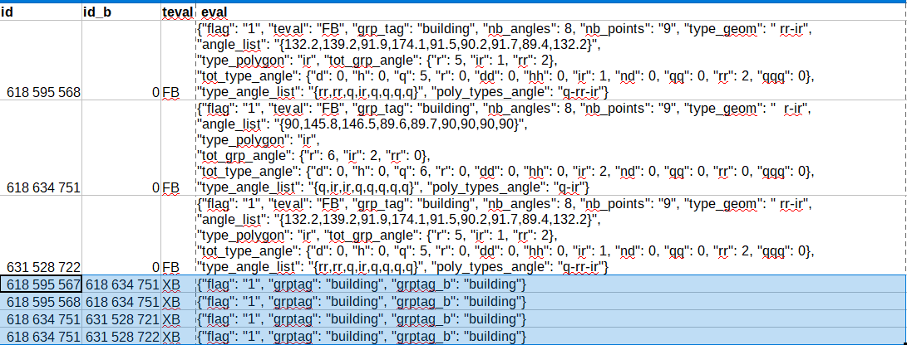
OQ Analysis Table Output
Eval JSON variable : we can easily add new analysis variables
,

Slide 29
OSM Quality Mapping : Metrics to Monitor Buildings Outbounds
Workflow
1. Script
Import OSM file into PostgreSQL / PostGIS using Osmosis Schema. A step can be easily added for extraction from Overpass
2. PostgreSQL call Functions to produce indicators
3. Analysis, export id lists or geojson visualisations
OQ Analysis Workflow

Slide 30
More info about
OQ Analysis Functions
Github pierzen/OQ_Analysis
Docs Documentation
  Installation.md Prerequesites + Installation instructions
  OQ_Analysis Variables Documentation.md
  OQ_Building_Analysis - Buildings Polygon errors and Geometry analysis.md
Script Tests and samples
  osmosis-postgis-import-osm.sh Windows Powershell script to import OSM file in PostGIS using Osmosis PgSnapshot Schema

Slide 31
OQ Analysis Functions
Github pierzen/OQ_Analysis
sql PostGIS Functions
  sql/analysis Geometry classif & Errors detection
  sql/orthogonal Transform Quasi-Regular to Regular polygons (In development)
  sql/test Examples how to use the functions

Slide 32
OQ Analysis Functions
Orthogonal correction : Project in development
Solution is possible like in JOSM
We can limit to angles close to 90 degres
But How far we go to correct polygons?
  - 5 degres variance?
  - 10? …

Slide 33
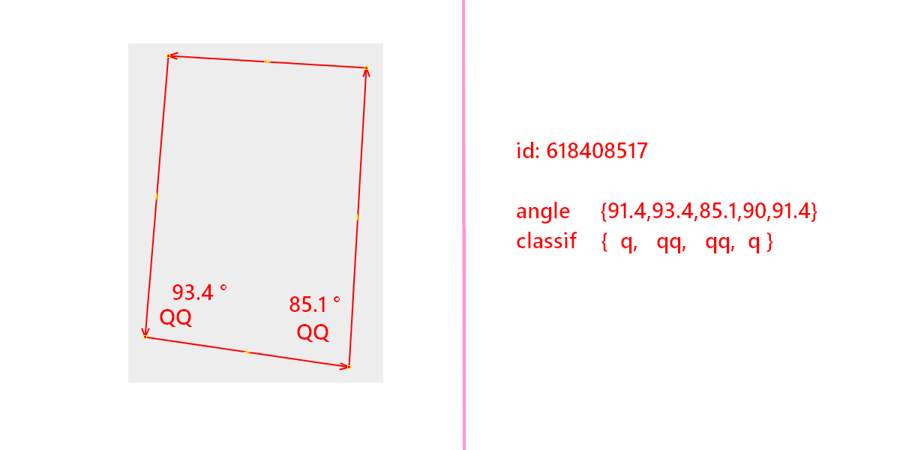
OQ Analysis Functions

Slide 34
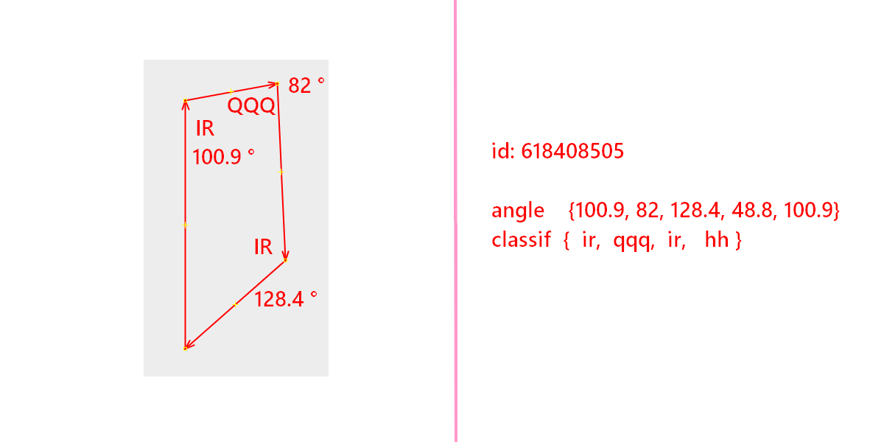
OQ Analysis Functions

Slide 35
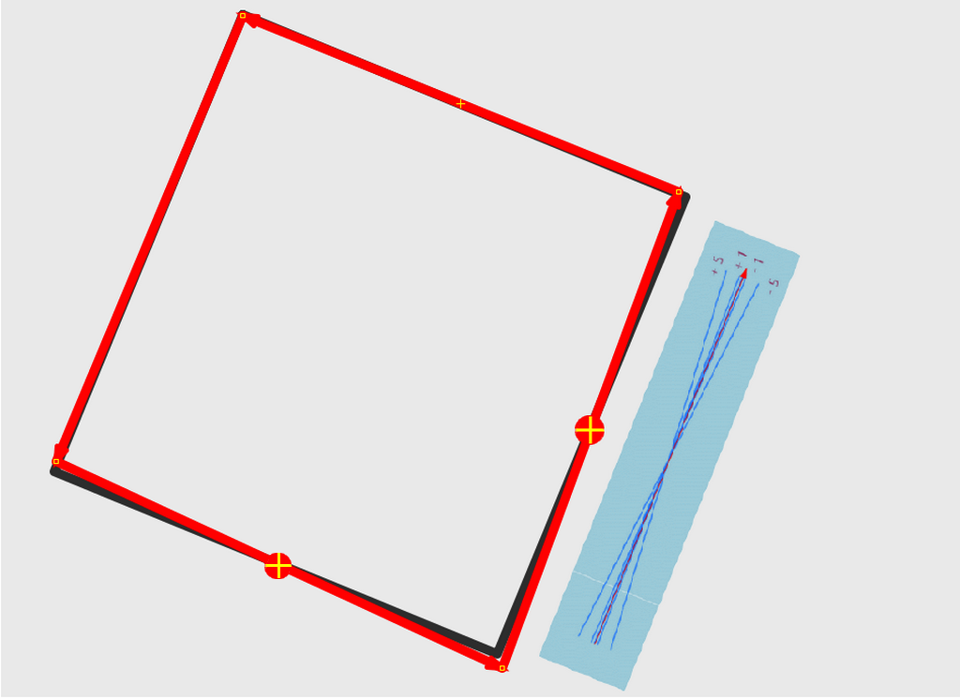
OQ Orthogonal correction
OQ_Rotation
Line Segment pivots
from center
Constraint to add:
Line do not extend
over adjacent walls

Slide 36
OQ Analysis
Input : Osm File History Tables
  Any OSM Table or Overpass Queries
  PostgreSQL Schemas to store many tables
PostGIS Functions for various analysis
  Geometry Forms class (regular, quasi-regular, irregular)
  Topological errors, overlaps detection
  Geometry visualisations
  List of OSM id’s for subsequent analysis / extracts

Slide 37
OQ Analysis
Publications : Blog OpenDatalabRDC
https://opendatalabrdc.github.io/Blog
PostGIS functions on Github
https://github.com/pierzen/OQ_Analysis/
Pierre Béland
OSM PierZen

