Slide 1
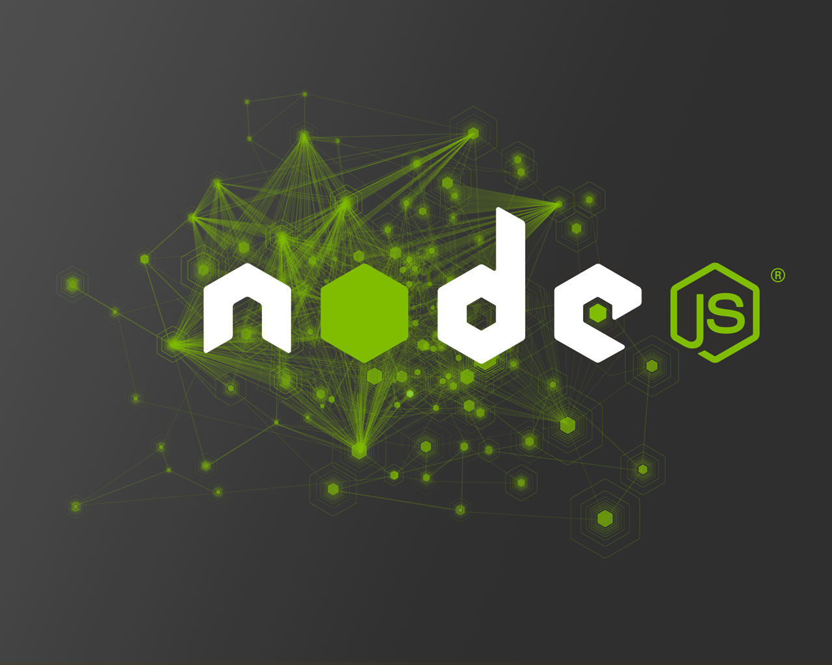
Martin Fillafer

Slide 2
NodeJS
Javascript (ECMAScript) Webserver
Ryan Dahl, 2009
Google Chrome V8 (Virtual Machine)
data- VS computation-centric
Javascript Concepts
  event - based
  asynchronous / non - blocking
Notes:
* Proxy servers / Service "Glue" / Data Plumbing
* Telemetry / Analytics
* Real-time connections to the web-browser
* real-time chat
* Sharing code between Server and Browser

Slide 3
NodeJS Fundamentals (1)
non-blocking I/O => event loop
  no multi-thread management overhead
  many concurrent connections
REPL
node package manager (NPM)
process
Timers
  setTimeout, setInterval

Slide 4
NodeJS Fundamentals (2)
Buffer
  fixed length, outside of V8
EventEmitters
  obj.on('evt', cb), obj.once, obj.emit
Streams
  events: data, end, error
  pipe
Modules
  exports.fun, module.exports

Slide 5
NodeJS Modules
Core
  fs, http, net, path, url, ...
lodash (Underscore.js extension)
Express - web framework
  express-generator
Async.js
  map, filter, series, parallel
Socket.IO – WebSocket
Node-ORM
https://github.com/joyent/node/wiki/modules

Slide 6


Slide 7
Pros and Cons
scalability
functional → expressiveness,
parallelism = no multithreading → deadlocks
propper error handling
  callback(err, …)
almost everything comes per module
asynchronous code = far more complex
production system more complicated than Apache2 + PHP (unhandled exceptions)

Slide 8
Do's and Don'ts
NodeJS + Backbone.js / Angular.js
  JSON handling, APIs
Realtime Communication (WebSockets),
Proxies
Heavy computation
  Solution: WebWorkers pattern
Serving files in big scale
  app.use(express.static(__dirname + '/public'))
  use Nginx as Proxy
Write Console Tools

Slide 9
Sources
What is NodeJS
  http://stackoverflow.com/a/6782438
Core Modules Docu
  http://www.nodejs.org/api/index.html
Introduction to Node.js with Ryan Dahl
  http://www.youtube.com/watch?v=jo_B4LTHi3I
nodeschool.io - open source lesson
  http://nodeschool.io/#workshoppers
Mixu's Node book
  http://book.mixu.net/node/index.html

