Slide 1
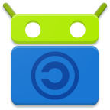
Waiting a bit before starting
In the meantime, you can install F-Droid on your Android phone for getting the best FOSS apps
The app store that respects freedom and privacy
https://f-droid.org

Slide 2
APPLE THREATWARNING
Limited ios support
Can change with sideloading (alternative app store)
Don’t buy apple devices, it’s junk

Slide 3
Multiple ways to install apps
1) F-Droid (best) : just install F-Droid and use it
2) Downloading the apk directly from the app’s website (annoying to update, can be better with the FOSS app « Obtainium »)
I’ll put the urls for both ways
DON’T USE GOGOLE PLAY STORE
→ usually add trackers in the app

Slide 4
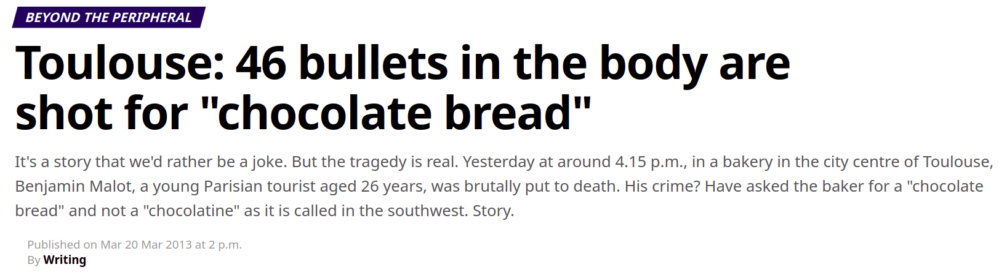

Slide 5
The solution : Comaps
- based on OpenStreetMap (everyone can contribute)
- is consistently faster than gogole maps (better indexation for searching, quick paths that only local people know, maps store on device)
- everything is offline (no mobile data used, usable in airplane mode, optional gps location)
- no ads, no tracking, no data collection
- battery friendly

Slide 6


Ditch evil gogole maps
EMBRACE COMAPS
F-Droid link : https://f-droid.org/en/packages/app.comaps.fdroid/
APK link (on codeberg) :
https://codeberg.org/comaps/comaps/releases

Slide 7

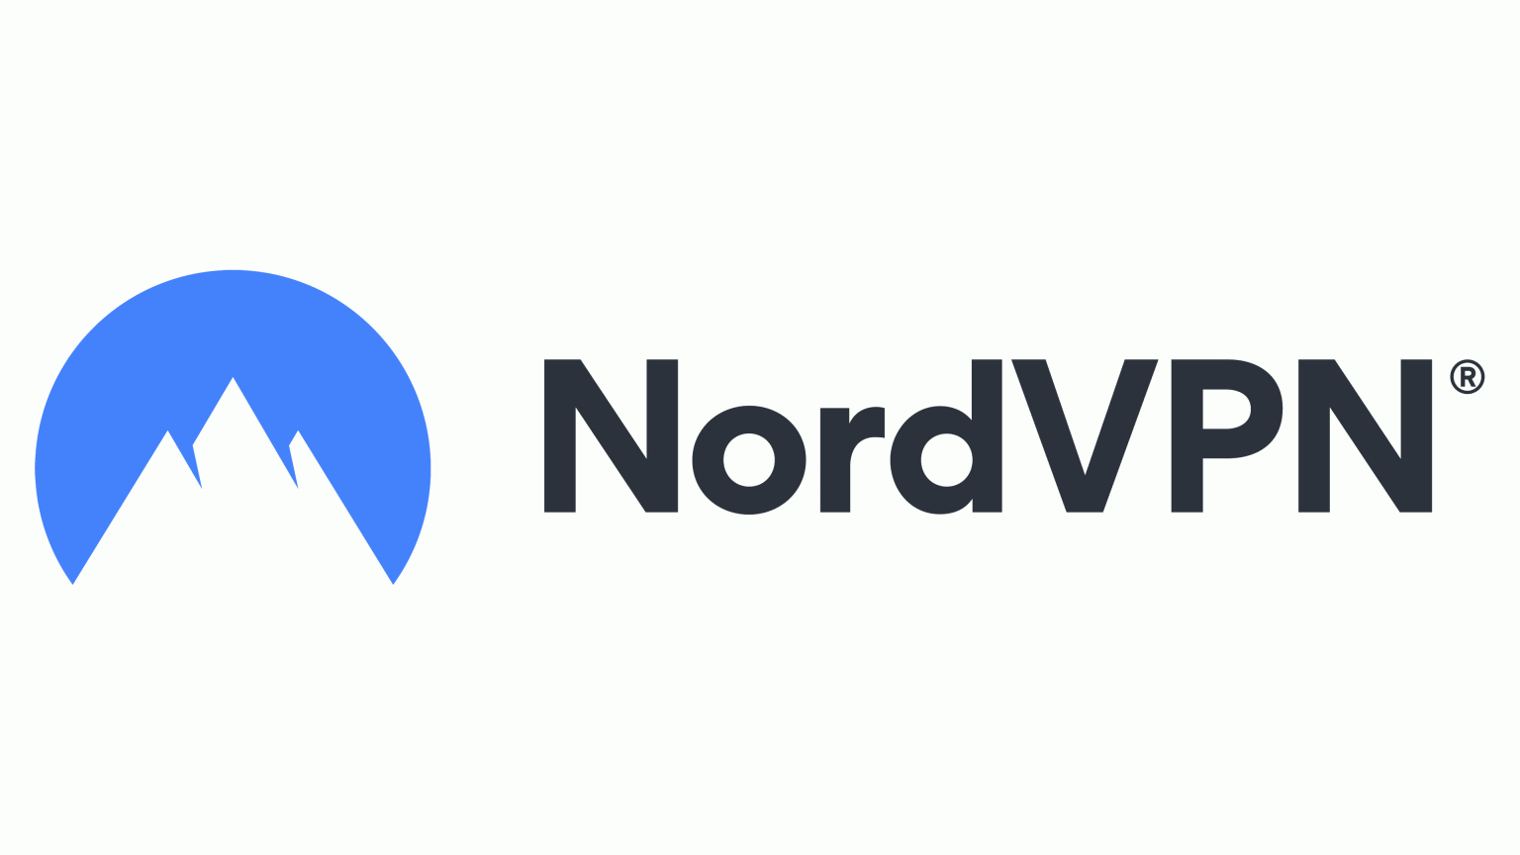

VPN
- slow
- expensive
- not that effective (only hides ip)
- collects data about you
- can snitch you to authorities
- annoying to set up
- can lead to dns leaks
- can help censorship

Slide 8
BUT URNETWORK ISN’T LIKE THIS
- secure, with good enough encryption
- no dns leaks
- easy to setup
- data providers quickly change, so ips change very fast too
- no data collection, no tracking, no bullshit
- free as in gratis (optional subscription tier of $5/month)

Slide 9
COMMUNITY BASED
- YOU are the provider : each person on the network share a bit of bandwidth
- network traffic becomes blurry for ip-based trackers
- evade censorship by connecting to someone in a country without censorship
- no logging, everything in RAM (provider can just restart a service, and the FBI is blocked)
- providers only have your ip or the trafic, so they can’t track you
- I am myself a big shareholder with many providers in France

Slide 10
To get urnetwork
F-Droid link : https://f-droid.org/en/packages/com.bringyour.network/
APK link :
https://github.com/urnetwork/android/releases

Slide 11

Bro, just stop looking at my messages
- spying just never ends
- creepy guys everywhere
- bro can’t get a life

Slide 12
SESSION IS THE SOLUTION
End to end encryption
No ip adress leak
No DNS leak
Onion routing : multiple servers, each one only has a part of the data
No email adress or phone number required

Slide 13
Many private features
- 1 to 1 chat
- small group chat
- voice calls
- video calls
- app lock with a password
- dumb logo to hide the app

Slide 14
To get Session :
F-Droid link :
https://f-droid.org/en/packages/ network.loki.messenger.fdroid/
APK link :
https://github.com/session-foundation/session-android/releases

Slide 15

People are getting dumb
- tiktok just makes you dumb
- how to become smarter ?
- how to waste time AND become smarter ?

Slide 16

WIKWOK IS THE GOAT
- small
- fast
- multiple languages

Slide 17
To get WikWok :
F-Droid link :
https://f-droid.org/en/packages/com.github.terrakok.wikwok.androidApp/
APK link
https://github.com/terrakok/WikWok/releases
Webapp (for ios) :
https://terrakok.github.io/WikWok/

Slide 18
Kotatsu
From my searches on mojeek, it’s a popular heating table for people in japan
Issue with reading manga/comics/manwa online:
- too many sources (what’s the sauce???)
- hard to find updates to a title currently being released from time to time
- annoying to find out what you’ve already read before
Kotatsu IS the answer:
- history of what you read on it
- mark a title as a favourite to put it on your virtual bookshelf
- find titles from more than 1121 sources

Slide 19
QUESTIONS ?

Slide 20
To get Kotatsu :
F-Droid link :
https://f-droid.org/en/packages/org.koitharu.kotatsu/
APK link :
https://github.com/KotatsuApp/Kotatsu/releases

