Slide 1

PODD
Participatory Oriented Disease Detection

Slide 2
Household animals
Humans and animals living together
as a community
High probability of cross-infection
  Avian influenza (chicken -> human)
  Japanese encephalitis (pig -> human by mosquito)

Slide 3
Our goal
Visualize the dangers of cross-infection

Slide 4
Various data sources
SMS
Government
Health organizations
Vets
Doctors
DoctorMe
Villagers
DoggyDoc
Human
Animals
!

Slide 5
Convert and store data
Human
Animals
Human DB
Pet DB
Bird DB
Livestock DB
Exotic DB

Slide 6
Collect the data
Create a data structure for reporting
  Type: Human / Pet / Bird / Livestock / Exotic
  Symptom: id, name, severeness level (1 - 5)
  Location, address, date of report
  ....
Provide export tools / interfaces for all organisations and doctors / vets
  Opendream could provide the tools and support

Slide 7
Narrow data to make comparable between species
Many different symptoms
5 Symptom categories

Slide 8
Symptom categories
Respiratory tract
Digestive tract
High body temperature
Nervous signs
Skin problems

Slide 9
Normalize / Classify
Map the symptoms to categories

Slide 10
Map symptoms to categories

Slide 11
Normalize / Classify
Map the symptoms to categories
Calculate the probability of cross-infection

Slide 12
Calculate probability of cross-infection

Slide 13
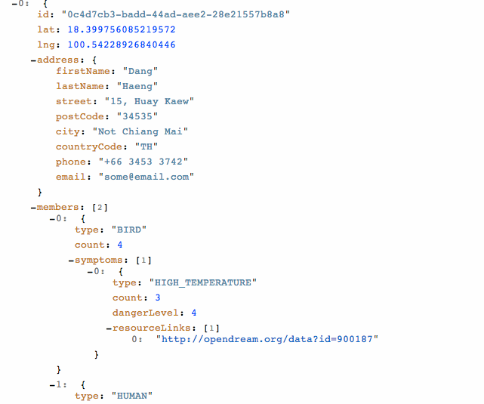
Merge all information

Slide 14
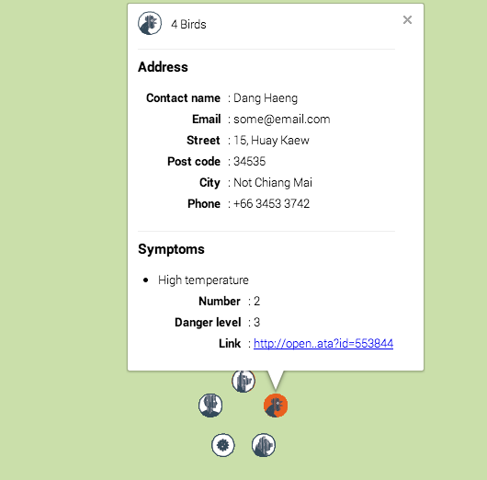
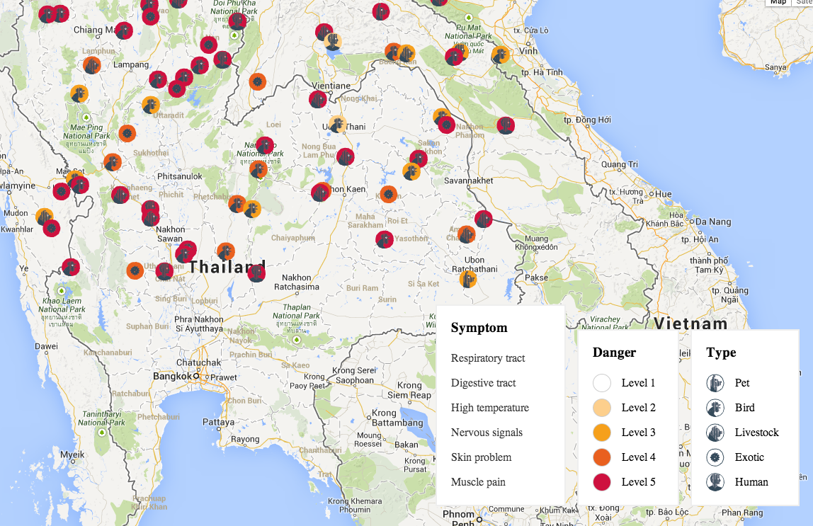
Visualize the information

Slide 15
Code+presentation @github
https://github.com/opendream/eph_animal

