Slide 1
Probabilistic tools in OpenEarth
An introduction

Slide 2


What do we need?
structure
Stochastic variables
+
function
Limit state function
+
Calculation method
=
Probability of failure

Slide 3
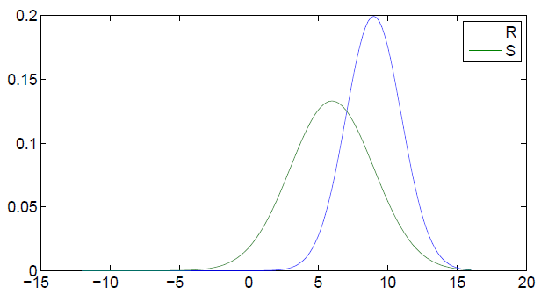
Stochastic variables…
@deterministic
@norm_inv
@unif_inv
@exp_inv
@bino_inv
@chi2_inv
@conditionalWeibull
@ev_inv
@gam_inv
@gumbel_inv
@logistic_inv
@logn_inv
@rayl_inv
@trian_inv
...
structure
Stochastic variables
stochast = struct();
% resistance
stochast(1).Name = 'R';
stochast(1).Distr = @norm_inv;
stochast(1).Params = {9 2};
% sollicitation
stochast(2).Name = 'S';
stochast(2).Distr = @norm_inv;
stochast(2).Params = {6 3};
+
function
Limit state function
+
Calculation method
stochast =
1x2 struct array with fields:
Name
Distr
Params
=
Probability of failure

Slide 4
…and a limit state function
structure
Stochastic variables
function z = x2z(varargin)
%X2Z Basic x2z function
OPT = struct( ...
'R', 0, ... % resistance
'S', 0 ... % sollicitation
);
OPT = setproperty(OPT, varargin{:});
%% compute z−values
z = OPT.R − OPT.S;
end
+
function
Limit state function
+
Calculation method
=
>> x2z(‘R’,r,’S’,s);
>> zFunction = @x2z
Probability of failure

Slide 5
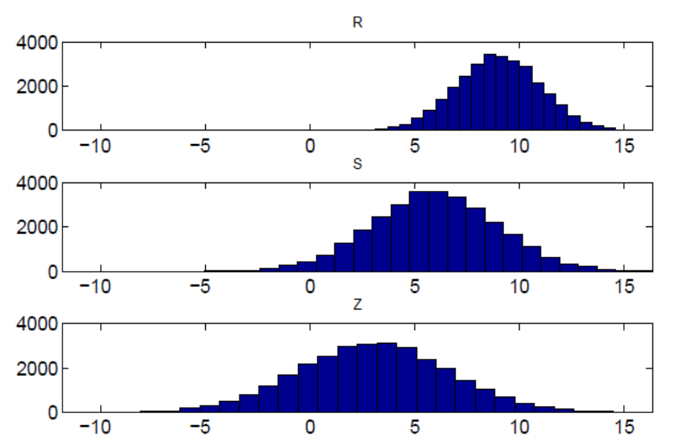
Select a calculation method
structure
Stochastic variables
% run calculation using Monte Carlo
resultMC = MC( ...
'stochast', stochast, ...
'NrSamples', 3e4, ...
'x2zFunction', @x2z );
% run the calculation using FORM
resultFORM = FORM( ...
'stochast', stochast, ...
'x2zFunction', @x2z );
+
function
Limit state function
+
Calculation method
resultMC =
settings: [1x1 struct]
Input: [1x2 struct]
Output: [1x1 struct]
resultMC.Output =
P_f: 0.2033
Beta: 0.8300
...
=
Probability of failure

Slide 6
Cases
Case 1: An example
Case 2: Create your own stochast structure and z-function
Case 3: Add some real-world troubles
a: Discontinous limit state functions due to multiple failure mechanisms
b: Extremely low failure probabilities (Importance Sampling)

