Slide 1
Probabilistic methods in Open Earth Tools
Ferdinand Diermanse
Kees den Heijer
Bas Hoonhout

Slide 2

Open Earth Tools
Deltares software
Open source
Sharing code for users of matlab, python, R, …
https://publicwiki.deltares.nl/display/OET/OpenEarth

Slide 3
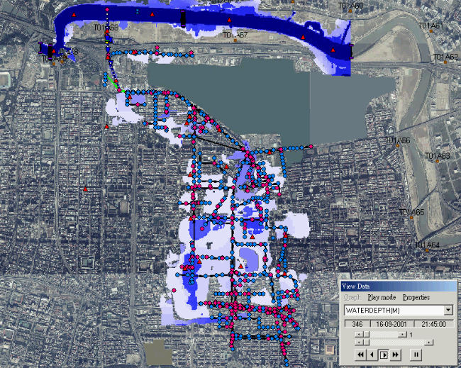
Example application: flood risk analysis
Rainfall
Upstream river
Discharge
Sobek
Sea water
level

Slide 4
General problem definition probabilistic analysis
X₁
X₂
System/model
Z
.
.
.
“system
variable”
X_{n}
“Boundary
conditions”

Slide 5
Notation
X₁
X₂
System/model
Z
.
.
.
X = (X₁, X₂, …, X_{n})
X_{n}
Z = Z(X)

Slide 6

General problem definition
X₁
?
X₂
complex
.
.
.
model
Z
Time consuming
Probabilistic
analysis
X_{n}
Statistical
analysis

Slide 7
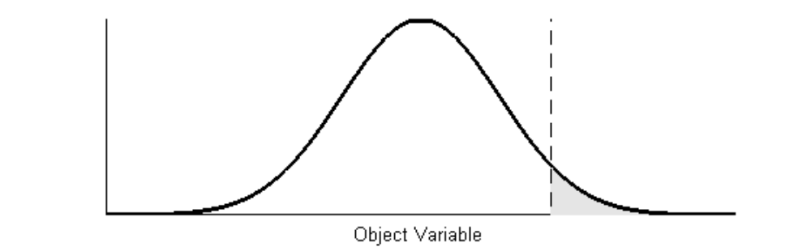
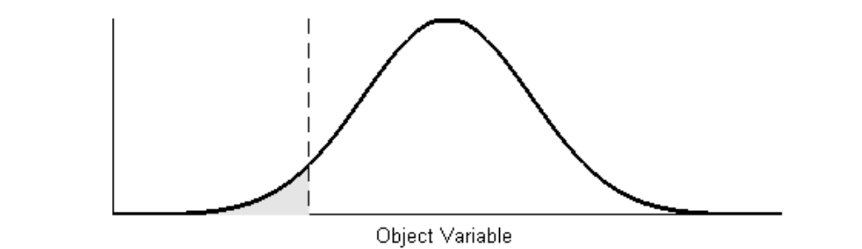
Application: probabilities of unwanted events (failure)
Floods (too much)
Droughts (too little)
Contamination (too dirty)

Slide 8
failure domain
x₂
“failure”
Z(x)<0
no “failure”
Z(x)=0
Z(x)>0
x₁
Wanted: probability of failure, i.e. probability that Z<0

Slide 9

Example Z-function
Failure: if water level (h) exceeds crest height (k): Z = k - h

Slide 10
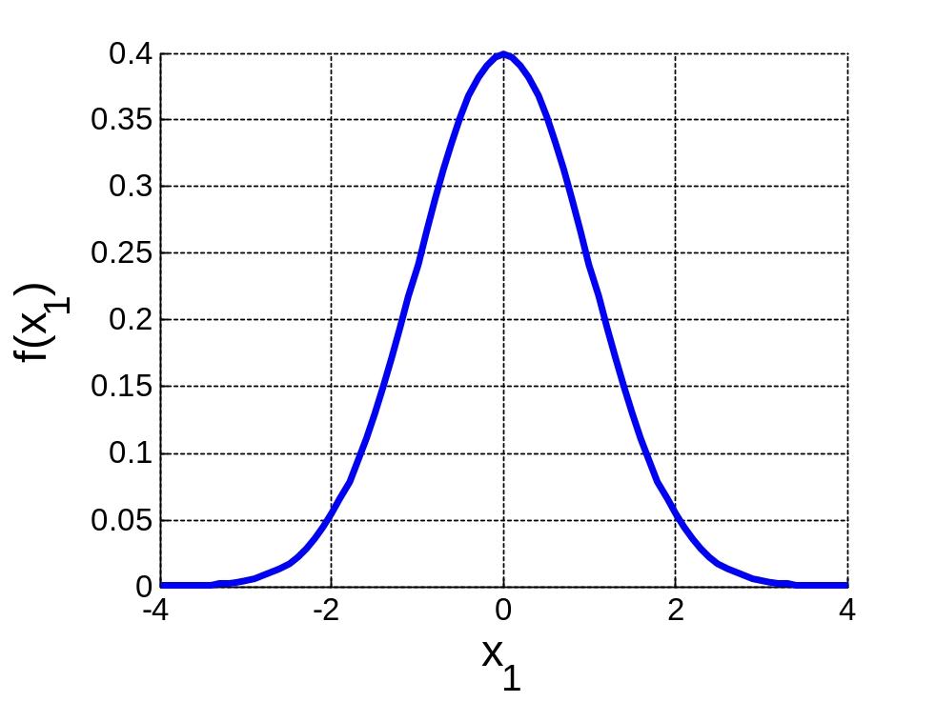
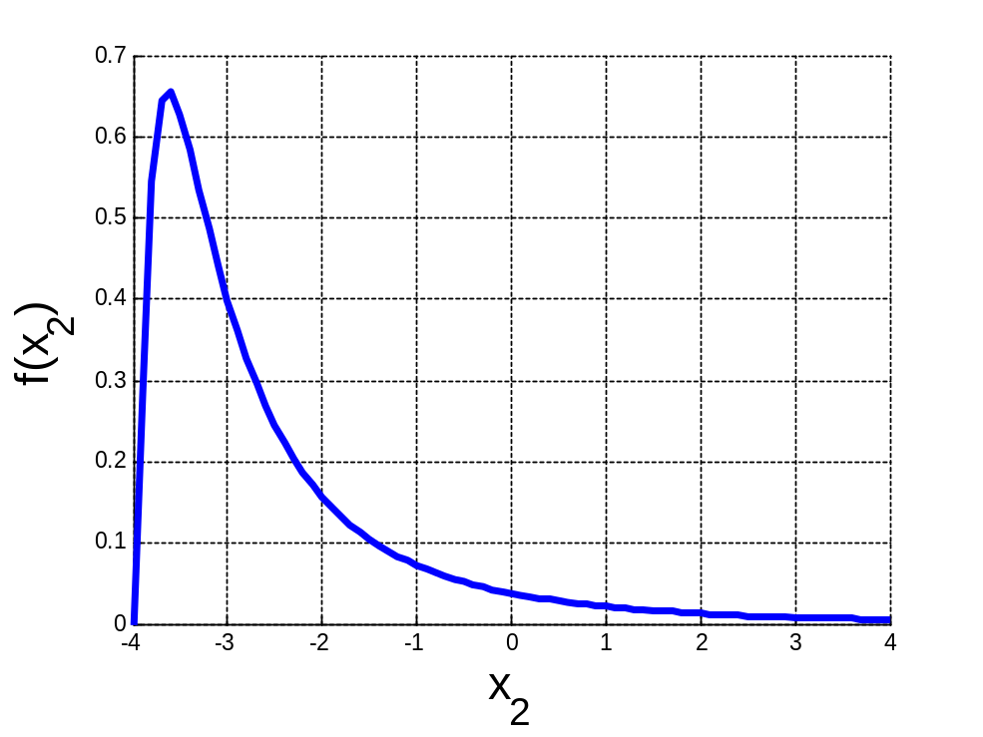
Probability density functions of x-variables

Slide 11
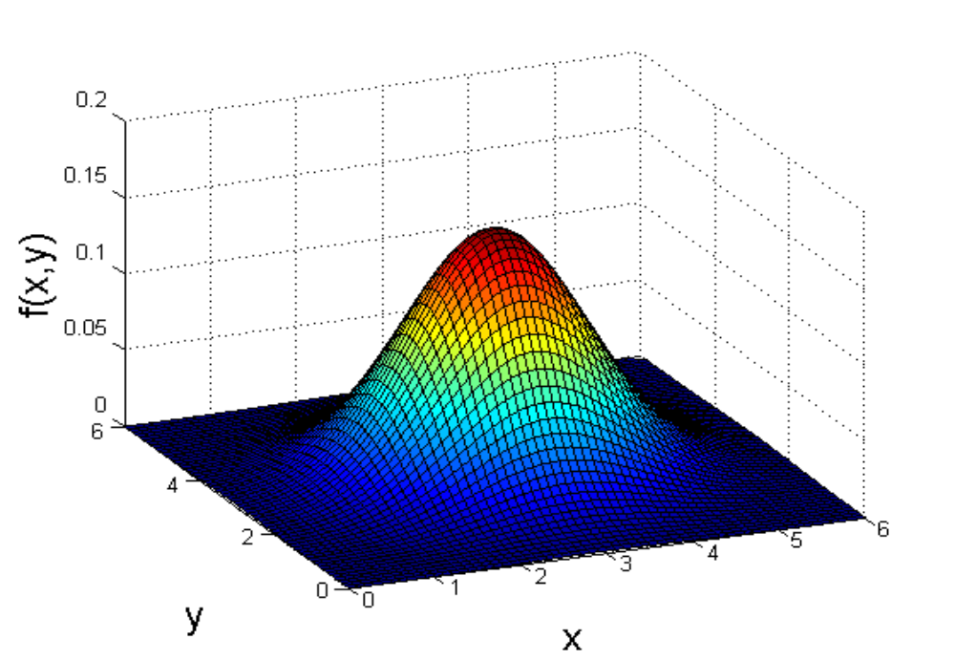
Correlations need to be included
x₂
f(x)
f(x)
x₂
x₁
x₁
Multivariate distribution function

Slide 12
Combination of f(x) and Z(x)
x₂
“failure”
f(x)
Z(x)=C*
no “failure”
x₁

Slide 13
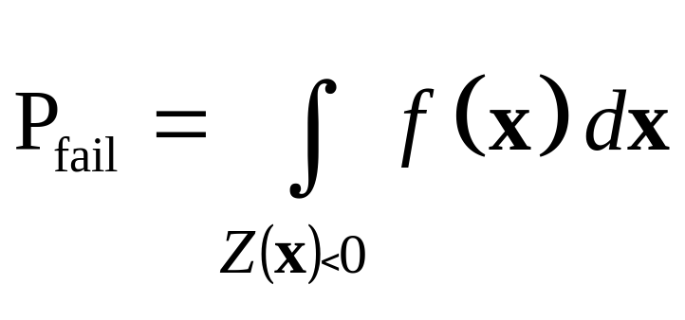
Probability of failure
x₂
f(x)
Z(x)=0
x₁

Slide 14
Problem definition
Problem cannot be solved analytically
Probabilistic estimation techniques are required
Evaluation of Z(x) can be very time consuming

Slide 15
Probabilistic methods in Open Earth Tools
Crude Monte Carlo
Monte Carlo with importance sampling
First Order Reliability Method (FORM)
Directional sampling

Slide 16
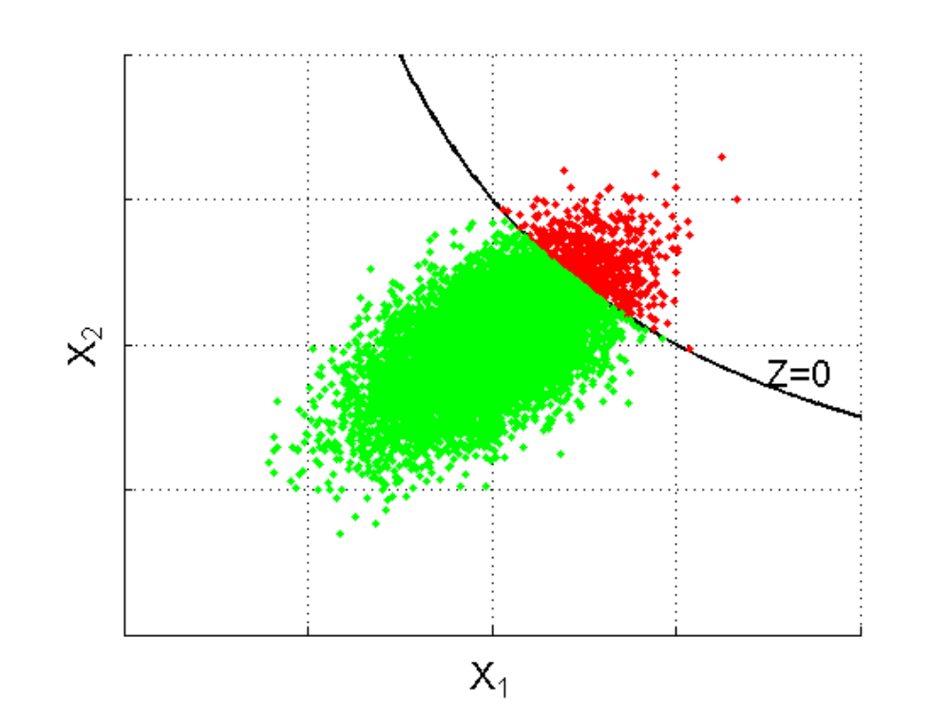
Crude Monte Carlo
Take N random samples of x
Count the number of samples (M) in failure domain Z(x)<0
Estimate P_{f} = M/N
failure
no failure

Slide 17
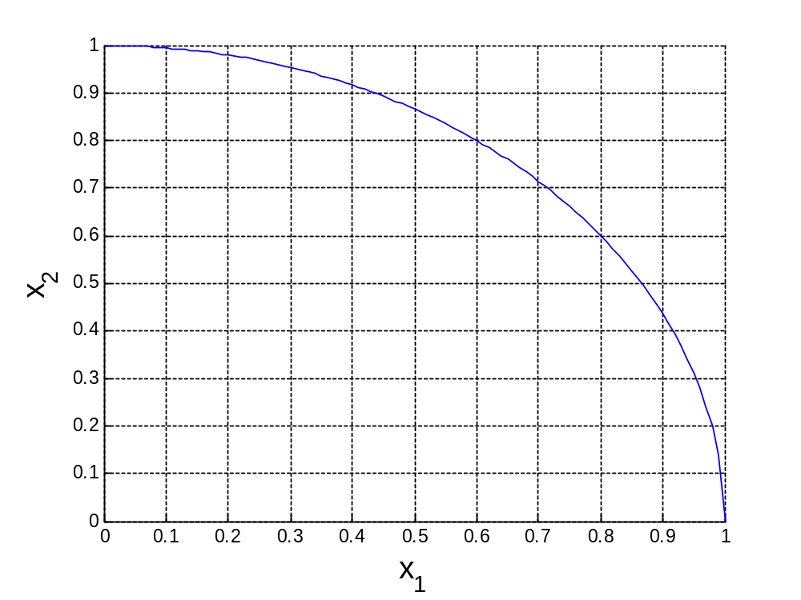
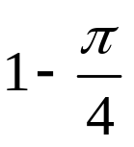


Simple example Crude Monte Carlo: ¼ circle

Slide 18
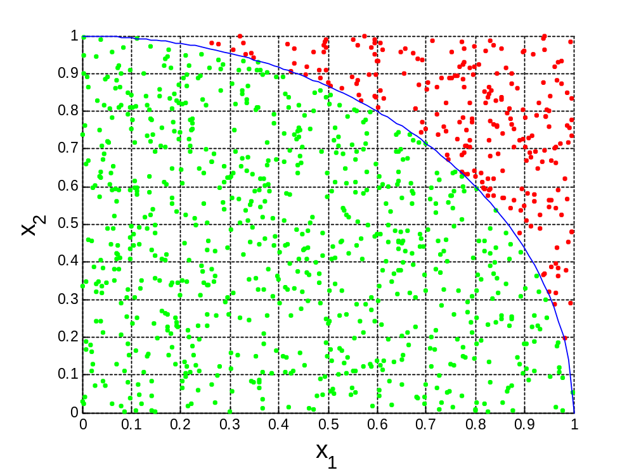
Samples crude Monte Carlo
failure
no failure

Slide 19
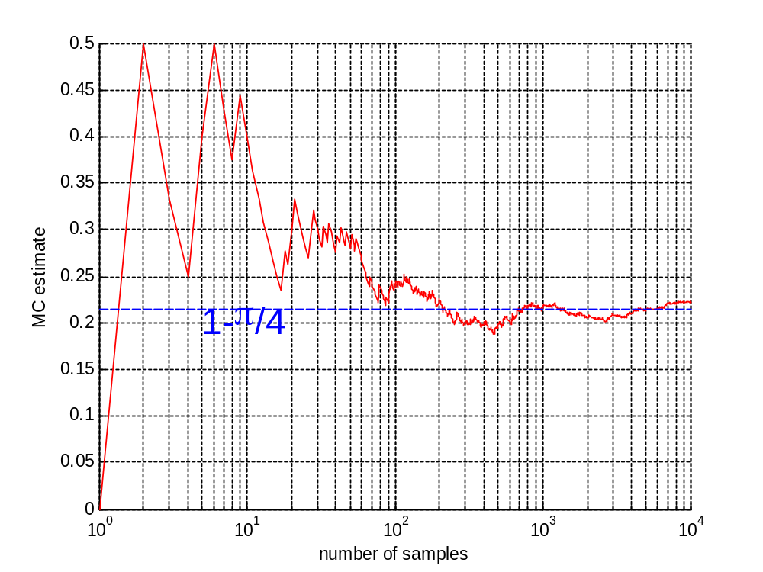
MC estimate

Slide 20
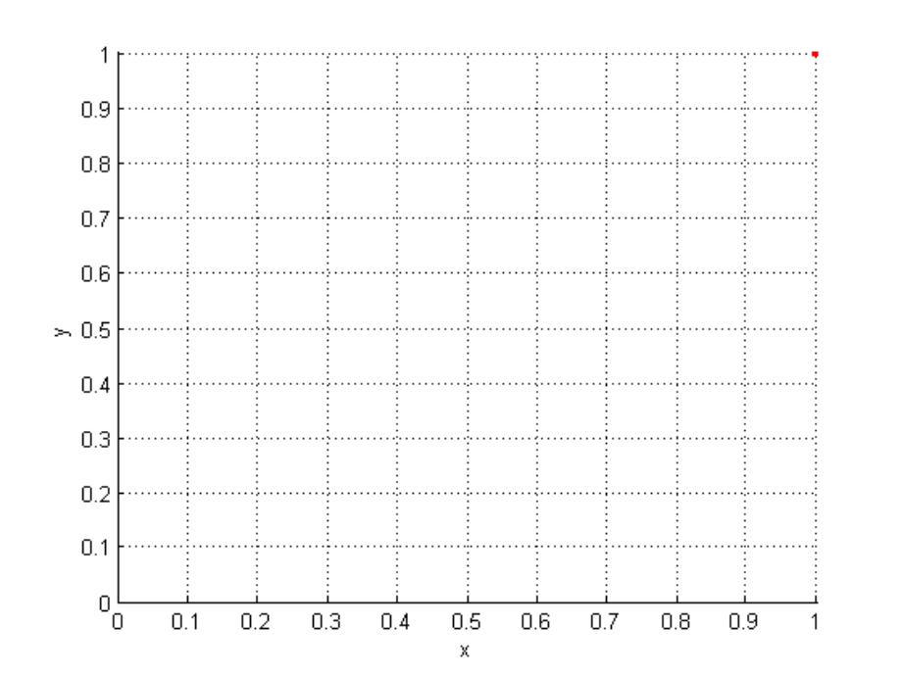
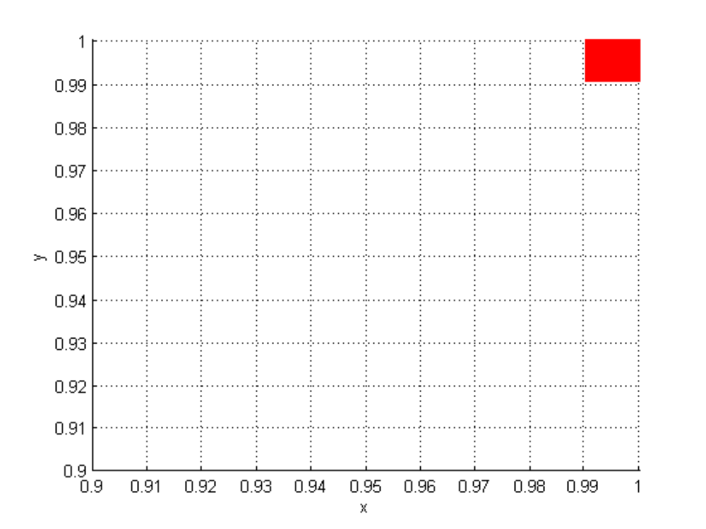
New example: smaller probability of failure
P_{fail}=10⁻⁴

Slide 21
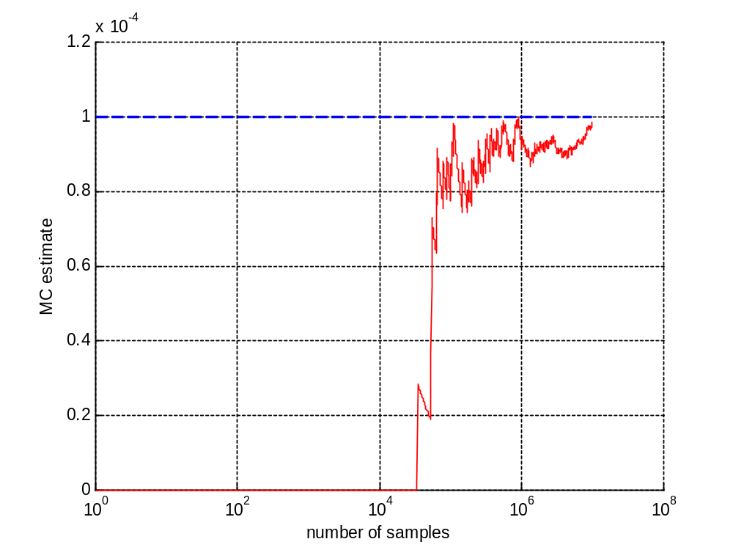
MC estimate

Slide 22
Crude Monte Carlo
Number of samples required for a sufficiently accurate estimate is inversely proportional to the probability of failure
For small failure probabilities, crude MC is not a good choice, especially if each sample brings with it a time consuming computations/simulations

Slide 23
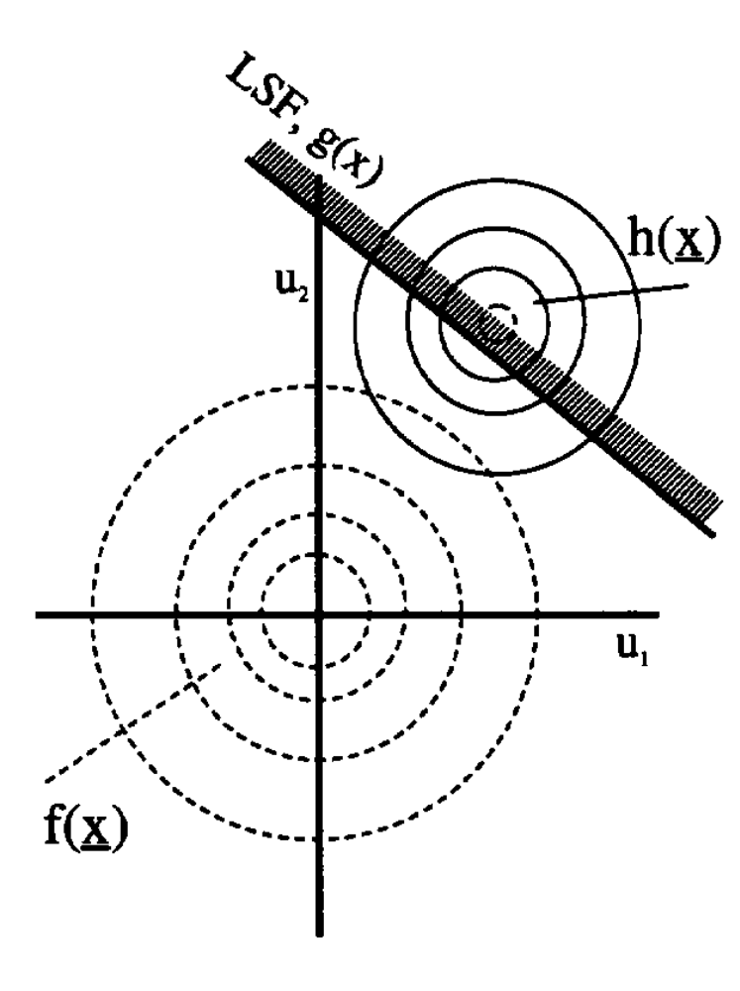
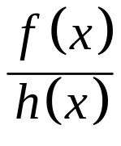
Possible solution: importance sampling
Failure sample “scores”:
x₂
Instead of 1 !!!!!!
Z(x)=0
x₁

Slide 24
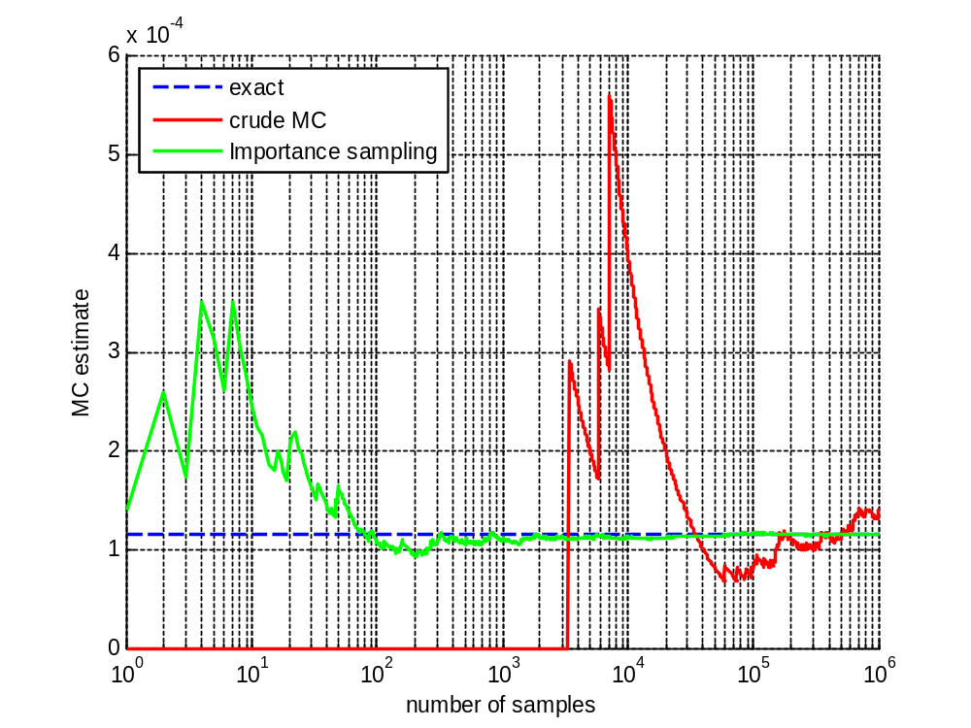
Speed of convergence, example dune erosion

Slide 25
Monte Carlo with importance sampling
Potentially much faster than Crude Monte Carlo
Proper choice of h(x) is crucial
Therefore: Proper system knowledge is crucial

Slide 26
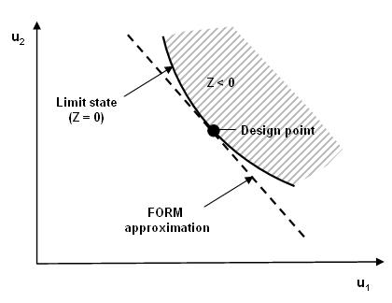
FORM
Design point: most likely combination leading to failure

Slide 27
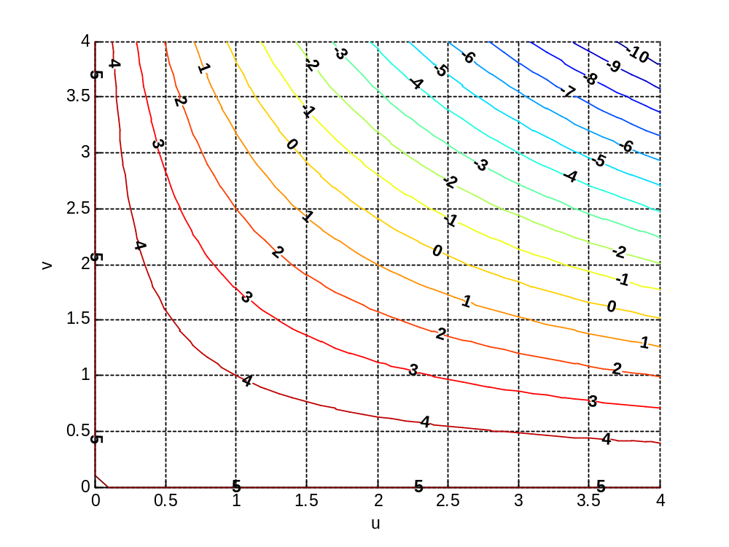
Design point for standard normal variables
Z=0 & shortest distance to origin

Slide 28
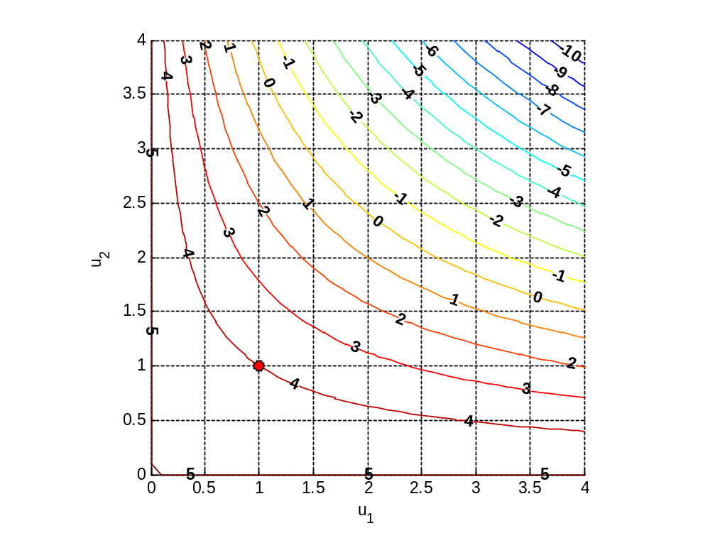
Start iterative procedure

Slide 29
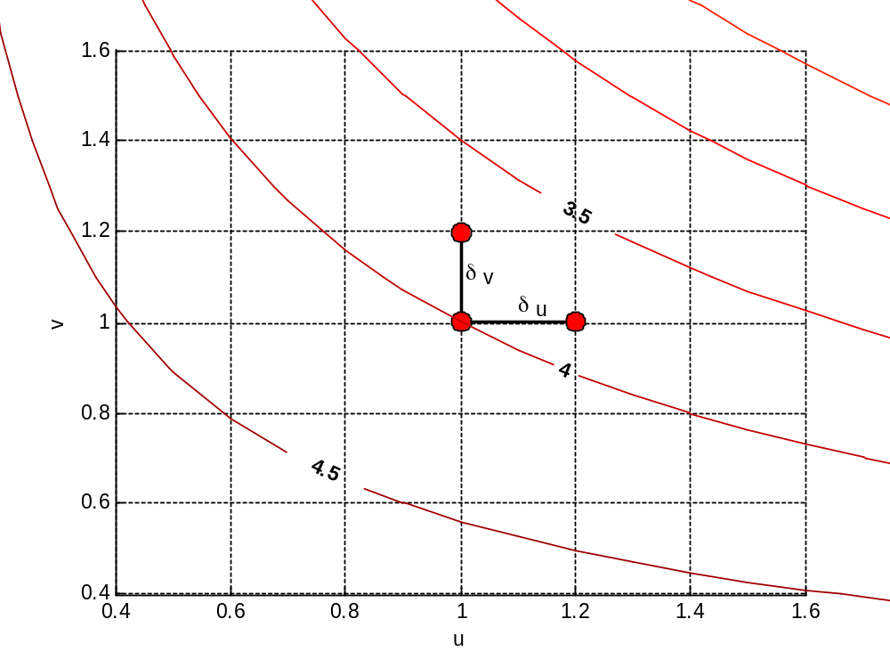
Linearisation based on derivatives

Slide 30
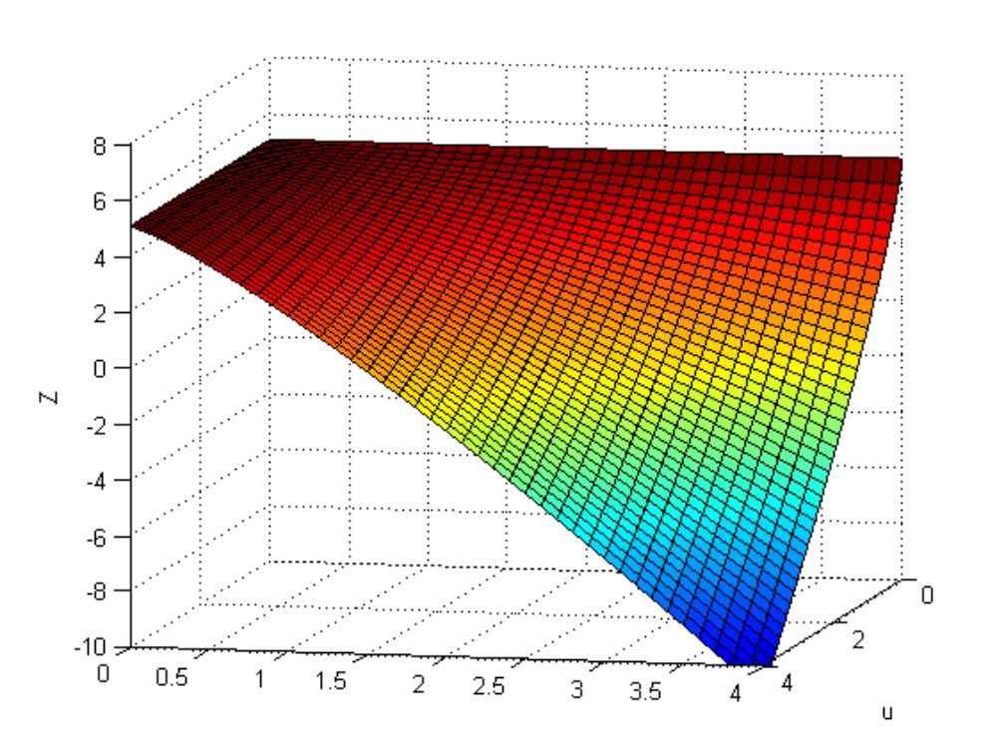
3D view: Z-function

Slide 31
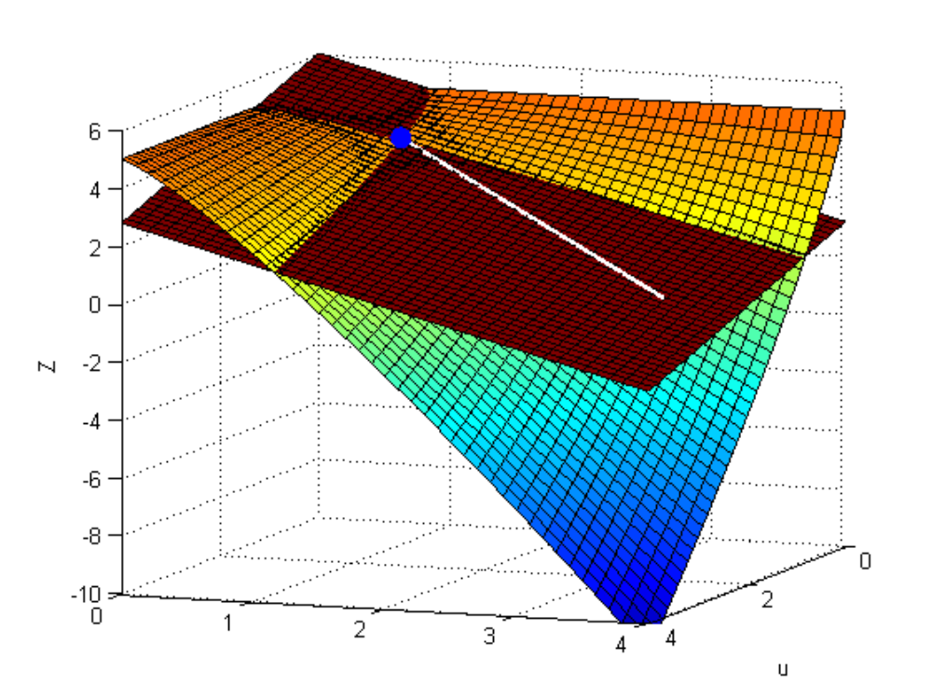
3D view: linearisation of Z-function

Slide 32
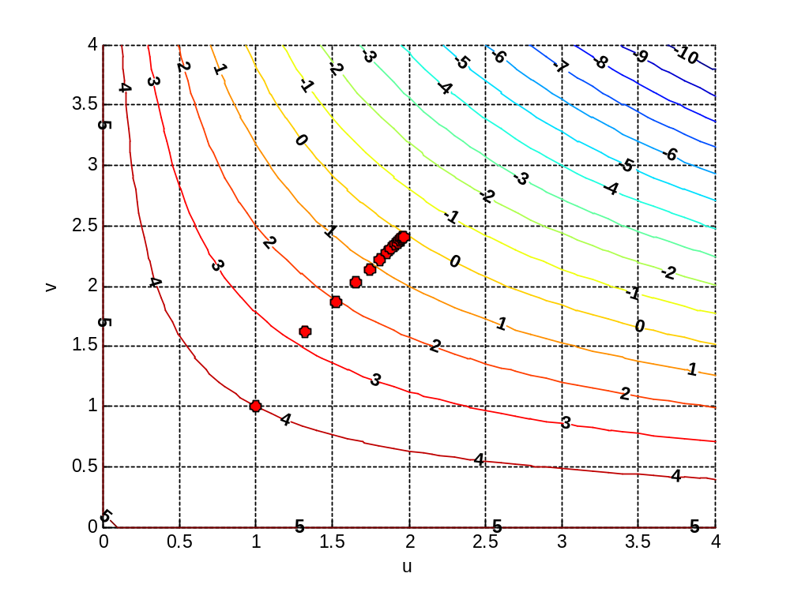
All iteration steps

Slide 33
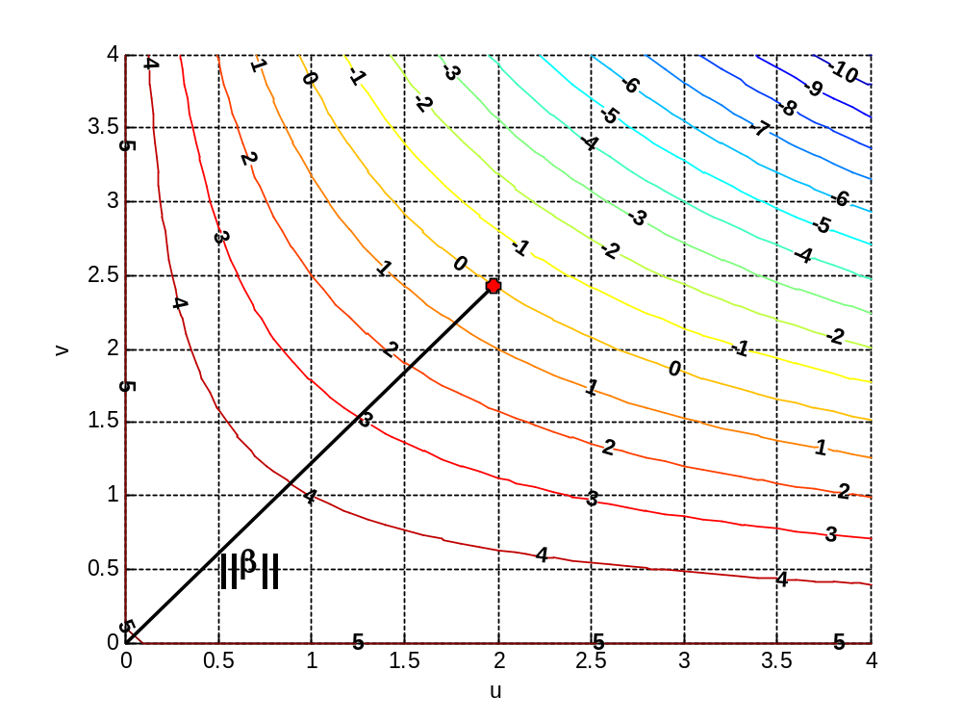
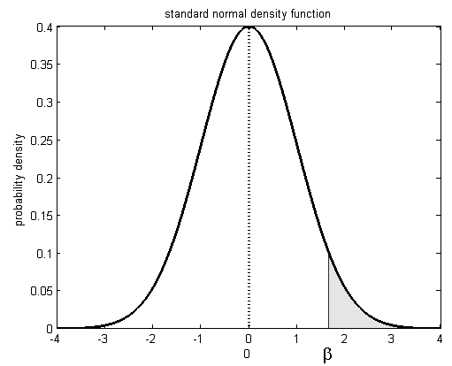
β-value of design point in standard normal space
P_{fail}

Slide 34
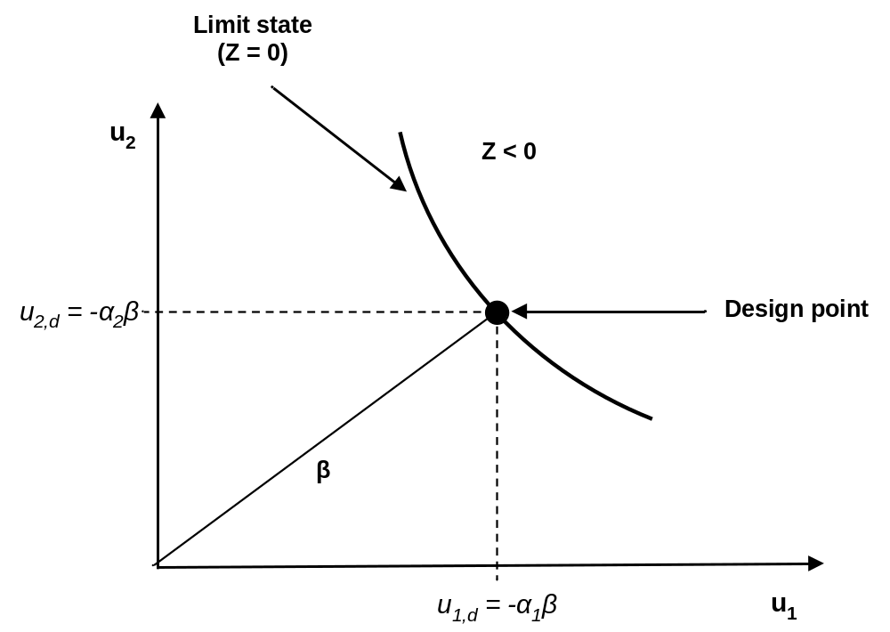
α-values in design point

Slide 35
FORM
Very fast method
Risk: iteration method does not converge, or converges to the wrong design point

Slide 36
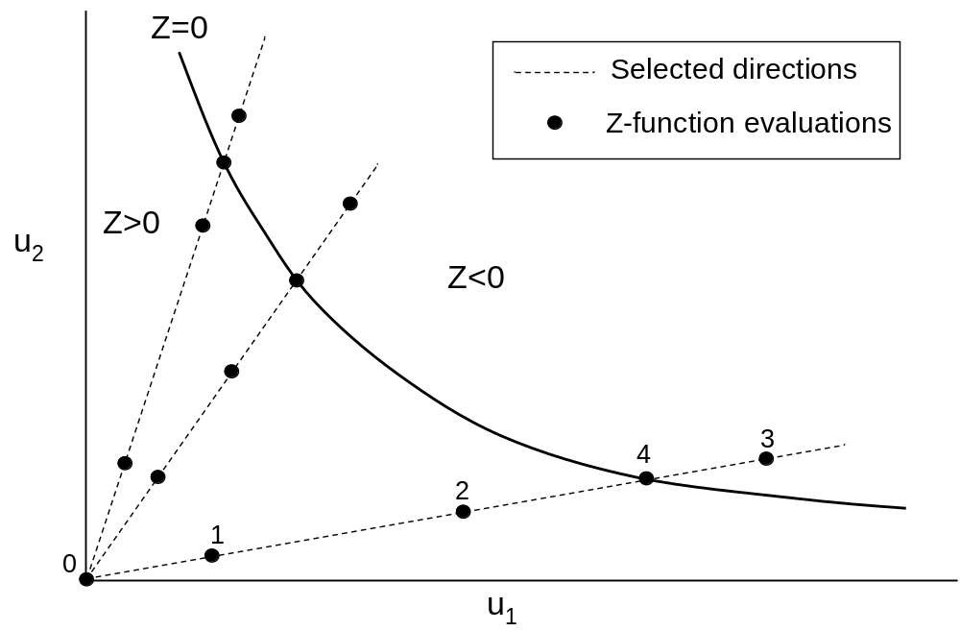
Directional sampling

Slide 37
Search along 1 direction
z
0
1
2
4
3

Slide 38
Resume
Crude Monte Carlo (MC)
Monte Carlo with importance sampling (MC-IS)
First Order Reliability Method (FORM)
Directional Sampling (DS)

Slide 39
Towards the exercises

Slide 40
Generic problem statement
x₂
f(x)
Z(x)=0
x₁

Slide 41
Generic problem statement
Probability functions, f(x): P -> X
Z-function: X -> Z

