Slide 1
Automated WFLOW-RIBASIM build
Procedure to setup combined WFLOW-RIBASIM schematizations.
02/11/2014
By: Daniel Tollenaar

Slide 2
Current version uses 5 steps (to be further automated in 1 step)
Define your river network, using Sobek for the moment
Create WaterDistricts (for the moment only Sub-Catchment ‘types’), and all WFLOW static maps
‘Improve network’: adding all demands per water district
Convert the Sobek network to a Ribasim network (network.ntw to confill.ntw)
Fill Ribasim binary data files with parameters

Slide 3
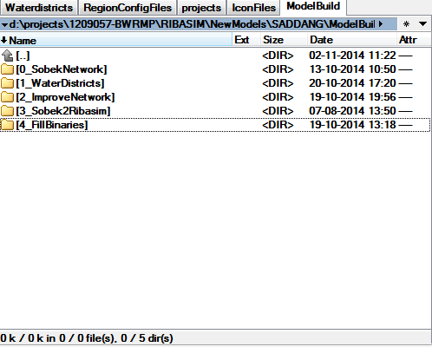
Current version uses 5 steps (to be further automated in 1 step)
How I organize my models atm:

Slide 4
0 Collecting river network
Using custom node types (all “connection node types”), so: between all structures there is 1 unique reach-vector*
Two types discriminated, vectors for which a water district will be generated, and vectors for which its catchment will be merged by the downstream one**
Currently it can handle reservoirs, weirs (‘diversions’) and Runoff-Rivers (power plants without storage)***
* If we use a GIS-snapping function, we can do the whole procedure without using SOBEK (the Netter of Sobek)
** All reaches are burned in the DEM for ldd-generation. I would suggest to add a third type for being able to add irrigation schemes and such (which should not be burned and not be split up in more water districts)
*** Would be nice to add location-specific demand (large irrigation schemes, cities, etc.) with their intakes and outlets in the network

Slide 5
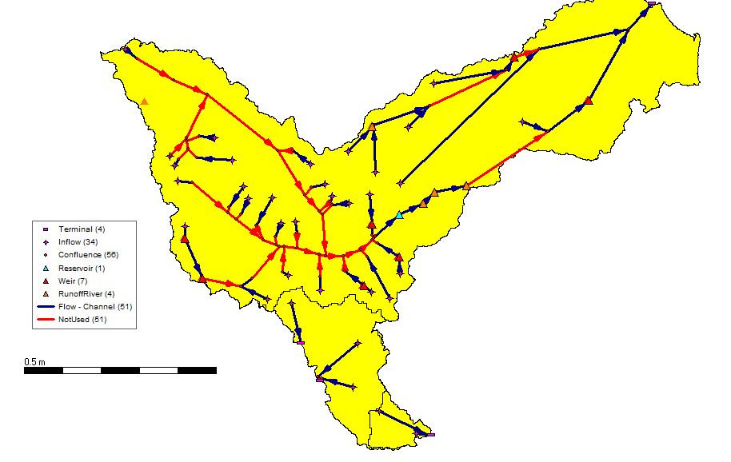
0 Collecting river network – Toba Asahan example

Slide 6
1 Creating water districts
Water district is basically a sub-catchment; it is derived from the LDD. For all catchments, not having a river defined, water districts are defined using the ‘clump’ method in PCRaster
WFLOW static maps are generated at the same time
LDD procedure is quite advanced: (1) it burns from upstream to downstream deriving strahler order from the river-shapefile, (2) it burns confluences a bit extra, (3) it burns outflows even deeper, (4) it can merge multiple catchments into 1 LDD (one unique outflow per catchment polygon)****
**** There is still an issue with about 5-10% of the catchments; if a tributary cell is adjacent to a main-river cell just upstream the confluence, the LDD can turn to the main-river 1 cell upstream of the actual confluence. RIBASIM solution would be to regenerate the river from the LDD (in OSM2HYDRO?) , but this is not a proper approach if you would like to connect Sobek 2 WFLOW using the same method (which could work essentially the same).

Slide 7
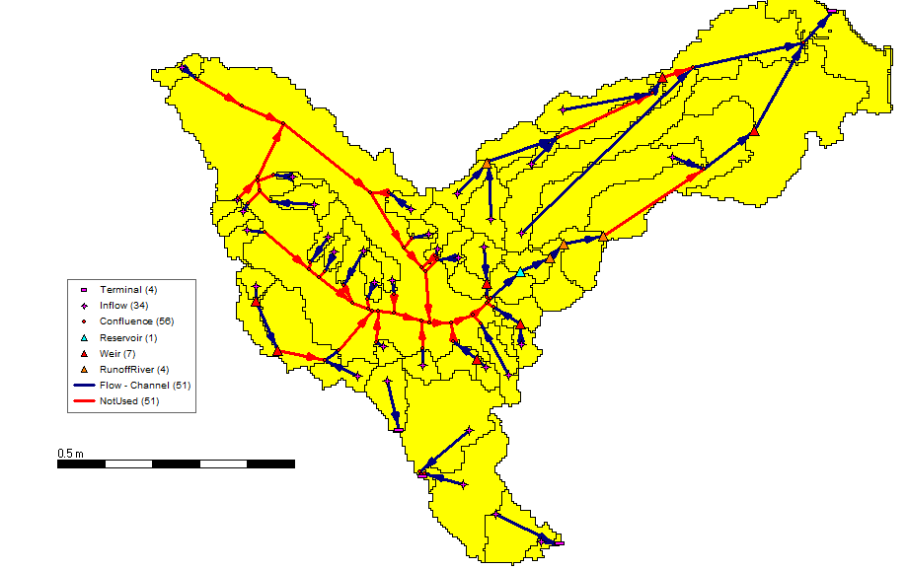
1 Creating water districts – Toba Asahan Example

Slide 8
2 Improved network
For every vector with a water district a ‘Variable Inflow’ node is added to add supply to the network
For every vector with a water district, demand nodes are added. This is ‘lumped’ demand. For example; all ‘rural’ population in a water district, or the sum of all small irrigation plots.
The river network is automatically extended based on demand specified in attributes of the water district shape-file. Only if a lumped demand is 0, no node is added *****
A ‘dummy’ network is generated for all water districts which do not have a river (see previous slide, first bullet)
***** We should automatically connect demand data (rasters, shapes, etc) to the water district shape-file.

Slide 9
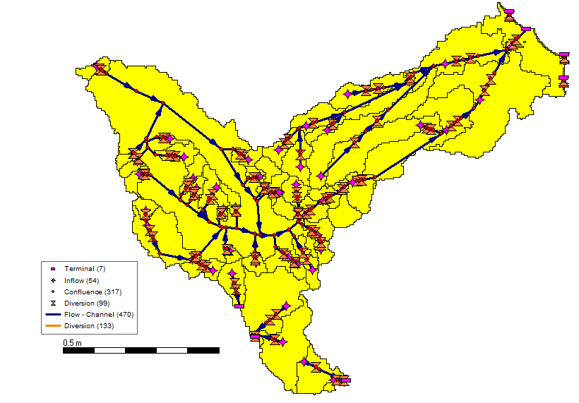
2 Improved network – Toba Asahan example

Slide 10
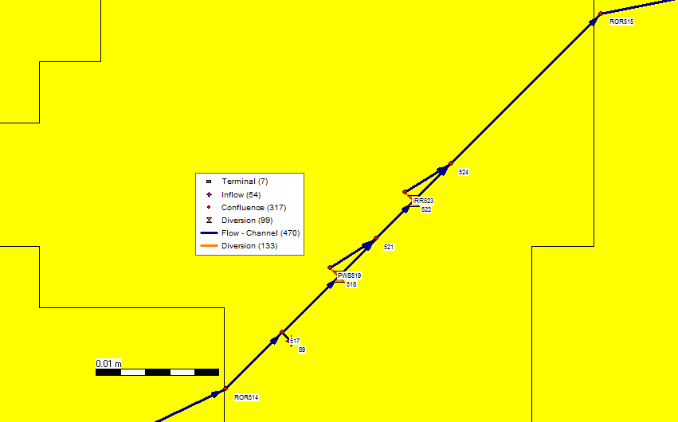
2 Improved network – Toba Asahan example

Slide 11
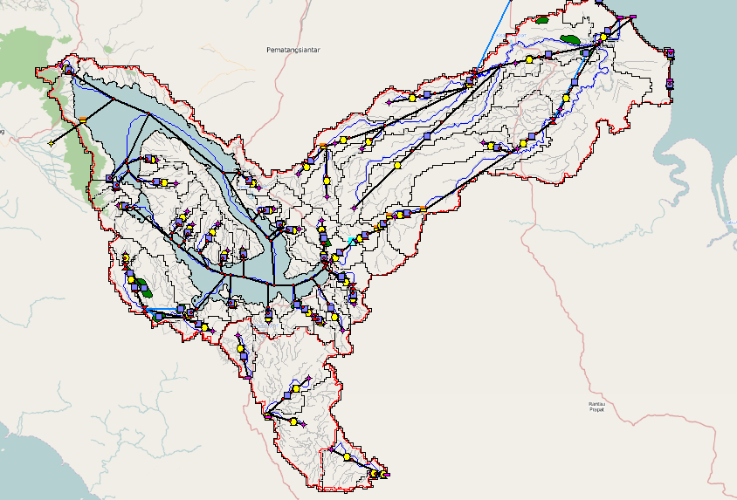
3 Sobek 2 Ribasim
A script converts the network.ntw (sobek) to a confill.ntw (ribasm), using node types and ID pre-scripts used in step 2

Slide 12
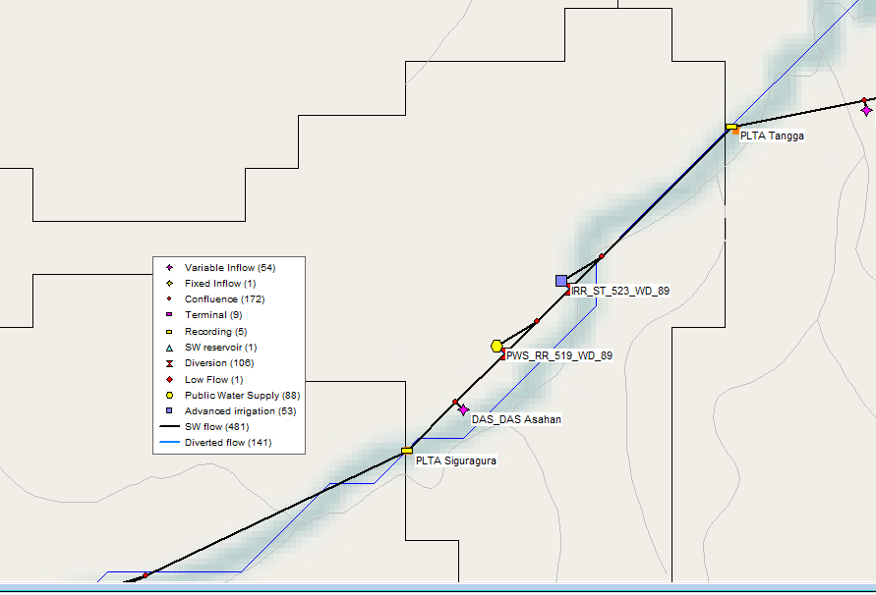
3 Sobek 2 Ribasim

Slide 13
4 filling binaries
All Ribasim-parameters are stored in binary files (.bin). Data for variable inflows (supply) and ‘lumped’ demand can largely be found in the water district shape-file. This can automatically be converted ******
****** So far only the binary code from the variable inflow and PWS bin-files have been ‘hacked’. For the Variable inflow, a script is ready. The PWS version should be finished by tomorrow. Much better would be active support from RIBASIM development (!!!) by sharing the (right!) binary structure.

Slide 14
WFLOW-RIBASIM so far
4 schematizations have been setup following this method in the BWRMP project (currently time spend to setup one schematization is 2h with proper data)
FEWS is used to run WFLOW and provide boundary conditions for RIBASIM. WFLOW is part of the FEWS, RIBASIM not.

Slide 15
WFLOW-RIBASIM so far
Some RIBASIM issues have emerged:
RIBASIM is a bit ‘buggy’ in some places. It seems the different programs (netter, model editor and model) do not really work together that well
RIBASIM is clearly not build to setup models fast (therefore we use SOBEK)
This approach easily generates large (more complex) schematizations. RIBASIM itself needs a bit of an upgrade to handle a sufficient amount of nodes.

