Slide 1


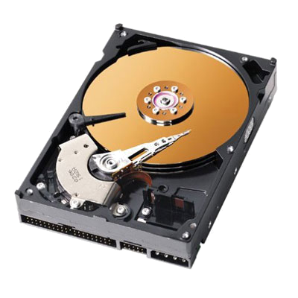
model design
Test-driven development
acceptance test
model code
SKILLBED
integration tests
modules
unit test
functions

