Slide 1
Data analyses

Slide 2
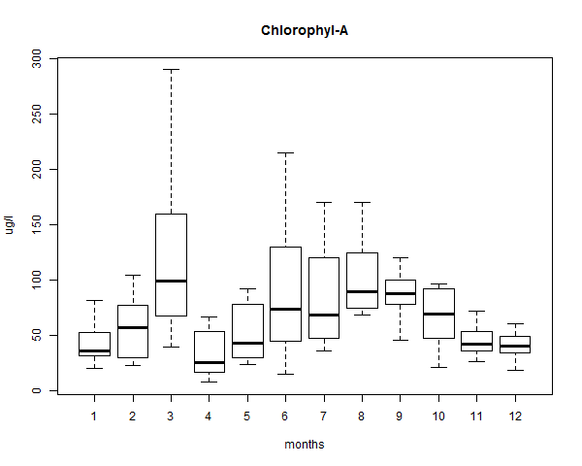
Den Oever Chlorofyl-A Months

Slide 3
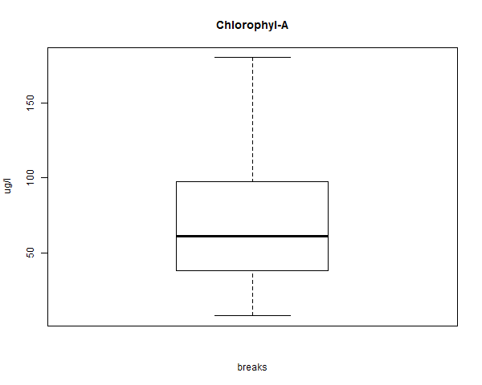
Den Oever Chlorofyl-A Predefined breaks

Slide 4
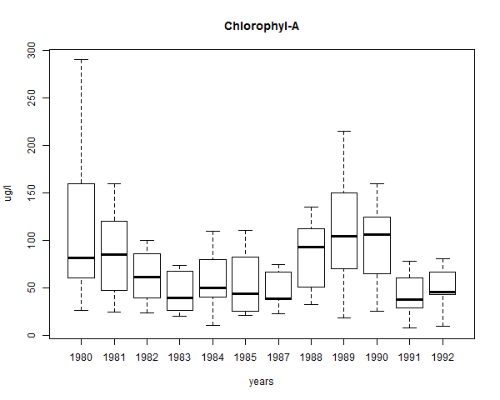
Den Oever Chlorofyl-A Years

Slide 5
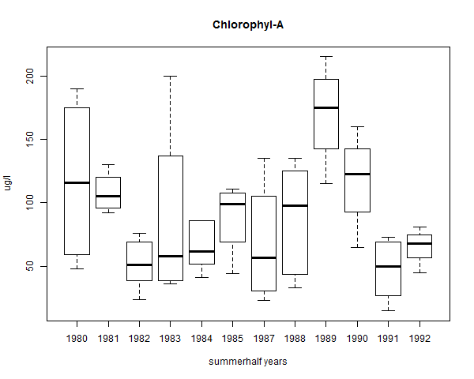
Den Oever Chlorofyl-A Summer halfyears

Slide 6
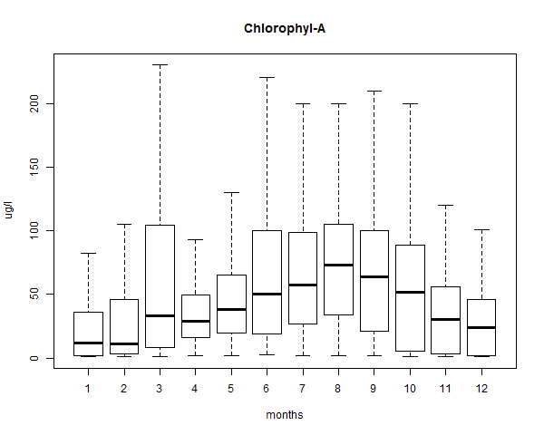
Overall locations Chlorofyl-A Months

Slide 7
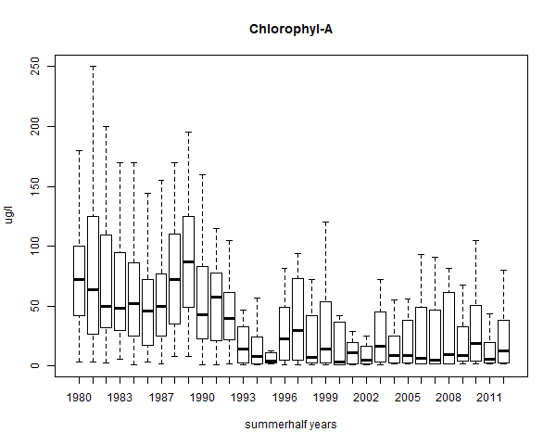
Overall locations Chlorofyl-A Summer halfyears

Slide 8
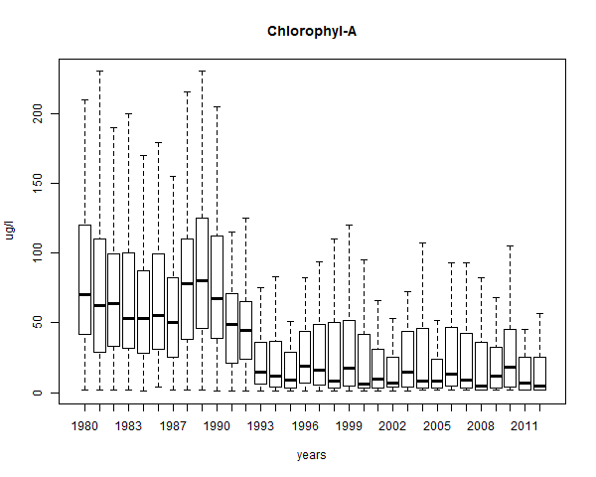
Overall locations Chlorofyl-A Years

Slide 9
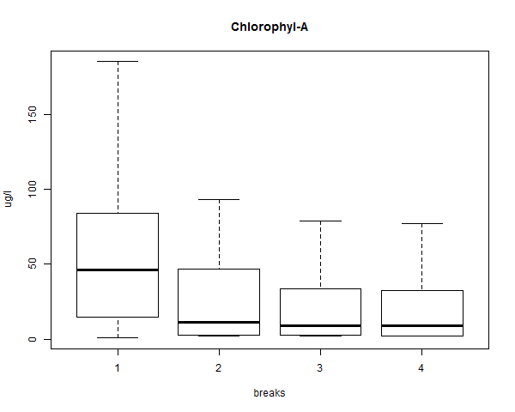
Overall locations Chlorofyl-A Predefined Breaks

Slide 10
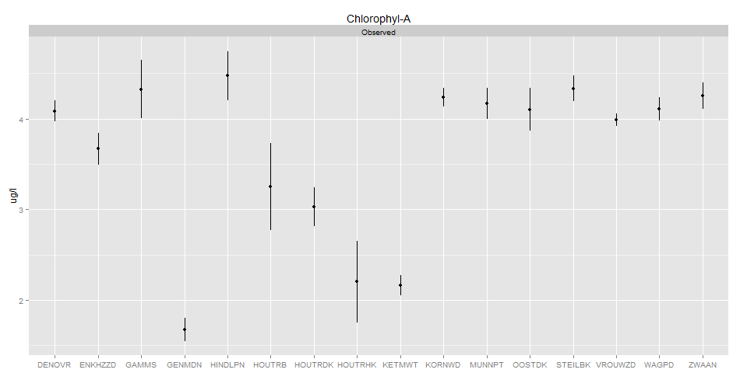
Overall locations Chlorofyl-A Multiple comparison

Slide 11
Overall locations Chlorofyl-A Multiple comparison
platform_id | platform_name | lon | lat | wgs_84 | epsg | x | y | z | x.upper | x.mean | x.lower
houtrhk | Houtribhoek | 5.472736 | 52.56048 | 4326 | 7415 | 160800 | 508100 | -1 | 2.649997 | 2.200578 | 1.75116
zwaan | De Zwaan | 5.833146 | 52.5647 | 4326 | 7415 | 185237 | 508659 | -1 | 4.39734 | 4.252089 | 4.106838
houtrdk | Houtribdijk | 5.486766 | 52.60895 | 4326 | 7415 | 161744 | 513495 | -1 | 3.243933 | 3.027503 | 2.811072
ketmwt | Ketelmeer west | 5.647043 | 52.61055 | 4326 | 7415 | 172600 | 513700 | -1 | 2.270789 | 2.158849 | 2.046908
houtrb | Houtrib | 5.524557 | 52.62693 | 4326 | 7415 | 164300 | 515500 | -1 | 3.73446 | 3.25394 | 2.773421
genmdn | Genemuiden | 6.038564 | 52.62972 | 4326 | 7415 | 199100 | 516000 | -1 | 1.802048 | 1.674929 | 1.547811
enkhzzd | Enkhuizerzand | 5.416226 | 52.69283 | 4326 | 7415 | 156962 | 522824 | -1 | 3.842293 | 3.667904 | 3.493516
oostdk | Oosterdijk | 5.267284 | 52.75066 | 4326 | 7415 | 146903 | 529265 | -1 | 4.338727 | 4.103918 | 3.86911
wagpd | Wagenpad | 5.198878 | 52.80481 | 4326 | 7415 | 142300 | 535300 | -1 | 4.235041 | 4.108663 | 3.982284
vrouwzd | Vrouwezand | 5.393138 | 52.81034 | 4326 | 7415 | 155400 | 535900 | -1 | 4.060315 | 3.992405 | 3.924495
steilbk | Steile bank | 5.629536 | 52.8281 | 4326 | 7415 | 171333 | 537903 | -1 | 4.475603 | 4.333607 | 4.191612
gamms | Gammels | 5.152524 | 52.87662 | 4326 | 7415 | 139200 | 543300 | -1 | 4.646302 | 4.324696 | 4.00309
munnpt | Munnikplaat | 5.228753 | 52.90892 | 4326 | 7415 | 144340 | 546881 | -1 | 4.343888 | 4.170688 | 3.997489
denovr | Den Oever | 5.103875 | 52.93456 | 4326 | 7415 | 135950 | 549760 | -1 | 4.201262 | 4.085212 | 3.969163
hindlpn | Hindeloopen | 5.345528 | 52.9703 | 4326 | 7415 | 152200 | 553700 | -1 | 4.744481 | 4.475294 | 4.206107
kornwd | Kornwerd | 5.346209 | 53.03832 | 4326 | 7415 | 152250 | 561270 | -1 | 4.339876 | 4.238701 | 4.137526

Slide 12
Model analyses
(limitation to -5 years > silumation < +5 year)

Slide 13
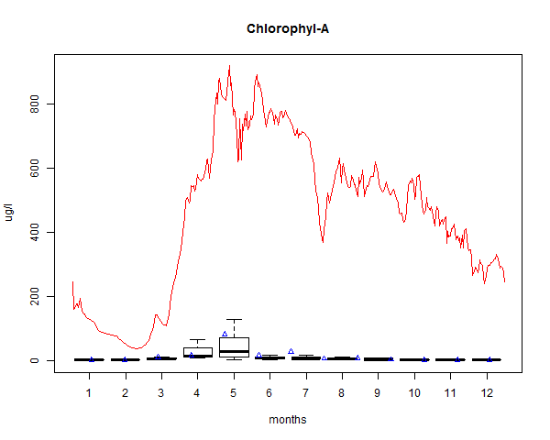
Genemuiden Chlorofyl-A Model plotted + observed of specific year boxplotted

Slide 14
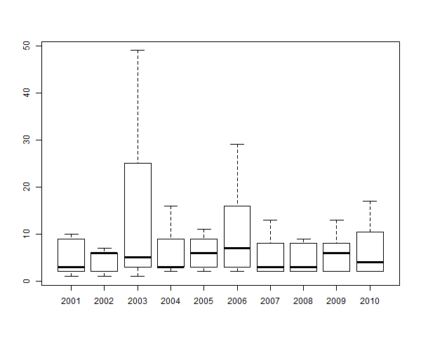
Genemuiden Chlorofyl-A Model plotted + boxplotted over years

Slide 15
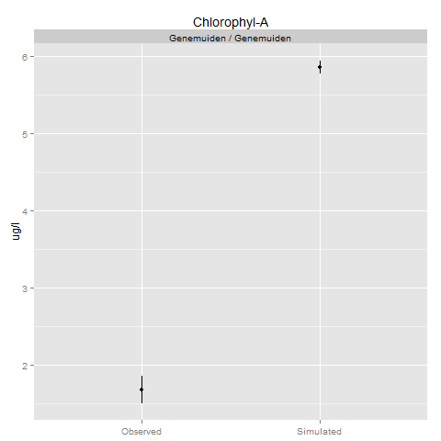
Genemuiden Chlorofyl-A Multiple comparison over +5 >sim< -5

Slide 16
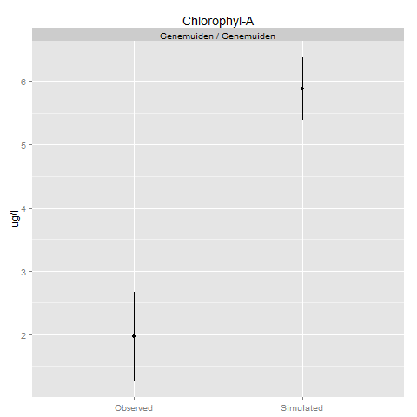
Genemuiden Chlorofyl-A Multiple comparison over year

Slide 17
Genemuiden Chlorofyl-A ANOVA over year
Df Sum Sq Mean Sq F value Pr(>F)
categorie 1 99.51 99.51 98.27 5.83e-10 ***
Residuals 24 24.30 1.01
---
Signif. codes: 0 ‘***’ 0.001 ‘**’ 0.01 ‘*’ 0.05 ‘.’ 0.1 ‘ ’ 1

Slide 18
Genemuiden Chlorofyl-A ANOVA over year
Df Sum Sq Mean Sq F value Pr(>F)
categorie 1 99.51 99.51 98.27 5.83e-10 ***
Residuals 24 24.30 1.01
---
Signif. codes: 0 ‘***’ 0.001 ‘**’ 0.01 ‘*’ 0.05 ‘.’ 0.1 ‘ ’ 1

Slide 19
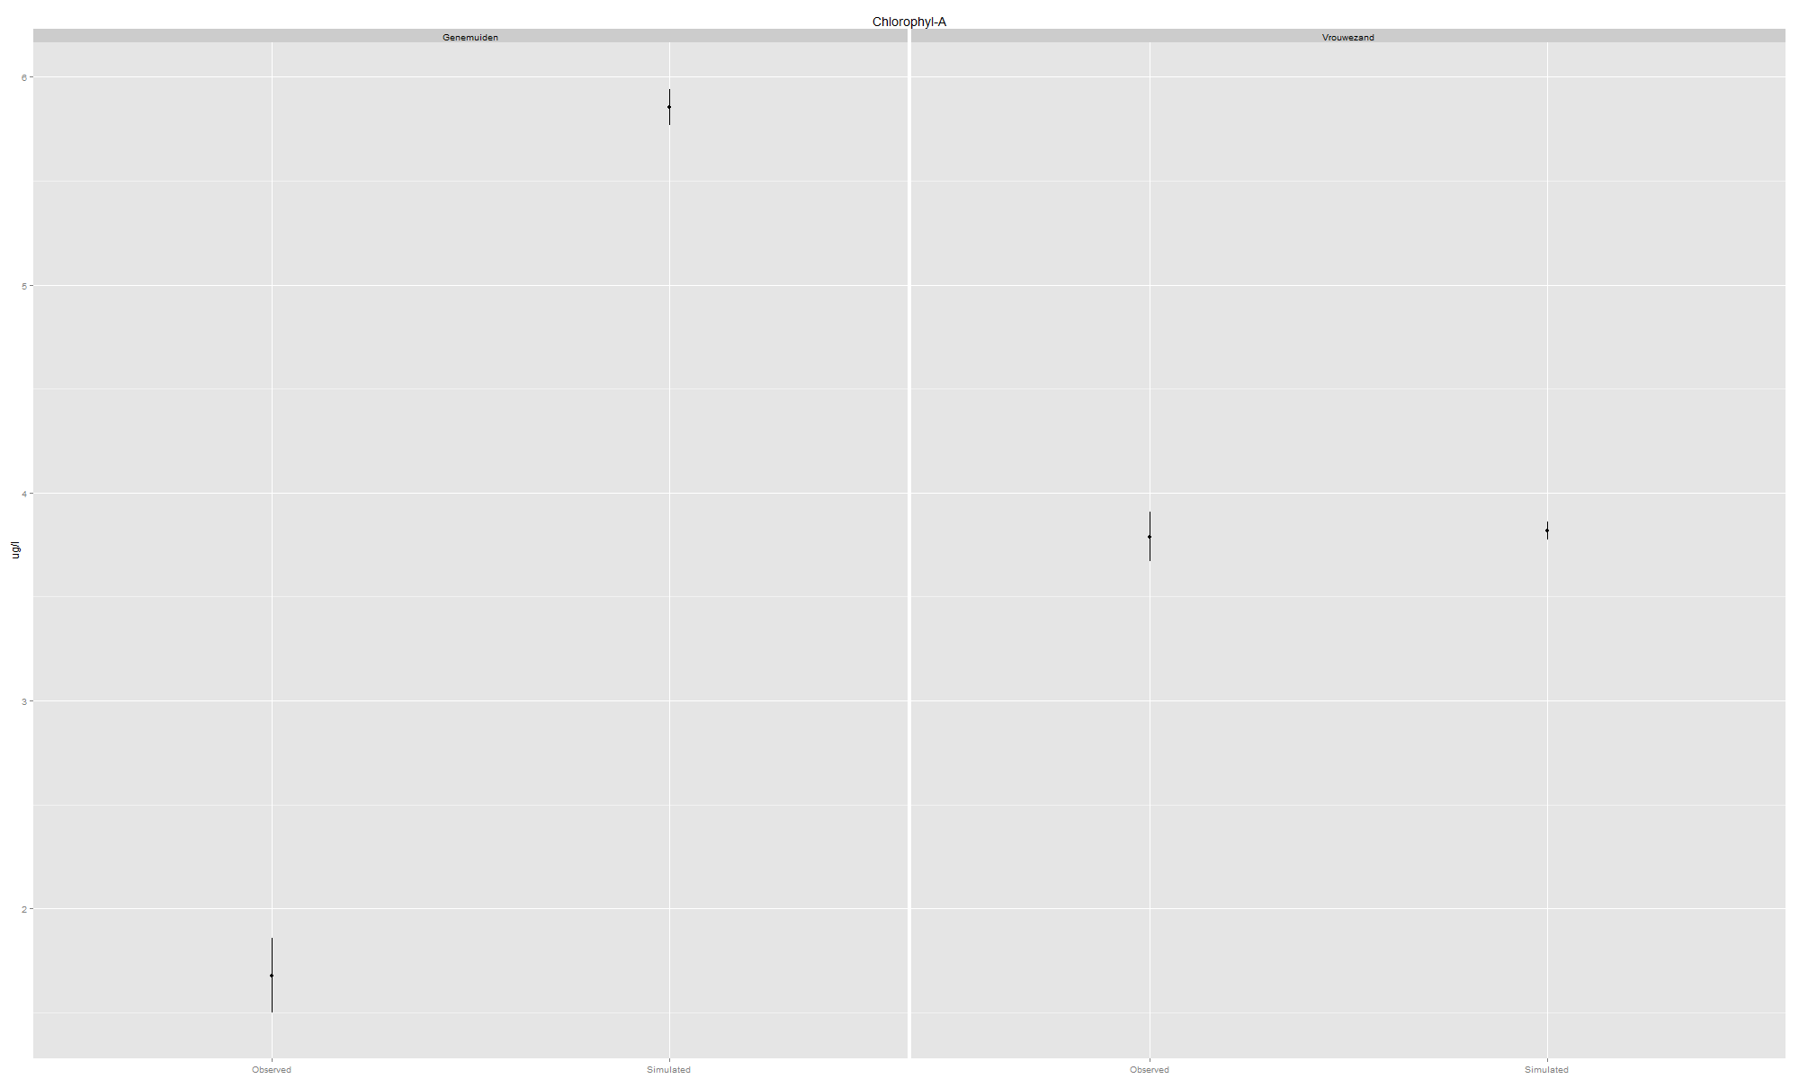
Overall locations Chlorofyl-A Multiple comparison over -5 > sim < +5

Slide 20
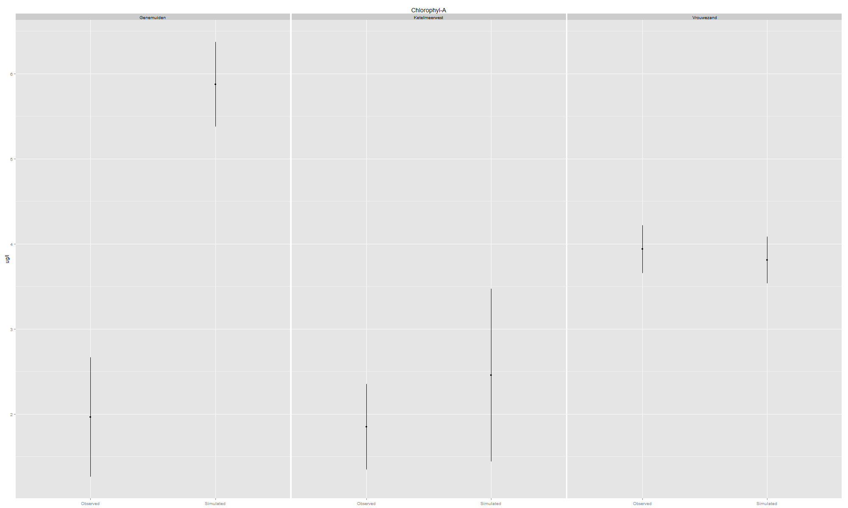
Overall locations Chlorofyl-A Multiple comparison over year

Slide 21
Overall locations Chlorofyl-A Simulated and observed confidence 5%
sim
variable | x.upper | x.mean | x.lower
Genemuiden | 605.9046 | 450.5792 | 295.2537
Ketelmeerwest | 53.28565 | 27.97343 | 2.661218
Vrouwezand | 60.28696 | 48.92803 | 37.5691
obs
variable | x.upper | x.mean | x.lower
Genemuiden | 14.13106 | 10.65891 | 7.18677
Vrouwezand | 58.52976 | 53.3806 | 48.23144

Slide 22
Overall locations Chlorofyl-A ANOVA Sim and OBS
OBS
Df Sum Sq Mean Sq F value Pr(>F)
categorie 2 35.84 17.919 23.8 2.59e-07 ***
Residuals 36 27.10 0.753
---
Signif. codes: 0 ‘***’ 0.001 ‘**’ 0.01 ‘*’ 0.05 ‘.’ 0.1 ‘ ’ 1
Sim
Df Sum Sq Mean Sq F value Pr(>F)
categorie 1 292.4 292.45 384.8 <2e-16 ***
Residuals 261 198.3 0.76
---
Signif. codes: 0 ‘***’ 0.001 ‘**’ 0.01 ‘*’ 0.05 ‘.’ 0.1 ‘ ’ 1

Slide 23
Validation analyses
(limitation to -5 years > silumation < +5 year)

Slide 24
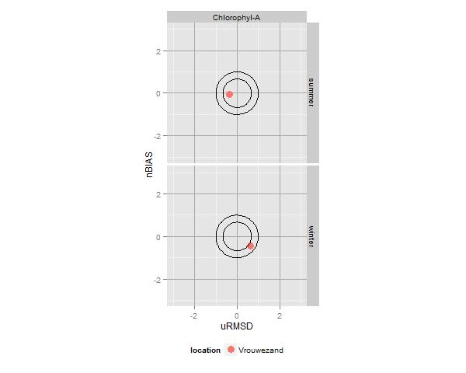
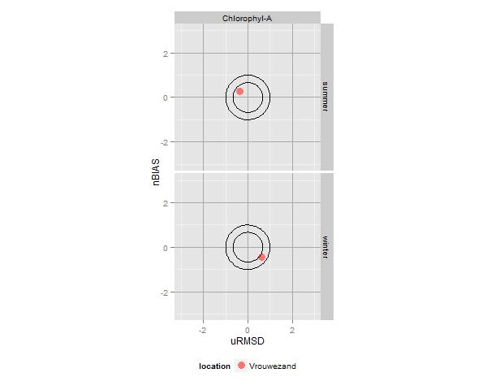
Vrouwezand Chlorofyl-A Target diagram version 1 best fit and mean

Slide 25
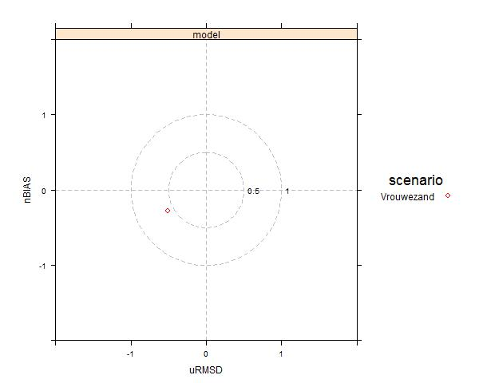
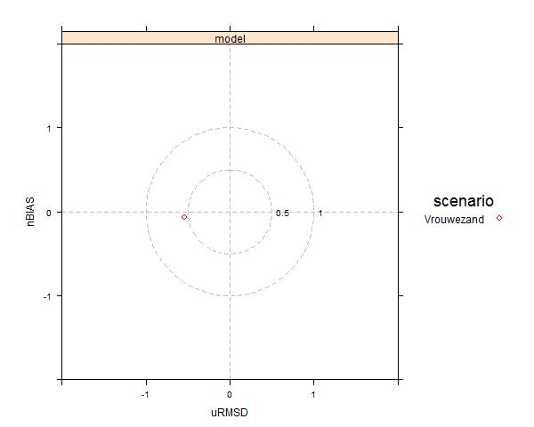
Vrouwezand Chlorofyl-A Target diagram version 2 best fit and mean

Slide 26
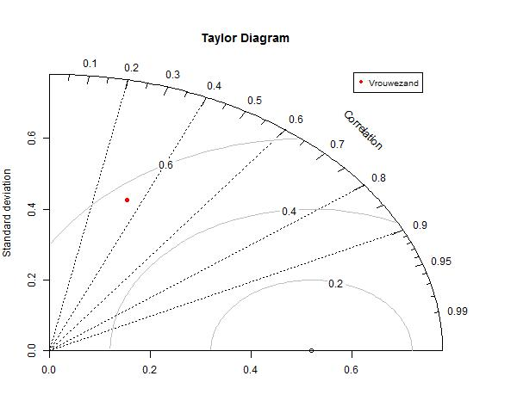
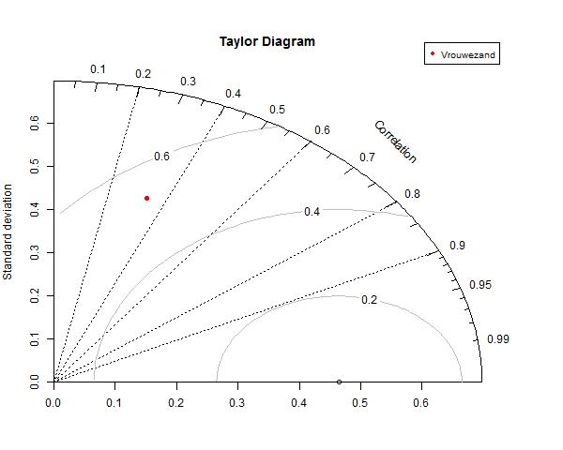
Vrouwezand Chlorofyl-A Taylor diagram best fit and mean

Slide 27
Vrouwezand Chlorofyl-a Statisctics
NashSutcliff
CostFunction
PercentageModelBias
Rsquared
Skew Observationdata
Skew SimulationData
CorrelationCoefficient
 | Obs | 2006
NS | * | -0.31921
Model_bias | * | -722.582
Costfunction | * | 0.960394
Skew | 0.162961 | 0.01469
R_squared | * | -0.00983

Slide 28
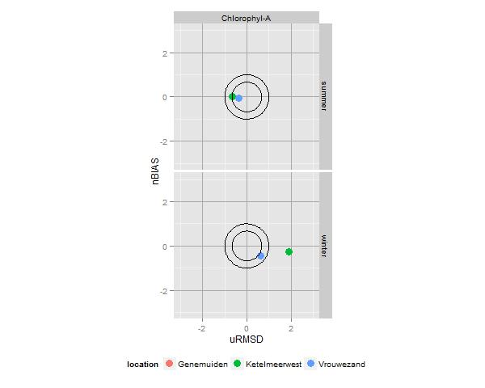
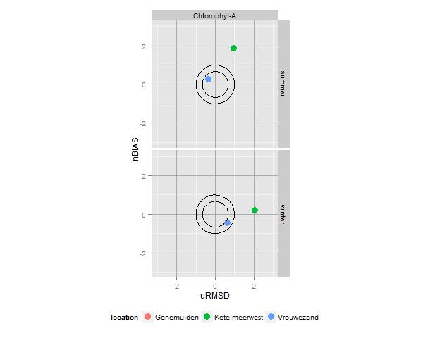
Overall locations Chlorofyl-A Target diagram version 1 best fit and mean

Slide 29
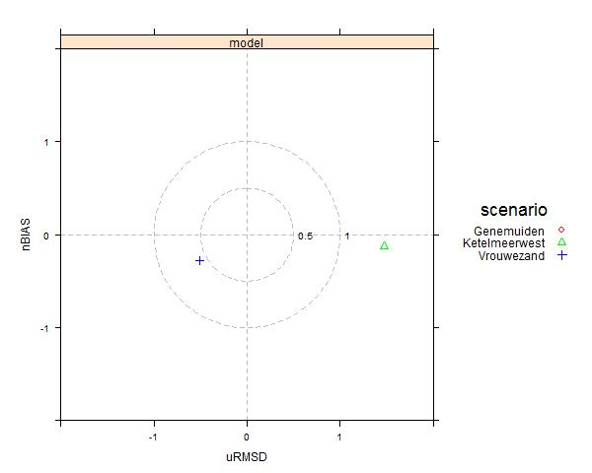
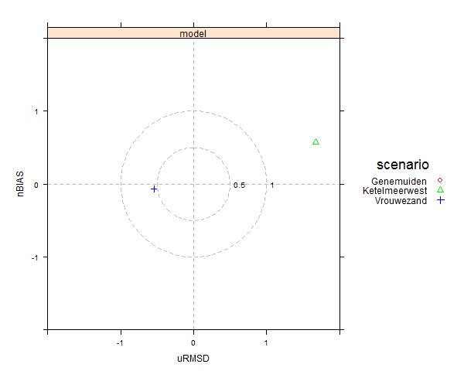
Overall locations Chlorofyl-A Target diagram version 2 best fit and mean

Slide 30
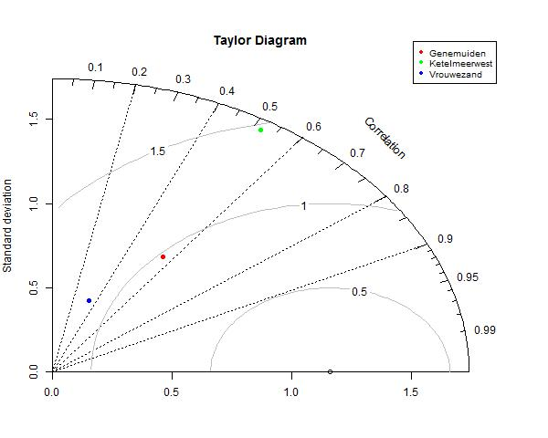
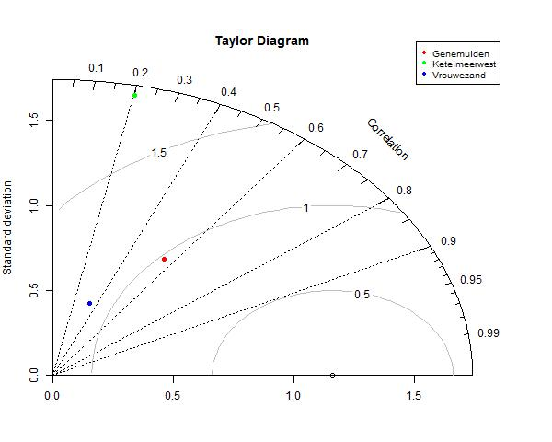
Overall locations Chlorofyl-A Taylor diagram best fit and mean

Slide 31
Overall locations Chlorofyl-a Statisctics
NashSutcliff
CostFunction
PercentageModelBias
Rsquared
Skew Observationdata
Skew SimulationData
CorrelationCoefficient
 | Obs | 2006
NS | * | -105.342
Model_bias | * | 14949.35
Costfunction | * | 5.676552
Skew | 1.055651 | 1.483726
R_squared | * | -0.02459

Slide 32
Wish list
Shell for selecting required functionallities
Output is R-script that only needs to be runned
No programming skills required
Make import of other observed data possible
CSV
TXT
Map file visualiseren

