Slide 1
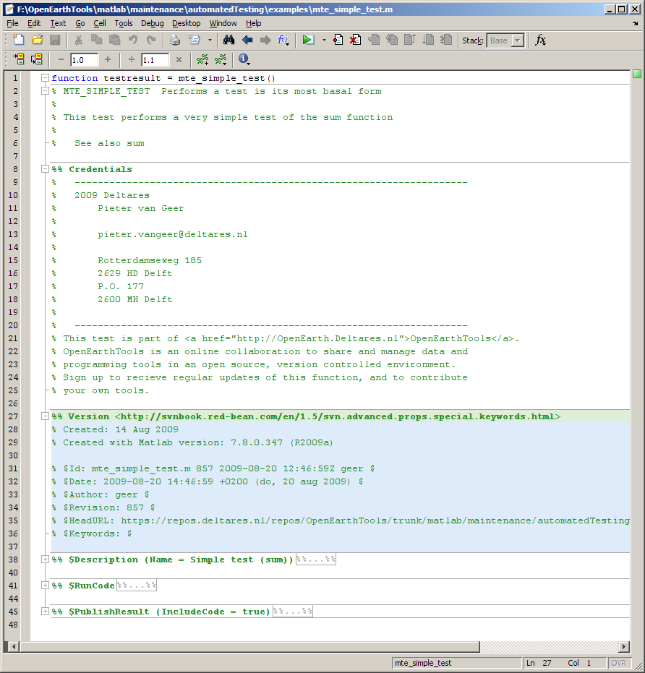
Function help
Function call:
No input
Boolean as first output
Copyright information
SVN keywords

Slide 2
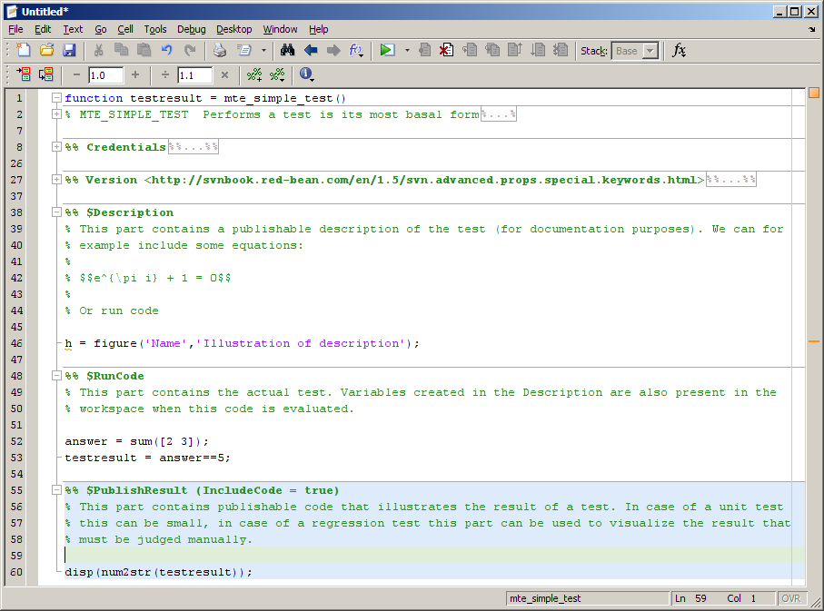
Description ($Description)
Actual test code ($RunCode)
Visualization of result ($PublishResult)

Slide 3
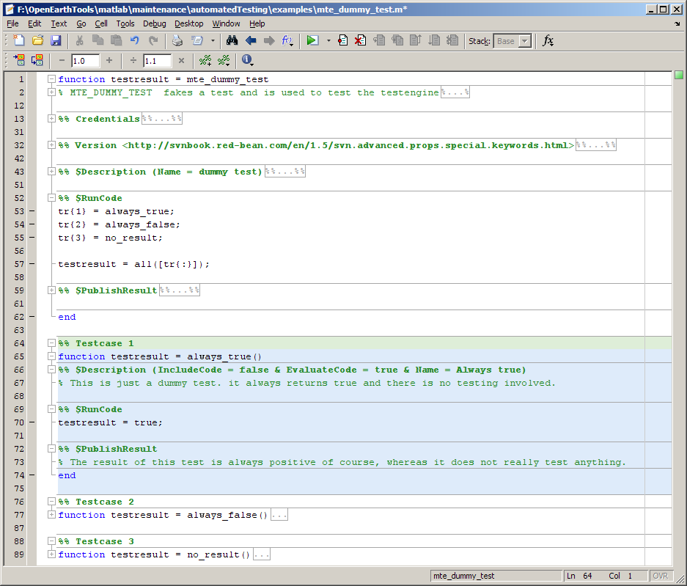
Test $RunCode including call to testcase
Function call of the testcase:
First output argument must be a boolean (logical)
Input arguments allowed
Testcase with similar layout as the main parts of the test

