Slide 1
MATLAB, netCDF, and OPeNDAP
John Evans
john.evans@mathworks.com

Slide 2
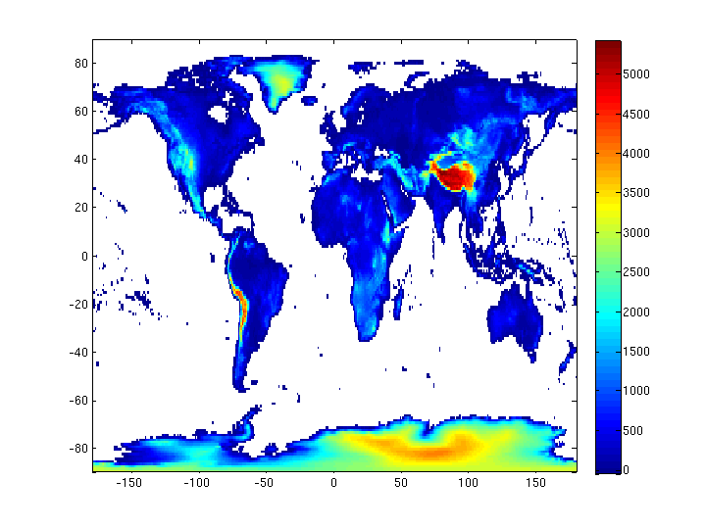
New In R2012a: NetCDF Library version 4.1.3 and OPeNDAP
>> url = ['http://eosdap.hdfgroup.uiuc.edu:8080/opendap/data/NASAFILES' …
'/hdf4/AIRS.2008.10.27.L3.RetStd001.v5.2.2.0.G08303124144.hdf'];
>> ncdisp(url, 'TopographyU274');
>> help ncread;
>> data = ncread(url,'TopographyU274’);');
>> lon = ncread(url,'LongitudeU272');
>> lat = ncread(url,‘LatitudeU271');
>> data(data==0) = NaN;
>> pcolor(lon,lat,data’);
>> shading flat; colorbar

Slide 3
Informal Interface (high level)
High level interfaces aimed at convenience, basic command line work.
ncdisp - Display contents of NetCDF file in command window.
ncread - Read data from a variable in a NetCDF file.
ncreadatt - Read an attribute value from a NetCDF file.
ncwrite - Write data to a NetCDF file.
ncwriteatt - Write an attribute to a NetCDF file.
ncinfo - Return information about a NetCDF file.
nccreate - Create a variable in a NetCDF file.
ncwriteschema - Add NetCDF schema definitions to a NetCDF file.

Slide 4
Formal Interface (low-level)
Low-level follow the library API, aimed at developers.
>> help netcdf
>> help netcdf.open
High level interface built on top of low-level interface.
Low level interface sits on top of netCDF library.

Slide 5
OPeNDAP with either interface
NetCDF library compiled with OPeNDAP support
Any customer code using either netCDF interface is now OPeNDAP-enabled by default.
>> ncid = netcdf.open(url);
>> [numdims, numvars] = netcdf.inq(ncid);
>> info = ncinfo(url)

Slide 6
OPeNDAP in earlier versions of MATLAB…
Possible to do with Unidata’s netcdf-java. Illustrates how to integrate MATLAB with 3rd party jar files.
>> javaaddpath('netcdfAll-4.2.jar');
>> import ucar.nc2.dods.*
>> jncid = NetcdfFile.open(url);
Possibly soon in Debian? Otherwise get from Unidata or go get SNCTOOLS from http://mexcdf.sourceforge.net.
Other OPeNDAP implementations, i.e. “LOADDAP”

Slide 7
NetCDF Support
✓netCDF-3 and netCDF-4 classic model
✓ netCDF-4 groups, unsigned integer datatypes
can read some HDF5 files
>> h5create(‘myfile.h5’,’/mydataset’,[100 200]);
>> h5disp(‘myfile.h5’);
>> ncdisp(‘myfile.h5’);

Slide 8
NetCDF Support (h5disp output)
HDF5 myfile.h5
Group '/'
Dataset 'myDataset1'
Size: 100x200
MaxSize: 100x200
Datatype: H5T_IEEE_F64LE (double)
ChunkSize: []
Filters: none
FillValue: 0.000000

Slide 9
NetCDF Support (ncdisp output)
Source:
myfile.h5
Format:
netcdf4
Dimensions:
phony_dim_0 = 200
phony_dim_1 = 100
Variables:
myDataset1
Size: 100x200
Dimensions: phony_dim_1,phony_dim_0
Datatype: double

Slide 10
NPP Access Example via HDF5 High Level
>> h5file = [‘VISTO_npp_d20100906_t2105098_’, …
‘e2106344_b00012_c20110707163027621025_noaa_ops.h5’]
>> rdataset = ‘/Data_Products/VIIRS-IST-EDR/VIIRS-IST-EDR_Gran_0’
>> h5disp(h5file,rdataset);
HDF5 VISTO_npp_d20100906_t2105098_e2106344_ … noaa_ops.h5
Dataset 'VIIRS-IST-EDR_Gran_0'
Size: 5
MaxSize: Inf
Datatype: H5T_REFERENCE
ChunkSize: 5
Filters: none
FillValue: H5T_REFERENCE
Attributes:
'Ascending/Descending_Indicator': 0
'Beginning_Date': '20100906'
'Beginning_Time': '210509.899480Z'
'East_Bounding_Coordinate': -97.946198
.
.
.

Slide 11
NPP Access Example (continued)
>> dreferenced_data = h5read(h5file,rdataset);
dereferenced_data =
[2457600x1 uint16]
[2457600x1 uint8 ]
[2457600x1 uint8 ]
[2457600x1 uint8 ]
[ 2x1 single]

Slide 12
References
http://www.mathworks.com
http://www.unidata.ucar.edu/software/netcdf-java
http://www.opendap.org
http://mexcdf.sourceforge.net (SNCTOOLS)
http://www.hdfgroup.org/ftp/HDF5/examples/examples-by-api/api18-m.html (low level HDF5 API examples)

