Slide 1
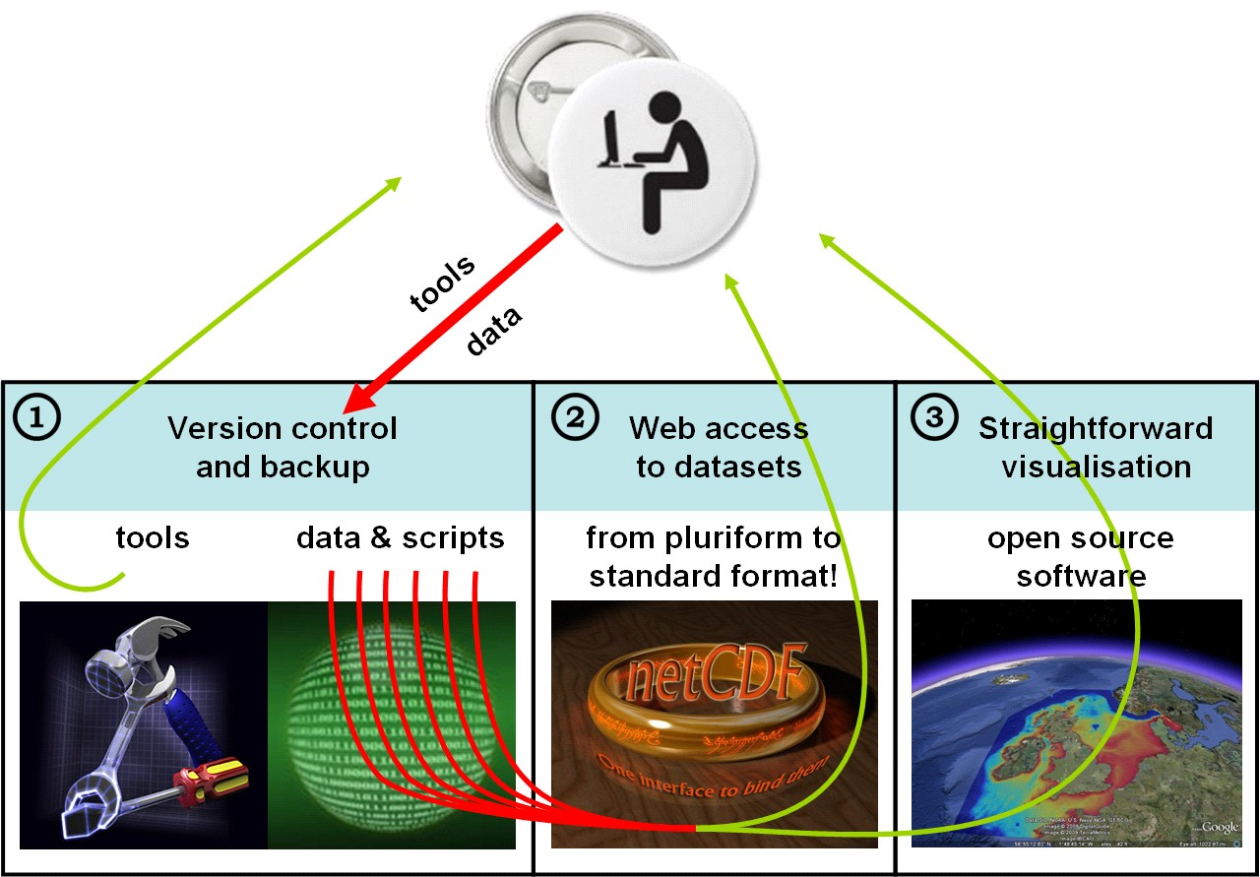
www.OpenEarth.eu workflow

Slide 2
SubVersion
SubVersion

Slide 3
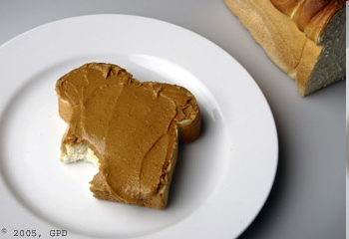

Version control
date x
batch no. x
ingredients x
calories x
℮ gram x
Quality control:
“Something
adheres to
some criteria”
Without a properly defined
something there is no basis
whatsoever for quality control.
Subversion provides for this
and is a necessary
(but not sufficient)
requirements for achieving
quality
date √
batch no. √
ingredients √
calories √
℮ gram √

Slide 4

SubVersion
SubVersion is a web-based system for version control
It allows a worldwide community of people to collaborate online
You can think of a SubVersion repository as
  an ftp drive with a memory
  sharepoint environment for any file format (not just *.doc, *.xls).
Everyone can add/alter/remove and retrieve data
But nothing can be added/altered/removed without being noticed
because SubVersion logs everything which
guarantees a safe way of collaborating without need for editors
This is exactly how wikipedia operates:
  no editorial board
  simply anyone can participate, but not unnoticed
  everything is logged
So SubVersion is a kind of ‘wikitoolia’ (or ‘toolipedia’ if you like)

Slide 5
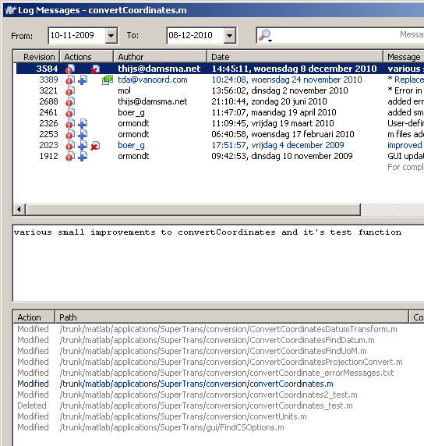
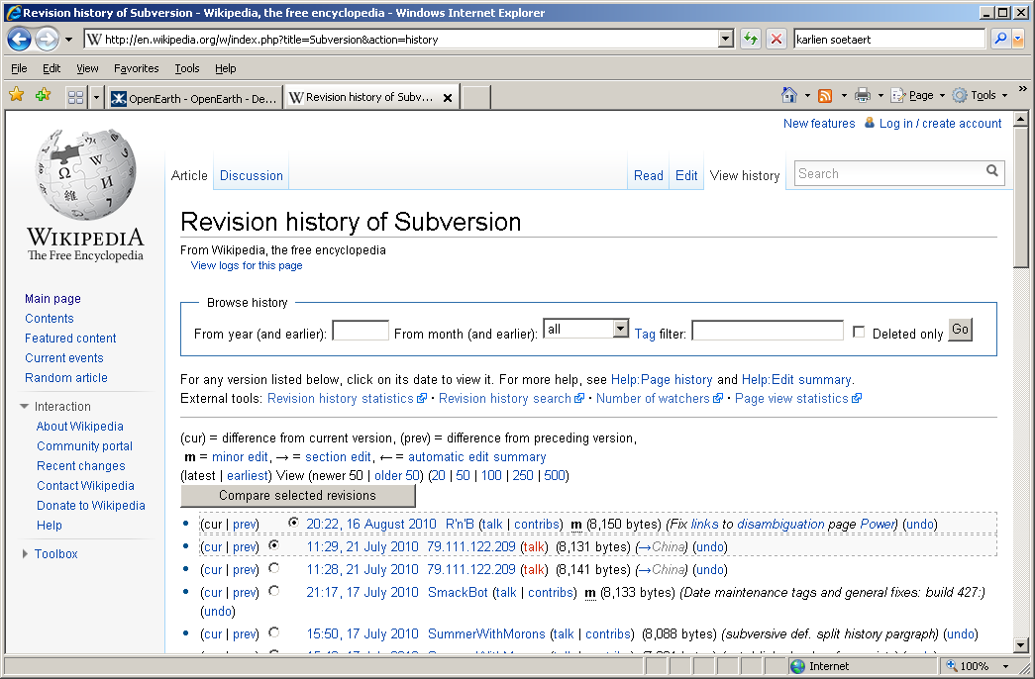
SubVersion
↓ Wikipedia keeps the history of all modifications, and so does Subversion ↓

Slide 6
SubVersion
SubVersion servers are for instance hosted by SourceForge.org
Deltares also hosts a SubVersion
OpenEarth has a free ride on the Deltares server
Everyone is invited to launch their own server for internal use
The OpenEarth server is for open tools
  proof-of-concept for internal clones by partners
  operational server for open data
SubVersion was originally meant for computer code.
Recently it is also used for model input schematisations
And OpenEarth has adopted it to host raw data + scripts as well

Slide 7
SubVersion
SubVersion is a tool to synchronize a local copy with a server copy
A SubVersion client is needed to :
  Get updates from the server to a local copy: checkout
  Put updates from a local copy onto a server: commit
The server mother-copy can be viewed with a web-browser only
  The server copy cannot directly be used
  The server copy only shows the latest version, not the history
A SubVersion client
  can get a local copy to work with
  can show the history of all modifications
Unlike Sharepoint: multiple people can work simultaneously
SubVersion makes sure that changes are merged without conflicts.

Slide 8



REPOSITORY basics
central database: repos.deltares.nl
browse
internet
checkout
update
PC
commit
add
local copy
D:\ E:\ F:\
delete
copy

Slide 9


REPOSITORY browse
central database: repos.deltares.nl
browse
checkout
update
commit
add
local copy
D:\ E:\ F:\
delete
copy

Slide 10
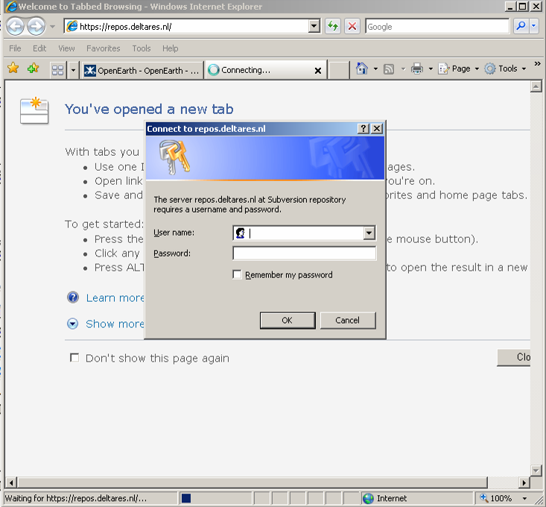
REPOSITORY browse
repos.deltares.nl

Slide 11
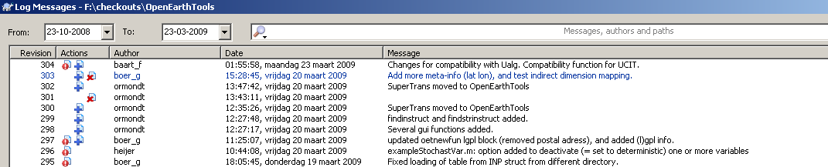
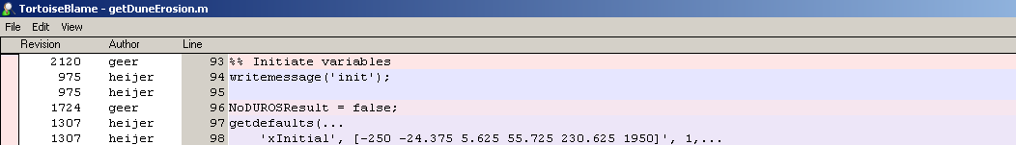
Repository username
Get username and password.
Why, OpenEarth is open, right? Yes, but closed community
For best quality all actions are logged (just like wikipedia)
Nothing can be lost, only temporarily disabled
So anyone can be allowed to join
Every file is logged …
… and every line in every file is logged.

Slide 12
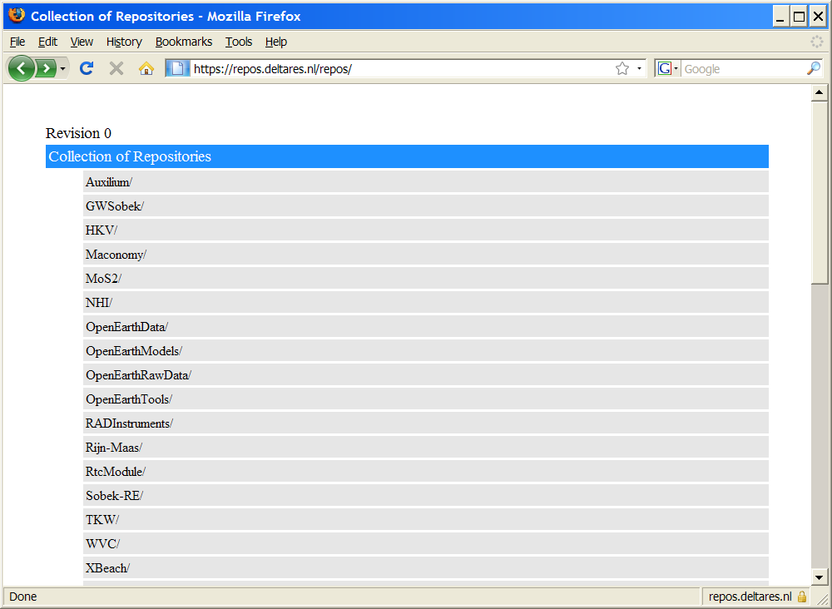
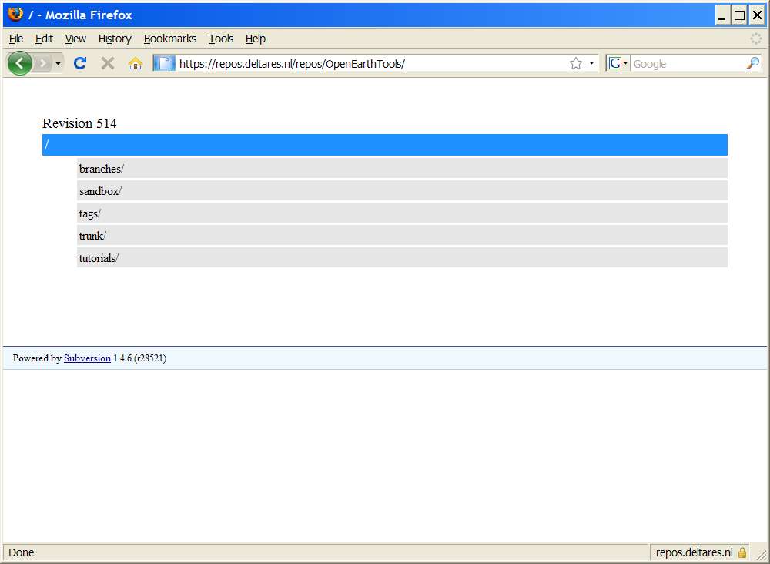
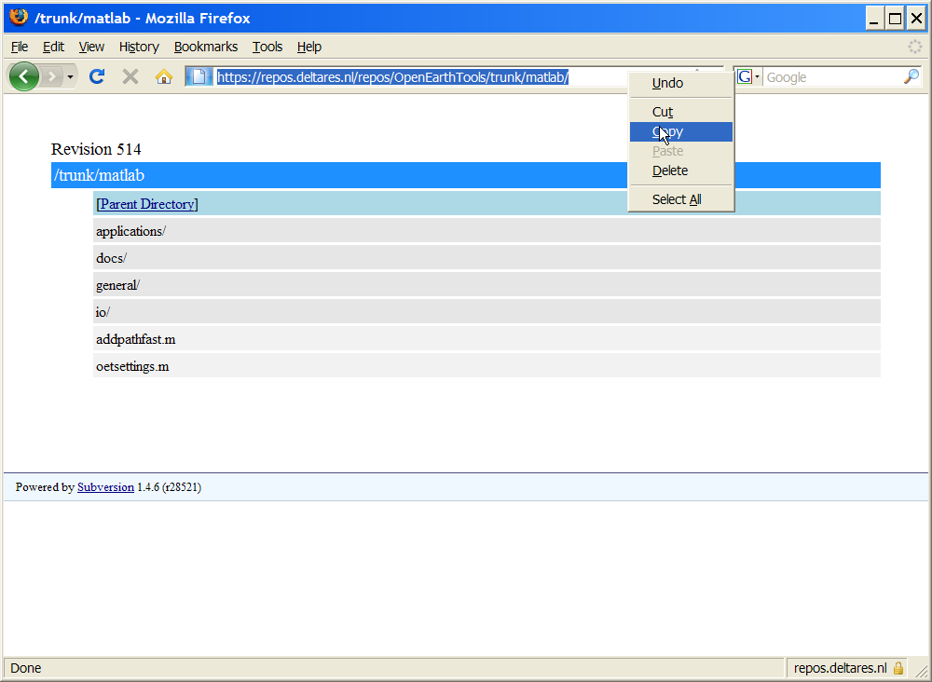
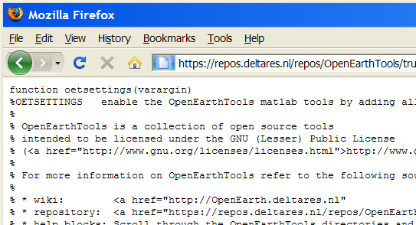
REPOSITORY browse

Slide 13

REPOSITORY checkout
Not handy to get files one by one with browser
Get them all at once with free program
Jargon:
Checkout
central database: repos.deltares.nl
browse
checkout
update
commit
add
local copy
D:\ E:\ F:\
delete
copy

Slide 14
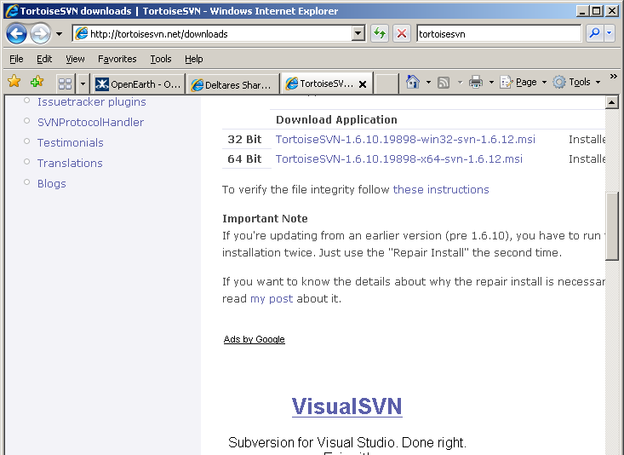
REPOSITORY checkout
Download and install Tortoise (http://tortoisesvn.net/)

Slide 15
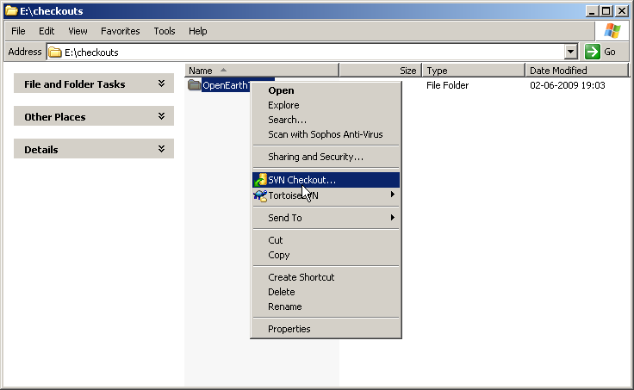
REPOSITORY checkout
Make a checkout in e.g. F:\checkouts\
No need to back this up, it’s only a copy ...
After installation of TorToiseSVN and rebooting, new icons show-up when right-mouse clicking on a directory.

Slide 16
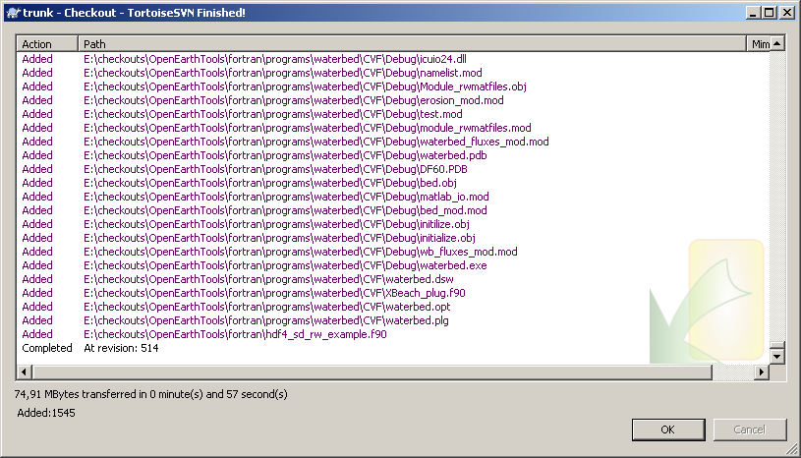
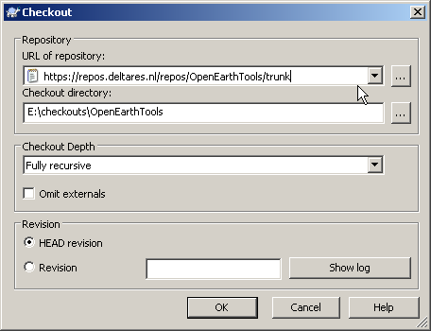
REPOSITORY checkout
Copy url from browser (case sensitive!)
Make sure that tree of
local copy mimics server

Slide 17

REPOSITORY commit
central database: repos.deltares.nl
browse
checkout
update
commit
add
local copy
D:\ E:\ F:\
delete
copy

Slide 18
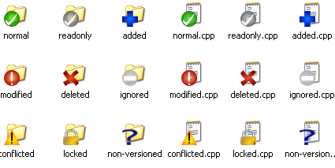
REPOSITORY commit
A commit is needed to put local changes into the central server.
This is needed if you locally did a meaningfull …
modification
deletetion
addition
move
rename
Each action is
indicated with a
unique icon in your
windows explorer
Non-meaningfull modifications (e.g. tests)
can be reverted (undo all local changes).
folders files

Slide 19
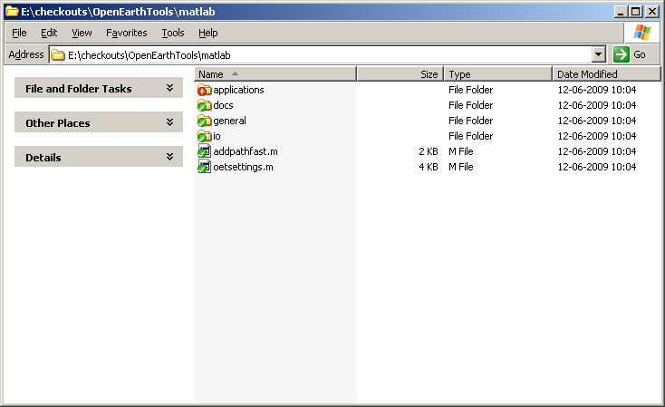
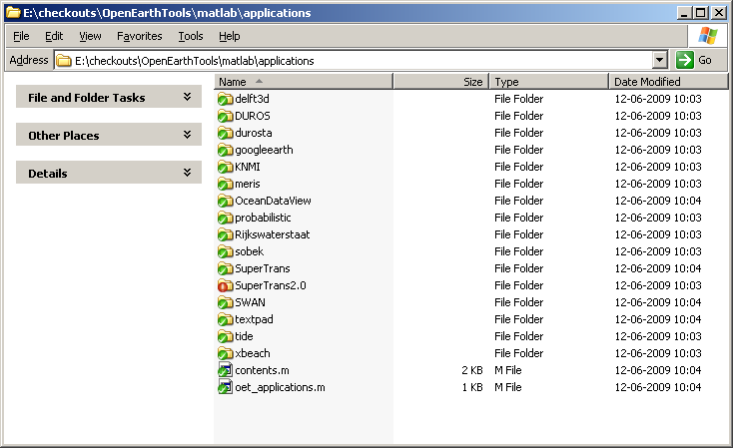
REPOSITORY commit
modified
up to date

Slide 20
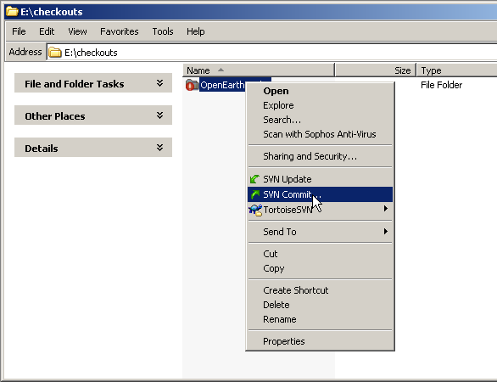
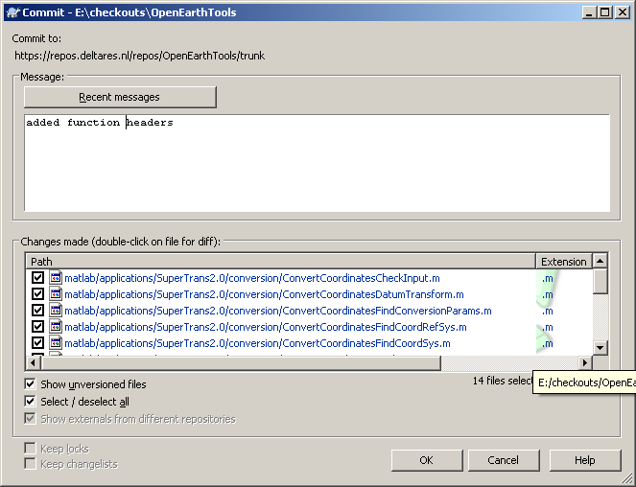
REPOSITORY commit
Always put a small remark to describe to comunity members what you modified (“did a lot” is not specific enough).

Slide 21
REPOSITORY update
central database: repos.deltares.nl
browse
checkout
update
commit
add
local copy
D:\ E:\ F:\
delete
copy

Slide 22
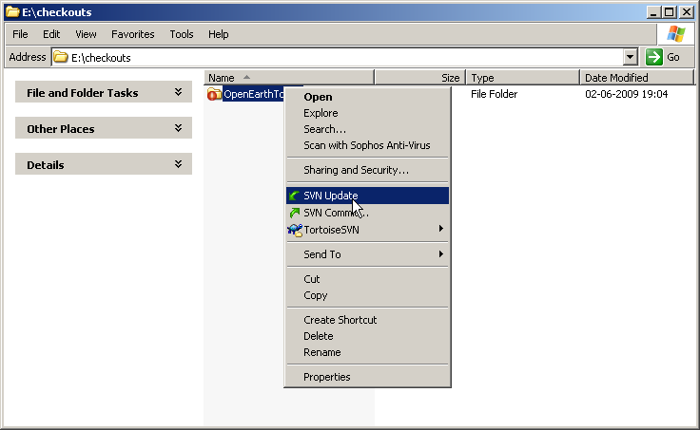
REPOSITORY update
Get updates from others from the server to your local copy.
Do this regular to benefit from improvements.
For active OpenEarthTools use: daily!
Always do this before a commit.

Slide 23
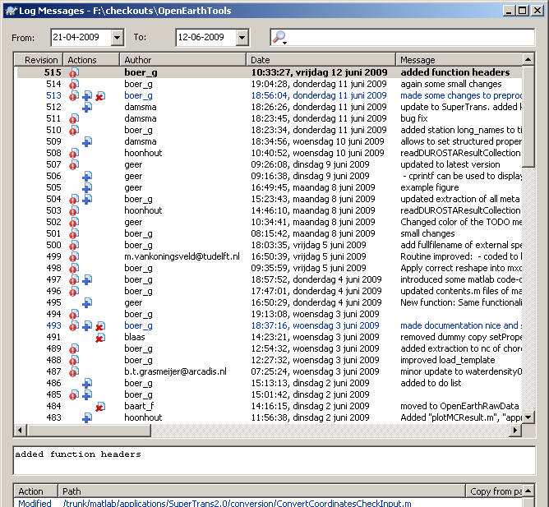
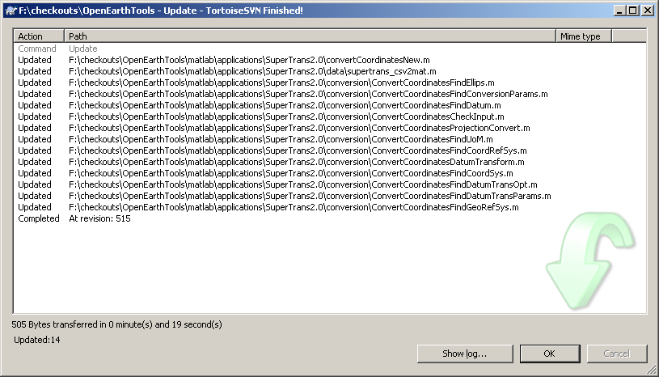
REPOSITORY update
Notes:
SubVersion: open source version control system. Users ‘commit’ their files in one central database (regular update local copy). Every commit gets a unique revision number. Per commit one can add a comment to indicate what was changed.

Slide 24
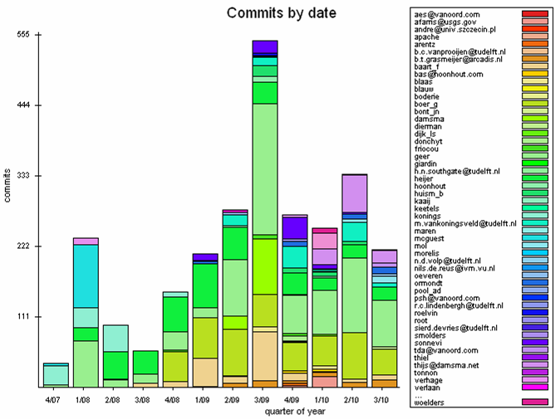
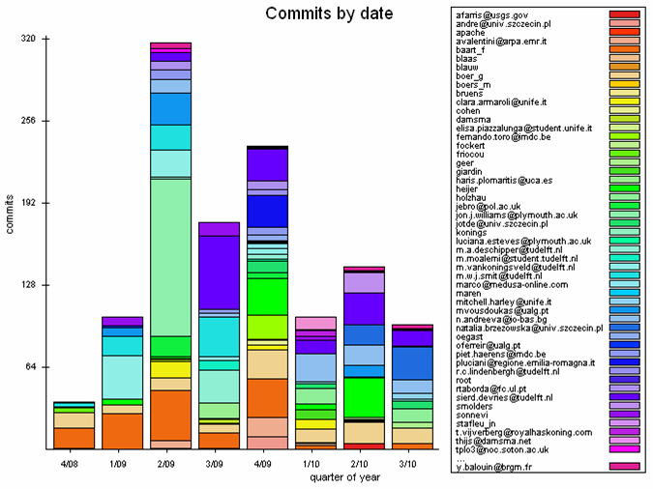
REPOSITORY statistics
TOOLS:
> 3000 commits!
> 60 active users
> 200 aanvragen
DATA:
> 1350 commits!
> 60 active users
Notes:
Statistics: Per project or tool one may create a separate ‘repository’. Bundling reusable tools into 1 central repository has huge advantages (sharing, collaborating, learning). OpenEarth tools, as used in Building with Nature, is open source en freeware.

Slide 25
REPOSITORY add
central database: repos.deltares.nl
browse
checkout
update
commit
add
local copy
D:\ E:\ F:\
delete
copy

Slide 26
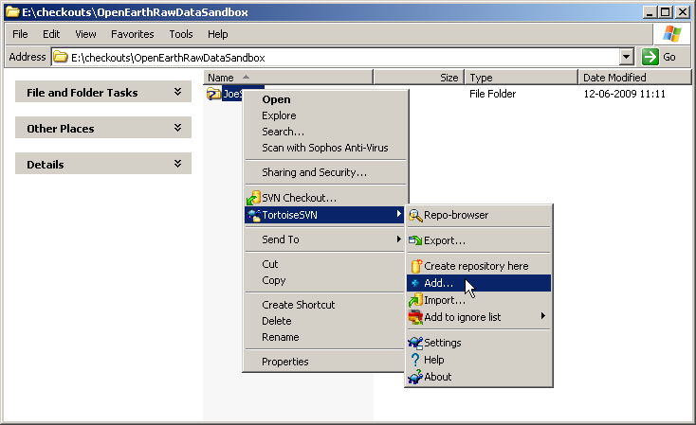
REPOSITORY add a raw dataset
There are 2 copies of 1 file on your PC:
  Visible working copy, for editing
  Hidden shadow copy, to detect changes
Before adding a file to the server, a shadow copy must be created.
Allows
for
offline
working

Slide 27
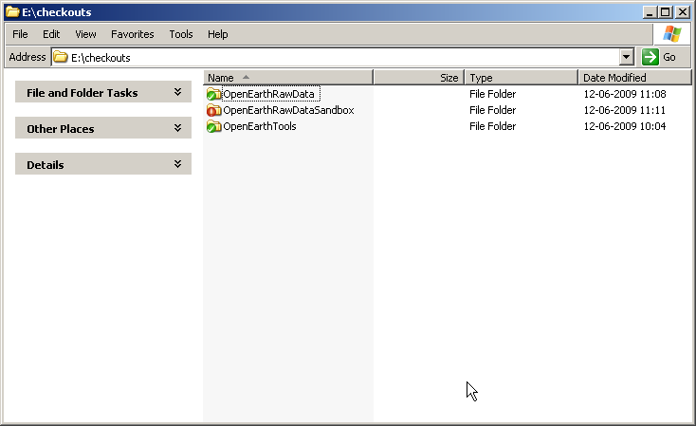
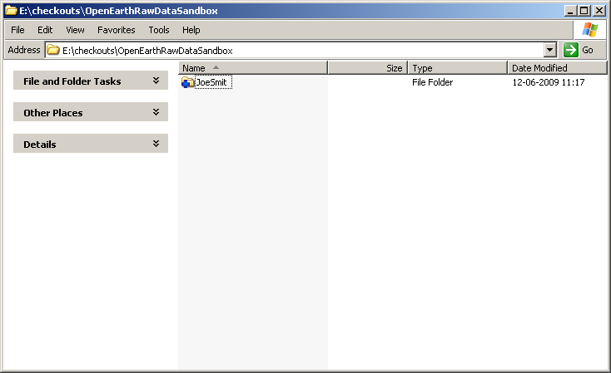
REPOSITORY add a raw dataset
Now the addition must be simply be committed as any change

Slide 28
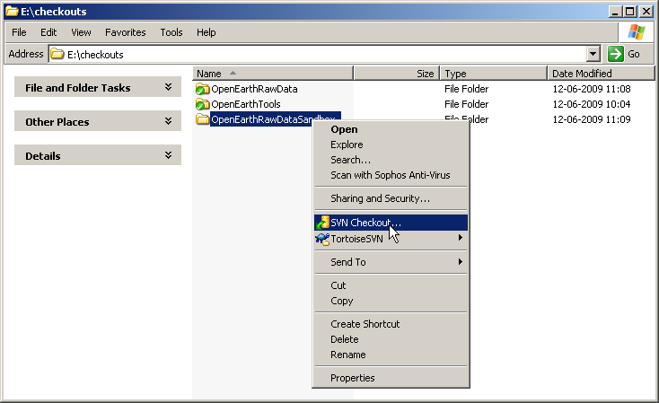
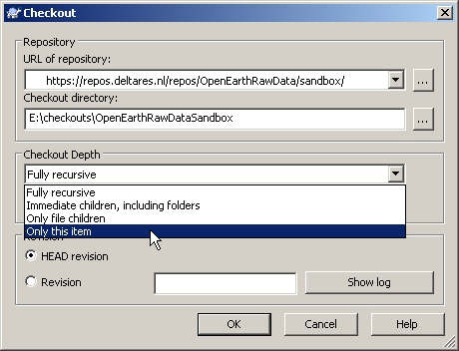
REPOSITORY add a raw dataset
OpenEarthRawData is very big: don’t make a full checkout
To add a thing, first make an empty checkout of the destination.

Slide 29
REPOSITORY delete
central database: repos.deltares.nl
browse
checkout
update
commit
add
local copy
D:\ E:\ F:\
delete
copy

Slide 30
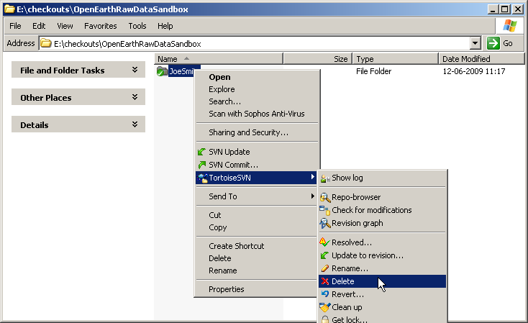
REPOSITORY add a raw dataset
There are 2 copies of 1 file on your PC:
  Visible working copy, for editing
  Hidden shadow copy, to detect changes
When deleting a file on the server, your shadow copy be informed
Allows
for
working
offline

Slide 31
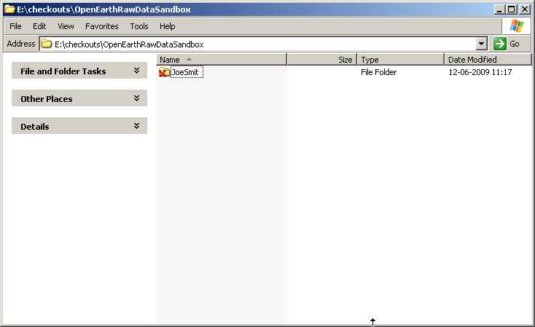
REPOSITORY add a raw dataset
Now the deletion must be simply be committed as any change

Slide 32
REPOSITORY copy
central database: repos.deltares.nl
browse
checkout
update
commit
add
local copy
D:\ E:\ F:\
delete
copy

Slide 33
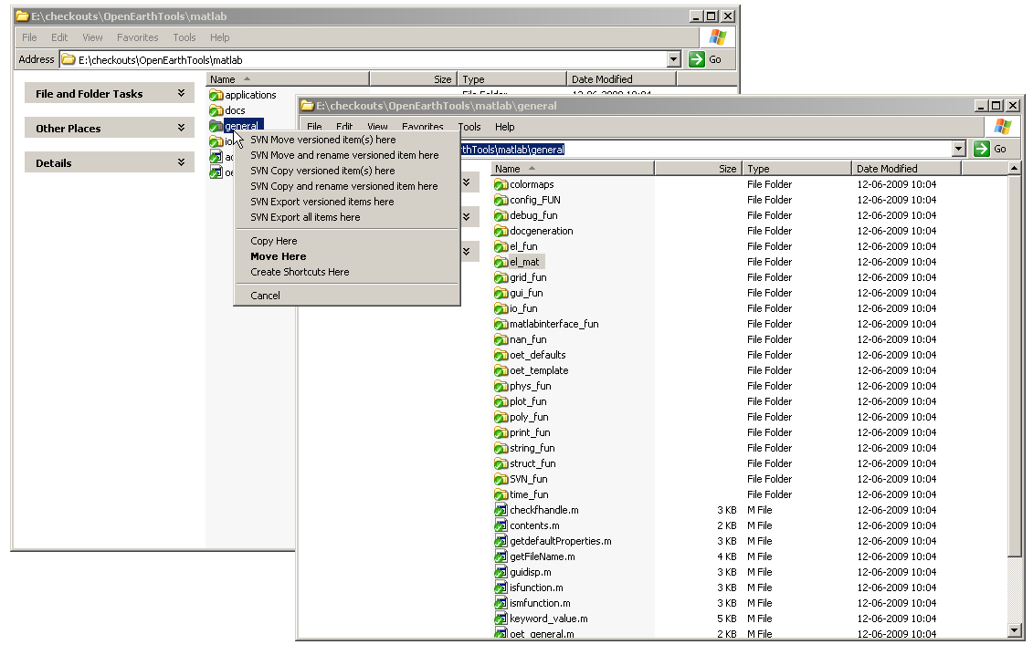
REPOSITORY copy
Again: first inform shadow copy locally, then commit to server …
Drag with right-mouse button

Slide 34
OpenEarthTools
Tools are stored under
https://repos.deltares.nl/repos/OpenEarthTools/trunk/
Tools are stored per language
Matlab has main activity
but Python and R toolbox are starting to grow now.

Slide 35

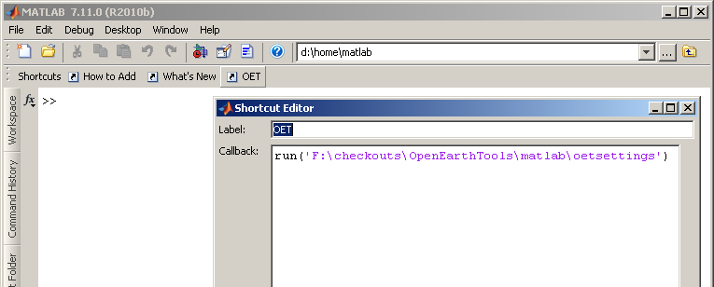
OpenEarthTools: Matlab: start
The Matlab toolbox has to be added to your matlab path
  Do not use addpath
    This wil also add all hidden (.svn) directories (a Matlab bug)
    This does not add the required JAVA paths (netCDF-4)
  Run oetsettings.m instead
  You have to do this every time you start Matlab
  So it’s easier to make a shortcut button this, right-mouse click on the shortcuts toolbar to add one

Slide 36
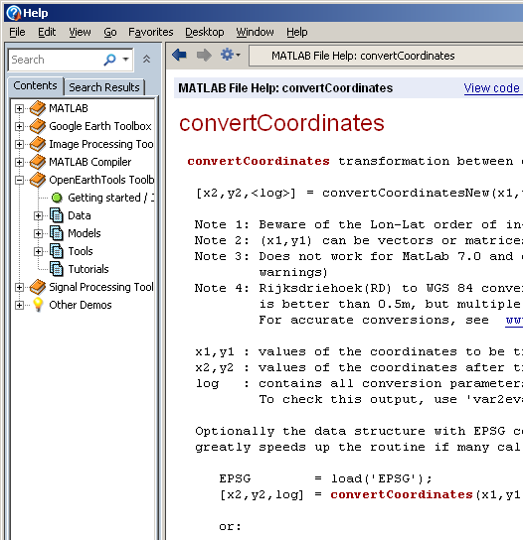
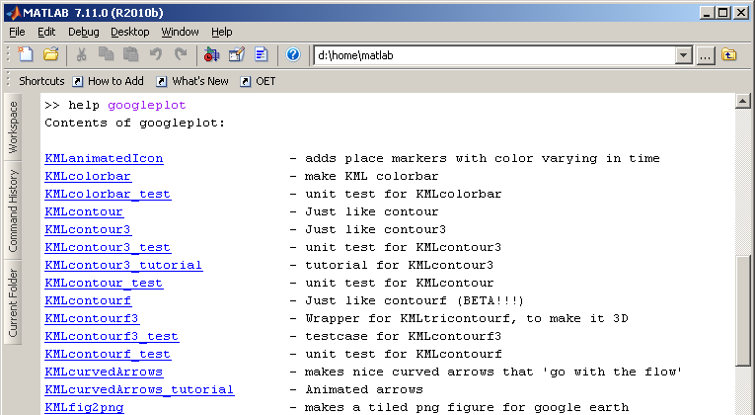
OpenEarthTools: Matlab: help
You can find the available Matlab tools the same way to you find official Matlab tools using use help, doc or lookfor
>> help oetsettings
>> doc googleplot
>> lookfor convertcoordinates

Slide 37
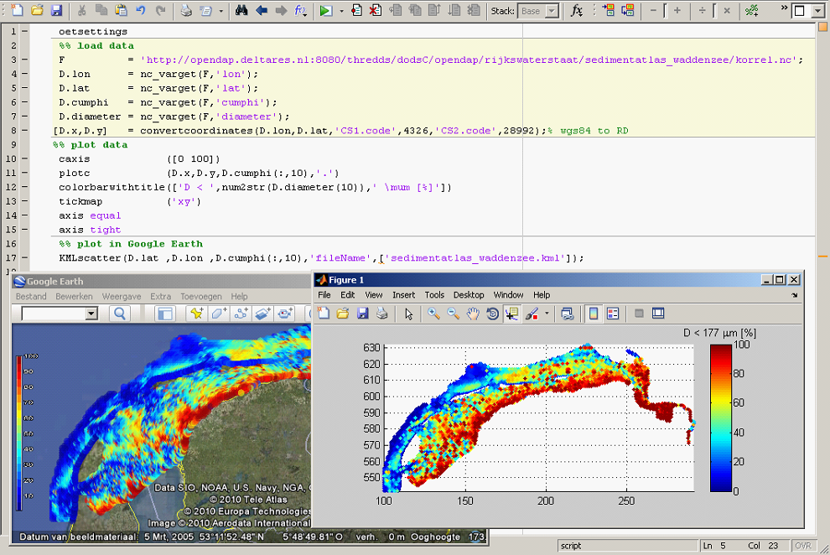
OpenEarthTools: Matlab: example

Slide 38
OpenEarthRawData
Raw data are stored under
https://repos.deltares.nl/repos/OpenEarthRawData/trunk/
Data are stored with copyright holder as main directory.
This allows
  copyright holders to maintain their own data
  copyright holders to shift easily from private to open source
  users to identify whom to acknowlegde
Data should also contain
  dedicated processing scripts (if not in OpenEarthTools)
  url file to web source
  INSPIRE XML meta-data file

Slide 39
OpenEarthModels
Raw data are stored under
https://repos.deltares.nl/repos/OpenEarthModels/trunk/
Model input schematisations are stored with copyright holder as main directory.
This allows
  copyright holders to maintain their own data
  copyright holders to shift easily from private to open source
  users to identify whom to acknowlegde

Slide 40
Exercise
The repository is supposed to be working anytime
Do not play with the actual repository
  All advanced users will by annoyed by this
But then, how I can I learn how to work with it?
  Solution: use the sandbox
  Play around at the highest level as much as you like
  And clean up afterwards (delete)
With your browser:
http://repos.deltares.nl/repos/OpenEarthTools/sandbox
Now delete the addition you made in
http://repos.deltares.nl/repos/OpenEarthTools/sandbox
And check the log file, to see what colleagues did.

Slide 41
www.OpenEarth.eu workflow

Slide 42
netCDF/OPeNDAP
netCDF OPeNDAP

Slide 43
netCDF/OPeNDAP
how to use: opendap.deltares.nl:
http://public.deltares.nl/display/OET/web+overview+of+OPeNDAP+data

Slide 44
Google Earth
Google Earth

Slide 45
Google Earth
how to use: kml.deltares.nl:
http://public.deltares.nl/display/OET/KML+Screenshots

