Slide 1
Cross-compilation with OpenEmbedded
LinuxTag 2008
Robert Schuster
OpenEmbedded

Slide 2
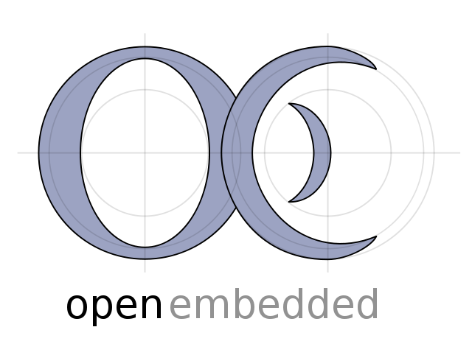
Scope & limitation of this talk
nurture your interest ;-)
make purpose clear
scratch surface on how things work
Limitation:
OE's flexibility makes it impossible to present all aspects

Slide 3
... but we have a manual!
http://openembedded.org/user-manual

Slide 4
OpenEmbedded in one sentence
  OE is a build environment that provides the necessary metadata to automate the tasks
  in the generation of a cross-compiled GNU/
  Linux distribution.

Slide 5
Usage scenarios
standalone GNU/Linux distribution (e.g. Angstrom, OpenMoko, Poky, ...)
build compatible packages for an existing non-OE-built distribution (e.g. for Maemo, OpenWRT or a pre-installed 'vendor-Linux'

Slide 6
Parties involved
bitbake task executor
  similar to 'make', processes OE metadata
OE metadata
  build recipes, machine and distribution configurations
your personal configuration file
  selects machine and distribution

Slide 7
How it works
run bitbake with a target (e.g. 'bitbake nano')
bitbake parses metadata and personal configuration
results in dependency graph of tasks
bitbake works through all the tasks*
* fetch sources, unpack, apply patches, compile,
copy to staging dir, create package/image

Slide 8
All this is not entirely new!
buildroot (OpenWRT/FreeWRT)
Scratchbox (Maemo)
T2 SDE
emdebian
Fedora Embedded
Notes:
but OE can be adapted to many different needs and customized in many way this is what makes it unique.

Slide 9
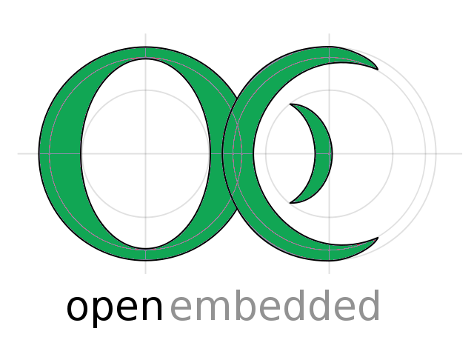
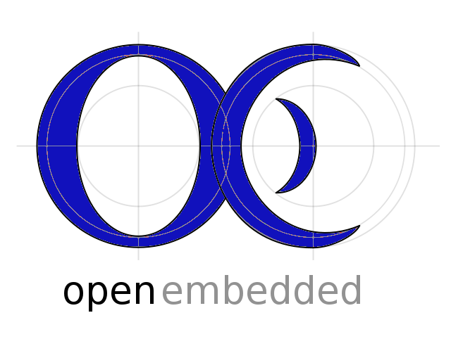
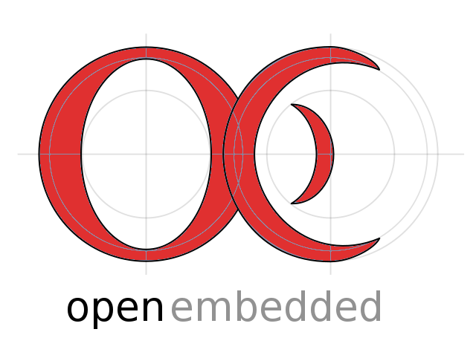
Adaptability makes OE unique

Slide 10
A short story about
OpenEmbedded
adaptability
<story>

Slide 11
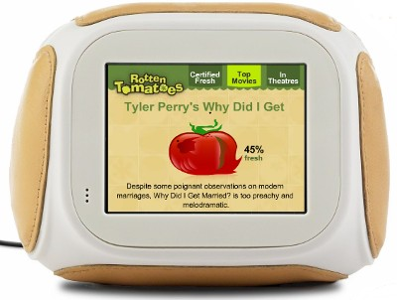

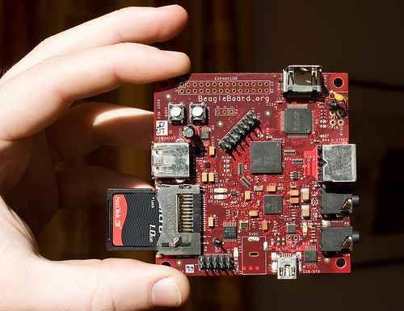
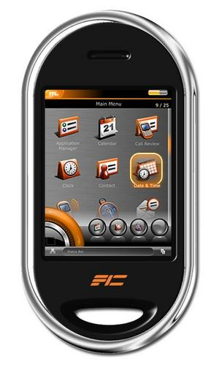
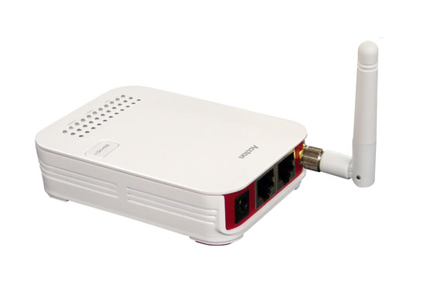
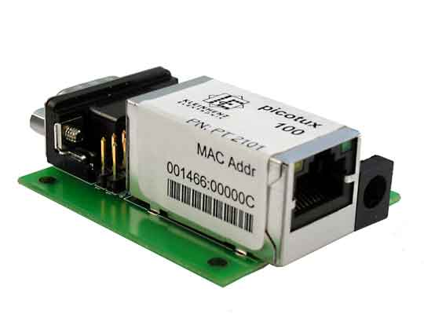
Imagine you have* an
embedded device ...
* or are designing one.

Slide 12


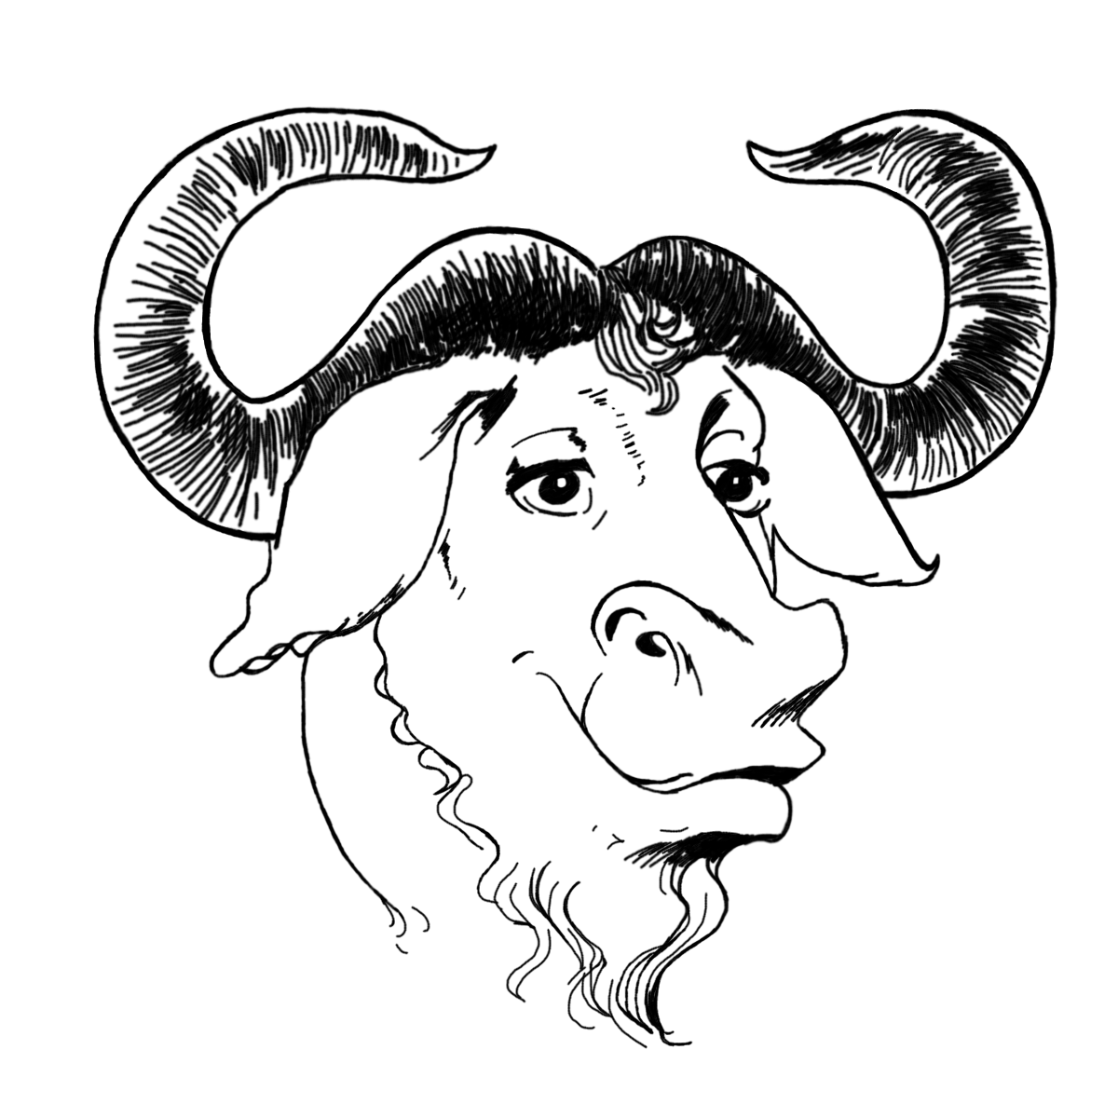

... and for whatever
good reason you want
a GNU/Linux-based
system on it.

Slide 13
You also know
that GNU/Linux
means choice!
Notes:
all shown components are supported by OE
just a glimpse, there is much much more

Slide 14
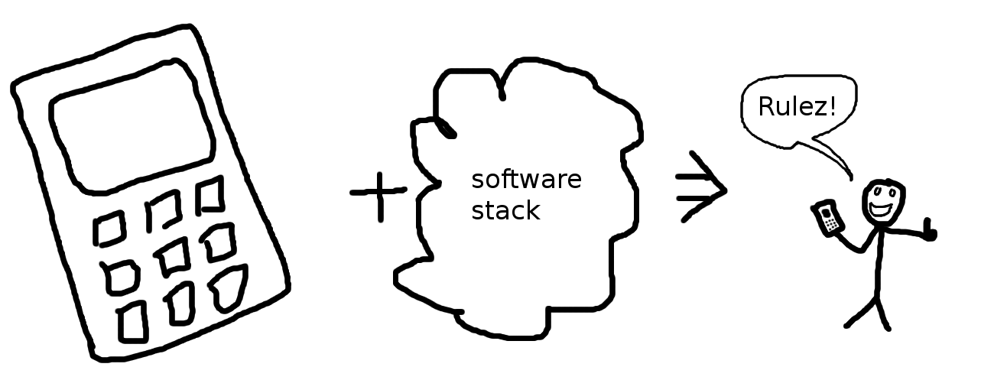
The important point is that you have to define
the software set that fits your device best.

Slide 15

When it comes to defining this software set
OpenEmbedded really shines.
PREFERRED_PROVIDER_xserver ?= "xserver-kdrive"
PREFERRED_PROVIDER_virtual/libc = "uclibc"
PREFERRED_VERSION_uclibc ?= "0.9.29"
PREFERRED_VERSION_busybox = "1.9.2"
...

Slide 16
If you don't want to start from zero inherit from an
existing distribution:
#-----------------------------------------------------------------------------
#@TYPE: Distribution
#@NAME: Openmoko
#@DESCRIPTION: Linux Distribution Configuration for the Openmoko Platform
#-----------------------------------------------------------------------------
require conf/distro/include/preferred-om-2008-versions.inc
require conf/distro/include/angstrom-2007-for-openmoko.inc
Notes:
excerpt from the distribution configuration file for OpenMoko

Slide 17
</story>

Slide 18
Strengths
Reproducable builds:
  set up build environment for different team members
Features:
  create standalone toolchains
  define different root file system images (e.g. for development & production)

Slide 19
Strengths
Builds from source
  no binary blobs
"If it isn't source, it isn't software."
(ad from Cygnus Support, ~1990)

Slide 20
Weaknesses
steep learning curve
  having an experienced mentor helps considerably
.dev branch (think CVS HEAD) is prone to break
  use .stable branch instead :-)
VCS operations are really slow
  transition to git is around the corner
'bitbake' is not as fast as pure 'make'

Slide 21
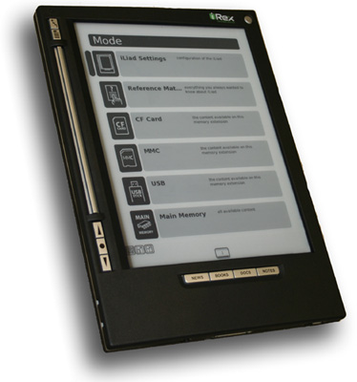
Device software build with OE
Angstrom (OE's default distro)
OpenMoko (Mobile phone stack)
Poky (prototyping)
Unslung/Ucslugc (distros for Linksys NSLU2)
many customer projects
Buyable:
iRex Iliad (Ereader)

Slide 22
Chances
grok OpenEmbedded today
gain ability to target many different devices (~150)
make use of other OE contributors' work
  e.g. someone puts in Java support for their own needs; then your distro can use it, too

Slide 23
Bitbake recipe anatomy I
Basic package information:
DESCRIPTION = "Routing protocol daemon for
multi-hop ad-hoc mesh networks."
SECTION = "console/network"
PRIORITY = "optional"
LICENSE = "GPL"
HOMEPAGE = "https://www.open-mesh.net/batman"

Slide 24
Bitbake recipe anatomy II
  Runtime dependencies, source location, patches to apply:
RDEPENDS = "kernel-module-tun"
SRC_URI = "\
http://downloads.open-mesh.net/
batman/stable/sources/batman-0.3.tar.gz \
file://makefile-fix.patch;patch=1 \
"
Fetcher also supports
cvs, svn, git, hg, bzr.
The source is downloaded, the patch is part of OE.

Slide 25
Bitbake recipe anatomy III
Source location after unpacking, compilation step:
S = "${WORKDIR}/batman-${PV}"
do_compile() {
oe_runmake
}
Provides -j option (set in your personal configuration).

Slide 26
Bitbake recipe anatomy IV
Staging and installation:
do_stage() {
:
}
do_install() {
install -d ${D}${bindir}
install -m 0755 batmand ${D}${bindir}
}
Do nothing. No one compiles against this package
Copies what should end up in the binary package.

