Slide 1
ACM SIGOPS STRATEGIC WORKSHOP
60
Celebrating 60 Years of SIGOPS
1965 – 2025
From Historical Wisdom to Forward-Looking Vision
Co-located with SOSP 2025 in Seoul
Monday, October 13, 2025 · Crystal Ball B, Lotte Hotel World
1965
2025
Honoring six decades of the operating systems community — and charting its next chapter

Slide 2
CONTENTS
Opening at a Glance
1965 – 2025
Sixty Years of SIGOPS
01
A Timeline (1965–2025)
A Storied Community
02
The SOSP 2015 History Day
Why a Strategic Workshop, Why Now
03
Mission and Goals
Today's Program
04
Two Keynotes, Four Visionary Sessions, Two Panels & Full Schedule
Opening at a Glance
02

Slide 3
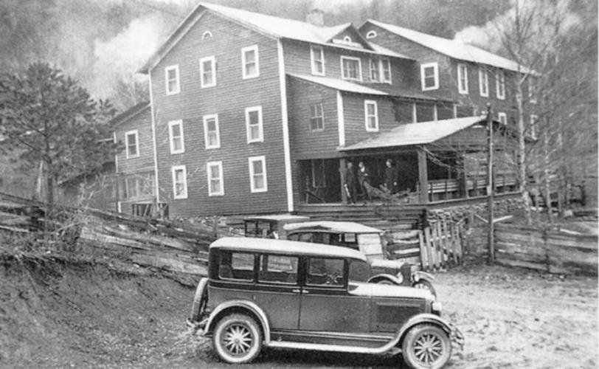
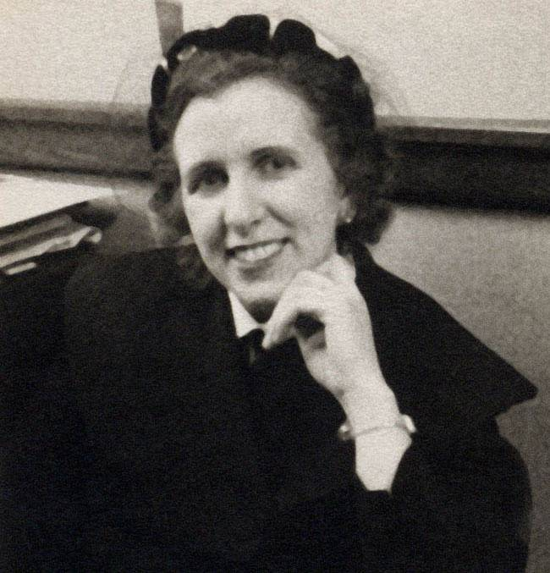
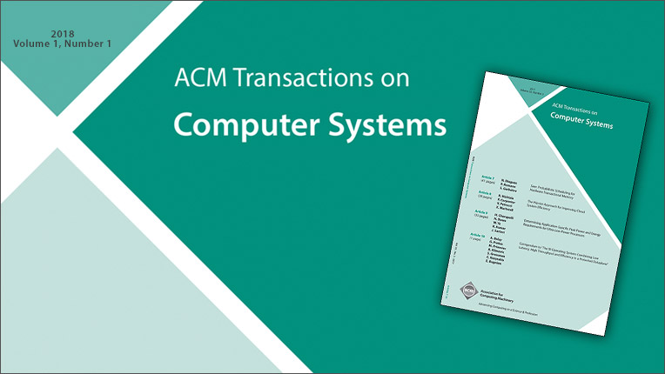
Sixty Years of SIGOPS: A Timeline
1965
Henriette Avram founds the Special Interest Committee
FROM THE ARCHIVES
on Time-Sharing (SICTIME) — the seed of SIGOPS
1967
First SOSP held October 1–4 in Gatlinburg, Tennessee
The birthplace of our flagship symposium
1968
SIGTIME officially becomes SIGOPS
The ACM Special Interest Group on Operating Systems
1969
Membership surges from ~400 to nearly 1,000
The newsletter evolves into Operating Systems Review
Mountain View Hotel, Gatlinburg — site of the first SOSP (1967)
1970
Over 1,800 members — the second-largest SIG in ACM
1982–83
The conference family expands: ASPLOS and PODC launch
First issue of ACM Transactions on Computer Systems (TOCS)
ACM TOCS — first issue, 1983
2025
SIGOPS turns 60
60
Years of SIGOPS
A community nearly as old as the field of operating systems itself
Henriette Avram
1965 – 2025
Founder of SICTIME, 1965

Slide 4
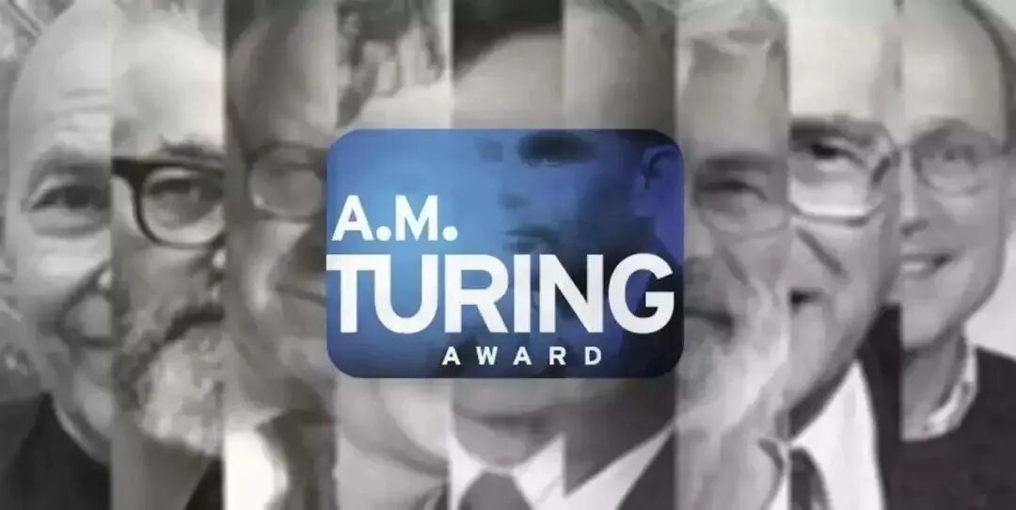
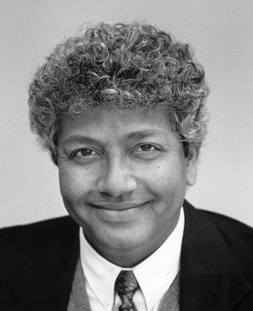
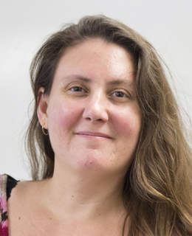
A Storied Community — and the SOSP 2015 History Day
Turing Laureates Woven into Our Fabric
Community Infrastructure
Edsger W. Dijkstra
1971
Conferences
SOSP · OSDI · EuroSys · ASPLOS · PODC
Ritchie & Thompson
1983
Butler Lampson
1992
Journals
Operating Systems Review · ACM TOCS
Hennessy & Patterson
2017
Awards
Mark Weiser Award
…plus Wilkes (1967), Gray (1998) and Brooks (1999)
Dennis M. Ritchie Thesis Award · Hall of Fame
The A.M. Turing Award — the ‘Nobel Prize of Computing’
OSDI (1994) and EuroSys (2006) later joined the flagship family.
SOSP 2015 History Day — Community Legends on One Stage
The first large-scale moment our community paused to revisit the people and ideas that shaped the field.
Peter Denning
Butler Lampson
Barbara Liskov
M. Satyanarayanan
Ken Birman
David Patterson
Frans Kaashoek
David Clark
Jeff Dean
Peter Neumann
Organized by Jeanna Matthews, with an opening tribute to Dennis Ritchie.
SOSP 2015 History Day · Monterey, CA
Three of them — Lampson, Patterson and Kaashoek — return to today’s stage.
SOSP 2015 · HISTORY DAY
SOSP 2025 · STRATEGIC WORKSHOP
Looked Back at Our Roots
Looks Forward to the Next Chapter

Slide 5
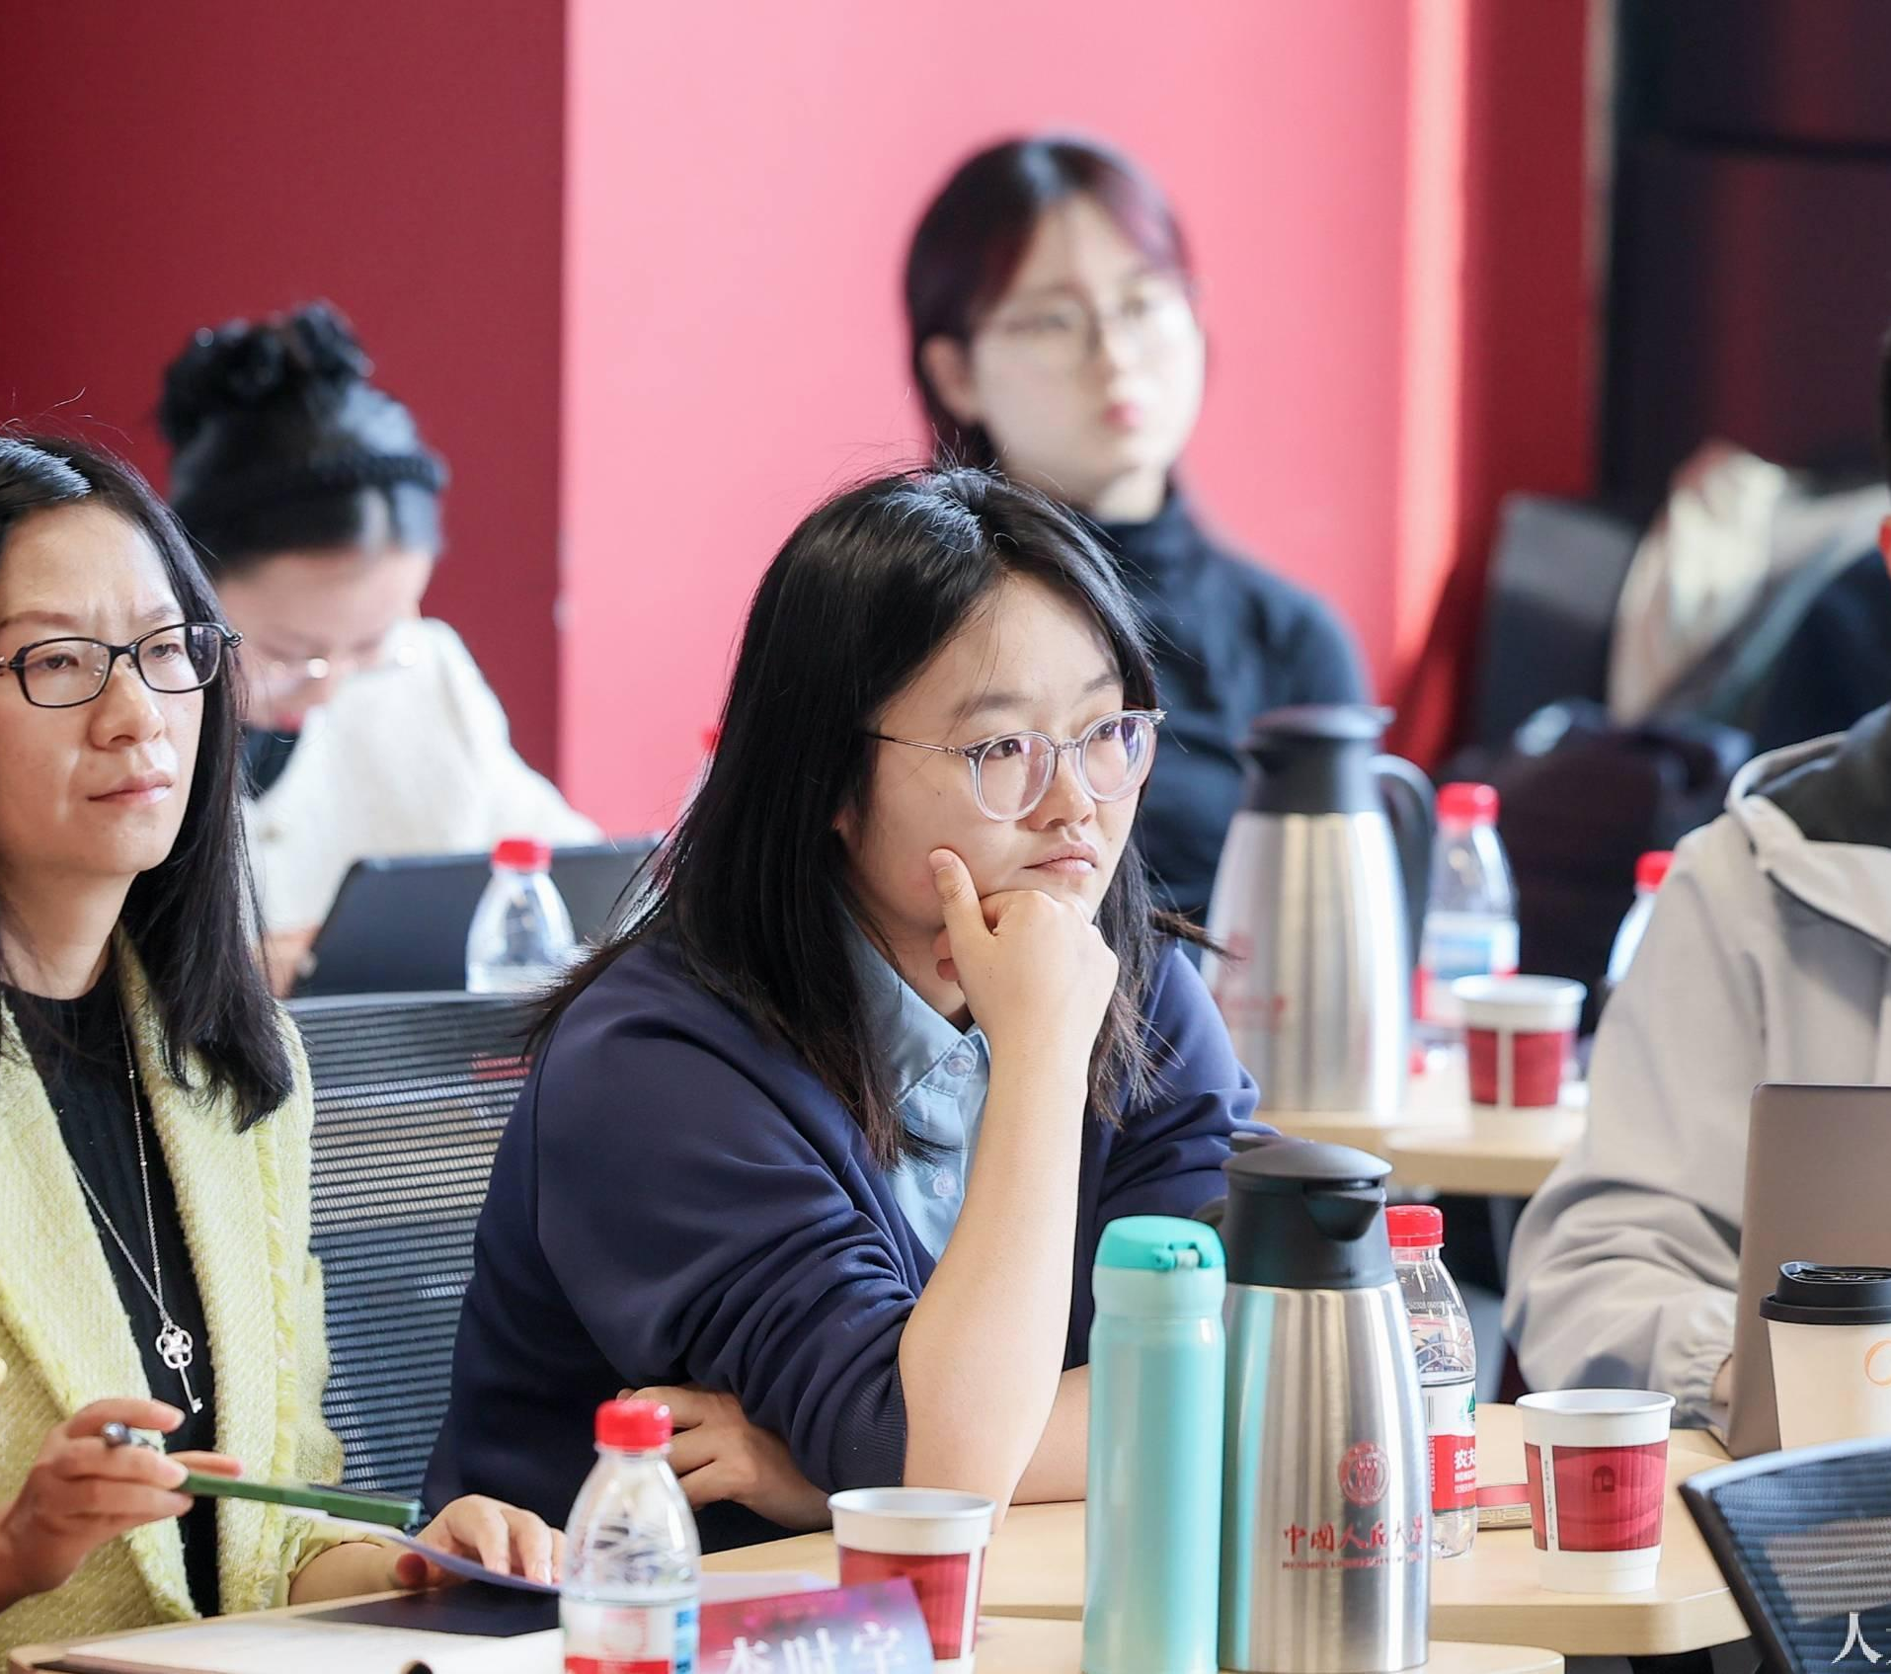
Why a Strategic Workshop, Why Now?
THE LANDSCAPE HAS SHIFTED
— four forces reshaping computing and OS research over the past decade
SOSP 2025 · Seoul, Korea
Hardware Evolution
Distributed Systems
AI-Driven Automation
Heterogeneous Computing
New devices, accelerators, memory
Planet-scale, always-on services
Learning reshapes the stack
Many architectures, one system
→
These shifts demand renewed reflection on the principles, priorities and opportunities that will define the next generation of OS research.
OUR MISSION
Building on the legacy of the SOSP History Day (2015), we gather to
bridge historical wisdom with forward-looking vision,
and collectively shape a strategic five-year roadmap for OS research.
THREE GOALS FOR TODAY
1
Identify Priorities
2
Foster Collaboration
3
Inspire a Shared Vision
Actionable items the community
Interdisciplinary work across
A common direction for OS
can rally behind
systems, AI and architecture
research in the coming decade
WHO IS IN THE ROOM
Senior researchers · foundational contributors
and emerging leaders — one diverse cohort
Honor the legacy of SOSP — and empower the community to navigate an increasingly complex technological future with clarity and purpose.

Slide 6
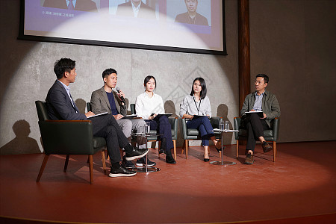
A High-Density, High-Caliber Program
7
2
15
2
Sessions in One Full Day
Keynotes by Turing Laureates
Ten-Minute Visionary Talks
Panels on the AI Era
8:50 – 18:00 · built for discussion
David Patterson · Butler Lampson
across four themed sessions
on research & on community
Four Visionary Sessions
every themed session is paired with a dedicated group discussion
01
The Intelligent Nexus: AI and Systems
11:00 – 11:40 · 4 talks
02
Building Blocks for a Reliable Future
14:00 – 14:40 · 4 talks
03
The Sky Is Not the Limit: Future of Cloud Systems
15:00 – 15:30 · 3 talks
04
The Core of the Machine: OS in a New Era
16:10 – 16:50 · 4 talks
Discussion-First Format
Session chairs:
Haibo Chen · Christos Kozyrakis · Rebecca Isaacs · Lorenzo Alvisi · Frans Kaashoek
Panels + group discussions — interaction over one-way listening
A Speaker Roster of Rare Caliber
INSTITUTIONS
UC Berkeley · MIT · Stanford · Cornell · CMU · Columbia · UCLA · ETH Zurich · UNSW · SJTU · SNU — plus Google, NVIDIA and beyond
HONORS & ROLES
NAE members · ACM & IEEE Fellows · Mark Weiser Award recipients · founders of Databricks, Anyscale, FriendliAI, BreezeML
BEYOND TALKS
Two 50-minute panels · three 20-minute group discussions · coffee breaks and lunch woven through the day

Slide 7
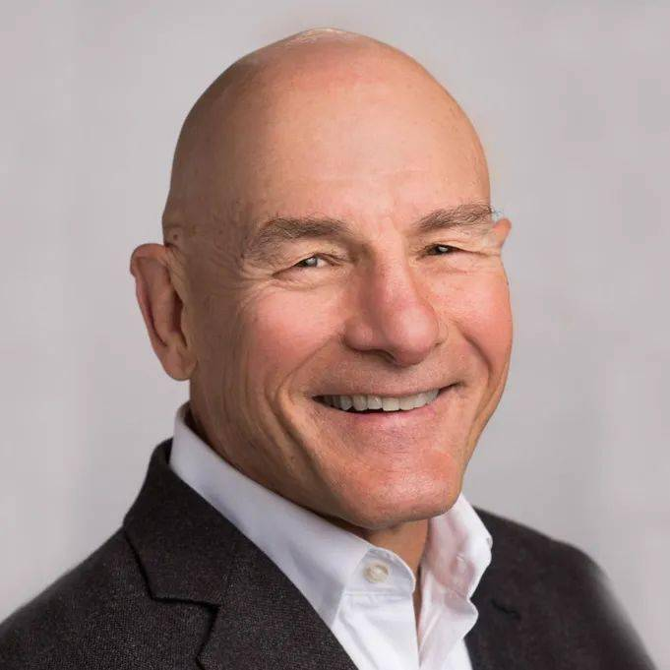
Keynote I — David Patterson
Computer Architecture 101 and Its Future
9:00 – 9:45
Chair: Haibo Chen
Session 1: Opening & Keynote Speech · This talk is recorded
Talk Preview
From the talk abstract
Drivers
Critical Challenges
Opportunities Ahead
Moore's Law
Memory bandwidth deceleration
Chiplets
Dennard Scaling
Memory capacity deceleration
High-Bandwidth Memory (HBM)
Domain-Specific Architectures
Power
High-Bandwidth Flash
Roofline Performance Model
A Legacy That Shaped Computing
Berkeley's Most Influential Projects
The Landmark Textbook
David Patterson
RISC — Reduced Instruction Set Computer
Computer Architecture: A Quantitative Approach
RAID — Redundant Array of Inexpensive Disks
Co-authored with John Hennessy
UC Berkeley Pardee Professor Emeritus
Google Distinguished Engineer
2017 ACM A.M. Turing Award
WHY IT MATTERS FOR OS RESEARCH
with John Hennessy · “Nobel Prize of Computing”
The shifting hardware ground that OS research must respond to.
2022 NAE Charles Stark Draper Prize
“Nobel Prize of Engineering”

Slide 8
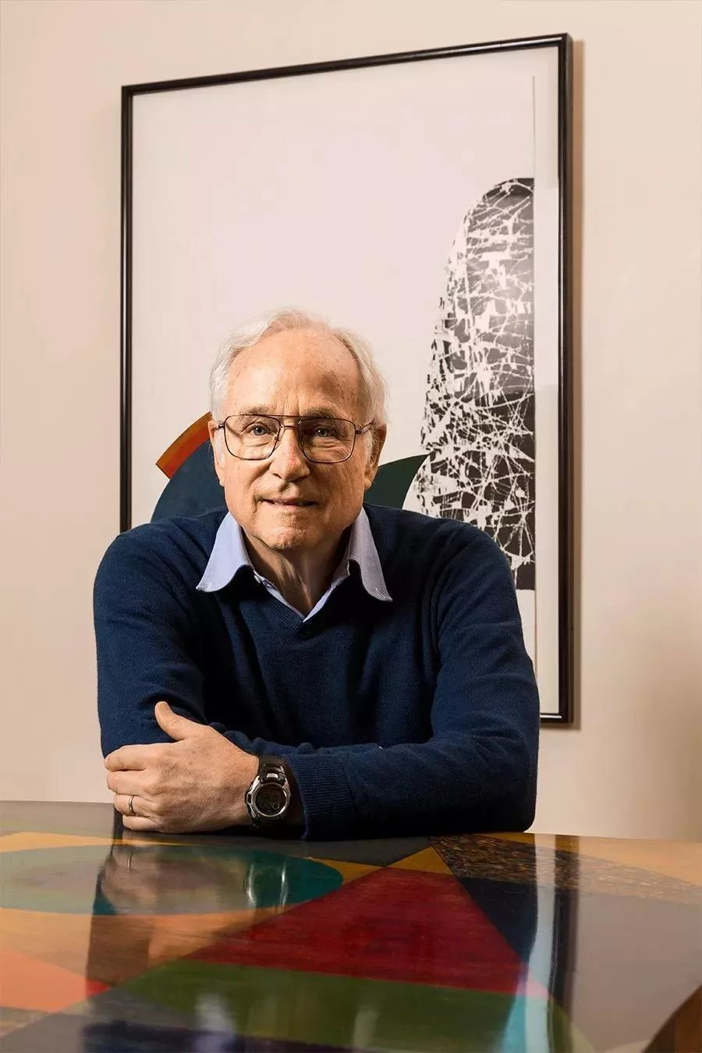
Keynote II — Butler Lampson
“How Does a Computer System Get to Be the Way It Is?”
10:00 – 10:45 · Session Chair: Haibo Chen · This talk is recorded
ABOUT THE SPEAKER
1992 ACM Turing Award · 2004 NAE Draper Prize
Co-designed the SDS 940 time-sharing system and the Alto personal distributed computing system
Co-invented two-phase commit protocols — a foundation of transaction processing
Career across Xerox PARC, DEC SRC, and Microsoft — now Adjunct Professor at MIT
Deep SIGOPS roots: Program Chair of SOSP 1971 · SIGOPS Vice Chairman in 1972
TALK PREVIEW
Big changes in systems follow big changes in the environment — often in hardware and scale
Modularity is fundamental to design — but for a complete system,
agility
matters more
THE STEADY GOALS
Butler Lampson
S
T
E
A
D
Y
Adjunct Professor, MIT
Simple
Timely
Efficient
Adaptable
Dependable
Yummy
1992 ACM Turing Award
TIMELESS IDEAS IN MOST SYSTEMS
2004 NAE Draper Prize
Recursion
Approximation
Batching
Caching
Concurrency
Indexing
Isolation
Logs
Sixty years of community design wisdom — illuminating the road ahead
ACM SIGOPS Strategic Workshop @ SOSP 2025 · Seoul
08 / 11

Slide 9
Visionary Talks — Four Themed Sessions
Fifteen 10-minute visionary talks across four themes — from AI-native systems to the OS itself — each designed to spark discussion, not just listening.
The Intelligent Nexus: AI and Systems
SESSION 2
Building Blocks for a Reliable Future
SESSION 4
11:00 – 11:40 · Session Chair: Christos Kozyrakis
14:00 – 14:40 · Session Chair: Rebecca Isaacs · + Group Discussion to 15:00
11:00
Ion Stoica · UC Berkeley
14:00
Peter Chen · University of Michigan
How AI Is Disrupting Systems Research
Challenges in Building Large, Trustworthy Systems
11:10
Haibo Chen · Shanghai Jiao Tong University
14:10
Jeff Mogul · Google
Towards Model-native OS: Rethinking System Foundations
Reliability Is Harder Than It Was
11:20
Junfeng Yang · Columbia University
14:20
Lorenzo Alvisi · Cornell University
Towards Trustworthy AI Systems
Metastable Fault Tolerance
11:30
Byung-Gon Chun · Seoul National Univ. / FriendliAI
14:30
Frans Kaashoek · MIT
What Matters More for Production AI Systems
Verifying Real-World Distributed Systems via Gradual Verification (etcd)
The Sky Is Not the Limit: Future of Cloud Systems
SESSION 5
The Core of the Machine: OS in a New Era
SESSION 6
15:00 – 15:30 · Session Chair: Lorenzo Alvisi · + Group Discussion to 15:50
16:10 – 16:50 · Session Chair: Frans Kaashoek · + Group Discussion to 17:10
15:00
Harry Xu · UCLA / BreezeML
16:10
Gernot Heiser · UNSW
The Core Problem with Cores: It's All About the Software
Don't Forget the OS — and the Principles!
15:10
Christos Kozyrakis · Stanford / NVIDIA
16:20
Timothy Roscoe · ETH Zurich
Systems in the AI Era
The Aversion to Systematization in Systems Research
15:20
Robbert van Renesse · Cornell University
16:30
Yubin Xia · Shanghai Jiao Tong University
What UNIX Got Right but the Cloud Got Wrong
Growth and Growing Pains: Systems Research in Asia's Next Chapter
16:40
Jeanna Matthews · Clarkson Univ. / DuckDuckGo
→ Group Discussion 15:30 – 15:50 · the floor is yours
Operating Systems and Socio-Technical Systems

Slide 10
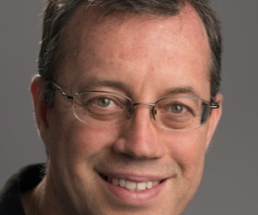
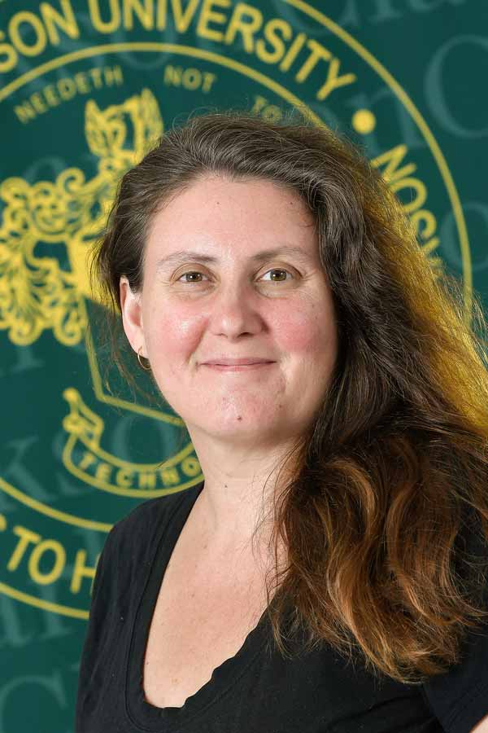
Two Great Panels — and Your Role Today
PANEL 1 · 11:40–12:30
PANEL 2 · 17:10–18:00
The Future is Now: System Research in the Era of AI
Building a Community in the Era of AI
Moderator: Christos Kozyrakis
Moderator: Jeanna Matthews
Stanford University · NVIDIA Research
Clarkson University · DuckDuckGo · SIGOPS Chair 2011–2015
Panelists
Panelists
Ion Stoica (UC Berkeley) · Mingxing Zhang (Tsinghua)
Jeff Mogul (Google) · Ana Klimovic (ETH Zurich)
Dimitris Skarlatos (CMU)
Ion Stoica
KyoungSoo Park (Seoul National University)
Panelist · UC Berkeley
Jeanna Matthews
Moderator
TWO QUESTIONS FOR THE DAY
Where should our research go?
How should our community grow?
Panel 1 on research direction · Panel 2 on community building
Day at a Glance
Monday, October 13, 2025 · Crystal Ball B, Lotte Hotel World
8:50
9:00
10:45
11:00
11:40
12:30
14:00
15:50
17:10
18:00
Opening
Two Keynotes
Coffee Break
AI & Systems
Panel 1
Lunch
Afternoon Sessions
Coffee Break
Panel 2
Adjourn
Patterson · Lampson
Visionary Talks
Research in AI Era
3 Themes + Discussion
Community in AI Era
With Thanks to the Organizing Committee
Join the Discussion →
Haibo Chen (Chair, SJTU) · Ding Yuan (Univ. of Toronto) · KyoungSoo Park (SNU) · Dong Du (SJTU)
Help write the opening chapter of
All talks are recorded. © 2025 ACM SIGOPS Strategic Workshop. All rights reserved.
SIGOPS' next sixty years.

Slide 11
1965
60
2025
Thank You
Thank you for a day of historical wisdom and forward-looking vision.
Now let's write the opening chapter of SIGOPS' next sixty years — together.
ACM SIGOPS Strategic Workshop @ SOSP 2025 · Monday, October 13, 2025 · Crystal Ball B, Lotte Hotel World, Seoul
With thanks to the Organizing Committee: Haibo Chen (Chair) · Ding Yuan · KyoungSoo Park · Dong Du — all talks are recorded.
Celebrating 60 Years of SIGOPS — From Historical Wisdom to Forward-Looking Vision

