Slide 1

Literature Review
Wuthering
Heights
A Soul's Dialogue Across the Moors
Exploring Emily Brontë’s Masterpiece
A Journey through Passion, Revenge, and the
Yorkshire Wilderness
Beyond Romance: A Study of the Human Soul
01

Slide 2
Presentation Overview
01
Introduction
Narrative Mastery
01
04
04
Not Just a Love Story
The Frame Structure
02
The Creator
Characters
02
05
05
Emily Brontë's Solitude
Mirrors of Obsession
03
The Setting
Legacy
03
06
06
Two Worlds in Conflict
Gothic Elements and Eternal Legacy
02

Slide 3
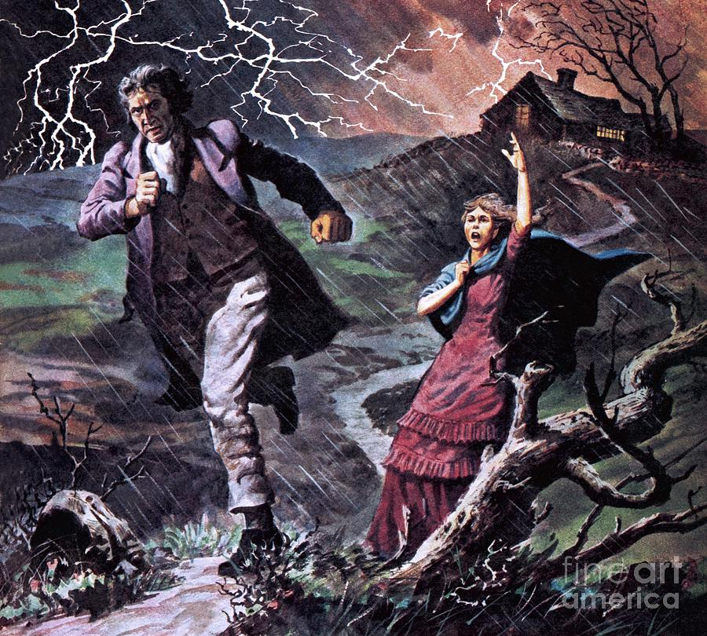
Not Just a Romance: The Raw Reality
Defying Conventions
Storms & Instincts
Beyond 'Pride and Prejudice'
Unlike Austen’s polite courtships,
Wuthering Heights
rejects
conventional romance. It presents a fierce soul's dialogue fueled by toxic
connections rather than refined social manners.
Wildness vs. Civilization
The Moors
The Valley
Wild, desolate, absolute freedom (Nature).
Elegant, structured, suffocating
(Civilization).
The physical distance acts as a metaphor for the unbridgeable emotional and social
Atmospheric Tumult
gaps between characters.
The title
Wuthering Heights
itself refers to turbulent weather, mirroring
the internal storms of the characters.
Love as a Weapon
No 'Happily Ever After'
Driven by raw instincts—hate, revenge, and obsession. The narrative
Rooted in Gothic elements like madness and ghosts. Catherine chooses
explores the destruction caused when love turns into systematic cruelty.
social security over spiritual truth, leading to a tragedy of repressed
Primal over Refined
passion rather than a wedding.
Characters display primal, animalistic instincts rather than the refined
behaviors expected of the Victorian gentry.
3

Slide 4
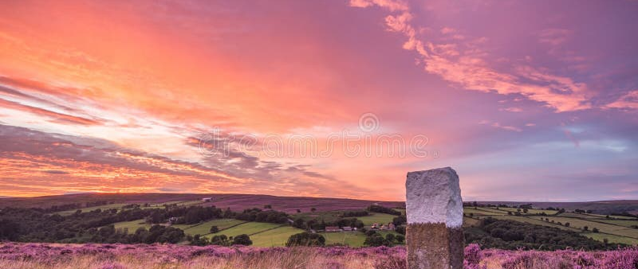
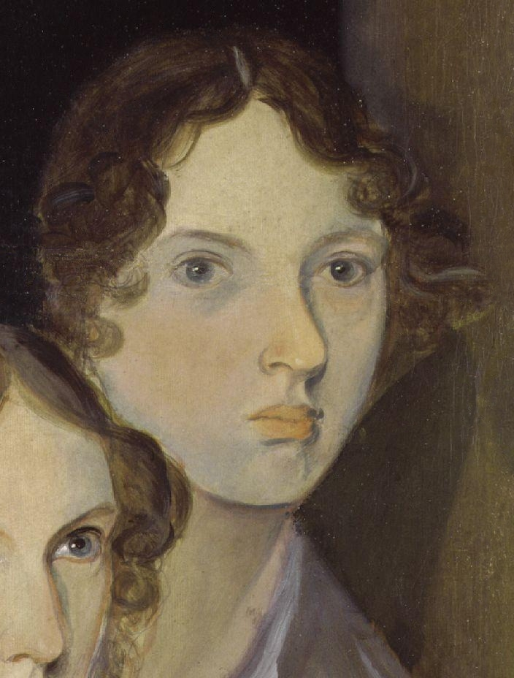
Emily Brontë: The Hermit of the Moors
The Enigmatic Creator
Landscape of the Soul
Brief but Brilliant (1818–1848)
Emily lived a tragically short life, passing away at 30 from
tuberculosis. Despite publishing only one novel, her singular genius
left an indelible mark on English literature.
The rugged Yorkshire Moors
Life at Haworth Parsonage
Isolated from London's literary society, the rugged, windswept
Yorkshire landscape was not merely a backdrop but a profound
Portrait by Branwell Brontë
influence that shaped her stormy soul.
The 'Ellis Bell' Pseudonym
Nature as a Spiritual Force
To bypass Victorian prejudice against female authors, she published
A known recluse, Emily found true freedom in the wild moors. She
under a masculine name, ensuring her work was judged on its raw
viewed nature not as a garden to be tamed, but as a source of
power rather than her gender.
liberty and raw spiritual energy.
4

Slide 5
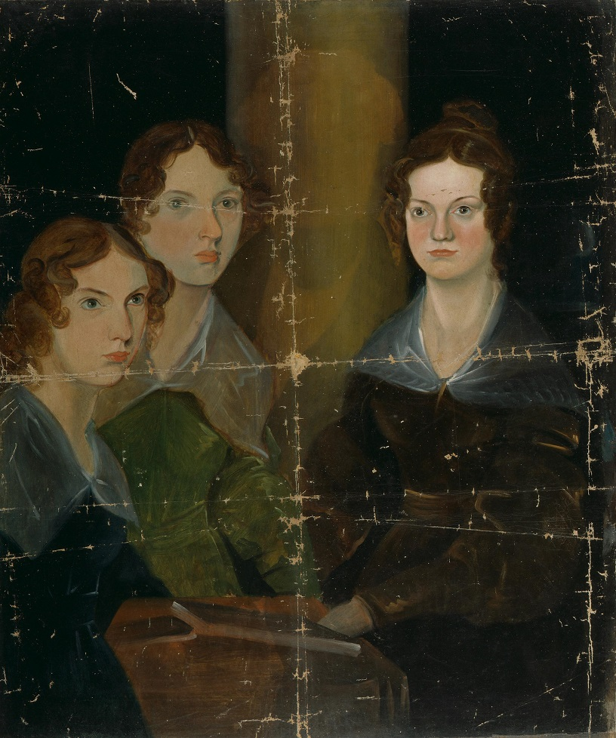
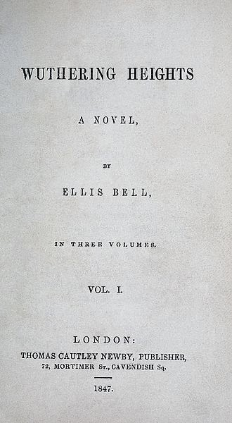
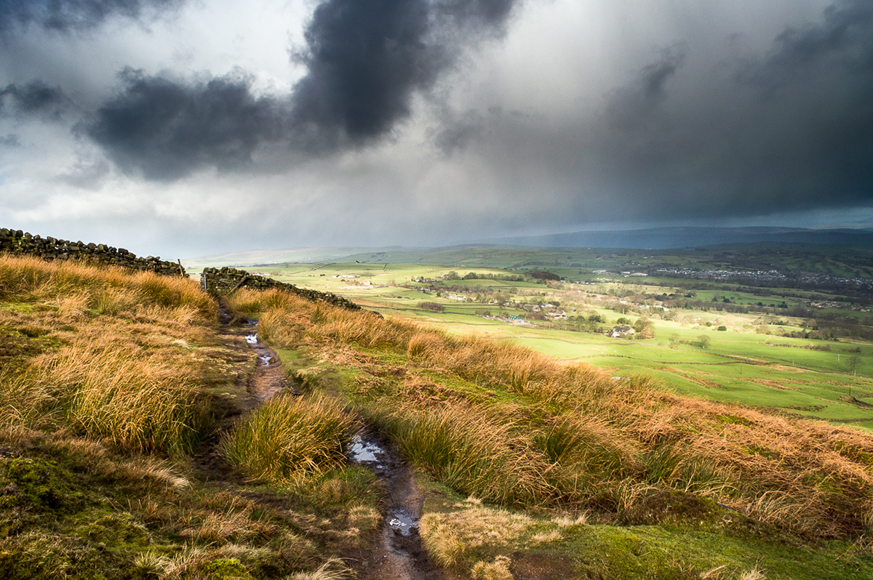
Translating Loneliness into Literature
A Household of Genius
Living in the isolated Haworth Parsonage,
A Masterpiece of Intensity
Emily was part of a legendary literary trio with
Published in 1847 under the pseudonym "Ellis
her sisters, Charlotte and Anne.
Bell" to navigate gender barriers.
Far from merely lonely, their home was a
Her only novel, written just one year before her
crucible of creativity where they built elaborate
tragic death at age 30.
fictional worlds (Gondal) together.
Unlike polished romances, it is defined by Gothic
Fiery Imagination from Isolation
darkness and primal emotion.
The wild, desolate moors were not just scenery but fuel. She
transformed her social solitude into a rebellious internal life, channeling
raw nature into her writing.
The Reclusive Visionary
Known as the "Sphinx of Literature," Emily rarely left Haworth. Her
legacy proves that one need not travel the world to understand
the depths of the human soul—she found the universal truths of
love and death within the wind of the moors.
5

Slide 6
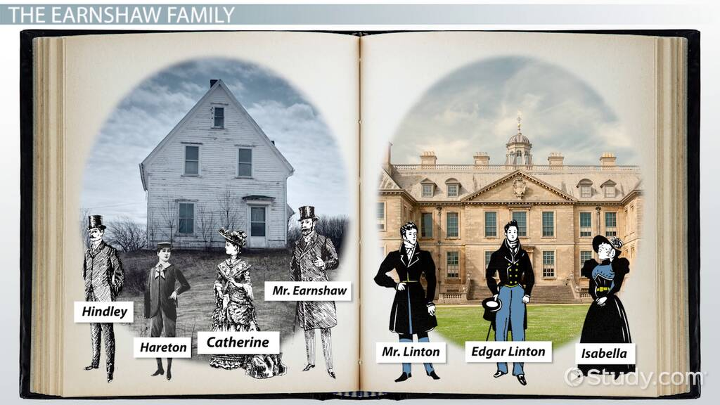
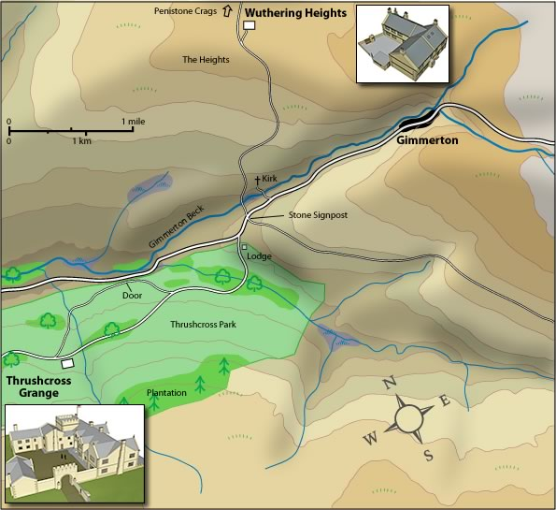
The Setting: A Clash of Two Worlds
The Two Estates
Symbolism & Tension
Geography as Metaphor
Wuthering Heights
The physical distance between the heights and the valley
High, stormy, primitive, and lawless. Located on exposed
mirrors the unbridgeable social and emotional gaps
moors, representing raw passion and nature's wild
between characters.
forces.
Inherent Tension
A collision between the "wildness" of the moors and the
Thrushcross Grange
"civilization" of the valley. The plot is driven by the intrusion
Low, calm, elegant, and suffocating. Represents
of one world into the other.
civilization, social propriety, and material comfort in the
"The setting is not just a backdrop; it personifies the internal
valley.
states of the characters."
6

Slide 7
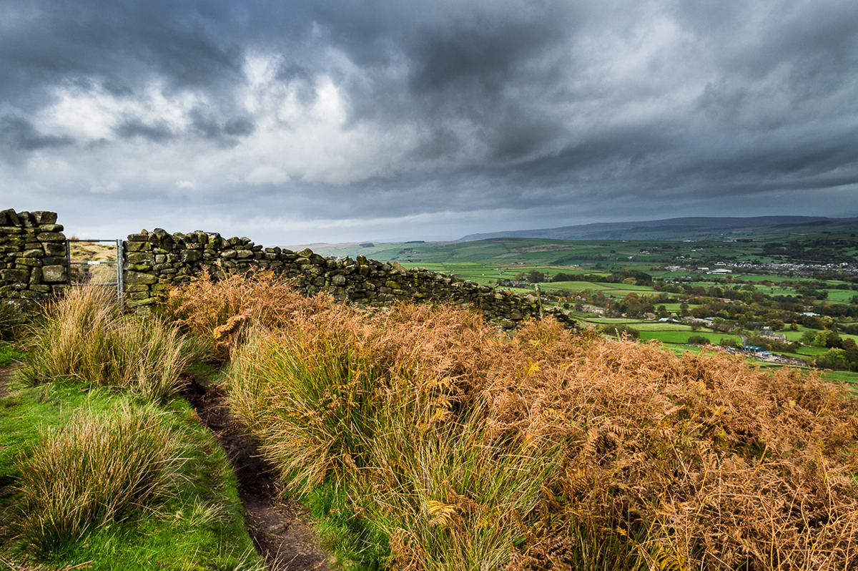
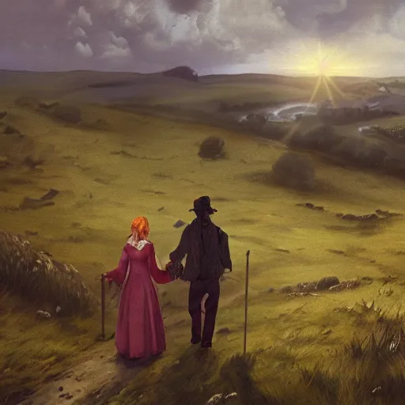
The Moors: The Silent Protagonist
Space of Absolute Freedom
Unlike cultivated gardens or farmland, the moors are
neither tamed nor productive. They represent a primitive,
lawless landscape that defies the constraints of
civilization.
Symbol of Wild Threat
The landscape is not merely a backdrop but an active
force. It mirrors the internal storms, destruction, and
primal instincts found within the characters.
Childhood Playground
Sanctuary and Prison
This desolate expanse served as the shared territory for
The moors function dually: a sanctuary for raw emotion
Catherine and Heathcliff. It was here, away from society,
where characters can be themselves, yet also an isolating
that their souls forged an unbreakable bond.
prison from which they can never truly escape.
7

Slide 8
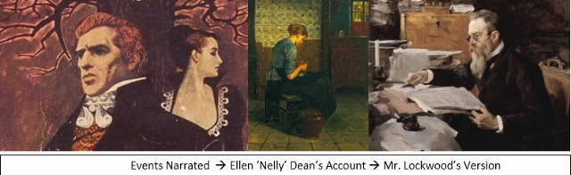
Narrative Mastery: The Frame Story
The Dual Narrators
Structure & Time
Lockwood: The Outsider
Arriving in 1801, he mirrors the "civilized" reader's
perspective. His confusion and subsequent diary entries form
the outer frame, justifying why the story is recorded.
Events Narrated → Nelly’s Account → Lockwood’s Diary
Nelly Dean: The Insider
The "Matryoshka" Structure
The housekeeper and oral historian. Unlike a neutral observer,
Like Russian nesting dolls, the novel features stories within
she is an active participant. Her "gossip" provides the core
stories. We read Brontë's novel, which contains Lockwood's
narrative, yet it is biased by her own morality and feelings.
diary, which holds Nelly's tale, which quotes others (e.g.,
Isabella's letter).
Layering of Time
The Reliability Gap: The truth is filtered through multiple minds
The narrative oscillates between the Narrative Present
before reaching the reader, creating ambiguity about the characters'
(Lockwood’s civilized observation) and the Narrative Past
true nature.
(the wild history of the Heights), enhancing the Gothic
atmosphere.
8

Slide 9
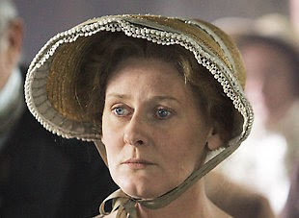
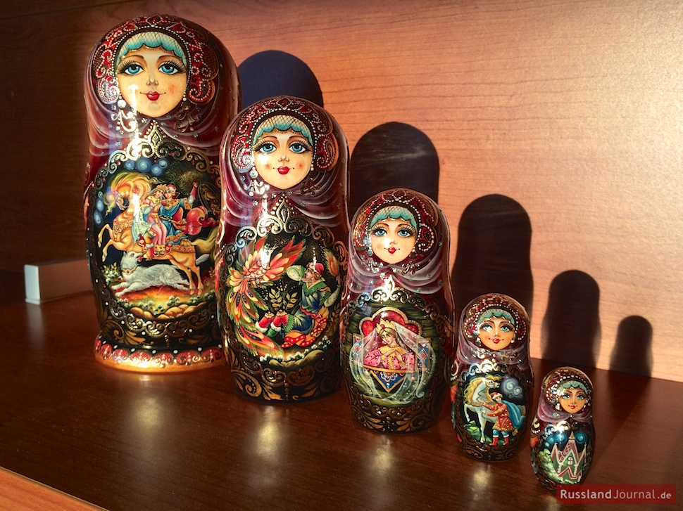
The Unreliable Narrator: Can We Trust Nelly?
A Silent Manipulator
Gothic Structure & Mystery
More Than a Servant
The "Matryoshka" Structure
Nelly Dean is not a neutral observer but an active participant. She
Stories within stories: Lockwood hears from Nelly, who quotes
often acts as a silent manipulator, withholding information or
others. This layering creates distance, enhancing the Gothic
intervening in events, driven by her own class consciousness and
atmosphere of legend and uncertainty.
moral judgment.
Subjectivity of Memory
The narrative is essentially "intimate gossip" told years later.
The Reader as Detective
History is distorted by Nelly's personal bias, favoring her
Because the narrator is biased and the listener (Lockwood) is naive,
perspective while casting judgment on the "wildness" of Heathcliff
the reader is forced to piece together the hidden truth by
and Catherine.
analyzing what is left unsaid.
9

Slide 10
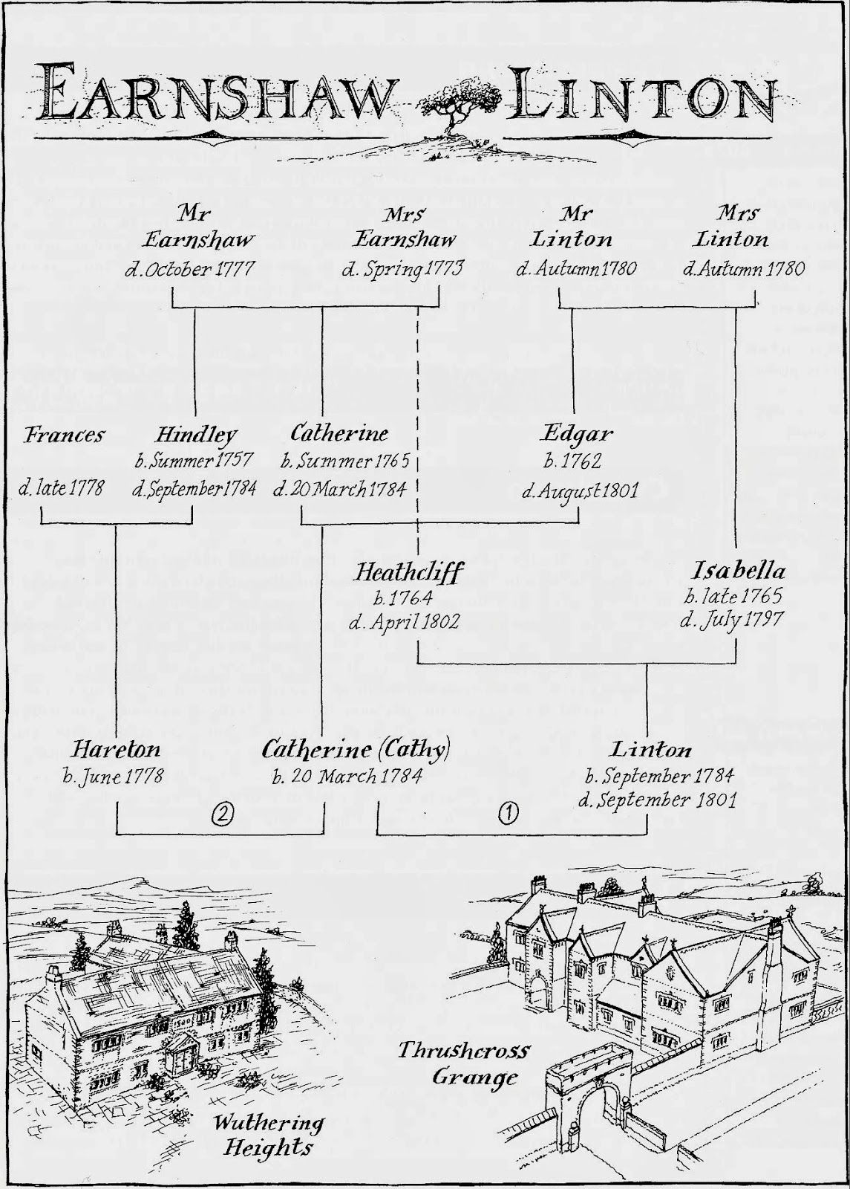
A Tangled Web: The Family Tree
Genealogy & Conflict
Generational Conflict
The Earnshaws (Wildness, Passion) clash with the Lintons (Civilization,
Propriety). Intermarriage destroys the peace of both estates.
The Cycle of Abuse
From Mr. Earnshaw to Hindley, and finally to Heathcliff. The victim
transforms into the tyrant, visiting the same degradation upon Hareton
and Isabella.
Weight of Heritage
Recurring names (Catherine/Cathy, Linton) symbolize the inescapable
past. Characters are haunted echoes of their ancestors.
Struggle for Ownership
Heathcliff disrupts Victorian class structure, rising from a homeless
"gipsy" to the legal master of both Wuthering Heights and Thrushcross
Grange.
10

Slide 11
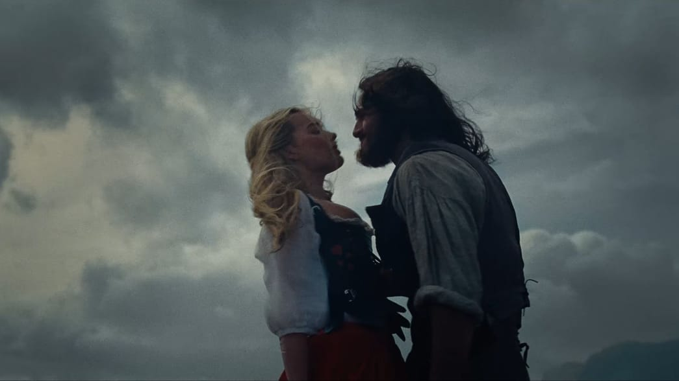
Heathcliff & Catherine: Mirrors of the Soul
Identity Fusion
Defiance & Divinity
"Nelly, I am Heathcliff!"
This famous declaration signifies a complete collapse of individual
identity. Unlike traditional romance, Catherine cannot conceive of a
universe where she exists without him. He is more "herself" than she
is.
Two Halves of One Soul
Catherine describes her soul and Heathcliff's as being made of the
Beyond Life and Death
same substance, whereas Edgar's is as different as "moonbeam from
The bond defies the "civilized" social gap between the Earnshaws and
lightning." They are spiritual twins who reflect each other's wild,
Lintons. Even death cannot sever it; Heathcliff is haunted by her
unrefined true selves.
ghost, viewing the grave not as an end, but as a thin veil separating
their reunion.
A Tormented Unity
Rejection of 'God'
Their connection is not soothing but fiery and rebellious. Because
They effectively replace traditional religion with idolatry of each
they are the same, they possess an innate knowledge of how to
other. Catherine dreams of being miserable in Heaven, and for
destroy one another, making their bond a source of both sustenance
Heathcliff, existence without Catherine is "hell." Their spiritual home is
and immense pain.
the wild moors, not the church.
10

Slide 12
Love as a Weapon of Destruction
Betrayal & Vengeful Madness
Security vs. Spiritual Truth
The Primal Catalyst
Class over Soul
·
Spiritual Amputation: Catherine's marriage to Edgar is viewed not as
·
The Tragic Pivot: Catherine chooses social safety (Edgar) over her
rejection, but as a severance of self.
identity ("I am Heathcliff").
·
Monomania: Heathcliff’s love curdles into a singular obsession;
·
Two Worlds: Attempting to straddle the civilized Grange and the wild
inflicting pain becomes his only connection to her.
Heights tears her apart.
·
Agent of Chaos: He shifts from a victim of abuse to an active
·
Consequence: By prioritizing Victorian social standing, she initiates
destroyer of the moral order.
the destruction of two lineages.
A Masterclass in Cruelty
The Toll of Repression
Systematic Dismantling
Internal & External Agony
·
Isabella as a Tool: Seduced and married solely to torment Edgar and
·
Physical Manifestations: Catherine's "brain fever" and starvation are
gain a foothold in the Grange.
rejections of her stifling life.
·
Degrading Hareton: Denying education to the rightful heir,
·
Haunted Existence: Heathcliff is haunted by the memory of a love
replicating Hindley's abuse.
that was denied life.
·
Financial Usurpation: Using gambling debts and forced marriages to
·
Festering Passion: Denied its natural course, love turns inward to
legally steal both estates.
destroy the vessel or outward to destroy the world.
12

Slide 13

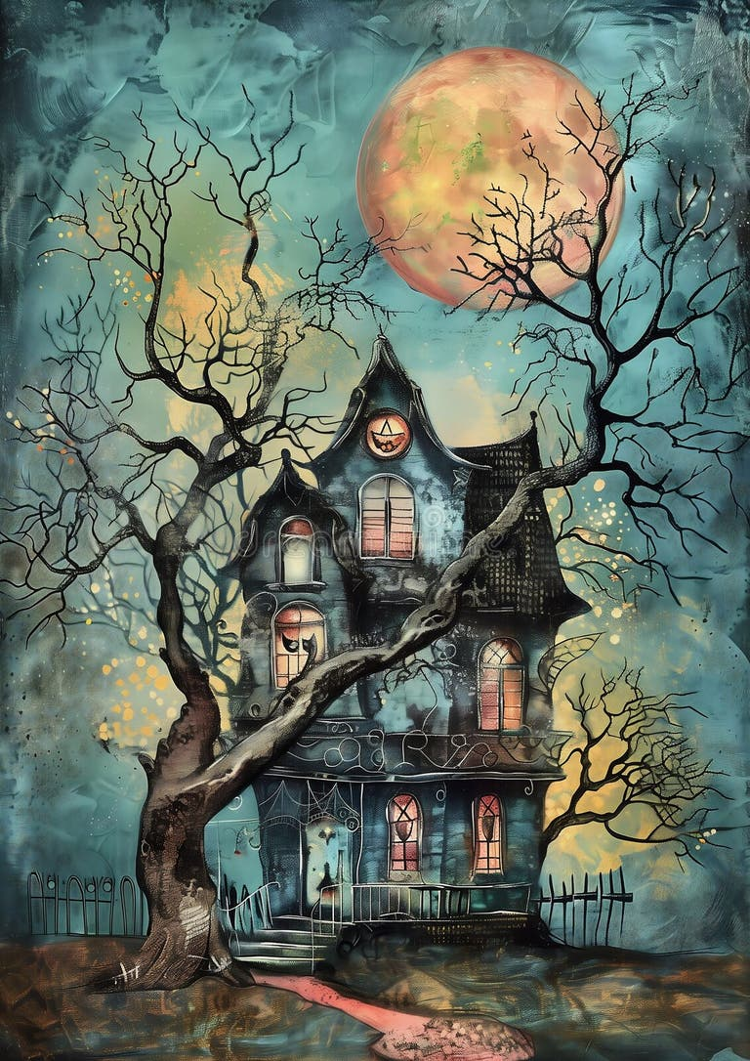

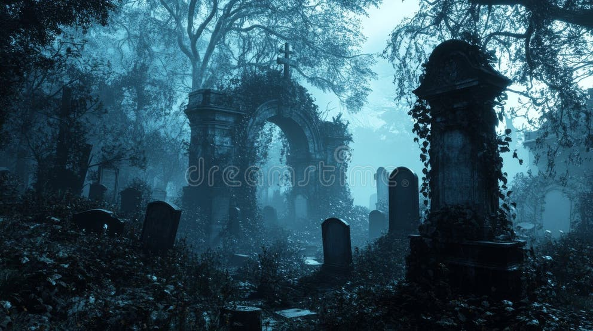
Gothic Elements: Whispers in the Dark
Physical & Supernatural
Psychological & Atmospheric
Madness & Obsession
Heathcliff does not fear the ghost but desires to be haunted. His
obsession blurs the thin veil between life and death, rejecting
religion for a spiritual union with the dead.
The Decaying Graveyard
A "wild" resting place near the moors, neither fully consecrated
nor free. It symbolizes that the storm lives on even in death,
Decaying Manors
offering no peaceful slumber.
Wuthering Heights embodies "ancestral curses" and stagnation.
The crumbling architecture physically mirrors the disintegration
and cycle of abuse within the Earnshaw family.
The Ghost at the Window
Lockwood’s terrifying encounter with "Catherine Linton"
establishes the theme of wandering spirits. The past refuses to
stay buried, literally reaching in from the cold.
13

Slide 14
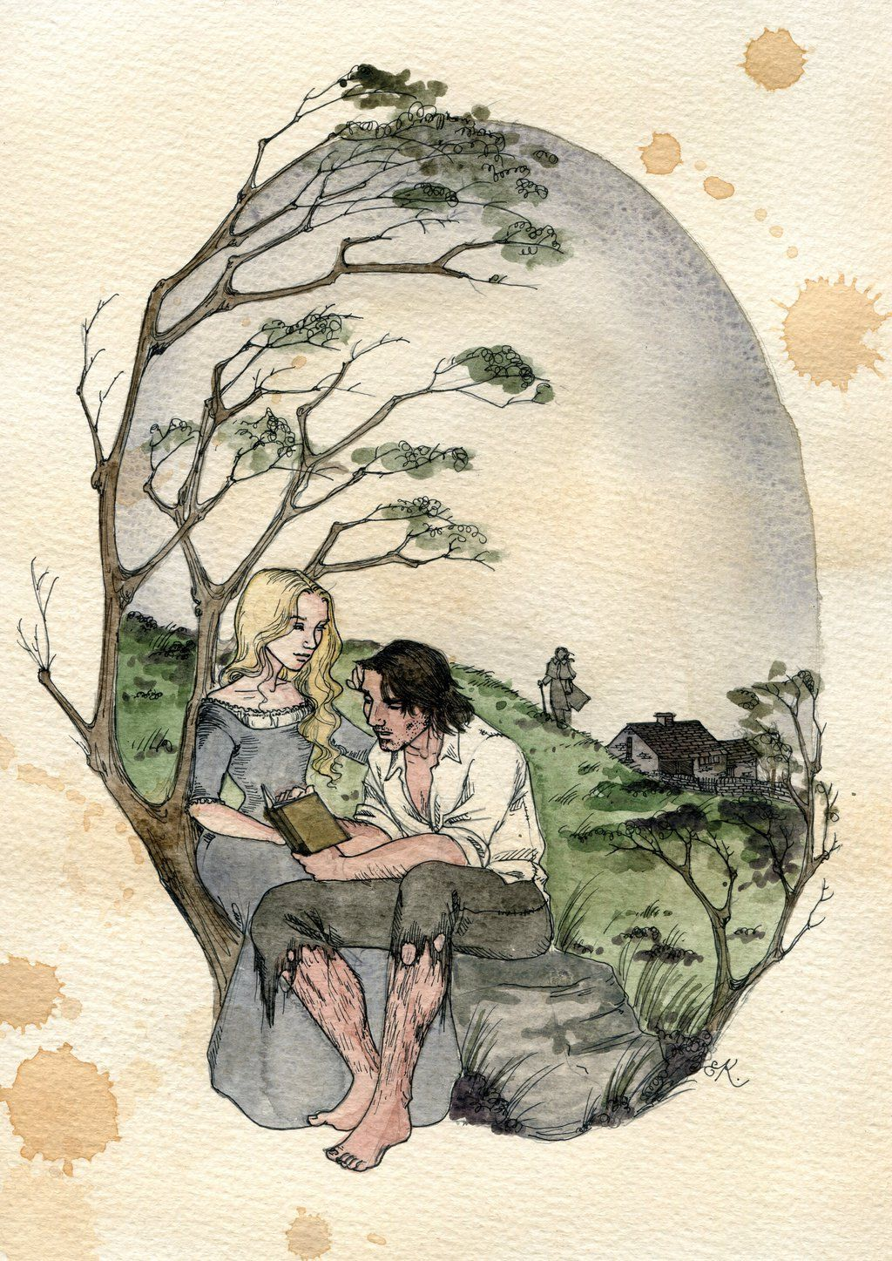
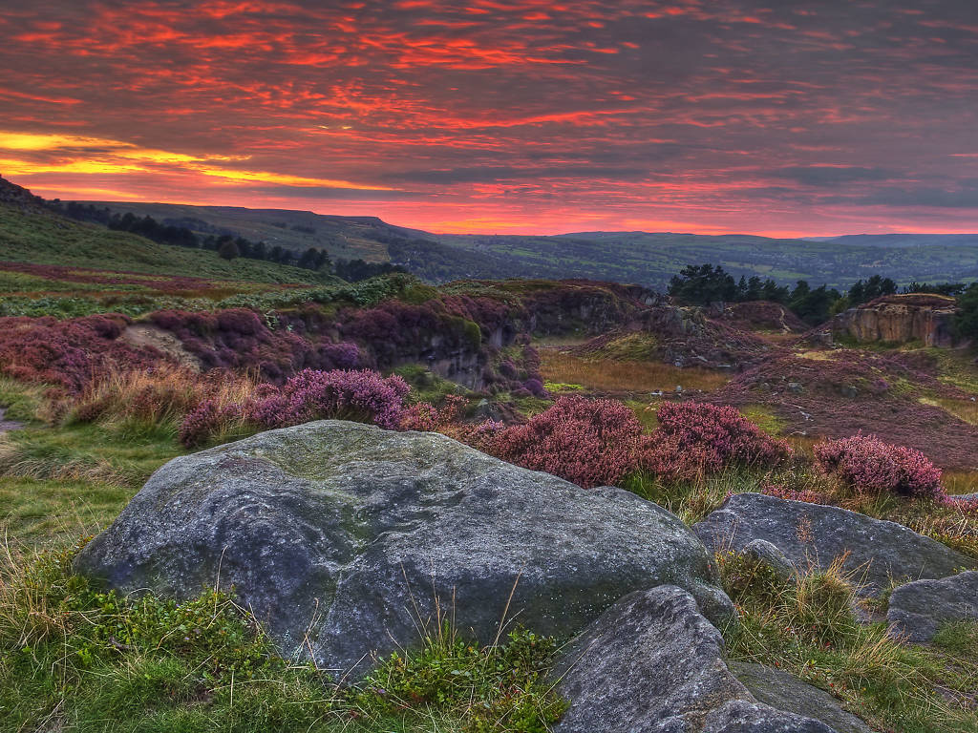
The Next Generation: Breaking the Cycle
Cathy & Hareton: Redemption
Restoring Balance to the Moors
A Quiet, Redeeming Love
Moving Towards Peace
Unlike the destructive obsession of the first generation, their union
The narrative moves from the "storm" of Heathcliff's revenge and
is built on genuine affection. It offers a resolution that honors the
insanity to a peaceful future. The darkness of Wuthering Heights
past but refuses to repeat its tragedy.
is finally lifted by the light of the next generation.
From Instinct to Education
Breaking the Cycle
The act of teaching Hareton to read symbolizes the transition from
The marriage unites the Earnshaw and Linton lines, restoring
raw primal instinct to educated, civilized affection, bridging the
structural balance and ending the generational conflict over
social gap between the families.
property and status.
14

Slide 15
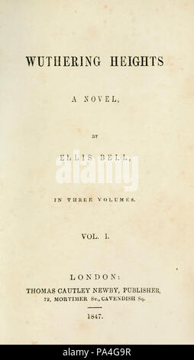
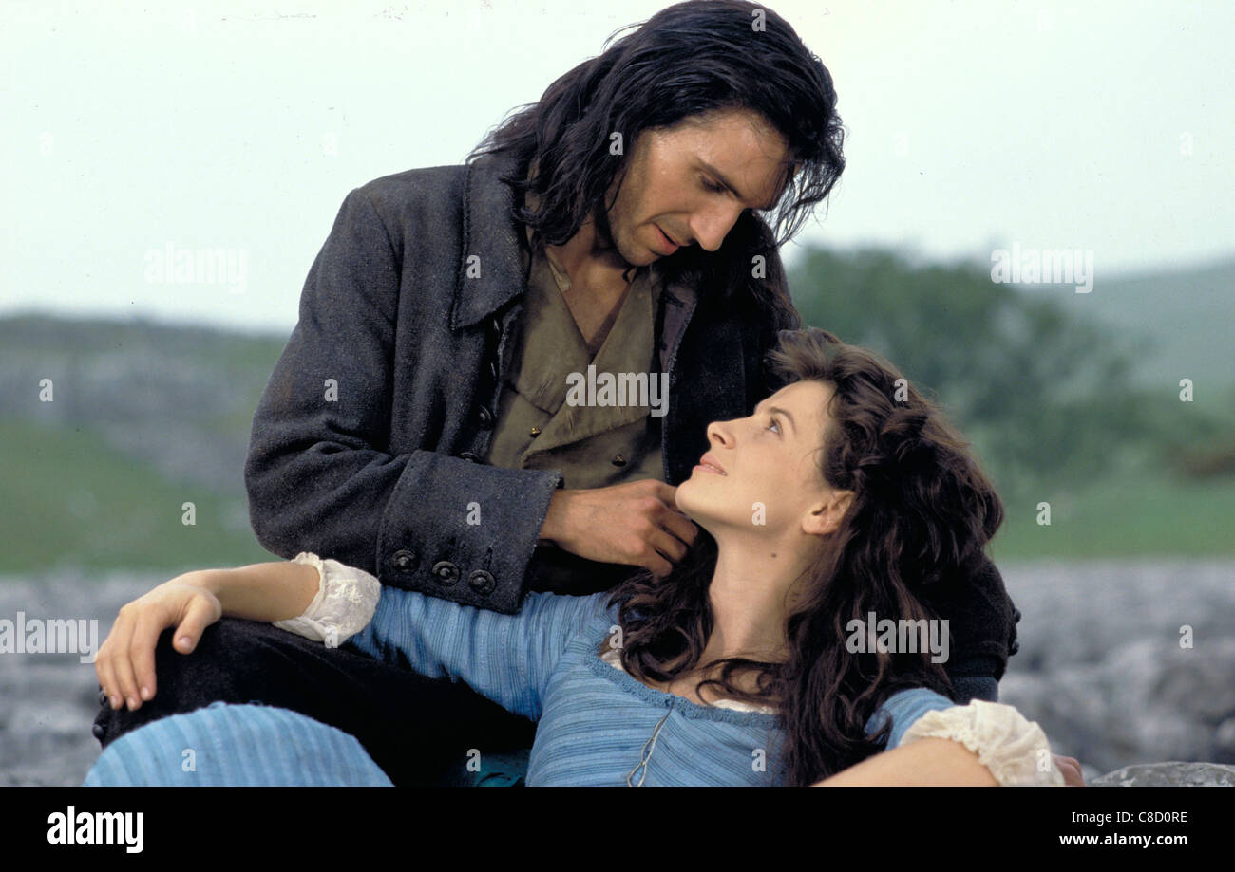
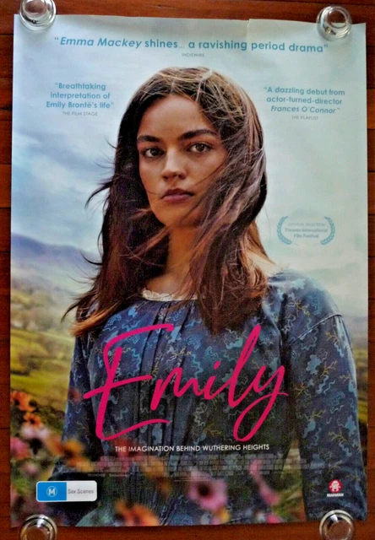
The Eternal Legacy: The Wind Never Ceases
From Scandal to Classic
Cinematic Adaptations
1847: A Critical Scandal
Definitive Romance (1992)
Emily Brontë’s only novel was initially rejected by
Starring Ralph Fiennes & Juliette Binoche
critics for its raw intensity and defiance of Victorian
moral norms.
Reissued by Charlotte Brontë (1850)
Why We Return to the Moors
We return not merely for romance, but to search for our own
Reimagining the Author (2022)
"wild" soul. The novel invites readers to explore the primal,
untamed instincts beneath the surface of civilized society.
The film
Emily
(starring Emma Mackey) explores the creative
fire that led to the masterpiece.
"The storm lives on in the pages."
Modern Pop Culture Influence
15

Slide 16
Thank You
Closing Thought
Discussion
Open for Questions
Are Heathcliff and Catherine truly meant to be, or are they
"He's more myself than I am. Whatever our souls are
toxic?
made of, his and mine are the same."
How does the setting of the Moors act as a character?
— Emily Brontë
Is Nelly Dean a reliable narrator?
Wuthering Heights
Legacy
A timeless exploration of human passion and the wildness of
Thank you for listening!
nature.
Any further insights are welcome.
16

