Slide 1
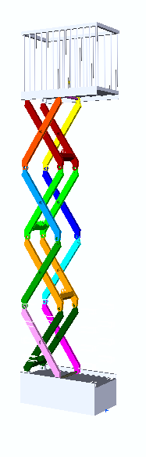
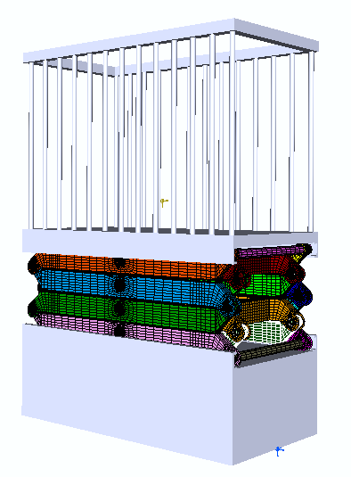
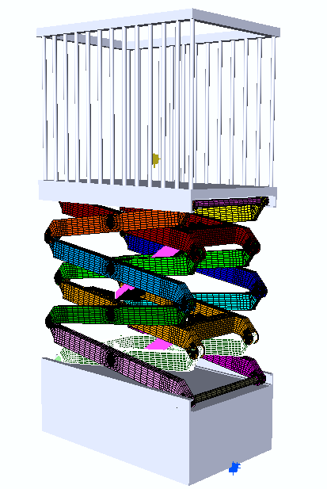
Tutorial
Scissor Lift Part 1

Slide 2
Tutorial Scissor Lift
FEDEM is a comprehensive modern CAE tool for virtual testing and verification of mechanical systems. The integrated use of dynamics and structural solving in FEDEM is an exceptionally efficient way of analyzing mechanisms, in this case a scissor lift.
This tutorial (part 1) will introduce the relevant tools used in order to simulate the ascend and decent of a scissor lift in the FEDEM Software. The result of the analysis will present the dynamic rigid body motion and the von Mises stress and deformation.
Part 2 of the tutorial will introduce loads and control system to the scissor lift mechanism.

Slide 3
Getting Started
Download the latest version of FEDEM
Download file containing all the necessary files from
www.fedem.com Link…
Make sure to familiarize with the FEDEM interface before initiation the tutorial

Slide 4
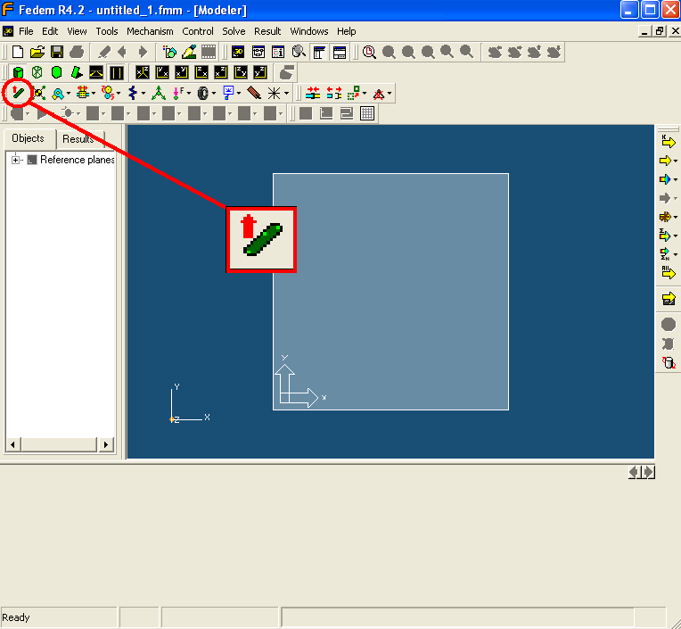
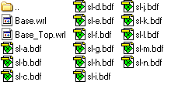
Importing Links
Open FEDEM and select the ‘’load link’’ symbol
Enter the directory where the files are located (Parts downloaded from ….Link…..)
Use the Ctrl key and select all parts. A List of the parts that should be in your directory is shown below (make sure to select ’’all files’ in the file type drop menu)
4. Open

Slide 5
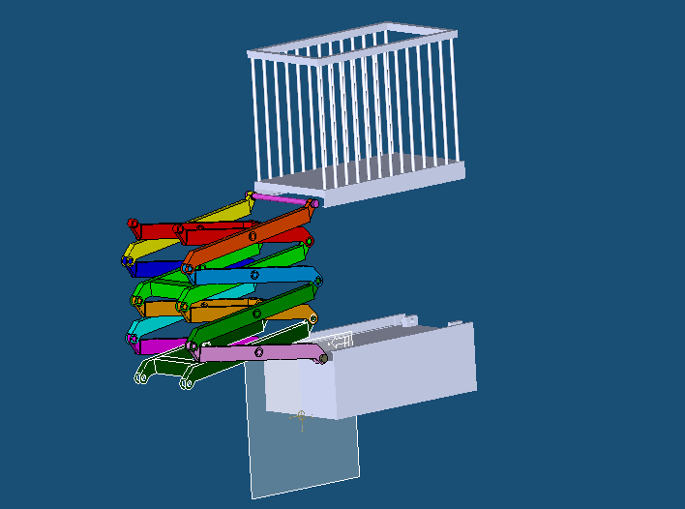
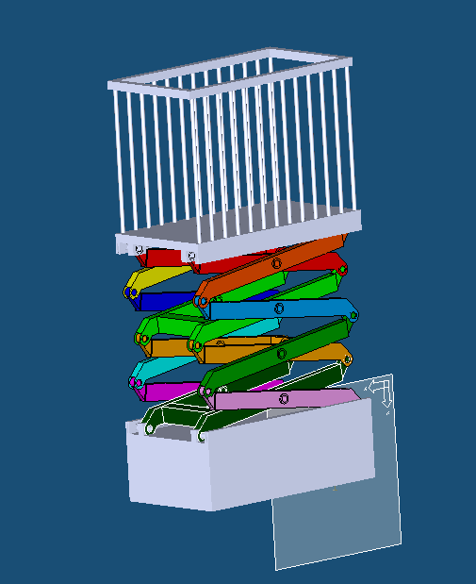
Aligning Parts
1. When all the parts are imported it is apparent that the base and top needs aligning
Click on the top part (‘’Base_top’’). The Property Editor (bottom of the screen ) will then appear.
Click on the ’’Origin’’ tab in the Property Editor and change the orientation ’’RotY[Deg]’’ from 0 to 180.0
4. Repeat the exercise for ’’Base’’. The model should then appear as shown to the right

Slide 6

Changing Link Appearance
In order to control the development of the model it is recommended that the structure is separated into smaller sections so that simulations can be performed, and errors can be located prior to the total completion of the model.
Highlight each individual part of the assembly except the base, sl-f, sl-e sl-i and sl-n and change the parts From ’’FE part’’ to ’’Visualization only’’ (in Property Manager)
2. Click the ’’Item Appearance’’ button located on the toolbar and select all links (except base, sl-f, sl-e, sl-i and sl-n) in the Model Manager. Change the appearance to ‘’off’’ so that the links are hidden

Slide 7
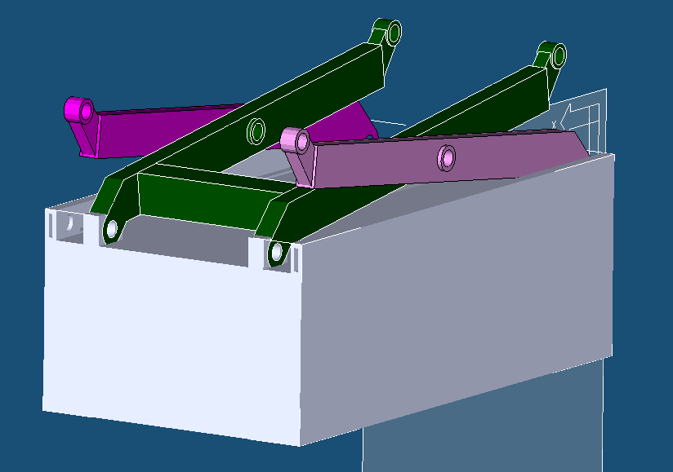
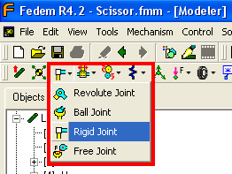
Constraining Base
The base has to be constrained to ’’Earth’’ in order for the structure to be connected to the ground.
The model should now appear as shown below
2. -Toolbar menu dropdown , select rigid joint and apply to one corner of the base by selecting one corner Done/ Enter.

Slide 8
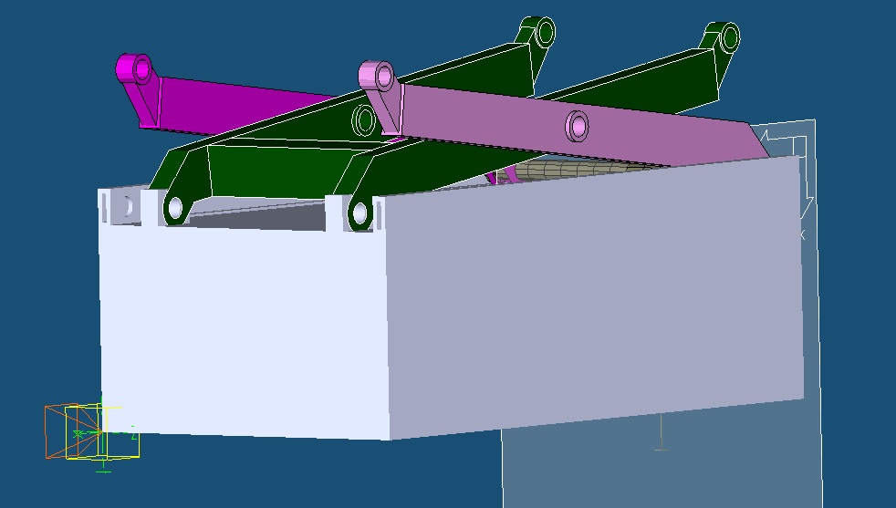
Attaching Rigid Joint To Base
Use the ’’Attach’’ button from the toolbar and attach the rigid joint to the workplane/earth (master) and then to the base (slave)
The joint should appear with green coordinate system and yellow cube. (if not, the joint is not properly attached). The model should now appear as shown below.

Slide 9
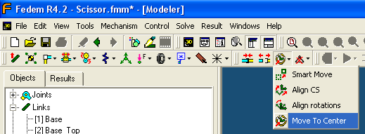
Applying Triads
In order to connect the links and have a mathematical relationship between the degrees of freedom and the link, triads have to be connected to each part. For more information regarding the function and application of triads se FEDEM User manual.
Hide all components except sl-i (bottom double scissor member).
Select the triad sign in the toolbar
Apply triad close to one of the bottom cylindrical supports. Change the local reference appearing in the bottom left corner slightly in order to separate the triad from the geometry you just applied it to. Done / Enter
Move the triad to the centre by clicking on the ’’move’’ drop down menu on the toolbar and follow the
prompts showing in the orange
field at the top right of the screen,
Done

Slide 10
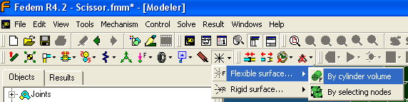
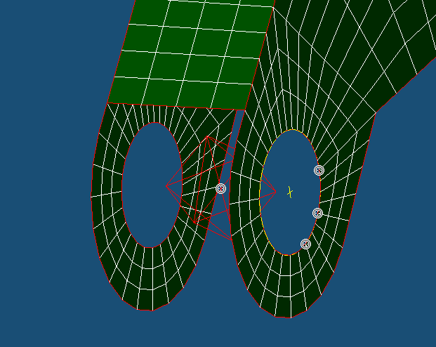
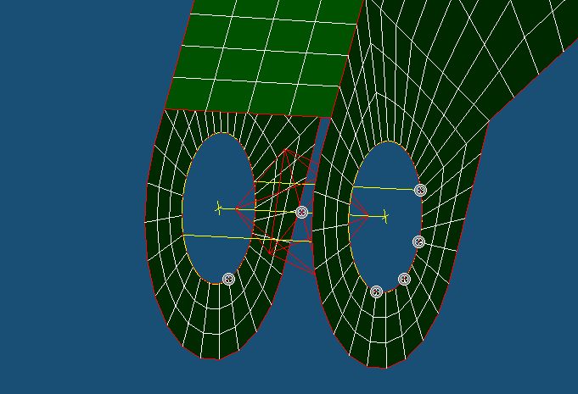
Connecting Surface to triad
Select the triad (The triad will turn red when selected) . The ’’Property Editor’’ will then appear. Change the origin Z value to -0.225 (X 1.25, Y -0.4325) this will locate the triad in the centre of the hole.
Select the ’’Surface connector’’ drop down menu in the toolbar. Select: flexible surface – by cylindrical volume.
7. Highlight the triad (so it is red) – Done, then select three point on the circumference of the circle – Done. Click ’’Complete Circle’’
8. Select a point/node on one side of the desired cylindrical volume – Done. Then select a node on the opposite side of the volume - Done

Slide 11
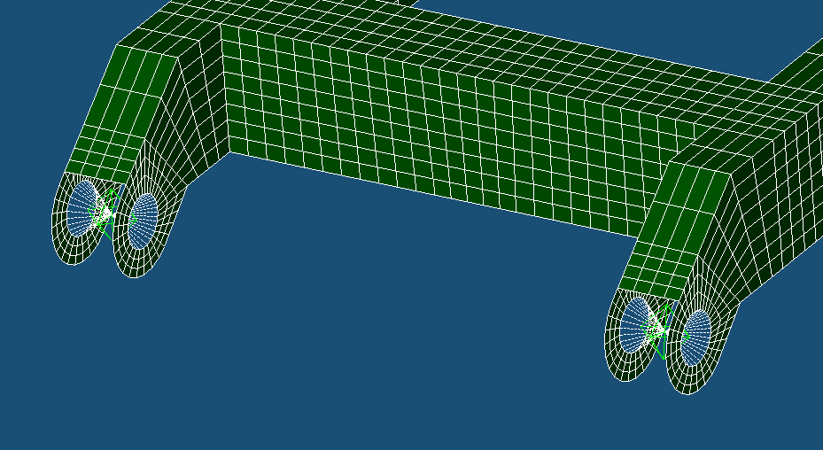
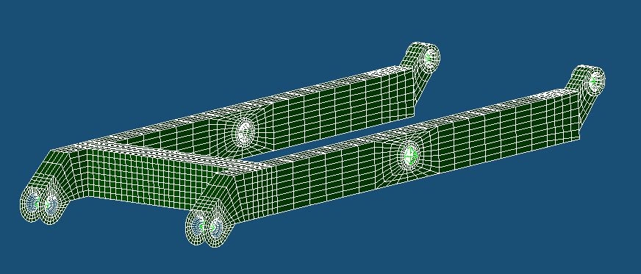
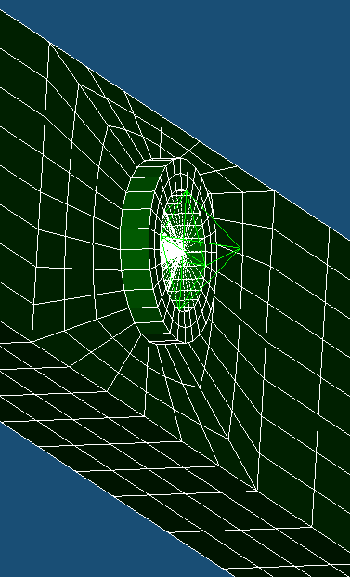
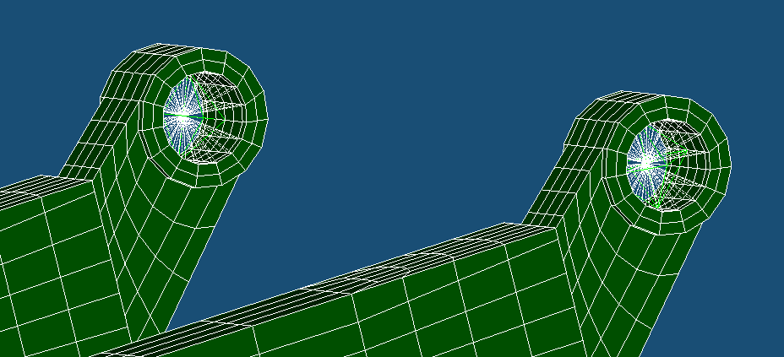
Applying Triads
The Joint should now appear as shown below.
Repeat the exercise for the other cylindrical supports. And remember the following:
Change the coordinate slightly after applying the triad in order to disconnect from node (z=0.225 on other side, 0.295 for opposing links)
The centre triads (middle of the link) are located on the outside of the structure
Snap Shots:

Slide 12
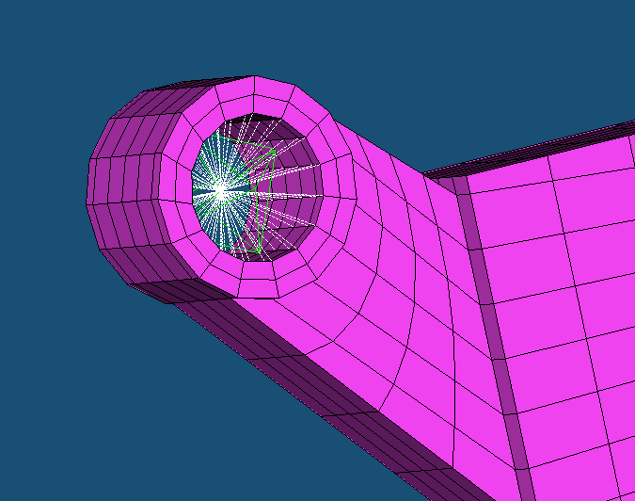
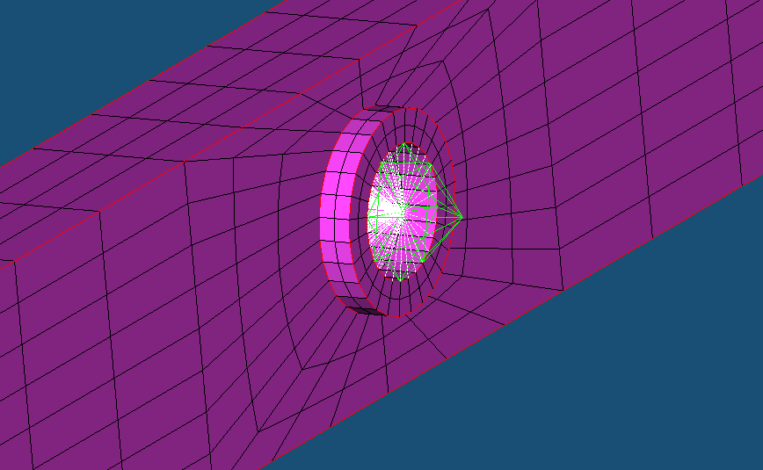
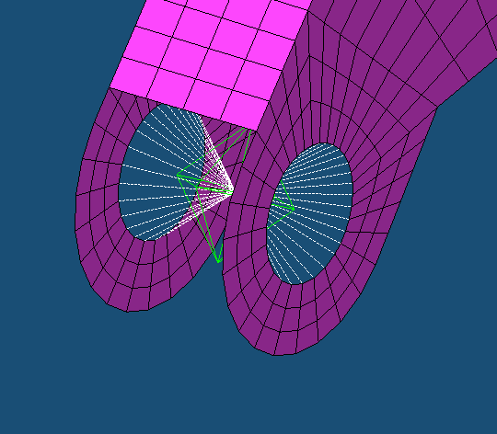
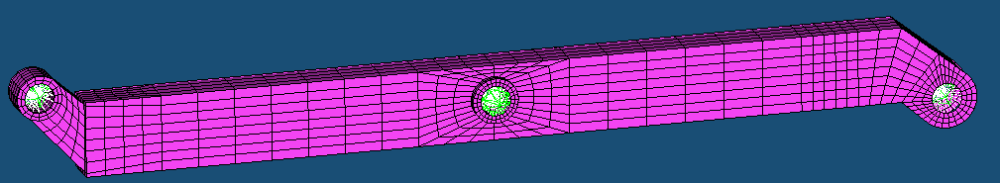
Applying Triads Cont.
Use the item appearance tool to hide the current link (ls-i) and make link ls-e visible.
Repeat the triad placement. Note that the triad that is already located in the centre hole can now be used to create the new surface connector for this link (where as a new triad will automatically be created) Note. New Z value to locate the triad
= -0.295
Snap Shots:

Slide 13
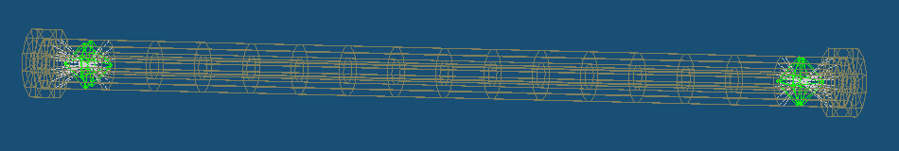
Applying Triads Cont.
Hide the current link and use the item appearance tool from the toolbar to make link ls-f. New Z value to orientate the triad +0.295
When this is completed, use the item appearance tool to hide ls-f and to make ls-n visible. This link will ultimately contain 4 joints. Two revolute joint to allow the connected link to swivel and two identical free joints that will allow the shaft to follow the designated rail in the base.
3. Apply a surface connector (by cylindrical volume) where triads already are located (from the connecting link). Use the existing triads to create the surface connector

Slide 14
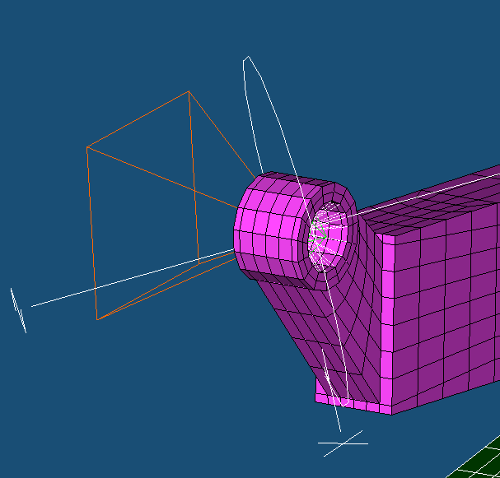
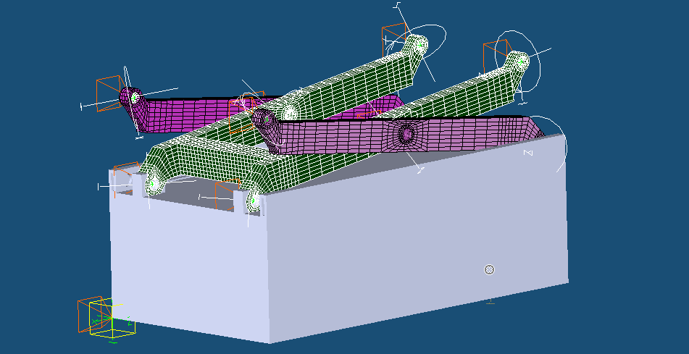
Applying Revolute Joints
In order to relate the separate parts and their triads to each other their individual degrees of freedom has to defined and constrained with respect to each other.
Show link: sl-n, sl-e, sl-f, sl-i and base
Use the joint selection menu as referred to earlier and pick the revolute joint
Apply the revolute joint to each part of the links where triads have been applied earlier. Note that only one joint is required per location. (it may be required to change the appearance of some links in order to locate the triad and hence apply the revolute joint). NOTE. Do not place joints in the top links that does not have a connecting link. (Shown in pictures for illustrative purposes)
Snap Shot:

Slide 15
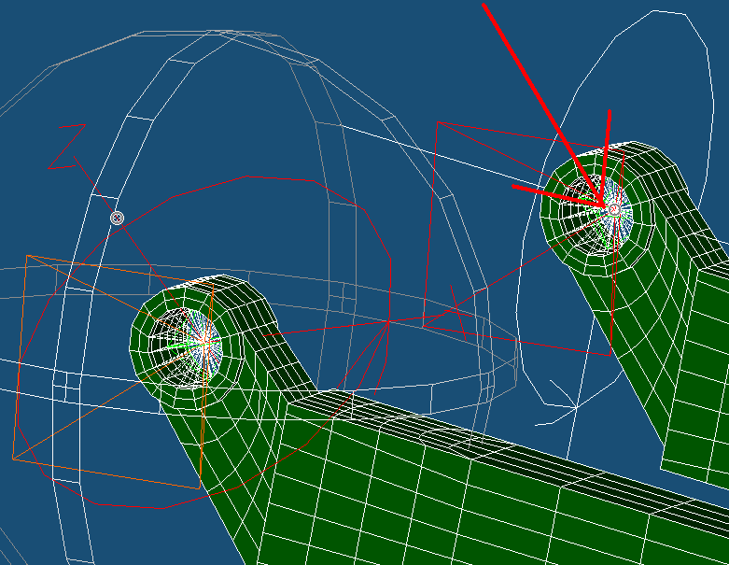
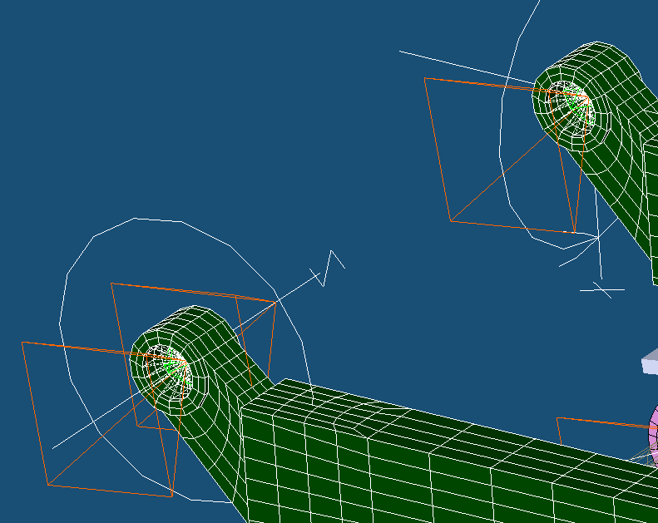
Aligning Revolute Joints
In order to allow the relative motion between links it has to be aligned so that the axis of rotation is normal and intersecting with the centre of of the cylinder volume.
Use the smart move command located in the ’’move’’ drop down menu in the toolbar.
Choose the z axis of a revolute joint by clicking on it- Done / Enter. A small cross will appear on the axis and the joint will appear red.
Click on a node / triad that is in the direction of where the z-axis will be intersecting – Enter. The z-axis will then move. Shown Below.
note that one pyramid indicates the location of the joint and the other the alignment of the axis

Slide 16
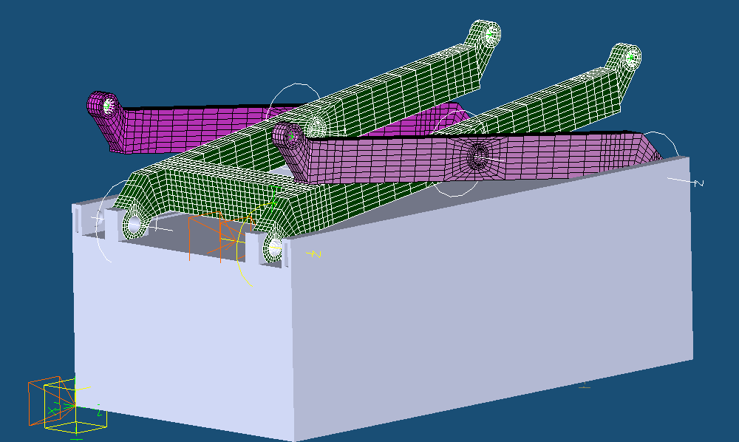
Align revolute Joints Cont.
Complete this procedure for all the applied joints.
Snap Shots:
Note that all the revolute joints have two stickers (pyramids) indicating that
both the centre and direction of the z axis (directing of rotation) are aligned.

Slide 17
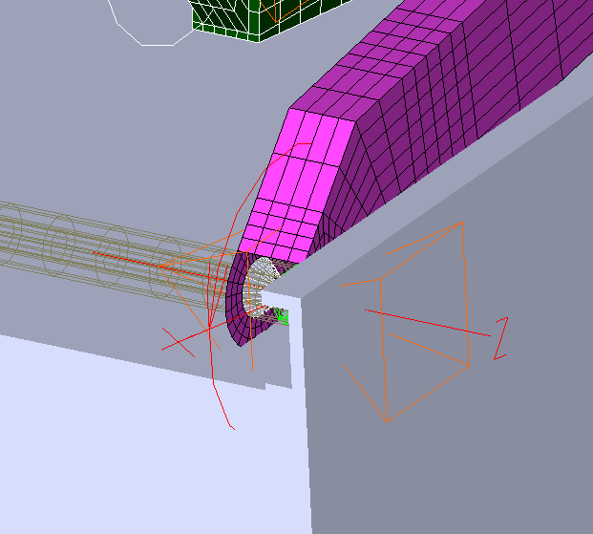
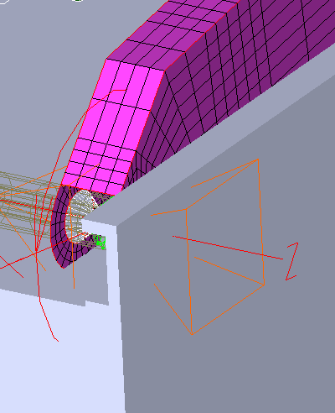
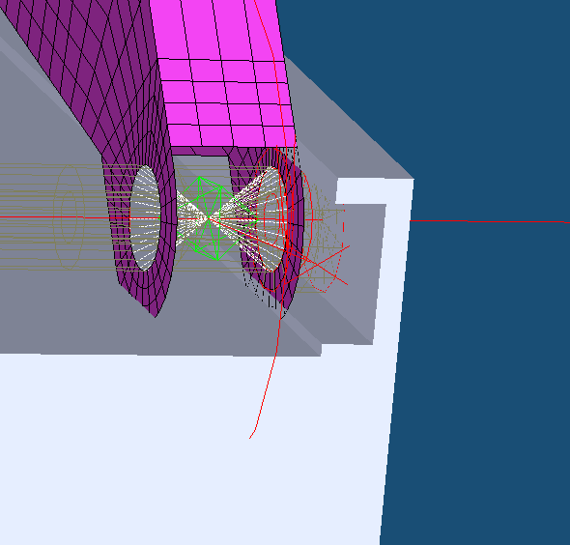
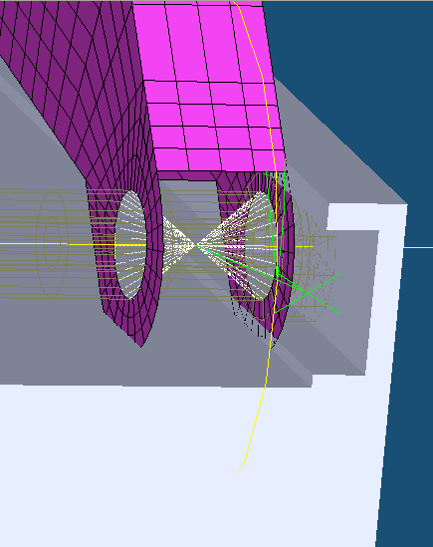
Attaching Revolute Joints
In order to relate the revolute joints to each part it is necessary to connect it to the individual links where relative motion is occurring.
Use the Attach button from the toolbar menu
Select the joint that needs to be connected Done/Enter
Select one of the connecting links Done/Enter
Select the other connecting link Done/Enter
Repeat for all revolute joints
The joint should appear yellow if it is connected. Master/slave is not relevant unless the joint is connected to ground. (when connecting to base, the master has to be the base)

Slide 18
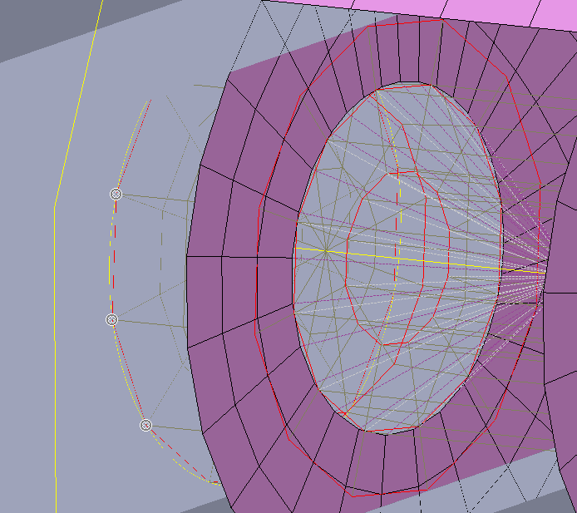
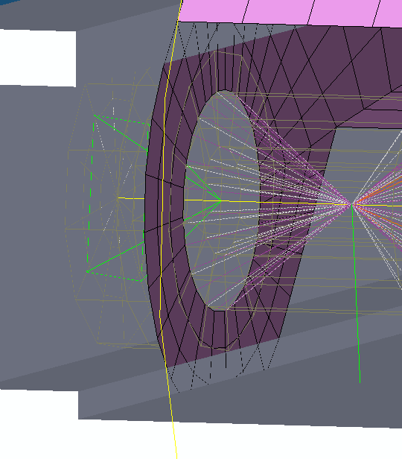
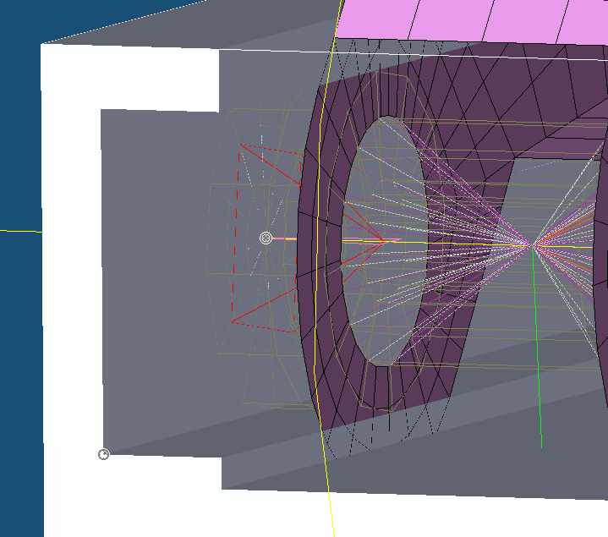
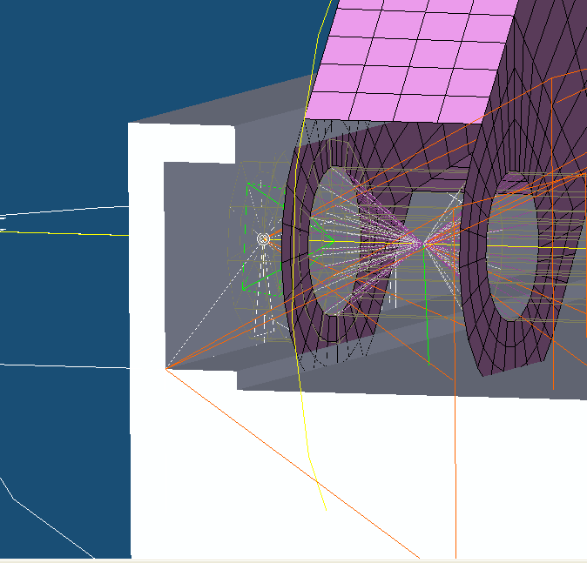
Applying Free Joint
In order to allow the bottom shaft to follow the rail (hence allowing the structure to move up and down) a free joint is applied. The joint will later be constrained in a manner so that only the desired degree of freedom is allowed.
Apply a triad to the centre end node of the shaft by selecting the ’’ surface connector-by cylindrical volume’’. Click on three point on the circumference of the end of the shaft (sl-n) Done/Enter – Done/Enter
Select free joint from the dropdown menu in the tool bare menu.
Select the Base Done/Enter
Select the centre triad of the shaft as made in 1 Done/Enter (appears red when selected)

Slide 19
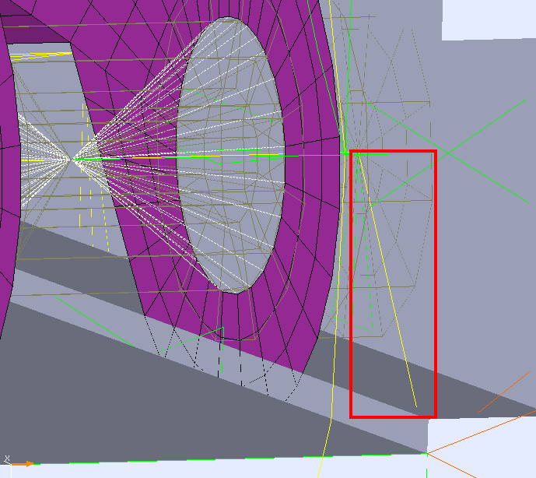
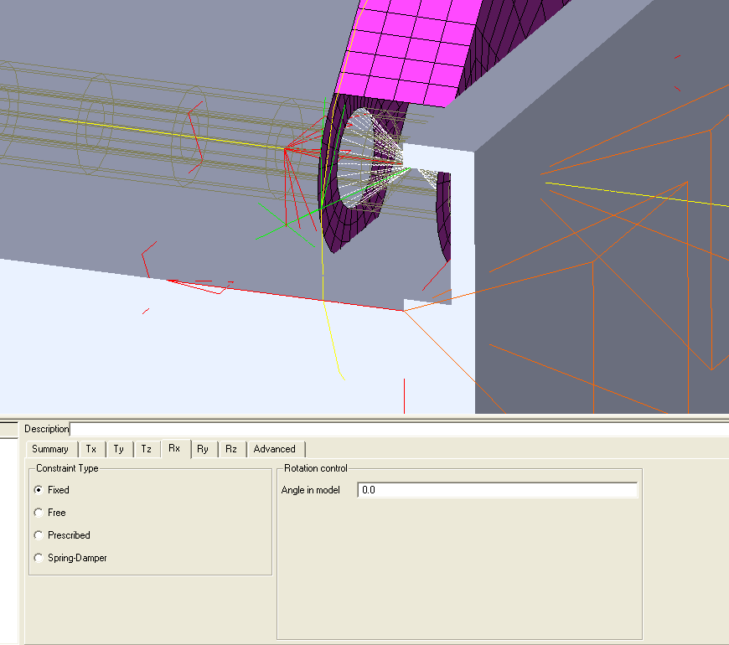
Attaching Free Joints
In order to define what links are in relative motion with respect to the free joint, it has to be attached.
Use the attach option from the tool bar menu.
Select the joint (closest to the base), Done/Enter
Select the base, Done/Enter. (this will now become the master)
Select the joint closest to shaft Done/Enter
Select the shaft Done/Enter (this will then become the slave)
The joint should now appear yellow (green coordinates)
6. Click on the joint so that the Property Editor comes up. (make sure to select the actual joint and not the coordinate systems). Set all except Tx to fixed

Slide 20
Change Direction Of gravity
The bottom left coordinate system indicates the directions of the global coordinatesystem. The Orange harrow indicates the direction of gravity.
To change direction of gravity
Edit
Model Preferences
Change the direction of gravity by setting the magnitude 9.81 in the correct direction. (z=0, x=0 Y=9.81 in this case)

Slide 21
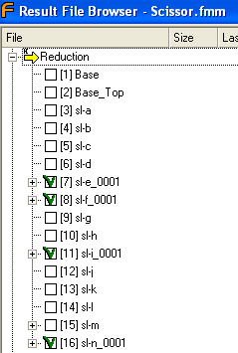
Checkpoint 1.
Click in the far left corner to reduce links.
Check the result file browser from the toolbar menu. Reduced links should have a green hatches as shown below.
Problems:
If a red cross appears on any other parts they are probably not switched to ’’visualization only’’. See slide 6.
If any of the relevant parts have a red cross it might be a problem with the application of triads or surface connector. Do over

Slide 22
Checkpoint 1
Now it is time to try the model for the first time. Click
(If some error messages appears on the screen, read the output and try and identify the error. Note that there are no revolute joint in the top 4 joints)
The model will then solve. Enter the result tab in the Model Manager (left on screen)
Enter the dynamics tree and right click ’’dynamics [rigid body motion]’’- Load Animation
Press Play button on the control that appears at the bottom right of the screen.
The links should now drop downwards as expected whereas there is nothing constraining them from this motion. Check that the shaft is only moving in the designated free motion (x-direction)

Slide 23
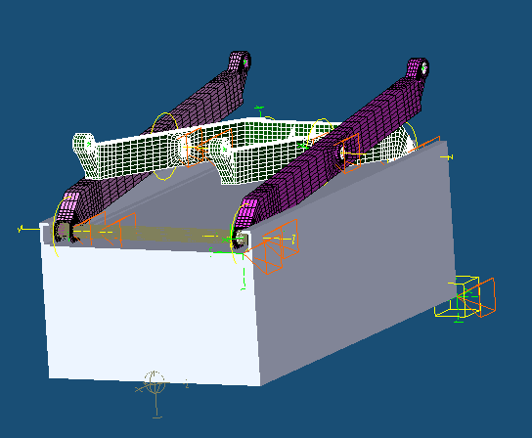
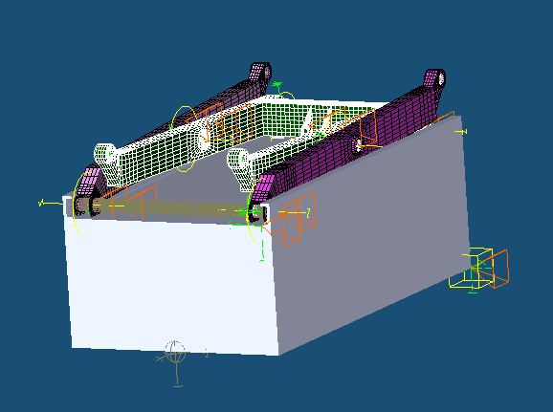
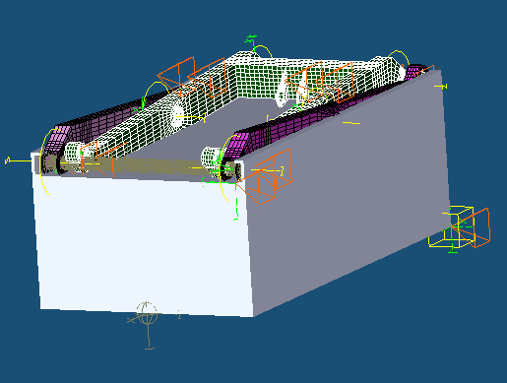
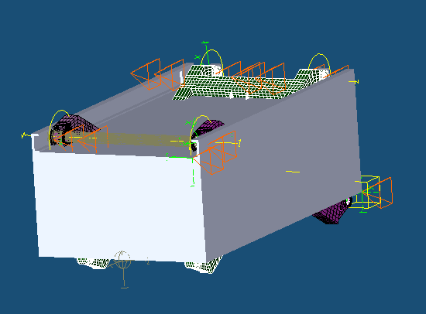
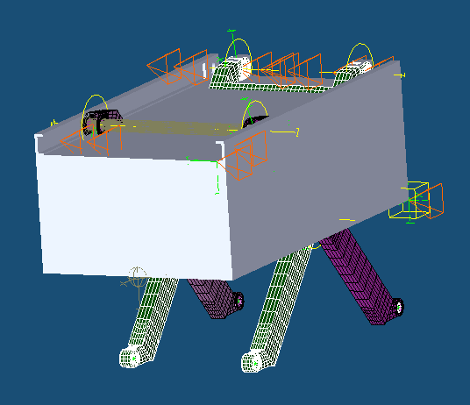
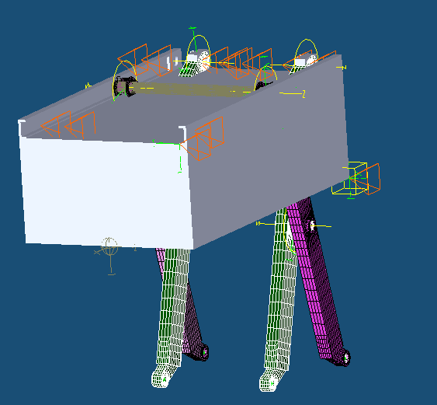
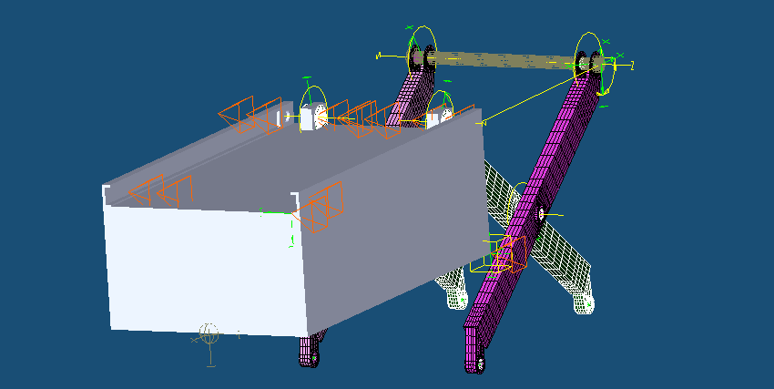
Checkpoint 1.
Snap Shots

Slide 24
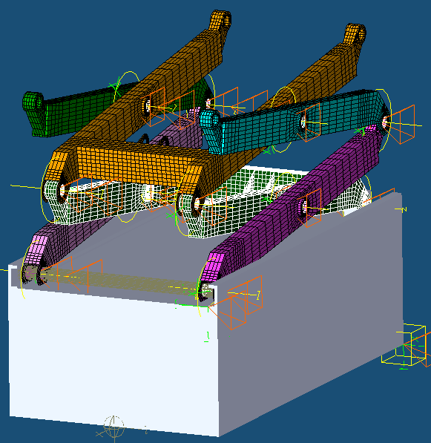
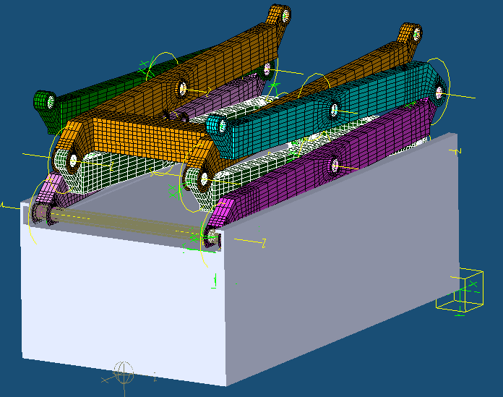
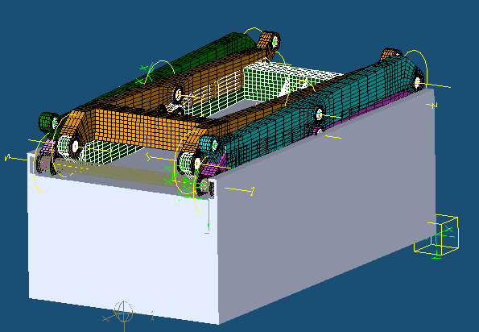
Adding Components
Now that the preliminary stage is completed it is time to add more links to the lift. It is recommended that only three pieces are added at the time and that the simulation is runned after each stage in order to obtained better control.
1. Enter the Model manager-Links, and change link sl-a, sl-b and sl-k to FE-Parts (no visualization only)
2. Follow the previous steps and place surface connectors in each of the holes in the new members
3. Put revolute joints in all the new triads and attach them to the links as per previous slides
4. Run the simulation

Slide 25
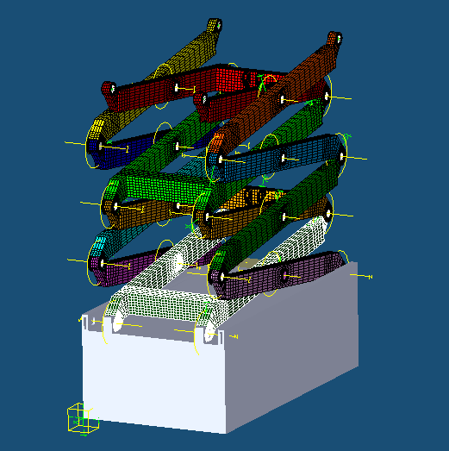
Complete The Lift
Repeat the previous steps for all remaining links

Slide 26




Attaching The Top Base
Make the top base visible
Add revolute joint, and attach
Add link sl-m and hide all connecting links
Create surface connector to current triad and at the end nodes similar to joint sl-n (slide 13)

Slide 27


Attaching Revolute Joints
Attach revolute joints to the shaft and the connecting links
The triads created at the end of the shaft will connect to the top base and allow the shaft to follow that rail by the use of a free joint
Apply free joint to the top shaft (sl-m) and the top base. Attach to both making the shaft the master. Set the
free joint to fixed i all directions
except x-direction

Slide 28


Run Simulation
Now it is time to run the simulation and watch the scissor lift fall (due to lack of applied loads)

Slide 29



Applying Loads
Select the free joint connecting the base (bottom) to the shaft and select the spring – damper option in the Property Manager that appears.
Inputs: Load magnitude = 30 000
Spring Properties = 100 000
damper Properties = 10 000
Select the Dynamic solver setup from the solver drop down menu on the far left of the screen. Increase the solver time from 1 to 5 sec.
Run Dynamic solver and Recover stress

Slide 30


Results
Enter the ‘’results’’ tab in Model Manager and load the animations
It is now possible to view the results. Use the Probe tool to find the stress in the areas of interest.

Slide 31


Notes
It is important to note that that the load applied in this case is strictly present to create movement. Part 2 of this tutorial will present areas of interest with respect to the application of loads and control system as well as introductory parts of post processing in FEDEM

Slide 32
End

