Slide 1
Fully Homomorphic Encryption for Privacy-Preserving Machine Learning using the OpenFHE Library February 19, 2024
Ian Quah, Yuriy Polyakov, Sukanya Mandal
{iquah,ypolyakov,smandal}@openfhe.org

Slide 2
Agenda
Lab Discussion: Comparing and Contrasting PPML Methods
Spinning Up in Homomorphic Encryption for ML
Q&A on FHE for ML
OpenFHE Library
Quick Break
Hands-on: Training an Encrypted Logistic Regression Model in the OpenFHE Framework
Using an In-the-Clear Model in the OpenFHE Library
ML Applications and FHE Challenges

Slide 3
Comparing and Contrasting PPML Methods

Slide 4
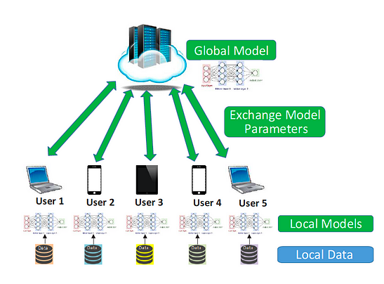
DISTRIBUTED LEARNING
Definition: A system of interconnected learning models that train on distributed datasets.
Key Features: Scalability, Privacy, Decentralization.
Applications: Large-scale machine learning, geographically dispersed data, collaborative research.
Source: https://digestize.medium.com/centralized-learning-vs-distributed-learning-c75ee9e94423

Slide 5
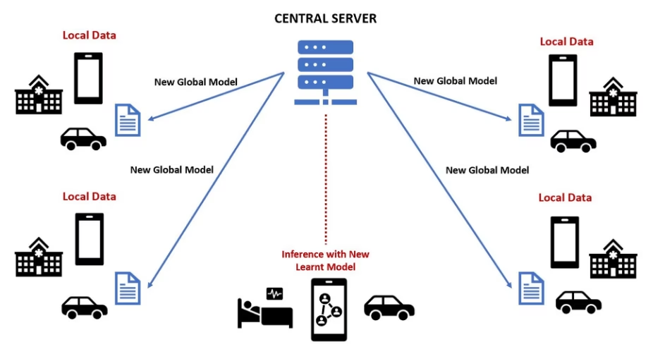
FEDERATED LEARNING
Definition: A machine learning approach where a model is trained across multiple decentralized devices or servers holding local data samples, without exchanging them.
Key Features: Privacy preservation, Reduced communication costs, Collaborative learning without sharing raw data.
Applications: Smartphone keyboard prediction, Healthcare data analysis, Collaborative fraud detection.
Source: https://www.netapp.com/blog/future-of-AI-federated-learning/

Slide 6
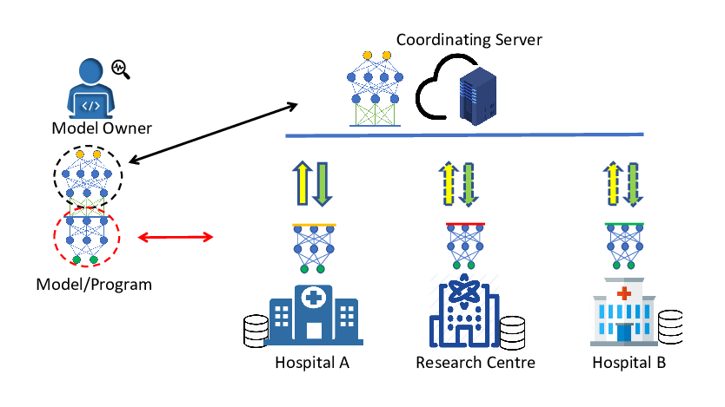
SPLIT LEARNING
Definition: A collaborative machine learning technique where the model training is split between the client device and a central server.
Key Features: Reduced data transfer, Privacy protection, Efficient use of bandwidth.
Applications: Edge computing, IoT devices, Privacy-sensitive industries.
Source: https://www.researchgate.net/figure/An-application-of-split-learning-in-a-cross-siloed-health-environment_fig5_344754274

Slide 7
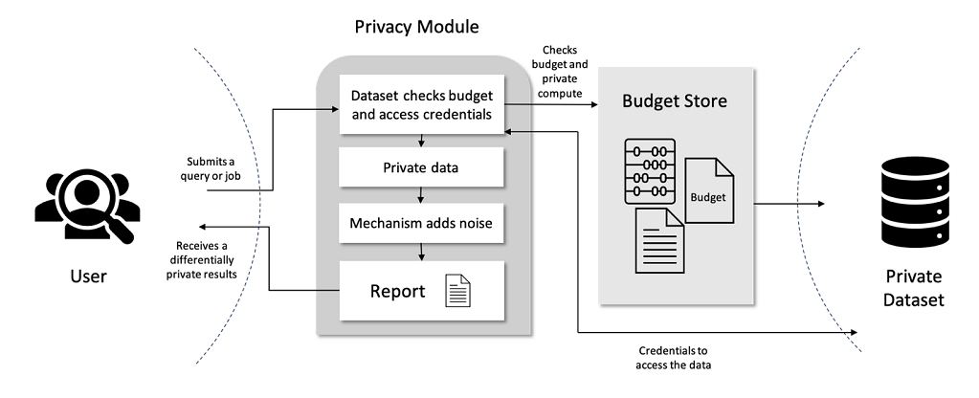
DIFFERENTIAL PRIVACY
Definition: A technique that adds 'noise' to data to prevent the disclosure of individual information while still allowing for accurate aggregate analysis.
Key Features: Privacy guarantee, Robust to post-processing, Quantifiable privacy loss.
Applications: Census data, User behavior analytics, Public data releases.
Source: https://cloudblogs.microsoft.com/opensource/2020/05/19/new-differential-privacy-platform-microsoft-harvard-opendp/

Slide 8
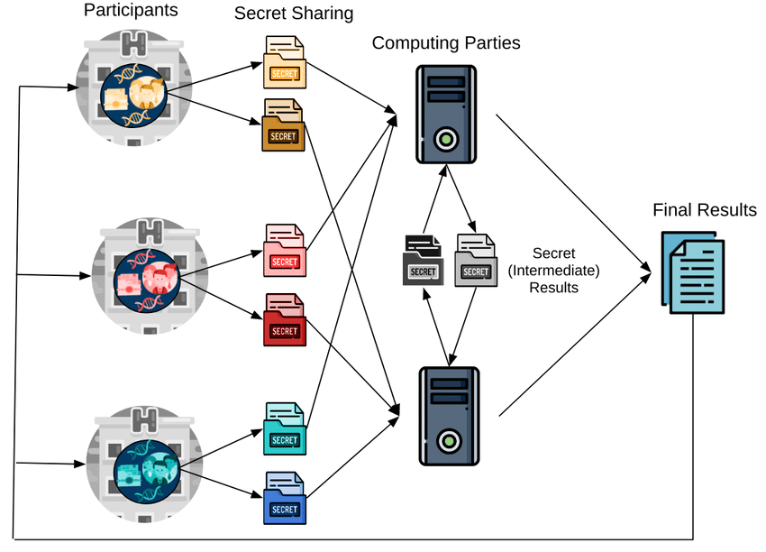
SECURE MULTI-PARTY COMPUTATION
Definition: A cryptographic protocol that enables parties to jointly compute a function over their inputs while keeping those inputs private.
Key Features: Data confidentiality, Computation integrity, Collaborative computation without mutual trust.
Applications: Joint financial analysis, Privacy-preserving scientific research, Secure voting systems.
Source: https://www.researchgate.net/figure/Secure-multi-party-computation-Each-participant-shares-a-separate-different-secret-with_fig2_343179246

Slide 9
SECURE ENCLAVES/TRUSTED EXECUTION ENVIRONMENT
Definition: Secure Enclaves, also known as Trusted Execution Environments (TEE), are protected areas within a processor or a larger computing system. They ensure that sensitive code and data are stored, processed, and protected in a secure environment.
Key Features:
Isolated Execution: Code within the TEE runs in an isolated environment to prevent unauthorized access or tampering.
Data Encryption: Data is encrypted in the TEE, ensuring confidentiality and integrity even if the system is compromised.
Remote Attestation: Enables a third party to verify the enclave's integrity and the authenticity of the software running inside.
Access Control: Only authorized code can run inside the TEE, preventing malicious operations.
Applications:
Secure Mobile Payment Processing: Protects payment information from being exposed to the rest of the system.
Confidential Computing: Allows sensitive operations like personal data processing or proprietary algorithms to run securely.
DRM and Content Protection: Ensures that digital rights are enforced by only allowing access to content under secure conditions.

Slide 10
Spinning Up in Homomorphic Encryption for ML

Slide 11
WHAT IS HOMOMORPHIC ENCRYPTION?
Encryption protocol with one extra operation: Evaluation
Allows for computation on encrypted data
Enables outsourcing of data storage/processing
How is FHE related to symmetric and public key encryption?
FHE schemes provide efficient instantiations of post-quantum public-key and symmetric-key encryption schemes
Homomorphic encryption can be viewed as a generalization of public key encryption
Key milestones in the history of homomorphic encryption
Rivest, Adleman, Dertouzos (1978) -- “On Data Banks and Privacy Homomorphisms”
Gentry (2009) -- “A Fully Homomorphic Encryption Scheme”
Multiple HE schemes developed after 2009

Slide 12
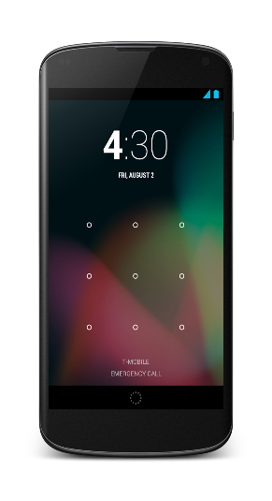




EXAMPLE OF FHE WORKFLOW
FHE Client
Data Source
Pk
Public Encryption Key
Encrypted Result
Encrypted Data
Sk
Secret Decryption Key
Computation Host
Decrypted Result

Slide 13
FHE vs OTHER SECURE COMPUTING APPROACHES
 | FHE | MPC | Secure Enclaves/SGX
Performance | Compute-bound | Network-bound | Close to plaintext
Privacy | Encryption | Encryption / Non-collusion | Trusted Hardware
Non-interactive | ✔ | ✘ | ✔
Cryptographic security | ✔ | ✔ | ✘ (known attacks)
Hybrid approaches are also possible, e.g., MPC + FHE

Slide 14
TYPICAL FHE OPERATIONS
Encrypt bits and perform logical AND, OR, XOR operations on the ciphertexts.
0 AND 1 → 0, 0 OR 1 → 1, 1 XOR 1 → 0
Encrypt small integers and perform addition and multiplication, as long as the result does not exceed some fixed bound, for instance, if the bound is 10000
123 + 456 → 579, 12 * 432 → 5184, 35 * 537 → overflow
Encrypt 8-bit unsigned integers (between 0 and 255) and perform addition and multiplication modulo 256
128 + 128 → 0, 2 * 129 → 2
Encrypt fixed-point numbers and perform addition and multiplication with the result rounded to a fixed precision, for instance, two digits after the decimal point
12.42 + 1.34 → 13.76, 2.23 + 5.19 → 11.57
Different homomorphic encryption schemes support different plaintext types and different operations on them.

Slide 15
SOME EXAMPLES OF REAL-SCALE FHE APPLICATIONS
Private information retrieval
https://eprint.iacr.org/2017/1142, IEEE S&P 2018
Private set intersection
https://eprint.iacr.org/2017/299, ACM CCS 2017
https://eprint.iacr.org/2018/787, ACM CCS 2018
https://eprint.iacr.org/2021/1116, ACM CCS 2021
Genome-wide association studies based on chi-square test and logistic regression training
https://eprint.iacr.org/2020/563, PNAS 2020
Logistic regression training
https://eprint.iacr.org/2018/662, AAAI Conference on AI 2019
Neural network inference (ResNet-20 to ResNet-110)
https://eprint.iacr.org/2021/1688, ICML 2022

Slide 16
MAIN CONCEPTS
Homomorphic: a (secret) mapping from plaintext space to ciphertext space that preserves arithmetic operations.
Mathematical Hardness: (Ring) Learning with Errors Assumption
Every image (ciphertext) of this mapping looks uniformly random in range (ciphertext space).
Security level: the hardness of inverting this mapping without the secret key
Often estimated as a work factor.
Example: 128 bits → 2¹²⁸ operations to break using best known lattice attack
Plaintext: Elements and operations of a polynomial ring (mod x^{n} + 1, mod p).
Example: 3x⁵ + x⁴ + 2x³ + ...
For all practical purposes, you can think of it as a vector of (small) finite integers
Ciphertext: elements and operations of a polynomial ring (mod x^{n} + 1, mod q).
Example: 7862x⁵ + 5652x⁴ + ...
For all practical purposes, you can think of it as a vector of (larger) finite integers
Noise: random integers with Gaussian distribution, which are “added” to the plaintext to achieve the desired security level based on Ring Learning With Errors

Slide 17
FRESH ENCRYPTION
Horizontal: each coefficient in a polynomial or in a vector.
Vertical: size of coefficients.
Initial noise is small in terms of coefficients’ size.
Plaintext mod p
Mask mod q
(removable with the secret key)
Initial Noise
(removable mod p)
Ciphertext

Slide 18
AFTER SOME COMPUTATIONS
Horizontal: each coefficient in a polynomial or in a vector.
Vertical: size of coefficients.
Initial noise is small in terms of coefficients’ size.
Result mod p
Mask mod q
(removable with the secret key)
Current Noise
(removable mod p)
Ciphertext

Slide 19
NOISE OVERFLOW (RESULTS IN DECRYPTION FALURE)
Horizontal: each coefficient in a polynomial or in a vector.
Vertical: size of coefficients.
Initial noise is small in terms of coefficients’ size.
Result mod p
Mask mod q
(removable with the secret key)
Too Much Noise
Ciphertext

Slide 20
BOOTSTRAPPING (NOISE REFRESHING PROCEDURE)
Evaluates the decryption circuit homomorphically and resets the noise.
Horizontal: each coefficient in a polynomial or in a vector.
Vertical: size of coefficients.
Initial noise is small in terms of coefficients’ size.
Plaintext mod p
Mask mod q
(removable with the secret key)
Refreshed Noise
(removable mod p)
Ciphertext

Slide 21
TYPES OF HOMOMORPHIC ENCRYPTION
Partially homomorphic encryption (weakest notion)
supports only one type of operation, e.g. addition or multiplication.
Somewhat homomorphic encryption schemes
can evaluate two types of gates/operations, but only for a subset of circuits.
Leveled fully homomorphic encryption
supports more than one operation but only computations of a predetermined size (typically multiplicative depth); supports much deeper circuits than somewhat homomorphic encryption
Fully homomorphic encryption
supports arbitrary computation on encrypted data; it is the strongest notion of homomorphic encryption.

Slide 22
Classes of FHE Schemes

Slide 23
CLASSES OF HOMOMORPHIC SCHEMES
Modular (Exact) Integer Arithmetic: BGV / BFV
Plaintext data represented as vectors modulo a plaintext modulus “t” (or their vectors)
Computations expressed as vectors arithmetic mod t
Functional (Programmable) Bootstrapping: DM (FHEW) / CGGI (TFHE)
Plaintext represented as integers/Boolean values
Supports evaluation of arbitrary functions using Look-Up Tables (LUTs)
Computation for each integer is evaluated separately
Approximate Number Arithmetic: CKKS
Plaintext data represented as vectors of real numbers (or complex numbers)
Compute model similar to floating-point arithmetic but dealing with fixed-point numbers

Slide 24
MODULAR (EXACT) INTEGER ARITHMETIC APPROACH
Features:
Efficient SIMD computations over vectors of integers (using batching, also called CRT packing)
Fast high-precision integer arithmetic
Fast private information retrieval/private set intersection/secure database query
Leveled design (often used without bootstrapping)
Main schemes:
Brakerski-Vaikuntanathan (BV) [BV11] - foundation for other schemes
Brakerski-Gentry-Vaikuntanathan (BGV) [BGV12]
Brakerski/Fan-Vercauteren (BFV) [Bra12, FV12]

Slide 25
FUNCTIONAL (PROGRAMMABLE) BOOTSTRAPPING APPROACH
Features:
Fast number comparison
Initially proposed for Boolean circuits
Supports arbitrary functions by evaluating LUTs
Fast bootstrapping (noise refreshing procedure)
Does not support batching/CRT packing
Related schemes:
Gentry-Sahai-Waters (GSW) [GSW13] – used in bootstrapping
Fastest Homomorphic Encryption in the West (DM/FHEW) [DM15]
Fast Fully Homomorphic Encryption over the Torus (CGGI/TFHE) [CGGI16,CGGI17]
Efficient FHEW Bootstrapping with Small Evaluation Keys [LMCKDEY23]

Slide 26
APPROXIMATE NUMBER ARITHMETIC APPROACH
Features:
Efficient SIMD computations over vectors of real numbers (using batching)
Fast polynomial approximation
Relatively fast multiplicative inverse and Discrete Fourier Transform
Deep approximate computations, such as logistic regression learning
Leveled design, but also used with approximate bootstrapping in many ML applications
Best amortized bootstrapping time
Selected schemes:
Cheon-Kim-Kim-Song (CKKS) [CKKS17]

Slide 27
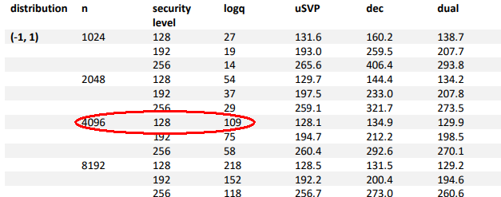
SELECTING SECURITY PARAMETERS
The ciphertext dimension (degree of polynomial) should be chosen according to the security tables published at HomomorphicEncryption.org

Slide 28
FHE Approaches for ML

Slide 29
THREE MOST COMMON WAYS TO DO ENCRYPTED ML USING FHE
Here we focus on (supervised) learning using the models based on logistic regression, decision trees, and neural networks, i.e., relatively deep computations requiring bootstrapping.
Approximate approach based on CKKS
Fastest for most ML applications, especially with larger problem sizes.
Polynomial approximations should be used with care.
Hybrid approximate/LUT approach based on CKKS and DM (FHEW) /CGGI (TFHE)
Significantly slower than approach 1 for most ML applications.
Evaluates “tricky” non-linear functions, such as comparison, using functional bootstrapping in DM/CGGI.
LUT approach based on functional bootstrapping in DM/CGGI
Slowest option (typically by orders of magnitude compared to option 1) and does not scale well with the problem size.
Easiest to use in most cases.

Slide 30
APPROXIMATE APPROACH BASED ON CKKS
Complicated functions are approximated using polynomials
Typically Chebyshev interpolations or similar minimax methods are used
Evaluates functions over vectors of real numbers, e.g., a function is evaluated for 32K real numbers at once
When building the polynomial interpolation, the input range has to be specified
Approximate CKKS bootstrapping is used to support deep computations, such as logistic regression training
Approximate bootstrapping significantly increases the approximation error after first bootstrapping, but further bootstrapping operations typically have a small effect for many ML applications (the ML computations are often approximate in nature)
Multiprecison CKKS (META-BTS) bootstrapping was recently proposed in https://eprint.iacr.org/2022/1167 (CCS’22)
Amortized cost of CKKS bootstrapping gets as low as 1ms per real number [BMT+21]
Inference is fast for many models, e.g., logreg inference for hundreds of samples and dozens of features takes less than 1 second

Slide 31
HYBRID APPROXIMATE/LUT APPROACH BASED ON CKKS+DM/CGGI
CKKS is used for all polynomial/matrix arithmetic computations
For “tricky” non-linear functions, LUT evaluation using functional bootstrapping with DM/CGGI is used
Useful for comparisons
Can be used for piecewise polynomial evaluation, addressing the input range issue in polynomial approximations
Requires scheme switching from CKKS to/from DM/CGGI
LUT evaluation is often the main bottleneck

Slide 32
LUT APPROACH BASED ON FUNCTIONAL BOOTSTRAPPING IN DM/CGGI
Any deep learning algorithm can be evaluated using LUTs for non-linear functions
The main drawback is performance
Functional bootstrapping does not support the evaluation of a LUT over a vector of integers in a SIMD manner
LUT evaluation even for a small plaintext modulus (few bits of precision) requires 100ms or so
To evaluate an arbitrary function for a larger plaintext space, many small LUT evaluations are needed
Typically orders of magnitude slower than the approximate approach based on CKKS
Even inference takes substantial time, e.g., logreg inference for hundreds of samples and dozens of features takes more than 10 minutes

Slide 33
Selected Studies in PPML using FHE

Slide 34
RECENT DARPA PROGRAMS
Cooperative Secure Learning (CSL) [August 2020 – January 2022]
Develop methods to protect data, models, and model outputs among a community of entities desiring to securely share their information to better inform ML model development
Enable multiple parties to cooperate for the purpose of improving each other’s ML models while assuring that each entity’s individual, pre-existing datasets and models will remain private
Data PRotection in Virtual Environments (DPRIVE) [January 2021 – present]
Develop a hardware accelerator for FHE computations that will dramatically reduce the compute runtime overhead compared to software-based FHE approaches
Motivating applications are logistic regression training, CNN inference, and CNN training

Slide 35
SELECTED PAPERS FOR APPROXIMATE METHOD BASED ON CKKS
Logistic regression training
https://eprint.iacr.org/2018/662, AAAI Conference on AI 2019
422108 samples over 200 features in 17 hours on a single machine
Genome-wide association studies based on chi-square test and logistic regression training
https://eprint.iacr.org/2020/563, PNAS 2020
500000 SNPs and 100000 individuals in 5.6 hours on a single machine
ResNet-20 deep neural network evaluation
https://eprint.iacr.org/2021/783; CIFAR-10 in 3 hours on a single server with 64 threads
https://eprint.iacr.org/2021/1688; CIFAR-10 in 40 minutes on a single server with 1 thread; Resnet-110 for the same setup took about 3.7 hrs

Slide 36
SELECTED PAPERS FOR HYBRID METHOD
Semi-parallel logistic regression training (GWAS)
https://eprint.iacr.org/2019/101, BMC Medical Genomics 2020
10643 SNPs, 245 patients, and 3 covariates: 4 min. to 3 hrs on a single machine
The best approaches based on the CKKS method took few minutes for the problem sizes that required few hours for the hybrid approach
Decision tree evaluation and K-means clustering
https://eprint.iacr.org/2020/1606, IEEE S&P 2021
Decision tree evaluation: for 60 internal nodes, 57 features, and 2 classification labels the runtime was about 7 seconds
K-means clustering: for 4096 data points and 8 clusters, the runtime was 52 minutes

Slide 37
Introduction to Approximate FHE

Slide 38
MOTIVATION FOR APPROXIMATE FHE
Good for any application where we work with real numbers, e.g., where we use floating-point numbers
Encrypt real numbers and perform addition and multiplication with the result rounded to a fixed precision, for instance, two digits after the decimal point
12.42 + 1.34 = 13.76, 2.23 * 5.19 = 11.57
The main limitation of integer homomorphic encryption (BGV/BFV) is that it requires very large plaintext moduli to support operations over real numbers
All computations in integer HE are performed exactly
Integer HE rapidly becomes inefficient as further multiplications are performed
Approximate homomorphic encryption allows dropping least significant bits by rescaling the encrypted data, similar to how it is done for floating-point numbers in practice
Typical applications of approximate HE
Statistical computations
Polynomial evaluation
Matrix arithmetic
Regression inference and training
Evaluation of non-linear/non-smooth functions using their polynomial approximations

Slide 39
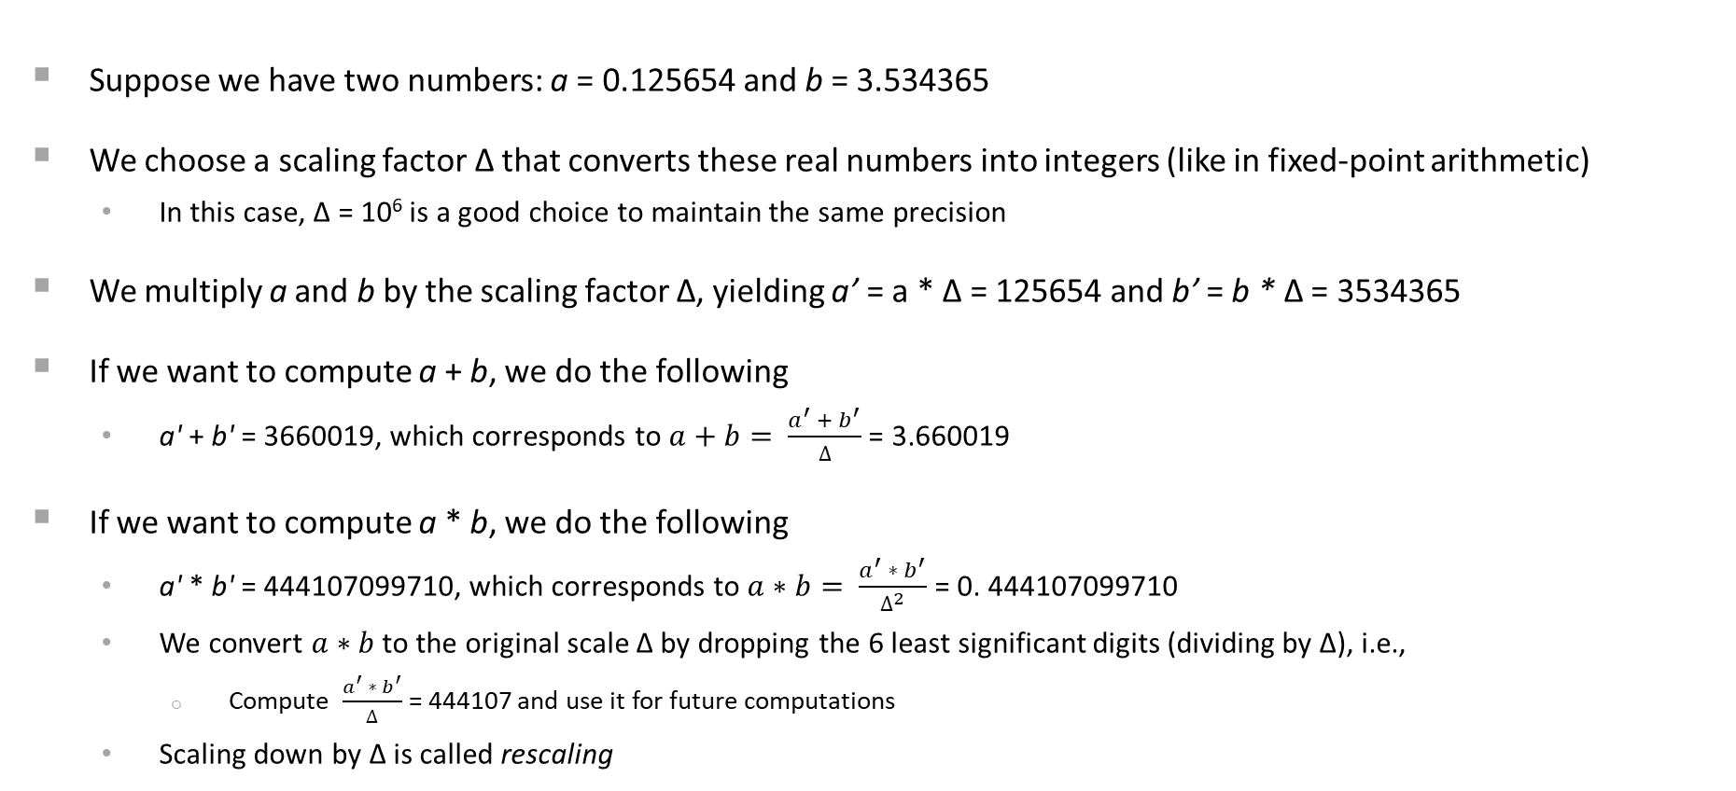
FIXED-POINT ARITHMETIC WITH RESCALING

Slide 40
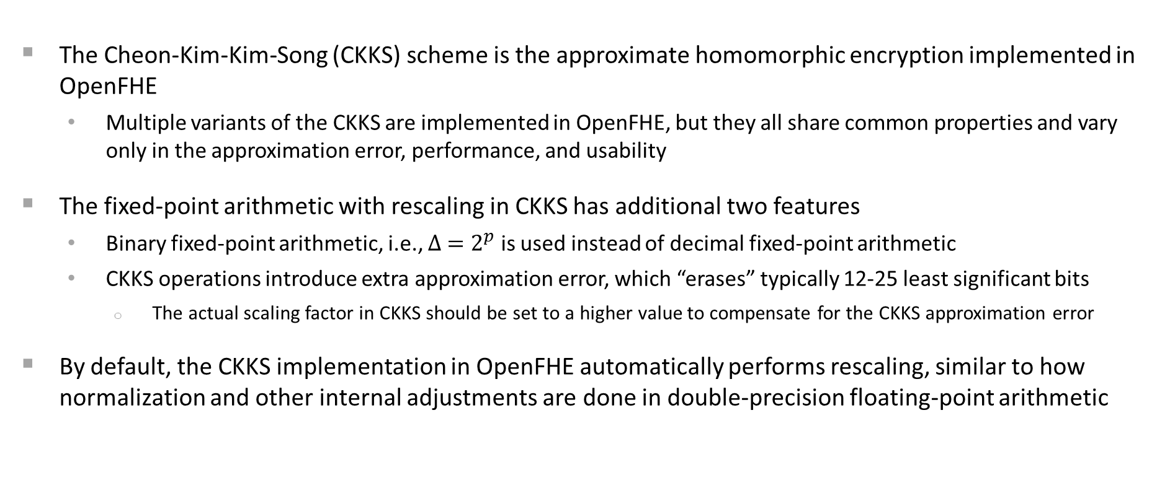
FIXED-POINT ARITHMETIC WITH RESCALING IN CKKS

Slide 41
MAIN DATA STRUCTURE
The main data structure is a vector (array) of real numbers
Many real numbers (typically between 2K and 64K) are “packed” in one vector (ciphertext)
Let us denote the vector size as n (a power of two)
Addition and multiplication of n real numbers can be done using a single addition/multiplication
Similar to Single Instruction Multiple Data (SIMD) instruction sets available on many modern processors
The SIMD capability should be used as much as possible to achieve best efficiency
Rotation operation is added to allow accessing the value at a specific index of the array
Addition, multiplication, and rotation are three primitive operations in approximate FHE

Slide 42
COMPLETE LIST OF PRIMITIVE OPERATIONS
Two-argument operations (the plaintext can represent a vector of real numbers or a single real number)
Ciphertext-Ciphertext addition: EvalAdd
Ciphertext-Plaintext addition: EvalAdd
Ciphertext-Ciphertext multiplication: EvalMult
Ciphertext-Plaintext multiplication: EvalMult
Ciphertext-Ciphertext subtraction: EvalSub
Ciphertext-Plaintext subtraction: EvalSub
Unary operations
Negation: EvalNegate
Vector rotation: EvalRotate
The result of all these operations is a ciphertext, i.e., an encrypted vector
The benefit of this in practice is that mixed model-data modes can be supported, e.g.,
Encrypted model, data in the clear
Model in the clear, encrypted data

Slide 43
DATA ENCODING
Packing technique: CKKSPackedEncoding
Packs real numbers into a vector of size n
Supports component-wise addition (EvalAdd) and multiplication (EvalMult)
[ 1.1 ] [ 4.4 ] [ 5.5 ] [ 1.5 ] [ 4.5 ] [ 6.75 ]
[ 2.2 ] + [ 5.5 ] = [ 7.7 ], [ 2.5 ] * [ 5.0 ] = [ 12.50 ]
[ 3.3 ] [ 6.6 ] [ 9.9 ] [ 3.5 ] [ 6.1 ] [ 21.35 ]
Adds a new rotation operation (EvalRotate)
Left shift: positive index
Right shift: negative index
Rotations work cyclically over a vector of size n

Slide 44
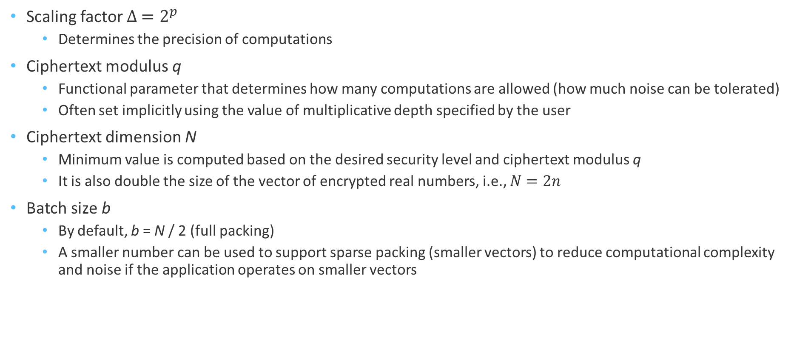
MAIN PARAMETERS

Slide 45
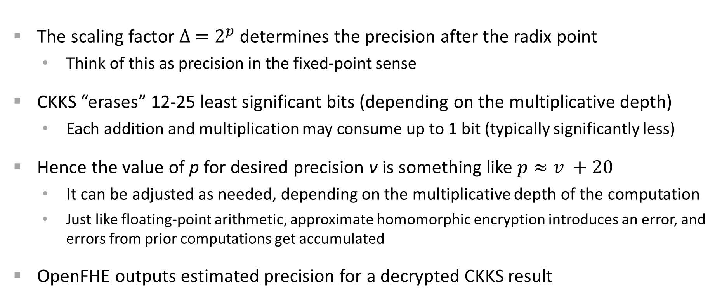
GUIDELINES FOR SETTING SCALING FACTOR

Slide 46
GUIDELINES FOR SETTING CIPHERTEXT MODULUS
Ciphertext modulus q is the main functional parameter that is determined by the computation
Each arithmetic operation increases the noise, and q should be large enough to accommodate the noise from all arithmetic operations
From the noise perspective, multiplication is much costlier than addition
In OpenFHE, q is automatically computed based on the multiplicative depth and scaling factor Δ
Multiplicative depth is not necessarily the number of multiplications
For example, if we need to compute a*b*c*d, we can compute e=a*b and f=c*d using one level, and then compute e*f using the second level. Hence we use 2 levels (depth of 2) rather 3 if we were to do the multiplication sequentially.
This technique is called binary tree multiplication, and it should be used to minimize the multiplicative depth wherever possible.

Slide 47
GUIDELINES FOR SETTING CIPHERTEXT DIMENSION
Ciphertexts are represented as two arrays of size N
This size N, called ciphertext dimension, should have a certain minimum value to comply with the chosen security level and desired ciphertext modulus
Main options for security levels in OpenFHE (we implemented the recommendations from the HE standard published at HomomorphicEncryption.org):
HEStd_128_[classic|quantum] – 128-bit security against [classical/quantum] computers
HEStd_192_[classic|quantum] – 192-bit security against [classical/quantum] computers
HEStd_256_[classic|quantum] – 256-bit security against [classical/quantum] computers
HEStd_NotSet – toy settings (for debugging and prototype development)
The ciphertext dimension N also determines the maximum size of the vector of encrypted real numbers (n = N/2).
It may sometimes be useful to use a larger ring dimension than the minimum one needed for security.
In this case, the user can specify the ring dimension explicitly.

Slide 48
CKKS SECURITY FOR SCENARIO OF SHARED DECRYPTIONS
Li and Micciancio recently showed (https://eprint.iacr.org/2020/1533, EUROCRYPT’21) that the IND-CPA security may not be strong enough when decryption results need to be published or shared with untrusted parties; they introduced IND-CPA^{D} security to account for this.
They also described mitigation strategies. Adding enough Gaussian noise during decryption is the most common option.
In a later paper, Li et al. (https://eprint.iacr.org/2022/816, CRYPTO’22) quantified how much noise should be added for 128 bits of security (about extra 45 bits on top of the existing approximation error) for the scenario with an unbounded number of related queries.
OpenFHE implements a practical mitigation for this scenario, and supports adding 45 bits of precision (using 128-bit CKKS) when decryptions are allowed to be shared without any restrictions

Slide 49
HIGH-PRECISION CKKS
OpenFHE includes a high-precision CKKS implementation
Scaling factor in this case can be as large as 2¹¹⁹ (compared to 2⁵⁹ for the regular CKKS implementation in OpenFHE)
The high-precision CKKS implementation provides support for double-precision arithmetic, i.e., 52 bits if the scaling factor is set to 70 or more bits
Another benefit is the support for 128-bit security for the scenario where decryption results are shared
High-precision CKKS is recommended for ML applications that require IND-CPA^{D} security
Runtime is about 4-6x slower than for regular CKKS implementation for the same ring dimension (additional 2x when the ring dimension needs to be doubled for LWE security)

Slide 50
OpenFHE library

Slide 51
OPENFHE DESIGN PRINCIPLES
OpenFHE is an open-source C++17 FHE software library launched in July 2022 that incorporates selected design ideas from prior FHE projects, including PALISADE, HElib, HEAAN, and FHEW, and includes several new design concepts and ideas.
The main new design features can be summarized as follows:
From the cryptography perspective, we assume from the very beginning that all implemented FHE schemes will support bootstrapping and scheme switching
From the performance perspective, OpenFHE supports multiple hardware acceleration backends using a standard Hardware Abstraction Layer (HAL)
From the usability perspective, OpenFHE includes both
user-friendly modes, where all maintenance operations, such as modulus switching, key switching, and bootstrapping, are automatically invoked by the library, and
compiler-friendly modes, where an external compiler makes these decisions

Slide 52
CRYPTOGRAPHIC CAPABILITIES
OpenFHE includes efficient implementations of all common FHE schemes:
Brakerski/Fan-Vercauteren (BFV) scheme for integer arithmetic
Brakerski-Gentry-Vaikuntanathan (BGV) scheme for integer arithmetic
Cheon-Kim-Kim-Song (CKKS) scheme for real-number arithmetic (includes approximate bootstrapping)
Ducas-Micciancio (DM/FHEW), Chillotti-Gama-Georgieva-Izabachene (CGGI/TFHE), and Lee-Micciancio-Kim-Choi-Deryabin-Eom-Yoo (LMKCDEY) schemes for evaluating Boolean circuits and arbitrary functions over larger plaintext spaces using lookup tables
OpenFHE includes the following multiparty extensions of FHE:
Threshold FHE for BGV, BFV, and CKKS schemes
Interactive bootstrapping for Threshold CKKS
Proxy Re-Encryption for BGV, BFV, and CKKS schemes
OpenFHE also supports switching between CKKS and FHEW/TFHE to evaluate non-smooth functions, e.g., comparison, using FHEW/TFHE functional bootstrapping.

Slide 53
SCHEME SUPPORT MATRIX
Library/ Scheme or Extension | BGV | BGV Bootstr. | BFV | CKKS | CKKS Bootstr. | DM | CGGI | Threshold FHE (MP) | PRE (MP)
Concrete |  |  |  |  |  |  | ✔
FHEW |  |  |  |  |  | ✔
HEAAN |  |  |  | ✔ | ✔
HELib | ✔ | ✔ |  | ✔
Lattigo |  |  | ✔ | ✔ | ✔ |  |  | ✔
OpenFHE | ✔ | * | ✔ | ✔ | ✔ | ✔ | ✔ | ✔ | ✔
PALISADE | ✔ |  | ✔ | ✔ |  | ✔ | ✔ | ✔ | ✔
SEAL | ✔ |  | ✔ | ✔
TFHE |  |  |  |  |  |  | ✔
* - prototype exists, but not part of release

Slide 54
KEY FACTS ABOUT OPENFHE
Current version is 1.1.2 (released on December 16, 2023)
Designed by (some of) authors of PALISADE, HElib, HEAAN, and FHEW libraries
Official successor of PALISADE
Complies with the HomomorphicEncryption.org post-quantum security standards for homomorphic encryption
We offer OpenFHE under the 2-clause BSD open-source license, making it easier to wrap and redistribute OpenFHE in products
Generously supported by DARPA
A community-driven open-source project developed by a diverse group of contributors from both industry and academia, including Duality, Samsung, Intel, MIT, UCSD, and others
Google Transpiler uses the CGGI (TFHE) implementation as the FHE backend
OpenFHE is formally affiliated with the NumFocus stable of open-source software projects

Slide 55
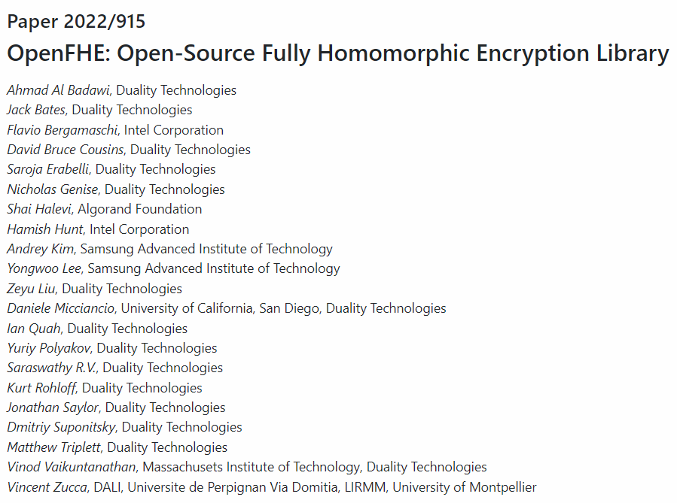
DESIGN PAPER [https://eprint.iacr.org/2022/915]

Slide 56
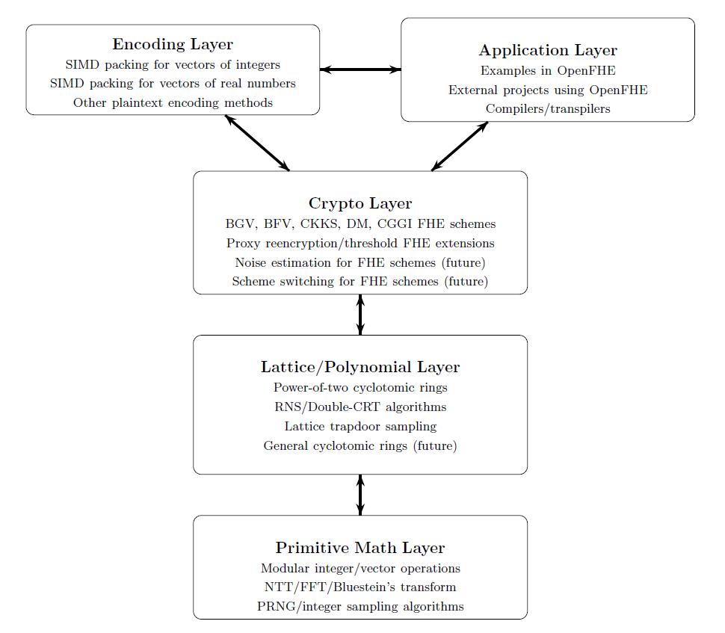
LAYERS IN OPENFHE (CONTRIBUTOR VIEW)

Slide 57
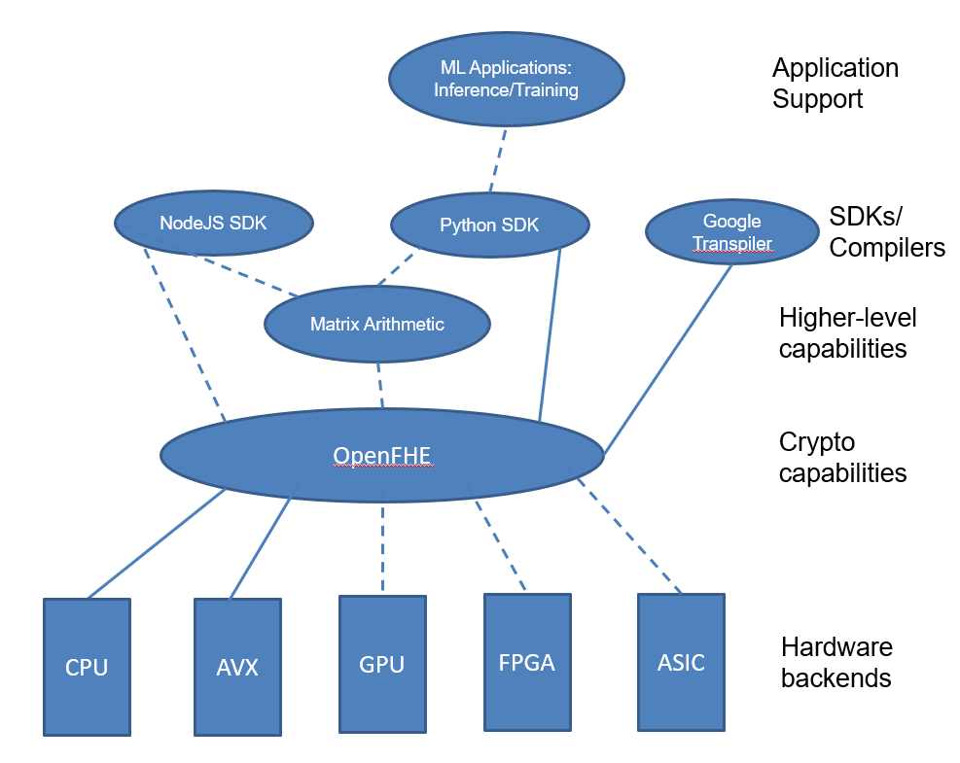
BROADER OPENFHE COMMUNITY (USER VIEW)

Slide 58
OPENFHE VISION FOR MACHINE LEARNING (ML) USING FHE
The main ML focus is on
Approximate method based on CKKS
Hybrid approximate/LUT approach based on CKKS and DM (FHEW) /CGGI (TFHE)
Features that are already available in OpenFHE
CKKS bootstrapping to support deep learning
Large-precision comparison and small-precision LUT evaluation
Scheme switching between CKKS and DM/CGGI to evaluate comparisons and (arg)min
Python SDK
Features under development
NodeJS SDK
Matrix arithmetic library

Slide 59
MAIN RESOURCES AND LINKS FOR OPENFHE
OpenFHE design paper: https://eprint.iacr.org/2022/915
OpenFHE website: https://openfhe.org
ReadTheDocs documentation for OpenFHE: https://openfhe-development.readthedocs.io/en/latest/
OpenFHE development repository: https://github.com/openfheorg/openfhe-development
OpenFHE github organization where various OpenFHE-dependent projects are housed: https://github.com/openfheorg
Community Forum for OpenFHE: https://openfhe.discourse.group/

Slide 60
CKKS Examples in Python

Slide 61
STEP 1 – SET CRYPTOCONTEXT
from openfhe import *
mult_depth = 1
scale_mod_size = 50
batch_size = 8
parameters = CCParamsCKKSRNS()
parameters.SetMultiplicativeDepth(mult_depth)
parameters.SetScalingModSize(scale_mod_size)
parameters.SetBatchSize(batch_size)
# Enable the features that you wish to use
cc = GenCryptoContext(parameters)
cc.Enable(PKESchemeFeature.PKE)
cc.Enable(PKESchemeFeature.KEYSWITCH)
cc.Enable(PKESchemeFeature.LEVELEDSHE)

Slide 62
STEP 2 – KEY GENERATION
# Generate a public/private key pair
keys = cc.KeyGen()
# Generate the relinearization key
cc.EvalMultKeyGen(keys.secretKey)
# Generate the rotation evaluation keys
cc.EvalRotateKeyGen(keys.secretKey, [1, -2])

Slide 63
STEP 3 – ENCRYPTION
# Inputs
x1 = [0.25, 0.5, 0.75, 1.0, 2.0, 3.0, 4.0, 5.0]
x2 = [5.0, 4.0, 3.0, 2.0, 1.0, 0.75, 0.5, 0.25]
# Encoding as plaintexts
ptx1 = cc.MakeCKKSPackedPlaintext(x1)
ptx2 = cc.MakeCKKSPackedPlaintext(x2)
# Encrypt the encoded vectors
c1 = cc.Encrypt(keys.publicKey, ptx1)
c2 = cc.Encrypt(keys.publicKey, ptx2)

Slide 64
STEP 4 – EVALUATION
# Homomorphic additions
c_add = cc.EvalAdd(c1, c2)
# Homomorphic subtraction
c_sub = cc.EvalSub(c1, c2)
# Homomorphic scalar multiplication
c_scalar = cc.EvalMult(c1,4)
# Homomorphic multiplication
c_mult = cc.EvalMult(c1, c2)
# Homomorphic rotations
c_rot1 = cc.EvalRotate(c1, 1)
c_rot2 = cc.EvalRotate(c1, -2)

Slide 65
STEP 5 – DECRYPTION
# Decrypt the result of addition
precision = 8
print("Results of homomorphic computations:")
result = cc.Decrypt(c1, keys.secretKey)
result.SetLength(batch_size)
print("x1 = " + str(result))
print("Estimated precision in bits: " + str(result.GetLogPrecision()))
# Decrypt the result of scalar multiplication
result = cc.Decrypt(c_scalar,keys.secretKey)
# Decrypt the result of multiplication
result = cc.Decrypt(c_mult,keys.secretKey)
# Decrypt the result of rotations
result = cc.Decrypt(c_rot1,keys.secretKey)
result = cc.Decrypt(c_rot2,keys.secretKey)

Slide 66
OTHER PYTHON EXAMPLES FOR CKKS
Examples listed in README.md of https://github.com/openfheorg/openfhe-python
FHE for arithmetic over real numbers (CKKS):
Simple Code Example
Advanced Code Example
Advanced Code Example for High-Precision CKKS
Arbitrary Smooth Function Evaluation
Simple CKKS Bootstrapping Example
Advanced CKKS Bootstrapping Example
Double-Precision (Iterative) Bootstrapping Example

Slide 67
ML Applications and FHE Challenges

Slide 68
ML Applications

Slide 69
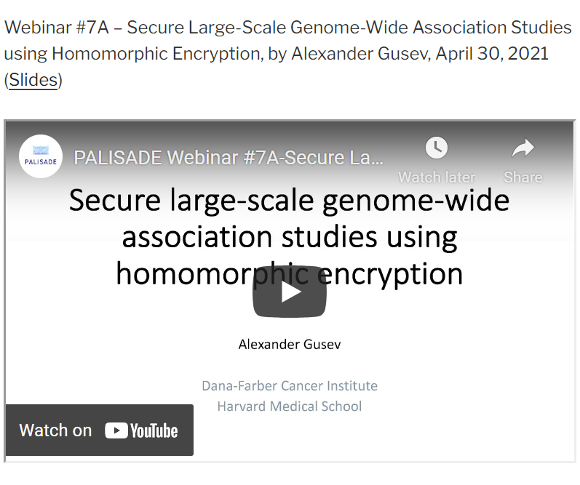
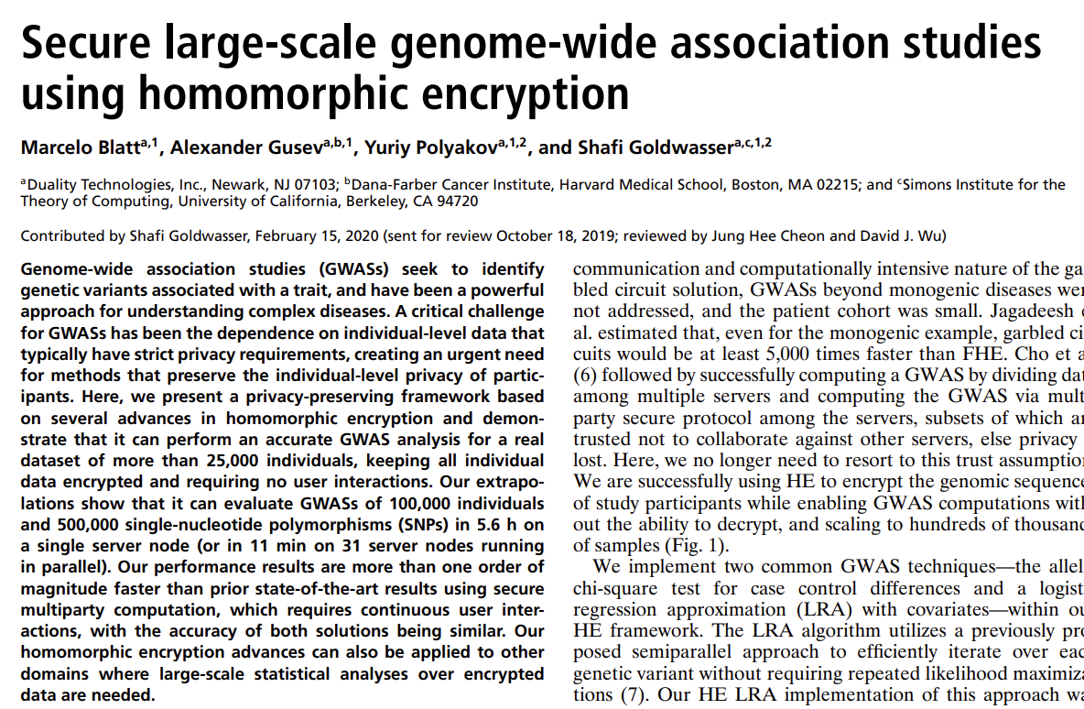
SECURE GENOME-WIDE ASSOCIATION STUDIES

Slide 70
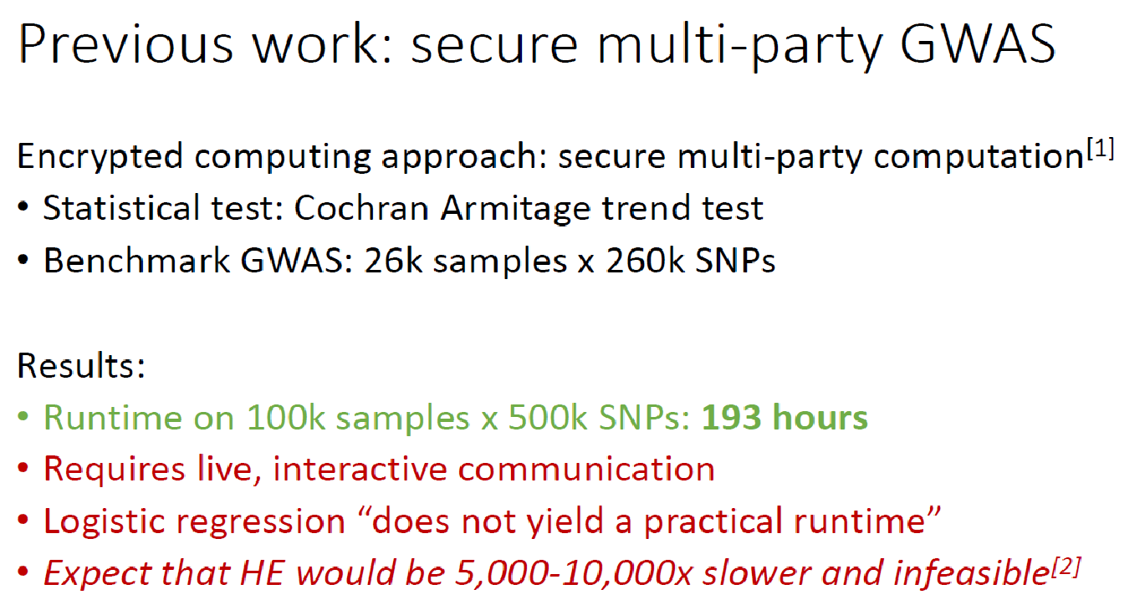
[1] Cho et al. 2018 Nat Biotechnol; [2] Jagadeesh et al. 2017 Science

Slide 71
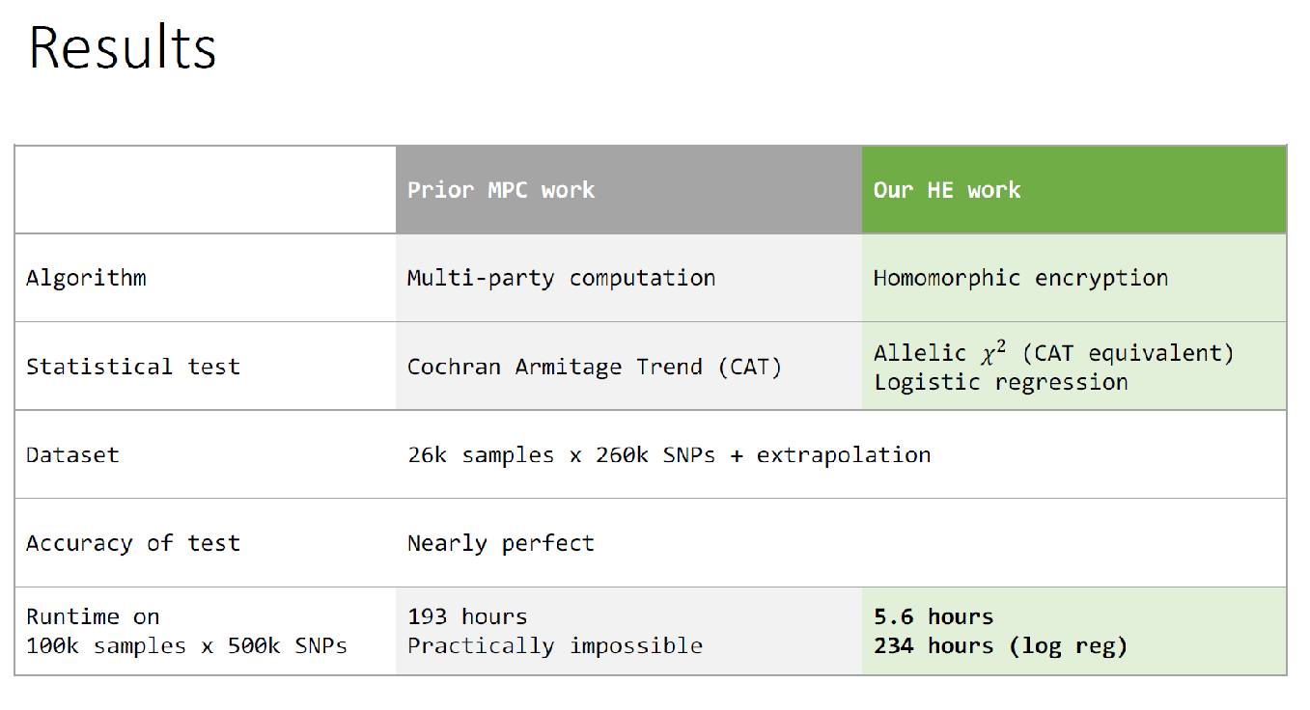

Slide 72
MORE INFORMATION
Source code: https://github.com/openfheorg/openfhe-genomic-examples
PNAS Paper: https://www.pnas.org/content/117/21/11608
PALISADE/OpenFHE Webinars
https://www.openfhe.org/portfolio-item/secure-large-scale-genome/
https://www.openfhe.org/portfolio-item/best-practices-for-building-efficient-homomorphic-encryption-solutions/

Slide 73
LOGISTIC REGRESSION TRAINING EXAMPLE
Source code: https://github.com/openfheorg/openfhe-logreg-training-examples
The examples were developed as part of the DARPA DPRIVE program
The repository provides an implementation of logistic-regression model training and model inference on the 2014 US Infant Mortality Dataset
Logistic Regression Training is performed using Nesterov Accelerated Gradient Descent
CKKS bootstrapping is performed after each iteration of logistic regression training

Slide 74
CNN INFERENCE
We recently developed a CNN prototype for a model with 7 convolution layers and one fully connected layer
CNN inference of a CIFAR-10 image in OpenFHE takes several minutes
The estimated runtime for an ASIC-accelerated implementation is about 3 orders of magnitude faster

Slide 75
COMMERCIAL ML CAPABILITIES BASED ON OPENFHE
Duality Platform includes several ML/statistical capabilities based on CKKS in OpenFHE
Logistic regression training
Linear/ridge regression training
Inference for GLM and gradient boosted trees
Kaplan-Meier survival analysis
Descriptive statistics

Slide 76
FHERMA Project

Slide 77
FHERMA: PLATFORM FOR FHE CHALLENGES
FHERMA is an open platform for Fully Homomorphic Encryption (FHE) challenges, jointly developed by Yasha Lab and the OpenFHE teams.
The main goal of the project is to develop an open-source library of FHE components.
Such a library can significantly simplify application development and accelerate the adoption of FHE.
The initial focus is on components for Machine Learning and Blockchain applications.
Launched on November 7, 2023
URL: https://fherma.io/
The winning solutions are published under the Apache 2.0 license
No IP restrictions
More details on the terms are available at https://fherma.io/terms

Slide 78
CHALLENGE TYPES
Black Box:
Participants develop solutions according to the challenge requirements, process encrypted test data, and submit to the platform only the serialized final ciphertext.
Does not require submitting source code or any other data that reveals the details of the solution itself.
The main criterion for evaluating and ranking solutions in this type of challenge is accuracy.
White Box:
It is not possible to evaluate the performance of the solution based solely on the ciphertext. While the Black Box type is suitable for many challenges, for others, it is crucial to obtain the most efficient solution from a performance perspective. For these, the White Box type is available.
Participants are required to submit the source code of their projects to the platform.
The platform will compile the project and run tests to measure performance and accuracy.
The main criteria for evaluating and ranking solutions are performance and accuracy.
Solutions uploaded to the platform are confidential and are not available to other participants.

Slide 79
GOVERNANCE
Transparency
One of the main priorities when developing the project was the creation of a transparent and equal environment for all participants.
We attempted to completely eliminate the human factor when assessing the results of the participants.
At the end of each challenge, we will publish the winner's solution in open form so that anyone can verify the correctness of the assessment.
Committee
Gurgen Arakelov, Yasha Lab
Elvira Kharisova, Yasha Lab
Yuriy Polyakov, Duality
Kurt Rohloff, Duality

Slide 80
INITIAL FHE CHALLENGES
Matrix Multiplication
Performing efficient multiplication of encrypted matrices
Award: $3,000
Sign Evaluation
Efficient comparison using CKKS
Award: $3,000
Logistic Function
One of main functions in machine learning
Award: $5,000

Slide 81
NEW FHE CHALLENGES
Will be announced on the day of the AAAI’24 tutorial

Slide 82

THANK YOU
contact@openfhe.org
https://openfhe.org

Slide 83
References
[BGV14] Z. Brakerski, C. Gentry, and V. Vaikuntanathan. (leveled) fully homomorphic encryption without bootstrapping. ACM Transactions on Computation Theory (TOCT), 6(3):1–36, 2014.
[Bra12] Z. Brakerski. Fully Homomorphic Encryption without Modulus Switching from Classical GapSVP. In CRYPTO 2012. Pages 868 – 886.
[BV11] Z. Brakerski and V. Vaikuntanathan. Fully homomorphic encryption from ring-LWE and security for key dependent messages. In Annual cryptology conference, pages 505–524. Springer, 2011.
[CGGI16]: I. Chillotti, N. Gama, M. Georgieva, and M. Izabachène. Faster fully homomorphic encryption: Bootstrapping in less than 0.1 seconds. In Asiacrypt 2016 (Best Paper), pages 3-33.
[CGGI17]: I. Chillotti, N. Gama, M. Georgieva, and M. Izabachène. Faster Packed Homomorphic Operations and Efficient Circuit Bootstrapping for TFHE. ASIACRYPT (1) 2017: 377-408.
[CKKS17] J. H. Cheon, A. Kim, M. Kim, Y. Song, Homomorphic Encryption for Arithmetic of Approximate Numbers. In ASIACRYPT 2017. Pages 409–437.
[DM15]: L. Ducas and D. Micciancio. FHEW: bootstrapping homomorphic encryption in less than a second. EUROCRYPT 2015.
[FV12] J. Fan and F. Vercauteren. Somewhat Practical Fully Homomorphic Encryption. Cryptology ePrint Archive. Report 2012/144, 2012. http://eprint.iacr.org/2012/144.
[GSW13]: C. Gentry, A. Sahai, and B. Waters. Homomorphic encryption from learning with errors: Conceptually-simpler, asymptotically-faster, attribute-based. CRYPTO 2013.
[LMKCDEY13]: Y. Lee, A. Kim, D. Micciancio, R. Choi, Deryabin M., J. Eom, D. Yoo. Efficient FHEW Bootstrapping with Small Evaluation Keys, and Applications to Threshold Homomorphic Encryption, EUROCRYPT 2023.

