Slide 1


PUBLIC INFORMATION MEETING
Bocage Sud wind farm
Saint-Mars-du-Désert · 18 March 2027 · town hall, 7 pm
Notes:
Thank the mayor for hosting. Remind the audience that questions are welcome at any time.

Slide 2
Tonight
7:00
Welcome
Mayor of Saint-Mars, Anne Briand
7:10
The project in a few figures
Lucas Morel, project manager
7:30
Landscape, noise and wildlife
Dr Élise Kervella, ecologist
7:55
What stays in the commune
Lucas Morel
8:10
Your questions
Everyone
Bocage Sud wind farm · public information meeting · Saint-Mars, 18 March 2027
2

Slide 3
What a turbine looks like
Blades
58 m long · glass fibre, 90 % recyclable
Nacelle
Generator and gearbox, 82 t
150 m
Tower
92 m steel tower in 4 sections
Foundation
18 m diameter · removed at end of life
Bocage Sud wind farm · public information meeting · Saint-Mars, 18 March 2027
3
Notes:
Model shortlisted: WindTek WT-3000, 3 MW. Figures are maxima allowed by the permit request.

Slide 4
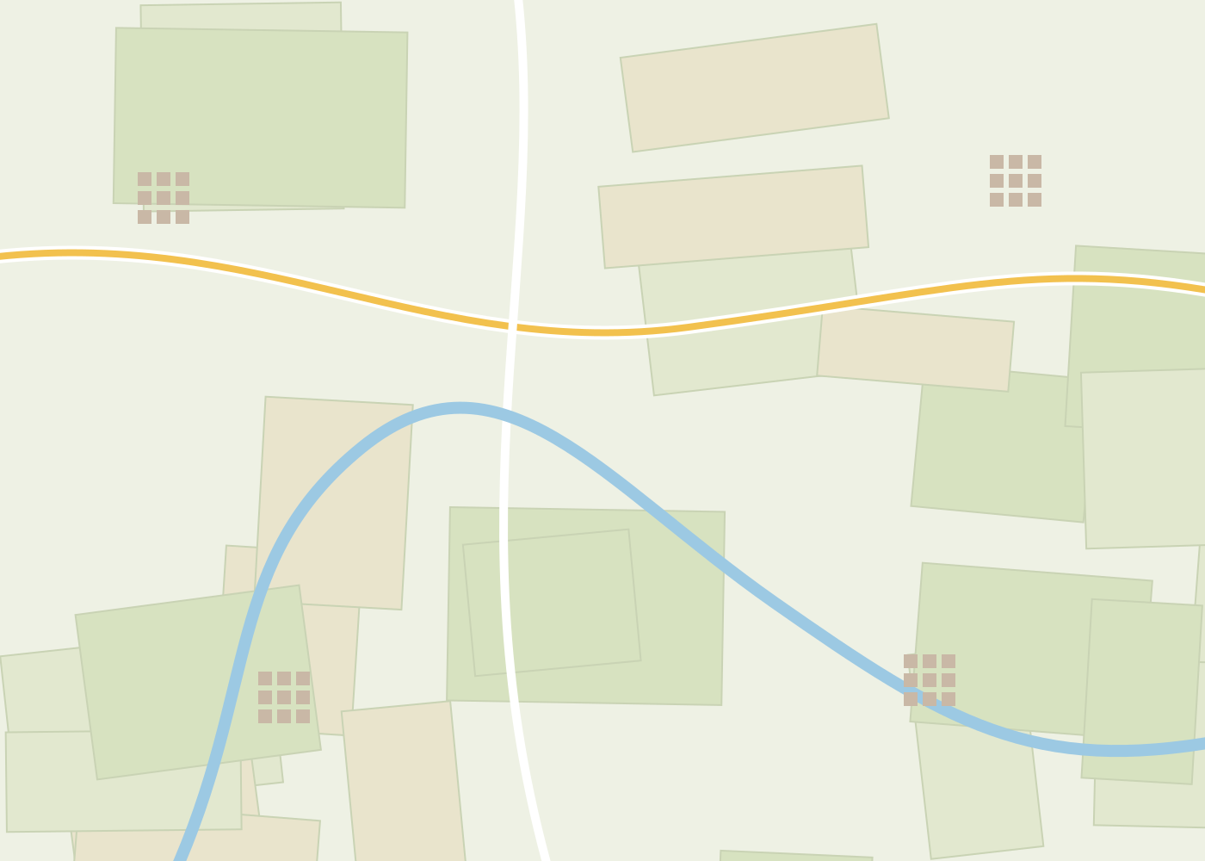

Where the turbines would stand
N
Study area dashed outline
Turbine position T1 to T6
500 m from turbine legal minimum distance to a home
Nearest hamlets La Haie 620 m · Bel-Air 780 m · Le Moulin Neuf 910 m
La Haie
T2
T1
T3
T4
T5
T6
Bel-Air
Le Moulin Neuf
0 500 m
Bocage Sud wind farm · public information meeting · Saint-Mars, 18 March 2027
4
Notes:
Positions T1 to T6 are the layout filed in the permit request (variant B).

Slide 5




What you would see from the D12 road
Today
2030 · simulation
6 of 6
turbines visible from this point
1.2 km
to the nearest turbine
2 km
of new hedgerows planted as screens
Bocage Sud wind farm · public information meeting · Saint-Mars, 18 March 2027
5
Notes:
Viewpoint 7 of 14: D12 road near La Haie, 1.2 km from T1, 50 mm lens, photographed 3 February 2027.

Slide 6

Will I hear it?
For comparison
35 dB
Bedroom at night
30 dB
40 dB
Library
35 dB
La Haie
620 m · 37 dB
45 dB
Wind in the trees
40 dB
Fridge
45 dB
Quiet office
50 dB
Le Moulin Neuf
910 m · 33 dB
Conversation
60 dB
Bel-Air
780 m · 35 dB
loudest home: 37 dB
Bocage Sud wind farm · public information meeting · Saint-Mars, 18 March 2027
6
Notes:
Night-time levels from the acoustic study (Acoustica, 2026), wind 8 m/s from the south-west.

Slide 7
Where we are in the procedure
2025
Wind measurement mast
Mar 2027
Public consultation
2028
Public inquiry
2030
Commissioning
You are here
2026
Environmental study
Sep 2027
Permit request
2029
Construction
Bocage Sud wind farm · public information meeting · Saint-Mars, 18 March 2027
7
Notes:
Dates after the permit request are estimates.

Slide 8

Birds and bats
Species | Group | Sensitivity | What we will do
Red kite | Bird of prey | High | No turbine within 300 m of the nest
Common pipistrelle | Bat | High | Turbines stopped on warm, low-wind nights
Skylark | Farmland bird | Medium | Works outside the nesting season
Noctule bat | Bat | Medium | Ultrasound monitoring for 3 years
White stork | Migratory bird | Low | Annual migration survey
Barn owl | Bird of prey | Low | 20 nest boxes in local barns
72
bird species observed
11
bat species recorded
Bocage Sud wind farm · public information meeting · Saint-Mars, 18 March 2027
8
Notes:
14 months of field surveys by Dr Élise Kervella (Bureau Faune & Flore).

Slide 9
What stays in Saint-Mars
Local taxes 210 k€ / year
to the commune and the community of communes
Saint-Mars
4,900 inhabitants
Shared ownership 2 M€
opened to residents through crowdfunding
Local jobs 3 technicians
based in Saint-Mars, plus construction work
Cheaper electricity -15 %
offer for households within 2 km
Bocage Sud wind farm · public information meeting · Saint-Mars, 18 March 2027
9
Notes:
Figures per year over 25 years of operation, unless stated otherwise.

Slide 10
Questions we hear often
?
Will my house lose value?
?
What happens at the end of life?
A 2022 national study of 90,000 sales found no measurable effect beyond 2 km, and a small one below 1 km.
AeolWind must remove everything and restore the land. 300 k€ per turbine are set aside from day one.
?
Will TV or mobile reception suffer?
?
Who can invest?
If it does, the law obliges us to fix it at our expense. Call the hotline below.
Residents of Saint-Mars and the five neighbouring communes first, from 50 €.
Bocage Sud wind farm · public information meeting · Saint-Mars, 18 March 2027
10

Slide 11




Have your say
Online register
bocage-sud.example/register
until 30 April
Town hall office hours
every Wednesday, 2-6 pm
from 22 March to 26 April
Guided site walks
meeting point: La Haie crossroads
6 and 13 April, 10 am
Your contribution
Bocage Sud wind farm · public information meeting · Saint-Mars, 18 March 2027
11
Notes:
All contributions are attached to the permit request and answered in writing.

Slide 12
Thank you
Lucas Morel, project manager · bocage-sud@aeolwind.example
Hotline 02 40 00 00 00 · Monday to Friday, 9 am to 6 pm

