Slide 1

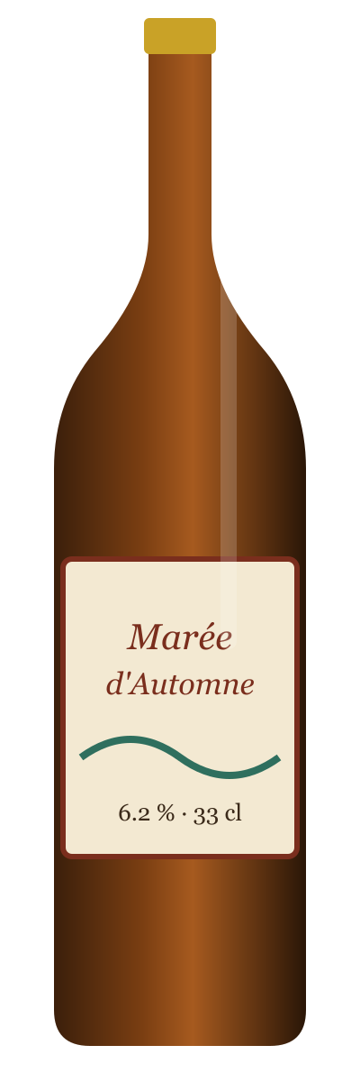
BRASSERIE DU FJORD · EST. 2011
Launch plan
Marée
d'Automne
Marketing team · presented to the partners on 3 March 2027
SEASONAL AMBER ALE
NEW · AUTUMN 2027
Notes:
Marée d'Automne is our fifth seasonal beer and the first one brewed with Breton chestnuts.

Slide 2
MARÉE D'AUTOMNE · LAUNCH PLAN
The beer
Tasting card
Style Amber ale with chestnuts
Strength 6.2 % ABV · 28 IBU
Colour Deep amber, 32 EBC
Malts Pale, Munich, Crystal
Hops Hallertau Mittelfrüh
Special Roasted Breton chestnuts
Pairing Buckwheat crêpes, game, aged Tomme
2

Slide 3



MARÉE D'AUTOMNE · LAUNCH PLAN
Who we brew it for
Gaëlle, 34
Marc, 52
Léo, 27
Graphic designer, Brest
Owns a crêperie, Quimper
Nurse, Rennes
“I like to discover a new beer every month, and to know who made it.”
“My customers ask for something local that goes with a crêpe.”
“At a festival I buy what my friends are drinking.”
Needs and channels
Story behind the beer
Limited editions
Instagram, craft beer shops
Needs and channels
Food pairing advice
Reliable delivery
Distributor visits, trade fairs
Needs and channels
Fun, easy-drinking
Price per pint
Festivals, TikTok, bars
3
Notes:
Personas built from 18 interviews and the 2026 customer survey.

Slide 4
MARÉE D'AUTOMNE · LAUNCH PLAN
Where it sits on the shelf
Our space
An adventurous but approachable amber, priced just below the abbey beers, with a local ingredient story that no competitor tells.
Closest rival: Lune Rousse (Brasserie de la Baie), launched in 2025.
Adventurous
Kerbrew IPA
Lune Rousse
Phare Blonde
Marée d'Automne
Budget
Premium
Fjord Pale Ale
Abbaye du Moulin
Corsaire Ambrée
Classic
4
Notes:
Bubble size = share of Breton amber/craft beer sales in 2026 (Nielsen panel).

Slide 5
MARÉE D'AUTOMNE · LAUNCH PLAN
Customer journey
Discover
Try
Buy
Share
Repeat
Instagram reel, bar chalkboard
Free tasting at the bar
Shelf at Coop Armor
Photo with the label
Back in stock?
☺ delighted
☹ frustrated
Hard to find on the shelf
Sold out after 3 weeks in 2026
5
Notes:
Emotion curve from the October tasting panel (n = 120).

Slide 6
MARÉE D'AUTOMNE · LAUNCH PLAN
Marketing mix
P
Product
€
Price
Amber ale with roasted chestnuts
33 cl bottle, 44 cl can, 20 L keg
Label by illustrator Maëlle Riou
3.90 € per 33 cl bottle in shops
5.50 € per pint in bars
Keg price aligned on Fjord Pale Ale
⌂
Place
✺
Promotion
180 partner bars in Finistère
Coop Armor and Marché Vert
Online shop, local delivery
Launch party at Fête du Large
Instagram campaign with 6 creators
Tasting tour in 24 bars
6

Slide 7
MARÉE D'AUTOMNE · LAUNCH PLAN
The road to launch
20 Sep
Launch party, Fête du Large
1 Dec
Christmas gift box
15 Oct
On the shelves at Coop Armor
2 Sep
Press tasting
12 Aug
Brew day
1 Oct
Bars roll-out (180 bars)
7
Notes:
Dates are firm for the brew and the party; shelf dates depend on Coop Armor.

Slide 8
MARÉE D'AUTOMNE · LAUNCH PLAN
Conversion funnel
Reach 400,000
people see the campaign
9.5 %
Engage 38,000
like, share or click
23.7 %
Taste 9,000
try a free sample
46.7 %
Buy 4,200
buy at least once
38.1 %
Repeat 1,600
buy a second time
8
Notes:
Targets for the first 12 weeks, based on the 2026 seasonal (Hiver Épicé).

Slide 9
MARÉE D'AUTOMNE · LAUNCH PLAN
Budget
Launch party
12,000 €
Creators and social ads
11,000 €
Point-of-sale material
9,000 €
48 k€
total
Tasting tour
7,000 €
Samples (beer)
6,000 €
Press
3,000 €
9
Notes:
Total 48,000 €, of which 60 % in the first six weeks.

Slide 10
MARÉE D'AUTOMNE · LAUNCH PLAN
Which label?
Marée
d'Automne
ROUND · CLASSIC
Marée
d'Automne
PLAQUE · VINTAGE
Marée
d'Automne
SNIPPED · MODERN
Proposal A
Proposal B
Proposal C
Decision: proposal A wins, but the panel preferred the wave of proposal C. Maëlle Riou will merge both by 1 March.
10
Notes:
Blind vote of the tasting panel (120 people) on 14 February.

Slide 11
MARÉE D'AUTOMNE · LAUNCH PLAN
What success looks like
450 hL
400 k
35 %
Volume sold
Campaign reach
Repeat purchase
Hiver Épicé 2026: 320 hL
2026: 220 k people
2026: 28 %
11
Notes:
Needle = result of last year's seasonal, measured against this year's target.

Slide 12


MARÉE D'AUTOMNE · LAUNCH PLAN
Yec'hed mat!
Thank you
Questions & tasting
Pierre Kerloc'h
Marketing
pierre@brasserie-fjord.example
Marie Quéré
Brewing
marie@brasserie-fjord.example
12
Notes:
Breton for "cheers". Thank the brewers: they will be in the room.

