Slide 1


CycloCity
Shared bikes for the cities of tomorrow
Company presentation · Investors & partners · 2026

Slide 2
CycloCity at a glance
A European bike-sharing operator, founded in 2018 in Nantes
Operates public bike-sharing services under 8-year concessions granted by city councils
Fleet of 4,800 connected bikes, 35% of them electric-assist
Own software platform, designed in-house and sold as SaaS to smaller municipalities
240 employees, of which 90 field technicians
Carbon-neutral operations certified since 2024
12
cities served
4,800
bikes in service
310
stations
1.9 M
rides in 2025
CycloCity · Company presentation 2026

Slide 3
Market context
Shared micro-mobility is now a mainstream urban transport mode
Low-emission zones are spreading across European city centres
Cities want integrated mobility: bike, bus, tram and train on one pass
E-bikes extend cycling to longer and hillier trips
Free-floating scooters lost trust; docked systems are back in favour
CycloCity · Company presentation 2026

Slide 4



Our offer
Three ways to ride, one app
Pay-as-you-go
Monthly pass
Corporate fleet
1 € to unlock + 0.15 €/min
19 € / month
From 12 € / employee / month
No subscription
Any station, any bike
Ideal for visitors
First 45 min of each ride free
Priority on e-bikes
Bundled with city transit pass
Dedicated docks on company site
Mobility budget reporting
Insurance included
CycloCity · Company presentation 2026

Slide 5


Our fleet
Two models in service, a third one in pilot
City Classic
City E-Assist
Cargo E-Bike
3,120 bikes
1,680 bikes
Pilot Q4 2026
7-speed hub, 17 kg
Puncture-proof tyres
In service since 2018
Manufacturer: VeloNord
250 W motor, 60 km range
Swappable battery
In service since 2021
Manufacturer: ArmorCycles
100 kg load capacity
Parcel and family use
Target: 200 bikes in 2027
Manufacturer: VeloNord
CycloCity · Company presentation 2026

Slide 6





Our value chain
From bike procurement to the daily ride
Procure
Deploy
Operate
Maintain
Serve
Bikes and docks from certified manufacturers
Install stations in agreement with the city
Run the platform, pricing and customer support
Inspect, repair and recharge the fleet
Deliver a reliable ride and report to the city
Procurement and maintenance are largely outsourced to local partners; platform and customer relationship stay in-house.
CycloCity · Company presentation 2026

Slide 7
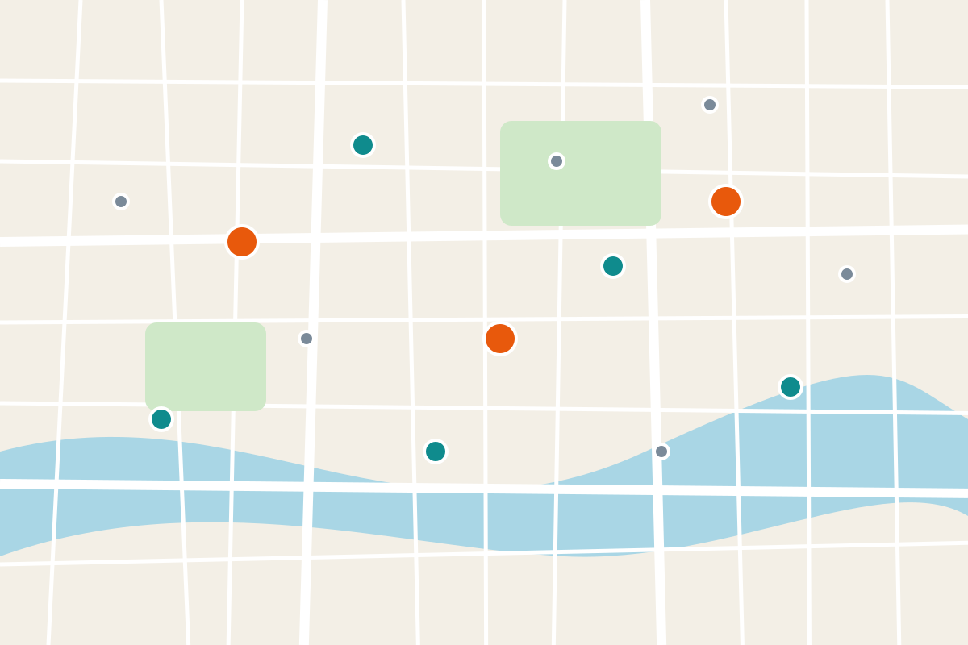
Our cities and stations
12 cities, 4,800 bikes, 310 stations
Nantes
since 2018
640 bikes
Rennes
since 2019
480 bikes
Angers
since 2019
310 bikes
Tours
since 2020
260 bikes
Lyon
since 2020
720 bikes
Grenoble
since 2021
340 bikes
Toulouse
since 2021
610 bikes
Bordeaux
since 2022
520 bikes
Montpellier
since 2022
330 bikes
Hub 30+ docks · Nantes Gare Sud, Lyon Part-Dieu
Standard station 16 docks · Place Graslin, Cours Mirabeau
Lille
since 2023
280 bikes
Strasbourg
since 2024
190 bikes
Dijon
since 2025
120 bikes
Mini station 8 docks · Campus Tertre, Parc Blandan
CycloCity · Company presentation 2026

Slide 8






Platform architecture
From the bike lock to the rider's phone
Smart bike
CC-Lock Gen2
Docking station
DockOne 16
IoT gateway
StationLink 4G
Cloud platform
CycloCore v4
Mobile app
CycloCity app 5.2
BLE
Wired
MQTT / 4G
REST API
SQL
Card token
Alerts
Fleet dashboard
FleetWatch
Payment provider
PayNova (external)
Rides database
PostgreSQL 15 cluster
CycloCity · Company presentation 2026

Slide 9


The rider journey
Five steps, under two minutes to unlock a bike
1. Find
2. Unlock
3. Ride
4. Dock
5. Pay
Locate a bike in the app
Scan the QR code on the bike
Pedal, with live trip tracking
Return it to any station
Fare charged automatically
Touchpoint: App map
Touchpoint: QR code
Touchpoint: Bike and app
Touchpoint: Station
Touchpoint: App wallet
CycloCity · Company presentation 2026

Slide 10
Daily fleet operations
A closed loop that keeps bikes available where riders need them
Monitor fleet
FleetWatch flags empty / full stations
Rebalance
12 electric vans, 3 dispatchers
Rebalancing orders
95%
target bike availability
Updated availability
Faulty bikes
Redeploy
Bikes back on the street
Repair and recharge
Nantes workshop · 90 technicians
Bikes ready
CycloCity · Company presentation 2026

Slide 11

Organization
A flat structure organised around operations and technology
Claire Moreau
Chief Executive Officer
Julien Lefèvre
Chief Operating Officer
Amina Benali
Chief Technology Officer
Sofia Rossi
Chief Customer Officer
Marc Dubois
Chief Financial Officer
City managers
12 people · Hugo Martin
Workshop
90 technicians · Lena Roche
Platform team
24 engineers · Yan Chen
Embedded team
9 engineers · Tom Faure
CycloCity · Company presentation 2026

Slide 12




Our ecosystem
Six partner categories, each with named partners
City councils
Nantes Métropole · Lyon Métropole · Toulouse Métropole
Transit authority
TransLoire · Rhônexpress Pass
Concession contract
Integrated ticketing
CycloCity
Bike manufacturer
VeloNord (Lille) · ArmorCycles (Brest)
Payment provider
PayNova
Supplies bikes
Processes fares
Insurer
MutuelleOuest Assurances
Covers liability
Sponsor stations
Advertising partners
AdMobilis · UrbanPanels
CycloCity · Company presentation 2026

Slide 13
Financial highlights
Revenue has grown 38% a year since 2022
(M€) | 2023 | 2024 | 2025 | 2026e
Revenue | 21.4 | 29.8 | 41.2 | 56.0
of which concessions | 17.9 | 24.1 | 32.6 | 43.0
of which SaaS platform | 3.5 | 5.7 | 8.6 | 13.0
EBITDA | -1.2 | 1.1 | 4.6 | 8.4
Rides (millions) | 1.1 | 1.4 | 1.9 | 2.5
EBITDA positive since 2024
SaaS revenue is growing 50% a year and carries a 70% gross margin.
CycloCity · Company presentation 2026

Slide 14





Roadmap 2026 - 2028
From 12 to 20 cities, and a third-generation smart bike
Q2 2026
Q4 2026
Q2 2027
Q4 2027
2028
Launch Marseille and Nice
Cargo e-bike pilot
Gen-3 smart lock
20 cities served
SaaS in 10 countries
CycloCity · Company presentation 2026

Slide 15


Thank you
Let's make cities ride together
partners@cyclocity.example
12 quai de la Fosse, 44000 Nantes
www.cyclocity.example
CycloCity · Company presentation 2026

