Slide 1
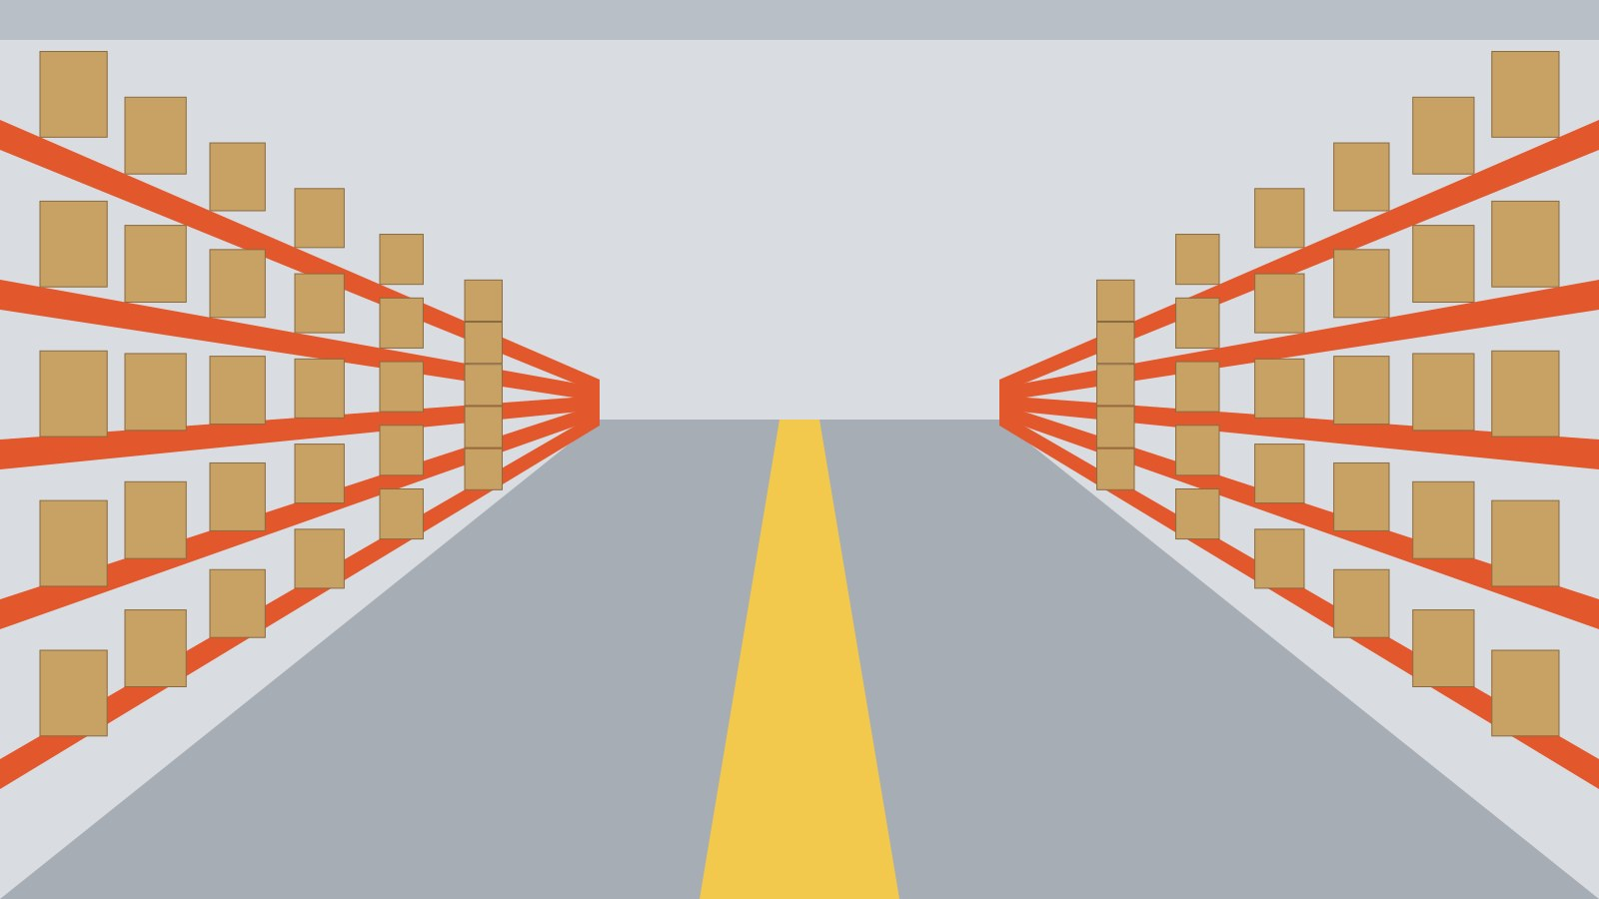
02
Safe & accurate picking
Picker onboarding · 45 minutes
Lille Lesquin fulfilment centre
Notes:
Hand out the hi-vis vests before starting. Check everyone has safety shoes.

Slide 2
MODULE 2 · PICKING
2.1
By the end of this module you can…
01
Recognise
the 8 safety signs of the warehouse
02
Find
any location from its code in under a minute
03
Pick
with the scanner, without skipping a scan
04
Lift
within the weight limits of each shelf height
ShipFast Academy · Lille Lesquin fulfilment centre · trainer: Nadia Benali

Slide 3







MODULE 2 · PICKING
2.2
Safety signs you will see
Wear your hi-vis vest
Safety shoes at all times
No phone while walking in aisles
Never climb the racks
MANDATORY
MANDATORY
PROHIBITION
PROHIBITION
Forklift traffic
Falling objects
Emergency exit
First aid kit
WARNING
WARNING
EMERGENCY
EMERGENCY
ShipFast Academy · Lille Lesquin fulfilment centre · trainer: Nadia Benali
Notes:
Shapes and colours follow ISO 7010: blue circle = must do, red ring = must not, yellow triangle = danger, green square = safe condition.

Slide 4
MODULE 2 · PICKING
2.3
Your way around Lille Lesquin
D1
A
B
C
D
E
F
01
02
03
04
05
06
07
08
P1
O1
Pick faces (yellow)
P2
Reserve (picking forbidden)
D2
P3
O2
Packing stations
D3
P4
Pedestrian walkway
P5
O3
D4
Forklift lane
RESERVE RACKS
P6
INBOUND
PICK FACES
Picking route
Battery charging
Break room
Start of the loop
ShipFast Academy · Lille Lesquin fulfilment centre · trainer: Nadia Benali
Notes:
The blue route is the standard picking loop of wave 1. Never cut through a forklift lane.

Slide 5
MODULE 2 · PICKING
2.4
Six steps for every line
1
Scan the location
Barcode on the shelf edge
LOC A-07-03-B
SKU 448210
Trail shoe 42
QTY 2
2
Check the quantity
Shown in large digits
3
Pick the items
Lift from the front
4
Scan each item
One scan per unit
1
2
3
4
5
6
5
Place in the tote
Heavy items at the bottom
7
8
9
6
Confirm
Press OK, next line appears
C
0
OK
ShipFast Academy · Lille Lesquin fulfilment centre · trainer: Nadia Benali
Notes:
Never pick before scanning the location: the scanner rejects the pick and you lose time.

Slide 6
MODULE 2 · PICKING
2.5
Reading a location code
A
–
07
–
03
–
B
ZONE
A = pick faces, R = reserve
AISLE
01 to 08, numbered from the docks
BAY
odd bays on the left, even on the right
LEVEL
A = floor, E = top shelf
Example: A-07-03-B is the second shelf from the floor, third bay on the left, aisle 7 of the pick zone.
ShipFast Academy · Lille Lesquin fulfilment centre · trainer: Nadia Benali

Slide 7


MODULE 2 · PICKING
2.6
Do and don't
Do
Don't
Scan the location before every pick
Pick from reserve racks
Use the step ladder for levels D and E
Stack totes higher than your chest
Report damaged items with the red button
Cross a forklift lane outside a crossing
Walk on the green walkway between zones
Scan the same item twice "to save time"
ShipFast Academy · Lille Lesquin fulfilment centre · trainer: Nadia Benali

Slide 8
MODULE 2 · PICKING
2.7
Where picking errors come from
80 %
of errors come from the first three causes.
All three disappear when step 1 and step 4 are never skipped.
ShipFast Academy · Lille Lesquin fulfilment centre · trainer: Nadia Benali
Notes:
Lille Lesquin, September 2026: 1,840 errors for 2.1 million lines picked (0.09 %).

Slide 9
MODULE 2 · PICKING
2.8
How much can you lift, and from where?
Level E · Above shoulder
5 kg
2.0 m
Level D · Shoulder
10 kg
Level C · Waist
25 kg
Golden zone: fast movers here
Level B · Knee
15 kg
Level A · Floor
10 kg
ShipFast Academy · Lille Lesquin fulfilment centre · trainer: Nadia Benali
Notes:
Limits for a single item, held close to the body. Above the limit: ask a colleague or use the lift table.

Slide 10
MODULE 2 · PICKING
2.9
Quick check
You scan an item and the scanner shows a different SKU from the one expected. What do you do?
Pick it anyway, it looks the same
Take the item from the next bay
A
B
Leave it, press "mismatch" and report
Scan it again until it matches
C
D
Hint: see slide 2.7
ShipFast Academy · Lille Lesquin fulfilment centre · trainer: Nadia Benali
Notes:
Correct answer: C. If the item does not match, never pick a "similar" one: the customer ordered that SKU.

Slide 11
MODULE 2 · PICKING
2.10
Words you will hear on the floor
Term | What it means
SKU | Stock keeping unit: one product reference, e.g. 448210
Pick face | Shelf location where pickers take items
Reserve | High racks with full pallets; forklifts only
Replenishment | Moving stock from reserve to a pick face
Wave | Batch of orders released together, e.g. wave 1 at 6:00
Tote | Plastic box that travels from pick face to packing
Line | One SKU and quantity inside an order
Mismatch | Scanned item differs from the expected SKU
ShipFast Academy · Lille Lesquin fulfilment centre · trainer: Nadia Benali

Slide 12
Module 2 completed
Your supervisor will now pick 20 lines with you on the floor.
Next: Module 3 · Packing and labelling (40 min)
Trainer signature · Nadia Benali

