Slide 1
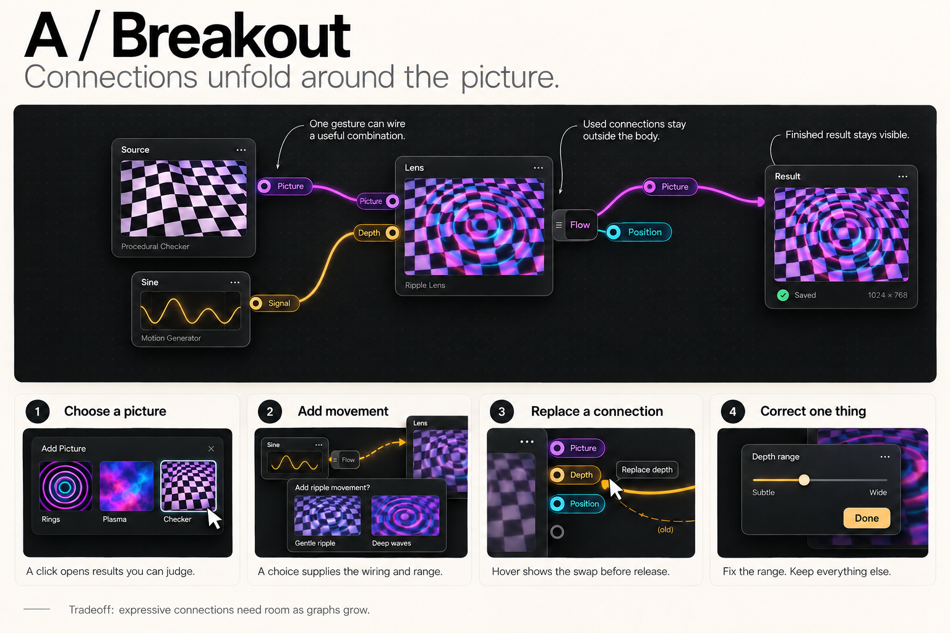
Notes:
Static design proposal based on the September 20 conversation. Generated with the built-in image-generation tool. These are illustrative UI mockups, not existing functionality or actual renderer outputs. Raster artwork, not editable UI components. Shared intent: one taste decision produces a usable result; flow outlets can apply several suitable connections and settings; regular wiring exposes compatible inputs; replacement is supported; precise correction preserves the rest. A uses visible breakout branches. B uses compact sockets with mappings available on demand. No product implementation in this deliverable.

Slide 2
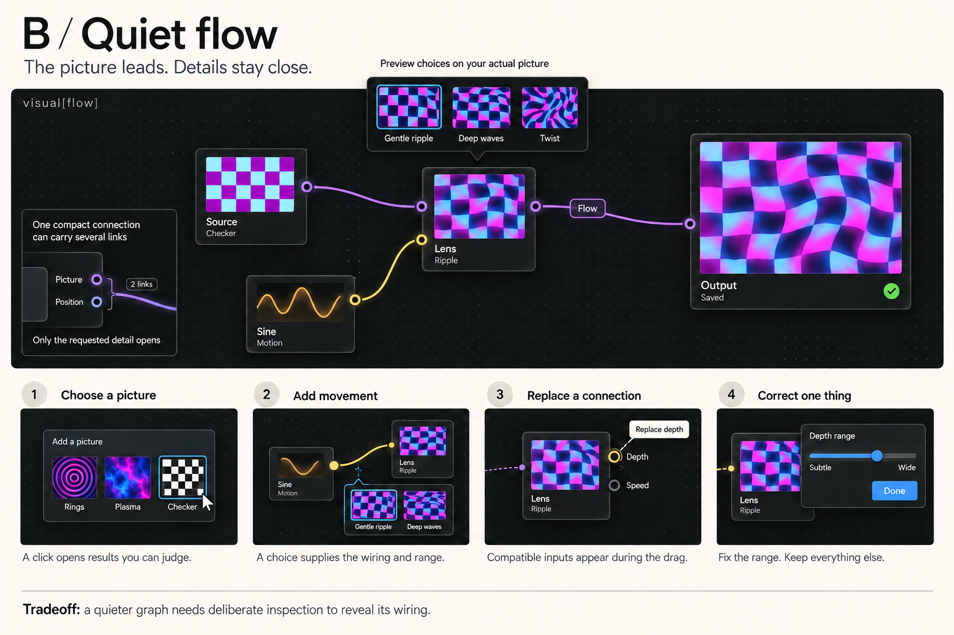
Notes:
Static design proposal based on the September 20 conversation. Generated with the built-in image-generation tool. These are illustrative UI mockups, not existing functionality or actual renderer outputs. Raster artwork, not editable UI components. Shared intent: one taste decision produces a usable result; flow outlets can apply several suitable connections and settings; regular wiring exposes compatible inputs; replacement is supported; precise correction preserves the rest. A uses visible breakout branches. B uses compact sockets with mappings available on demand. No product implementation in this deliverable.

