Slide 1
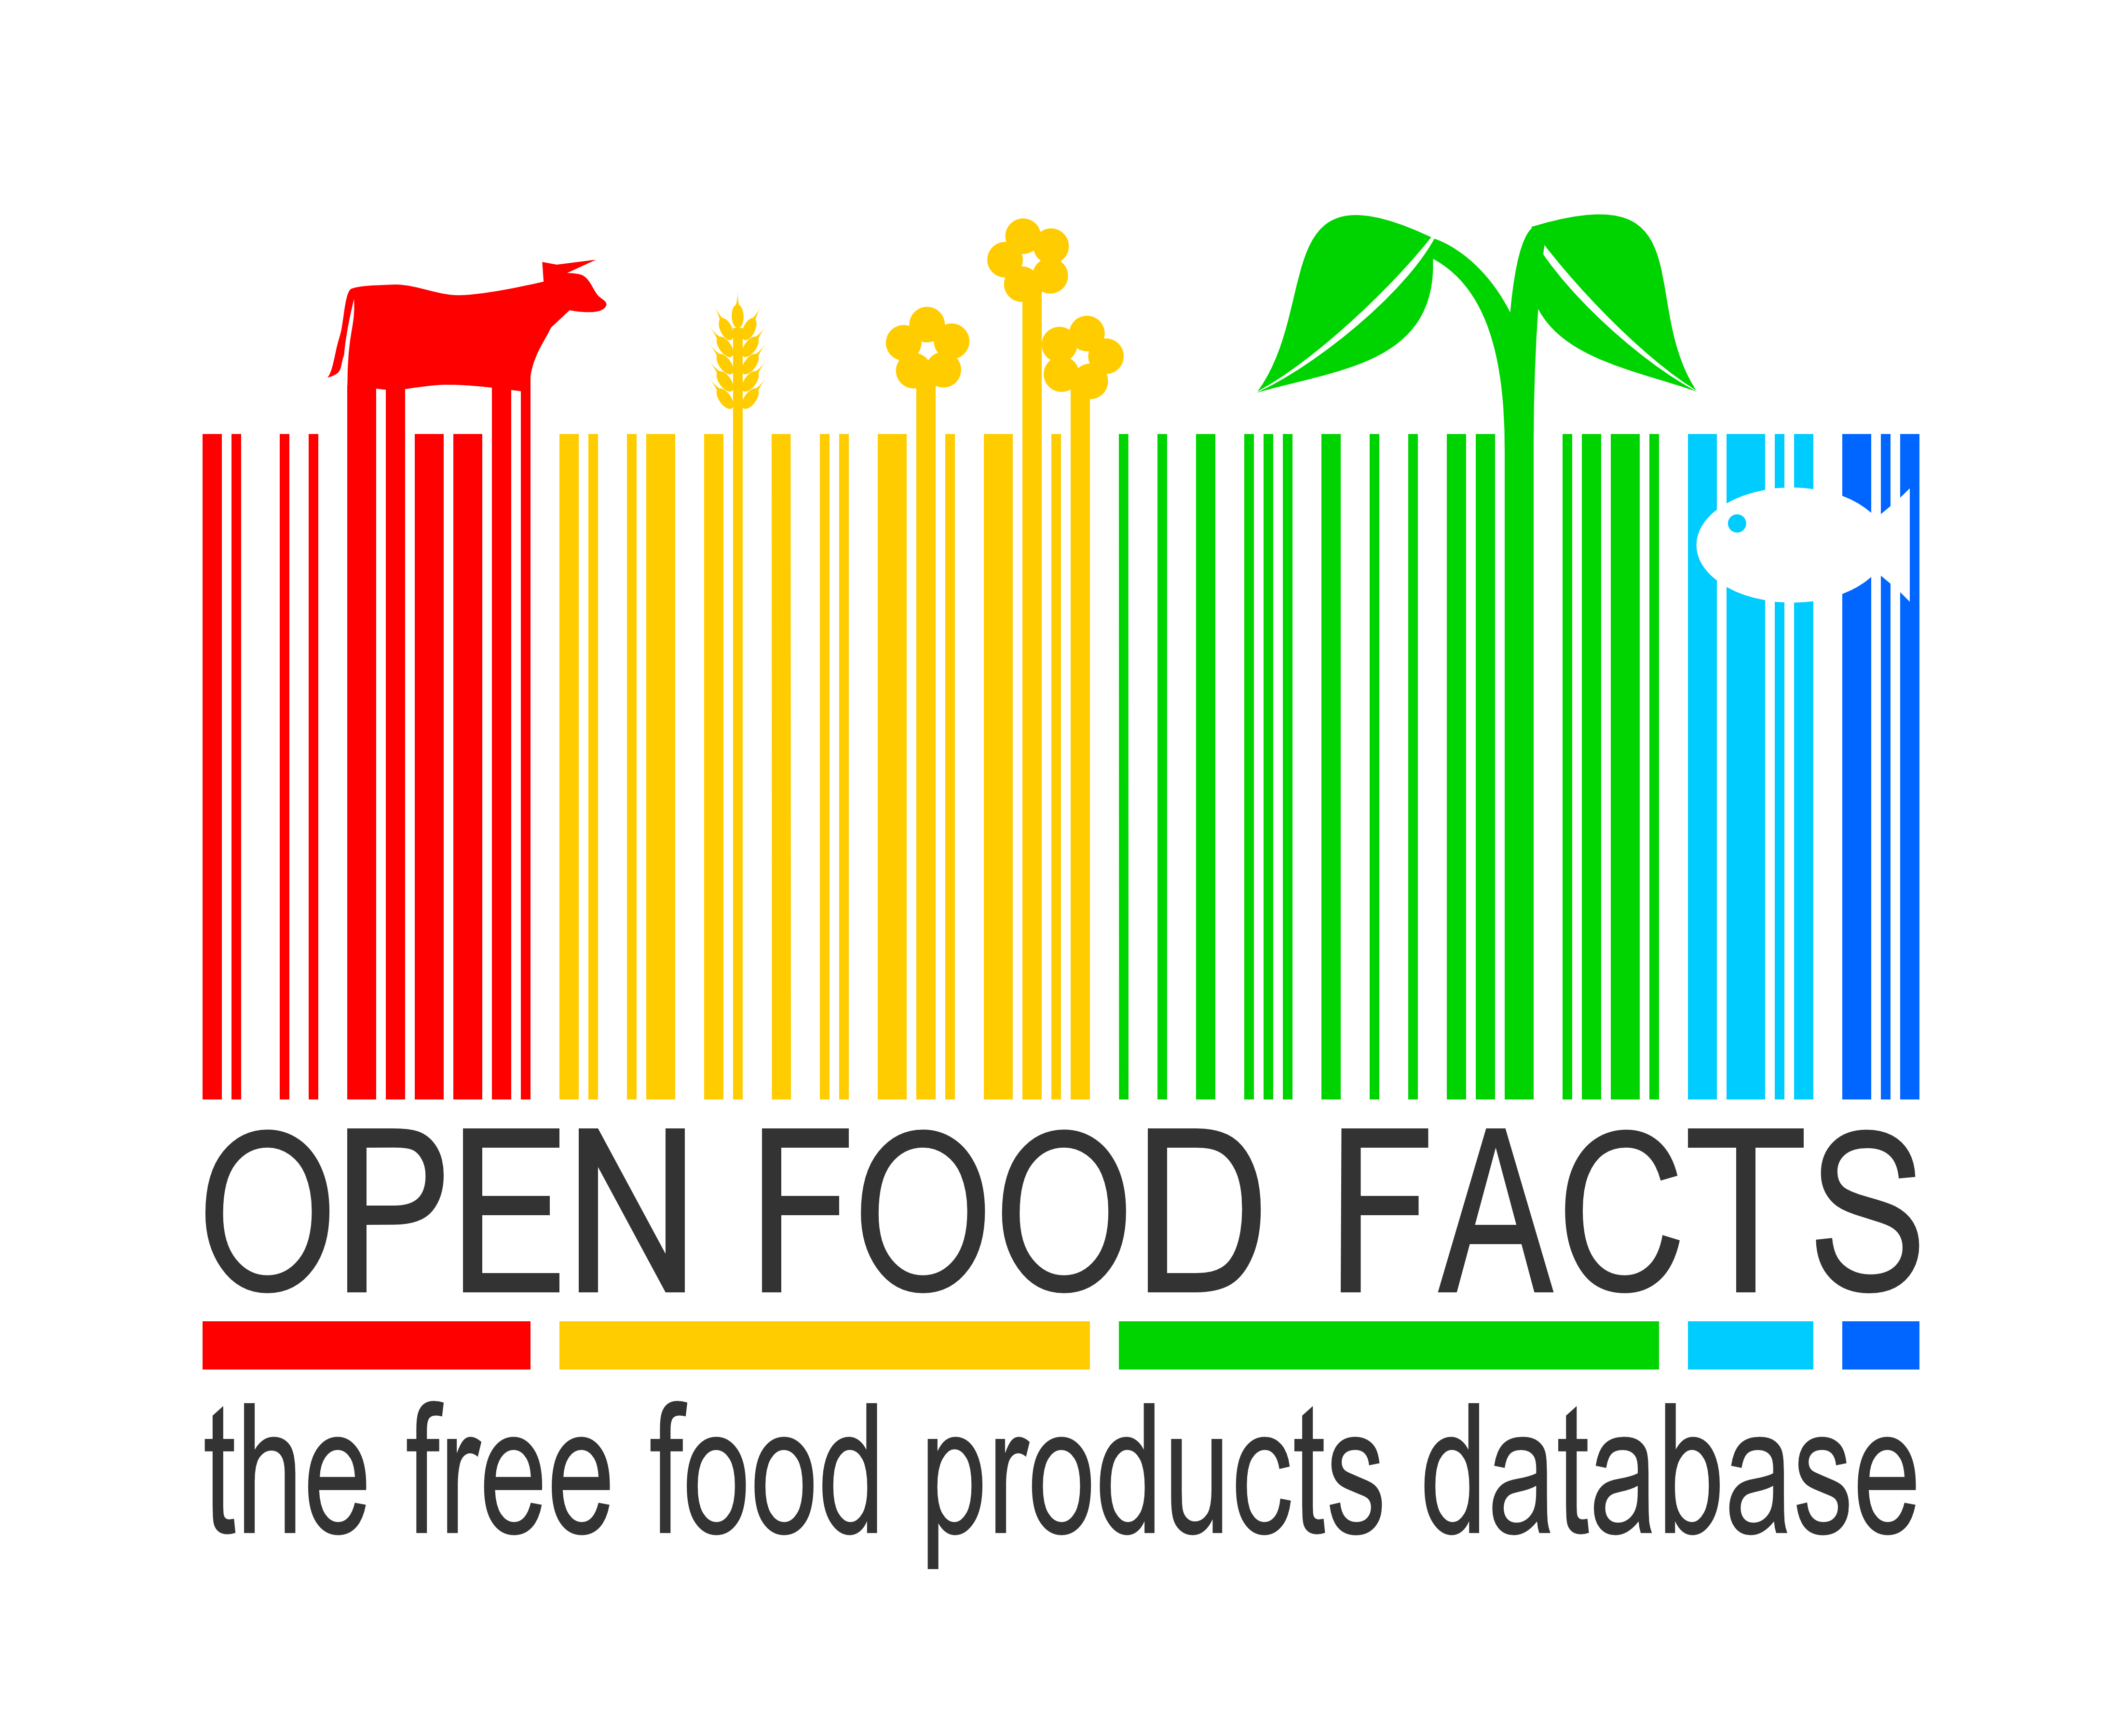
Making the food industry more transparent,
thanks to open data and crowdsourcing
Open Data Day – February 21st 2015

Slide 2
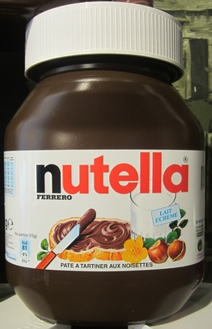
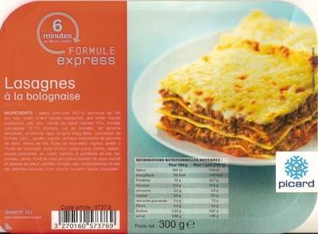
For consumers,
the food industry
is a black box
“vegetable oil”
?
?
“beef meat”

Slide 3
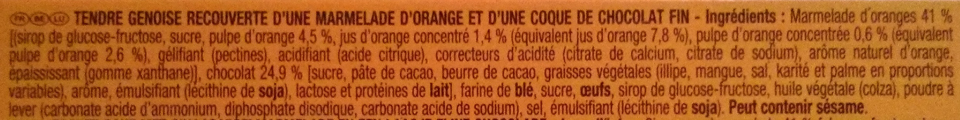
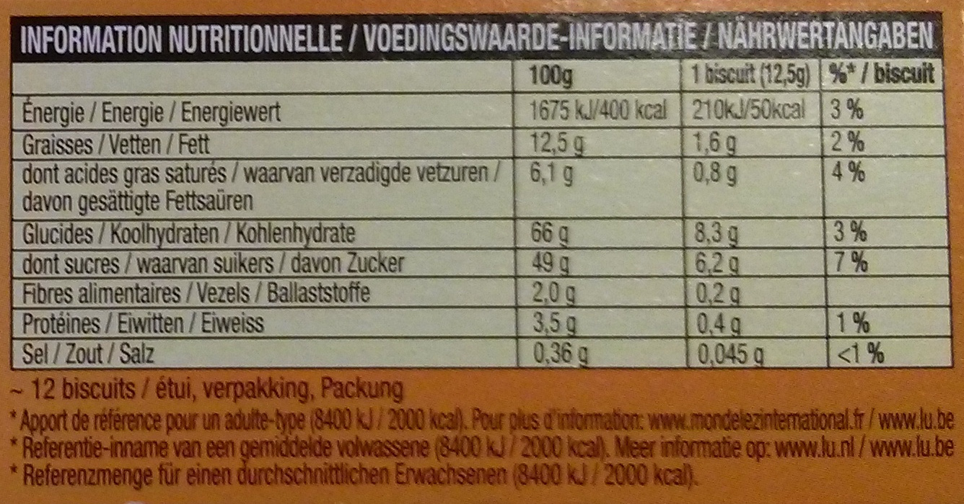
A lot of useful data, if you read the fine print

Slide 4
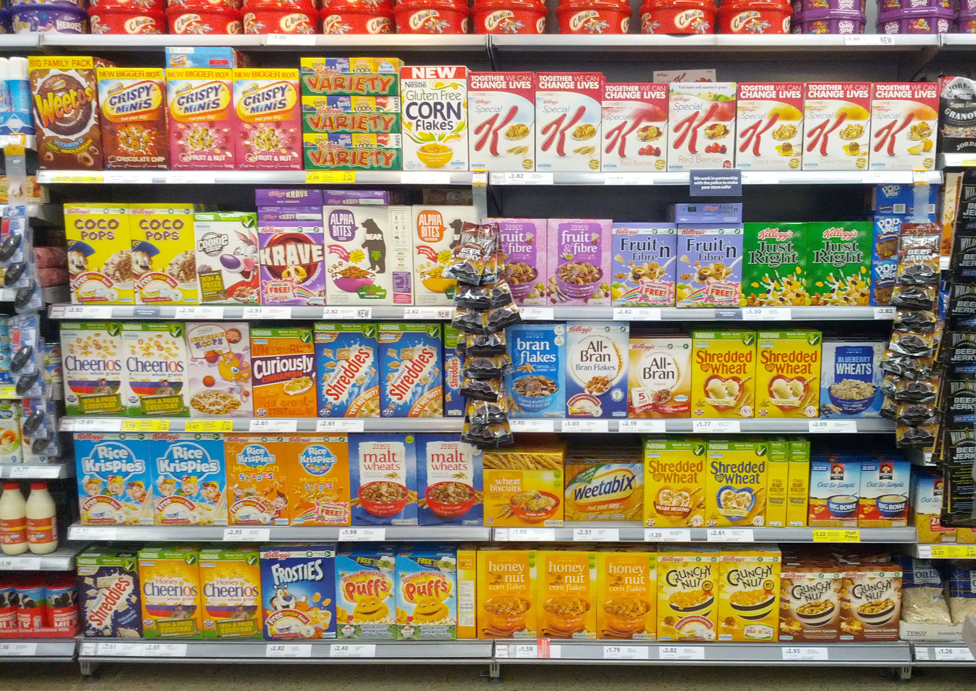
Which cereals are healthier?

Slide 5



Can we open the data on food products ourselves?
OpenStreetMap
The Free Wiki World Map
and ?

Slide 6
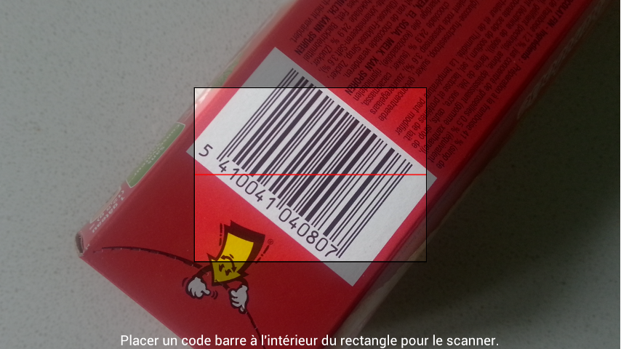
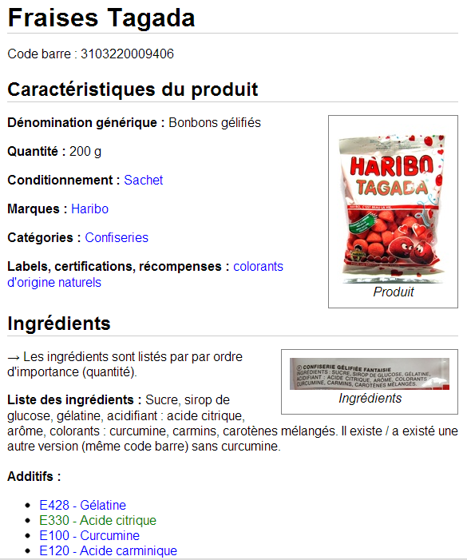


An Open and Collaborative Database
Crowdsourcing with mobile apps:

Slide 7
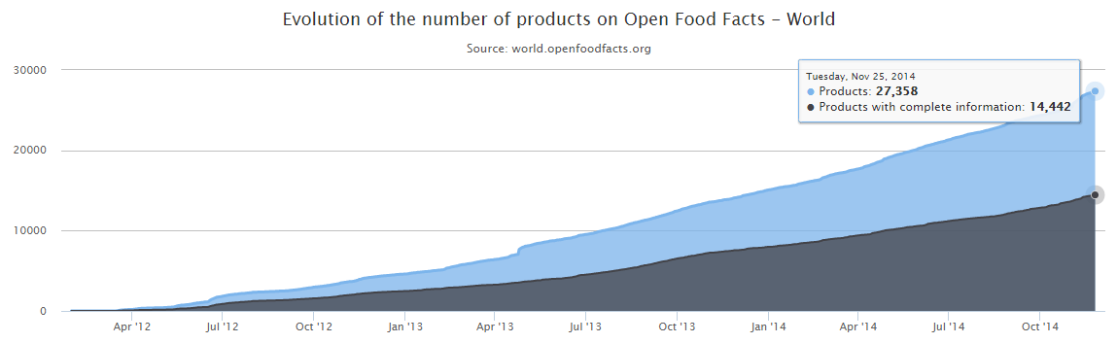
A few dates and numbers
Launch on May 19th 2012
Incorporated as non-profit on April 11th 2014
1500 contributors
33000 products (23000 from France)
27500 ingredients, 312 additives

Slide 8
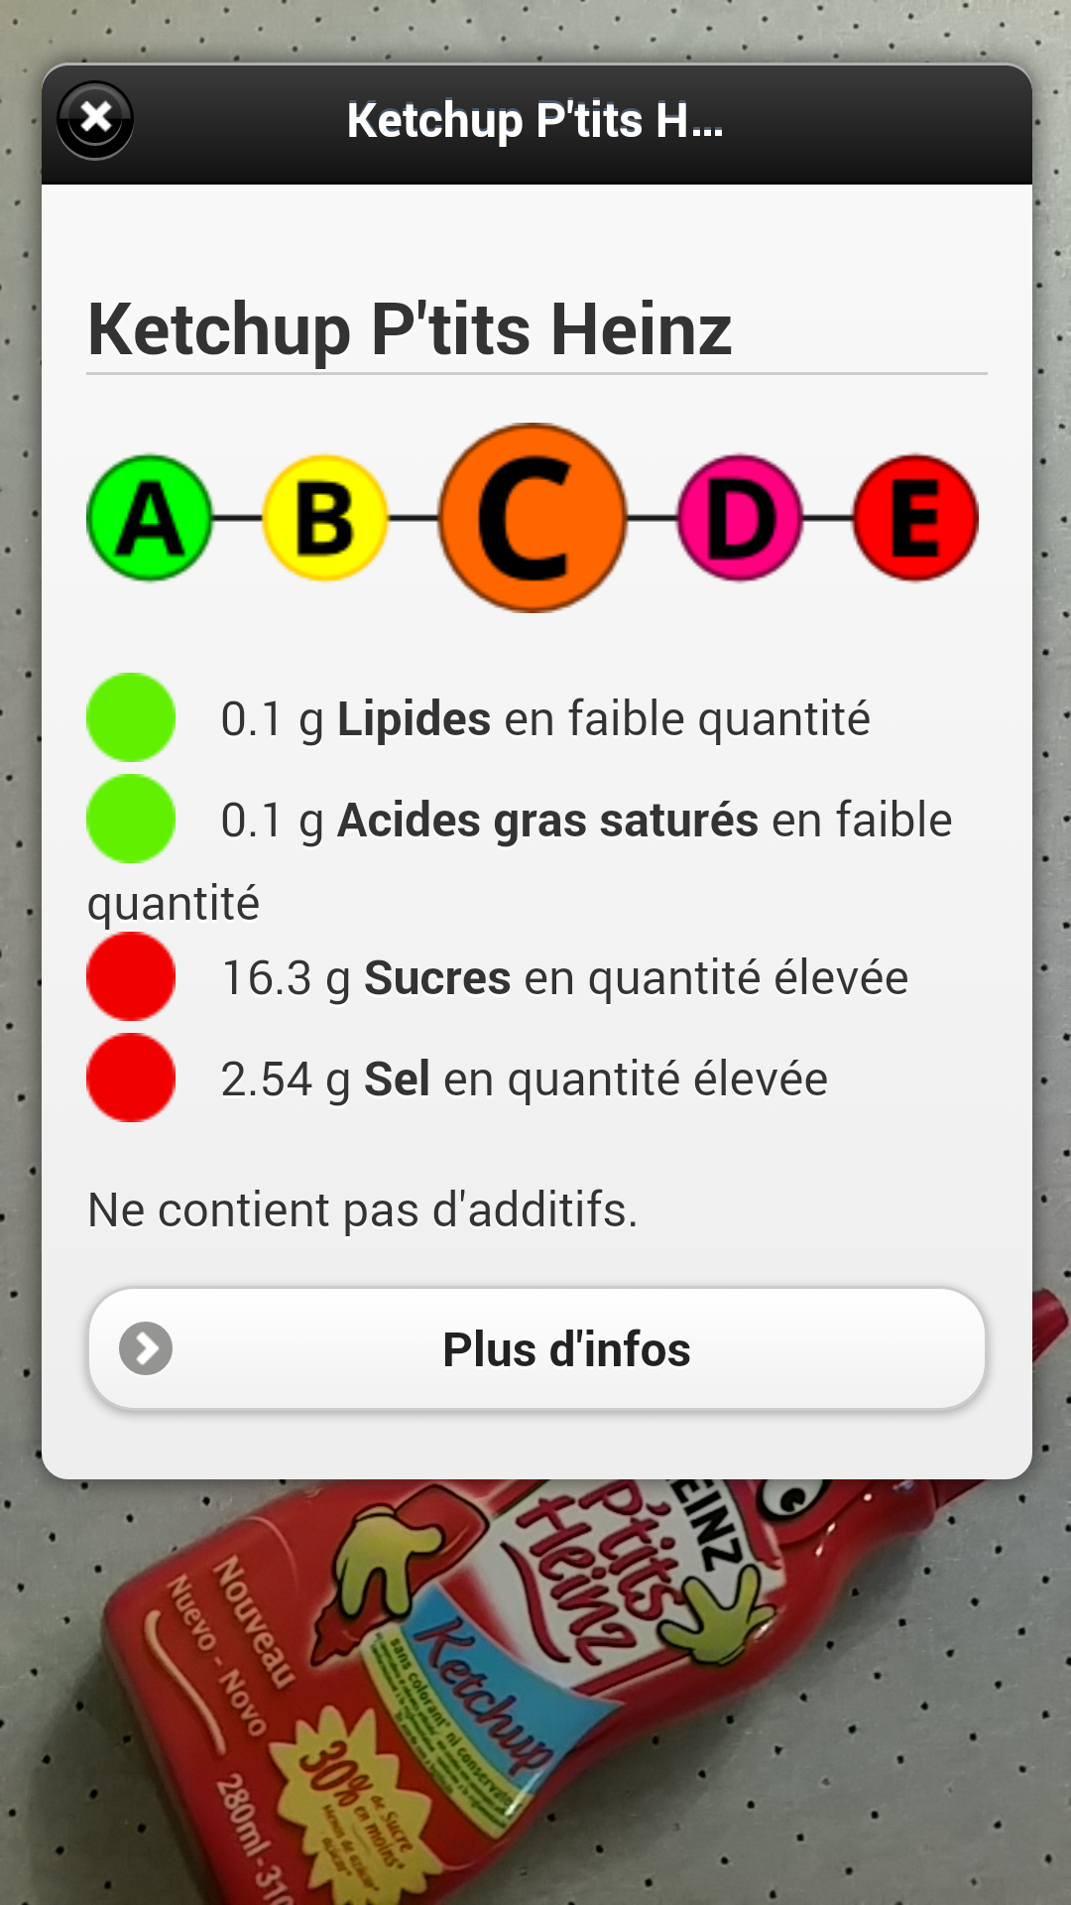

Use : decrypting labels
Additives : E150d ?
Palm oil
Allergens
Nutrition trafic lights
Nutrition grade A → E
Augmented reality
  Visual recognition

Slide 9
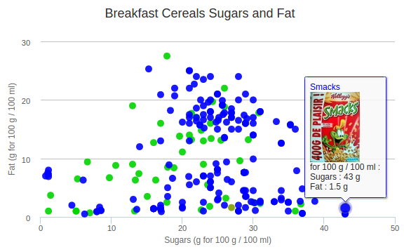
Use : comparing products in 3 clicks
Interactive graph that you can create in 3 clicks on http://openfoodfacts.org

Slide 10
Re-uses
Not public data but data of public interest
Open data :
  Open Database Licence (OdbL)
    Free re-use for everyone and for all uses
    Attribution and Share-Alike
  Full database export in CSV, RDF
  API JSON
  More info: http://world.openfoodfacts.org/data

Slide 11


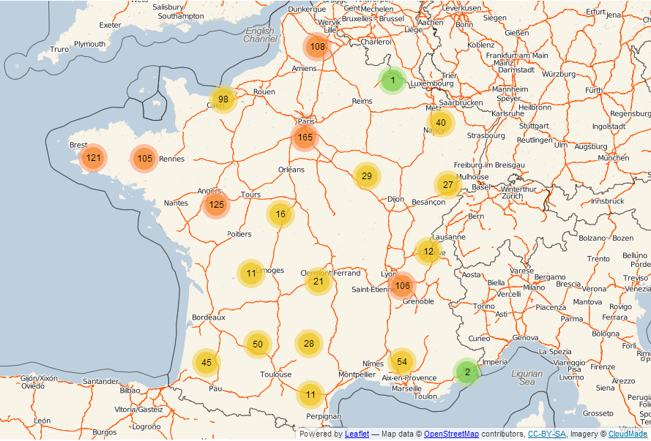
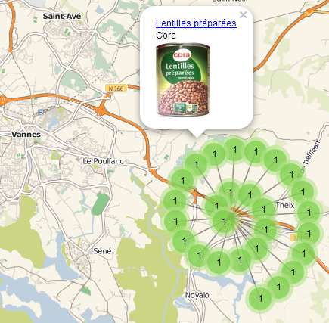
emballé
http://cestemballepresdechezvous.fr
http://madenear.me
Open Food Facts data
+ OpenStreetMap map

Slide 12
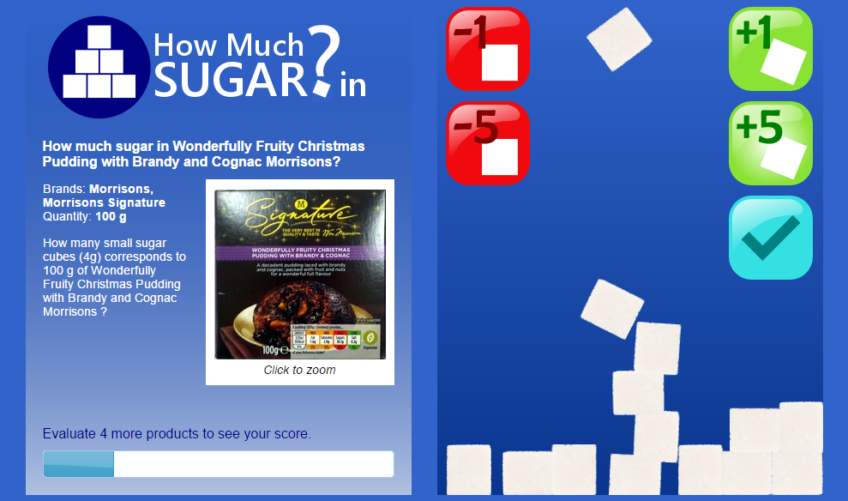
Educative game: how many sugar cubes?
English: http://howmuchsugar.in French: http://combiendesucres.fr

Slide 13
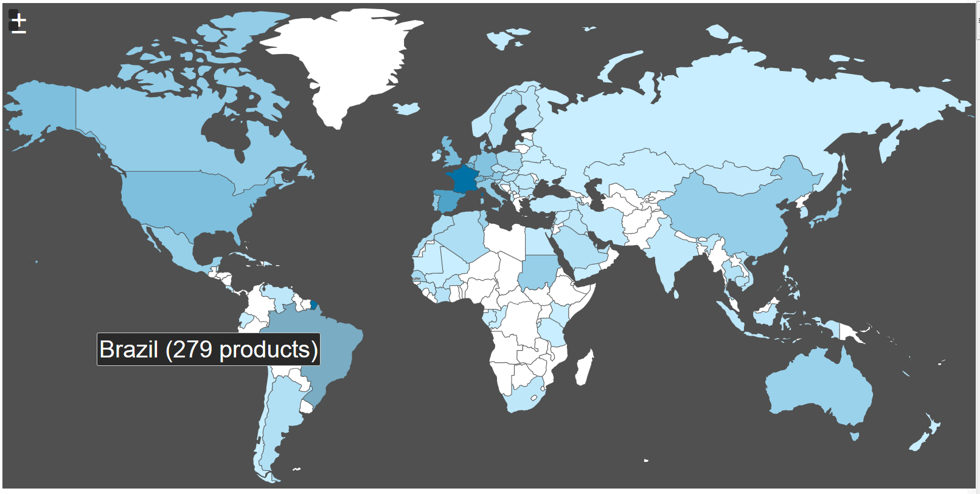
A database of food products from around the world
Started in France, designed for the world
Translated in 12 languages, products from 127 countries
http://world.openfoodfacts.org/countries

Slide 14

Open Data Day 2015
http://world.openfoodfacts.org/open-food-hunt-2015

Slide 15
Open Food Hunt 2015
Goals:
  Add food products in all 250 countries
  Reach a critical mass of products in as many countries as possible
  Start or develop local contributors communities
Food Explorers who add products
Food Ambassadors who recruit new contributors
Friendly competition with points and rankings
  Bonus points when we have no or few products in a country

Slide 16
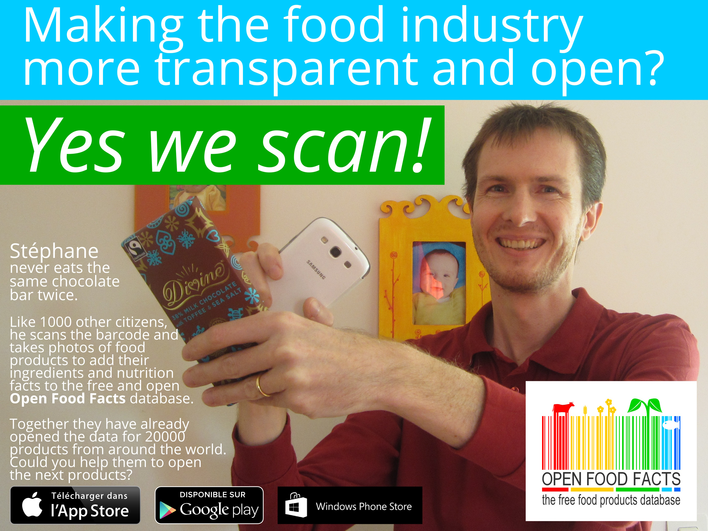

Slide 17

Contact
contact@openfoodfacts.org
Twitter: @OpenFoodFacts
Facebook: http://facebook.com/OpenFoodFacts
Wiki: http://en.wiki.openfoodfacts.org
We use extensively a tool called Slack to communicate between contributors, developers and reusers. Please e-mail contact@openfoodfacts.org to join!

Slide 18
More slides ;-)
Slides for some project or project ideas to do with Open Food Facts

Slide 19



Open Data Day 2014
Milk ?
http://whatsinmyyogurt.com/

Slide 20
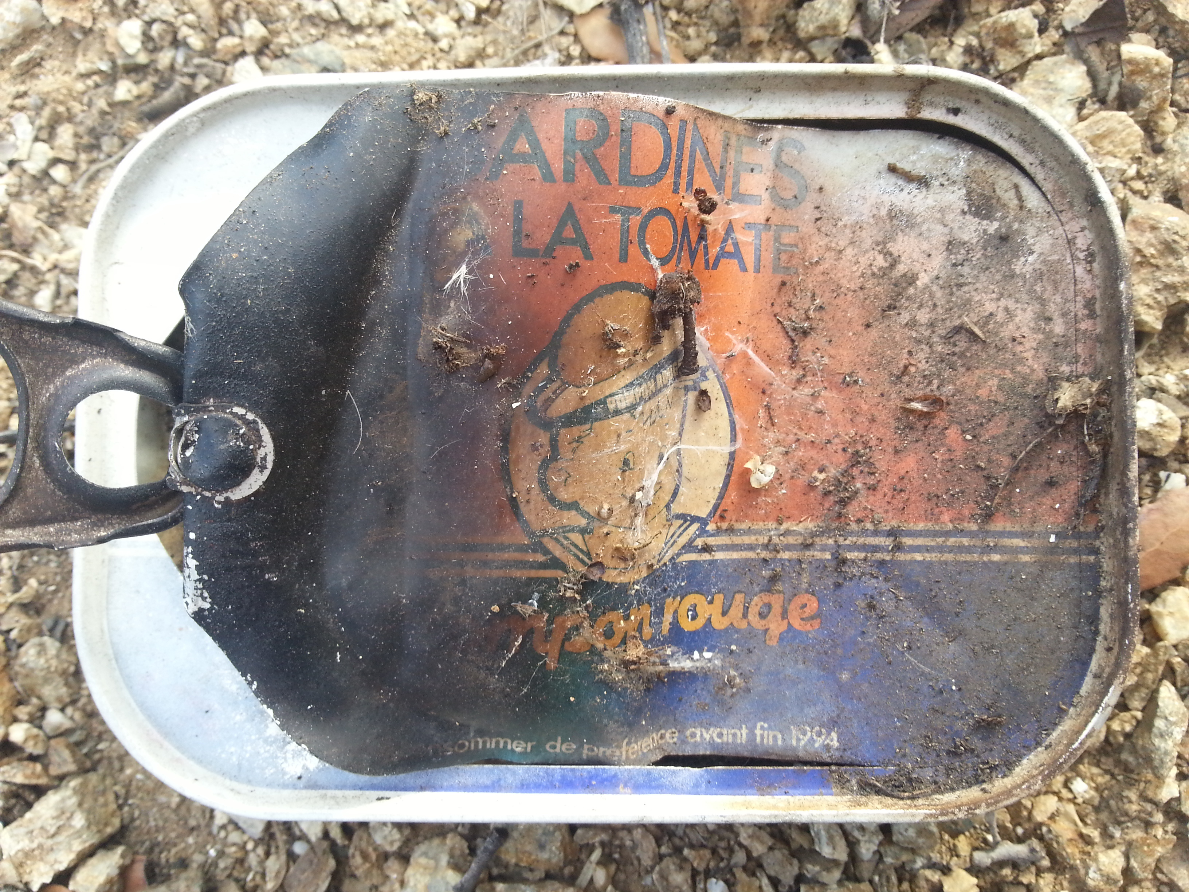
Food Archeology Project
What was food from 5, 10, 20, 50, 100 years ago like?

Slide 21
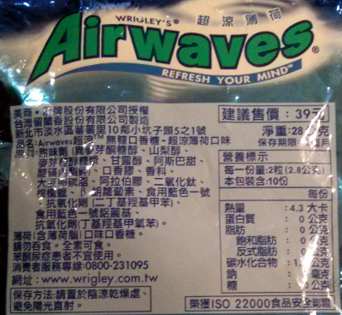
Ingredients Translator

Slide 22
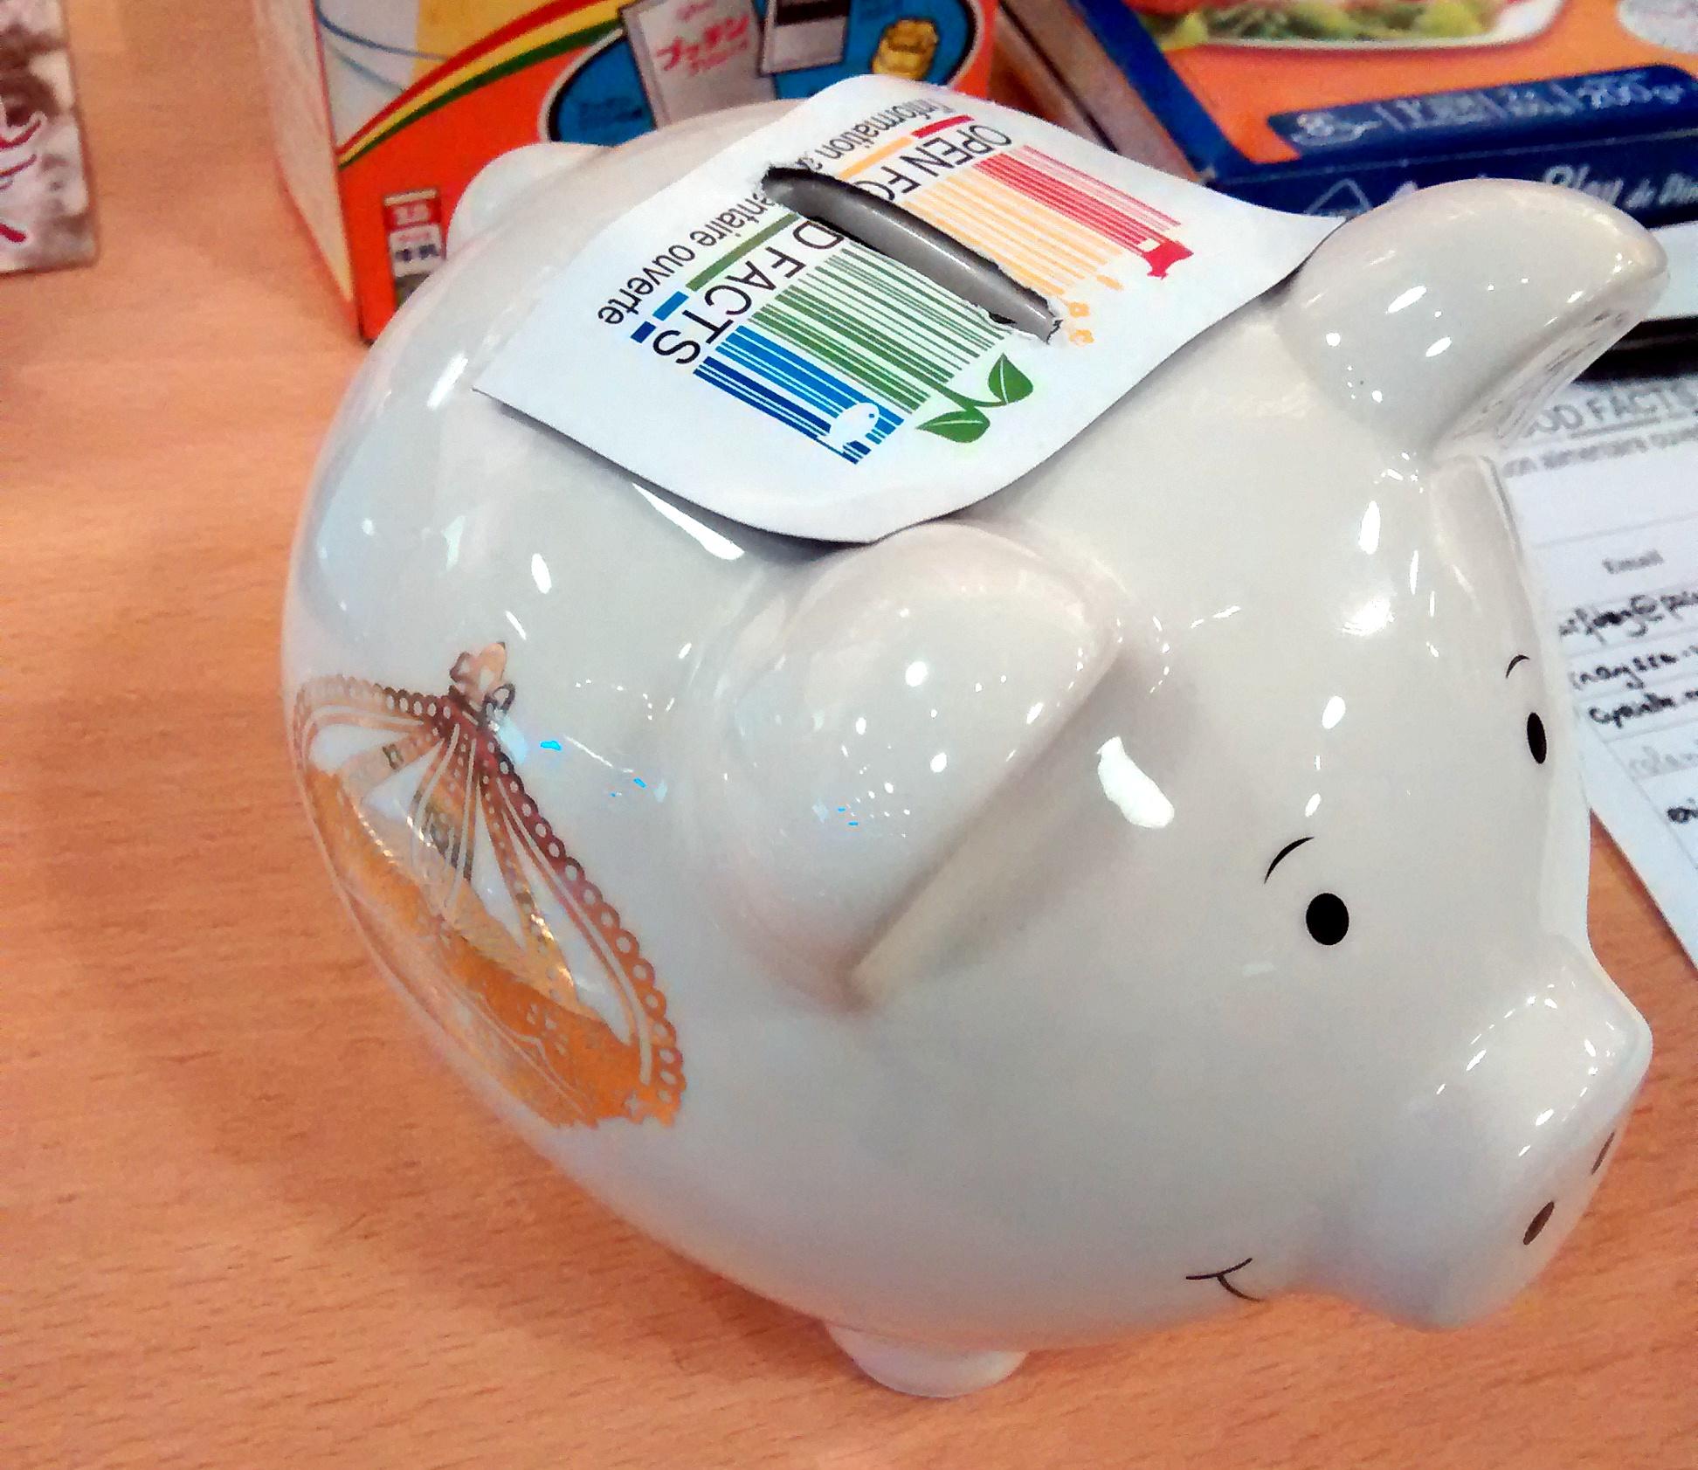


Our business model

