Slide 1
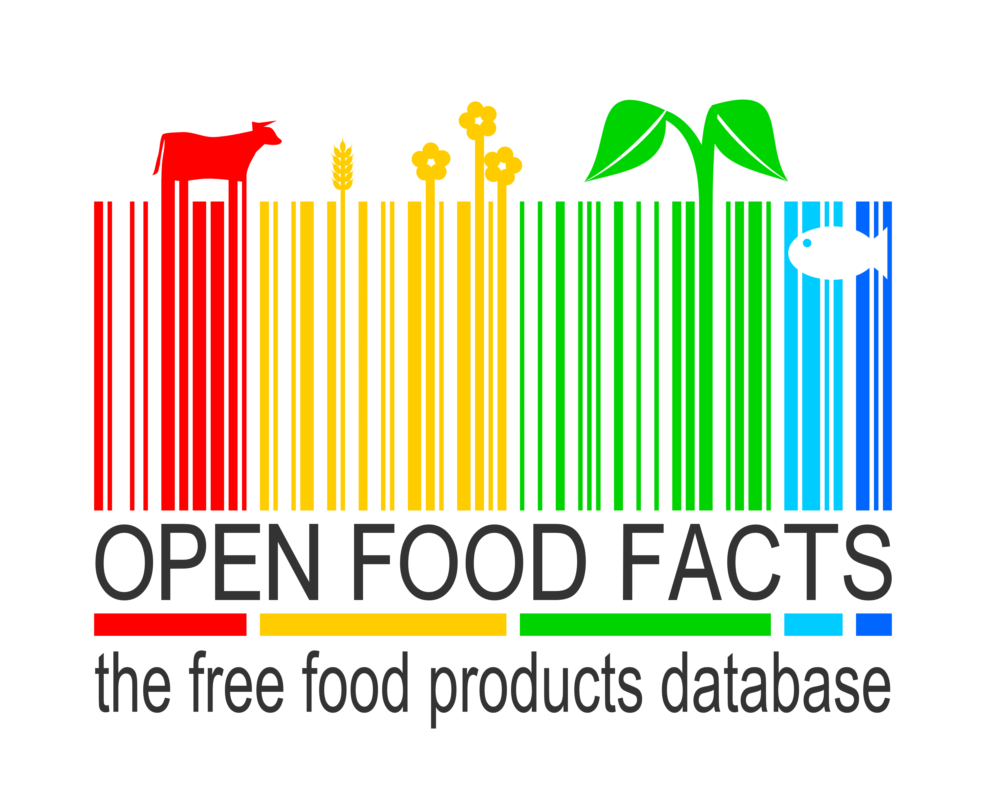
Making the food industry more transparent,
thanks to open data and crowdsourcing
Stéphane Gigandet – ESSEC – 16 septembre 2014

Slide 2
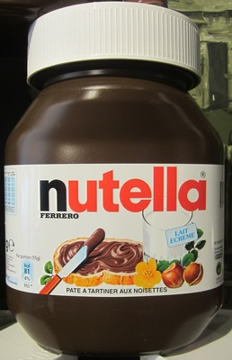
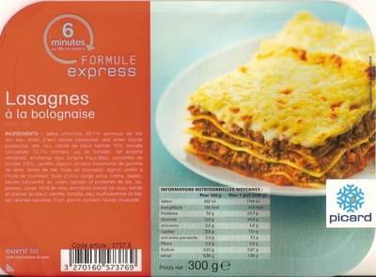
For consumers,
the food industry
is a black box
“vegetable oil”
?
?
“beef meat”

Slide 3



Can we open the data on food products ourselves?
OpenStreetMap
The Free Wiki World Map
and ?

Slide 4
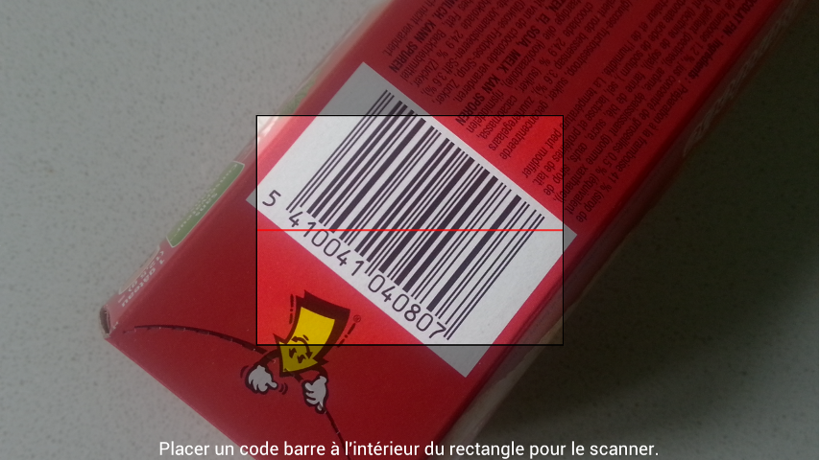
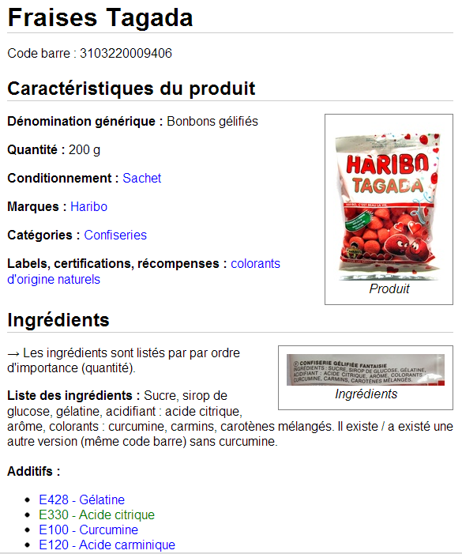


An Open and Collaborative Database
Crowdsourcing with mobile apps :

Slide 5
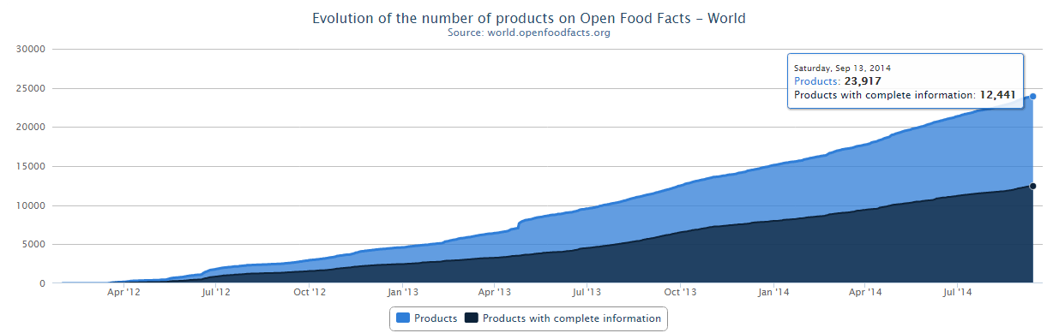
A few dates and numbers
Launch on May 19th 2012
Incorporated as non-profit on April 11th 2014
1150 contributors
24000 products (18000 from France)
24400 ingredients, 262 additives

Slide 6
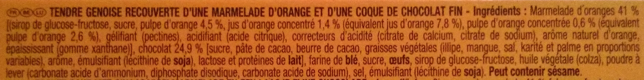
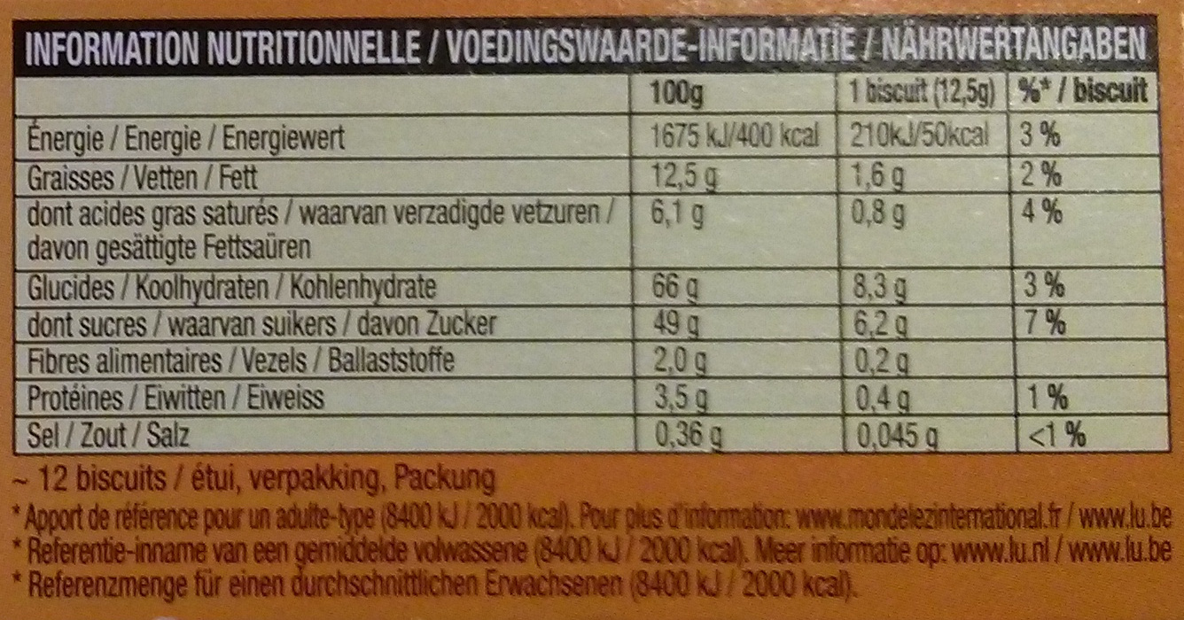
Use: decrypting labels

Slide 7
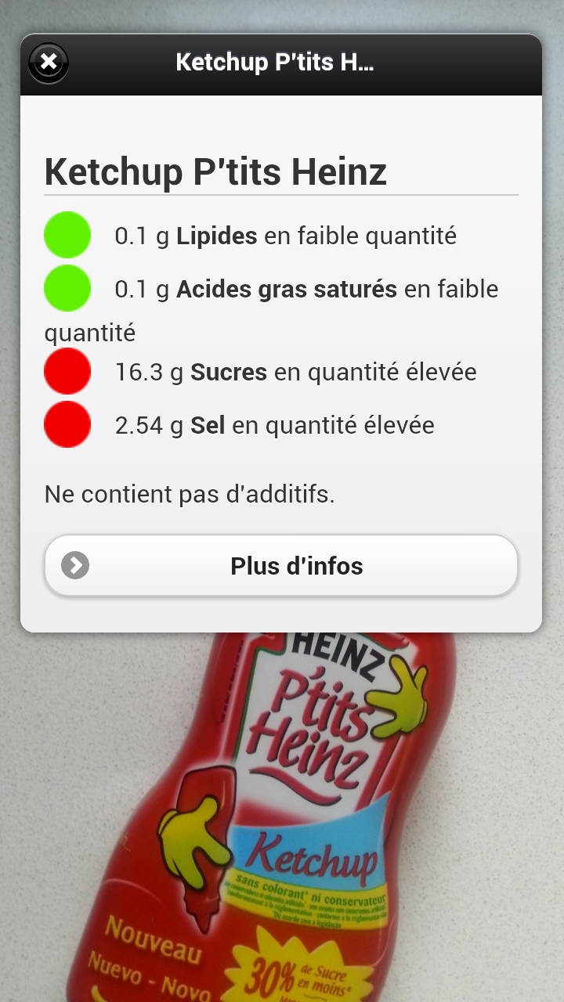

Use : decrypting labels
Additives : E150d ?
Palm oil
Allergens
Nutrition trafic lights
Augmented reality
  Visual recognition

Slide 8
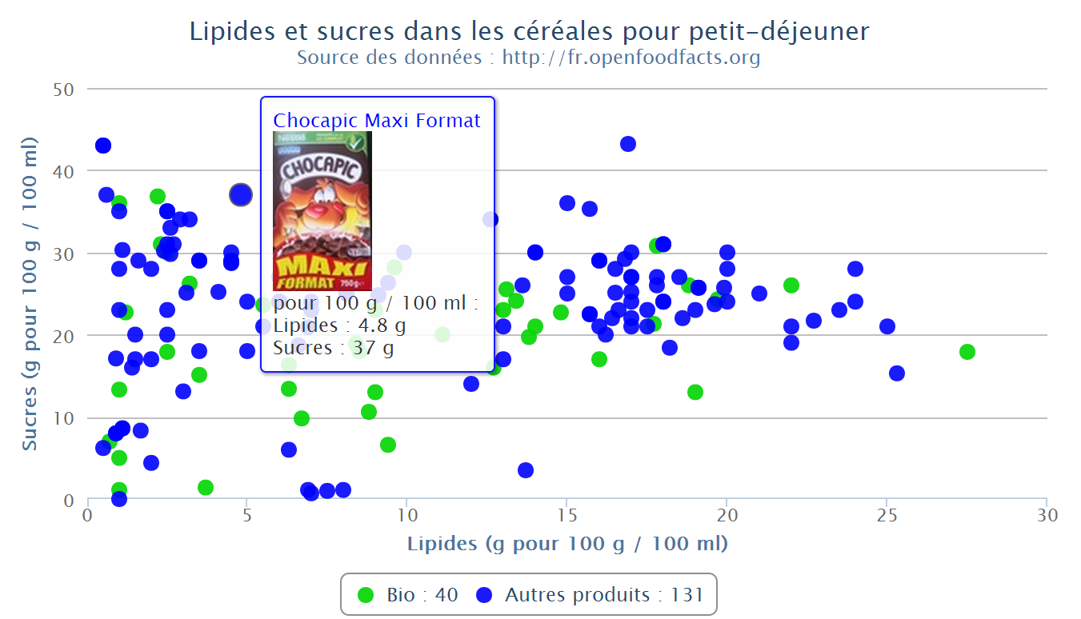
Use : comparing products in 3 clicks
Graphique interactif créé en 3 clics sur le site http://fr.openfoodfacts.org

Slide 9
Re-uses
Not public data but data of public interest
Open data :
  Open Database Licence (OdbL)
    Free re-use for everyone and for all uses
    Attribution and Share-Alike
  Full database export in CSV, RDF
  API JSON
  More info: http://world.openfoodfacts.org/data

Slide 10

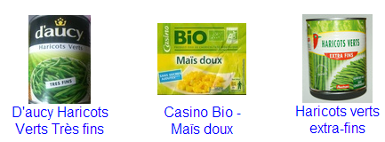
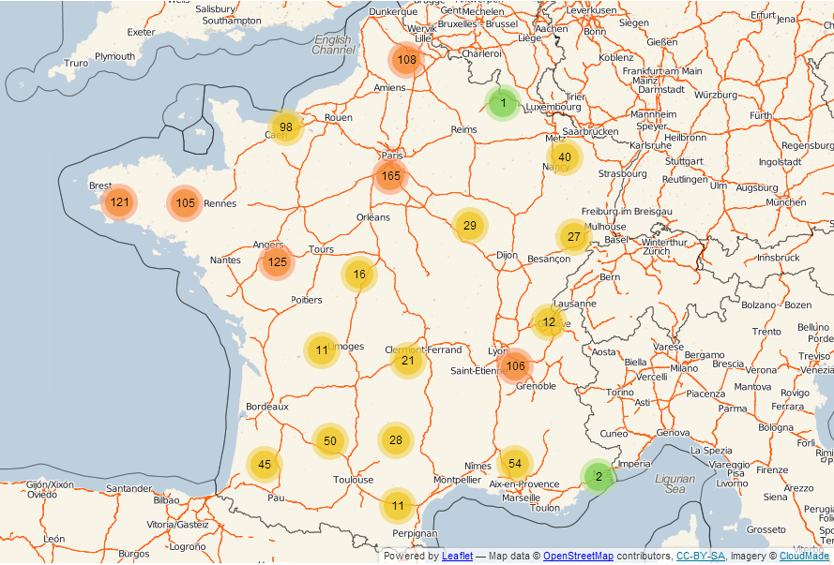
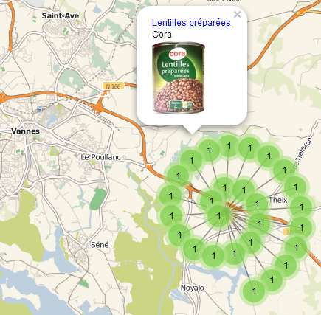
emballé
Open Food Facts data
+ OpenStreetMap map
http://cestemballepresdechezvous.fr

Slide 11
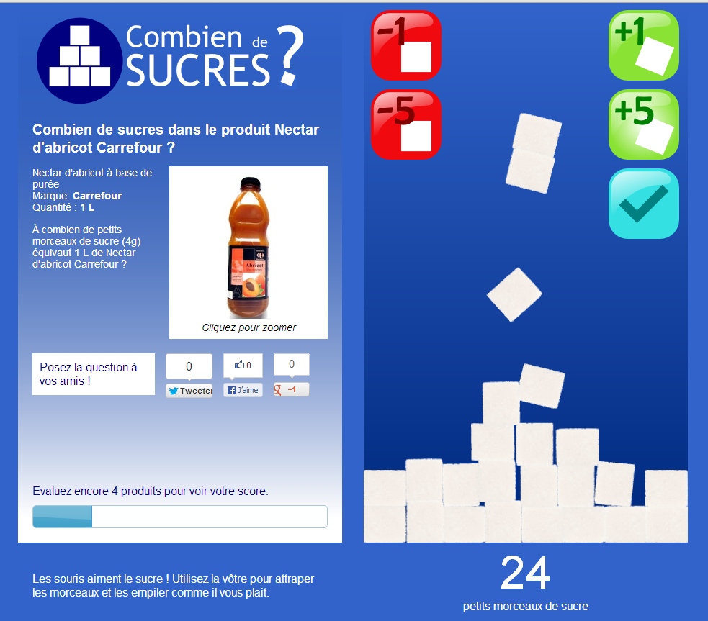
Educative game: how many sugar cubes?
http://combiendesucres.fr

Slide 12
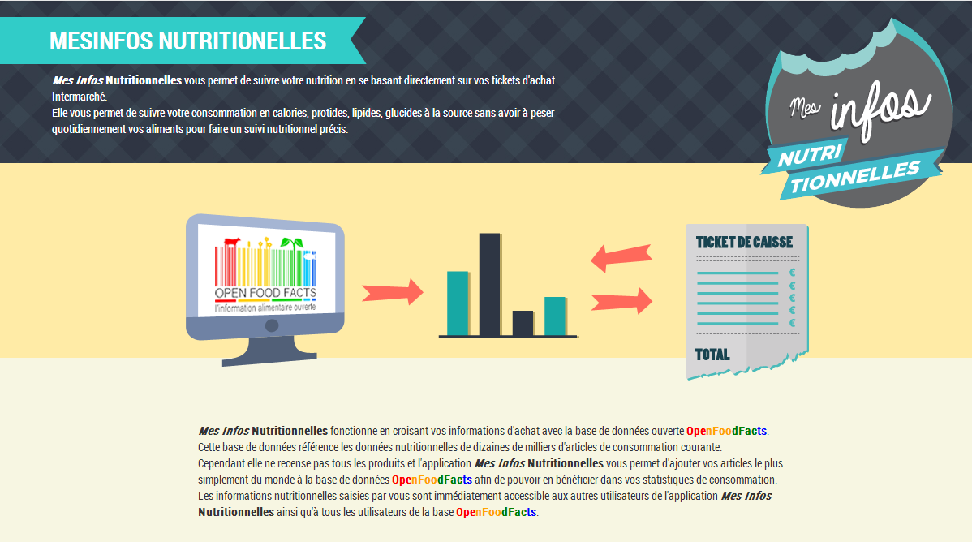
Expérience MesInfos avec la Fing et Intermarché
http://mes-infos-nutritionnelles.lookal.fr/

Slide 13
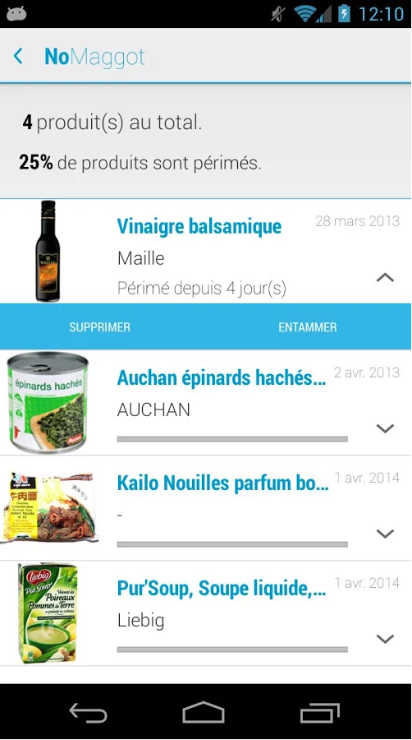
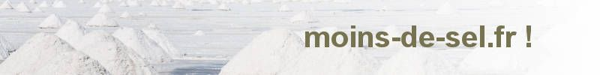

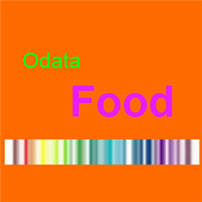

More re-uses

Slide 14
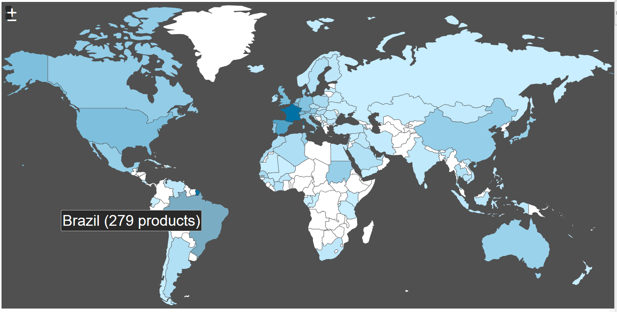
A database of food products from around the world
Started in France, designed for the world
Translated in 12 languages, products from 127 countries
http://world.openfoodfacts.org/countries

Slide 15



http://whatsinmyyogurt.com/
Milk ?

Slide 16
Projet : Détecteurs de gluten et de lactose
Analyser la liste des ingrédients
Afficher “contient du gluten” etc.
Et surtout permettre la recherche de produits sans gluten, lactose, huile de palme etc.
Ingrédients : Sucre, graisses végétales, lait entier 10%, farine de froment 8,5%, oeuf 8,5%, sirop de glucose-fructose, lait écrémé en poudre 5%, cacao maigre

Slide 17
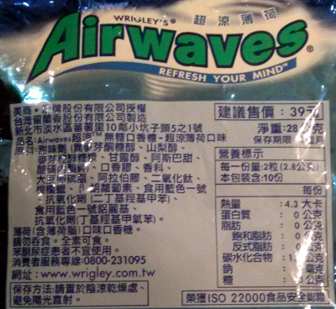
Ingredients Translator

Slide 18
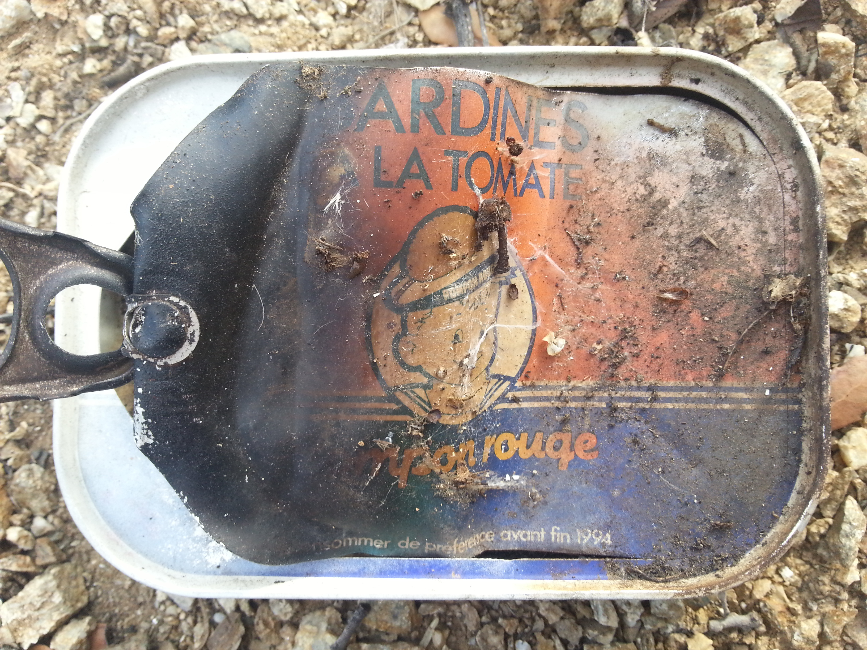
Food Archeology Project
What was food from 5, 10, 20, 50, 100 years ago like?

Slide 19
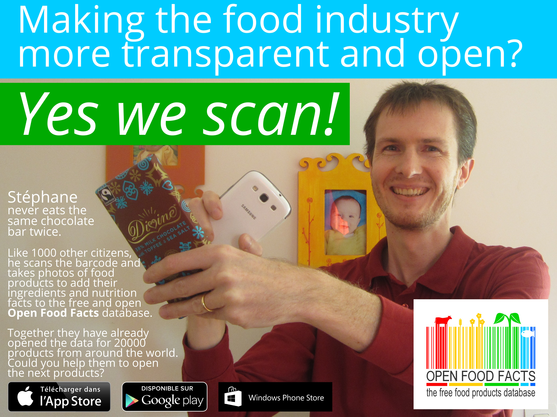

Slide 20
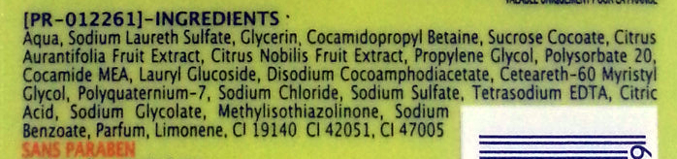


Slide 21
Contact
stephane@openfoodfacts.org
Twitter: @OpenFoodFacts
Facebook: http://facebook.com/OpenFoodFacts
Wiki:
  http://fr.wiki.openfoodfacts.org
  http://en.wiki.openfoodfacts.org
Association Open Food Facts
21 rue des Iles
94100 Saint-Maur des Fossés

