Slide 1
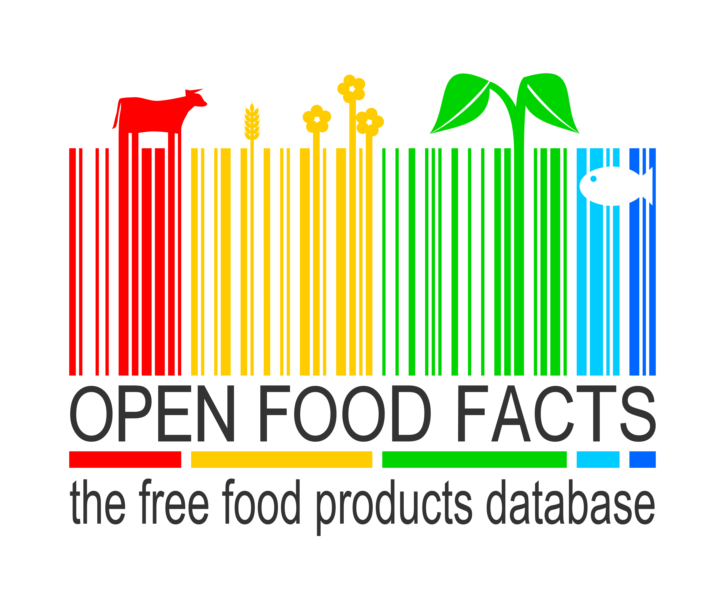
(Food) Products are made to be opened!
Stéphane Gigandet – Product Tank Paris – September 25th 2014

Slide 2
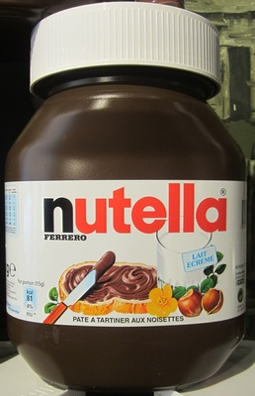
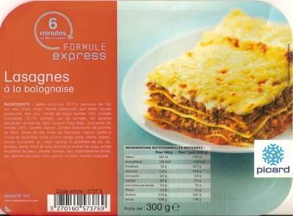
For consumers,
the food industry
is a black box
“vegetable oil”
?
?
“beef meat”

Slide 3



Can we open the data on food products ourselves?
OpenStreetMap
The Free Wiki World Map
and ?

Slide 4
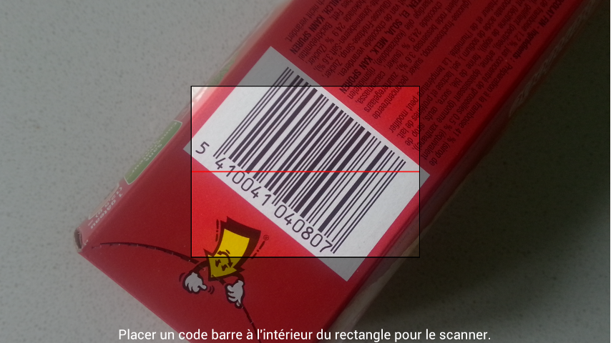
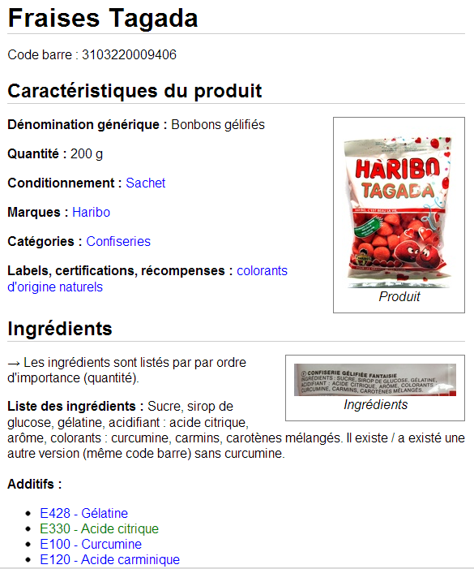


An Open and Collaborative Database
Crowdsourcing with mobile apps :

Slide 5
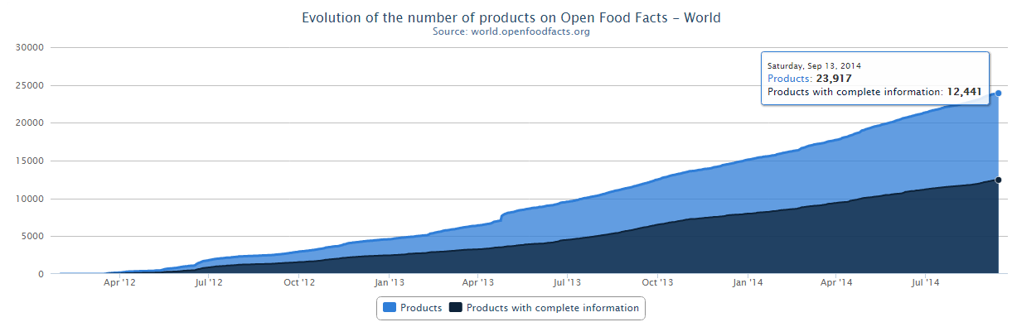
A few dates and numbers
Launch on May 19th 2012
Incorporated as non-profit on April 11th 2014
1200 contributors
24000 products (18000 from France)
24400 ingredients, 262 additives

Slide 6
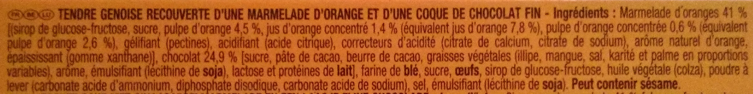
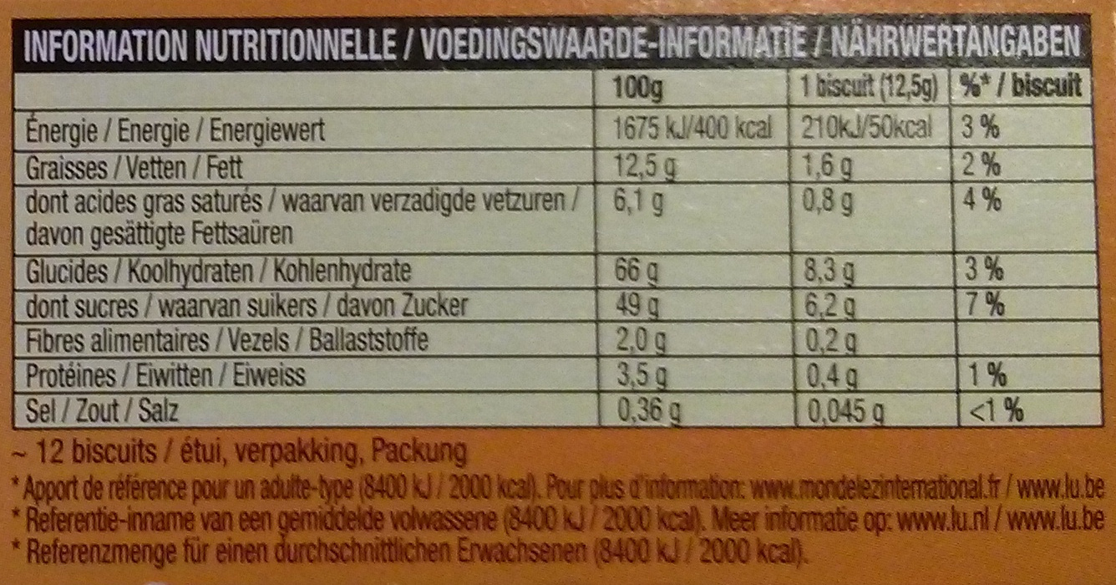
Use: decrypting labels

Slide 7
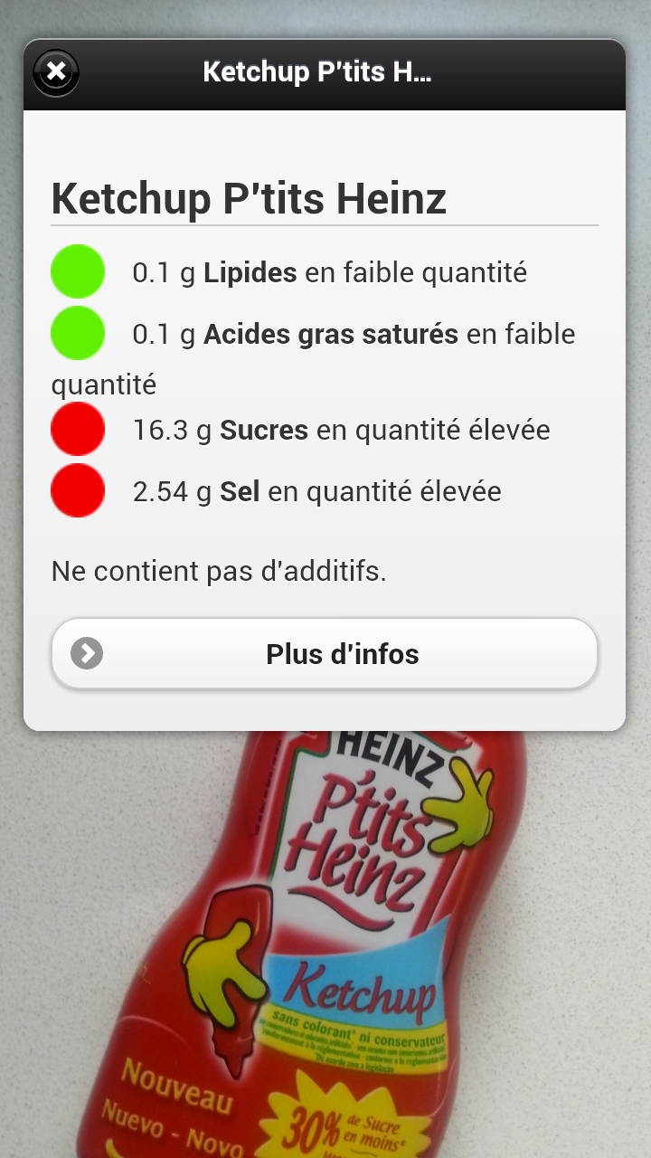


Use : decrypting labels
Additives : E150d ?
Palm oil
Allergens
Nutrition trafic lights
Augmented reality
  Visual recognition

Slide 8
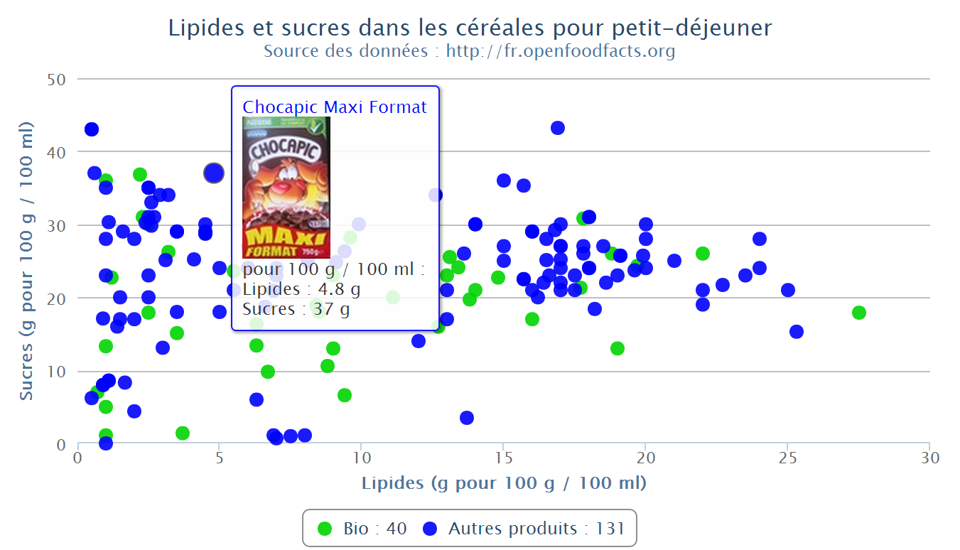
Use : comparing products in 3 clicks
Graphique interactif créé en 3 clics sur le site http://fr.openfoodfacts.org

Slide 9
Re-uses
Not public data but data of public interest
Open data :
  Open Database Licence (OdbL)
    Free re-use for everyone and for all uses
    Attribution and Share-Alike
  Full database export in CSV, RDF
  JSON API
  More info: http://world.openfoodfacts.org/data

Slide 10

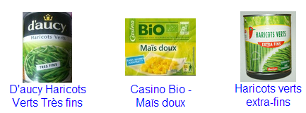
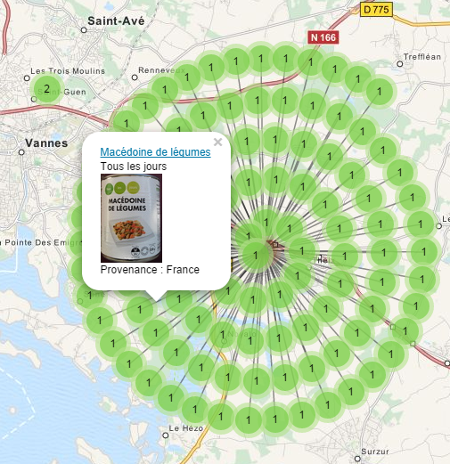
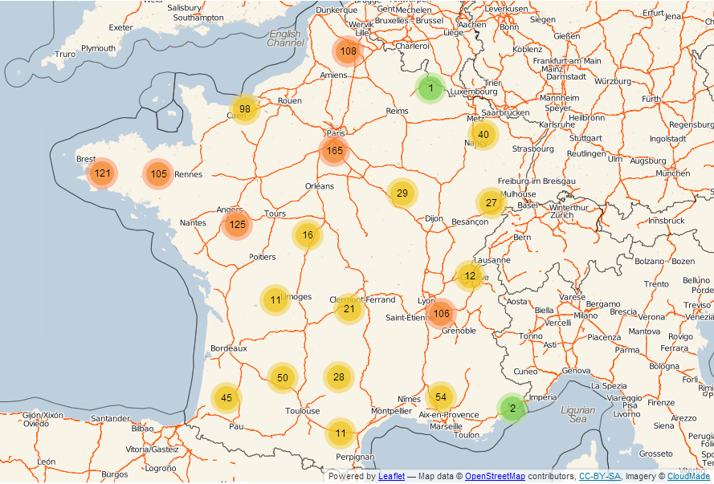
emballé
Open Food Facts data
+ OpenStreetMap map
http://cestemballepresdechezvous.fr

Slide 11
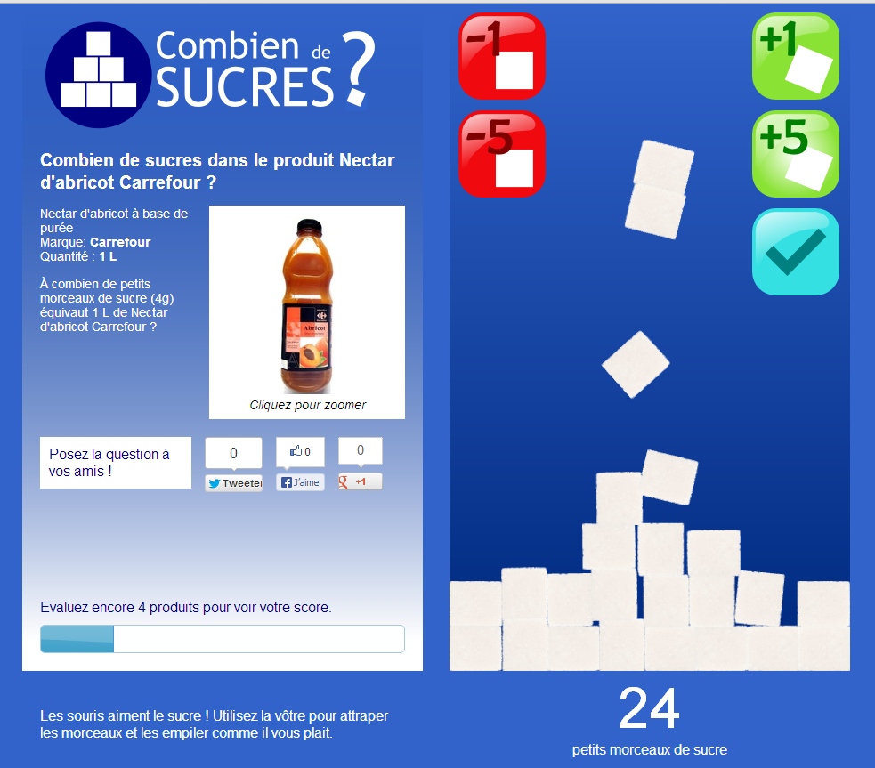
Educative game: how many sugar cubes?
http://combiendesucres.fr

Slide 12
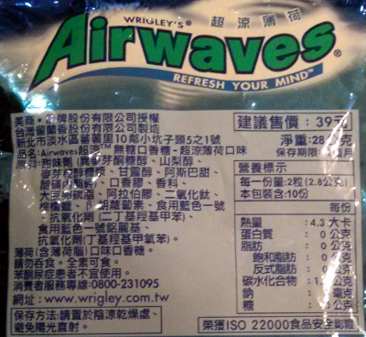
Ingredients Translator

Slide 13
The Co-Everything Challenge
1200 contributors
40 members
20 active
1 main developer
Co-planning + co-design
+ co-management + co-development
Part-time volunteers

Slide 14
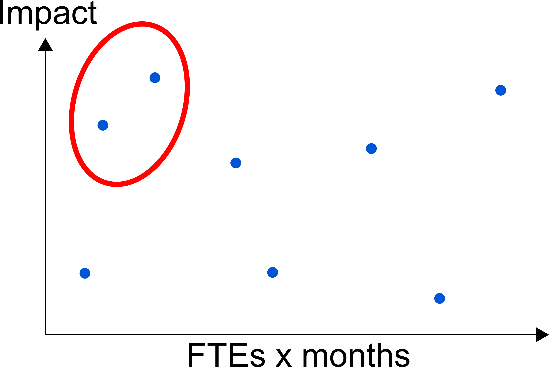
Setting priorities

Slide 15
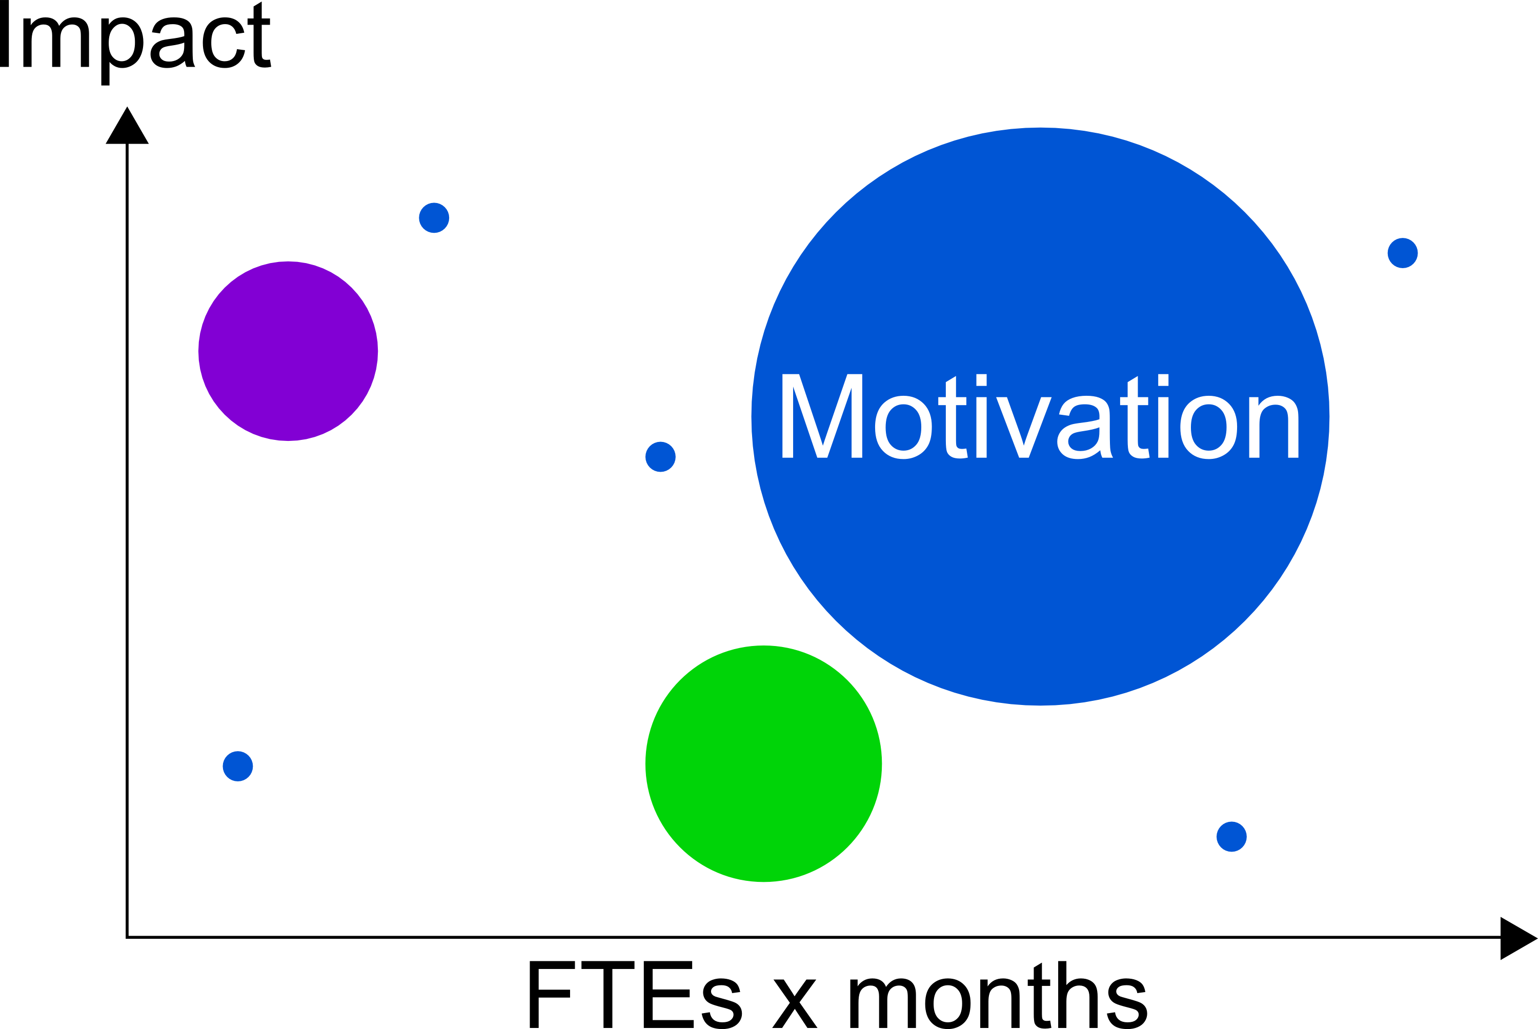
Co-setting priorities

Slide 16
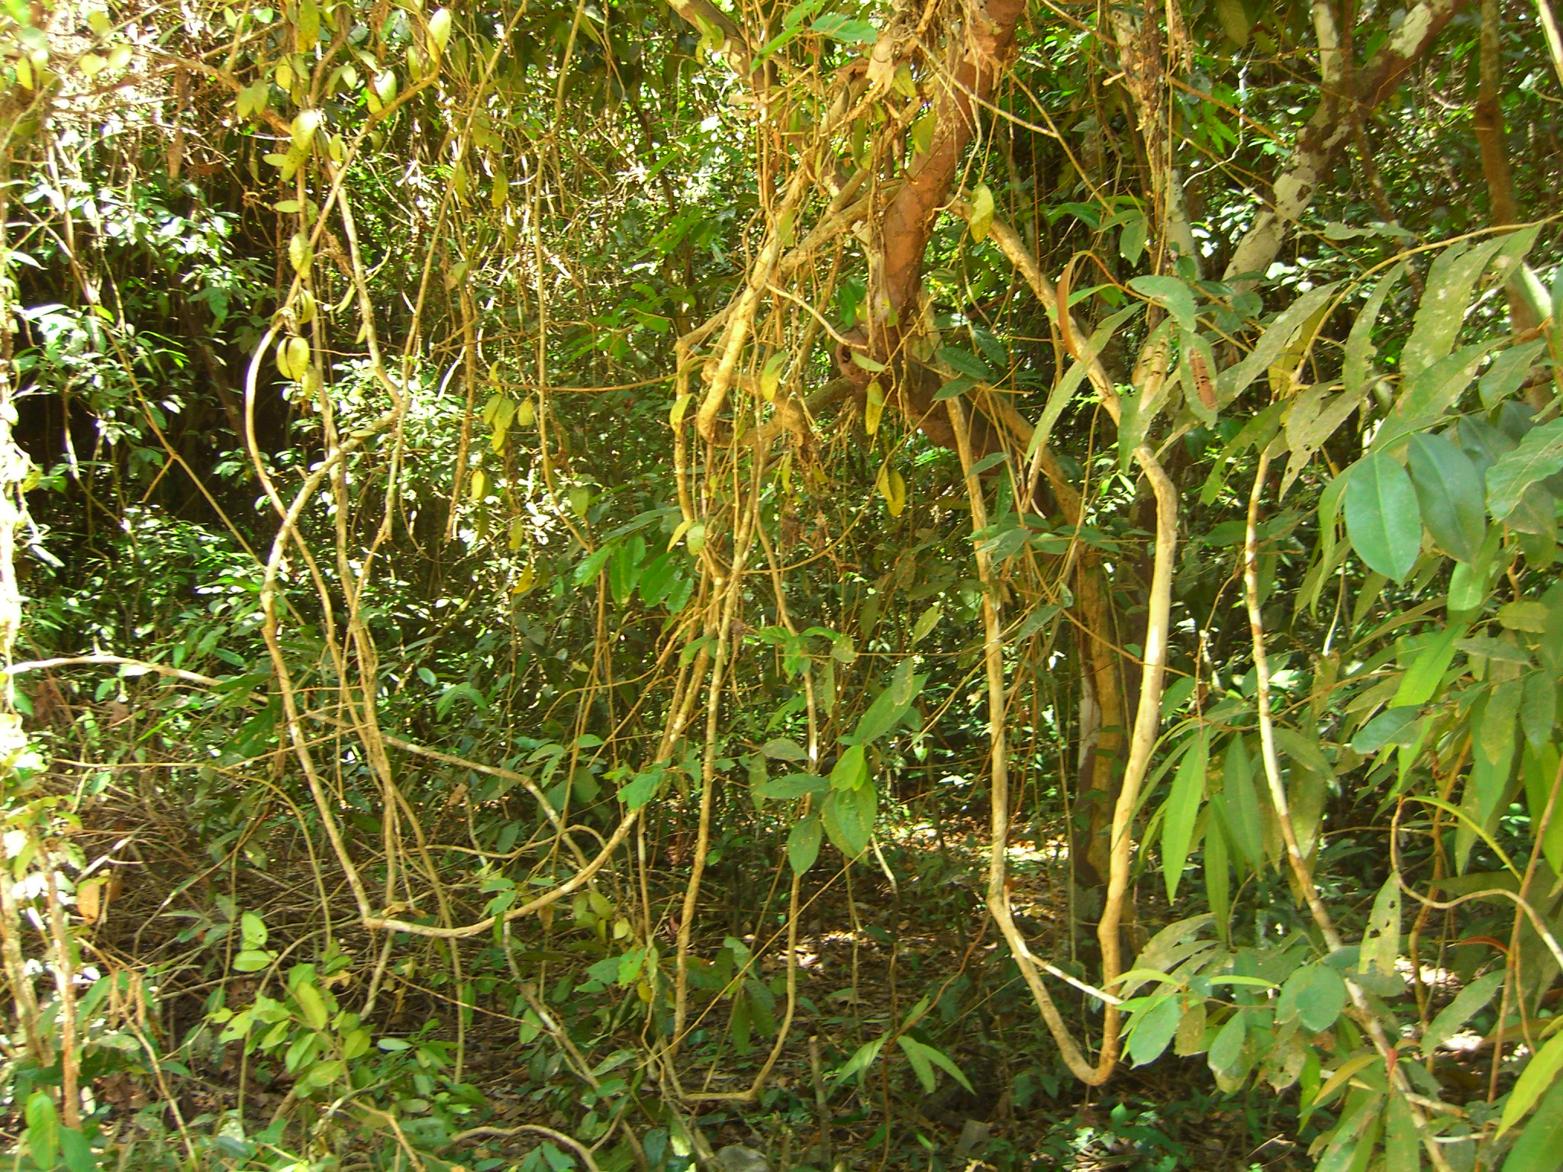
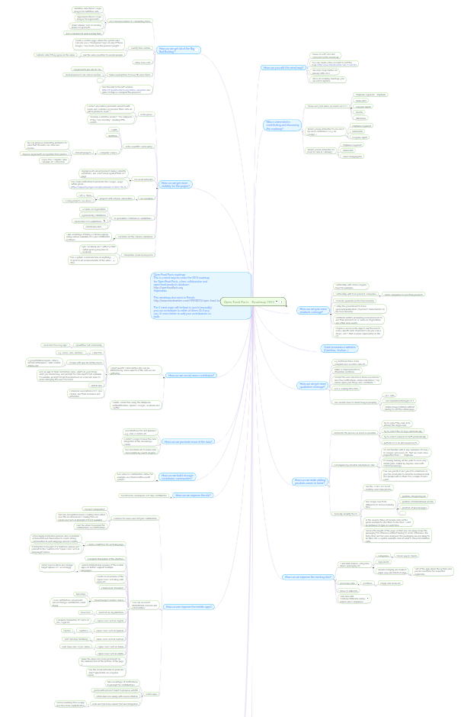
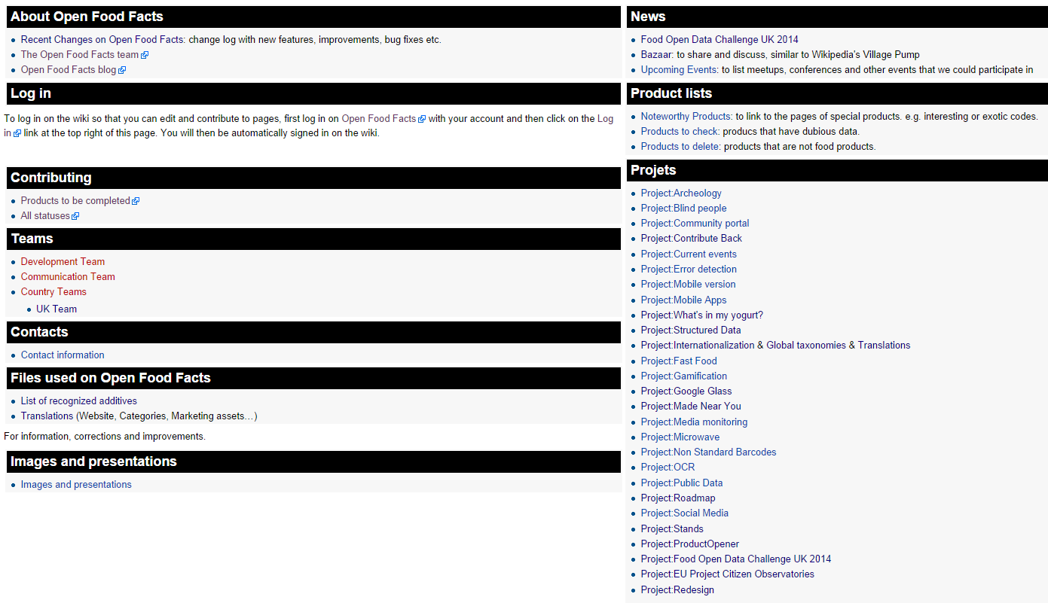
Organic growth → Jungle
Photo by Eric Mollna – Creative Commons cc-by

Slide 17


How can we get to a well-managed forest?
openfoodfacts.slack.com trello.com/openfoodfacts
Redesign: Web site + Mobile apps + Wiki

Slide 18
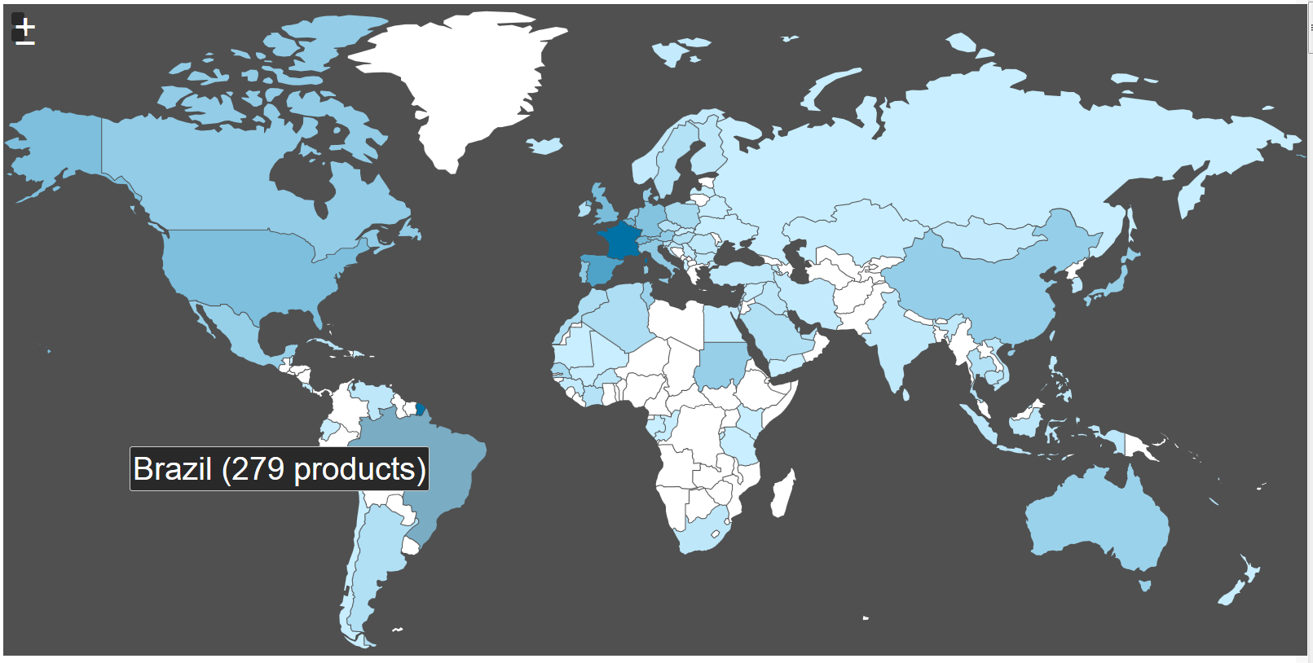
The Spreading the Wor(l)d Challenge
Started in France, designed for the world
Translated in 12 languages, products from 127 countries
http://world.openfoodfacts.org/countries

Slide 19
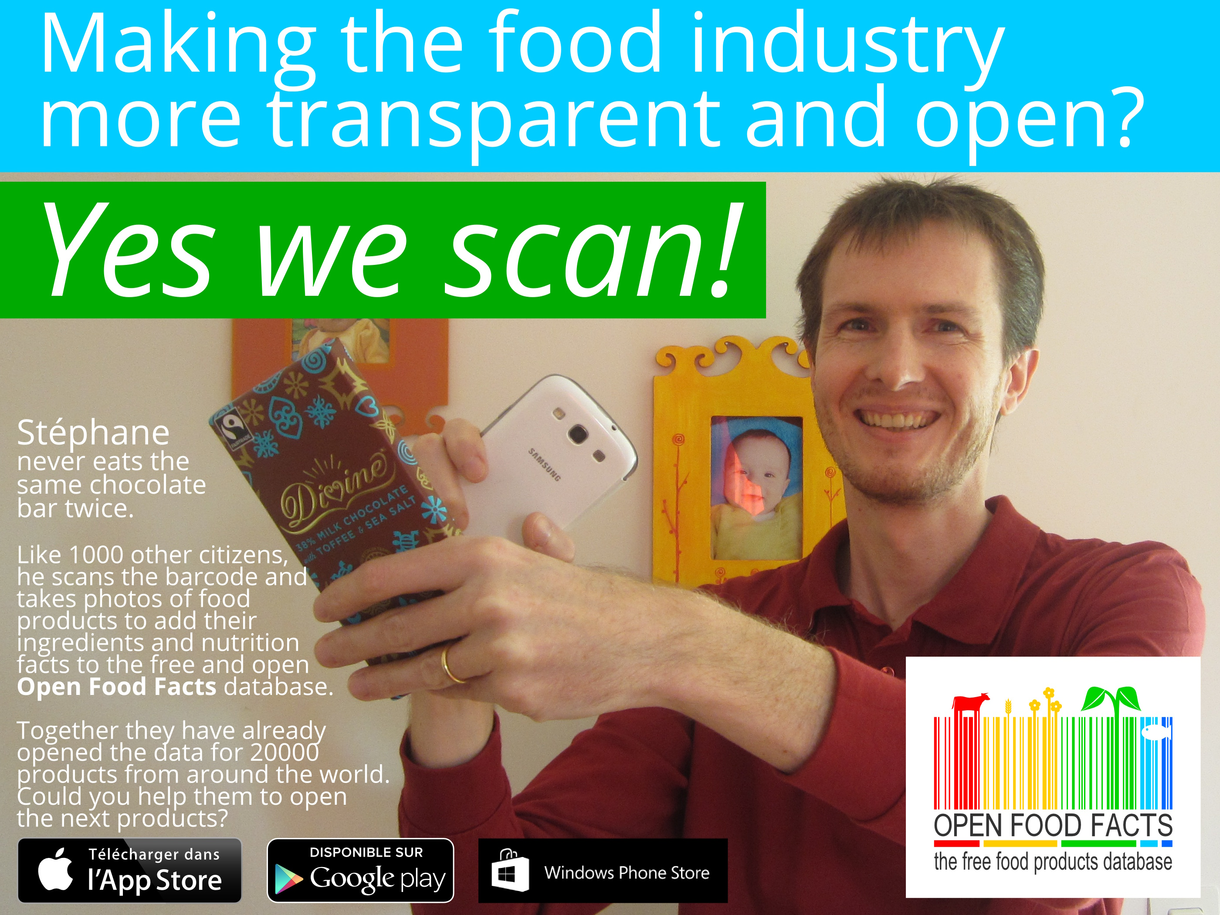

Slide 20
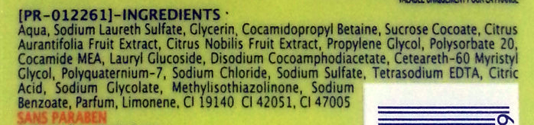


Slide 21

Join us!
stephane@openfoodfacts.org
@OpenFoodFacts
@OpenFoodFactsFr
http://fr.wiki.openfoodfacts.orghttp://en.wiki.openfoodfacts.org

