Slide 1

Arena Mobile
WHAT’S NEW · 2026
Maps, sync and precise positioning for field teams
Open Foris · November 2026
Notes:
Welcome. What we shipped in 2026 for Arena Mobile, the field data collection app for Android and iOS.

Slide 2
A year in the field
2026 AT A GLANCE
53
5
2
releases
headline features
platforms
from v2.2.4 to v2.10.7
in the in-app “What’s new”
Android and iOS
Arena Mobile · collect data offline in the field and sync it with Arena
Arena Mobile · What’s new in 2026
02
Notes:
Release count from the Arena Mobile changelog (January to early November 2026).

Slide 3
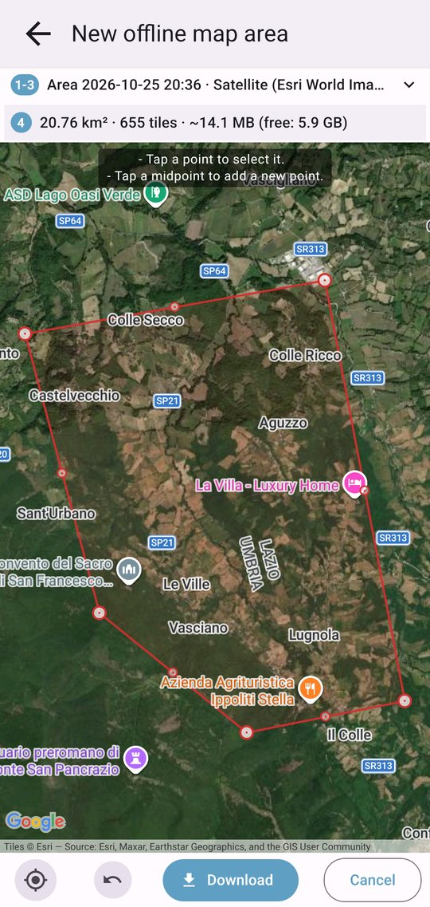
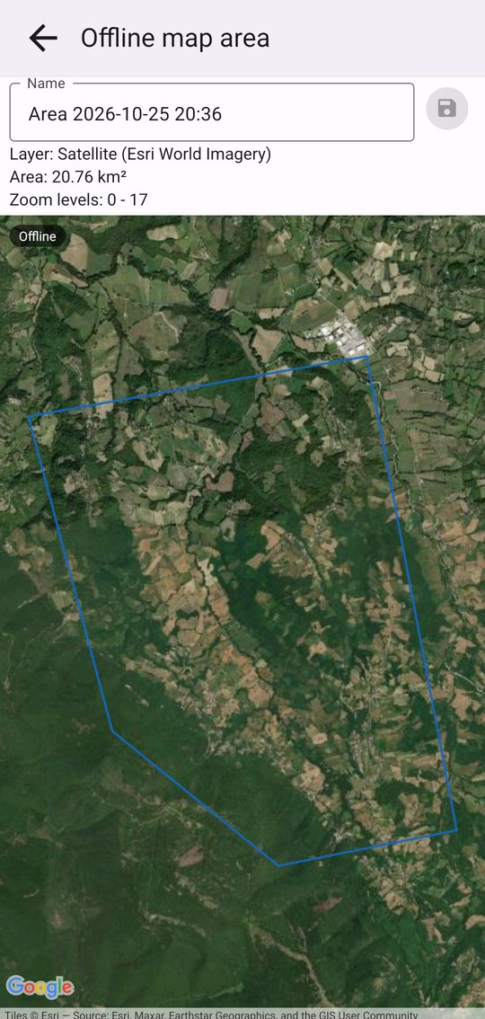

Offline maps: the map comes along
ARENA MOBILE · MAPS
Ready before you leave
Open Offline maps and add the area you need: it works without a connection.
Draw the area on the map
Satellite or other base layers
Georeferenced PDF maps on top
Arena Mobile · What’s new in 2026
03
Notes:
Offline map areas and PDF maps are managed from the main menu.

Slide 4
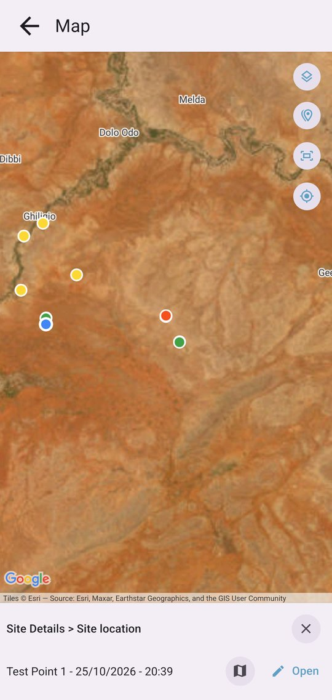
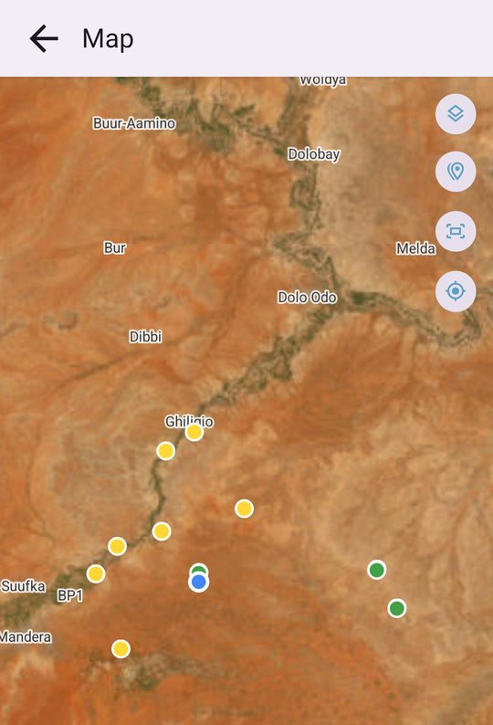
Records on the map
ARENA MOBILE · MAPS
See where you have been
Tap the map button in the records list.
Sampling points, visited or not
Coordinates and position tracks
Tap a point to open its record
Arena Mobile · What’s new in 2026
04
Notes:
Use Layers to choose what to show. Sample points can also be moved manually on the map.

Slide 5
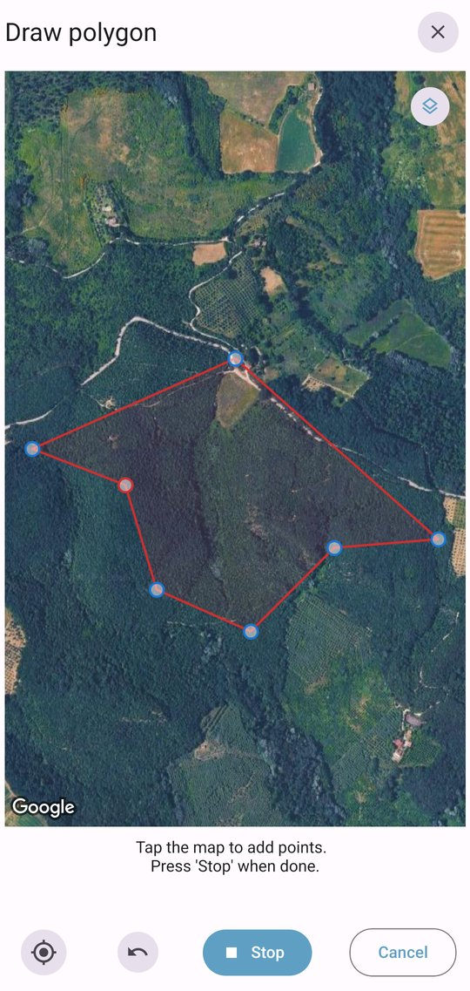
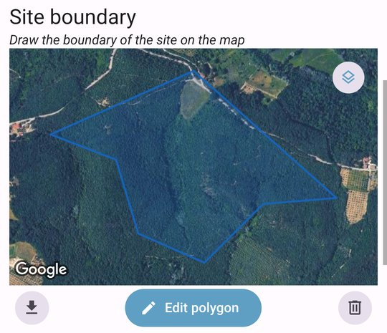
Draw polygons in the field
ARENA MOBILE · DATA ENTRY
New geospatial attribute
Map the boundary of a site, a plot or a stand.
Tap the map or walk the boundary
Drag points to fix the shape
Download it as GeoJSON
Arena Mobile · What’s new in 2026
05
Notes:
While walking, use Add current location to add the boundary points.

Slide 6
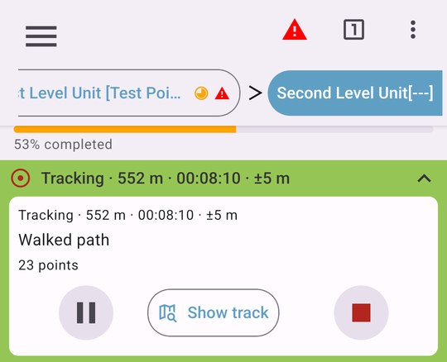
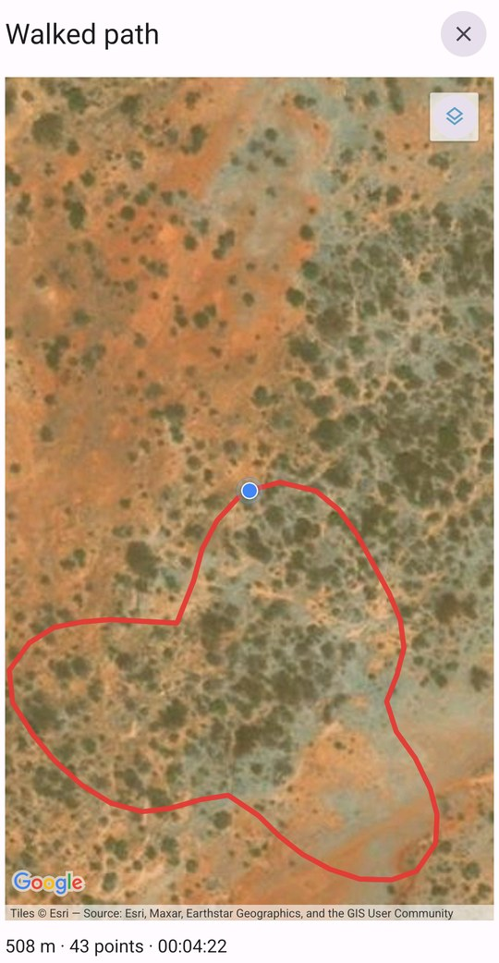
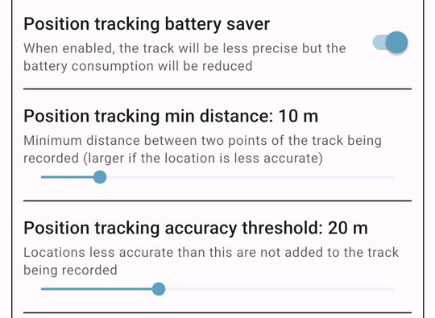
Position tracking: record the path you walk
ARENA MOBILE · DATA ENTRY · EXPERIMENTAL
Your route, saved in the record
A geospatial attribute marked Position tracking in Arena records the device’s path while the record is filled in.
Start, pause, resume and stop
See the track on the map
Accuracy, distance and battery saver
Arena Mobile · What’s new in 2026
06
Notes:
Experimental. Enable it on a geospatial attribute in Arena’s form designer (Position tracking); the value can’t be edited by hand. Tracks also appear in the records map. Screenshots: demo survey on an emulator with a simulated walk.

Slide 7
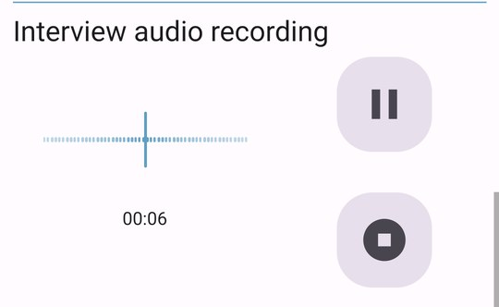
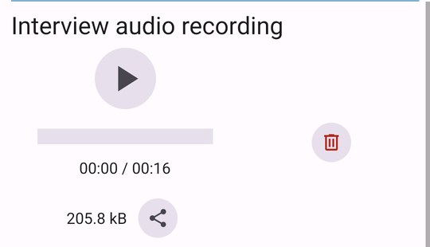
Audio attributes: record in the field
ARENA MOBILE · DATA ENTRY
Record audio in the form
The new audio file type: record an interview or a sound inside the record, or pick an existing file.
Record, pause, resume and stop
Play it back, share or delete it
Shown only when relevant, e.g. after consent
Arena Mobile · What’s new in 2026
07
Notes:
Audio files are uploaded to Arena with the record, like photos and videos. Screenshots: demo survey, Interview audio recording.

Slide 8
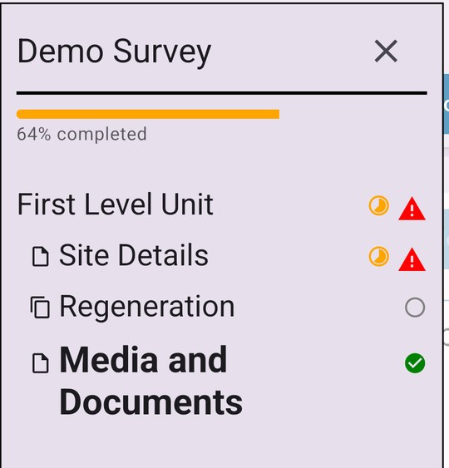
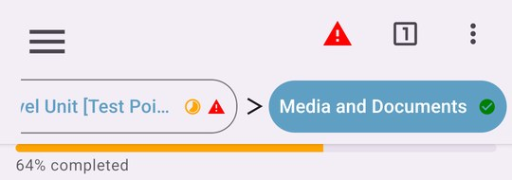
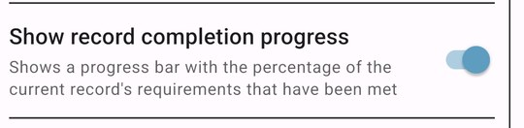
Record completion at a glance
ARENA MOBILE · DATA ENTRY
See what’s left to do
A progress bar shows how much of the record’s requirements are already met.
Percentage for the whole record
Status icon for each page
Can be turned off in Settings
Arena Mobile · What’s new in 2026
08
Notes:
The page icons show pages partly filled in, with errors, not started or complete.

Slide 9
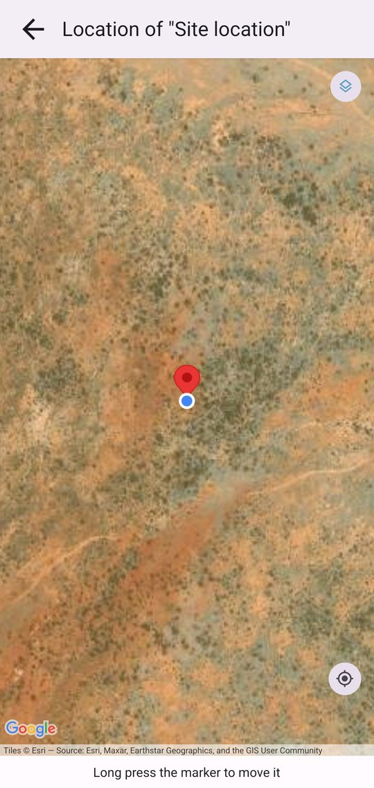
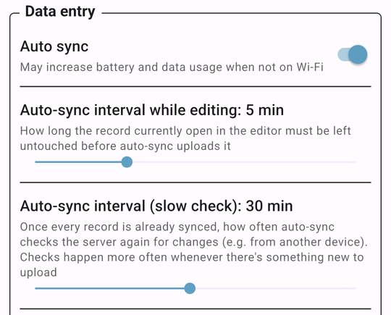
Sync on its own, locate more precisely
ARENA MOBILE · CONNECTIVITY
Automatic data sync
External GPS devices
New and changed records upload in the background whenever the server is reachable.
Pair a Bluetooth receiver (e.g. Bad Elf) for better accuracy; Auto falls back to the internal GPS.
Arena Mobile · What’s new in 2026
09
Notes:
Auto sync can be turned on from the records list or Settings.

Slide 10












Many smaller wins for field teams
ARENA MOBILE · AND MORE
Login with a QR code from Arena
Two-factor authentication
User groups, read-only access to other groups
Key attributes locked while editing
Required-if, editable-if, visible-if
Re-validate records from the list
CSV export, attached files included
Navigate to a point with radar view
Rotate pictures in file attributes
Cards view, pick entity list columns
Survey files (e.g. areas of interest) downloaded
“What’s new” carousel
Arena Mobile · What’s new in 2026
10
Notes:
Plus a Japanese translation and many layout improvements and fixes.

Slide 11
Thank you
Full changelog and source code:
github.com/openforis/arena-mobile
Notes:
Questions?

