Slide 1

Open Foris Arena
WHAT’S NEW · 2026
A year of new features, from survey design to data analysis
Open Foris · November 2026
Notes:
Welcome. A quick tour of what we shipped in 2026 for Arena (web). Arena Mobile has its own deck.

Slide 2
A year of steady releases
2026 AT A GLANCE
71
18
3
Arena releases
headline features
new interface languages
from v2.2.13 to v2.12.0
in the in-app “What’s new”
Portuguese, Japanese, Serbian
Arena · design, collect, clean and analyse data on the web, with Arena Mobile in the field
Open Foris Arena · What’s new in 2026
02
Notes:
Release count from the changelog (January to early November 2026, up to v2.12.0); headline features are the ones shown in the What’s new dialog.

Slide 3
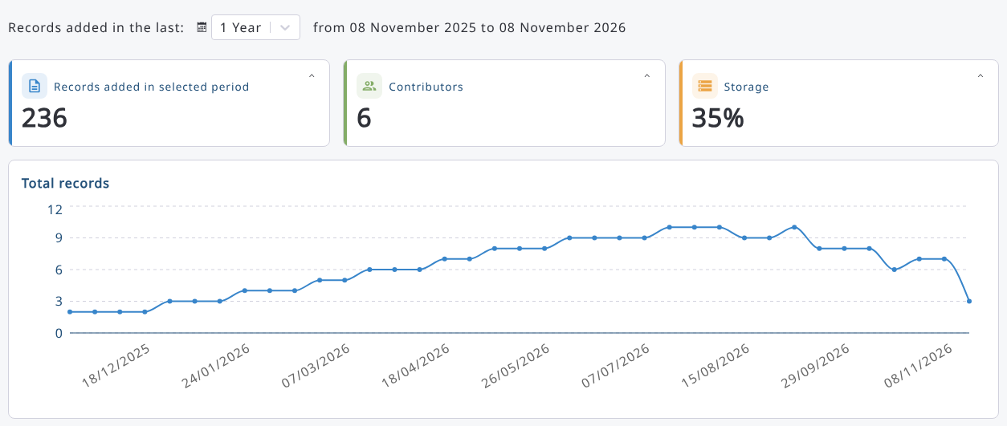
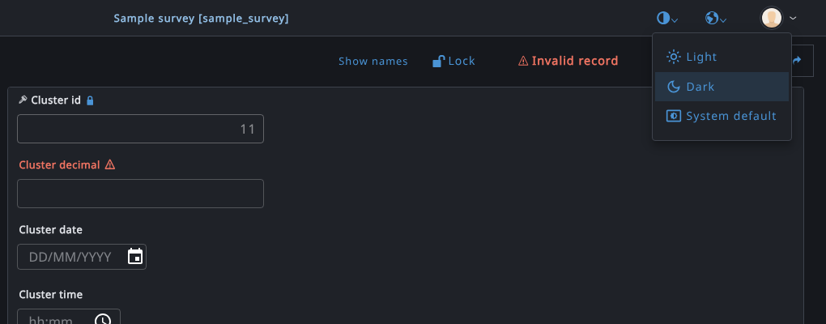
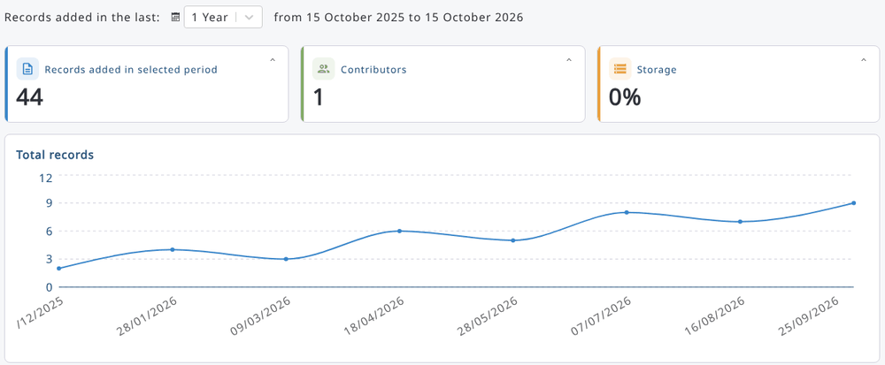
A fresh look: new dashboard and dark theme
ARENA · EVERYONE
New dashboard
Light and dark theme
Records, contributors and storage at a glance, a map of the data and the records trend.
Switch from the header or the login page, or follow the system setting.
Open Foris Arena · What’s new in 2026
03
Notes:
The dashboard was redesigned; the theme can be light, dark or follow the operating system. Dashboard screenshot: sample survey with a year of records from six contributors (test/e2e/specs/dashboardUpgrade.spec.ts).

Slide 4
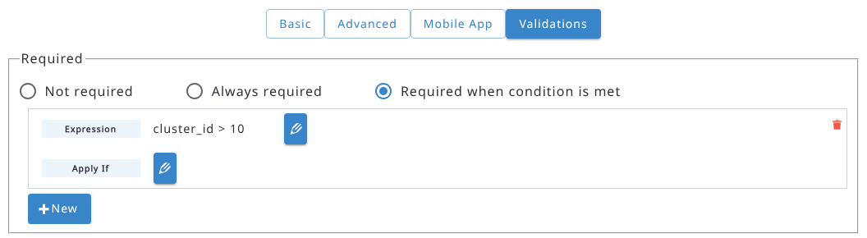
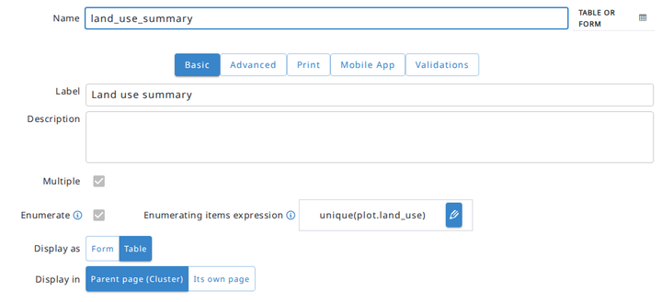
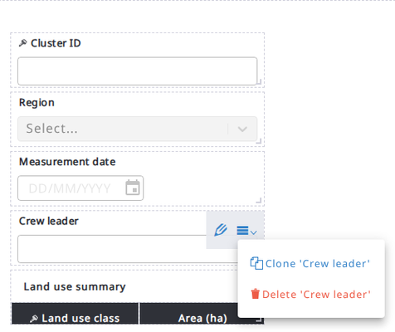
Smarter forms, less effort
ARENA · SURVEY DESIGN
Required if
Dynamic enumerators
Clone attributes
An attribute becomes mandatory only when a condition is true.
An expression decides which rows an enumerated entity gets.
Copy an attribute, with all its properties, into any entity.
Also: editable-if and visible-if · clone entities from another survey · publish warns about changes that affect existing data · time attributes with seconds
Open Foris Arena · What’s new in 2026
04
Notes:
Survey designers get conditional logic (required-if, editable-if, visible-if), dynamic enumerators and cloning of attributes and entities.

Slide 5
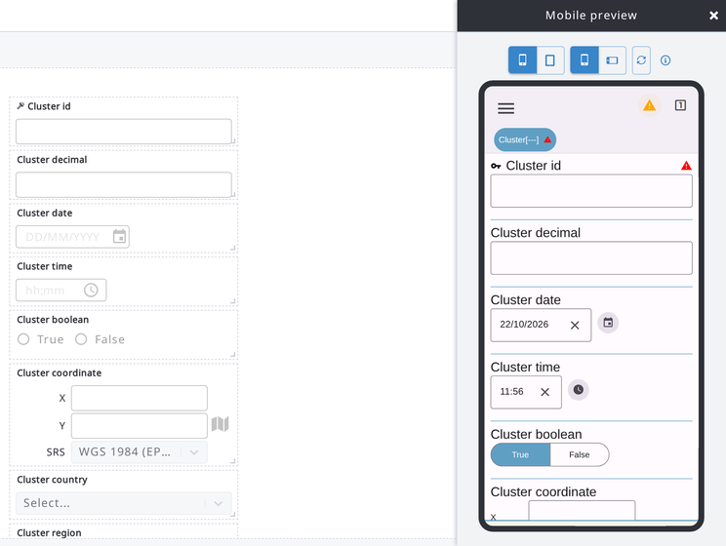

Preview your survey as it looks in Arena Mobile
ARENA · SURVEY DESIGN
Open Preview (mobile) in the form designer and try the draft survey just as field teams will see it.
Phone or tablet
Portrait or landscape
No device needed, it runs in the browser
Available to every survey designer
Open Foris Arena · What’s new in 2026
05
Notes:
Runs Arena Mobile in the browser; some device features such as maps and camera are not available in the preview.

Slide 6
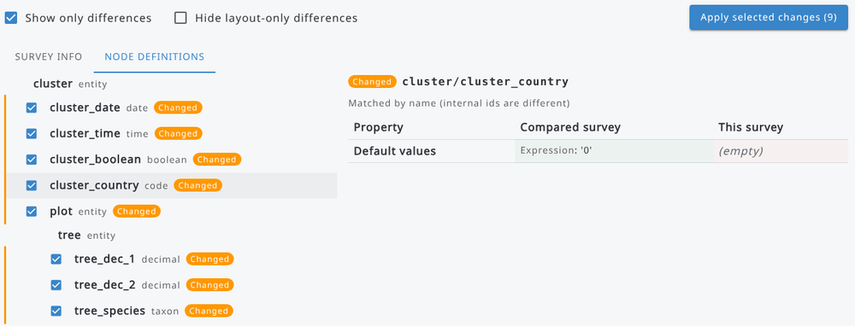
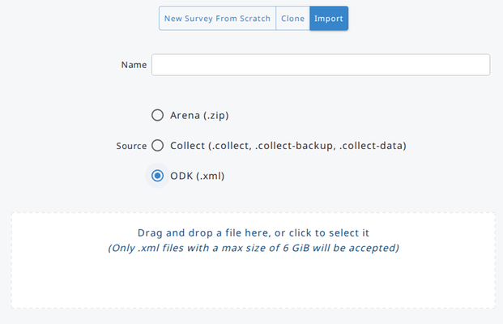
Move surveys between servers and tools
ARENA · SURVEY MANAGEMENT
Compare and update
Import from ODK (beta)
Compare with a survey from another server (e.g. test → production) and apply only the changes you pick.
Create a survey from an ODK form and import the data collected with ODK Collect.
Open Foris Arena · What’s new in 2026
06
Notes:
Applied changes stay in the draft until the survey is published. ODK import is still in beta.

Slide 7
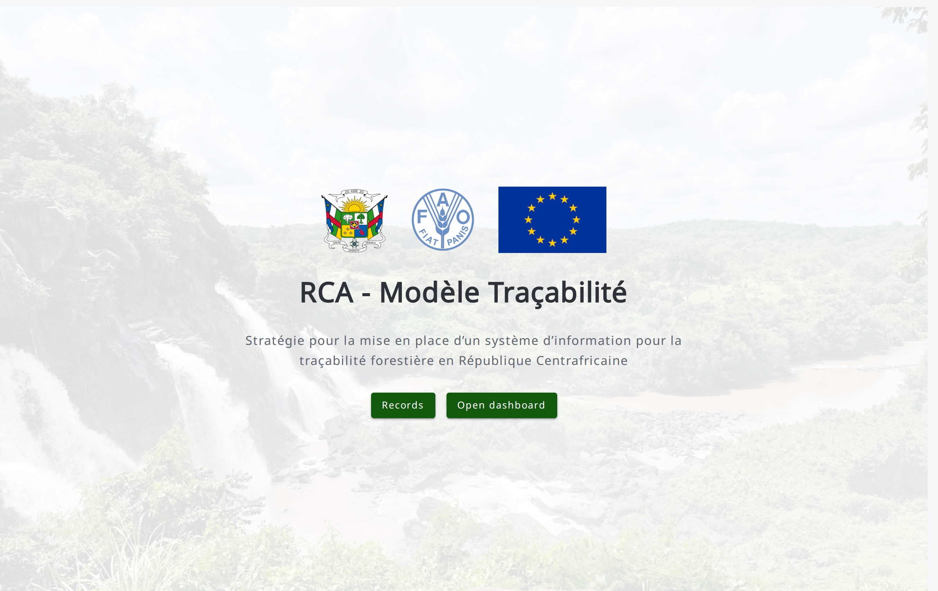
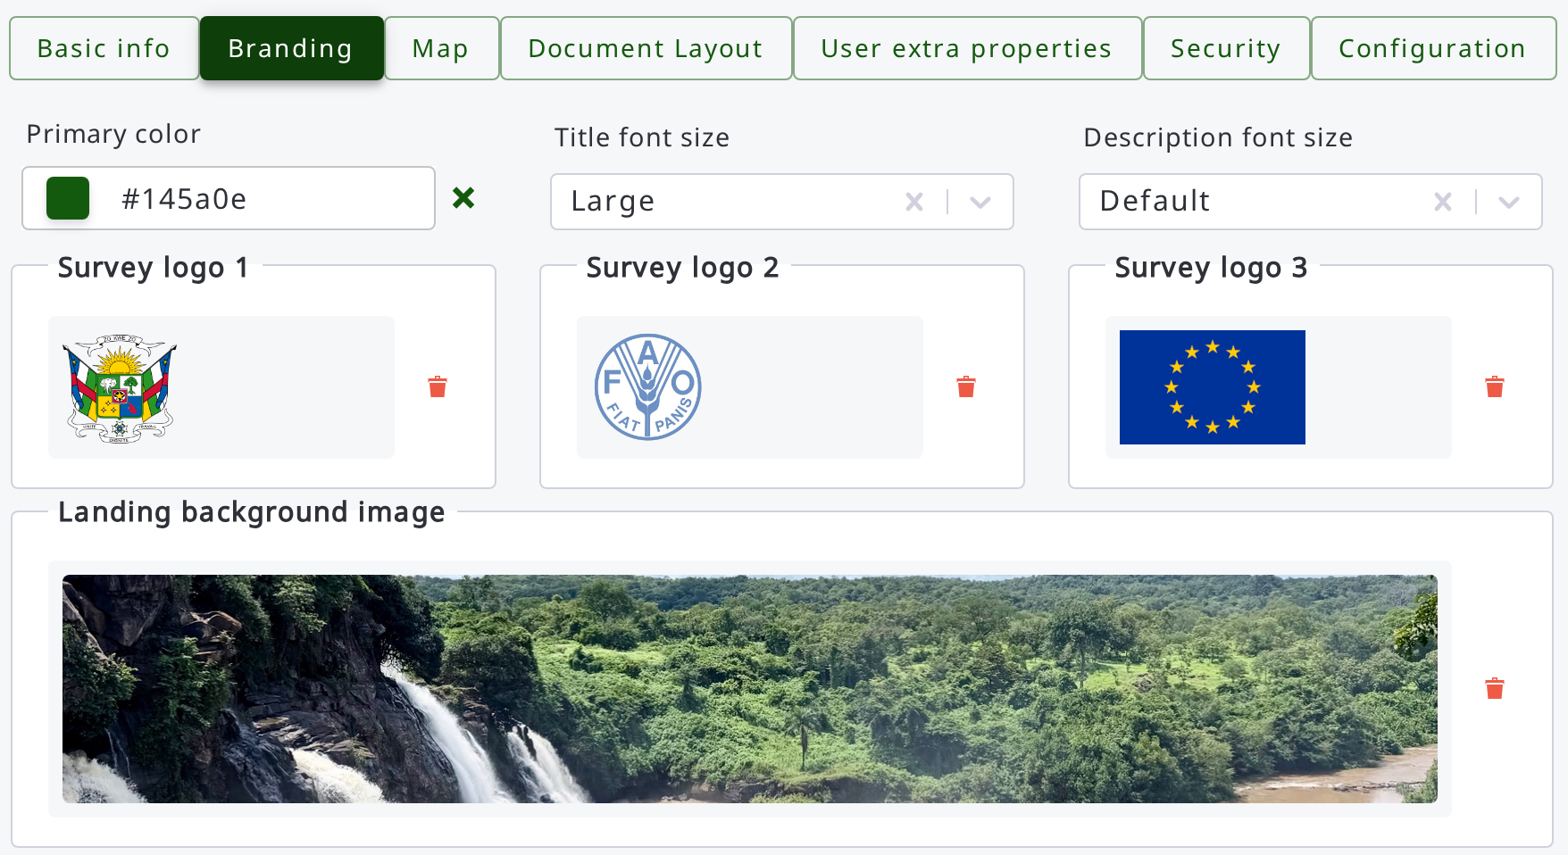



Branding: each survey with its own look
ARENA · SURVEY ADMINS
Up to 3 logos and a background image
Primary colour applied to the whole app
Title and description sizes, live preview
Open Foris Arena · What’s new in 2026
07
Notes:
Survey info, Branding tab (survey admins only). Branding images also travel with the survey to Arena Mobile. Screenshot: RCA traceability survey on a local server.

Slide 8
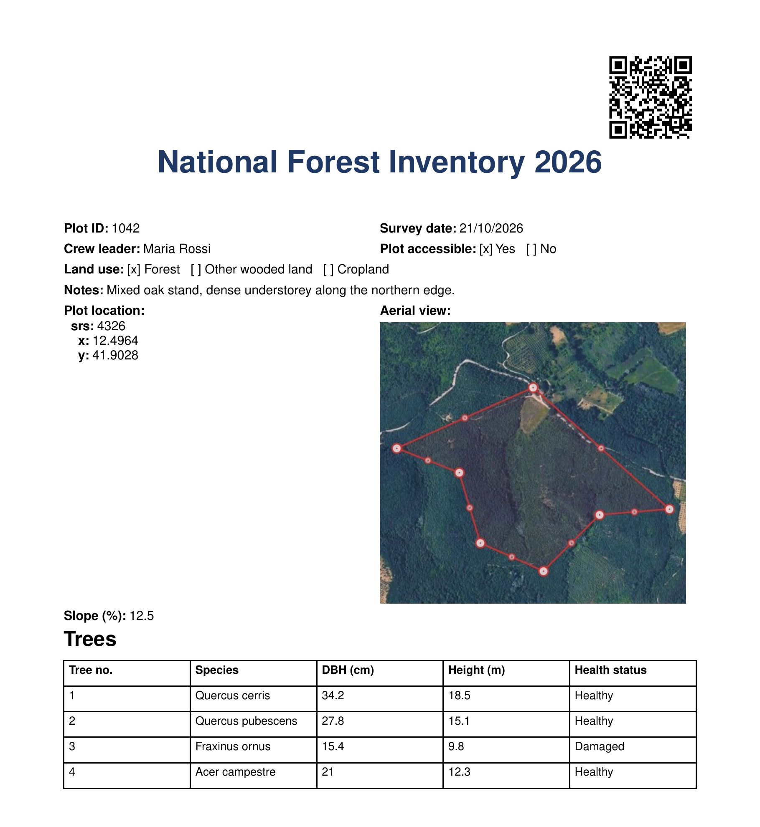





Print records, ready to file or share
ARENA · DATA ENTRY
Word or PDF
The whole record or the current page, portrait or landscape.
Follows the form layout
Same columns as the form; multiple entities become tables.
Pictures included
Photos and other images from file attributes are printed.
QR code
Scan the page to open the record’s PDF online.
Your letterhead
Header and footer images, optional conditions, page numbers.
Open Foris Arena · What’s new in 2026
08
Notes:
The page on the right was produced by Arena’s own PDF generator from a sample record. Header/footer images are set in Survey info, Document Layout.

Slide 9
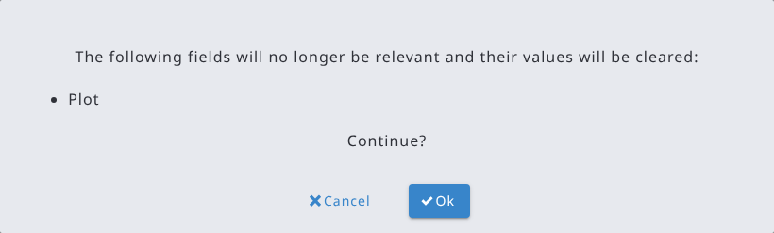




Cleaner data while you type
ARENA · DATA ENTRY
Non-relevant values cleared
When a change makes fields irrelevant, their values are cleared, after asking for confirmation.
Export selected records in Arena format
Selection kept when changing page
Option to merge records with the same keys
Minimum number of entities created automatically
Open Foris Arena · What’s new in 2026
09
Notes:
Survey admins can keep the old behaviour for non-relevant values with a survey security option.

Slide 10






Safer access, finer control
ARENA · SECURITY
Two-factor authentication
QR code login
Group visibility
A code from an authenticator app at login; each code works only once.
Sign in to Arena Mobile by scanning a code shown in Arena.
“Can view the records of”: read-only access to other groups’ records.
Access-aware exports
Data analysts
Hardened server
Record files, exports and mobile uploads limited to the records a group can access.
Survey option to let analysts see records they don’t own.
Request rate limiting and security updates all year.
Open Foris Arena · What’s new in 2026
10
Notes:
User group visibility also applies in Arena Mobile.

Slide 11
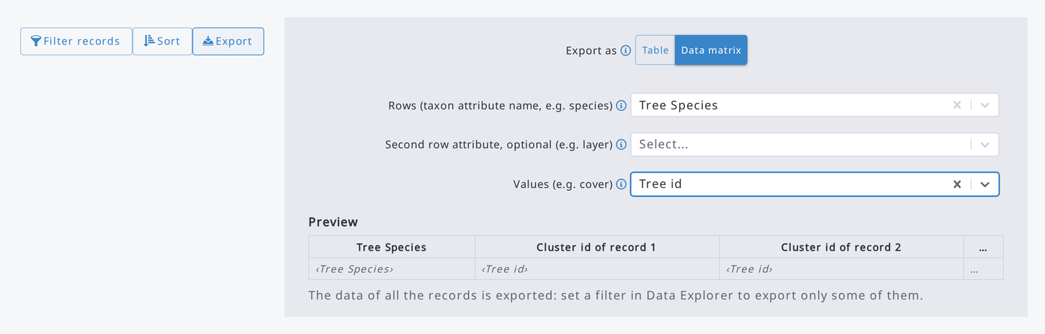
Explore and export your data
ARENA · DATA EXPLORER
Data matrix export
Species × records tables, ready for vegetation analysis tools such as Turboveg, Juice and Synbiosys.
Also: totals and percentages in aggregate mode (new View menu) · charts on large data sets (random samples that keep the outliers) · JavaScript filter syntax with text search · queries generated by AI
Open Foris Arena · What’s new in 2026
11
Notes:
Data matrix: one row per species (or other attribute), one column per record, the chosen value in the cells. Totals: in Aggregate mode with a single measure, View > Show total and percentage adds a percentage column and a Total row.

Slide 12
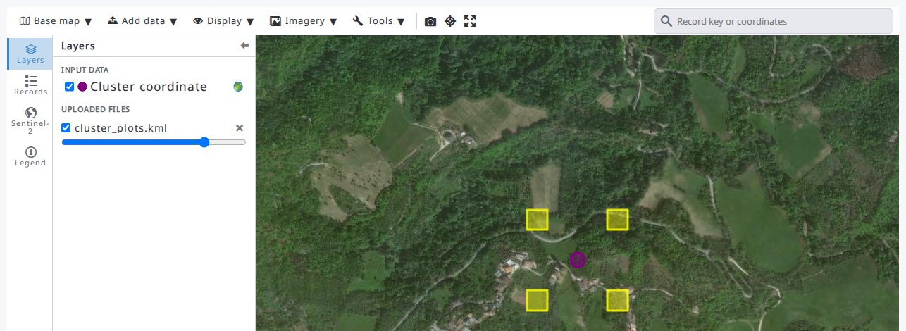
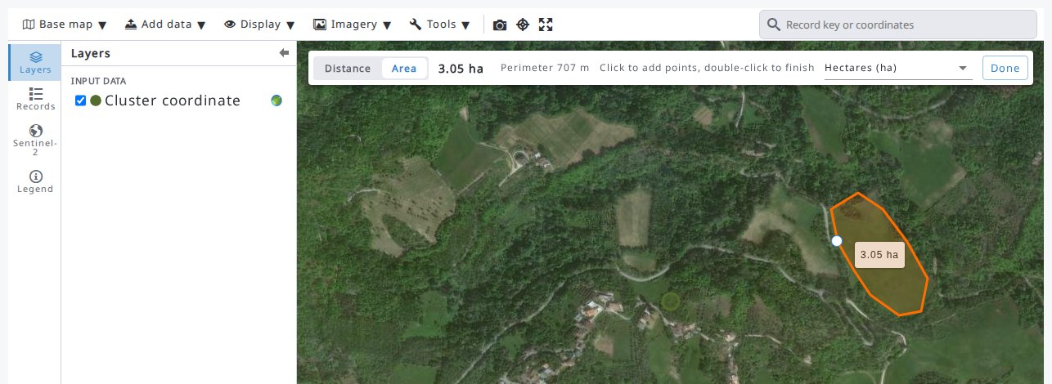
A new map workspace
ARENA · MAPS
Bring your own layers
Measure and capture
KML, KMZ, Shapefile, GeoJSON, WMS / WMTS and XYZ tiles, for you or the whole survey.
Distances and areas; screenshots saved as files or into a record.
Also: search by coordinates (decimal, DMS, UTM) or record keys · Records tab for everyone, with previous / next · Layers and Legend tabs · status bar with coordinates and scale
Open Foris Arena · What’s new in 2026
12
Notes:
Data > Map was redesigned in v2.11.0: Base map, Add data, Display and Tools menus, a search box, Layers / Records / Legend tabs and a status bar. Recent Sentinel-2 scenes are available as experimental imagery.

Slide 13
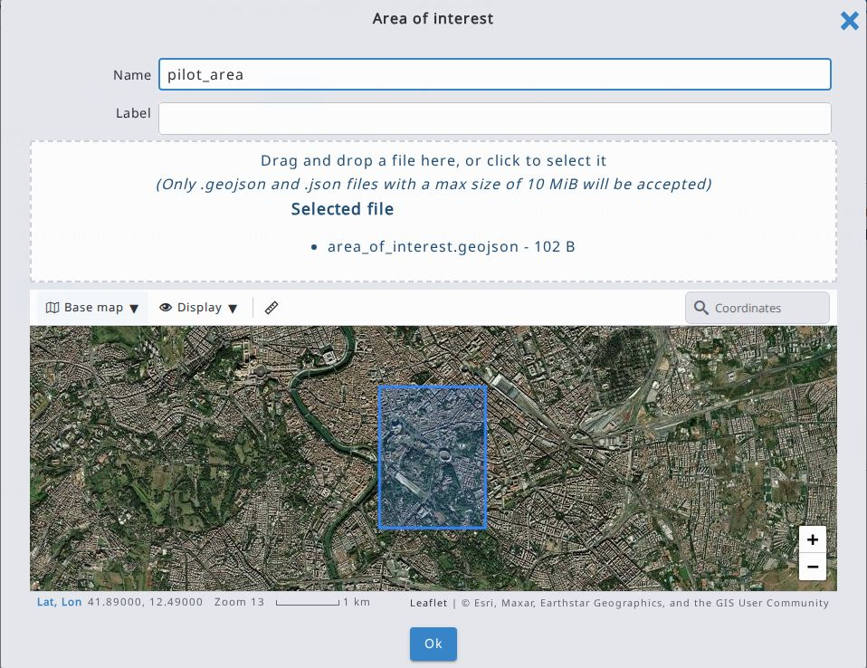
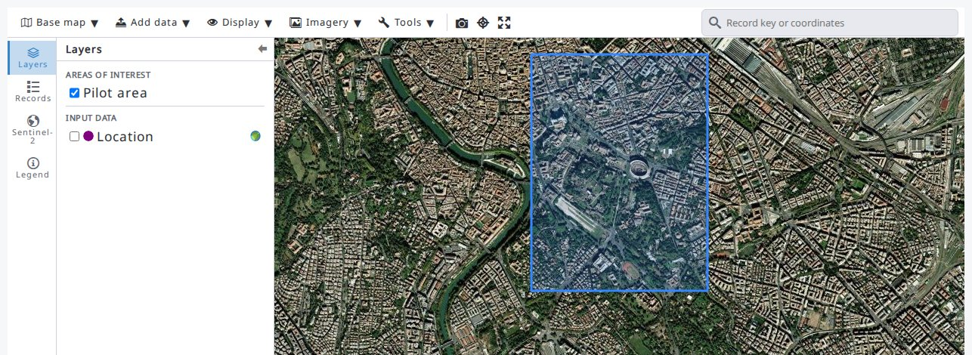
Areas of interest: draw the line
ARENA · NEW IN 2.12 · SURVEY DESIGN
One or more GeoJSON polygons per survey
Checked on a map while you add them
Shown as layers in Data > Map
Open Foris Arena · What’s new in 2026
13
Notes:
Survey info, Map: add areas of interest (e.g. the municipalities of a pilot area), each with a name and a polygon in GeoJSON (WGS84). Show them one by one or all together. Requested by ASSEDEV Alerte Environnement.

Slide 14
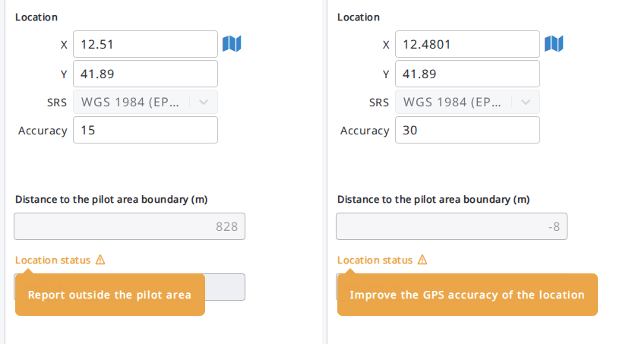
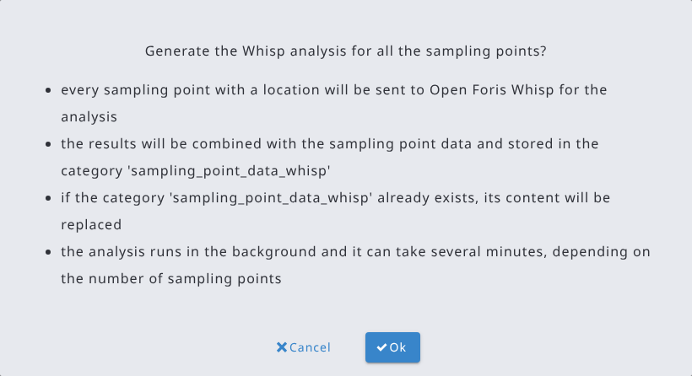
Is the plot inside the area?
ARENA · NEW IN 2.12 · EXPRESSIONS
geoDistanceToAOIBoundary()
Distance in meters to the boundary of an area: negative inside, positive outside.
Inside, outside or uncertain
Compare the distance with the GPS accuracy and warn field teams on the spot.
geoAOIContaining()
Returns the name of the area containing a location.
Offline in Arena Mobile
The same checks run in the field, with no connection.
Open Foris Arena · What’s new in 2026
14
Notes:
Example: geoDistanceToAOIBoundary(location, 'pilot_area') in the default value of a read-only attribute, and validation rules with severity warning comparing it with location.accuracy. Left: a location 828 m outside the area; right: 8 m inside but with a 30 m accuracy, so uncertain.

Slide 15
Whisp analysis and richer processing chains
ARENA · ANALYSIS
Whisp, in the background
Analyse every sampling point with Open Foris Whisp; results are saved as a new category.
Two-phase sampling
Now supported in the chain editor, with better sampling design settings.
Area files and templates
Area file (MAU) per cycle; clone chains from templates.
GeoPackage export
Export categories with their geometries.
Open Foris Arena · What’s new in 2026
15
Notes:
Whisp runs as a background job; chain improvements target the R/RStudio analysis workflow.

Slide 16
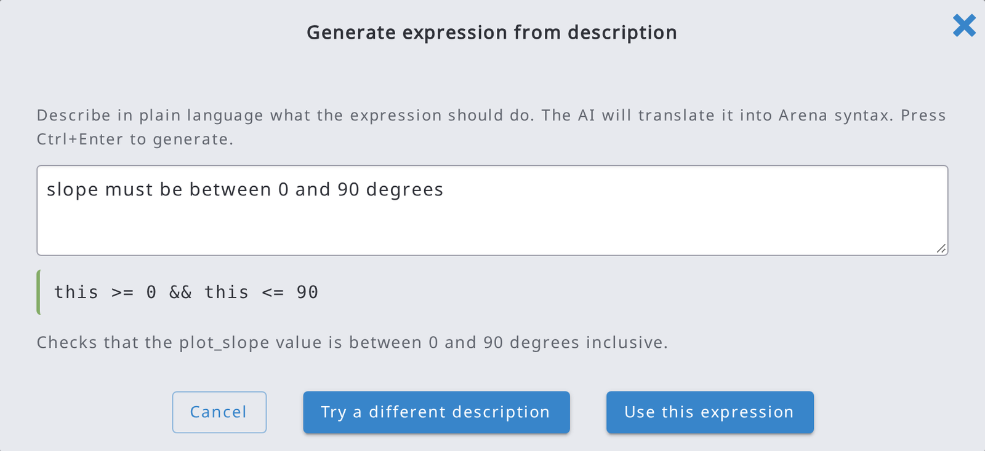
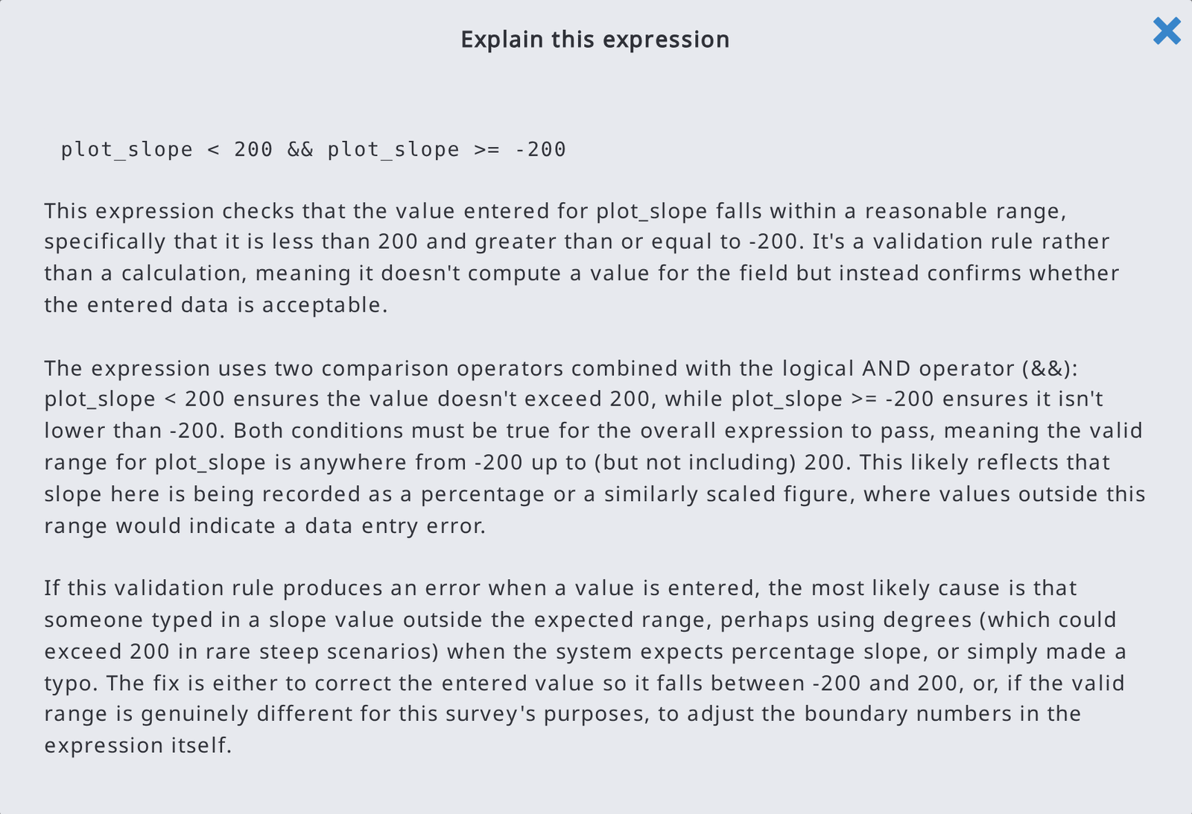
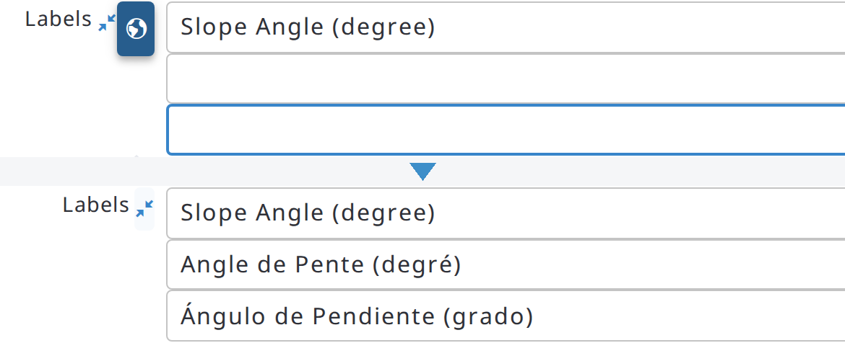
AI for survey designers
ARENA · AI ASSISTANT (OPTIONAL)
Expressions from plain language
Explain any expression
Translate labels
Describe a rule; the AI writes it in Arena syntax and checks it before you use it.
Validation rules, default values and conditions explained in plain language.
One click fills in the missing labels in all the survey languages.
Also: AI-drafted attribute descriptions in the data dictionary export
Open Foris Arena · What’s new in 2026
16
Notes:
AI features are off unless the administrator enables them; each user then turns on the areas they want in their profile. Screenshots: local server, demo survey, Anthropic provider.

Slide 17
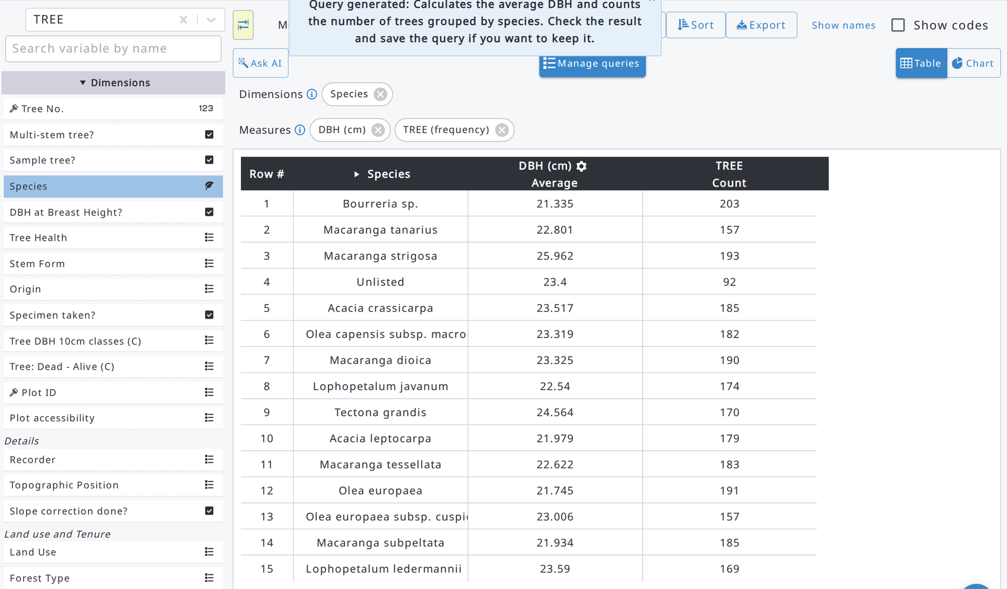
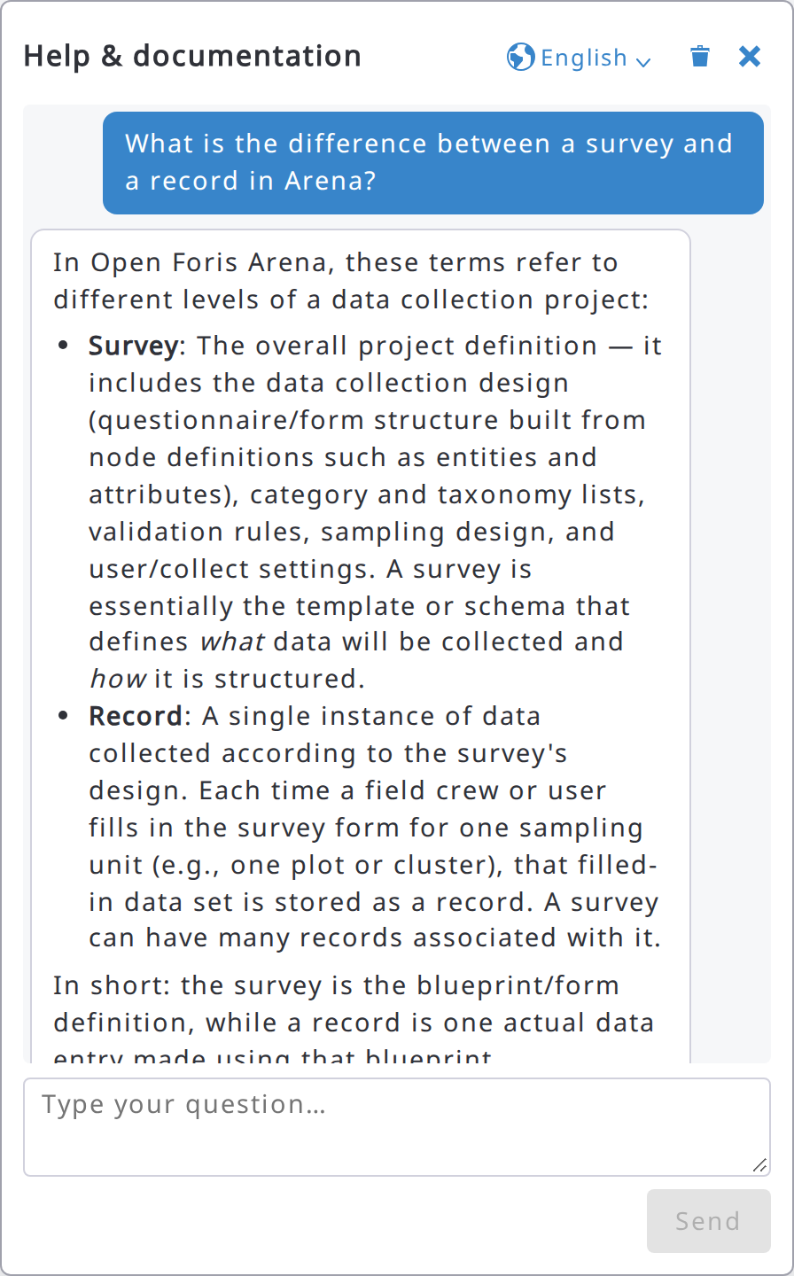
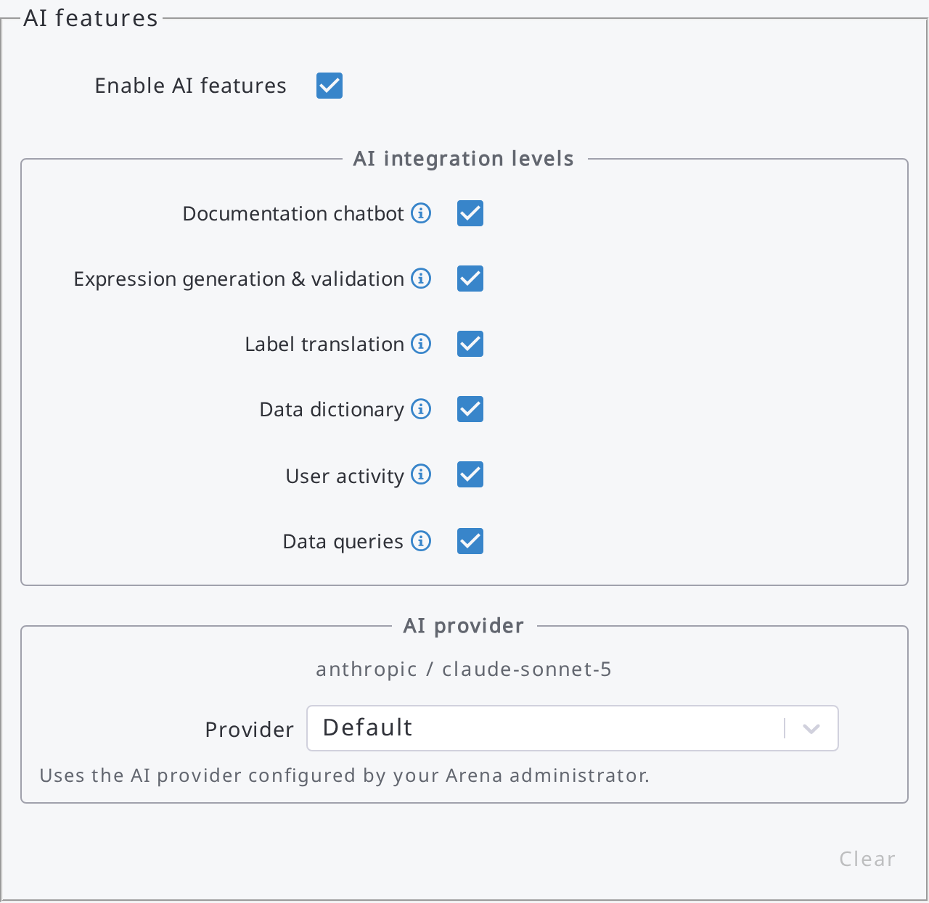
Ask in plain language
ARENA · AI ASSISTANT (OPTIONAL)
Your choice of AI
Anthropic, OpenAI, Google or OpenAI-compatible (also self-hosted), with your own key if you like.
Data Explorer queries
“Average tree DBH and number of trees by species”: the AI picks entity, dimensions, measures and filters.
Help chatbot
Questions about Arena answered in the language you choose.
Open Foris Arena · What’s new in 2026
17
Notes:
The generated query can be reviewed, changed and saved; the AI can also suggest its name and description.

Slide 18
Faster where it matters
UNDER THE HOOD
Minutes → seconds
Lighter records
No duplicates
records merged by key on import and when they come from Arena Mobile
to import Arena files with large records
less database space and memory for large records
Plus faster record updates, data export and uploads from Arena Mobile.
Open Foris Arena · What’s new in 2026
18
Notes:
Performance work across the year: data import, record updates, storage and mobile sync.

Slide 19
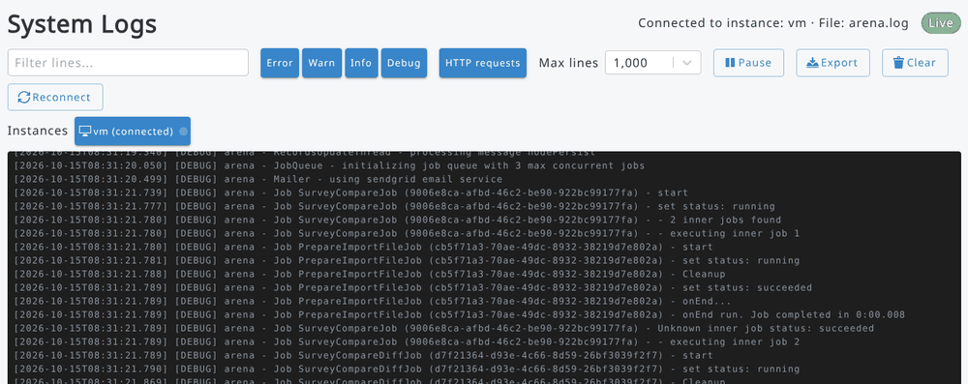





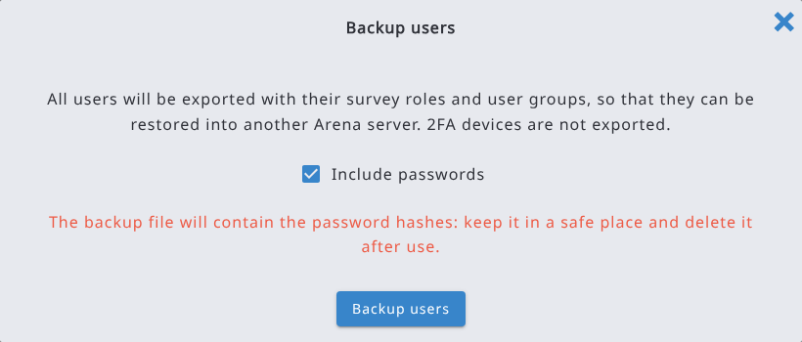




Everything for system admins, on one page
ARENA · SYSTEM ADMINISTRATORS
System logs: follow server logs live
Users backup / restore between servers
Messages in System Administration, also to survey admins only
Email via Amazon SES
Temporary files on Amazon S3
Request rate limiting, single-use 2FA codes
Activity log can be turned off
Expired, never-activated accounts cleaned up
Access request emails sent in BCC
Open Foris Arena · What’s new in 2026
19
Notes:
All system-admin features of the year in one slide. Admin menus are now at the bottom of the sidebar.

Slide 20
Thank you
Full changelog and source code:
github.com/openforis/arena
Notes:
Questions? Arena Mobile’s news are in a separate deck.

