Slide 1

AI-Assisted Disaster Mapping with NASA OPERA Data in GeoLibre
Qiusheng Wu
University of Tennessee, Knoxville
https://gishub.org

Slide 2
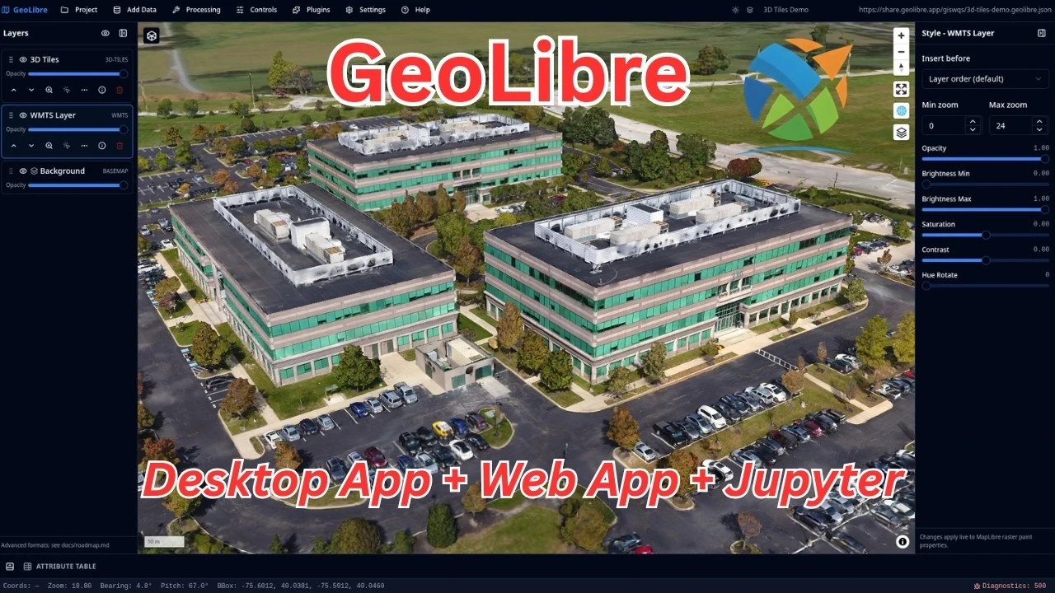
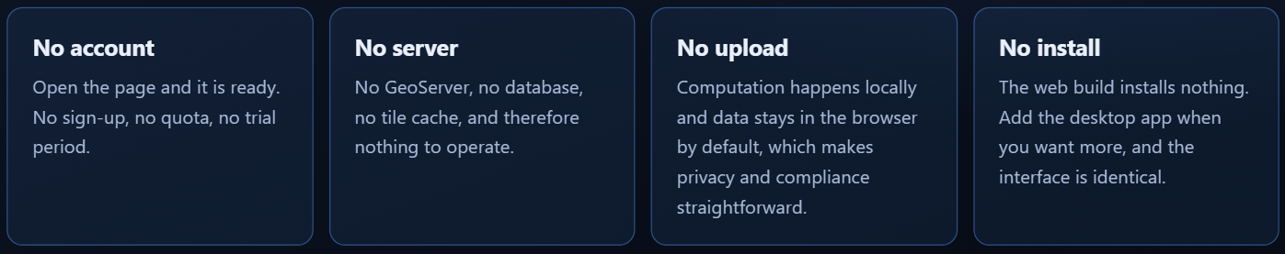
What is GeoLibre
A free and open-source, lightweight, cloud-native GIS platform for visualizing, exploring, and analyzing geospatial data.
GeoLibre runs everywhere you do, in the web browser, on the desktop, on mobile, and inside Jupyter notebooks, all while keeping your data local and private.
Website: https://geolibre.app
Web App: https://web.geolibre.app
GitHub: https://github.com/opengeos/GeoLibre

Slide 3
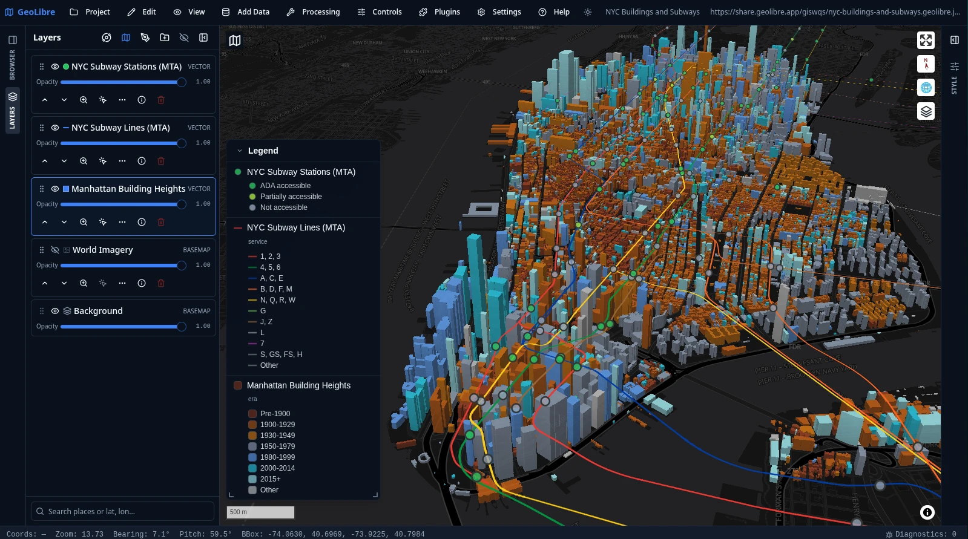
Geospatial Data Visualization
Supported formats:
GeoJSON
Shapefile
GPKG
GeoParquet
FlatGeobuf
COG
PMTiles
COPC
3D Tiles
Zarr
NetCDF
XYZ
WMS
WFS
…

Slide 4
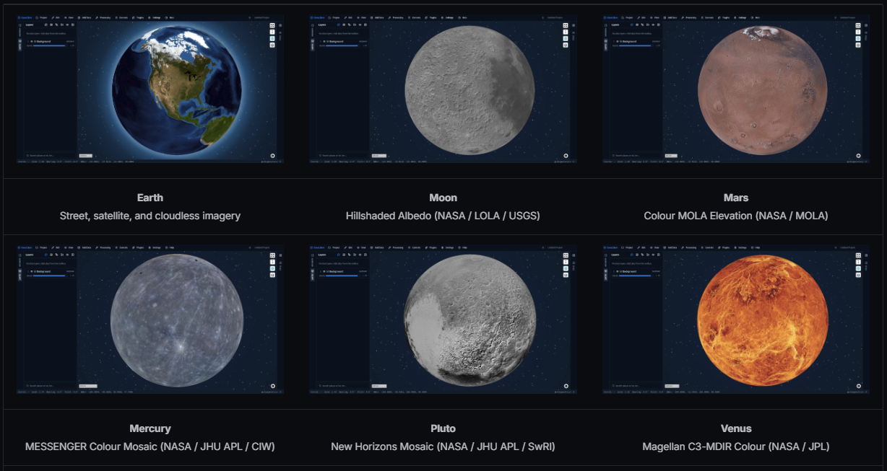
Not Limited to Earth
Planetary basemaps:
Earth
Moon
Mars
Mercury
Venus
Europa
Ganymede
Callisto
Titan
Pluto
Charon

Slide 5
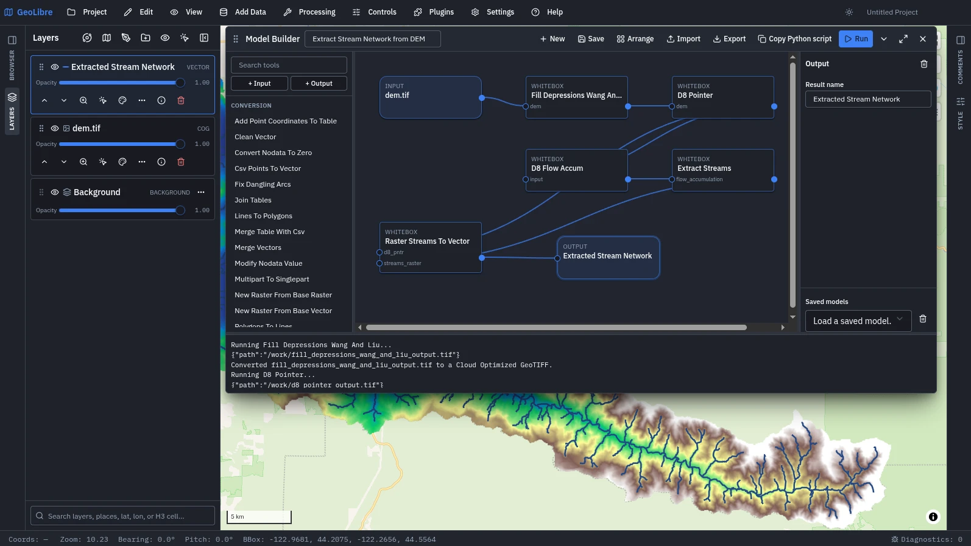
1,000+ Geoprocessing Tools
Toolbox:
Vector
Raster
Conversion
Hydrology
LiDAR
Network
Projection
Remote Sensing
Terrain
Model Builder
AI Assistant

Slide 6
Explore OPERA Data in GeoLibre
A cloud-native GIS platform for visualizing, exploring, analyzing, and sharing OPERA data.
GeoLibre -> Plugins -> Web Services -> Activate Plugin (NASA Earthdata / Earthdata GIS)
GeoLibre -> Settings -> Manage Plugins -> Install NASA OPERA Plugin
PLUGIN | SERVES | GRANULARITY | BEST FOR
NASA Earthdata | GIBS pre-rendered global imagery tiles | Daily global mosaic | The fast look - context and backdrop
Earthdata GIS | ArcGIS Image / Map / Feature services | Curated service, incl. NASA Disasters event groups | Authoritative event layers - FEDS perimeters, burn severity
NASA OPERA | CMR granule search + titiler-cmr COG tiles | Individual granule, individual band | The analysis itself - specific scenes, specific dates

Slide 7
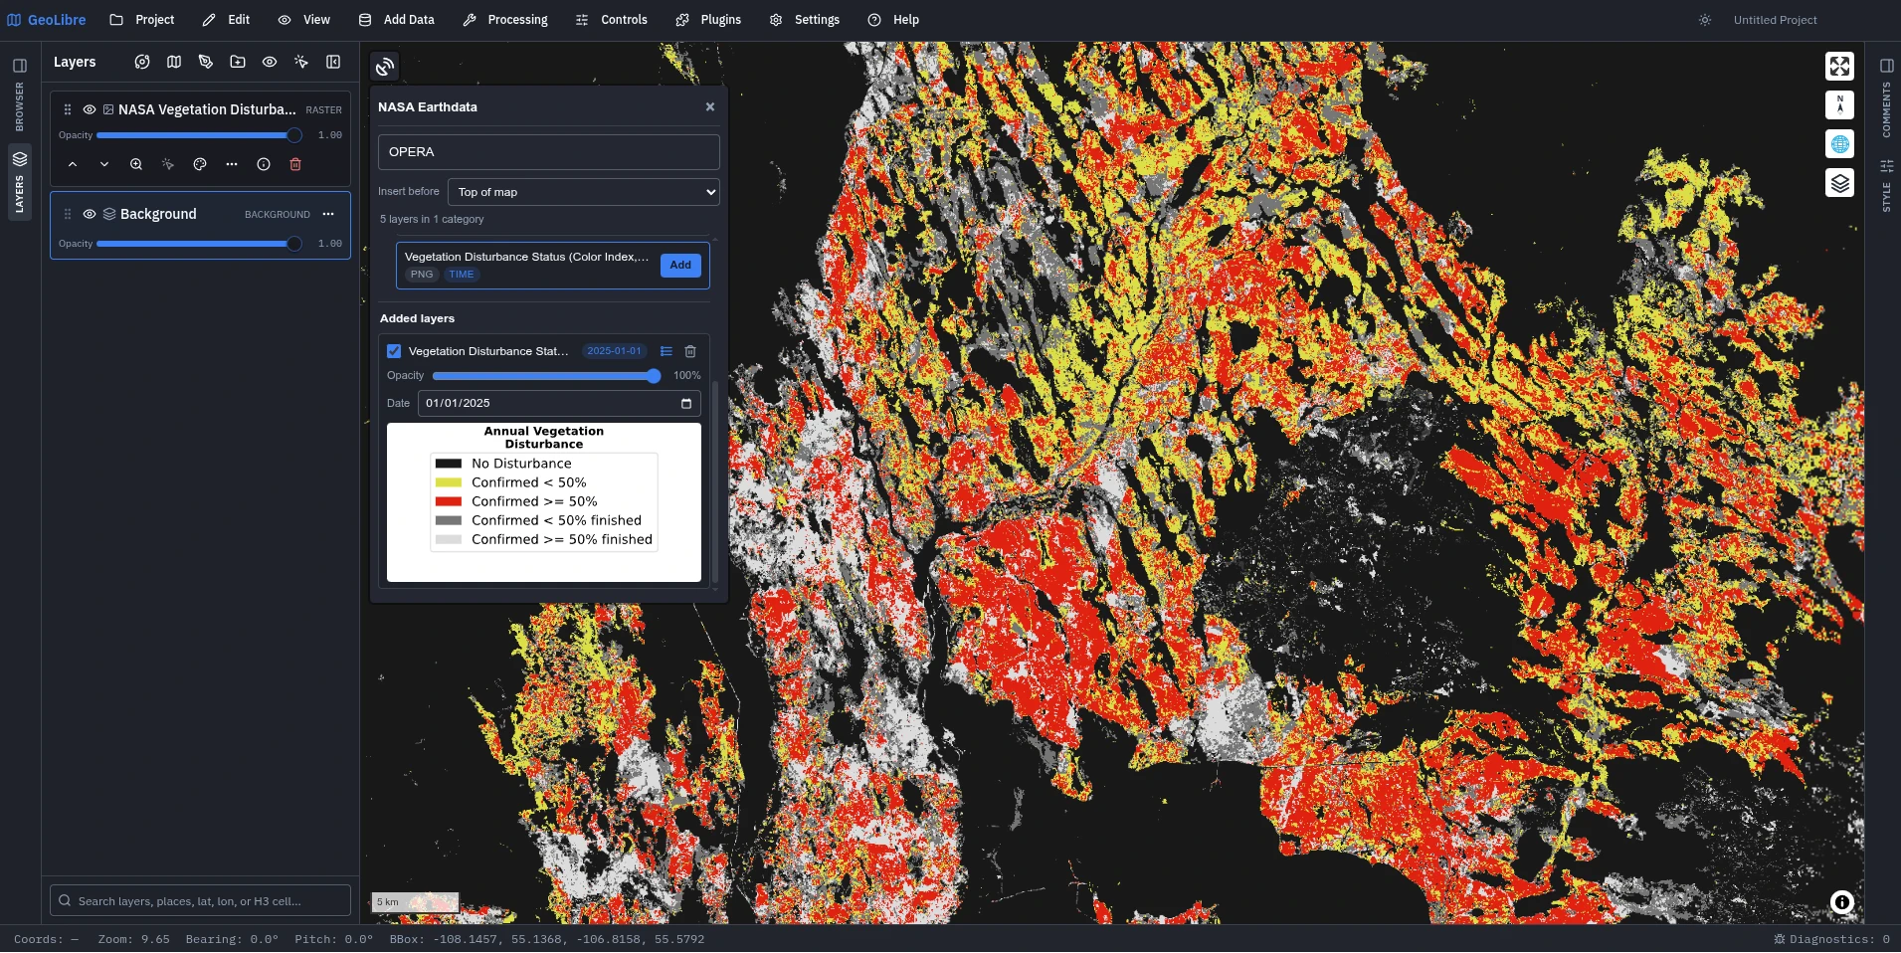
NASA Earthdata Plugin
NASA GIBS - the Global Imagery Browse Services tile catalog, browsable from a map panel.
Strength:
Instant. No search, no granule, no auth - a global backdrop in one click, ideal for situational context around an event.
Limit:
Pre-rendered pixels. You cannot restretch a band, query a value, or run statistics - it is a picture, not a measurement.

Slide 8
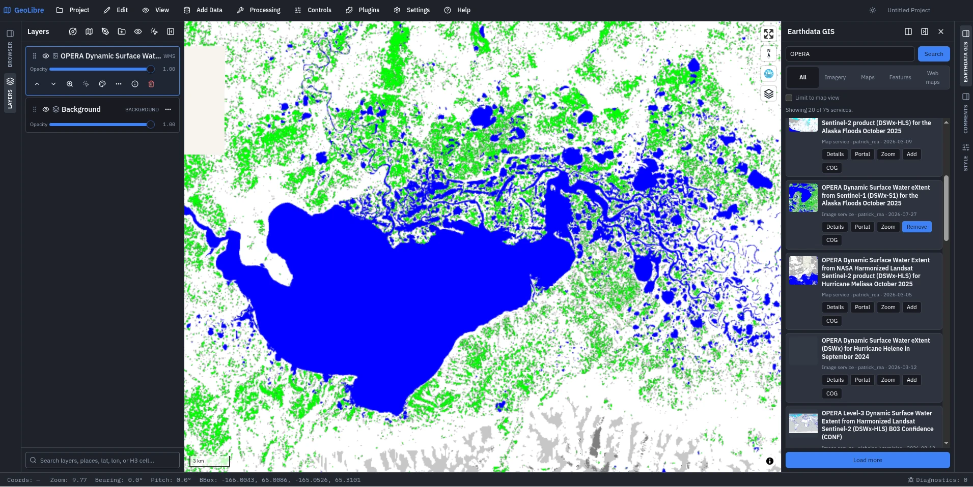
Earthdata GIS Plugin
Search gis.earthdata.nasa.gov and add EOSDIS ArcGIS services straight to the map.
Strength:
Curated event-based data layers:
Inundation extent
Burn severity
FEDS fire perimeter
…
Limit:
Some imagery layers are only available as WMS, not COG.

Slide 9
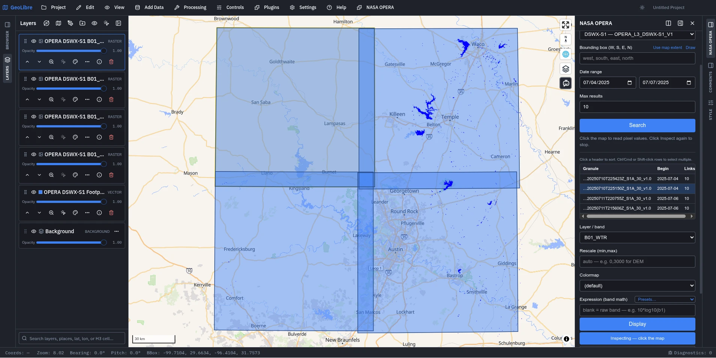
NASA OPERA Plugin
Granule-level search and display for eight OPERA collections.
Functionalities:
Search
Select
Display
Rescale
Colormap
Statistics
Download

Slide 10
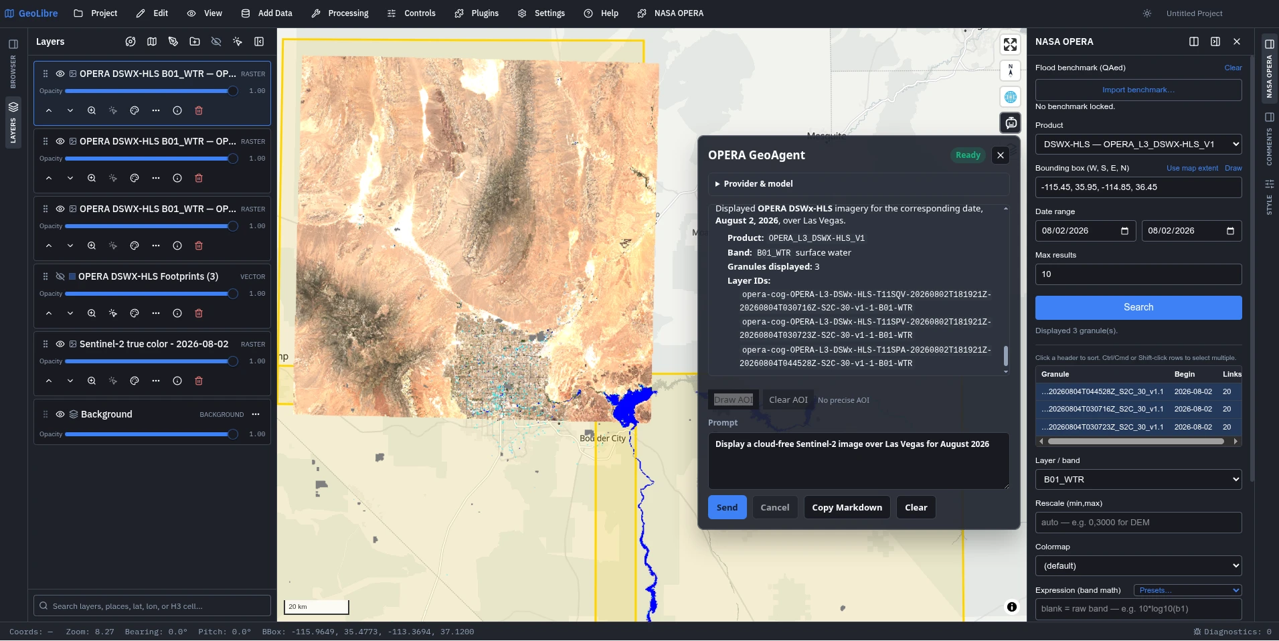
OPERA GeoAgent
A chat control on the map that can inspect and operate the live map.
Data Sources:
Planetary Computer
NASA OPERA
AI Providers:
Anthropic
OpenAI
Gemini
Amazon Bedrock
Ollama
OpenAI-compatible

Slide 11
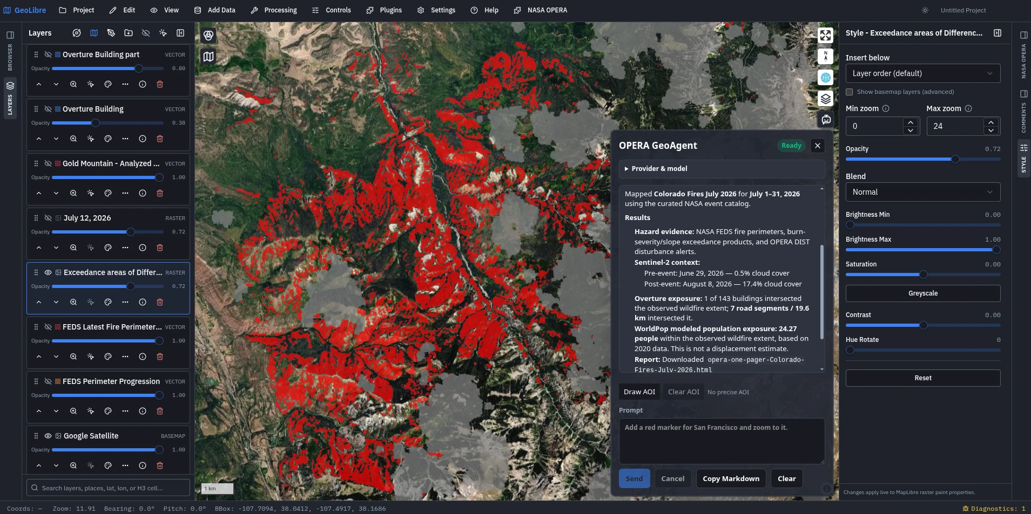
Disaster Mapping
Disaster mapping using plain language. One sentence: A place, a hazard, and a time window.
Example:
Map Colorado fire in July 2026

Slide 12
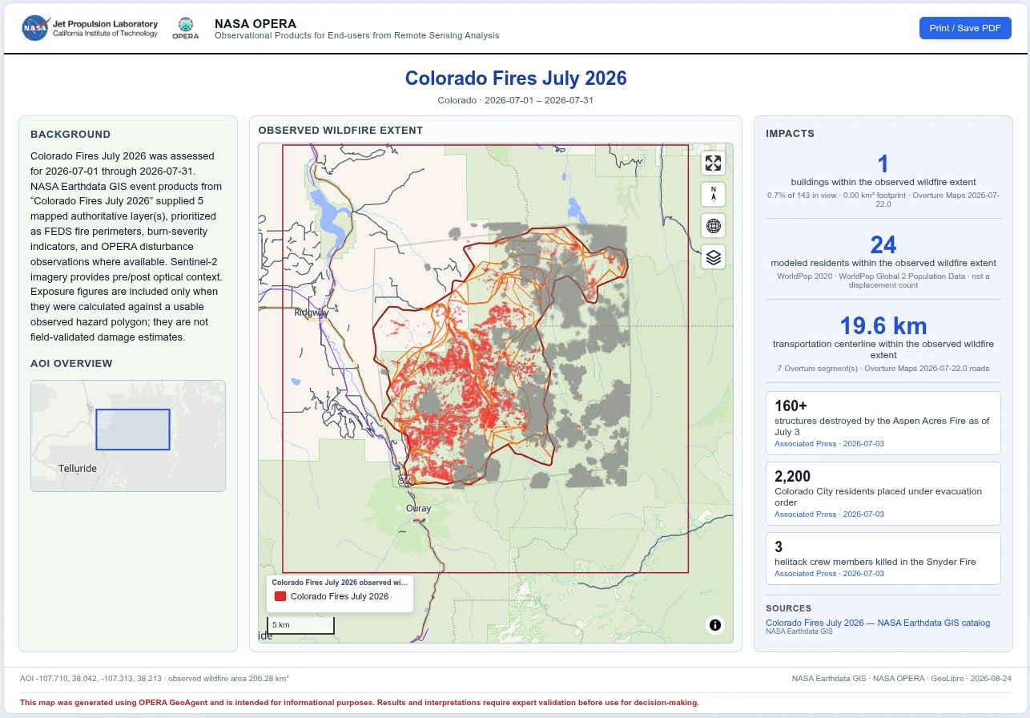
Self-contained HTML and PDF
Sections:
Background
AOI overview
Observed hazard extent
Impacts
Sources
Disclaimer

Slide 13

Live Demo
https://opera-plugin.geolibre.app

Slide 14
Q&A

