Slide 1
OGC Conference
Field Operations and Telematics
Ben Craker
Product Manager Global Fuse: Data , Partners & Standards
AGCO Corp.
Project Chair, SPADE3

Slide 2
SPADE
Standardized Precision Ag Data Exchange
PAIL
Precision Ag Irrigation Leadership

Slide 3

SPADE Projects
Core Document Definition
  Crop Plan
  Recommendation
  Work Order
  Work Record
  Observations and measurements
User Stories
  Seeding
  Crop Protection
  CART- Grain Movement Field to Processor
  WAVE-Telematics
  Crop Nutrition
  Scouting, Observations & Measurements
  Mechanical & Non-Mechanical Harvest
Geopolitical Context Work
  Government & Insurance, Sustainability Reporting
Reference Data APIs
  ContextItem POC
  Equipment, Product, Seed Definiton
Implementation Guidelines

Slide 4
Pail Project
Previously covered by Andres
PAIL and SPADE share several common concepts
  Core Documents
  Observations & measurements
  Telematics and remote data access

Slide 5
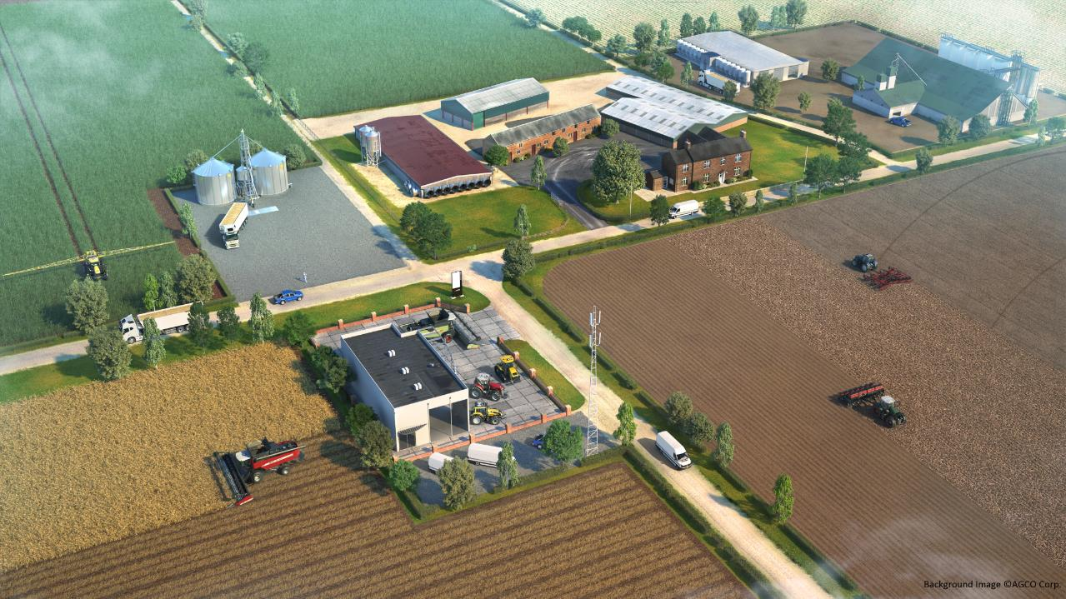
Field Operations & Telematics
Advisor & Input Supplier Data
Crop Storage & Conditioning Data
Farm Office
Crop Protection & Nutrition Data
Tillage & Soil Data
Livestock Data
Irrigation Data
Mobile Access
Seeding Data
Harvest Data
Equipment Data

Slide 6







Information Flow
Crop Scout or Other Data Source
Crop Plan
Reports
Observations & Measurements
Partners & Sustainability
Grower
Work Record
History
(Work Records, Observations & Measurements)
Advisor
Work Order
Service Provider
Recommendation

Slide 7
SPADE Development Process
User
Stories
Use
Cases
Data
Buckets
Selected Standard
Gap Check
Publish
SPADE1
  Seeding
SPADE2
  Mechanical Harvest
  Non-Mechanical Harvest
  Crop Protection
  Regulatory Reporting
SPADE3
  CART: Field to elevator/Processor
  Crop Nutrition
  WAVE: Telematics
  Scouting, Observations & Measurements
  Implementation guidelines
Reference
Data needs
Ref Data API
POC
Publish
API Docs
Reference Data APIs Defned Throughout SPADE Projects
  Equipment
  Seed
  Product
  ContextItem

Slide 8
Telematics Standardization
Review on several efforts & their focus

Slide 9
AgGateway – SPADE3: WAVE
Define user stories
  Dashboard and logistics
    Single web UI for a farmer to monitor entire operation including fixed and mobile assets
  Wireless task file transfer (work orders and work records) between machines & back office/FMIS
  Grain storage & handling, remote monitoring of grain dryer
  Subfield operational costs, breaking down work totals by management zones within a field for economic analysis
  In field sensors (PAIL)
Identify standards coordinate other efforts

Slide 10
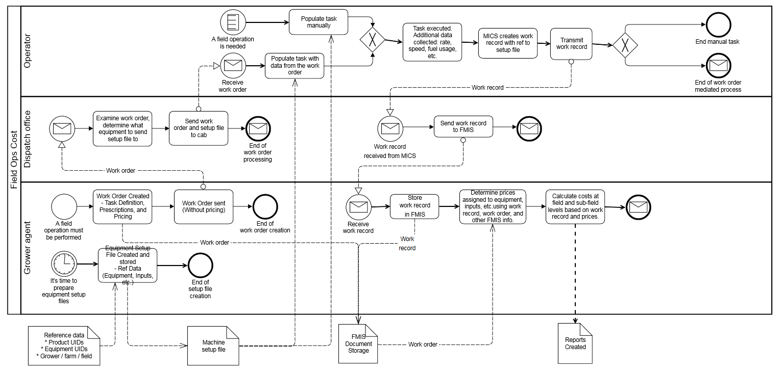
WAVE User Stories to BPMN

Slide 11
WAVE Data Buckets
Machine data elements essentially matched ISO1183 DDI’s
PAIL project has list of required data elements
Finalizing list for remote grain storage & conditioning

Slide 12
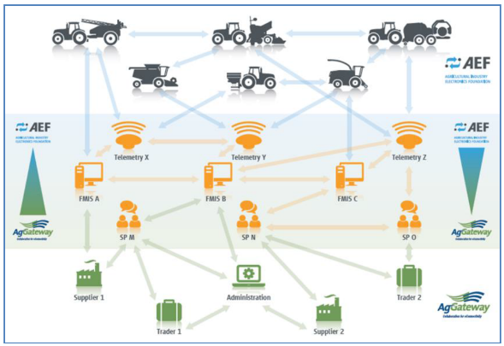
AEF PG9:FMIS, Sub-group EFDI
EFDI = Extended FMIS Data Interface
Machine to Cloud or Cloud to Cloud standard based on ISO11783
Focus on protocol for transferring data - protobufs

Slide 13
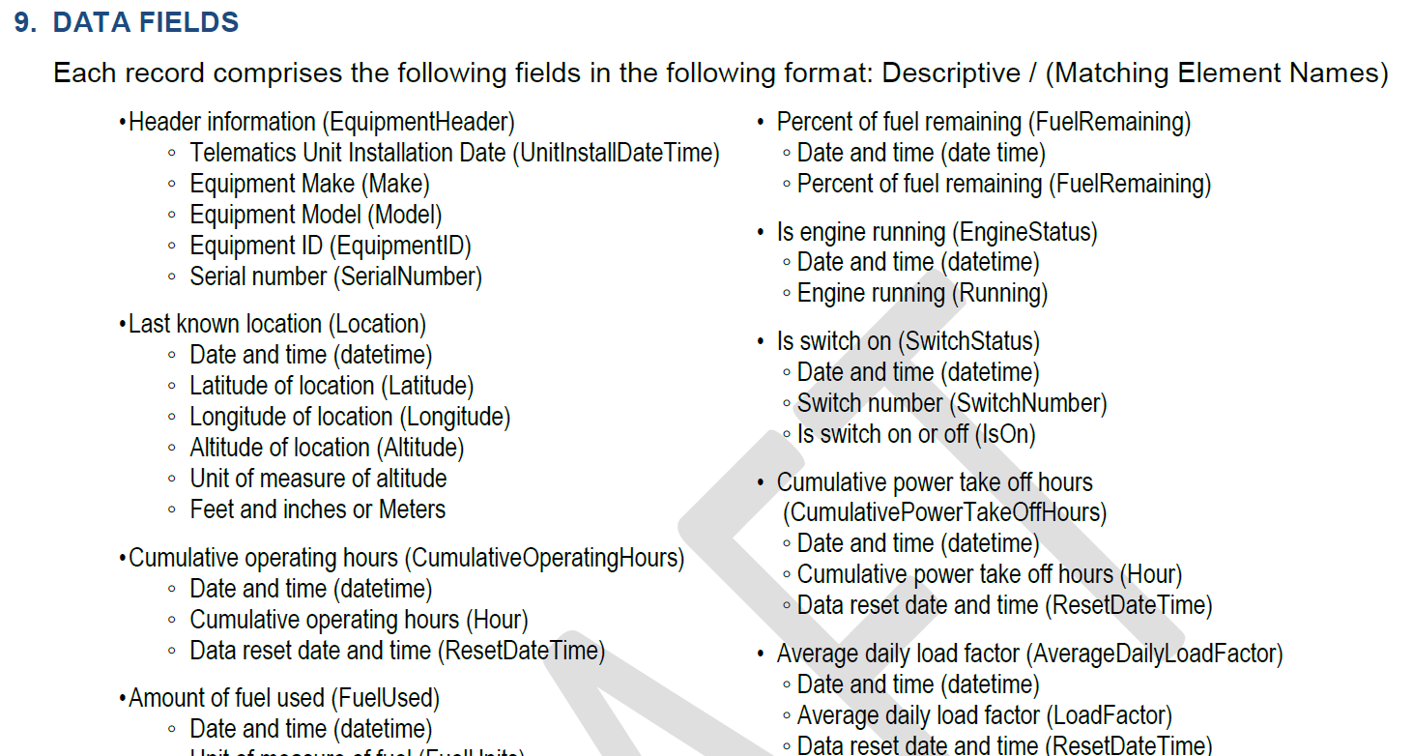
AEM/AEMP 2.0 – ISO15143
Construction/mining focused standard
  Started as AEMP(Association of Equipment Management Professionals) standard
  AEM (Association of Equipment Manufacturers) helped promote ver 2.0 through ASABE to ISO Standard

Slide 14
OADA
OADA = Open Ag Data Aliance www.openag.io
Coordinating with AgGateway, initial focus on authentication & authorization
  OAuth2 & OpenID Connect Implementation guidelines

Slide 15
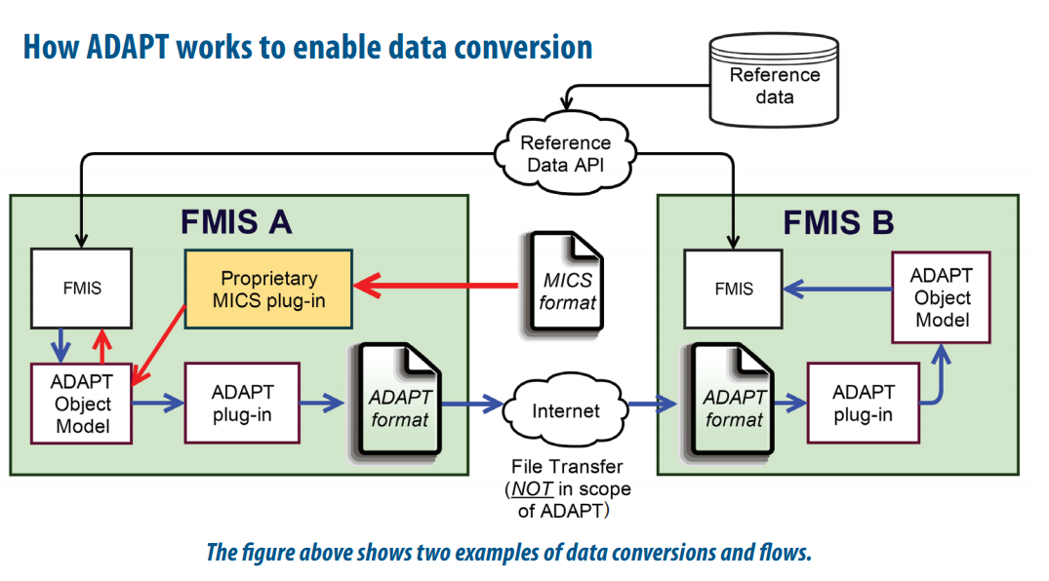
ADAPT
www.ADAPTFramework.org

Slide 16
IOFF2020
EU Funded project that recently kicked off
Goals:
  Demonstrate the business case of IoT for a large number of application areas in farming and food
  Integrate and reuse available IoT technologies by exploiting open architectures and standards
  Ensure user acceptability of IoT solutions in farming and food by addressing user needs, including security, privacy and trust
  Ensure the sustainability of IoT solutions beyond the project by validating the related business models and setting up an IoT Ecosystem for large scale take-up

Slide 17
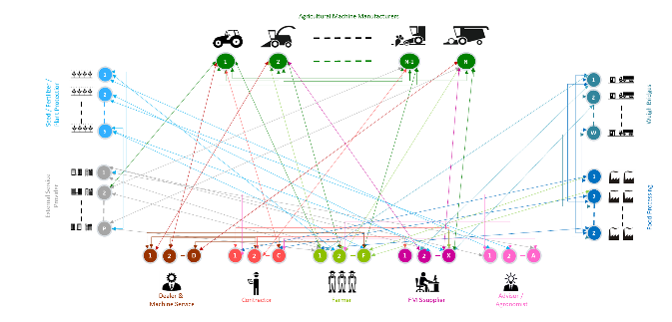


DKE
Consortium founded by ~7 equipment manufacturers
  Create central hub for data transfer
  Plan to leverage industry standard API (if available)
Agricultural Machine Manufacturers
1
1
2
n-1
n
Weigh Bridges
2
1
Seed / Fertilizer /
Plant Protection
2
S
W
External Service
Provider
1
1
Food Processing
2
2
P
Z
1
2
D
1
2
C
1
2
F
1
2
X
1
2
A
Dealer &
Machine Service
Contractor
Farmer
FMIS supplier
Advisor /
Agronomist
Current Ag Industry Connections
Data Hub Connections

Slide 18
Growers Ag Data Cooperative/Ag Data Coalition
Neutral, Farmer controlled data repository
www.gisc.coop & www.agdatacoalition.org
Focus on grower controlled permissioned access to data
Not for profit coalition brings in University and non-profit research connection that is difficult to facilitate with a commercial entity

Slide 19
How does all this relate to OGC
Work orders and work records generally contain geo-referenced data points or management zones (polygons) within a field (bigger polygon)
A struggle in the industry is filed identification
  USDA CLU, field operational boundary, legal field boundary
  Some field boundaries defined with high accuracy GPS on machine, some drawn with a finger in an app
Growers also want to transfer data such as machine guidance lines between systems
  Different manufacturers use different planes, coordinate systems, projections, and algorithms for contour smoothing
Field topography/elevation may play a larger role in nutrient management regulations in the future as well

Slide 20
Core Documents Examples
Additional slides with interest & time permitting

Slide 21
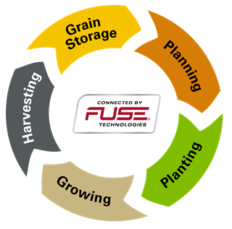
Planning

Slide 22
Planning
What is going to be grown where and how
Highly varied process from farm to farm
  Some farmers have a documented plan based on input from advisors
  Some just do what grandpa did
  Most are somewhere in-between
A lot of work is done in the off season within in Farm Management Information System (FMIS)
  Review historical information
  Review projected crop prices
  Estimates on long range forecast
  Review of seed, chemical and other input costs
May pre-purchase inputs like seed and fertilizer
May forward contract grain

Slide 23
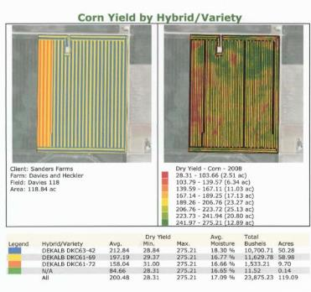
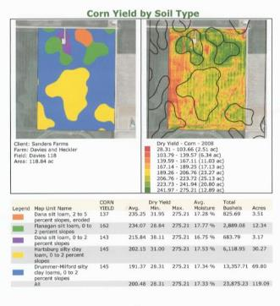
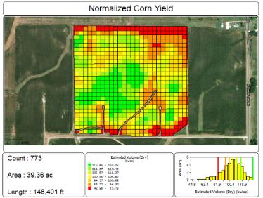
History and Records
Historical data
  Past fertilizer & chemical applications
  Past observations and Measurements
    Yield maps
    Soils sample
    Weather
  Historical yield details

Slide 24
Crop Plan
This is how we are going to grow this crop this season
  First we will no-till the filed ,then plant Roundup Ready corn on April 23rd (weather and soil temperature permitting), Variety DKC63-55 with fertilizer applications at planting, V4 and V8. An in furrow rootworm insecticide will be applied at planting as well. Weeds will be managed by spraying Round-up post emergence.

Slide 25
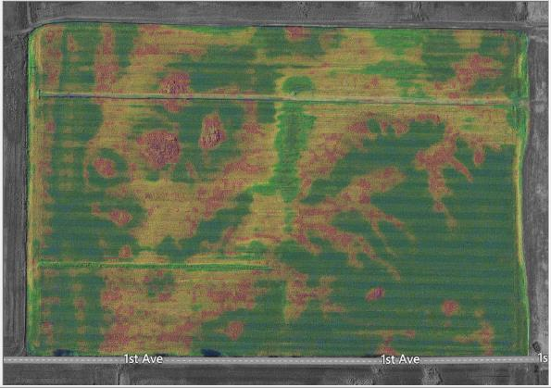
Observations and Measurements
This is happening out in the field
  There is a fungus growing in a corner of the field
  Drone imagery showing nutrient deficiency

Slide 26
Recommendation
This is what I recommend we do about it
  Lets spray fungicide on the field
  We should do an additional application of 28-0-0 fertilizer at these rates in these areas of the field

Slide 27
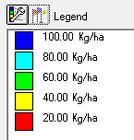
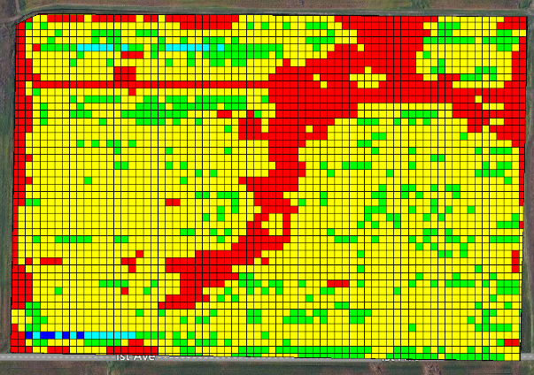
Work Order
This is what we are going to do about it
  Preplanned tasks
  Variable/flat rate application
  Variable/flat rate seeding

Slide 28
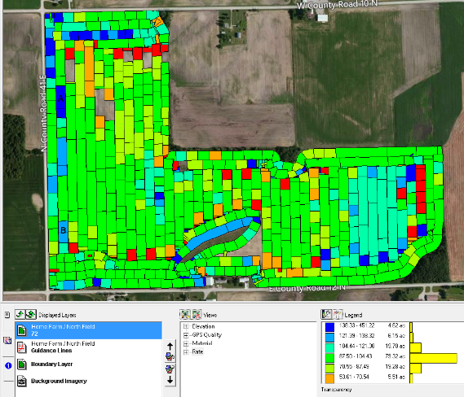
Work Record
This is what we actually did
  As-Applied
  As-Planted
  Yield

Slide 29
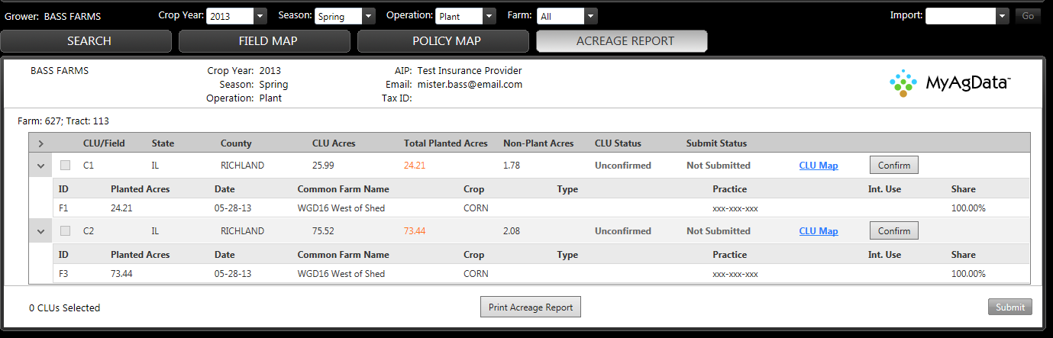
Reports
Records of field operations needs for carious reporting purposes
  Crop insurance
  Environmental/regulatory
  Sustainability
  Traceability

