Slide 1
Soil for starters
102nd OGC Technical Committee
Delft, The Netherlands
David Medyckyj-Scott, Landcare Research NZ
21st March 2017

Slide 2


Contributors
Thanks to
  Peter Wilson – CSIRO
  Alistair Ritchie – Landcare Research
  Those involved in the OGC Soil IE

Slide 3
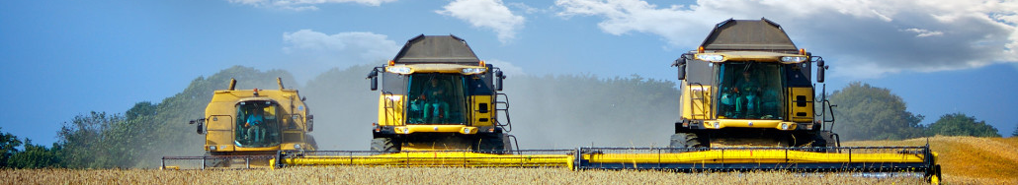
Soil – the resource

Slide 4
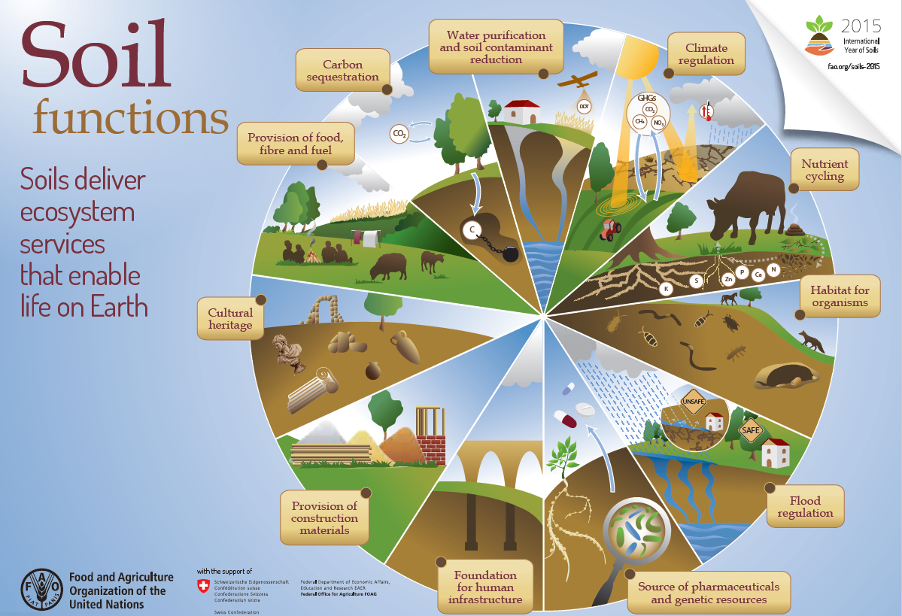

Slide 5
Soil & Agriculture
Need to feed 9.1 billion people by 2050*
  FAO estimate this will require a 70% increase in food production
  80% to come from yield increases
  20% from expansion of area farmed
But just 3% of the world’s surface represents the soil available to feed everyone on the planet
Knowledge of soils + right tools and practices = good soil management = improved crop productivity with environmental sustainability
“The right amount of inputs, in the right place, at the right time, in the right way”
* Source: United Nations Population Division, World Population Prospects: The 2006 Revision.

Slide 6
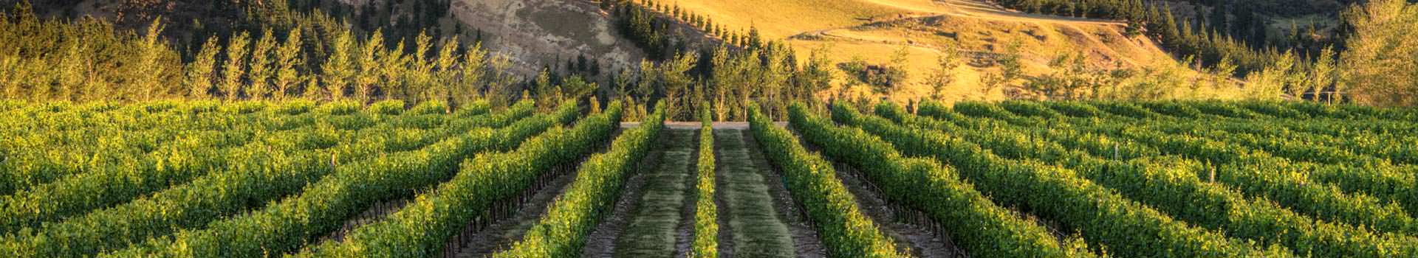

Agriculture, forestry, mining and tourism provide more than 25% of New Zealand’s GDP making New Zealand’s prosperity highly dependent on the ‘land economy’
Government Economic Growth Agenda – 40% GDP by 2025 to come from agri-foods, minerals, tourism and high value goods and services
Intensification of land use
Competition for land
Loss of elite soils
Soil quality (unwanted elements)
Poor water quality
Soil erosion
Loss of productivity
Loss of soil biota
Around 17% or $43B of New Zealand’s GDP dependent on soil resources…
Wise use of New Zealand’s soils – increasingly within a regulatory environment

Slide 7
Intensification | Sector | Distribution | Environmental Consequences
Cropping | Harvest frequency | Global | Soil quality and resilience
 | Continuing monoculture | Developing & transition countries | Soil health, pesticide residual
Nutrient | Over fertilization | Developing countries | Soil acidification, water pollution, nitrate accumulation
Irrigation | Submerged rice | Developing countries, Asia | Water scarcity, methane emissions
 | Dry crops | Arid/semi arid regions | Secondary salinization, water scarcity
Livestock | Over grazing | Developing countries | Soil degradation, water storage, C loss
 | Industrial breeding | Industrialised countries | Water pollution, residue antibiotics
Forest clearance, wetland drainage | Deforestation, wetland shrink | Developing & transition countries | Biodiversity loss, C loss
Source: Status of the World’s soil resources, FAO, 2015

Slide 8
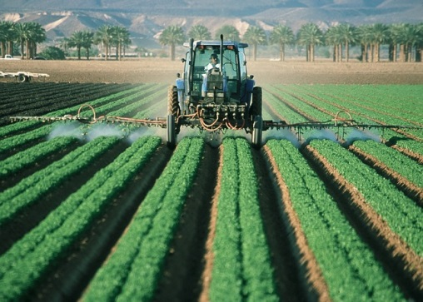
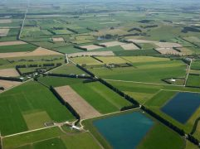
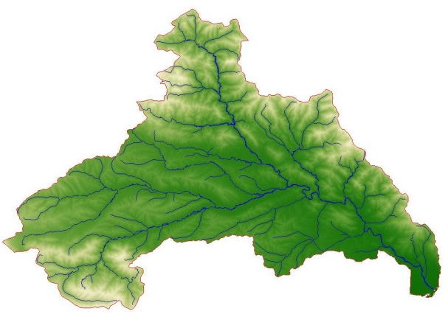
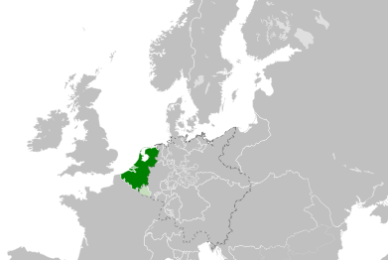

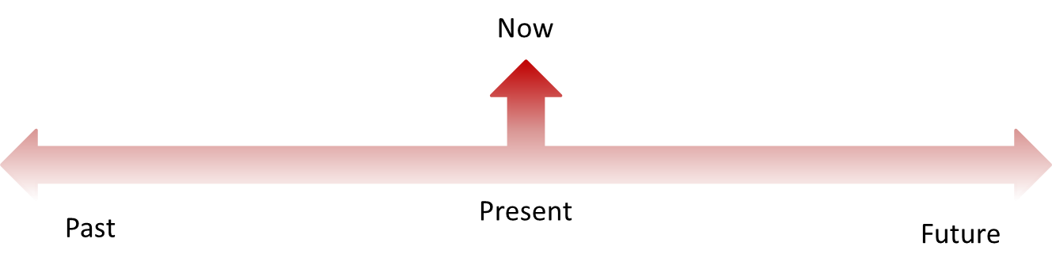
All scales
We need data!!

Slide 9
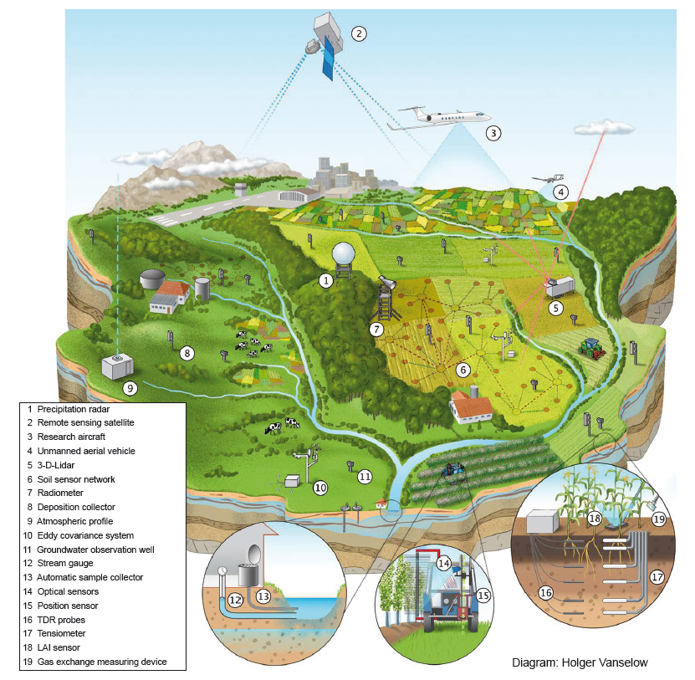
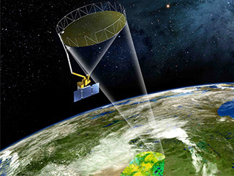
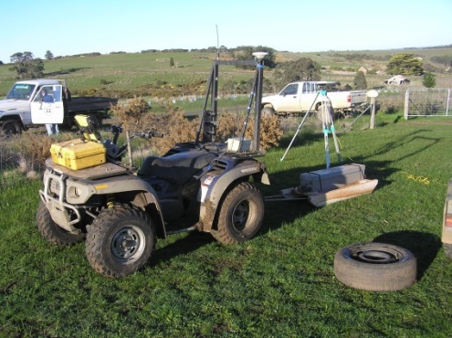
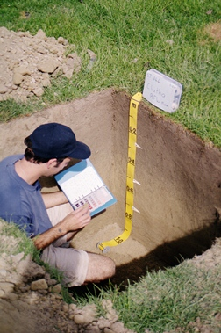
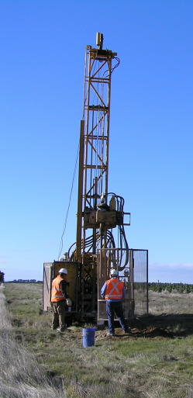
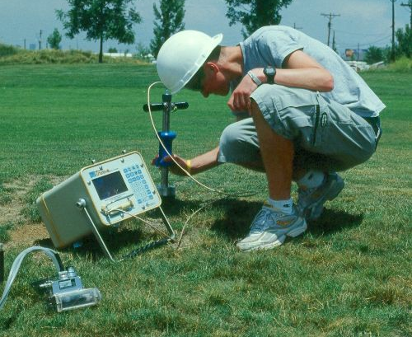
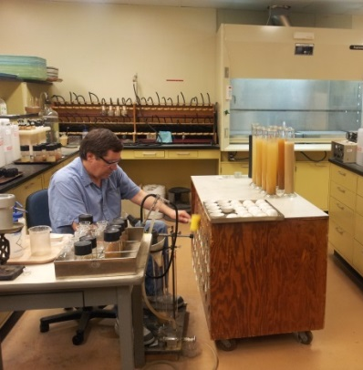
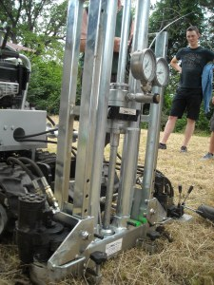
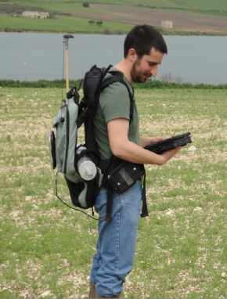
Characteristics of
big data
(volume, veracity, velocity, variety)

Slide 10
In summary…
SOIL is IMPORTANT… particularly for agriculture
Urgent need for more data on soils at all geographic scales
More and more data are being collected but diversity of data sources make integration and harmonisation difficult
Soil data needs to be easily accessible, freely available and in formats that can be readily used for a wide range of purposes
There is a need for harmonization of methods and terminology

Slide 11
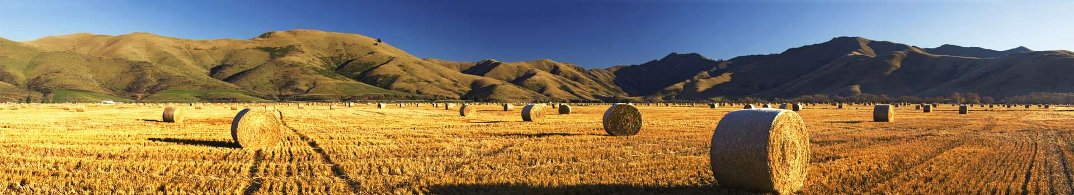
Soil Data Interoperability – state of play

Slide 12
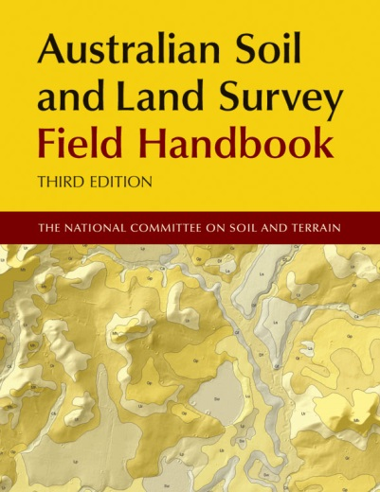
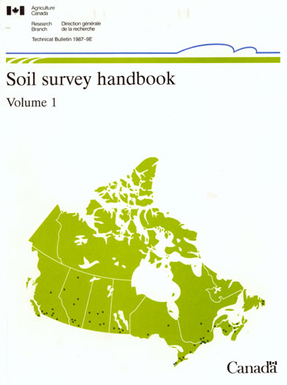
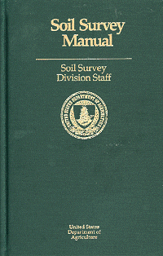
Long track record
The international soil community is old – in a ‘mature’ sense
Strong collaboration at technical levels
Recognised ‘standards’ exist for soil description and analysis
Increasing awareness and support for creation of soil data exchange standards

Slide 13
Major initiatives
Global Soil Map – product specification
FAO Global Soil Partnership
  Pillar 4 (global soil info system)
  Pillar 5 (harmonisation – including data exchange, vocabularies)
IUSS Working Group on Soil information Standards
OGC Soil Interoperability Experiment
GODAN Soil data working group - new

Slide 14
Standards…
Australia and New Zealand Soil Mark-up Language (ANZSoilML)
e-SOTER Soil and Terrain Mark-up Language (SoTerML)
INSPIRE D2.8.III.3 Data Specification on Soil (INSPIRE Soil)
ISO 28258:2013 Soil quality – Digital exchange of soil-related data (ISO SoilML) Up for revision
IUSS/ISO ‘Wageningen Proposal’ (a variation of 4 with reference to 1, 2 and 3)
SoilIEML – created in OGC Soil Interoperability Experiment

Slide 15
Comparison of the modelling approach and scope of each information model
Model Soil Information | ANZSoilML | eSoTer | INSPIRE Soil |  | ISO SoilML | IUSS/ISO SoilML | OGC SoilIEML
Site Registration | F | S | F |  | F | F | F
Soil Formation | F | S | P |  | X | X | X
Soil Description | F | S | F | S | P | P | F | S
Soil Sampling | F | S | F |  | F | F | F
Observations | F | S | S |  | F | F | F
Soil Classification | F | F | F |  | F | F | F
Vocabularies | F (SKOS) | X | F (XSD/SKOS) |  | X | X | F (SKOS)
Soil Mapping | F | F | F |  | F | F | X
Modelling approach refers to how the model was defined. Models may be: comprehensive, attempting to cover as many dimensions of the soil as possible; targeted, hard-typing a selected set of essential properties while relying on soft-typing for a significant set of properties; or framework, a model that simply provides a framework of classes.
Notes:
Green cells (F) denote aspects of a soil description covered by classes and formally defined properties;
Yellow cells (S) denote aspects of a soil description covered by classes and soft-typed properties
Grey cells (P) denote partial coverage
and white cells (X) denote aspects of a soil description that are not covered, or handled by a soft-typing mechanism.
The criteria for comparison can be grouped into eight categories:
Site registration: identity, location, timing and other metadata about sampling sites;
Soil formation: environmental and human factors influencing the formation of the soil;
Soil description: physical, chemical and organic character of a soil;
Sampling: collection of physical samples;
Observation: field or laboratory measurements of soil properties;
Classification: categorisation of soil and horizons according to formal taxonomies;
Vocabularies: systems for managing terms and their definitions; and
Mapping: mapping the distribution of soils according to their type.
Modelling approach refers to how the model was defined. Models may be: comprehensive, attempting to cover as many dimensions of the soil as possible; targeted, hard-typing a selected set of essential properties while relying on soft-typing for a significant set of properties; or framework, a model that simply provides a framework of classes.

Slide 16
Comparison of model accessibility and implementation
Model | Accessibility | Implementation
ANZSoilML | Public; free of charge | Production services
eSoTer | Public; free of charge | Prototype (?)
INSPIRE Soil | Public; free of charge | Prototype (GS Soil)
ISO SoilML | Private; charge for access | Prototype (GS Soil) (?)
IUSS/ISO SoilML | No model | No
OGC SoilIEML | Public; free of charge | Prototype
Accessibility refers to the availability of the model (UML models, XML schema, specification documents and other artefacts) in terms of access constraints or charges for access.
Implementation shows whether a standard has been implemented, either as a prototype in a production environment.

Slide 17
Web Service Interfaces
Examples exist where WFS, WCS etc. have been used to publish soil data
Often experimental and not ‘live’ for others to experiment with
New Zealand and Australia only places where production services?
Are there other services available?
Where?

Slide 18
OGC Interoperability Experiment
Focus: development and testing of a Soil Markup Language, a GML compatible encoding for soil features
Participants: IE Initiators (CSIRO, Landcare Research, IRSIC) plus a number of other agencies e.g. USDA, USGS
4 use cases: soil data integration & publication, soil sensor data, soil property modelling and predictions, pedo-transfer functions
Set of design principles
  open development, open publication, re-use existing models wherever possible
Deployment of set of demonstrators using WFS, SOS, and WPS that used a IE GML schema developed in the IE
Notes:
Development of a GML-XML (XSD) schema and instance documents

Slide 19
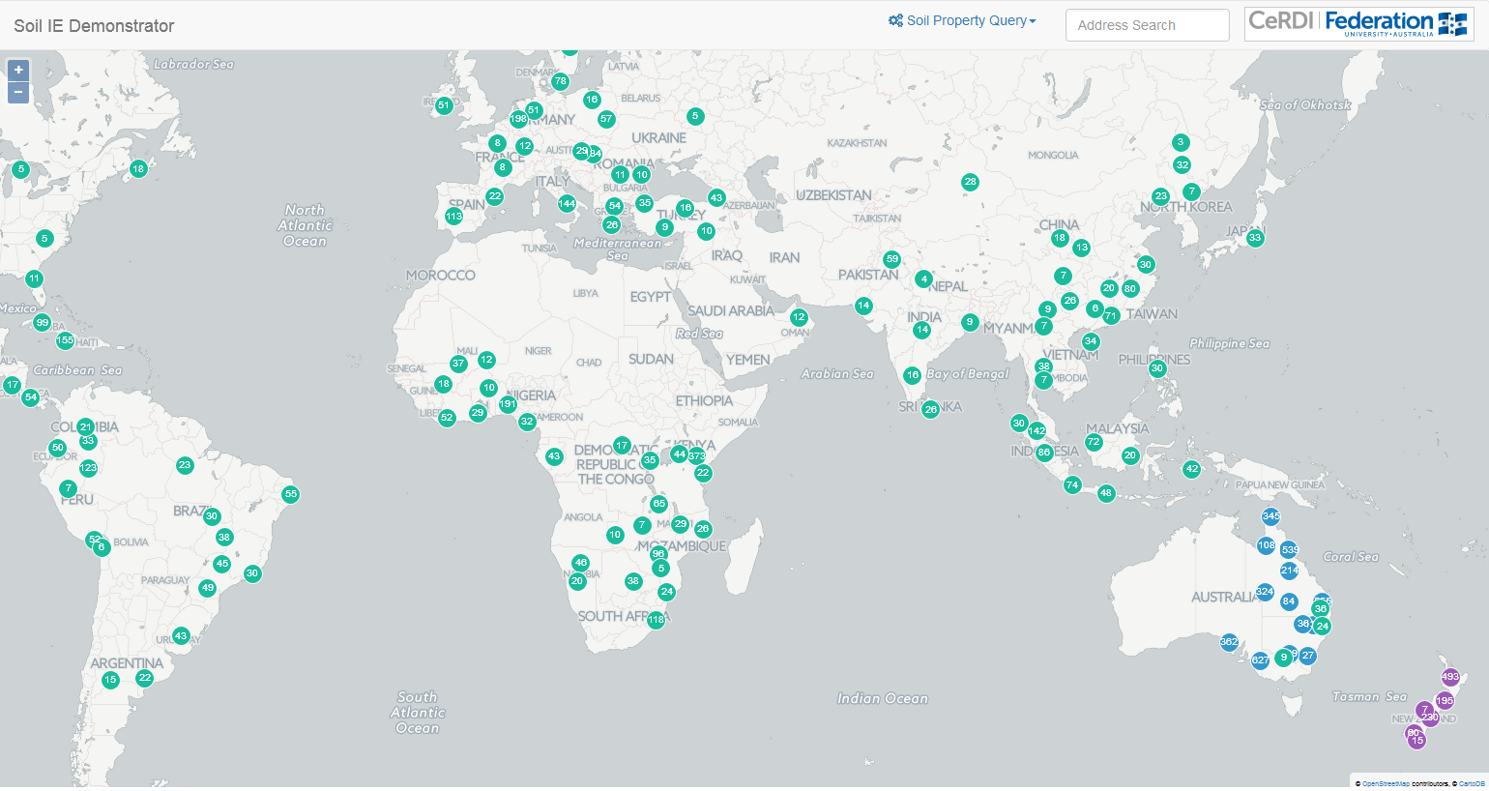
Soil IE Outcomes
Created a simple information model for soils data
Demonstrated cross agency data sharing (4 demos)
Structural harmonisation and some content harmonisation of soils data between agencies
Use of O&M specification without specialisation
Use of Timeseries profile of O&M without specialisation
References to RDF (SKOS) vocabularies in GML
Lightweight, linked data approach wherever possible
WFS-WPS chaining for processing data
Engineering report written and approved

Slide 20
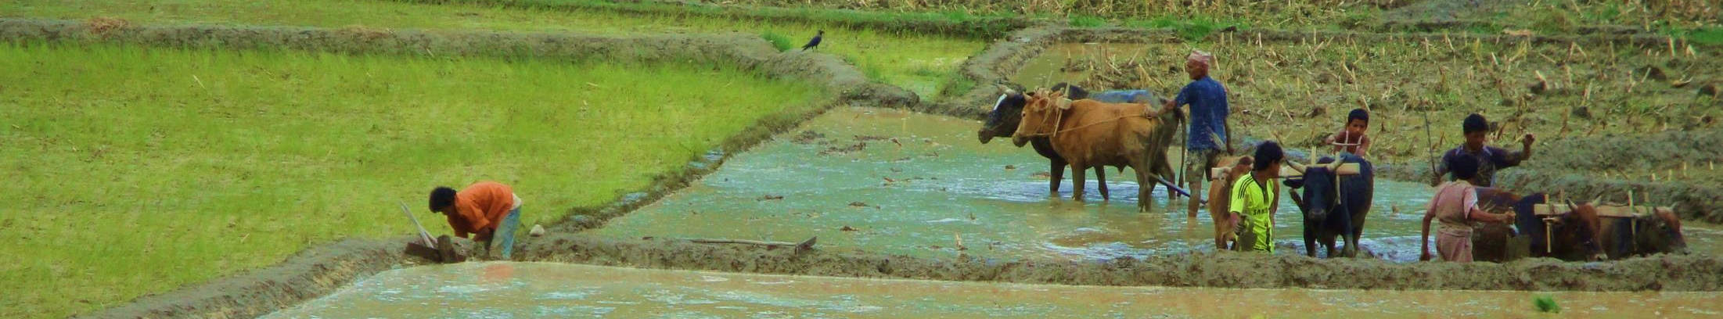
Barriers to interoperability

Slide 21
Technical challenges
Technology is available to implement a standard
Keeping pace with the rapid developments in IT, while maintaining the stability needed by standards
Data challenge is mapping to a standard without loss of information. One that is:
  not hideously complicated with massive payloads
  supports fit-for-purpose views of data
Need a model that can evolve with new types of soil data
Need models & standards to develop in related domains e.g. vegetation, landscapes, climate

Slide 22
Social
Developing standards is time consuming and expensive
Work is fragmented and under resourced
Internationally, it’s unclear who should be doing this
There is duplication of effort
  we need to engage further with the global soil community to reconcile existing models
Capability
  modelling methodology is unfamiliar to scientists
  those implementing systems lack right technical expertise
Assumes open access to data and good governance
Notes:
Assumes open access to data and good governance - but security and privacy important and governance weak

Slide 23
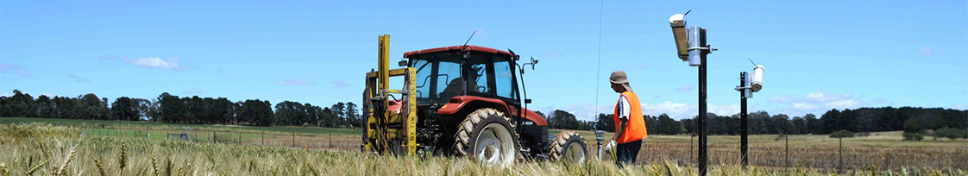
“Vision with action can change the world”
Notes:
Joel Arthur Barker is a technology and business futurist and the bestselling author of "Future Edge," which was republished in paperback under the title "Paradigms,"

Slide 24
Conclusions
Urgent need for more data on soils at varying geographic scales
Globally consistent soil data needs to be -
    freely available
    web-accessible
    integrate-able
    useable
    widely used
We need a globally developed, managed (governance), accepted and implemented soil data exchange model with associated semantic information and usable interfaces

Slide 25
Technology is available to implement a standard
Leverage don’t re-invent
  e.g. O&M, Time-series Profile of O&M, GeoscienceML
  only extend standards when it is impossible to describe domain specific things … soil and soil horizons
Need support for a domain-driven model development group and a technology/ implementation group (both for providing data and consuming data)
Need to sort out who is performing what role
Need to resource those providing their expertise
Notes:
Establish a OGC SWG to undertake the modular development of a set of abstract and implementation models for soil data in coordination with activities of the IUSS WGSIS and the FAO Global Soil Partnership (Pillars 5 and 4)
Initiate a Soil Coverage Interoperability Experiment to test the integration of soil description, observation, monitoring data (plus other environmental covariates) for the development of soil property predictions to support farm and environmental management activities.

Slide 26

e: medyckyj-scottd@landcareresearch.co.nz
t: 00 64 6 353 4979
Soil IE Engineering Report at http://www.opengeospatial.org/docs/er

