Slide 1
The OGC Deformation Model Abstract Specification
Open Geospatial Consortium (OGC) deformation model project team International Association of Geodesy (IAG) Working Group 1.3.1 Presenter: Chris Crook, Geodetic Analyst Toitū Te Whenua, Land Information New Zealand

Slide 2
Why do we need a specification?
Most accurate and accessible positioning systems are global reference frames based on GNSS
Everything is moving in terms of global reference frames!
Deformation model estimates movement of "stationary" objects on the surface of earth (e.g. buildings, underground services...)
Used in coordinate transformations to align data observed at different times
Coordinate transformations are “infrastructural” - infrastructure needs standards
No standard format for encoding deformation models

Slide 3
Coordinate transformations as “infrastructure”
Coordinate system registry eg EPSG
Coordinate system definition
National geodetic agency
Users
Geospatial and positioning system vendors

Slide 4
Deformation model history
Historically, geodetic agencies have used tightly integrated custom formats and software for managing deformation (e.g. HTDP)
Time dependent transformations were not supported by GIS/coordinate transformation software
No common format or structure for publishing deformation models
In 2019 Land Information New Zealand (LINZ) commissioned the development of a deformation model transformation capability in PROJ based on a JSON “master file” referencing multiple GeoTIFF gridded data sets
Lead to proposal for an OGC specification for standardising the description of deformation models. Occurred at the same time as a proposal for GGXF

Slide 5
OGC standards project history
GGXF (Geodetic gridded data exchange format) and deformation model functional model teams established in June 2020
GGXF project to determine a common format for geodetic data sets
Deformation model to determine a common structure for defining deformation models for use in coordinate operations
Deformation model team working in conjunction with IAG (International Association of Geodesy) WG 1.3.1 on "Time-dependent transformations between reference frames in deforming regions".
Deformation models are structurally more complex than other gridded geodetic data sets - has dictated scope of GGXF, and depends on GGXF for realization
Project artefacts in https://github.com/opengeospatial/CRS-Deformation-Models and https://github.com/opengeospatial/CRS-Gridded-Geodetic-data-eXchange-Format.
Submitted to OGC for consideration in June 2022. Public review period during April/May 2023. Next phase is responding to and integrating feedback, moving towards ratification.

Slide 6
User (primarily producer) survey (2020)
Responses from 27 countries on 5 continents
Mainly from geodetic/mapping agencies – potential producers of deformation models
9 have models in use, 10 in development, 4 planned
13 are velocity models, but 7 include some coseismic or postseismic models
Production systems mainly using custom formats and custom software. Recently some models implemented into PROJ coordinate system conversion library.

Slide 7
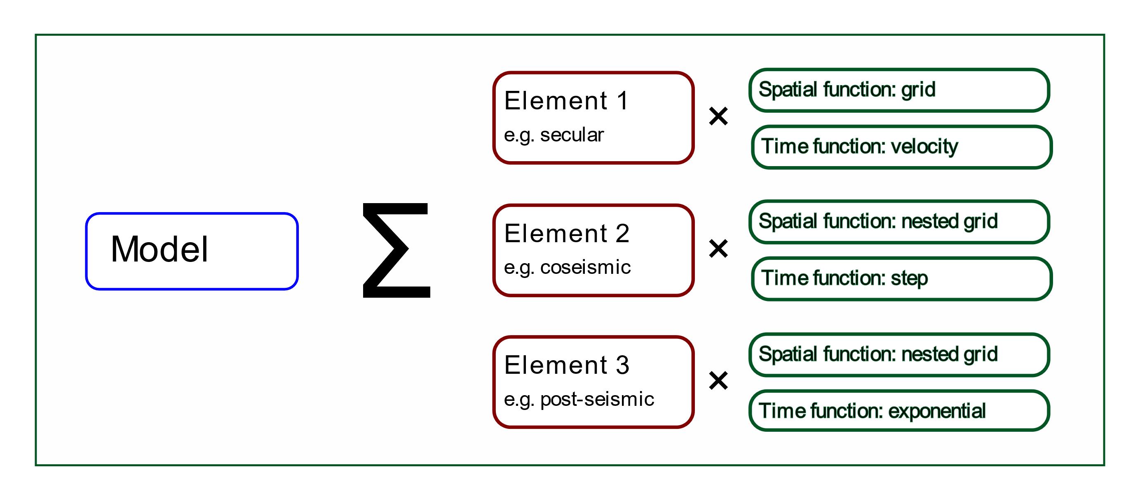
High level structure of deformation model

Slide 8
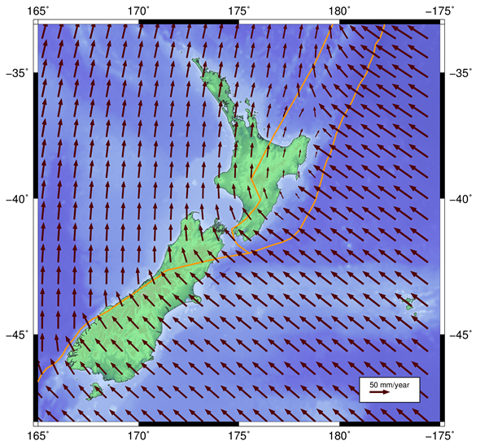
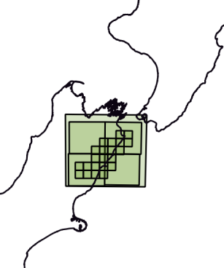
Example: NZGD2000 deformation model
Version | Reason
20000101 | National deformation model - initial version
20130801 | Patches for the following events: Dusky Sound, 2009 Darfield (Christchurch), September 2010 Christchurch, February 2011 Christchurch, June 2011 Christchurch, December 2011 + 3 other earthquakes
20140201 | Patches for events: Cook Strait, 17 July 2013 Lake Grassmere, 16 August 2013
20160701 | Patches Christchurch, 14 February 2016
20170601 | Patch for Kaikoura 14 November 2016
(Simplified for presentation)

Slide 9
What is not in the specification
Does not support other representations of deformation such as:
triangulation based spatial models
rigid body transformation between reference frames such as time dependent Helmert or Bursa-Wolf transformations,
trajectory models for individual points, such as ITRF reference station coordinate models,
global plate tectonic models,
three dimensional geophysical models of faulting, for example using elastic formulae for uniform half space models of the earth, or finite element models.

Slide 10
What is in the specification
5. Deformation model definition
6. Calculation formulae
6.1. Spatial interpolation (nested grid of 1, 2, or 3 dimensional displacements)
6.2. Time functions (simple velocity, step function, exponential decay …)
6.3. Combination of elements
6.4. Applying the total displacement to a coordinate
Annex A (informative) Notes for deformation model producers
A.1. Decomposition into elements
A.2. Requirement for the model to be continuous and invertible
A.3. No data and zero values
A.4. Alternative interpolation methods
A.5. Deformation models near poles
A.6. Time function epochs

Slide 11
Questions?

Slide 12
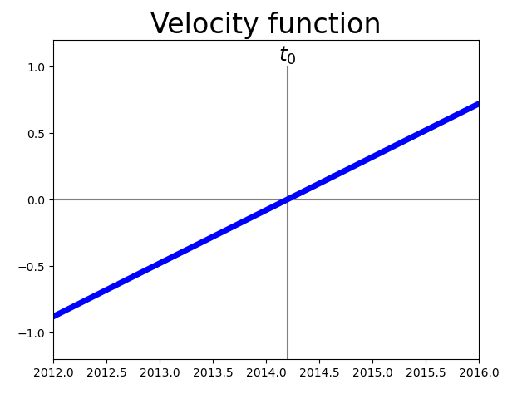
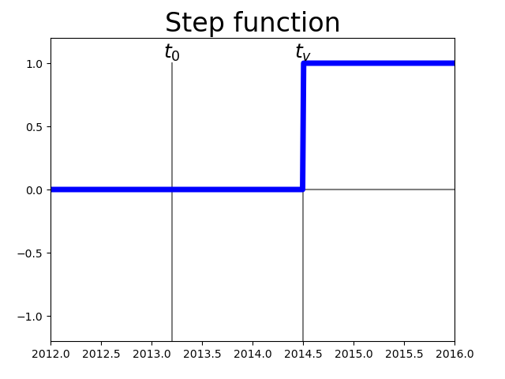
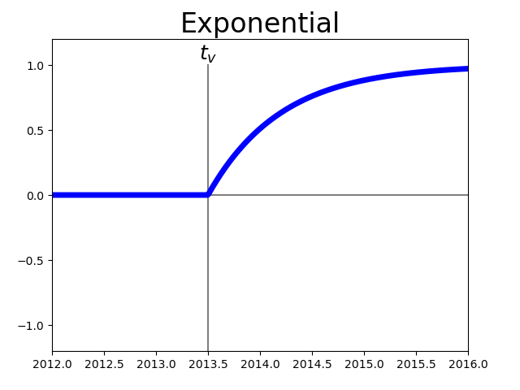
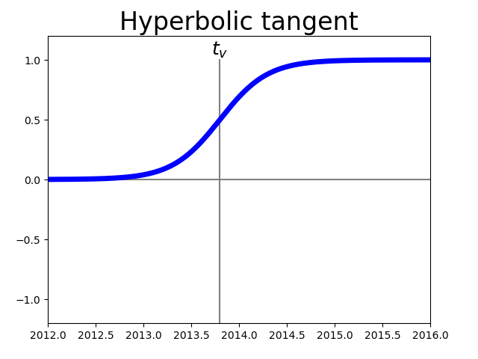
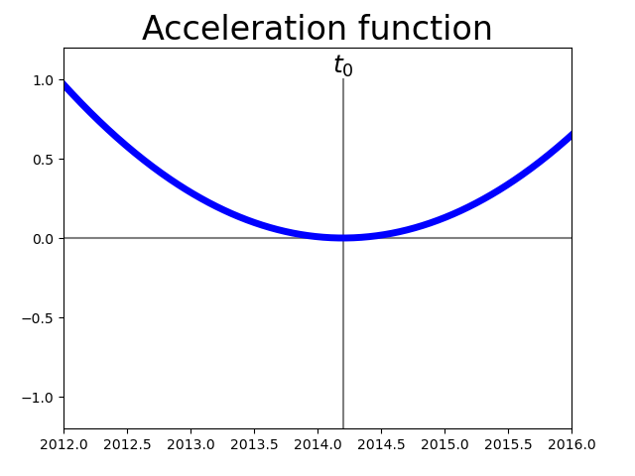
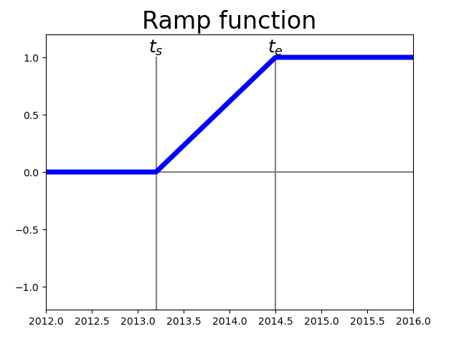
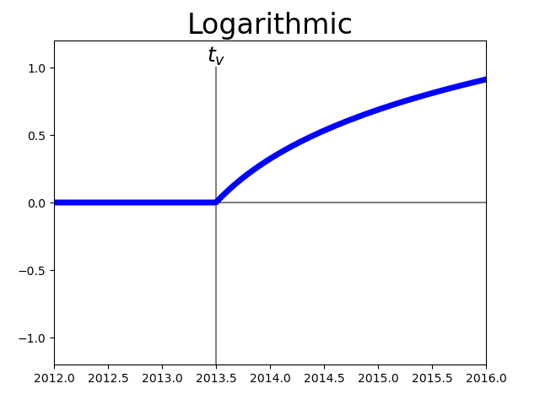
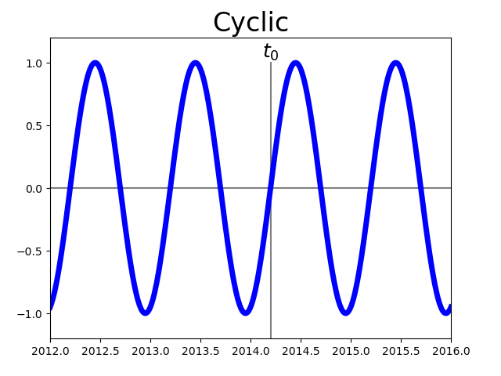
Time functions

