Slide 1

Deformation Model abstract specification
The 123rd OGC Member Meeting
Meeting sponsor
Chris Crook, LINZ
DD June 2022

Slide 2
Agenda

Slide 3
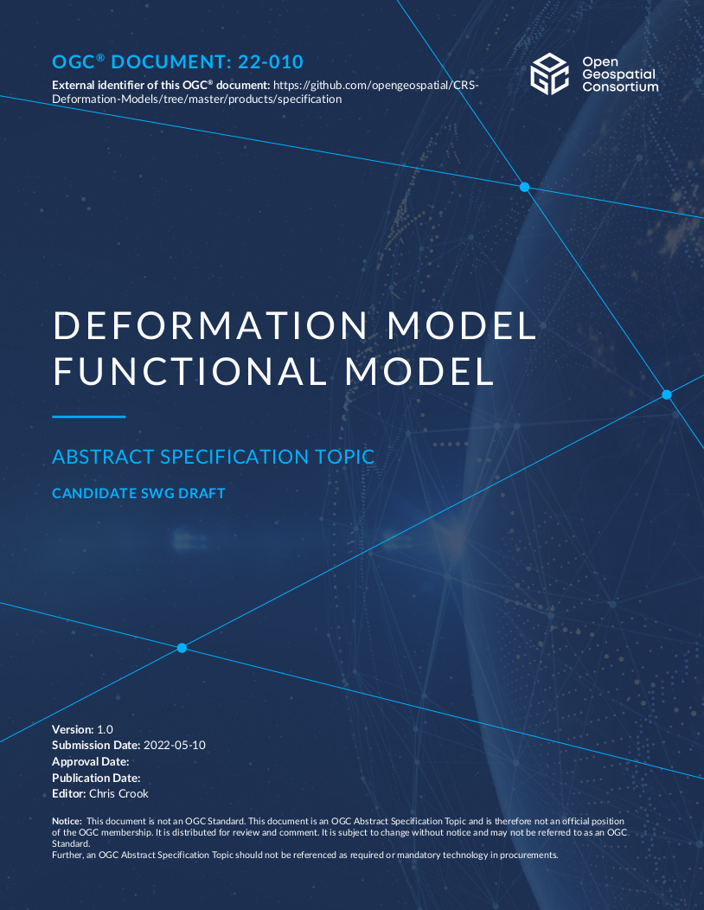
Promoting draft Abstract Specification
The project team has endorsed this draft specification
Seek promotion to SWG

Slide 4
Why?
Most accurate and accessible positioning system is global reference frame based on GNSS
Everything is moving in terms of global reference frame!
Deformation model estimates movement of "stationary" objects on the surface of earth (eg buildings, buried services...)
Used in coordinate transformations to align data observed at different times
No standard format for encoding deformation models

Slide 5
Deformation model history
Historically geodetic agencies have used tightly integrated custom formats and software for managing deformation
Time dependent transformations were not supported by GIS/coordinate transformation software
No common format or structure for publishing deformation models
In 2019 Land Information New Zealand (LINZ) commissioned the development of a deformation model transformation capability in PROJ based on a JSON “master file” referencing multiple GeoTIFF gridded data sets
Proposal for an OGC specification for standardising the description of deformation models coincided with proposal for GGXF

Slide 6
Project history
GGXF (Geodetic gridded data exchange format) and deformation model functional model teams established in June 2020
GGXF project to determine a common format for geodetic data sets
Deformation model to determine a common structure for defining deformation models for use in coordinate operations
Teams have been meeting on alternate fortnights – meetings well supported
Deformation model team working in conjunction with IAG (International Association of Geodesy) WG 1.3.1 on "Time-dependent transformations between reference frames in deforming regions".
Deformation models are structurally more complex than other gridded geodetic data sets - has dictated scope of GGXF, and depends on GGXF for realization
Project artefacts in https://github.com/opengeospatial/CRS-Deformation-Models

Slide 7
User survey (2020)
Responses from 27 countries on 5 continents
Mainly from geodetic/mapping agencies – potential producers of deformation models
9 have models in use, 10 in development, 4 planned
13 are velocity models, but 7 include some coseismic or postseismic models
Production systems mainly using custom formats and custom software. Recently some models implemented into PROJ coordinate system conversion library

Slide 8
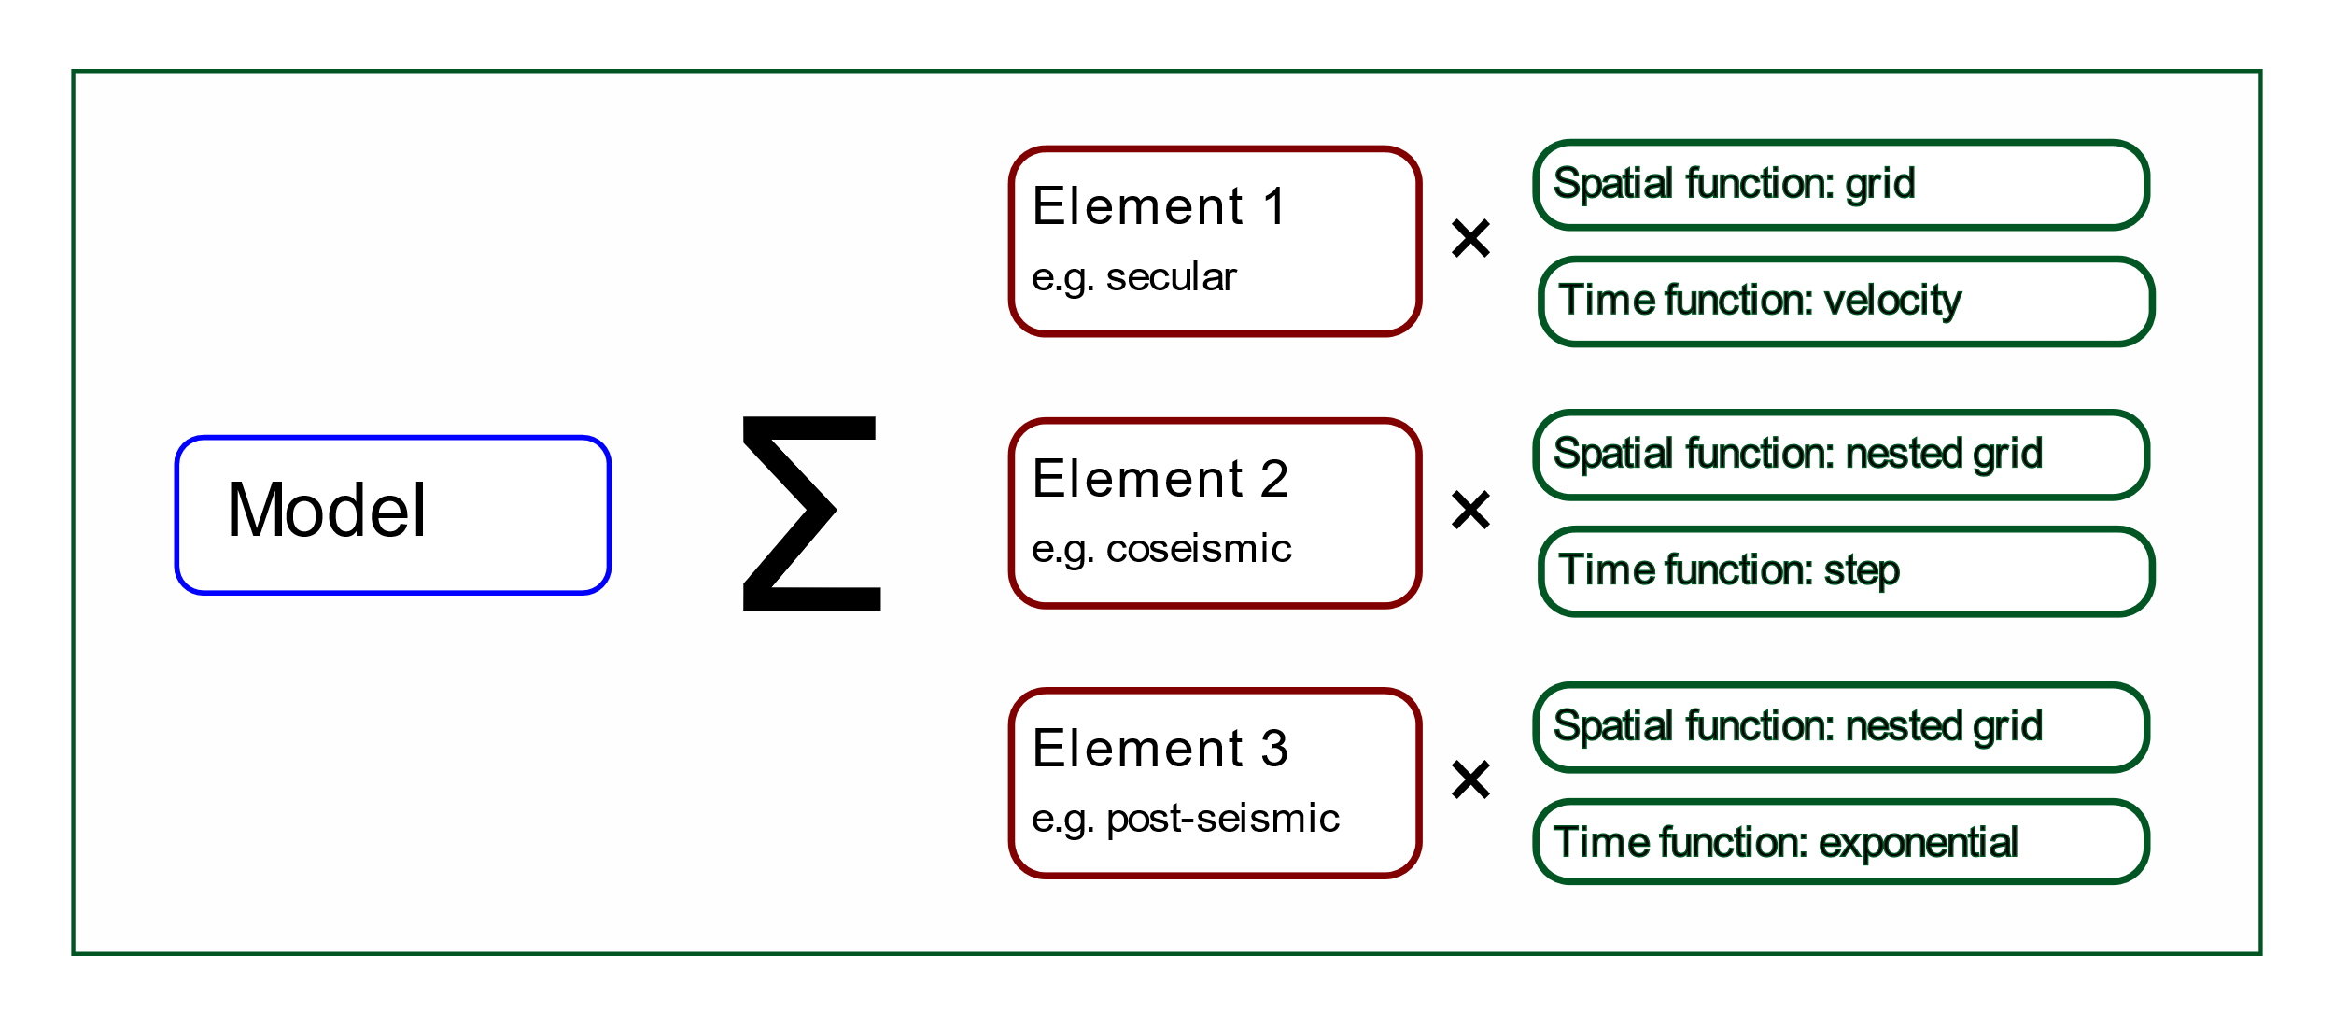
High level structure of deformation model

Slide 9
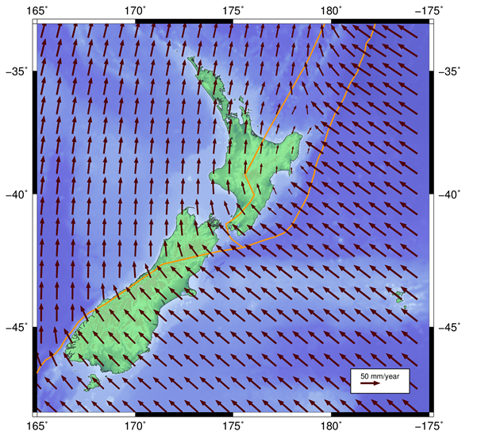
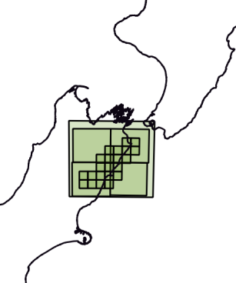
Example: NZGD2000 deformation model
Version | Reason
20000101 | National deformation model - initial version
20130801 | Update of national deformation model and patches for: Patches for the following events: Dusky Sound, 2009 Darfield (Christchurch), September 2010 Christchurch, February 2011 Christchurch, June 2011 Christchurch, December 2011 + 3 other earthquakes
20140201 | Patches for events: Cook Strait, 17 July 2013 Lake Grassmere, 16 August 2013
20160701 | Patches Christchurch, 14 February 2016
20170601 | Patch for Kaikoura 14 November 2016

Slide 10
Specification contents
5. Deformation model definition
6. Calculation formulae
6.1. Spatial interpolation
6.2. Time functions
6.3. Combination of elements
6.4. Applying the total displacement to a coordinate
Annex A (informative) Notes for deformation model producers
A.1. Decomposition into elements
A.2. Requirement for the model to be continuous and invertible
A.3. No data and zero values
A.4. Alternative interpolation methods
A.5. Deformation models near poles
A.6. Time function epochs

Slide 11
Abstract specification exclusions
Does not support other representations of deformation such as:
triangulation based spatial models
rigid body transformation between reference frames such as time dependent Helmert or Bursa-Wolf transformations,
trajectory models for individual points, such as ITRF reference station coordinate models,
global plate tectonic models,
three dimensional geophysical models of deformation in terms of dislocations on fault surfaces such as elastic half space or finite element models.

Slide 12
GGXF update
Abstract specification of GGXF structure
YAML text based format
Proof of concept YAML/NetCDF implementation
NetCDF agreed binary carrier
NetCDF implementation choices:
Investigating alignment with CF conventions
Investigating ACDD NetCDF metadata conventions
NetCDF structure decided
Next steps:
Documentation of NetCDF profile
Update NetCDF proof of concept Github implementation and example data sets

Slide 13
Acknowledgements
Commitment from global project team at four weekly meetings despite unfortunate time zone differences
Support from IAG working group

