Slide 1
Deformation model functional model project team report Chris Crook, Kevin Kelly – convenors
Note: this work is being conducted in association with the International Association of Geodesy (IAG) working group IAG WG 1.3.1 on "Time-dependent transformations between reference frames in deforming regions".
Working with associated project Gridded Geodetic Data Exchange Format (GGXF) project for transport layer.

Slide 2
Why?
Most accurate and accessible positioning system is global reference frame based on GNSS
Everything is moving in terms of global reference frame!
Deformation model estimates movement of "stationary" objects on the surface of earth (eg buildings, buried services...)
Used in coordinate transformations to align data observed at different times
No standard format for encoding deformation models

Slide 3
Working definition:
A deformation model is a model of the displacement of the earth’s surface within a defined spatial and temporal extent. It predicts the location of a point fixed to the surface at any time within the temporal extent in terms of an accessible coordinate system. The position of the point is represented as a displacement from a reference position for that point.

Slide 4
User survey
Responses from 27 countries on 5 continents
Mainly from geodetic/mapping agencies – potential producers of deformation models
9 have models in use, 10 in development, 4 planned
13 are velocity models, but 7 include some coseismic or postseismic models
Production systems mainly using custom formats and custom software. Recently some models implemented into PROJ coordinate system conversion library

Slide 5
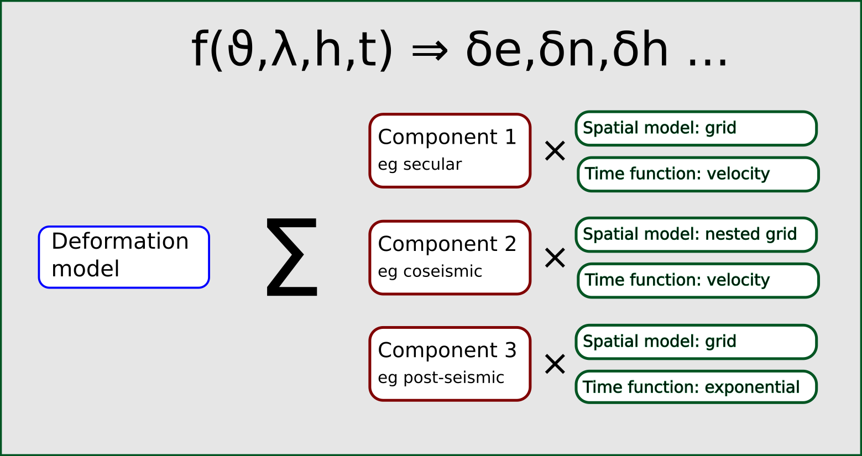
Analysis of potential capabilities
Focus over the last three months has been deciding which capabilities the functional model specification should support.
Opened 7 technical github issues for discussion – resolved 2
Example technical issues
Refine feature matrix
Refine calculation formulae
Choice of time functions

Slide 6
Alignment with GGXF
It is hoped that GGXF will provide a transport mechanism for deformation models
The deformation model is the most complex data type likely to be encoded in GGXF and is driving some aspects of the specification.
To support developing the standard the deformation model meetings have considered the parameters and keywords that are required in GGXF to ensure it will be able to carry deformation models.
For example deformation models include time functions – how should these be specified in GGXF.

Slide 7
Want more information?
The work of the project team is documented in github at:
https://github.com/opengeospatial/CRS-Deformation-Models
Meeting dates and connection urls are published on this page.
The main discussion points from meetings are recorded as github issues.

