Slide 1
OS Autonomous Vehicle Data Experiments
We have undertaken some experiments using autonomous vehicle test data provided by Ordnance Survey, GB. These are intended to validate and demonstrate the JSON encodings of GeoPoses 1.0. There are eight different kinds of GeoPoses:
The two Basic GeoPose targets are simple and concise – no options. They satisfy most use case requirements and assume a local tangent plane ENU frame derived from WGS84.
An Advanced GeoPose target supports more complex use cases where the outer geographic reference frame is not LTP-ENU and/or a valid time is needed.
Composite:
The Chain GeoPose target provides additional flexibility with multiple intermediate frames or specific coordinate reference systems as needed.
The Frame Graph target supports the full structure need to represent networks of reference frames that arise with the use of multiple and linked location technologies.
The three (Time) Sequence targets support the packaging of fixed-length time series of GeoPoses and the payload data objects for open-ended GeoPose streams.

Slide 2
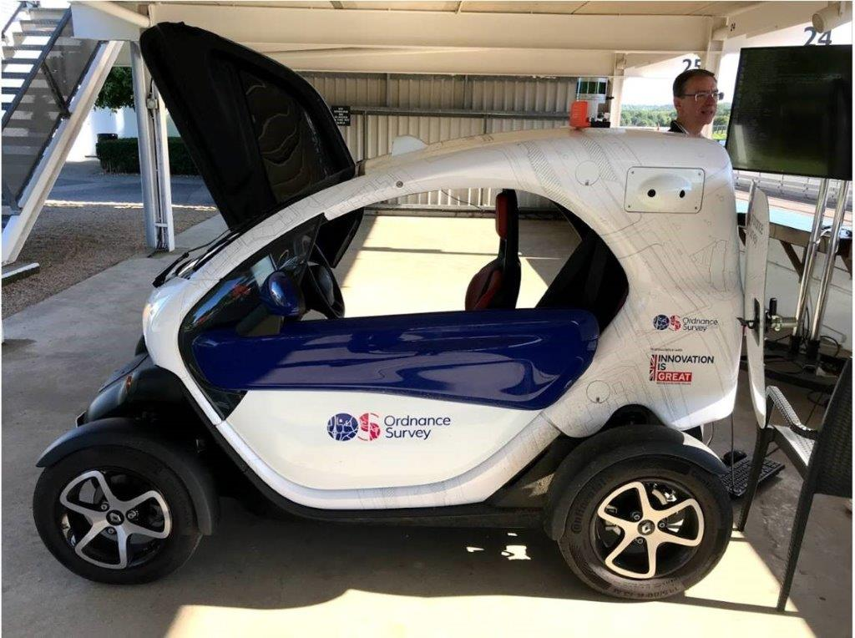
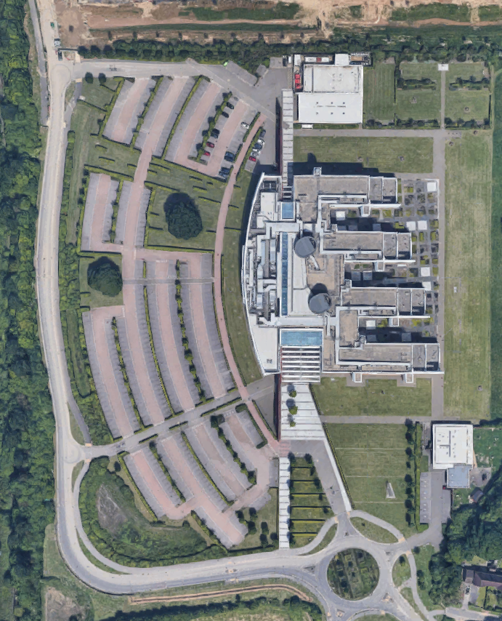

OS Autonomous Vehicle Data Experiments
The OS Twizy
OS GB has provided navigation sensor and video data on a round-trip track of approximately 1 km (yellow strip).
Goal of the GeoPose experiments is to have eight real-world examples of the application of each of the eight GeoPose 1.0 Standarisation Targets and a demo web app:
Basic-YPR, Basic-Quaternion, Advanced:
Goals 1, 2, 3: Serve selected type {YPR, Quaternion} of the two Basic or the Advanced GeoPoses for either nav sensors or video at any time within the data time span
Chain
Goal 4: Serve GeoPose chains using the nav sensor frame as a link at any time within the video data time span
Graph
Goal: 5 Serve GeoPose graphs with multiple target GeoPoses at any time within the video data time span
Series
Goal 6: Serve nav sensor or video poses at a specified rate as a regular series
Goal 7: Serve nav sensor or video poses as an irregular series
Stream
Goal 8: Serve nav sensor or video poses from start to end at real time rate
Goal 9: Demo web app using Google Street View to animate stream
The OS Test Range

Slide 3
OS Autonomous Vehicle Data Experiments
More details including raw and processed data and code available on the GeoPose GitHub repository
https://github.com/opengeospatial/GeoPose/tree/main/Data/Examples/ROS-GeoPose/Experiments
Please communicate via repo Issues.
We expect to be finished 1st October 2021 1st November 2021.

